Slide 1
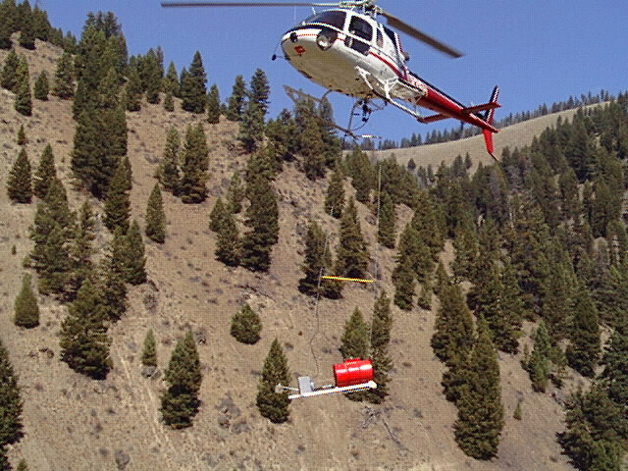
Unit 1
HELITORCH HISTORY & CAPABILITIES

Slide 2
Unit Objectives
Become familiar with the evolution of the helitorch.
Identify advantages & disadvantages of helitorch operations.

Slide 3
History
A Canadian conceived idea, established in the early 1960’s as a flying drip torch.
Fuel thickening compounds designed by the military were added.

Slide 4
Safety was identified as a critical limitation to utilizing the torch.
Due to safety concerns, all personnel working with the torch need to complete a certification training program.

Slide 5
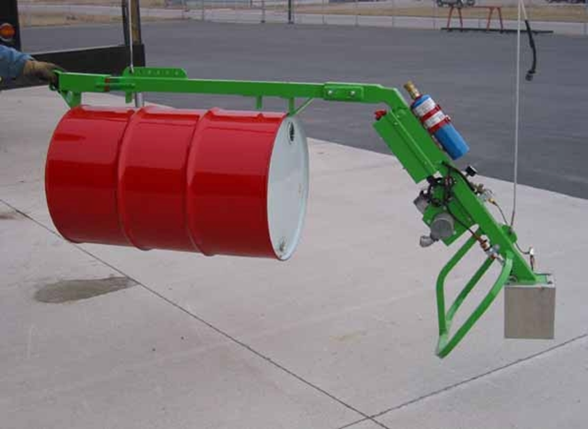
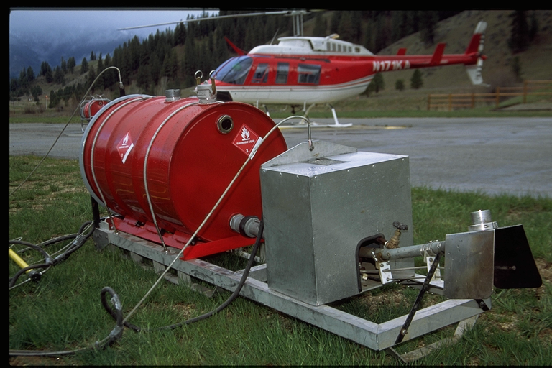
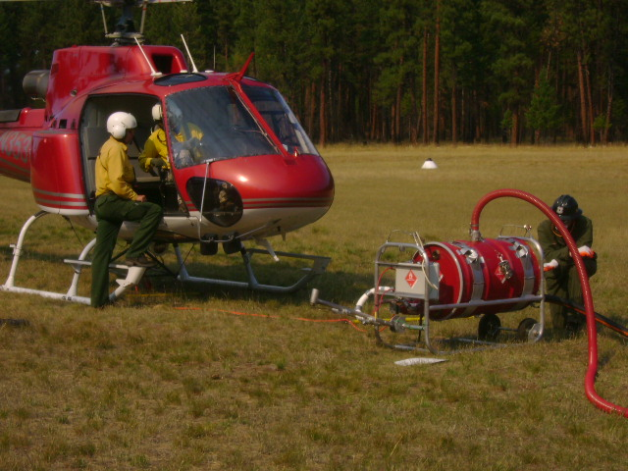
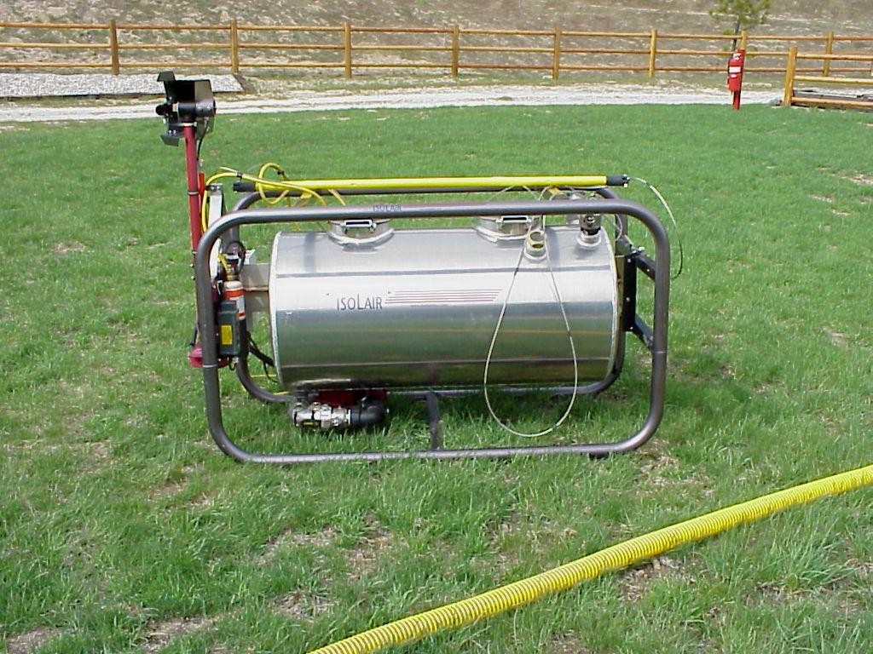

Slide 6
Advantages
Gelled fuel provides a longer residual burning time on the ground.
Helitorch has the potential of generating a more continuous line of fire.
Helitorch can be easily jettisoned by the pilot in the event of an emergency.

Slide 7
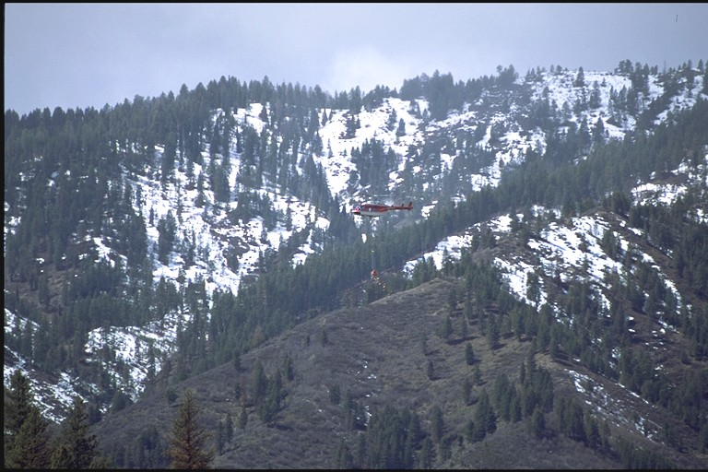
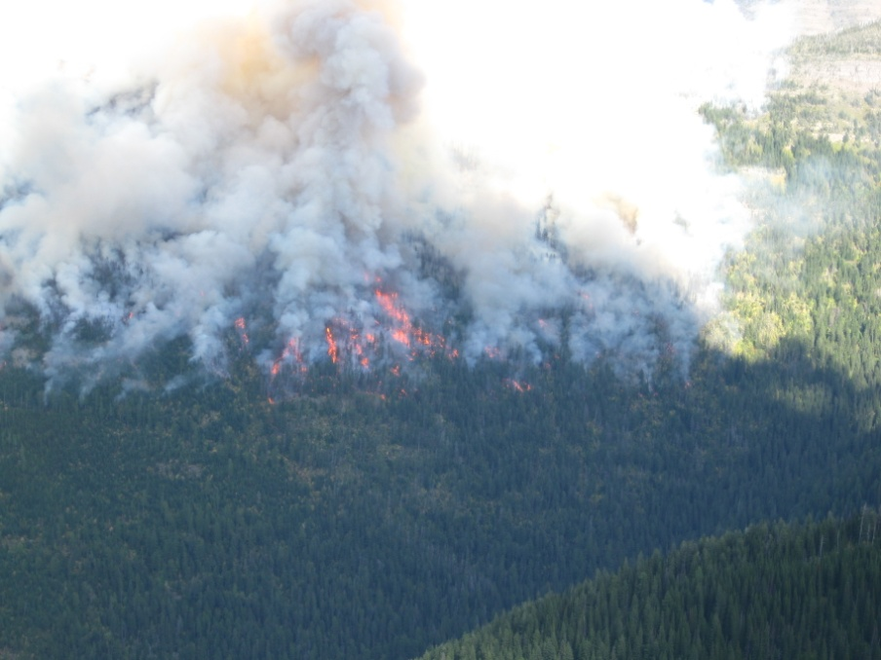
Ignition is possible in less accessible areas.
Reducing hazards to ground personnel.

Slide 8
More acres can be ignited in less time.
Broader prescription window.
Can ignite more than one fuel layer.
Helitorch can be more effective under marginal weather, site, or fuel conditions.

Slide 9
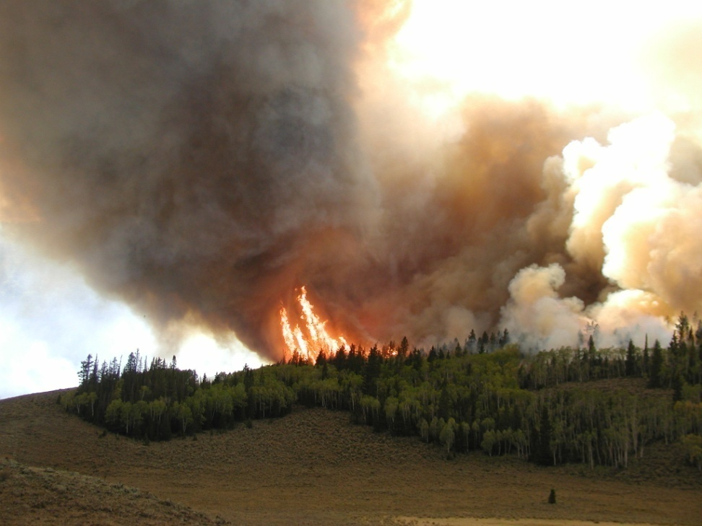
Convection column can develop quicker, increasing control of the fire..

Slide 10
Advantages - Barrel Torch
The small size of the torch allows it to be transported to remote areas inside any medium and most light helicopters.
No need to transport large amounts of mixing equipment and supplies.
Requires a smaller ground crew to mix gel, operate, and maintain.

Slide 11
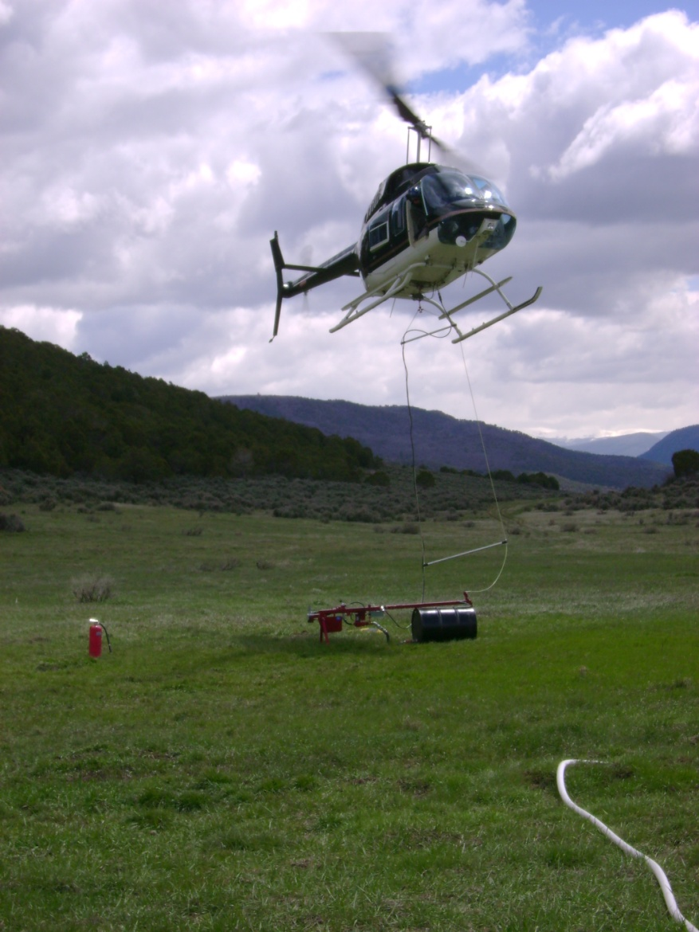
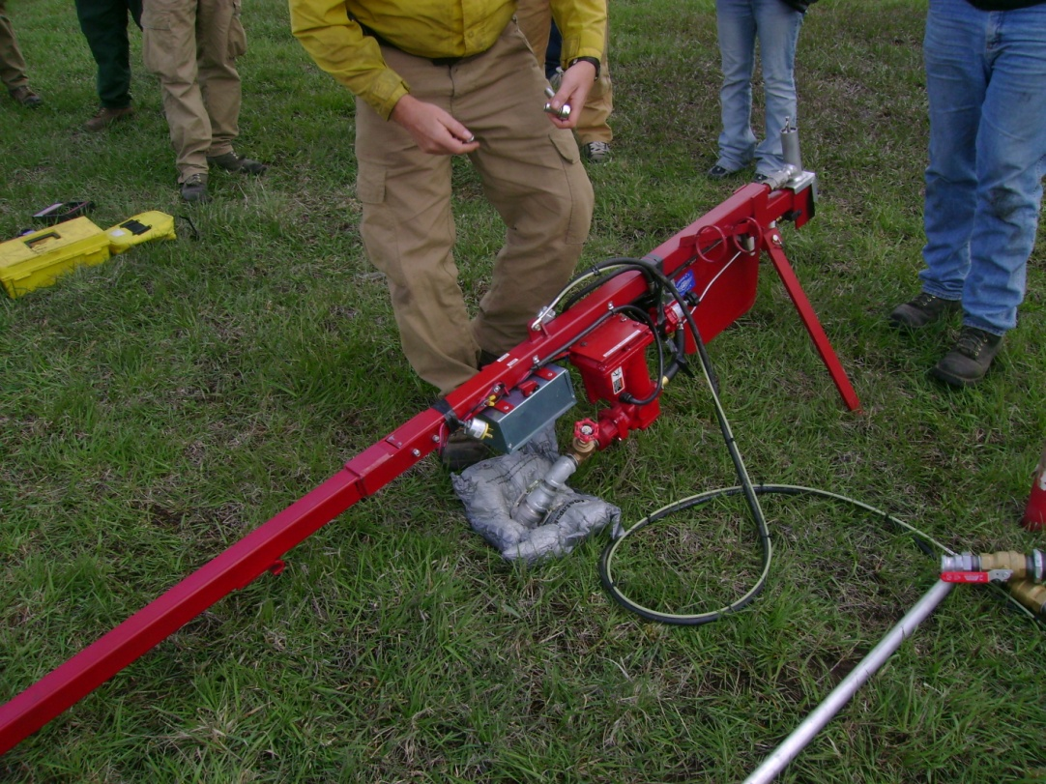

Slide 12
Disadvantages
The use of gasoline is hazardous.
There is substantial resource outlay.
Crew requires extensive training and commitment.
Bulk fuel and chemicals must be hauled to the site complying with DOT and OSHA requirements.
Costs can be significant.

Slide 13
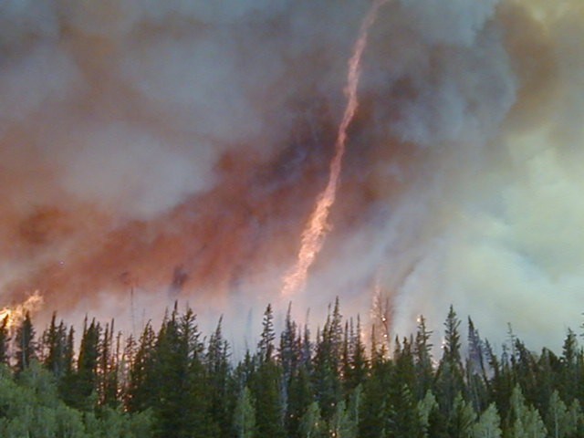
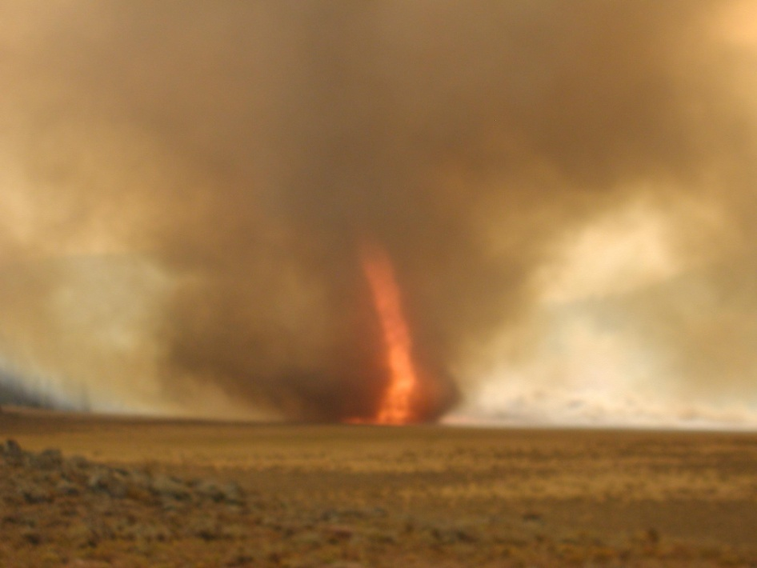
Control of the convection column may be lost with a break in ignition operations.

Slide 14
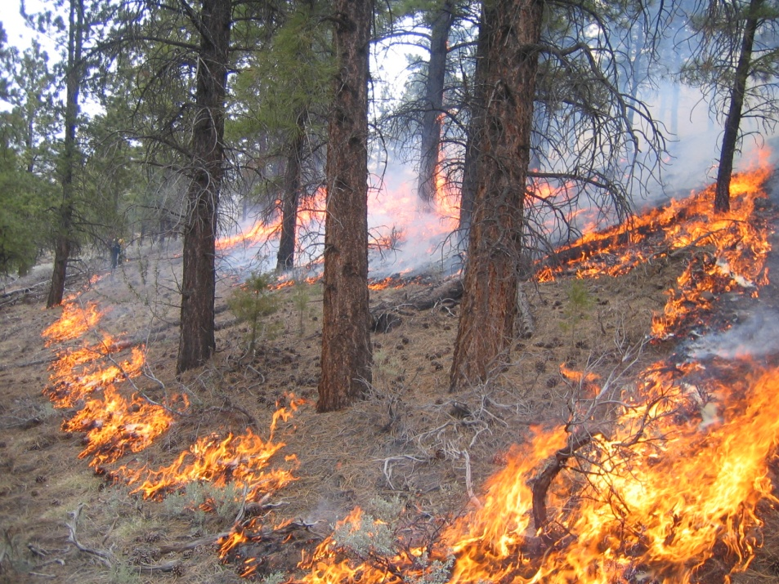
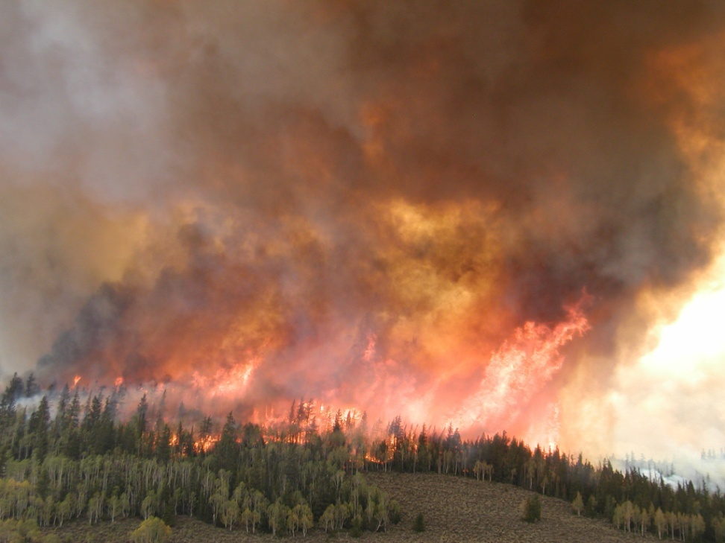
Helitorch will put fire into crowns, it is NOT a good choice for understory ignition operations.
Drip Torch
Helitorch

Slide 15
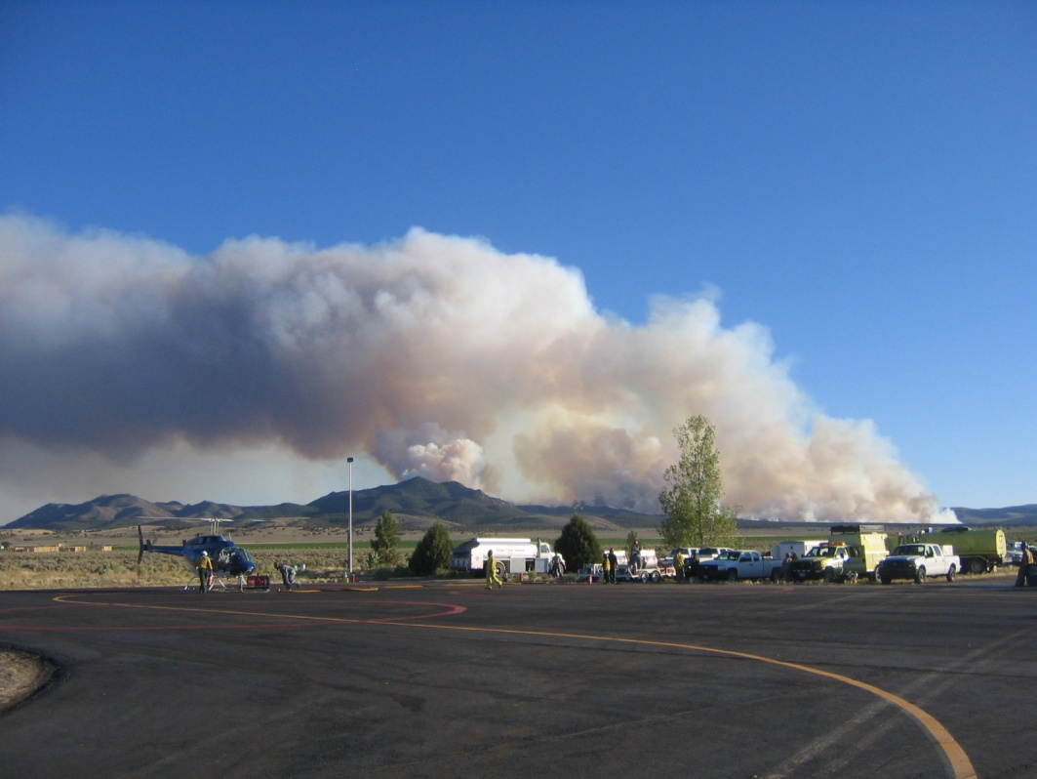
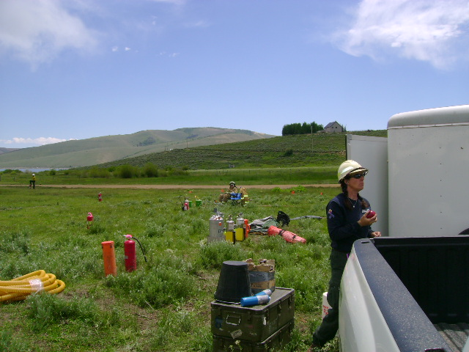
Operation requires considerable planning.

Slide 16
Helicopter must return frequently to refill with gel.
Complex safety procedures must be followed.
Hazmat removal and storage can be complicated.
CDL with Hazmat endorsement may be required for transportation of fuel and equipment.
Requires special pilot carding and ground crew qualifications.

Slide 17
Disadvantages – Barrel Torch
Lack of barrel protection may require special site considerations.
Transportation of barrel fuel to remote sites may require additional logistics.
Close proximity while mixing the gelling agent requires awareness of hazmat issues.
Notes:
Bullet 1 – avoid rocky landing areas, as barrels can be punctured.
Bullet 2 – More than 3 barrels needed for the operation will require additional flights with additional fuel to remote location.
Bullet 3 – No mechanized mixing systems, means that manual labor for mixing & moving of barrels will require additional personnel.

Slide 18
Unit Objectives
Become familiar with the evolution of the helitorch.
Identify advantages & disadvantages of helitorch operations.

