Slide 1
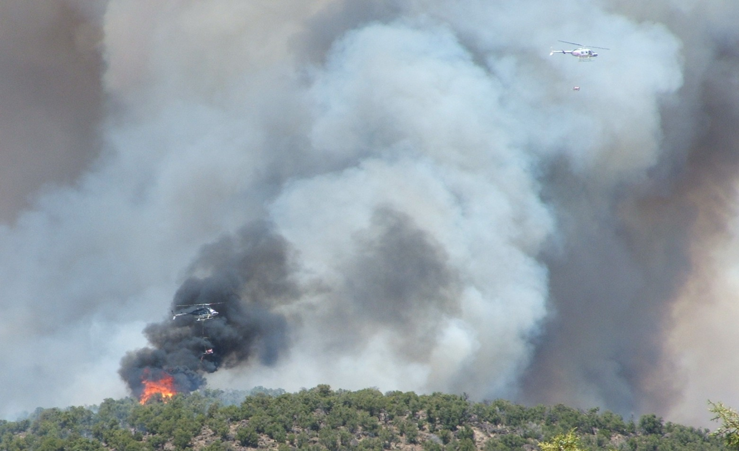
Unit 3
Safety Procedures

Slide 2
Unit Objectives
Become familiar with:
Briefings – pre-operational and post operational
Communications
Hazardous Material Safety Data Sheets (MSDS)
Mixing hazards and PPE standards
Static Bonding procedures
Hazardous material transportation
Spill response procedures

Slide 3
Unit Objectives
Job Hazard Analysis/ Risk Assessments
Operational Safety, Go/No Go and Equipment checklists
Fire Protection
Emergency contingency plans

Slide 4
Briefing

Slide 5
Briefing Board Example

Slide 6
Pre-operational Briefing
Pilot pre-flight briefing, including load calculation, fire shelter use, flight hazards & mission objectives.
Pre-operational briefing will include the pilot, fuel truck drivers, Operations/Burn Boss, Firing Boss, Helitorch/Helibase, and fire protection personnel.
Review burn plan objectives and sequence of events.

Slide 7
Review the Aviation Safety Plan, Helitorch Operations Checklist & Job Hazard Analysis.
Helitorch Manager will brief helitorch personnel on:
Hazards and safety requirements
Emergency procedures
Personnel assignments
Inform pilot of helibase operation procedures and alternate emergency landing areas.

Slide 8
Orientation Flight
Burn Boss/Ignition Specialist shall brief the pilot separately about:
Unit orientation
Terminology/commands
Firing patterns
Fire Behavior
Unit control lines/boundaries
Equipment and personnel locations
Hang-fire flight procedures
Alternate landing areas identified

Slide 9
Communications Plan
Discreet tactical frequency between pilot, Parking Tender, and Burn/Firing Boss.
All aircraft and ground personnel must have assigned tactical frequency.
Air-to-Air frequency assigned.
Flight following communications established.
Helibase must maintain a communication link to activate emergency services.

Slide 10
Parking Tender: headset with hardhat or ALSE approved flight helmet w/ remote transmit button to communicate with pilot.

Slide 11
Hazardous Material Safety Data Sheet
MSDS – provides information to work safely with hazardous material.
MSDS explains proper ways to use, handle, and store chemicals, health hazards, precautionary measures to follow, and emergency procedures for spills, fire, and first aid.
All employees will receive information regarding hazardous materials.

Slide 12
Mixing Hazards
Mixing requires working with chemicals that may cause physical harm when PPE is not used and procedures not followed.
Review the fire and explosion, health hazard, and special precautions sections of MSDS.
Portable eyewash station required on-site.

Slide 13
Inhalation Hazard

Slide 14
Mixing PPE Standards
Ensure all procedures are followed to reduce exposure.
Hard hat with chinstrap.
Chemical splash goggles.
Ear protection.
Fire resistant clothing labeled as non-static or 100% cotton clothing.
Nitrile gloves are required during mixing.
Cotton/leather gloves, non fuel handling.
NIOSH approved dust mask.

Slide 15
Static Bonding
Bonding is the process of joining equipment with conductive wire to neutralize the potential static discharge.
Federal, State and Local regulations require bonding connections during gravity transfer of flammable liquids.
All fuel handling equipment must be bonded.

Slide 16
Static Bonding

Slide 17
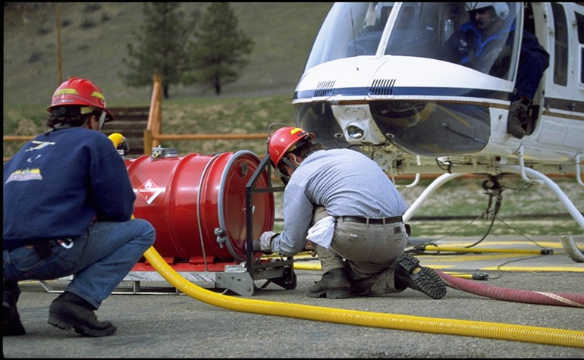
Static Bonding
All hoses used in helitorch operations shall have bonding built into their structure.

Slide 18
Bonding Components and Testing
Use only approved 1½” or 2” gasoline transfer hose.
Use only approved 2” vapor hose.
All hardware and equipment will be bonded prior to contact with mixing system (bare metal).
Continuity testing shall be done on all fuel transfer and vapor hoses and bonding cables prior to use.

Slide 19
Hazardous Material Transportation
Drivers must follow DOT requirements when transporting hazardous materials.
Federal regulations concerning the transportation of flammable liquids are listed in the Code of Federal Regulations, Title 49, Parts 100-180.

Slide 20
Employer Responsibility
Employer must ensure drivers meet DOT Regulations and are current with a CDL with Hazmat Endorsement, prior to transporting materials over 119 gallons/1001 lbs:
General awareness
Function specific
Safety
Driver training

Slide 21
Fuel Spill Procedures
Ensure on site personnel safety.
Remove any ignition source.
Notify Agency Dispatch/Hazmat Coordinator of spills in excess of 5 gallons.
Use appropriate PPE during cleanup.
Spill cleanup: soak up with absorbent material.
If spill exceeds on site capabilities notify Agency Dispatch/Hazmat Coordinator.
Disposal must be in accordance with applicable Federal, State, and Local regulations.

Slide 22
Job Hazard Analysis
A required document outlining the primary tasks, identifying hazards, and describing methods to mitigate or reduce risks associated with helitorch operations.

Slide 23
Operational Safety & Equipment Checklists
Go No/Go checklist must be completed prior to commencing a helitorch operation.
Checklists are a reminder of elements, items, and inspections which are required prior to initiating helitorch operations.
Stop operations if all checklist items do not remain a Go.

Slide 24
Fire Protection
Four 40-B:C dry chemical fire extinguishers at operation minimum, one extinguisher at each landing pad.
And/or, 3 gallon class B CAF or engine with class B foam capability.
Helitorch personnel should be trained on fire extinguisher use.
D.O.T. regulations require Batchmixer and fuel trucks have a 40-B:C fire extinguisher on unit when transporting.

Slide 25
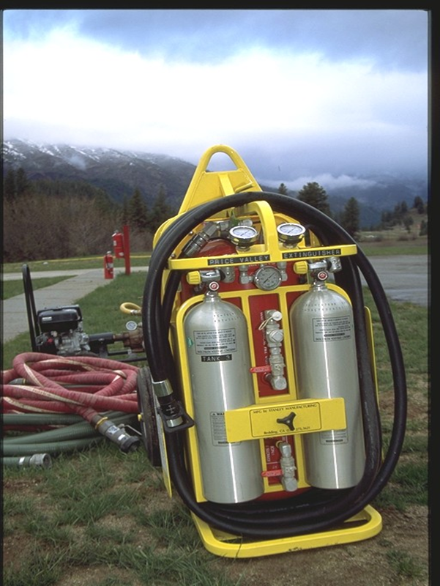
Trimax Extinguishers

Slide 26
Parking Tender will staff fire extinguisher at all times.

Slide 27
Emergency Contingency Plan
Establish and follow approved crash rescue plan.
Establish and maintain a communication link to Dispatch/ICP.
Establish escape routes and a safety zone.
Maintain accountability.
Identify and brief suppression, extraction, and first aid personnel.

Slide 28
Unit Objectives
Become familiar with:
Briefings – pre-operational and post operational
Communications
Hazardous Material Safety Data Sheets (MSDS)
Mixing hazards and PPE standards
Static Bonding procedures
Hazardous material transportation
Spill response procedures

Slide 29
Unit Objectives
Job Hazard Analysis/ Risk Assessments
Operational Safety, Go/No Go and Equipment checklists
Fire Protection
Emergency contingency plans

