Slide 1
RED DRAGON PSD
CROSS TRAINING

Slide 2
Course Overview
Course Outline
UNIT 1: PSD Function and Maintenance
UNIT 2: Operations
UNIT 3: Ground Qualification
UNIT 4: PSD Flight Qualification

Slide 3
Course Overview
Logistics
Prerequisites
Plan of Events
PLDO Task Sheet
Field Requirements
Test Requirements

Slide 4
UNIT 1 PSD FUNCTION & MAINTENANCE
Unit Objectives:
Dispenser Components and Functions
Ignition Sphere Properties
Assemble and Disassemble the PSD
Cleaning and Maintenance

Slide 5
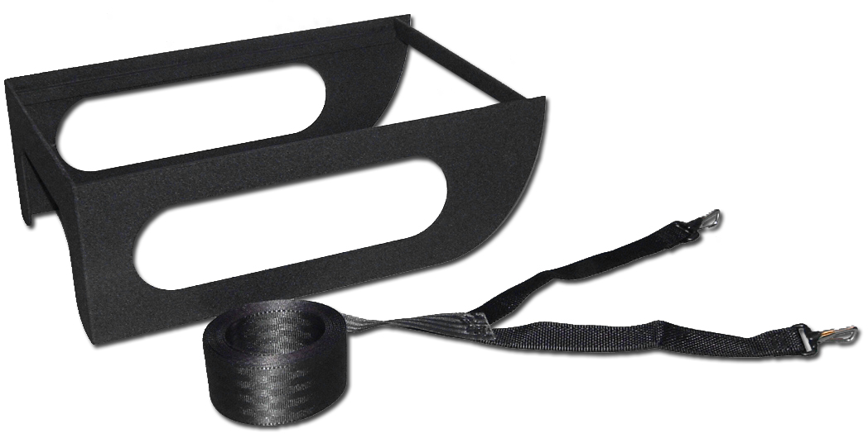
Red Dragon Components
Mounting System
206 Series Adapter
Y Strap
Photo: Nancy Argyle, © SEI Industries Ltd.

Slide 6
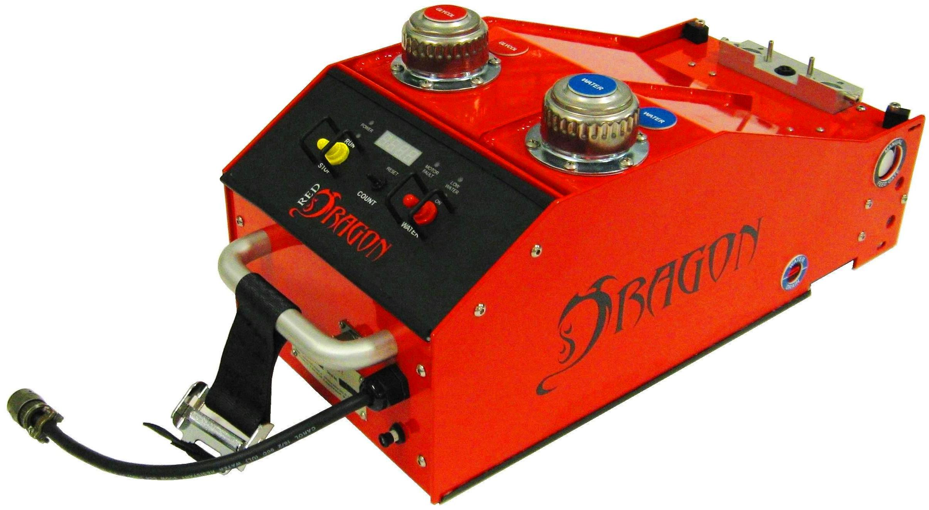
Red Dragon Components
Tank Assembly
Glycol Filler
Water Filler
Water Drain Valve
Ref: Red Dragon Operations Manual, Sec 1
Photo: Mark Toeckes, © SEI Industries Ltd.

Slide 7
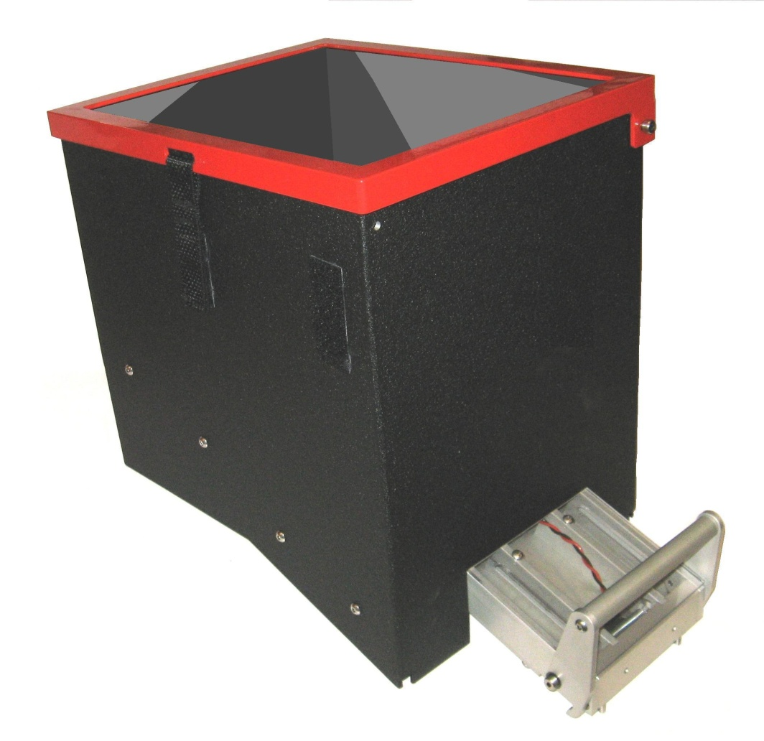
Red Dragon Components
Hopper
Removable Lid
Lock Handle
Ref: Red Dragon Operations Manual, Sec 1
Photo: Mark Toeckes, © SEI Industries Ltd.

Slide 8
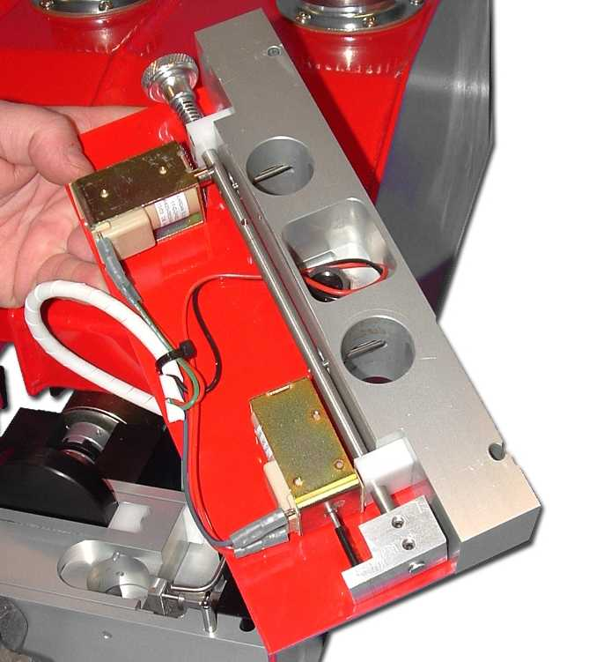
Red Dragon Components
Feed Gate Assembly
Manual Gate Control
Feed Gates
Open Solenoid
Feed Gate Control Rod
Close Solenoid
Ref: Red Dragon Operations Manual, Sec 1
Photo: Nancy Argyle, © SEI Industries Ltd.

Slide 9
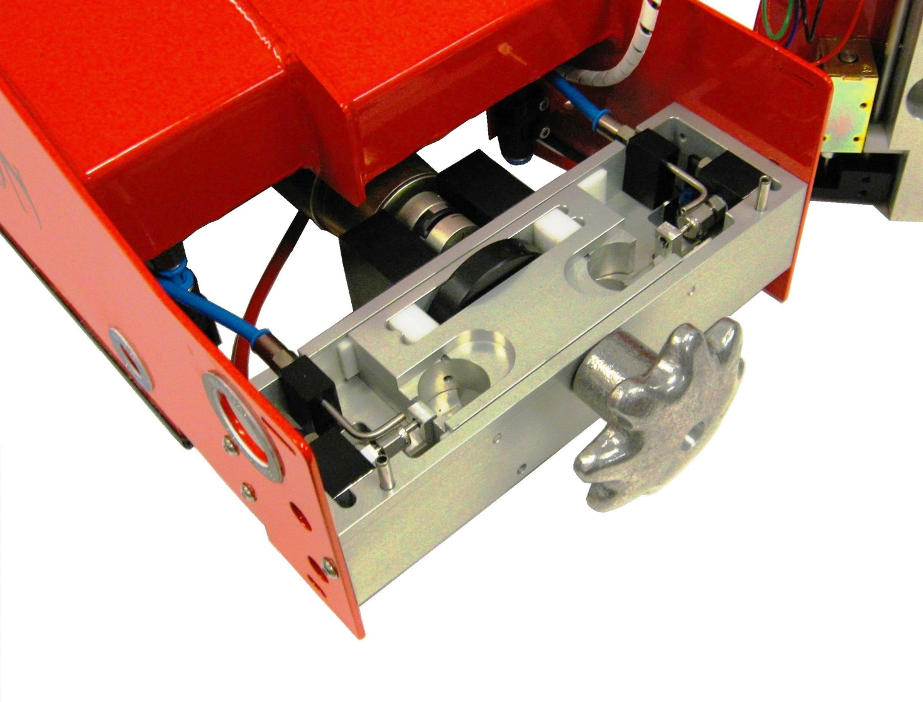
Red Dragon Components
Injection Head
Shuttle
Glycol Pump
Injection Needle
Hand wheel
Cam
Water Nozzle
Ref: Red Dragon Operations Manual, Sec 1
Photo: Mark Toeckes, © SEI Industries Ltd.

Slide 10
Red Dragon Components
Outlet Chute
Outlet Chute
Ref: Red Dragon Operations Manual, Sec 1
Photo: Nancy Argyle, © SEI Industries Ltd.

Slide 11
Red Dragon Components
Main Control Panel
Motor Fault Indicator
Low Water Indicator
Run Indicator
Power Indicator
LED Display
Water Pump Indicator
Run / Stop Switch
Count Reset Switch
Water Pump Switch
Ref: Red Dragon Operations Manual, Sec 1
Photo: Mark Toeckes, © SEI Industries Ltd.

Slide 12
Red Dragon Components
Tethered Remote Control
Power Indicator
Run Indicator
Fault Indicator
Gate Switch
Speed Control
Ref: Red Dragon Operations Manual, Sec 1
Photo: Mark Toeckes, © SEI Industries Ltd.

Slide 13
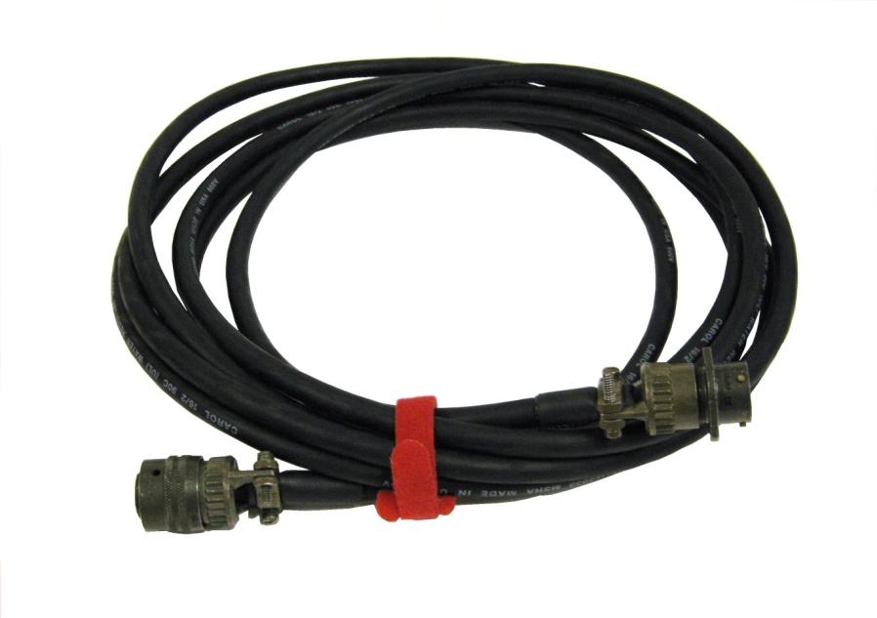
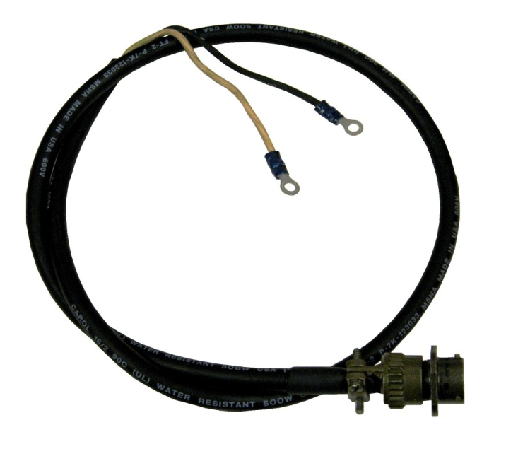
Red Dragon Components
Power Cords
Main Power Cord
Auxiliary Power Cord
Ref: Red Dragon Operations Manual, Sec 1
Photos: Mark Toeckes, © SEI Industries Ltd.

Slide 14
Red Dragon Specifications
Performance
Number of Speeds 7
Min Drop Rate 25 spheres / min
Max Drop Rate 175 spheres / min
Hopper Capacity 650 spheres
Power
Voltage 24-32 VDC
Connector MS3116F-12-3P
Circuit Breaker 5A, MS3220
Ref: Red Dragon Operations Manual, Sec 5

Slide 15
Red Dragon Specifications
Fluid Volumes
Glycol Tank 0.8 gal 3.2 liter
Water Tank (Full) 0.5 gal 1.9 liter
Water Tank (Min) 0.4 gal 1.5 liter
Weights
Dispenser 48.0 lb 21.8 kg
Spheres (650) 6.4 lb 2.9 kg
Ethylene Glycol 7.9 lb 3.6 kg
Water 4.1 lb 1.9 kg
Operational Weight 66.4 lb 30.2 kg
Ref: Red Dragon Operations Manual, Sec 5

Slide 16
Red Dragon Specifications
Dimensions
Length 24.5 in 63 cm
Width 10.8 in 27 cm
Height (No Base) 19.0 in 61 cm
Height (206 Base) 24.0 in 48 cm
Ref: Red Dragon Operations Manual, Sec 5

Slide 17
Dragon Egg Specifications
Diameter 1.0 in 26 mm
Potassium Permanganate 0.11 oz 3.0 g
Total Mass 0.17 oz 4.8 g
Shell Material High Impact Polystyrene
Ignition Delay 20-30s @ 50°F
Ref: Red Dragon Operations Manual, Sec 5
Photo: Mark Toeckes, SEI Industries Ltd.

Slide 18
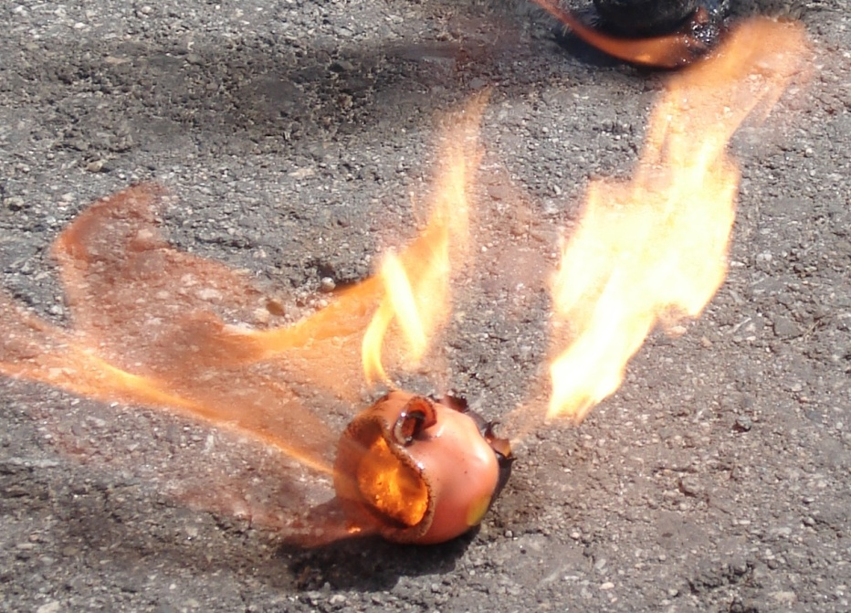
Dragon Egg Ignition Spheres
Ignition Delay Variables
Temperature
Humidity
Amount of Glycol
Ref: Red Dragon Operations Manual, Sec 5
Photo: Matt Davis, SEI Industries Ltd.

Slide 19
Ethylene Glycol
Which Antifreeze?
Standard Vehicle Antifreeze (90 - 100% Ethylene Glycol)
Do not use 50/50 Pre-Mixed Antifreeze
Do not use Propylene Glycol Antifreeze (Non-Toxic)

Slide 20
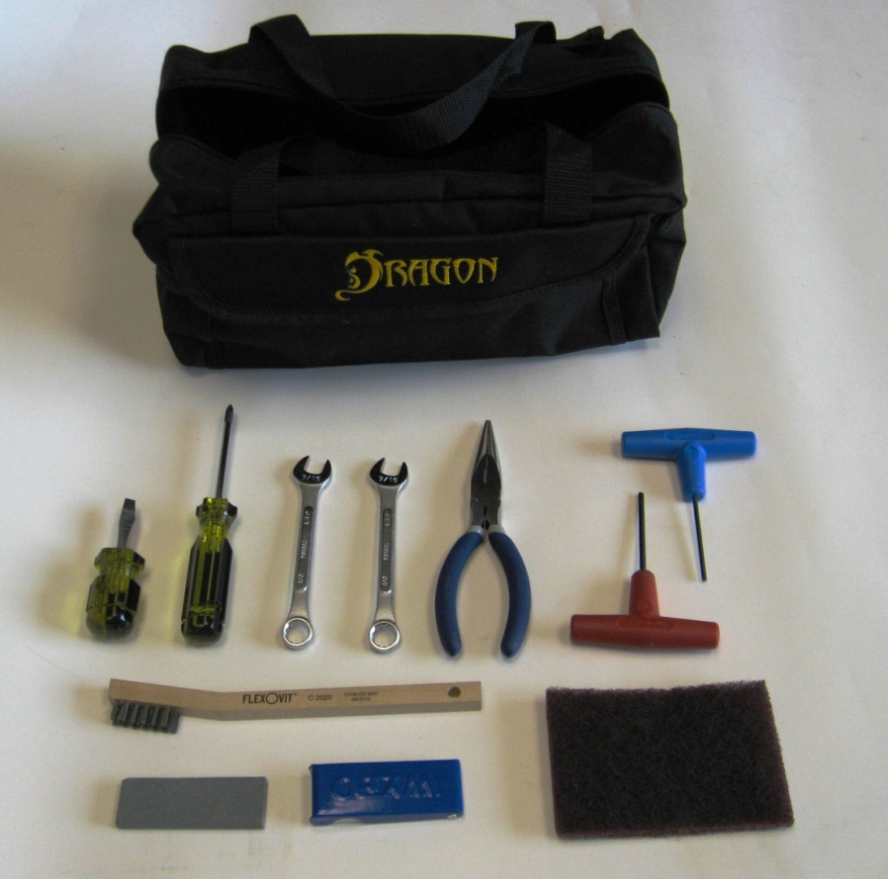
Cleaning and Maintenance
Tool Kit
1/4” Slotted Screwdriver
#1 Phillips Screwdriver
7/16” Combination Wrenches
Long Nose Pliers
1/8” Allen Key Wrench
2.5 mm Allen Key Wrench
Metal Bristle Brush
Sharpening Stone
Tip Cleaner Set
Scotch Brite Abrasive Pad
Ref: Red Dragon Operations Manual, Sec 6

Slide 21
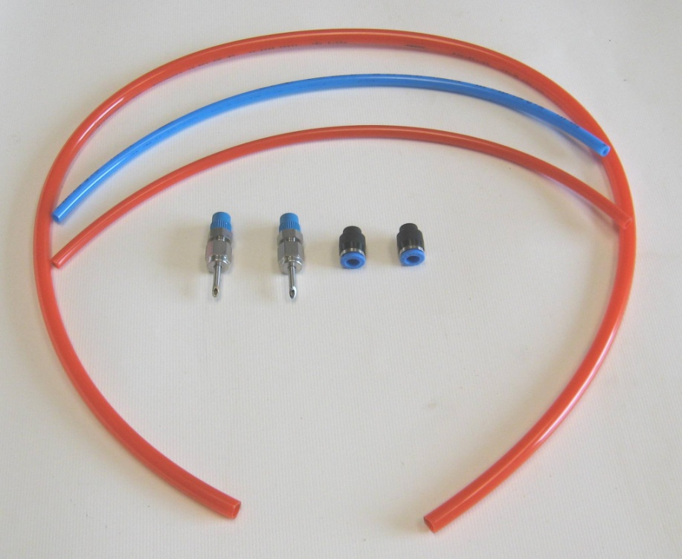
Cleaning and Maintenance
Spare Parts
8mm x 32” Red Drain Tube
6mm x 12” Blue Tube
6mm x 12” Red Tube
(2) Injection Needles
(2) 6mm Tube Caps
Ref: Red Dragon Operations Manual, Sec 6

Slide 22
Cleaning and Maintenance
Cleaners & Lubricants
Use Citrus Based Cleaner / Degreaser
No Petroleum Based Lubricants
Ref: Red Dragon Operations Manual, Sec 6

Slide 23
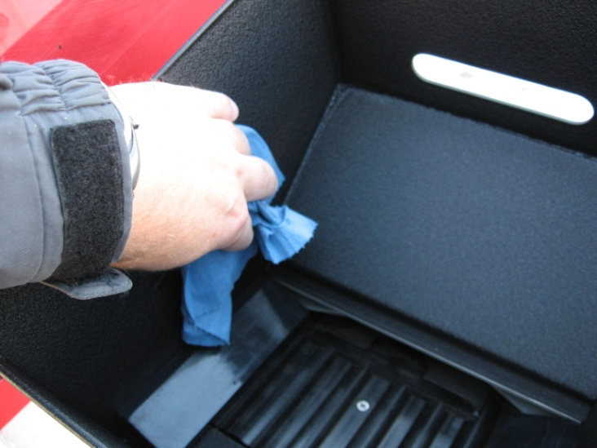
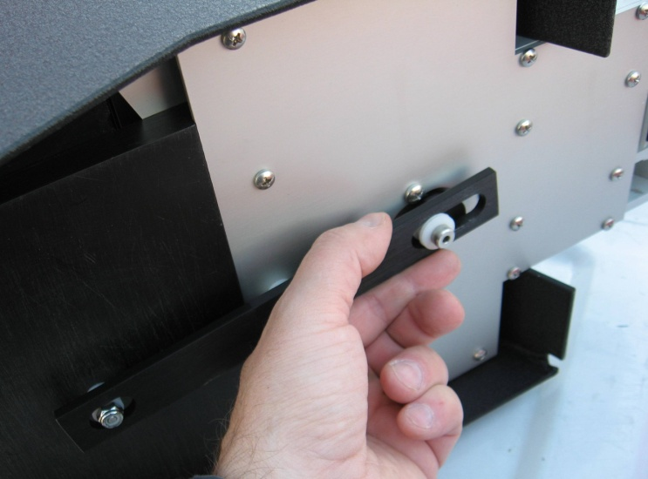
Daily Cleaning
Hopper
Wipe down hopper
Check linkages for wear
Ref: Red Dragon Operations Manual, Sec 6
Photo: Mark Toeckes, SEI Industries Ltd.

Slide 24
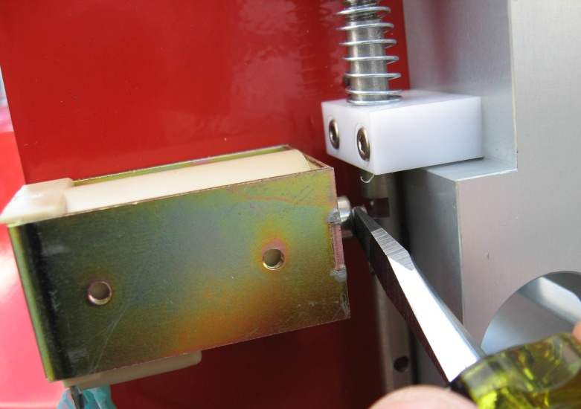
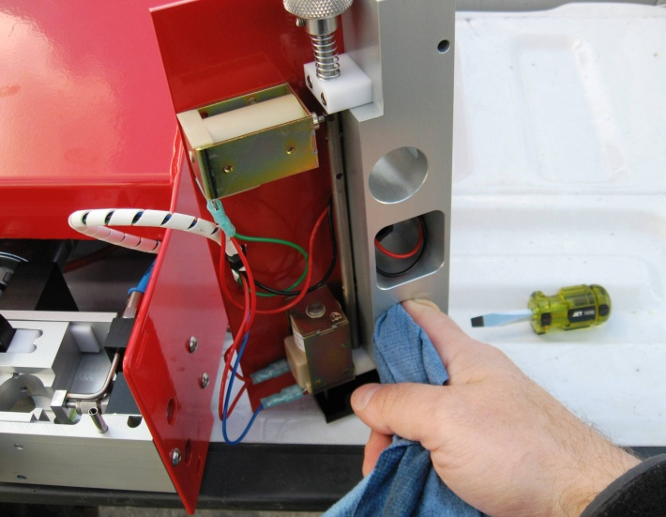
Daily Cleaning
Gate Assembly
Remove gate assembly from injection head.
Unlock the feed gate control rod
Clean the sphere paths.
Ref: Red Dragon Operations Manual, Sec 6
Photo: Mark Toeckes, SEI Industries Ltd.

Slide 25
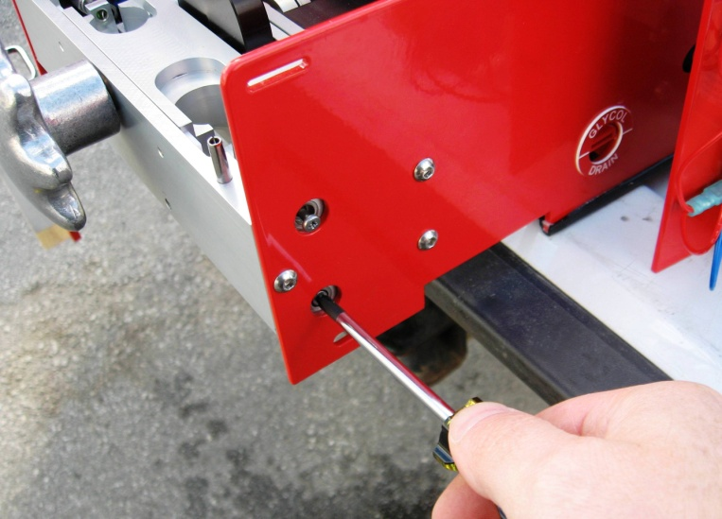
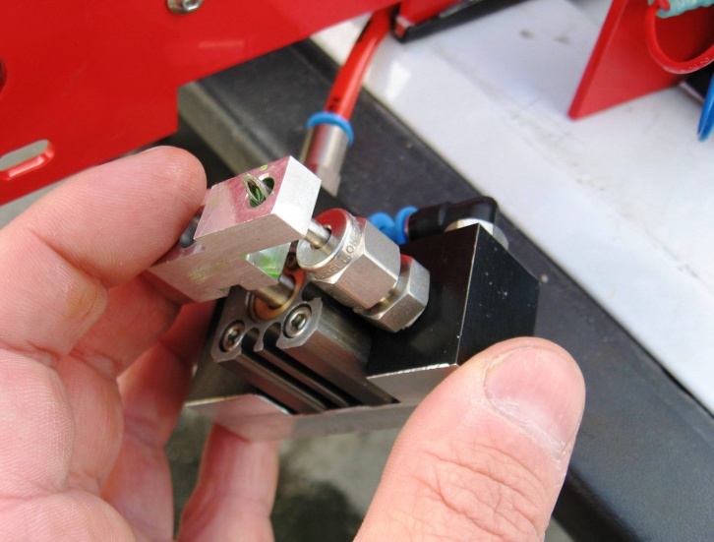
Daily Cleaning
Glycol Pumps
Remove glycol pump assemblies from injection head
Clean using cloth and cleaner / degreaser as required
Check condition of needles and sharpen as required
Check pump operation
Ref: Red Dragon Operations Manual, Sec 6
Photo: Mark Toeckes, SEI Industries Ltd.

Slide 26
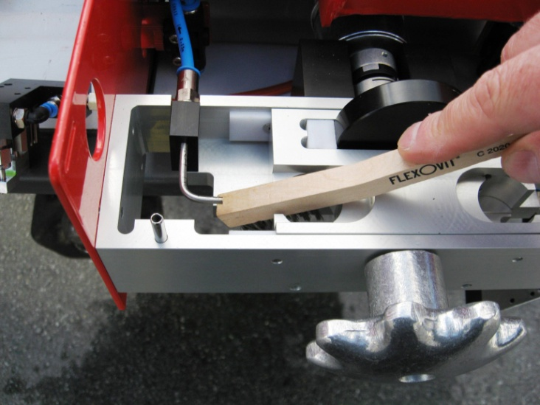
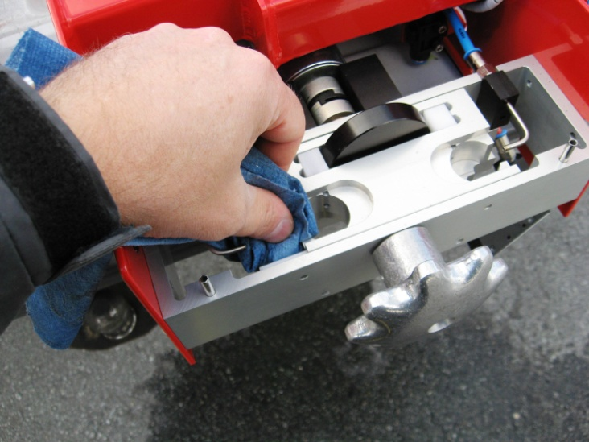
Daily Cleaning
Injection Head
Wire brush the injection shuttle and injection block as required.
Clean using a cloth and cleaner / degreaser.
Rotate handwheel and check for smooth operation and signs of wear.
Ref: Red Dragon Operations Manual, Sec 6
Photo: Mark Toeckes, SEI Industries Ltd.

Slide 27
Daily Cleaning
Tank Assembly
Wipe tank surfaces with cloth to remove any glycol
Check tanks and lines for signs of leakage
Ref: Red Dragon Operations Manual, Sec 6

Slide 28
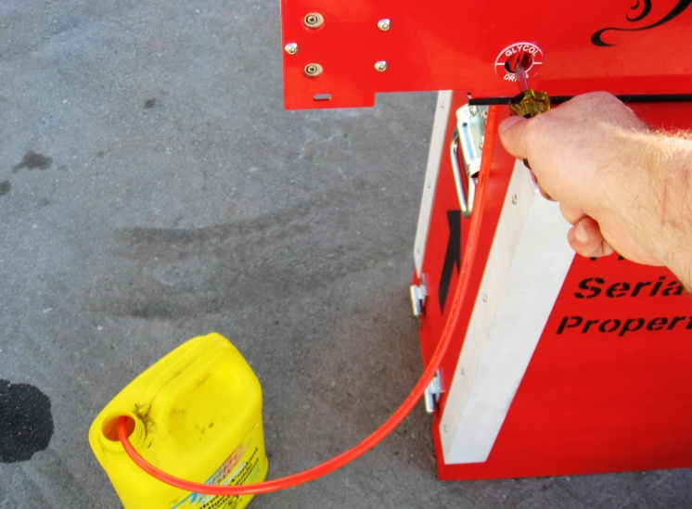
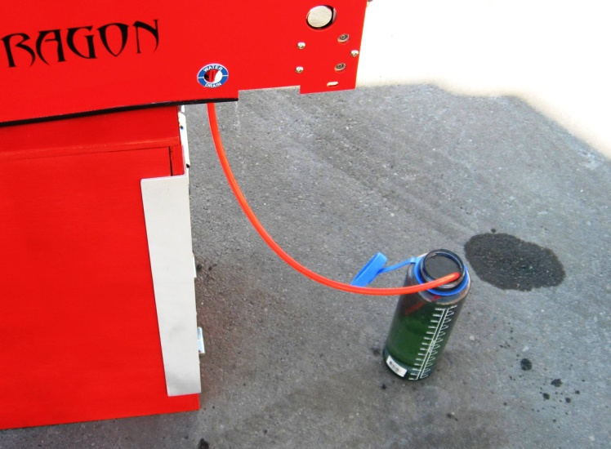
Long Term Storage
Drain Tanks
Drain the glycol tank
Drain the water tank
Photo: Mark Toeckes, SEI Industries Ltd.

Slide 29
UNIT 2 OPERATIONS
Unit Objectives:
Bench Testing
Installation & Pre-Flight Checks
Firing Commands and Actions
Emergency Procedures

Slide 30
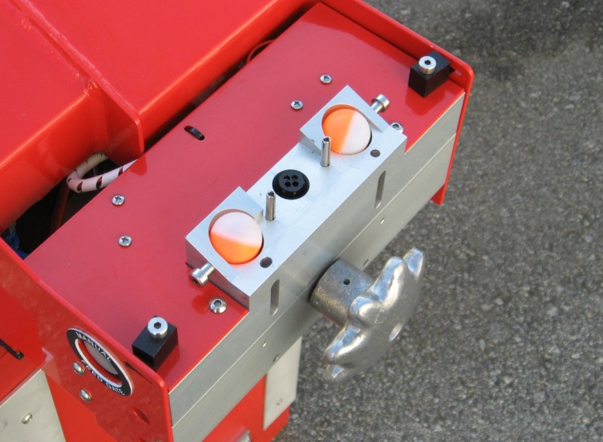
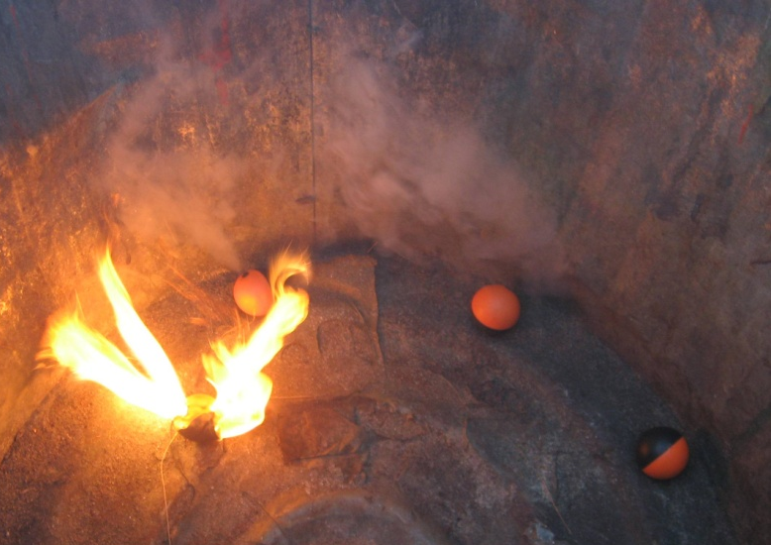
Pre - Operational Events
PSD Bench Test
Confirm PSD Operation
Confirm Sphere Ignition
No Calibration
Photo: Mark Toeckes, SEI Industries Ltd.

Slide 31
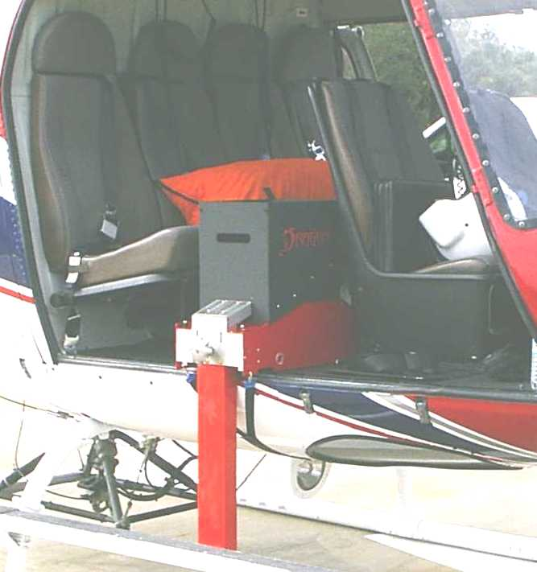
Operational Events
PSD Installation
Prepare PSD Outside Aircraft Safety Circle.
Prepare Aircraft.
Install PSD in Aircraft
Pre-Flight Checks
Check function of PSD
Ref: IAIG Ch III.VIII.A & Ch III.VIII.B

Slide 32
PSD Operation
Firing Commands and Actions
Firing Boss
Command
PSD Operator
Action
PSD Operator
Reply
“Prepare to Fire”
Switch to RUN
“Ready to Fire”
“Start Firing Speed X”
Select SPEED X
Feed Gate OPEN
“Firing Speed X”
“Prepare to Stop Firing”
Grasp Remote Control
“Ready to Stop Firing”
Feed Gate CLOSE
Check Gate Closed
“Stop Firing”
“Gates Closed”
Check Drive Stopped
“Machine Cleared”
“Secure Machine”
Switch to STOP
“Machine Secured”
Ref: IAIG Ch III.XI.A

Slide 33
PSD Operation
Purge Sequence
After gate closed, the drive motor runs to purge remaining three spheres.
Three revolutions.
Increase speed to shorten purge time

Slide 34
PSD Operation
Anti-Jam Sequence
Controller detects jam if the motor should be turning, but it is not.
Motor reverses direction at slow speed for a fraction of a second to allow the jam to clear.
“MOTOR FAULT” indicator on the main control panel illuminates
The “FAULT” indicator on the remote control flashes.
Motor resumes forward operation at the selected speed.
Fault indicators extinguish.

Slide 35
Emergency Procedure
Power Failure
Sphere Jam
PSD Fire
PSD Jettison

Slide 36
Emergency Procedure
Power Failure
Notify the pilot of the situation.
Press the manual feed gate control.
Clear machine with manual handwheel.
Investigate the cause of the power failure.
Sphere Jam
Notify the pilot of the situation.
Press the manual feed gate control.
Clear machine with manual handwheel.
Failure to clear may lead to fire in dispenser.

Slide 37
Emergency Procedure
Fire in Dispenser
Notify the pilot of the situation.
Press and hold the emergency water switch until the fire is extinguished.
If the emergency water pump fails to extinguish the fire, pour water from the canteen into the hopper.
Fire Extinguished
Switch the RUN/STOP switch to the STOP position.
Watch the machine for 3 minutes for possible smoke before leaving the ignition unit.
Land and perform manual and visual inspection to identify and solve the problem.

Slide 38
Emergency Procedure
Fire not Extinguished - PSD Jettison
Notify the pilot of failure to extinguish fire.
Request permission from pilot to jettison the PSD.
Grasp the power cord on each side of the connection, twist to release and pull apart.
Cut the restraining strap between the buckle and aircraft door with a seatbelt cutter.
Grasp the PSD, lift, and jettison clear of the aircraft.

Slide 39
UNIT 3 GROUND QUALIFICATION
Unit Objectives
Perform bench test on PSD
Simulate in-flight communications and actions
Perform emergency procedures on PSD
Trouble shoot PSD

Slide 40
UNIT 4 PSD FLIGHT QUALIFICATION
Unit Objectives
Install PSD in Helicopter
Perform Pre-Flight Checks of PSD
Participate in Pre-flight Briefing
Complete PSD Go/No Go Checklist
Demonstrate Proper In-Flight Operating Procedures

Slide 41
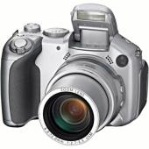
Photo Credits
Nancy Argyle SEI Industries Ltd.
Delta, BC
C.T. Boys Field Support Services
Atlanta, GA
Tabby Crabb Flatwood Studios
Leslie, GA
Opal Fulton Florida Division of Forestry
Carrabelle, FL
Jeff Schardt US Fish & Wildlife Service
Titusville, FL
Mark Toeckes SEI Industries Ltd.
Delta, BC

