Slide 1
BLM Fire
U.S. Department of the Interior Bureau of Land Management
Positions and Job Opportunities

Slide 2
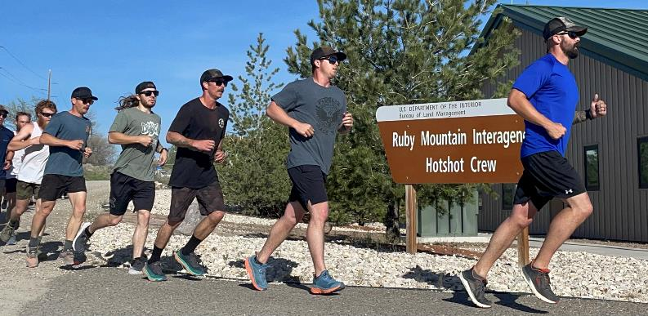
Physical Fitness
Physical fitness standards are required for all National Wildfire Coordinating group (NWCG) sanctioned firefighters.
These standards are assessed during the Work Capacity Test (WCT).
Prior to attempting the WCT, employees must participate in the DOI Medical Qualifications Standards program.

Slide 3
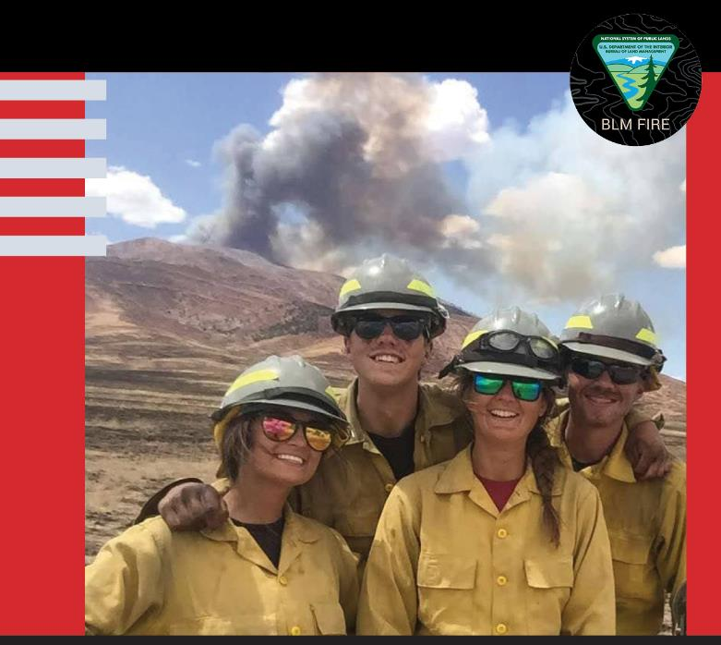
It’s Not Your Ordinary Job
All of our resources consist of cohesive teams of employees that uphold a tradition of excellence with solid reputations of multi-skilled professionals.

Slide 4
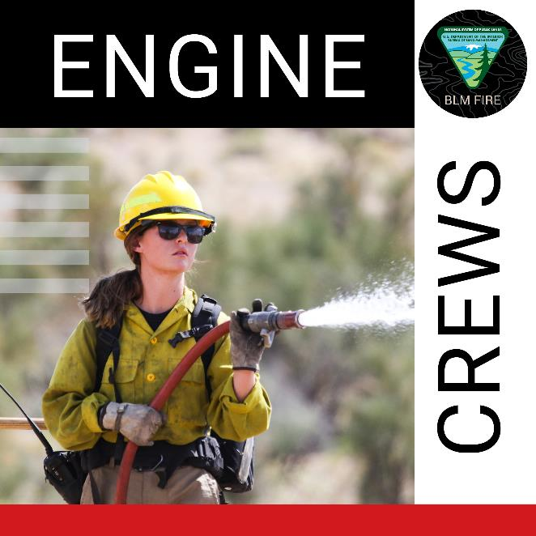
Engine Crews
The BLM deploys over 325 wildland fire engines across the country.
Types include light, heavy, and super heavy.
Crew sizes vary from 3 to 5 people but could be higher.
Serve as a primary initial attack force.

Slide 5
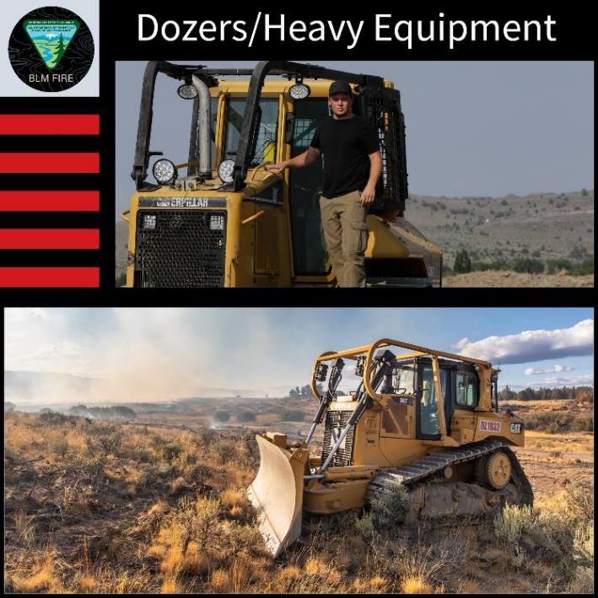
Dozer/Heavy Equipment
Dozers are specifically designed and modified for wildland fire suppression.
Build quick fireline on moderate to rough terrain and mountainous areas.

Slide 6
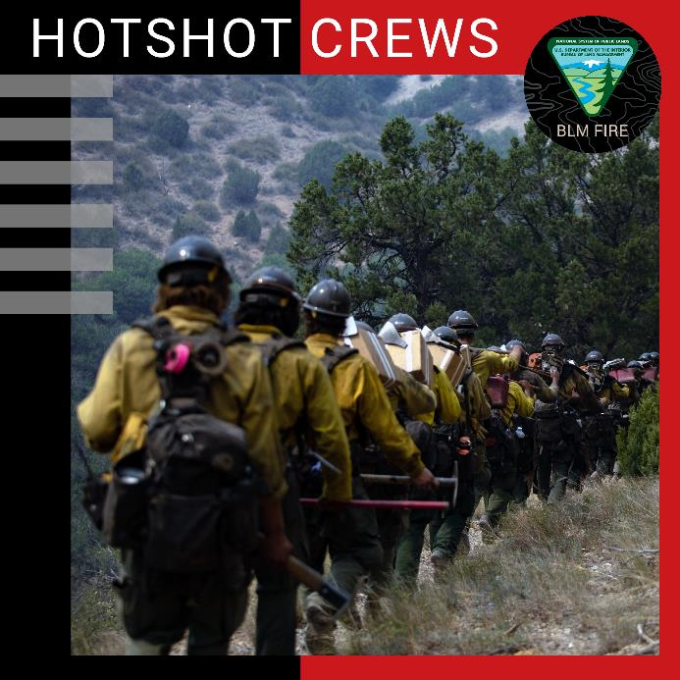
Interagency Hotshot Crews
Consist of 18-22 specially trained firefighters that provide an organized, mobile, and skilled workforce for all phases of wildland fire management.
The BLM has 13 interagency hotshot crews spread out across the western states and one in Jackson, Mississippi.

Slide 7
Veterans Crews
Comprised primarily of veterans.
Provide a highly skilled hand crew for all aspects of wildland fire management while recruiting, employing, and training veterans as wildland firefighters and promoting individual career development for placement throughout all disciplines within the BLM.

Slide 8
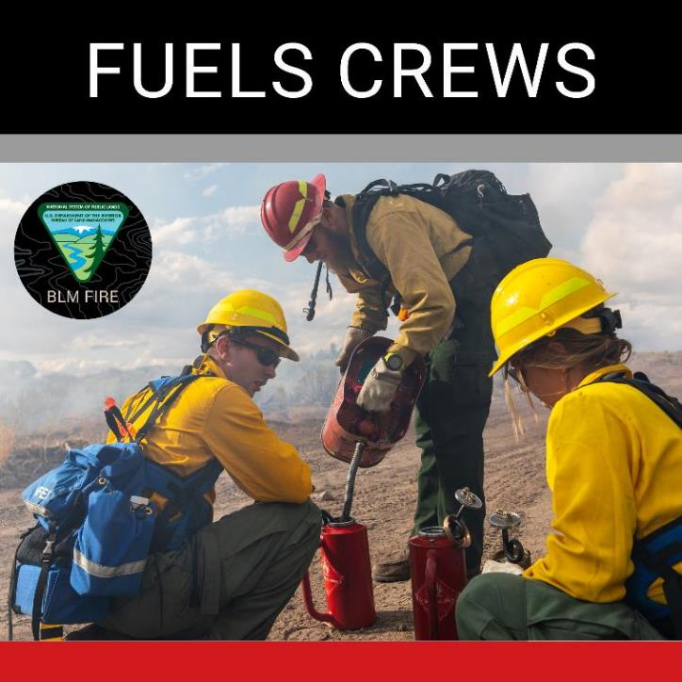
Fuels Crews
Specialize in vegetation management.
Generally, a 10-person crew.
Promote healthy landscapes by thinning or clearing vegetation.

Slide 9
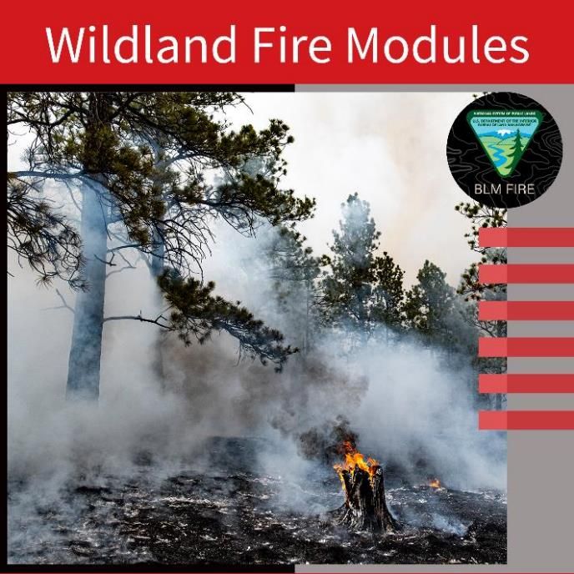
Wildland Fire Modules
Versatile fire crews of about 7-10 personnel, that provide technical and ecological based expertise in areas of long-term planning.
Some are very proficient with Uncrewed Aircraft Systems (UAS).

Slide 10
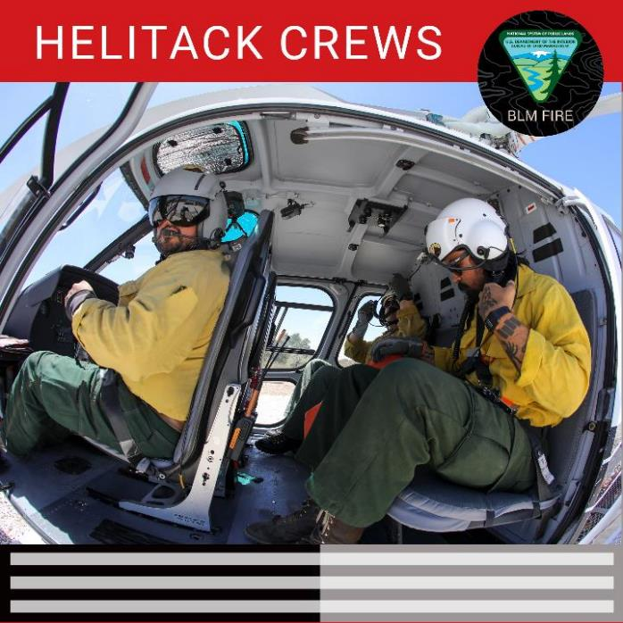
Helitack Crews
1-type 1, 4-type 2, 13-type 3 BLM helicopters spread out across the West.
Crews are made up of seven or more.
Specialized crew can insert firefighters into the fire area quickly, especially in areas where vehicle access is limited.
Provide fireline operational support.

Slide 11
Smokejumpers
Unique because of the way they reach a wildfire.
First-time rookie smokejumpers go through an intense training regimen that covers aircraft and parachuting.
Physically and mentally demanding line of work that requires a broad knowledge of aviation resources and fire tactics.
SMOKEJUMPER

Slide 12
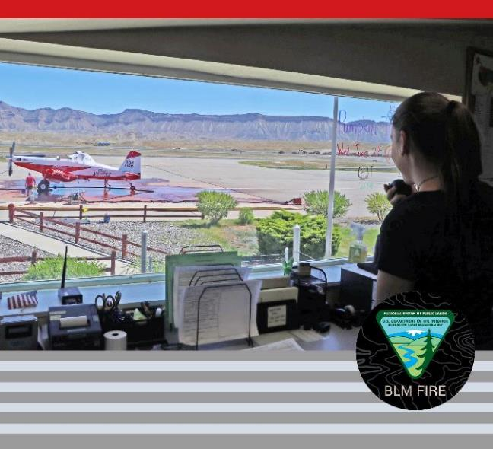
Airtanker Base
Staffing is used to support aircraft used on wildland fire incidents which include the following:
Single Engine Air Tankers (SEAT)
Large Airtankers (LAT)
Very Large Airtankers (VLAT)
Tactical Aircraft
Helicopters
Smokejumper Aircraft

Slide 13
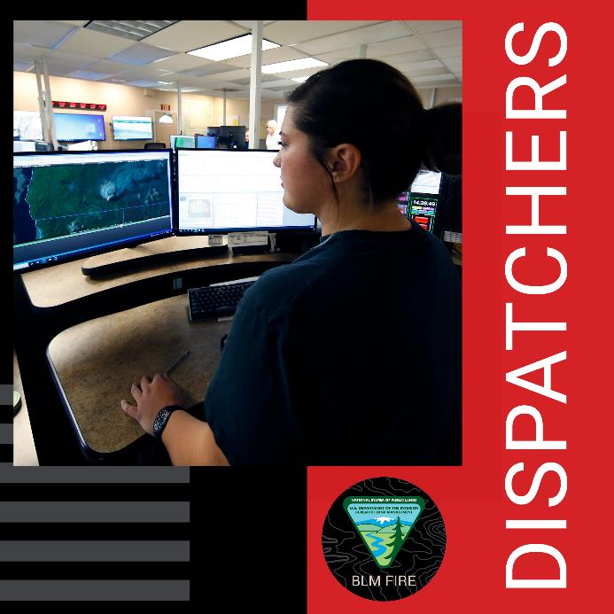
Dispatchers
Information hub for all on-the-ground and aerial wildland firefighting resources.
Coordinate response to wildfires.
Crucial communication link between initial attack resources and the additional equipment they need.

Slide 14
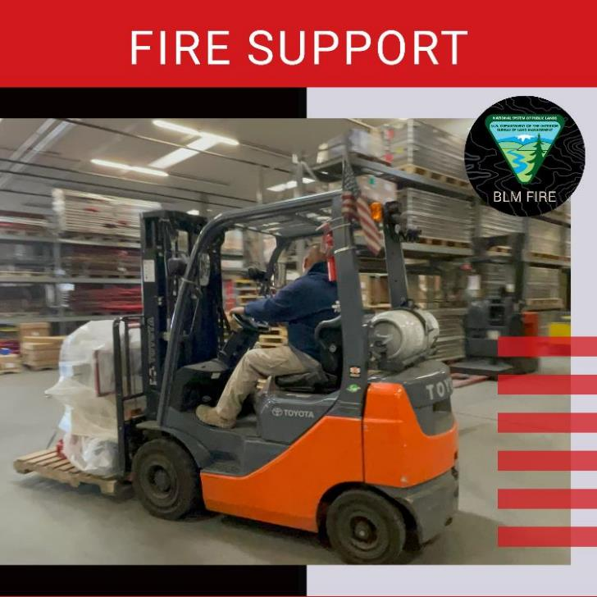
Materials Handler
Repair and rehabilitate wildland fire supplies and equipment.
Pack, ship, and unpack supplies.
Maintain inventory at various cache or warehouse locations.

Slide 15
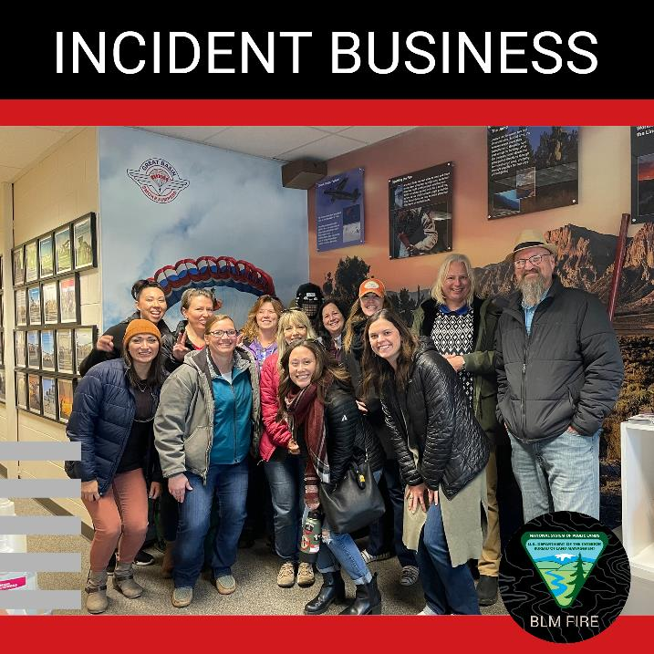
Incident Business
Subject matter expert on policy related to the finance side of wildland fires.
Provide expertise on issues like payroll, budget, and work through claims for compensation for injuries on the fireline.
Help purchase equipment and logistical items in emergency fire situations.

Slide 16
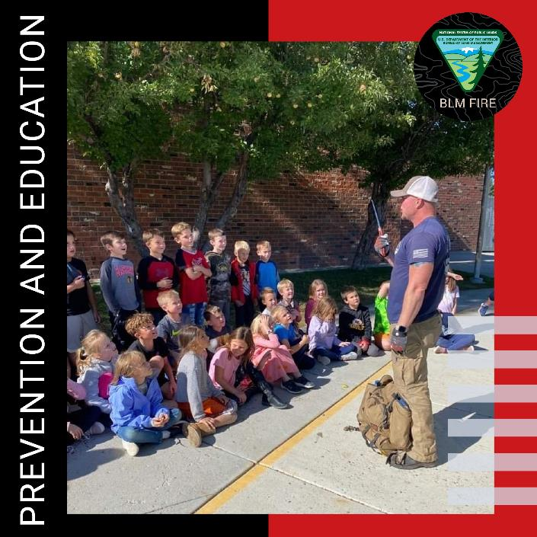
Fire Prevention, Mitigation, Education
Develop educational campaigns and programs to educate the public on fire prevention and mitigation.
Participate in local community events for both adults and children.
Work with local cooperators to ensure people know how to reduce the risk of wildfire.

Slide 17
Fire Investigation
Determine the origin and cause of a wildfire, using scientific methods.
Knowing the causes of wildfires helps create prevention and education campaigns specific to the local level.

Slide 18
Geographic Information Specialist
Manage and maintain fire data.
Collect real-time data on incidents to create maps for fire briefing and planning purposes.
Provide maps and data with information that is important for post-fire rehabilitation.
Experts in geospatial information software for data collection and analysis.

Slide 19
Questions

