Slide 1
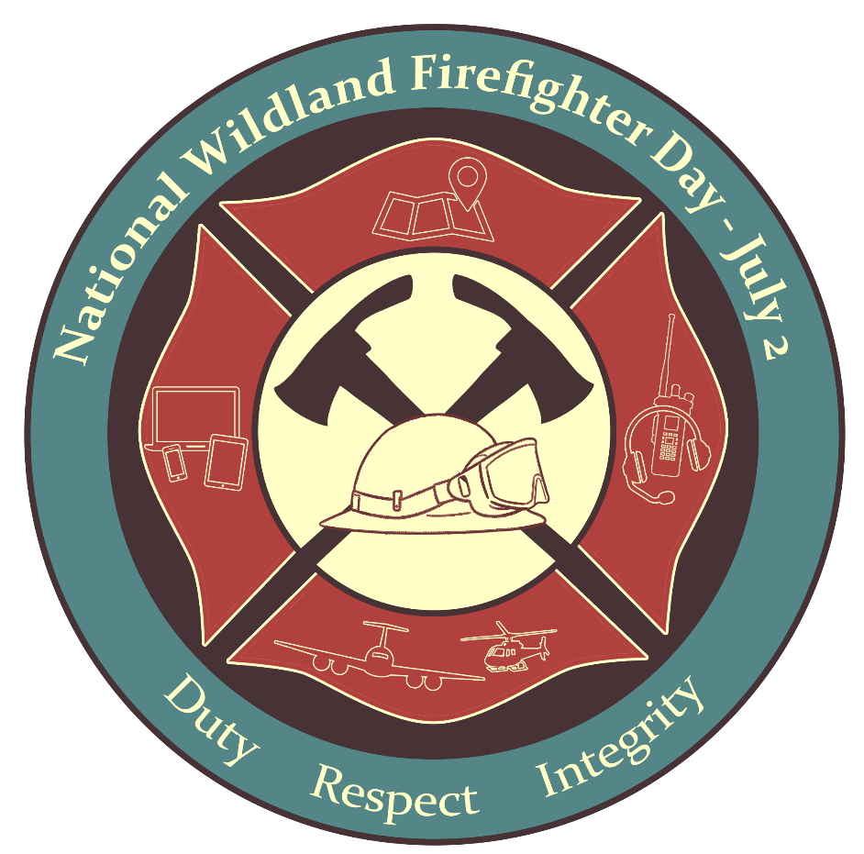
Join us for the Fireline 5K for #NWFFD 2024!
National Wildland Firefighter Day
Established July 2, 2022

Slide 2
2024 National Wildland Firefighter Day Fireline 5K
This event recognizes the dedication of wildland firefighters, including federal, state, local, Tribal, military, rural, contract, and support personnel who are the backbone of the wildland fire community. These men and women work to save lives, property, infrastructure, and precious natural and cultural resources every year, and we are incredibly thankful for their professional skills and efforts.

Slide 3
How do I participate?
If you are in or near Boise, ID, join the local wildland fire community in person on June 2, 2024 and enjoy the 3.1-mile course along the scenic Boise Greenbelt from Ann Morrison Park to the Broadway Bridge. This free event begins at 9:00 a.m. MST! Register here.
Can’t make the event?
Participate virtually by running, walking, jogging, or hiking any 3.1-mile route! This virtual option starts June 2 and counts down to National Wildland Firefighter Day on July 2. Make sure to snap a couple of photos and use a NWFFD Fireline 5K template to share on social media. Tag #NIFC and #Fireline5K!

Slide 4
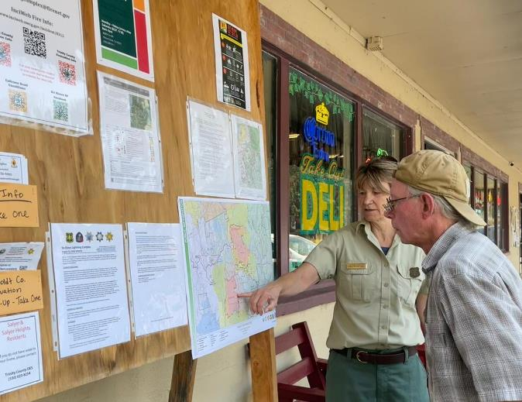
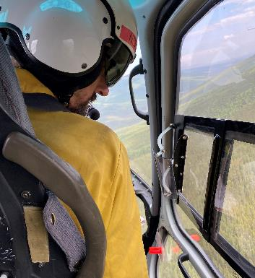
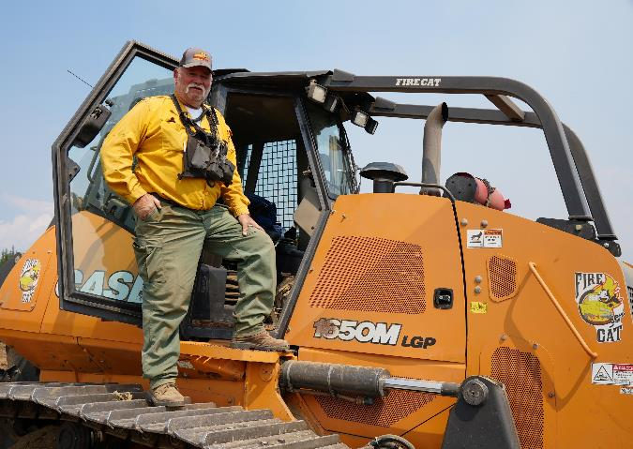
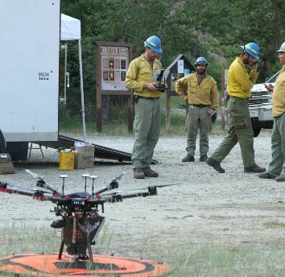
Social campaign
Share your support for wildland firefighters and celebrate your participation in the 5K (in person or virtual!) by turning your 5K photo into a #NWFFD 5K card. See our examples for inspiration!
Add the provided graphic overlays to your photos. You can use PowerPoint or the photo application of your choice!
Once you add the overlay, share the image on Twitter, Facebook, Instagram, or other platforms with the hashtags #FireLine5K, #NWFFD, and #ItTakesAllOfUs.
Be sure to tag agencies, teams, or individuals in your post as appropriate!
Share as many stories as you’d like.

Slide 5
Toolkit
Sample social media posts Graphic overlays

Slide 6
Example Social Media Post

Slide 7
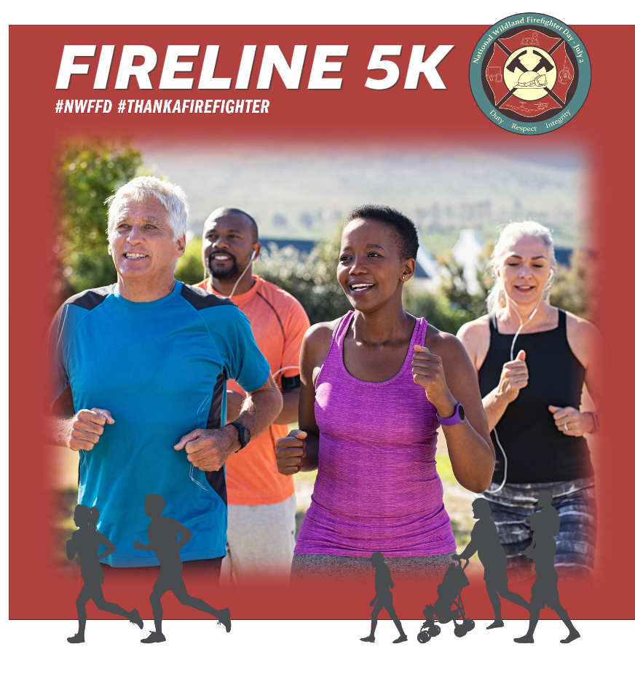
Sample
The team got out of the office this morning to join the community running the #Fireline5K along our beautiful Boise greenbelt to show our support for the wildland firefighters and support staff! How will you celebrate #NWFFD?

Slide 8
Sample
I challenged my family to participate virtually in the #Fireline5K this month to show our appreciation for wildland firefighters! Everybody did their own version of the challenge! #ItTakesAllOfUs

Slide 9
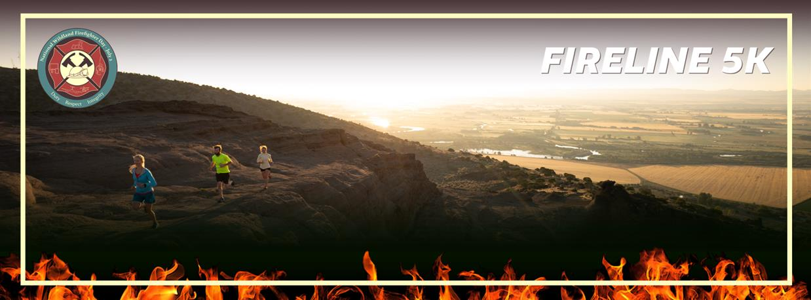
Sample
We are joining firefighters all over the country in getting in shape for fire season by participating in the #Fireline5K this month. Can’t wait to get out there! #NWFFD

Slide 10
Sample
It’s never too early to get the kids out on the trails. Today we are running the #Fireline5K to celebrate National Wildland Firefighter Day! We love our first responders! #ItTakesAllOfUs

Slide 11
How to use #Fireline5K graphics
Customizable #Fireline5K graphics can be found on the following slides.
Insert your photos to make your own Fireline 5K images. Once finished, select all, right click, “Save As Picture,” and then use anywhere!
The graphics are yours to use across any materials.
Use it for your social media platforms, blog posts, website, or in your newsletter – the possibilities are endless!

Slide 12
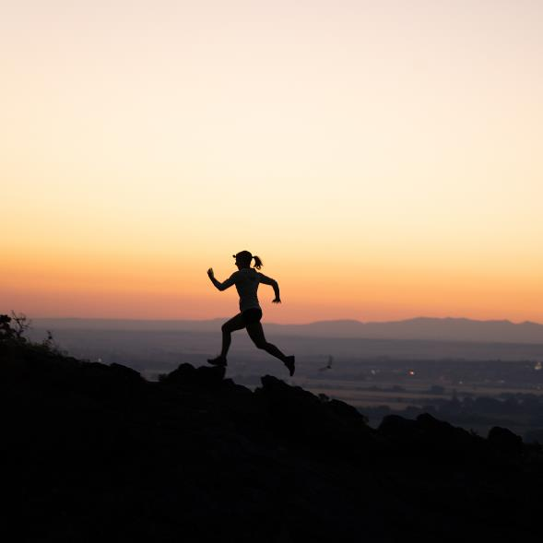
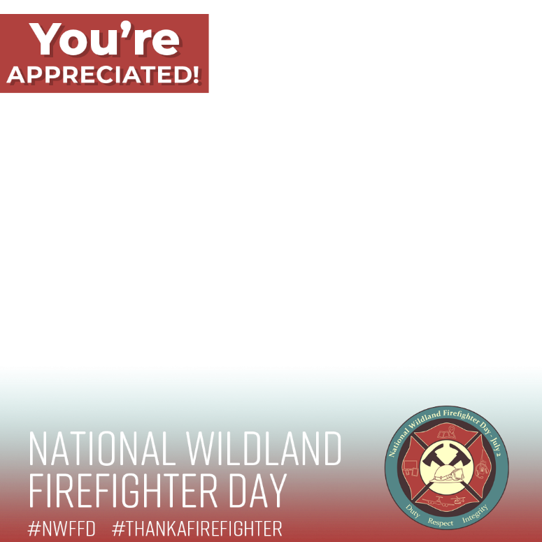
Customize #NWFFD graphics
Add your photo to the slide.
Resize to fit into one of the open boxes.
If you need to crop the photo, double click it and then find the crop tool on the upper right.
Select your photo.
Right click and choose “Send to Back”

Slide 13
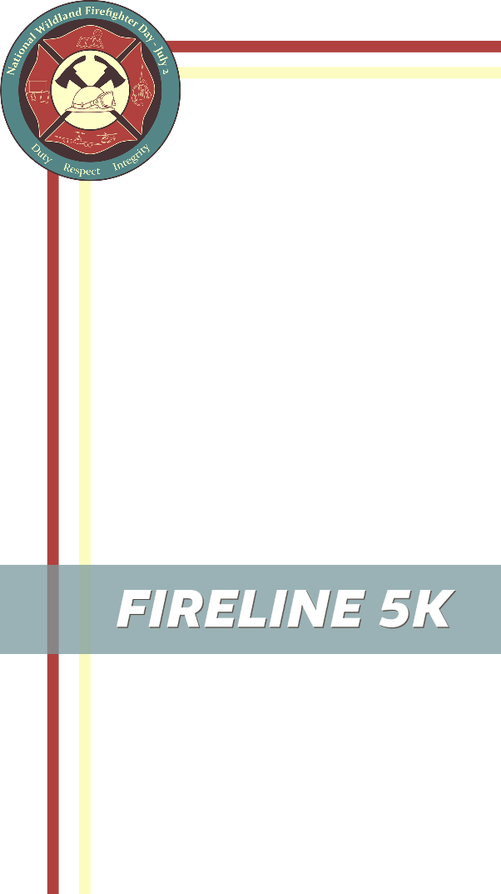

Slide 14
