Slide 1
USA Targeted External Communications Query
(USA-TECQ)
May 22, 2019
Dirk Fillpot
USDA’s Office of Communications
Notes:
USDA recently launched a GIS-based media system that took more than two years to develop, and many volunteer hours from several federal departments to complete. I hope that you will find that the resulting system will vastly improve our ability to target audiences that we need to get information to in order to protect their safety and health and for ensuring that the right audiences get the right information in a much more timely fashion than other services allow.

Slide 2
Key benefits of USA-TECQ:
Likely the only system that allows users to target media outlets that serve specific geographic areas
Built upon a validated and comprehensive database of media outlets
Allows us to highlight the relevance and credibility of our news, likely increasing media pickup of our news
Notes:
There are three key benefits of USA-TECQ:
This may be the only system that allows users to target media outlets that serve specific geographic areas
It is built upon a validated and comprehensive database of media outlets nationwide
And, it will allow us to highlight the relevance and credibility of our news, likely increasing media pickup for users

Slide 3
Available tools are ineffective for targeted outreach
Limit searches to cities or states
Not useful in targeting populations affected by disasters and for hyperlocal outreach because, to do so effectively, we would need to:
Search for news outlets in all individual media markets in the areas of interest
Conduct new searches as hurricane forecasts change, for example
Time-consuming; Inevitable result: media distribution lists are incomplete
Notes:
The tools we currently have available are ineffective for targeted media outreach. Because they require searches by cities and states, users would need to search for news outlets in all individual media markets in the area of interest each time they try to target a specific area - and, if you consider hurricane forecast cones, which change every six hours, in order to get information to the right audiences during a disaster of that nature, users would need to conduct entirely new searches whenever the forecast changes. It’s time consuming, and, ineffective.

Slide 4
So we created a solution:
May be the first of its kind: No known equivalent in the public or private sector
Geographic reaches of newspaper and broadcast outlets mapped using GIS, incorporating their contact information
Allowing searches of specific geographic areas to return email addresses for media outlets serving those areas
PAOs then can target news to media outlets serving residents in specific geographic areas
Notes:
What makes the system we launched really unique and perhaps the first of its kind is its ability to allow users to develop media distribution lists simply by searching for the areas they cover - not where the outlets are specifically located, but rather, which media outlets people in certain areas would access to receive their news. With their circulation areas mapped out in the system, this allows users to be very specific about the geographic region they are interested in targeting.

Slide 5
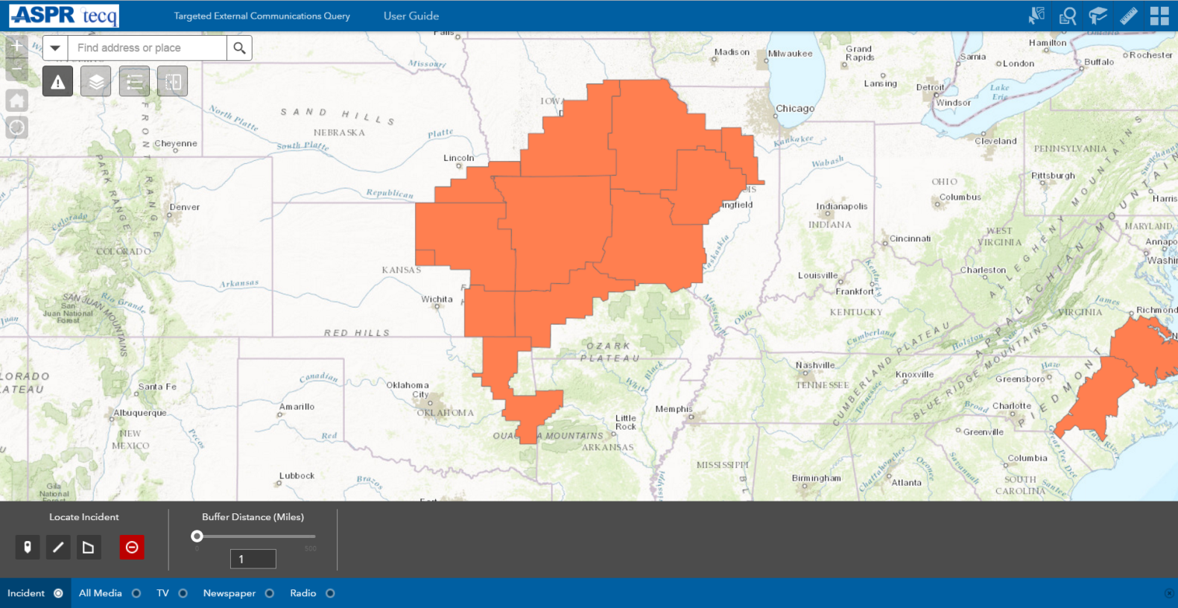
Here’s how it works:
(selecting media covering area affected by National Weather Service heat advisory)
Notes:
Here is an example of a heat advisory area issued by the National Weather Service: The user traces around the area they are interested in distributing news or PSAs to and…

Slide 6
System Identifies More Than 700 Outlets:
(selecting media covering area affected by National Weather Service heat advisory)
Notes:
the system quickly identifies more than 700 news outlets and produces a distribution list the outlets that can be copied and pasted into an email for the distribution. The system is intuitive to use, quickly produces results, and automatically identifies the media markets that serve specific geographic regions, so someone using the system doesn’t need to be familiar with media markets that covering the area of interest in order to generate complete and appropriately targeted media distribution lists.

Slide 7
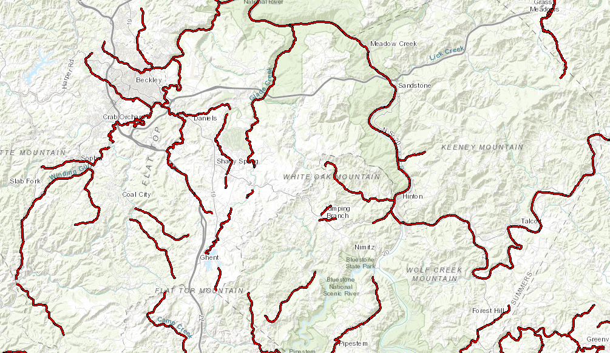
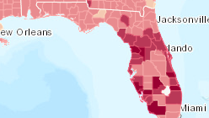
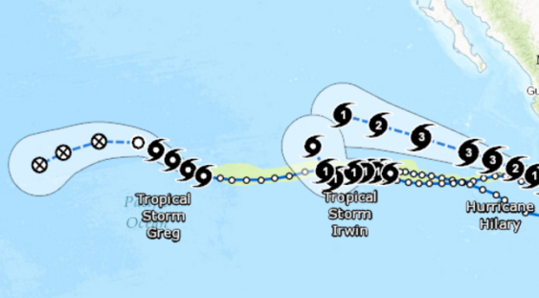
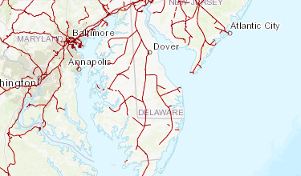
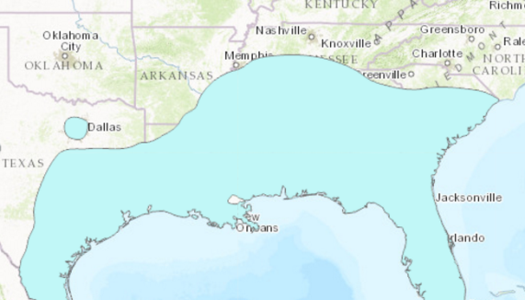
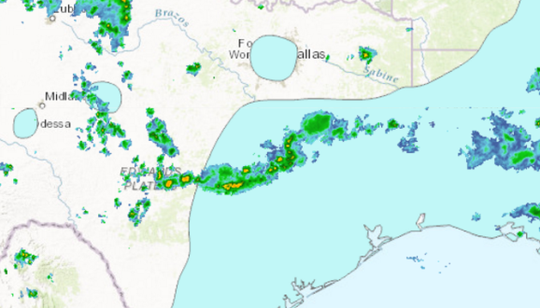
Conduct media searches against any GIS layer:
Contaminated waterways
Demographic layers (% aged 65+)
Hurricane & typhoon forecast areas
U.S. railroads
Aedes aegypti mosquito habitat
Multiple: rainfall & mosquito habitat
Notes:
Because it is GIS-based, it allows for searches against any GIS layer, or for searches against multiple layers. For example, you can perform searches against crime index data (down to county and census tract), demographic layers, including the percentage of populations that are 65 or older, hurricane forecast tracks, railroads, and the habitat for mosquitos that could carry Zika, as well as areas within that habitat where rain is falling and people may need to dump standing water.

Slide 8
How it works:
Notes:
Here’s how it works: (Demo)

Slide 9
To each, their own
USA-TECQ can be specifically tailored for each department, agency or group
Identify the GIS group within your department or agency that will house your version of USA-TECQ
USDA will grant them access to USA-TECQ media layers for your system
With the USA-TECQ media layers incorporated:
Search against only the layers you want
Search against internal layers to which no other agency or department has access
Tailor it to help you better accomplish your department’s mission
Notes:
You heard me mention earlier that beginning today you can use THIS version of the system. Another unique aspect about this system is that it allows every department, agency, or even person to use different versions of the USA-TECQ system that are tailored to your department and agency’s needs by allowing you to incorporate only the GIS layers you are interested in, including GIS layers that are internal to your department and agency. And did I mention that it’s free? We want this tool in the hands of as many departments and agencies to help you all most effectively deliver vital information to the public, so, at the end of the day, it’s the people we serve who get the information they need to protect their safety and health during disasters, public health emergencies, to a host of other events. I hope you can see that the range of applications for this system is broad, and I look forward to learning how you all apply it.

Slide 10
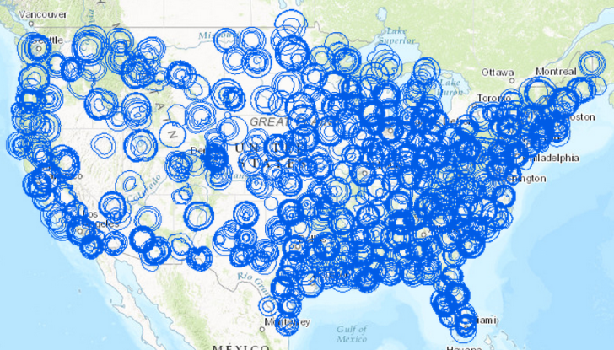
Questions?
(Map showing reach of TV news stations in U.S.)

