Slide 1

Wildland Fire
Public Information Webinar
Hosted by External Affairs
June 10, 2020

Slide 2
Webinar Topics
Wildland fire response during COVID-19
Season themes
PIO Bulletin Board resources and requests
Social media
FireNet migration
InciWeb best practices
IROC reporting

Slide 3


Wildland Fire Response During COVID-19
Jessica Gardetto
Bureau of Land Management

Slide 4
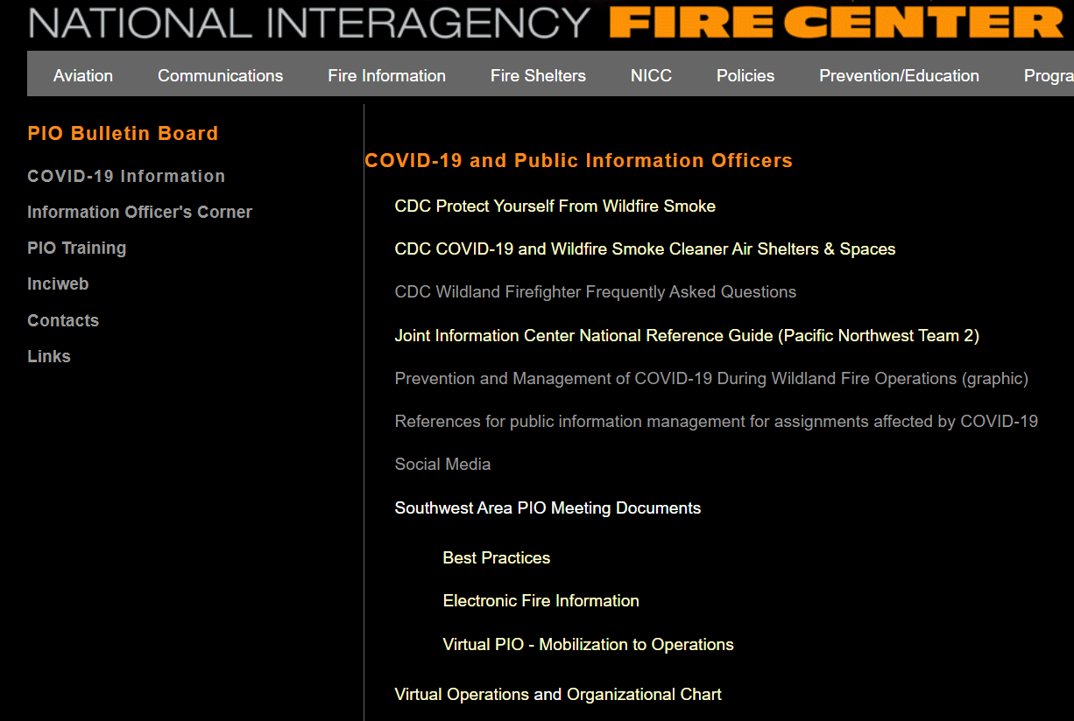
National Messages
Broad, national COVID-19 messages posted to the COVID-19 PIO page
Can be tailored to specific WFRPs or forests/districts
Will update as the situation develops
DOI and USDA clearance still required
Notes:
Talking points:
-We know PIO work will be a different game during covid
-As I’m sure you’re all aware: the public and elected officials are keenly interested in how we’ll handle fire suppression during the pandemic.
-Knowing the GACCs and specific forests/districts have or are developing their own specific PIO guidance and helpful resources, I’m not going to cover detailed PIO tactics.
-We’ve developed a set of broad interagency COVID-19 messages that PIOs can tailor to their specific forests/districts/incidents, much like our season themes.
-These talking points are posted to the COVID section of the PIO BB.
-We will update these as the situation changes.
-The current administration is also keenly aware of our messaging.
-DOI and FS continue to request that all COVID-19 related media inquiries be cleared through DOI and USDA communications, which could get tricky during busy incidents.
-Suggest working closely with the local PAO during fire assignments to ensure you stay on message.

Slide 5
Additional COVID-19 Resources
Posting PIO materials to the COVID PIO page. Please share!
Other tools:
  FS COVID page
  DOI COVID page
  All linked from our NIFC COVID page and NIFC PIO COVID page
Notes:
Talking points:
-We’ve been gathering helpful COVID PIO materials from the GACCs, IMTs, etc.
-If you have materials that you think would be helpful, we’d love to post them
-Feel free to send them to me or anyone in EA and we’ll get them posted to the COVID public affairs page.
-We’ve also developed some agency specific prevention messages that we can share if you’re interested.

Slide 6

2020 National Fire Season Themes
Jennifer Myslivy
Bureau of Land Management

Slide 7
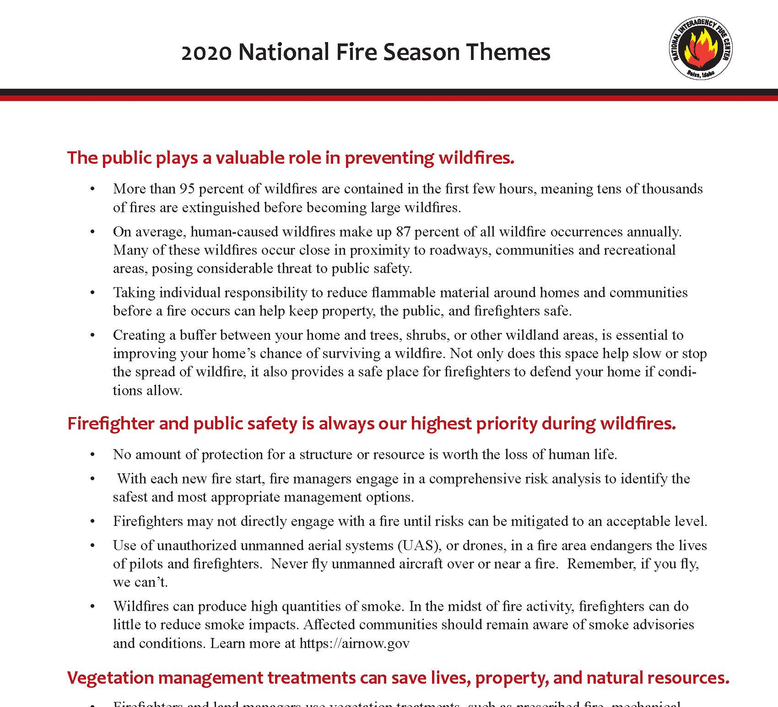
Interagency
Highlights important topics
50,000-foot level overview
Notes:
The National Seasonal Themes are a coordinated effort from all agencies that highlights important topics from a variety of subjects. Over the years, the following topics have been addressed: UAS, budget, air tankers, and staffing to name a few.
These themes are developed from a 50,000-foot view but can be easily revised to support local needs.

Slide 8
The public plays a valuable role in preventing wildfires.
“It takes a team approach to battle wildfires and we need everyone to be a part of this team. It is vital that we work together to help lessen the exposure for our firefighters and first responders this fire season.”
“Preventable wildfires threaten lives, property and precious resources every year. Firefighters and emergency responders are needed more than ever to keep Idahoans safe, so please do your part to prevent human-caused wildfires.”
Notes:
The very first theme this year talks about fire prevention and the public role. An example of that theme that can be used at a local level –
“Preventable wildfires threaten lives, property and precious resources every year. Firefighters and emergency responders are needed more than ever to keep Idahoans safe, so please do your part to prevent human-caused wildfires.”
or
“It takes a team approach to battle wildfires and we need everyone to be a part of this team. It is vital that we work together to help lessen the exposure for our firefighters and first responders this fire season.”

Slide 9
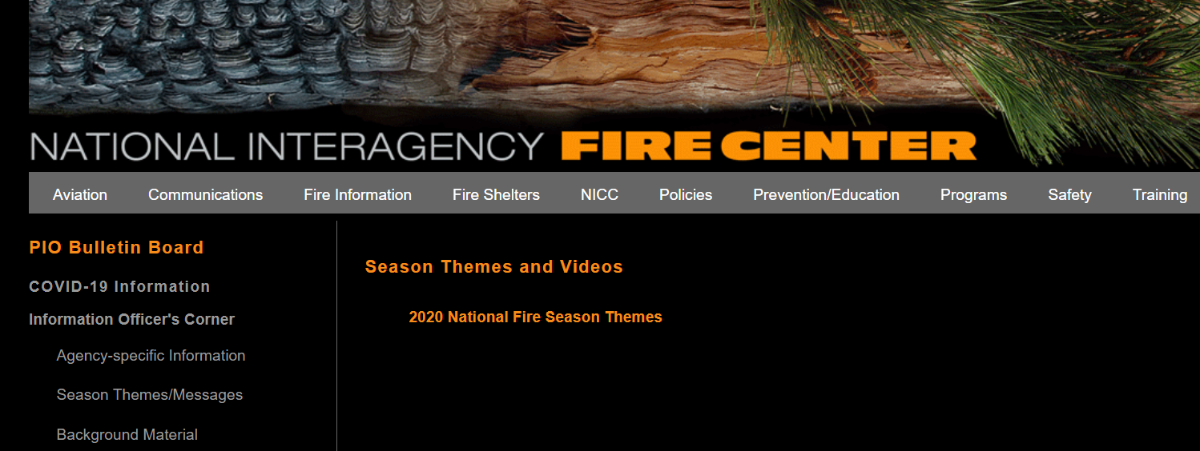

Season Themes are online
https://www.nifc.gov/PIO_bb/messages.html
Notes:
If you’re not familiar with the PIO Bulletin Board, it’s a great place to start when trying to find resources and information helpful to PIOs. If you can’t find what you’re looking for here, or you have any updates, please be sure to contact one of us and let us know. The PIO Bulletin Board is found by clicking on the Fire Information tab at the top of the NIFC page and clicking the PIO Bulletin Board link in the left column.
For those of you who have used this page in the past, you’ll be happy to know that there are upgrades coming soon! The new NIFC website will include a more intuitive and easy to follow PIO Bulletin Board.
Some new content you will most likely be using this season is the COVID-19 information. Just one click on the left side will bring you a plethora of information that PIOs may need to know during incident response or just to keep yourself and staff safe and healthy this season. Many CDC links are provided here as well as references and best practices on how to run virtual PIO operations. Familiarize yourself with these resources and let us know if you have something to add. New links and guidance will be updated frequently, so be sure to check back here for the latest.

Slide 10
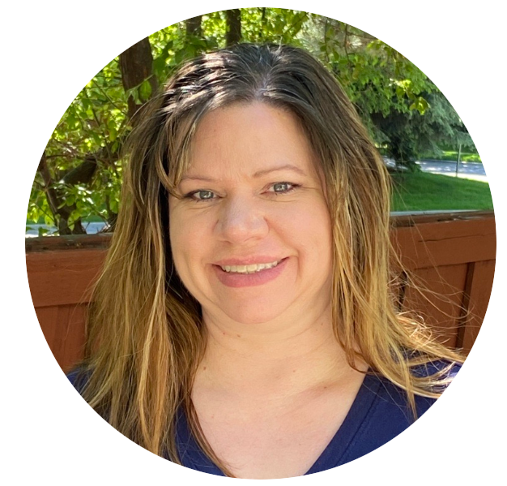
PIO Bulletin Board Resources And Requests
Candice Stevenson
National Park Service

Slide 11
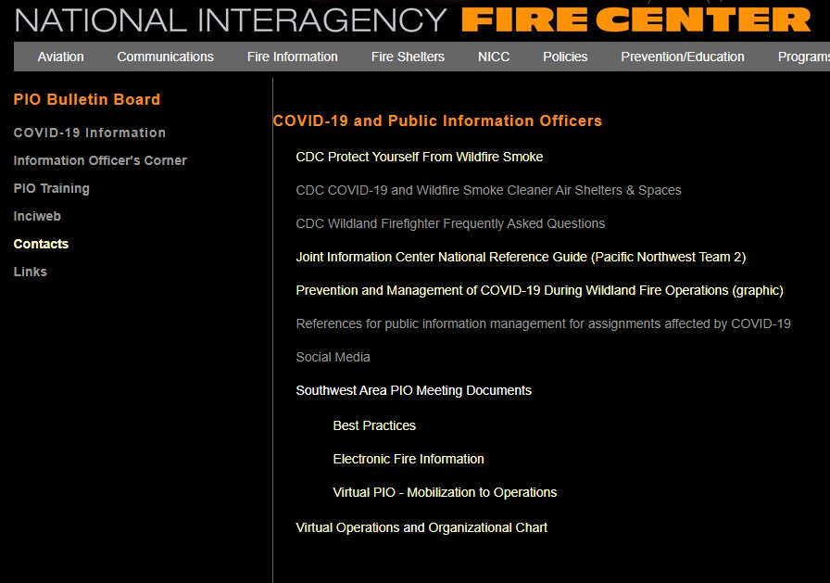
PIO Bulletin Board
New Content
Notes:
If you’re not familiar with the PIO Bulletin Board, it’s a great place to start when trying to find resources and information helpful to PIOs. If you can’t find what you’re looking for here, or you have any updates, please be sure to contact one of us and let us know. The PIO Bulletin Board is found by clicking on the Fire Information tab at the top of the NIFC page and clicking the PIO Bulletin Board link in the left column.
For those of you who have used this page in the past, you’ll be happy to know that there are upgrades coming soon! The new NIFC website will include a more intuitive and easy to follow PIO Bulletin Board.
Some new content you will most likely be using this season is the COVID-19 information. Just one click on the left side will bring you a plethora of information that PIOs may need to know during incident response or just to keep yourself and staff safe and healthy this season. Many CDC links are provided here as well as references and best practices on how to run virtual PIO operations. Familiarize yourself with these resources and let us know if you have something to add. New links and guidance will be updated frequently, so be sure to check back here for the latest.

Slide 12
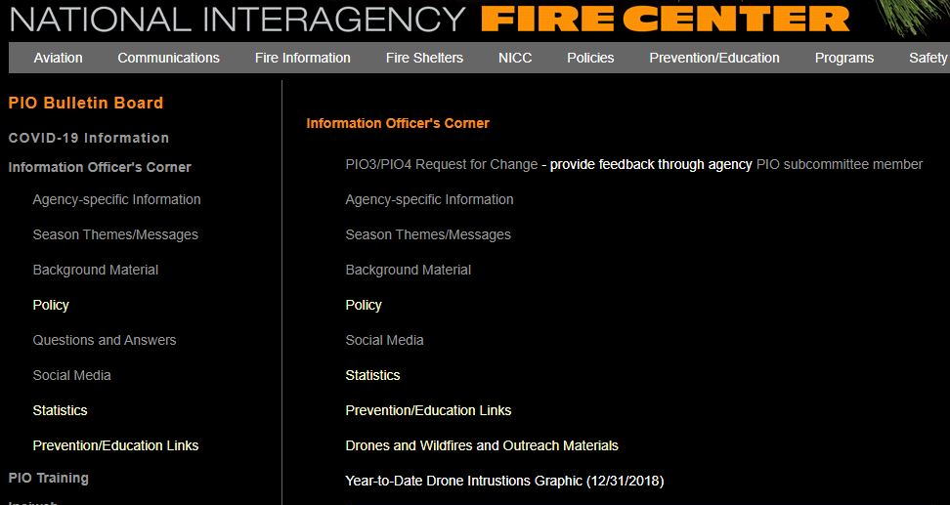
PIO Bulletin Board
Information Officer’s Corner
Helpful Incident Resources
Notes:
The Information Officer’s Corner is another great place to keep checking throughout the season for updates. In here you’ll find your agency-specific information and the 2020 Season Themes. Make sure you check your agency specific information page regularly for updates. The information officer’s corner is also where you can find incident resources like the PIO Incident Organizer under the heading “Background Material.”

Slide 13
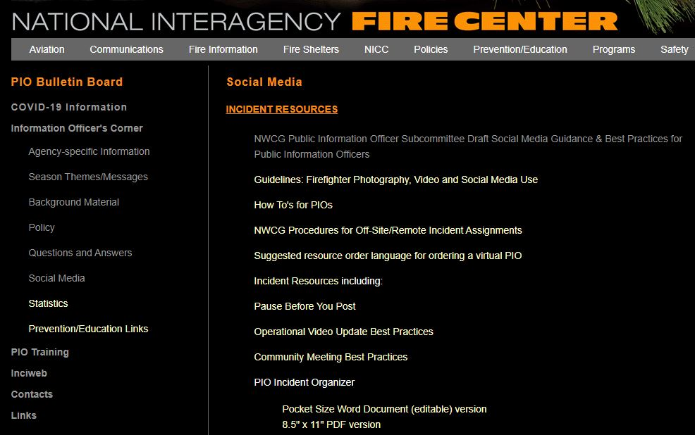
PIO Bulletin Board
NEW
Social Media
Notes:
Another new resource this year is under the social media heading. The NWCG Information Officer Subcommittee Social Media Guidance and Best Practices document provides a comprehensive list of policy, regulations, and best practices regarding social media use on incidents. It’s meant to be used by PIOs and can also be given to other responders as a tool for social media best practices. It’s a great source of information for the new PIO or for policy reference for the seasoned PIO.
Those are the latest updates for this year, but if you’re new to the site, be sure to take a look through all the headings to become familiar with the resources available.

Slide 14
PIO Bulletin Board – Agency Updates
FWS – send updates to Kari Cobb
NPS – PIO resource checklists including a checklist for on-boarding virtual PIOs.
Notes:
There are a few items under the Agency Updates link I’d like to mention. Kari Cobb is a BLM External Affairs employee and is on detail with USFWS. Kari will be updating the site and welcomes any feedback, suggestions, or needs you may have for the site.
NPS updates include PIO resource checklists providing a comprehensive of reminders of what to do when brining in a new PIO. There is also a virtual PIO checklist that could be very useful this year. These checklists could be easily modified and used by other agencies, so take a look if you think this is something you could use.

Slide 15
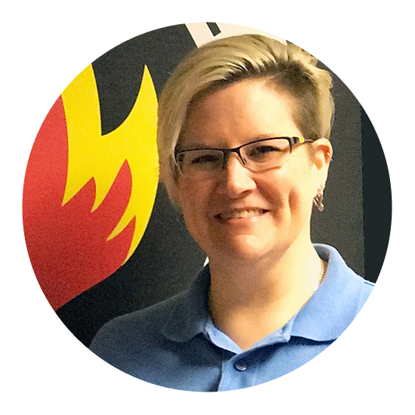

Social Media
Jennifer Smith
Bureau of Land Management
Samantha Storms
Bureau of Land Management

Slide 16









Engage
With Us
@FSNIFC
@BIAFireForestry
@BLMFire
FB: @NIFCFire
Twitter: @NIFC_Fire
@usfire
@usfws
@FireAviationNPS
@StateForesters
@us.National.WeatherService.IMET.gov
#FireYear2020
Notes:
All NIFC agencies utilize social media to engage employees, partners, congressionals and community members while raising wildland fire and all-hazard awareness at a national level.
Social media is a bit different than probably your state, forest, local, or incident social media strategy since we’re located at NIFC and work with different wildland fire agencies. NIFC represents all of the wildland fire agencies including the Bureau of Land Management Fire and Aviation, Bureau of Indian Affairs, U.S. Fish and Wildlife Service, National Park Service, U.S. Forest Service, National Oceanic and Atmospheric Administration, National Business Center, U.S. Fire Administration and National Association of State Foresters.
All of these agencies have individual social media accounts, our goal is to come together to collaborate on campaigns, share interagency work, and provide the best fire information possible. You can find everyone on Facebook and Twitter and we hope you will take advantage of opportunities to tag us in content from the field so we can share! Please also utilize our growing interagency Flickr and YouTube for photo and video needs.
One of our goals is to set the standard for wildland fire information sharing and provide resources for incident public information officers.

Slide 17
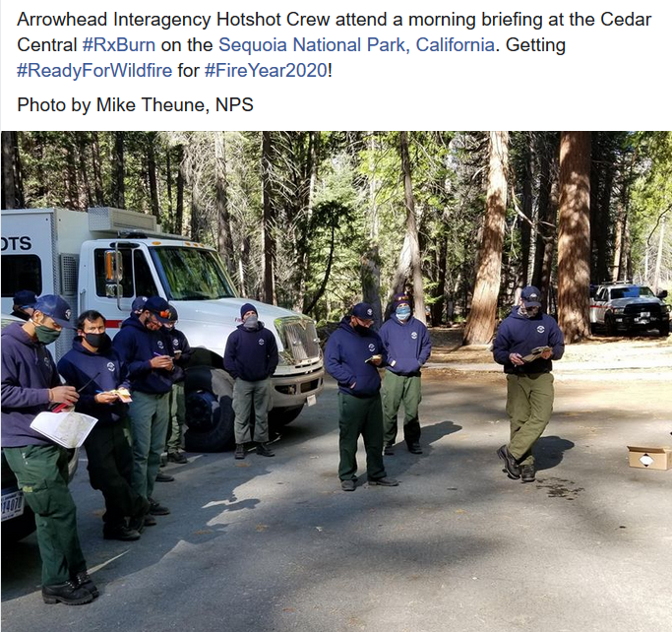
Consistent Hashtags
#ReadyForWildfire
#FireYear2020
#NotYourOrdinaryJob
#FireJob
#FirefightingResources
#DOIDelivers
#FireName (#NorthFire)
Notes:
We want you to engage with us during #FireYear2020 – it’s a team effort to:
Raise awareness about wildland fires and other all-hazard incidents to the public.
Demonstrate how the wildland fire community supports firefighting efforts and other natural disasters and highlight interagency coordination.
Coordinate the use of consistent hashtags for wildland fire related social media content.
The next few slides show examples of social media shared by the agencies at NIFC.

Slide 18
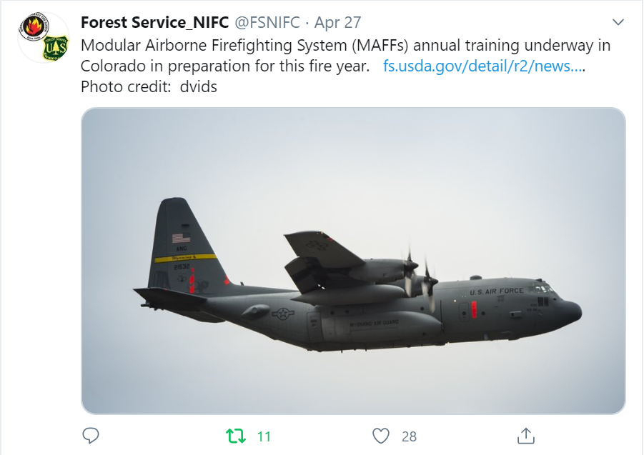
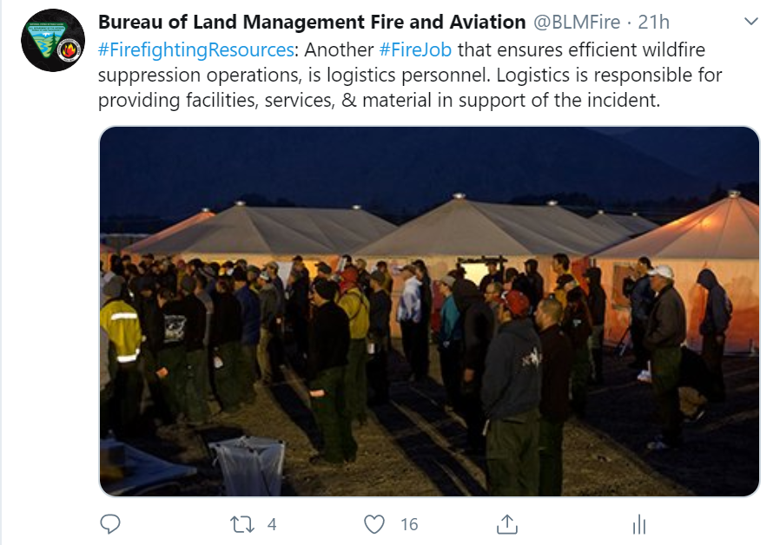
Notes:
Talk about different slide examples and hashtags

Slide 19
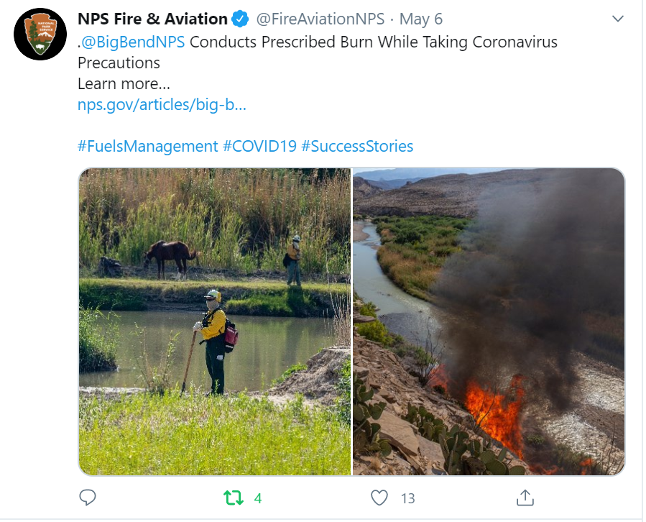
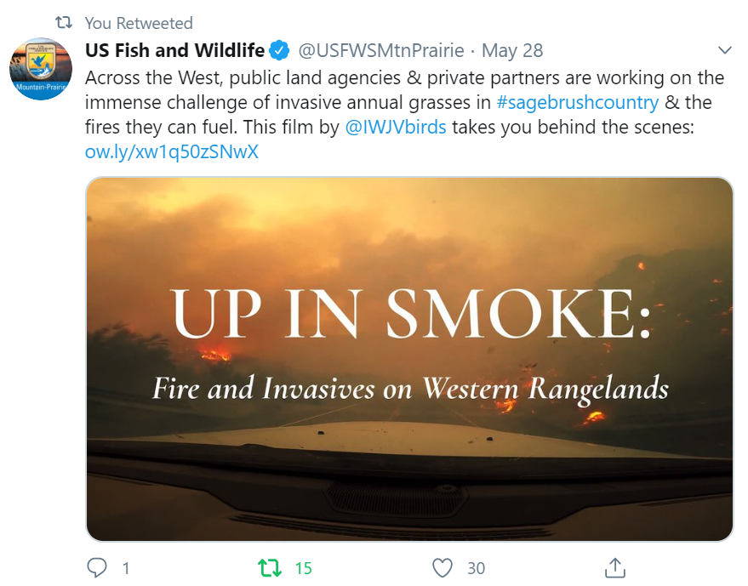
Notes:
Talk about different slide examples and hashtags

Slide 20
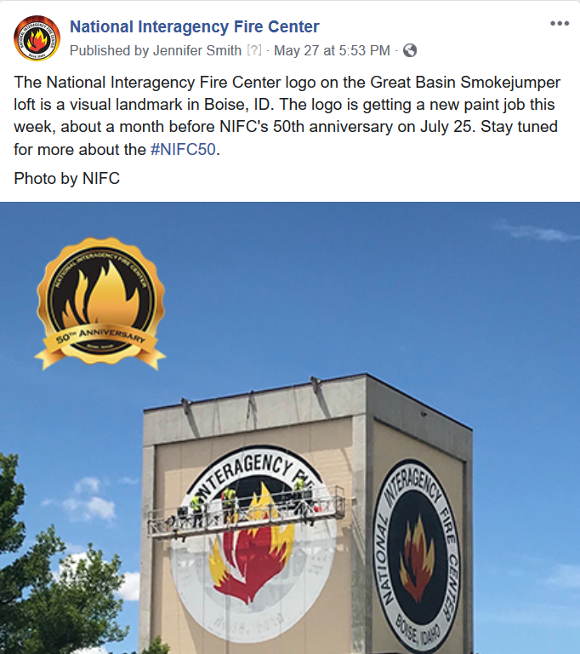
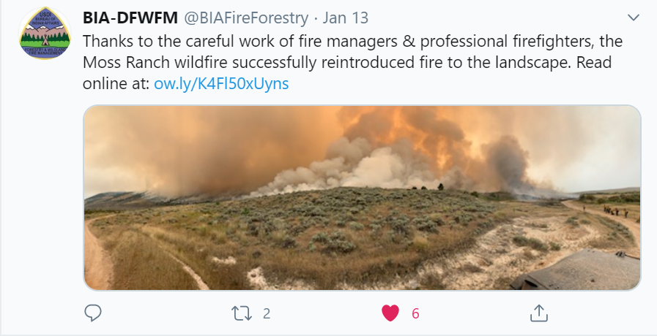
Notes:
Talk about different slide examples and hashtags

Slide 21


Upcoming Campaigns
#FireYear2020
#WeekofRemembrance
#NIFC50
Notes:
Upcoming campaigns
#FireYear2020
We’ll be transitioning from #ReadyForWildfire to #FireYear2020 as we move into the western fire season and more fire information becomes readily available.
#WFWeekofRemembrance
The Wildland Firefighter Week of Remembrance is dedicated to all those who have fallen in the line of duty and is intended to serve as an opportunity to renew our commitment to the health, wellness, and safety of wildland firefighters.
#NIFC50
We will be highlighting NIFC’s 50th anniversary, the week of July 25. The posts will highlight NIFC’s history, mission, and how interagency collaboration creates a support center that establishes policy, exchanges information, and trains wildland fire personnel.

Slide 22


UPDATE
Katy O’Hara
Department of the Interior

Slide 23

FireNet365 Update Overview
FireNet365….Where are we now?
  Still Here!
  Migration Update
  Named and Guest Accounts
  Browser Recommendations/Setup
Incident Account Setup
  From Incident Account Request to Completion
  NEW FEATURES!!

Slide 24
FireNet365
Migration of accounts to Microsoft Office 365 completed 4/20/20
Wildland Fire Community tool of choice
  Collaborate interagency and with state/local partners
  Secure environment
Recommended by NMAC
Primary electronic documentation storage space
Secure environment

Slide 25
FireNet365
Account Review
  Account creation delay: leadership decisions & expansion of options
  Introducing “GUEST” accounts!
  Users needing access to incident “shared inbox” and Team management/scheduling will still need a firenet.gov account
DMOB | Ordering
Finance | PIO
ITSS | Plans
IC | Resource Unit
Logistics | Situation

Slide 26
FireNet365 Incident Setup
Incident Account Request form: www.firenet.gov
Incident Team Created in FireNet365
  ITSS, PIO, PSC added to manage the Team
  Electronic DocBox added
  Incident Account Tracker
Shared Inbox
  Delegated to PIO
  Additional inboxes can be created
Conference number
Voice number trial (Type I & II)

Slide 27
FireNet365 Support
FireNet365 Learning Series
FireNet Web Admin
  firenetwebadmin@firenet.gov
Incident Help Desk
  Incident.helpdesk@firenet.gov
  Should only be used if you are on an active incident
  Evening and weekend support available!
FireNet Support
  Firenet_support@firenet.gov

Slide 28
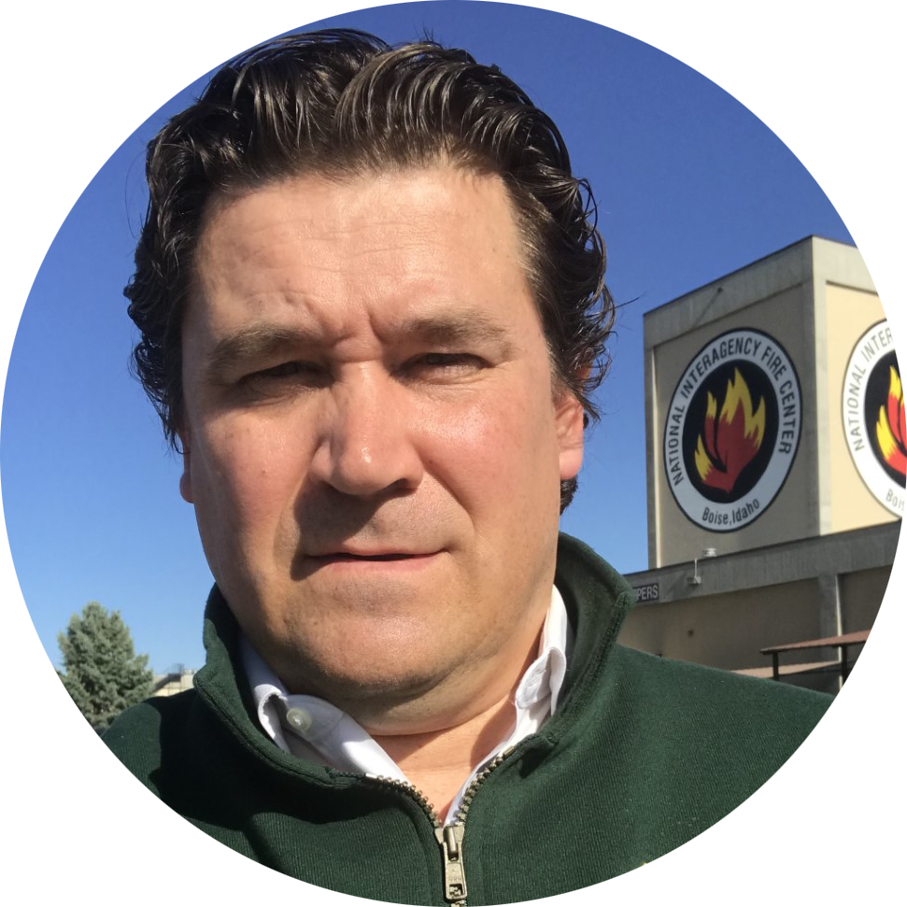
Inciweb Best Practices
Stanton Florea
U.S. Forest Service

Slide 29
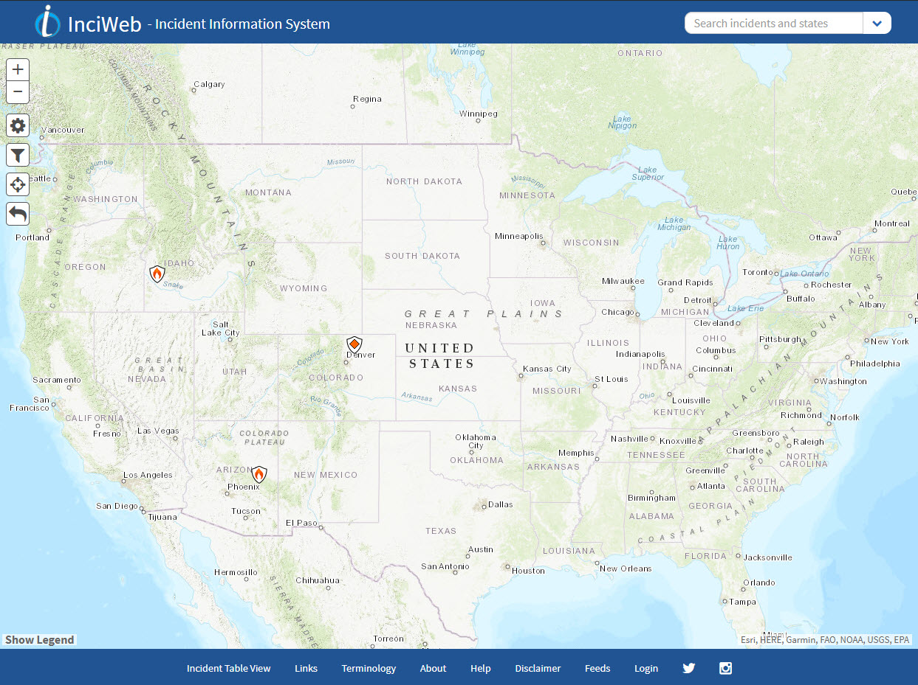
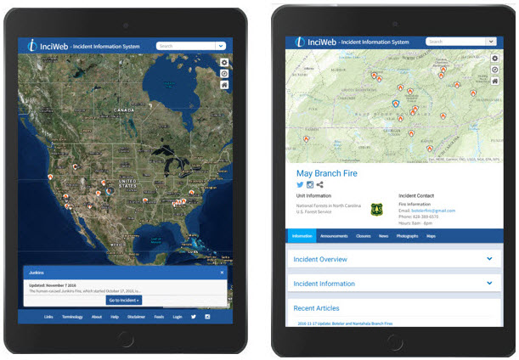
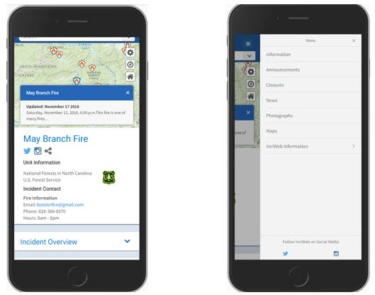
InciWeb
Third year for modernized, map-based InciWeb format.
Information about all fires of interest should be posted on InciWeb.
More than 34 million people visited InciWeb in 2018 (Source: Google Analytics).
Mobile-enabled to format on smartphones, iPad or Tablet.
Tried filtered table of incidents or state URLs?
Keep approved videos to less than one minute in length.
Ensure Ness Application Portal (NAP) password is updated and you have access to your unit in InciWeb.
https://www.nifc.gov/PIO_bb/inciweb.html

Slide 30

Interagency Resource Ordering Capability
Carrie Bilbao
Bureau of Land Management

Slide 31

FAM-IT Portal: https://famit.nwcg.gov/applications
Access to IROC Self Status through FAMAuth: https://iwfirp.nwcg.gov/
Request access using IROC Login Request Module
IIA Help Desk: 1-866-224-7677 https://iiahelpdesk.nwcg.gov/
Notes:
IROC replaced ROSS. Highly recommend you self-status; dispatchers will be busy enough this year.

Slide 32
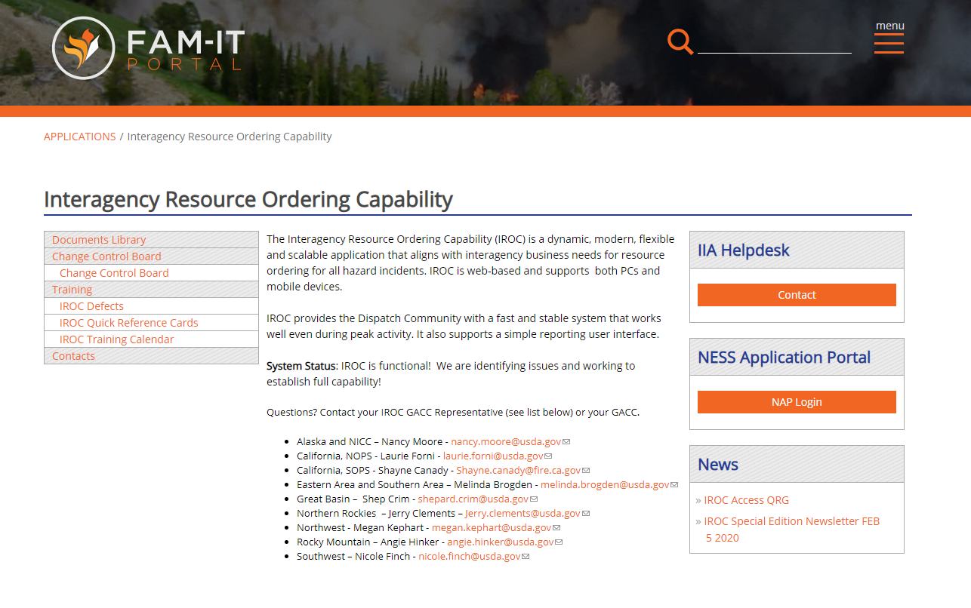
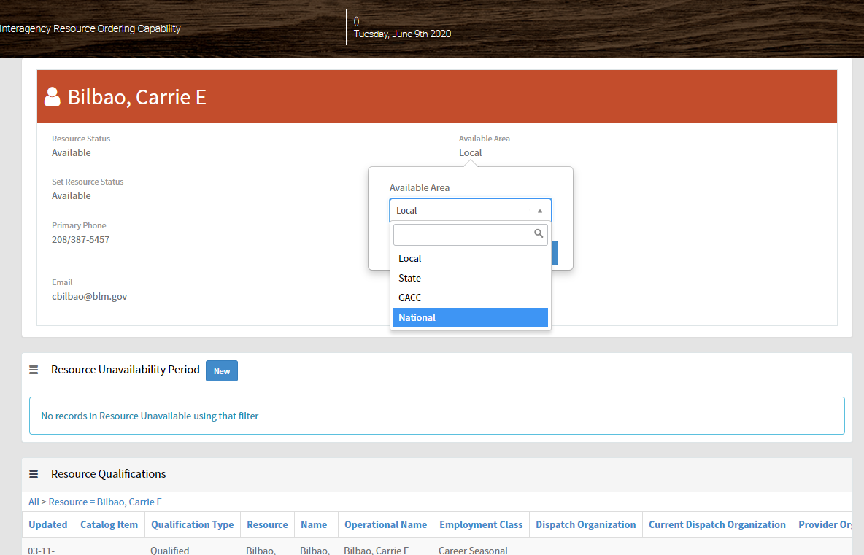
FAMIT Portal and Dashboard

Slide 33
Ordering – just like ROSS
  Identify need in request
  Virtual PIO - “work will be virtual, from home”
  Note any other special needs in documentation
  For name requests, also note the individuals dispatch unit
Make sure you check your status
Notes:
Ordering – document what you want in order

Slide 34
Current issues:
  Programmers are working on system daily so screens may look different each log in
  Limited reporting capability right now – can’t access resource availability or committed resource numbers
Notes:
Current issues – Contractors 90 days behind schedule starting with the furlough last year; working through problems daily, slowly coming around. No reports, yet. They are in the process of building ten different report templates.

Slide 35

Questions?
Robyn Broyles (BIA)
Robyn.Broyles@bia.gov
208-387-5473
Jessica Gardetto (BLM)
jdgardetto@blm.gov
208-387-5845
Kari Cobb (FWS – detail)
kjcobb@blm.gov
208-387-5508
Tina Boehle (NPS)
Tina_Boehle@nps.gov
208-387-5875
Stanton Florea (USFS)
stanton.florea@usda.gov
208-387-5437

