Slide 1

AFF NextGen Update - CDAT
April 7, 2026

Slide 2
Project Update
AFF Status Update
Summary of Enhancements
NextGen Timeline
Next Steps
Future of AFF

Slide 3
AFF Status Update
AFF is currently being supported by ICF, EGP contractor (ex. WildFIRE SA Advanced).
Project Team is made up of Aviation, FAM IM, FIT and CIO Staff.
Integrated Project Team (IPT) coordinated with the NCCM and National Aviation Groups to bring on members of the User Community as Testers.

Slide 4
Summary of Enhancements
Complete Code refactor and overhaul.
Transitioned the Map from Google to ESRI Base Layer.
Improved UI/UX.
Integrate FastAPI into the architecture.
Remove Username and Password.
Full MFA Integration.

Slide 5
NextGen Timeline
April FY’26 Q3
Integrate MFA
(Current Sprint)
Early FY’26 Q3
Begin Testing NextGen
Mid FY’26 Q3
Deploy NextGen to Prod
Feb. FY’26 Q2
Deploy to DEV env.

Slide 6
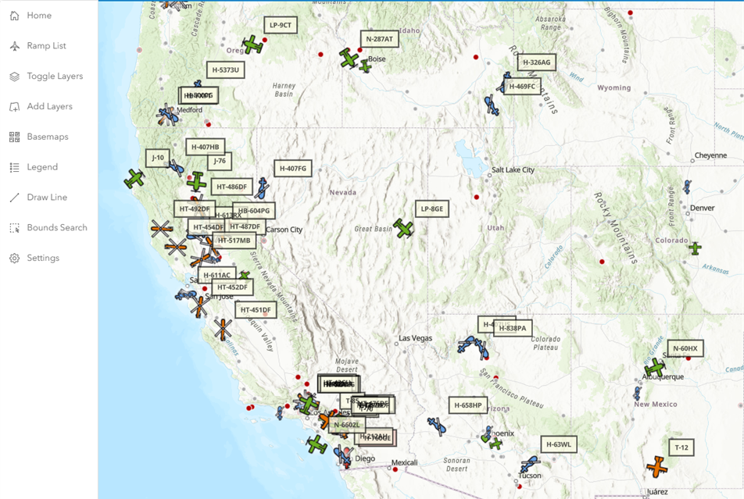
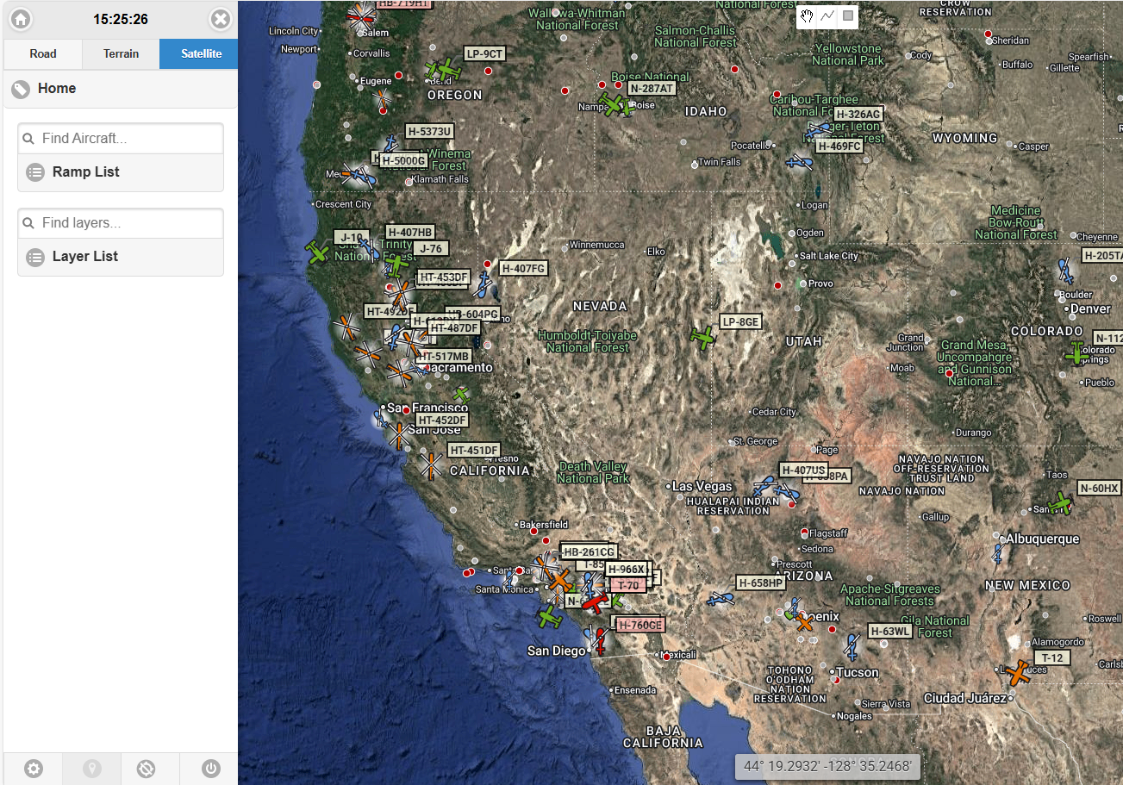
NextGen vs. Legacy

Slide 7
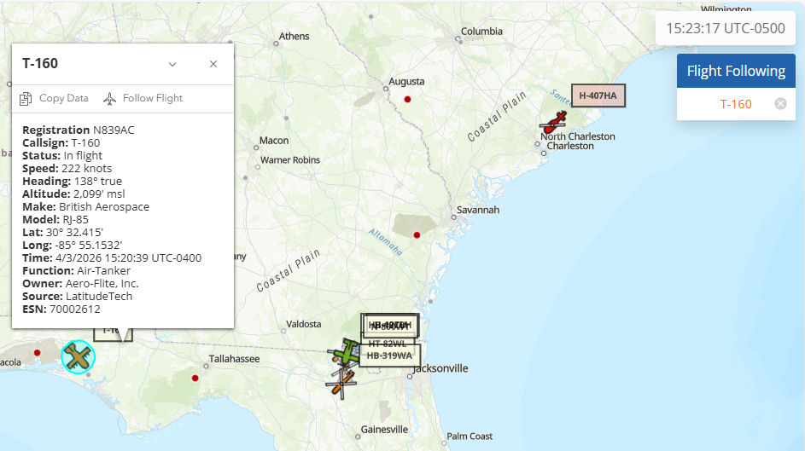
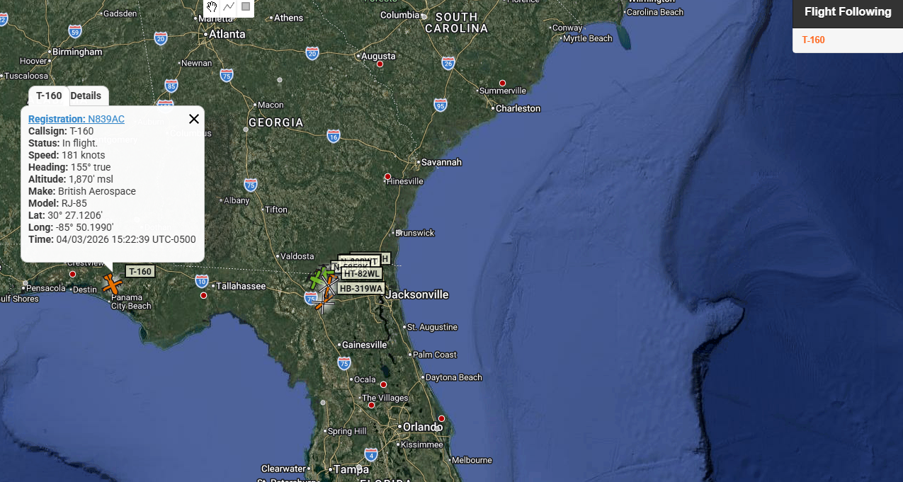
NextGen vs. Legacy

Slide 8
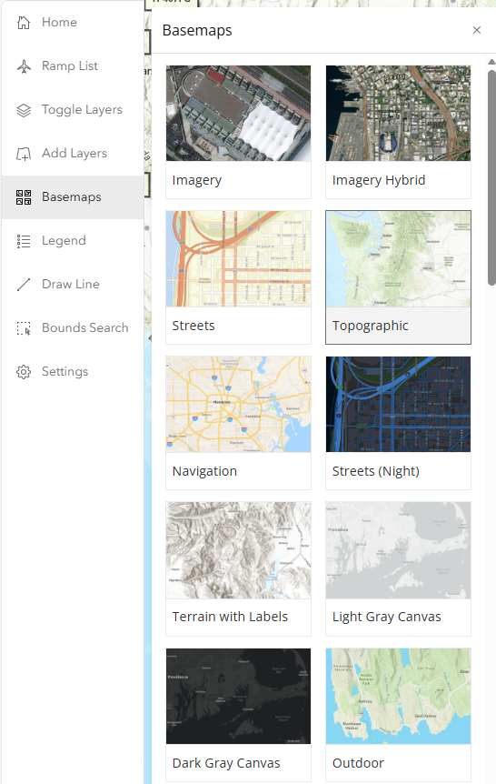
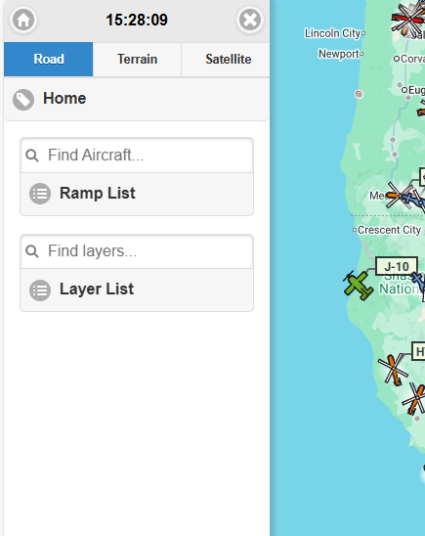
NextGen vs. Legacy

Slide 9
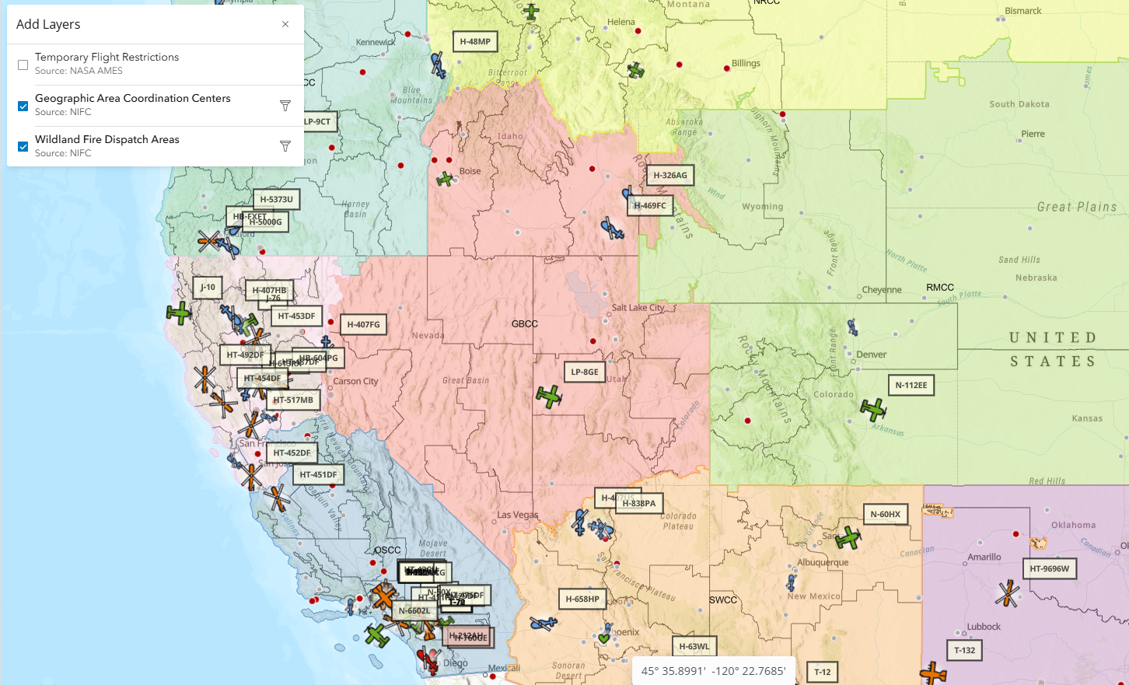
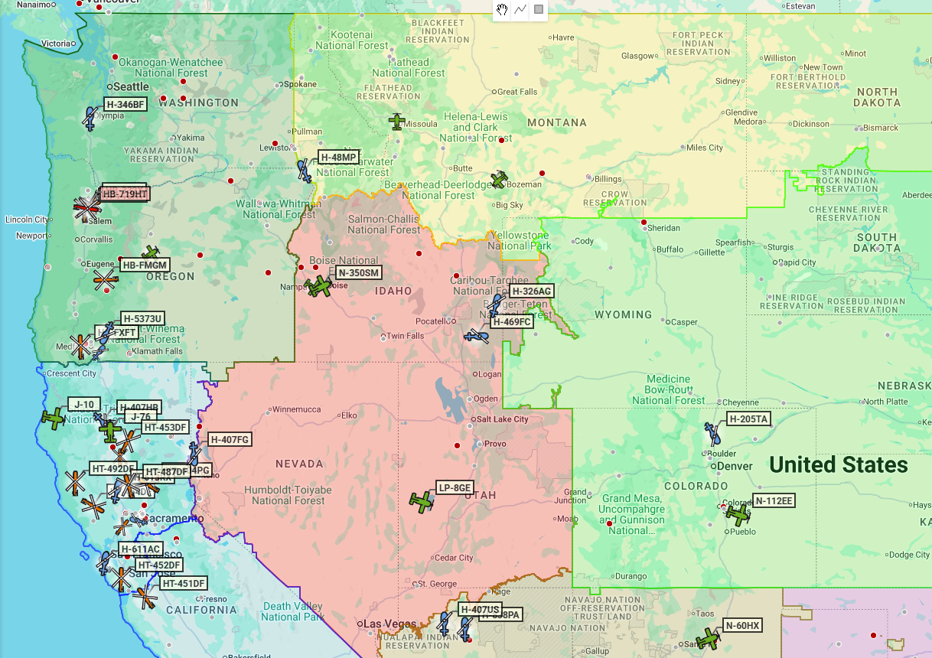
NextGen vs. Legacy

Slide 10
Next Steps
Integrate and Test Eauth MFA into NextGen DEV.
Configure API for other Applications (WildFire SA, WildCAD, etc.)
Test Application in Phases to ensure it is production ready.
  DEV Testing – Ongoing

Slide 11
Future of AFF
AFF as a flight following application will exist for the foreseeable future.
AFF will have the ability to share data with other Fire applications via an API.
Deprecate Username and Password.
Integrate with FAMAuth.
Enhance AFF to the needs of the User Community.

Slide 12
IPT Contacts
Product Owner, Deborah Lampton
  Deborah.Lampton@usda.gov
Product Manager, Cameron Dupriest
  Cameron.Dupriest@usda.gov
FIT System Administrator, John Lovato
  John.Lovato@usda.gov
FIT Technical Lead, Neil Flagg
  Neil.Flagg@usda.gov
FIT Technical Acceptance Tester, Joseph Seechang
  Joseph.Seechang@usda.gov
CIO Project Manager, John Naslund
  John.Naslund@usda.gov

