Slide 1
Dispatch Cost Analysis Tool DCAT
2026

Slide 2
What are we trying to solve for?
Wildland Fire Community has consistently expressed need for a national tool to assist in determining individual agency contributions associated with interagency partnerships of local fire management as it relates to dispatch costs, staffing needs, dispatch core duties and workload.
Notes:
A standard process to assess workload and budget for dispatch/coordination centers. Fair Share Cost Analysis capability.
Dispatch Centers, Fire Managers, Budget Officers, Agency Administrators, Fire Business Officers, and Administrative Officers have expressed the need for a national tool to assist in determining individual agency contributions associated with interagency partnerships of local fire management as it relates to dispatch costs, staffing needs, dispatch core duties and workload. Annually, interagency local unit dispatch center boards meet to determine and allocate their respective agency contributions. The proposed tool will recommend contribution percentages by agency represented within the local unit(s). The business case and proposed workload analysis utilizes defined data elements and methodologies and assigned weighted values associated with core duties. The output values from the model serve to address contentions between partnering organizations by objectively recommending a data driven contribution share by agency. Knowing the appropriate costs of the dispatch/coordination system for each agency will be of value in optimization and modernization. The intent of Tool’s output, Final Agency Adjusted Total, is to serve as a starting point for dispatch board of directors or coordinating groups to discuss financial contributions. It is not intended to determine an exact financial obligation.
The only duties utilized in the RMA FCAT (KIS Tool) are the Core Duties identified in IDIP Final Report. All non-core duties would be a pay-as-you-go, or ala carte, and not part of the KIS tool. It was determined that systems of record needed to be used to minimize subjectivity. The systems identified that met the needs of the KIS tool were the Computer Aided Dispatch system (CAD) and the Resource Ordering and Status System (ROSS). It was determined that some of the core duties did not fall into either of those systems for measurement and therefore an additional category needed to be added to catch the “baseline” core duties. Baseline core duties are duties accomplished regardless of fire activity or resource ordering, thus not objectively measured in a system of record. Baseline workload would equate to the minimum an agency would pay to be a part of a dispatch center, even if the KIS tool assigned that agency a lower dollar amount.¹ The dollar amount associated with the Baseline workload would be determined by the zone dispatch board.

Slide 3
Workflows
All Wildland Fires within Dispatch Zone
Resource Orders processed for incidents within the Dispatch Zone
Number of qualified ICT3s filled for incidents within Dispatch Zone
Number of IMTC, IMT1, IMT2, NIMO filled within the Dispatch Zone
Resource Orders processed for incidents outside the Dispatch Zone
Number of local/dispatch zone resources current NWCG qualification
Baseline
Input Data Elements
Methodology
Output Data Elements
Notes:
The business case and proposed workload analysis utilizes defined data elements and methodologies and assigned weighted values associated with core duties. The output values from the model serve to address contentions between partnering organizations by objectively recommending a data driven contribution share by agency. Knowing the appropriate costs of the dispatch/coordination system for each agency will be of value in optimization and modernization. The intent of Tool’s output, Final Agency Adjusted Total, is to serve as a starting point for dispatch board of directors or coordinating groups to discuss financial contributions. It is not intended to determine an exact financial obligation.

Slide 4
Workflows
Input Data Elements
Methodology
Output Data Elements
Workload Portion By Agency %
Unadjusted Portion Amount
Adjust to Baseline Amount
Final Agency Adjusted Total
Notes:
The output values from the model serve to address contentions between partnering organizations by objectively recommending a data driven contribution share by agency. Knowing the appropriate costs of the dispatch/coordination system for each agency will be of value in optimization and modernization. The intent of Tool’s output, Final Agency Adjusted Total, is to serve as a starting point for dispatch board of directors or coordinating groups to discuss financial contributions. It is not intended to determine an exact financial obligation.

Slide 5
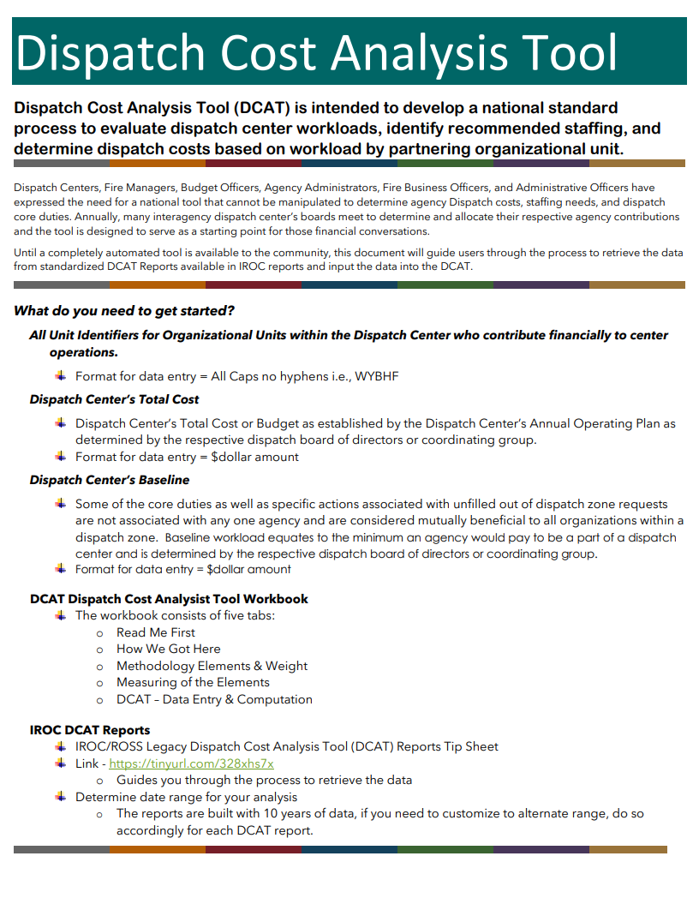
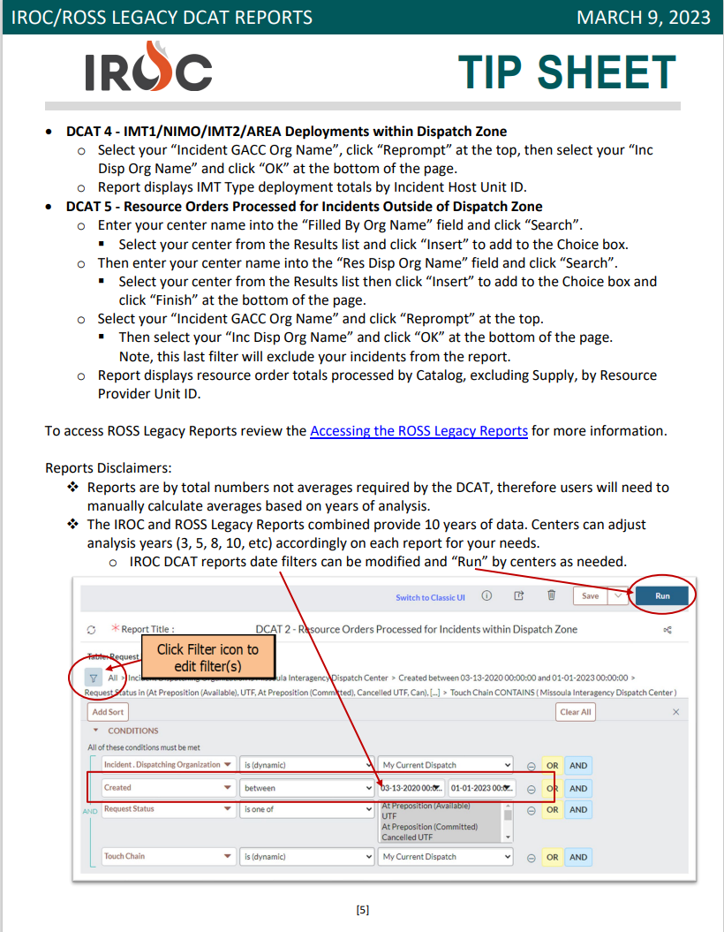
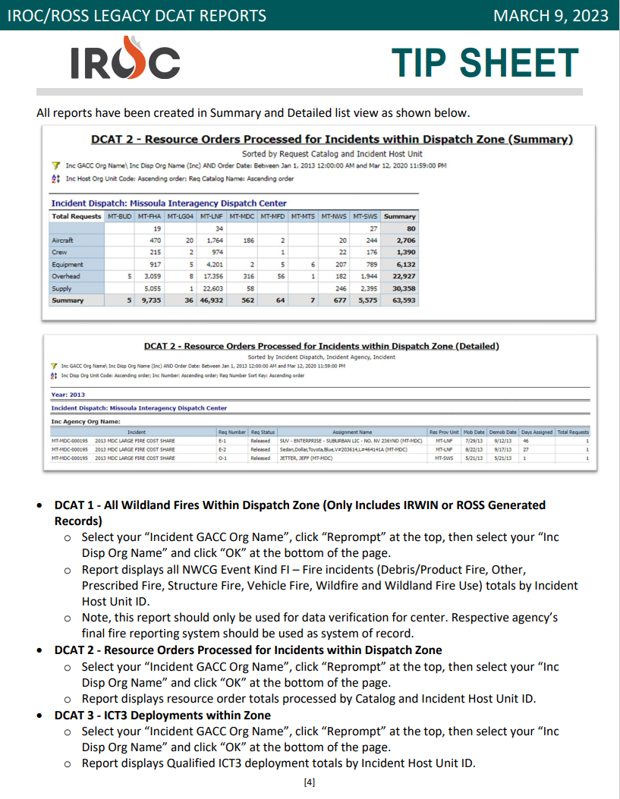
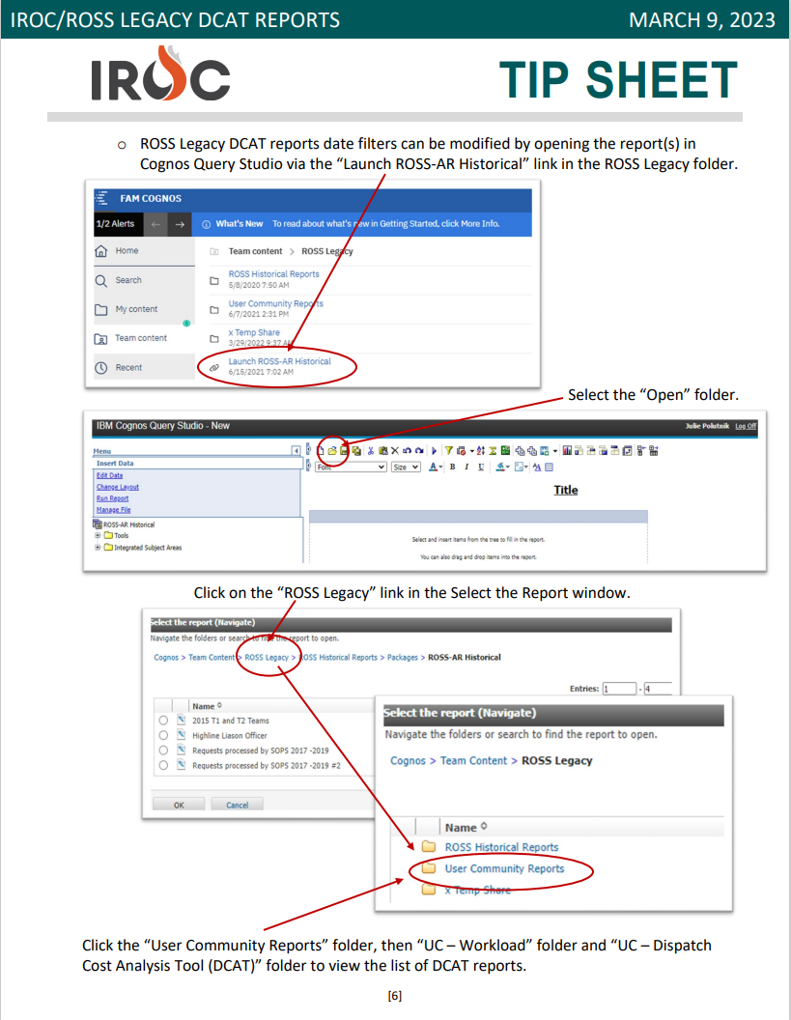
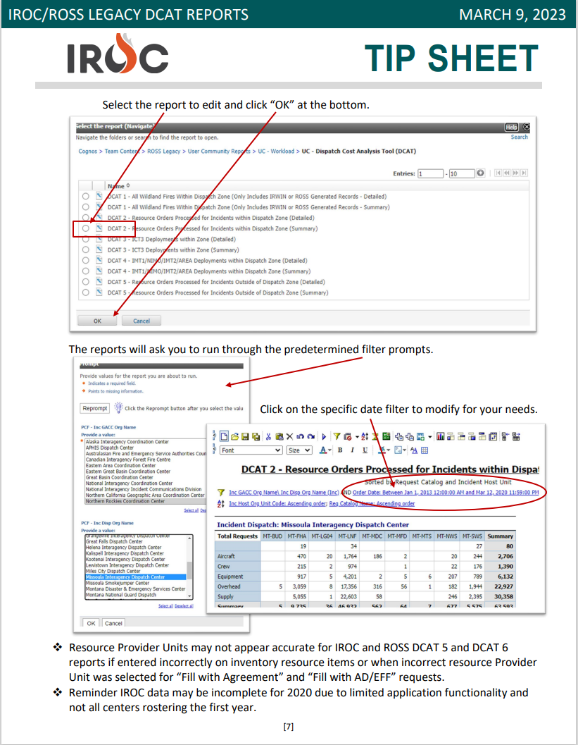
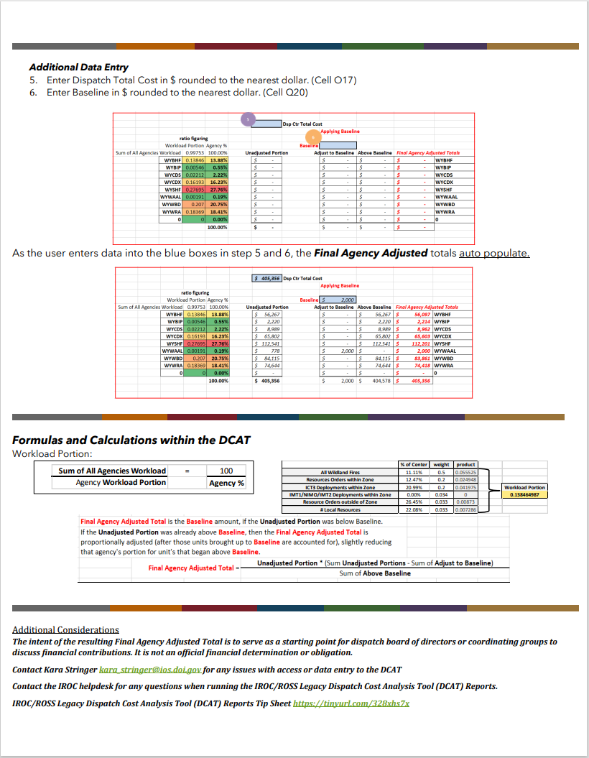
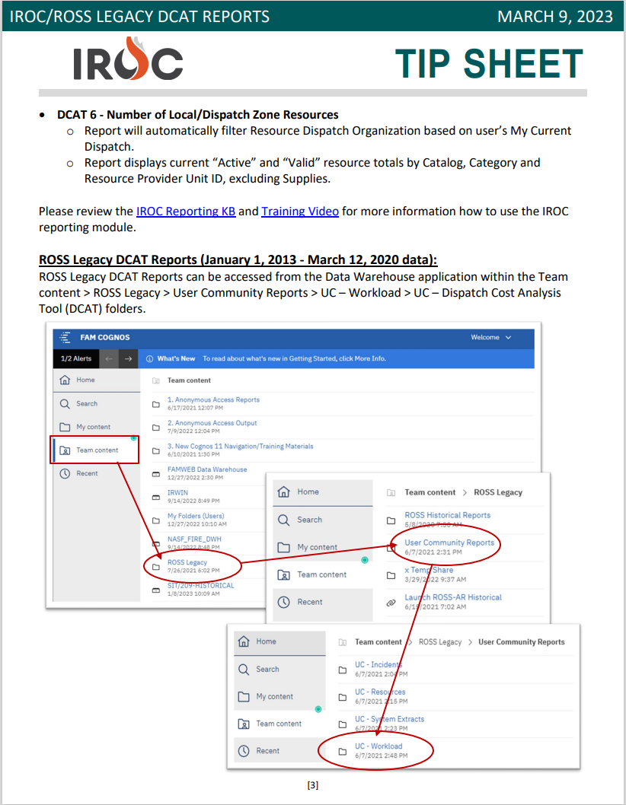
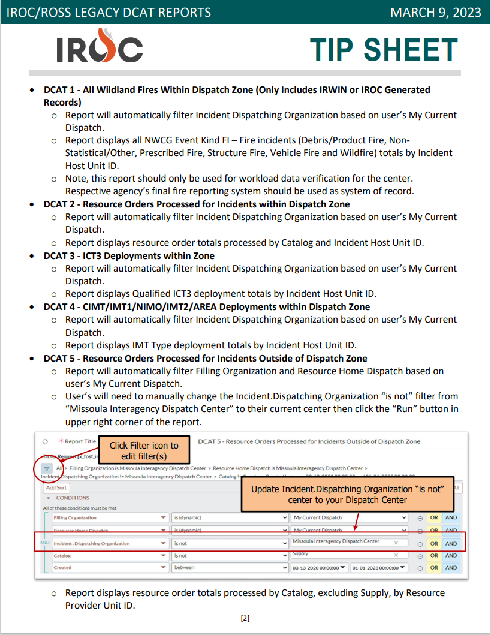
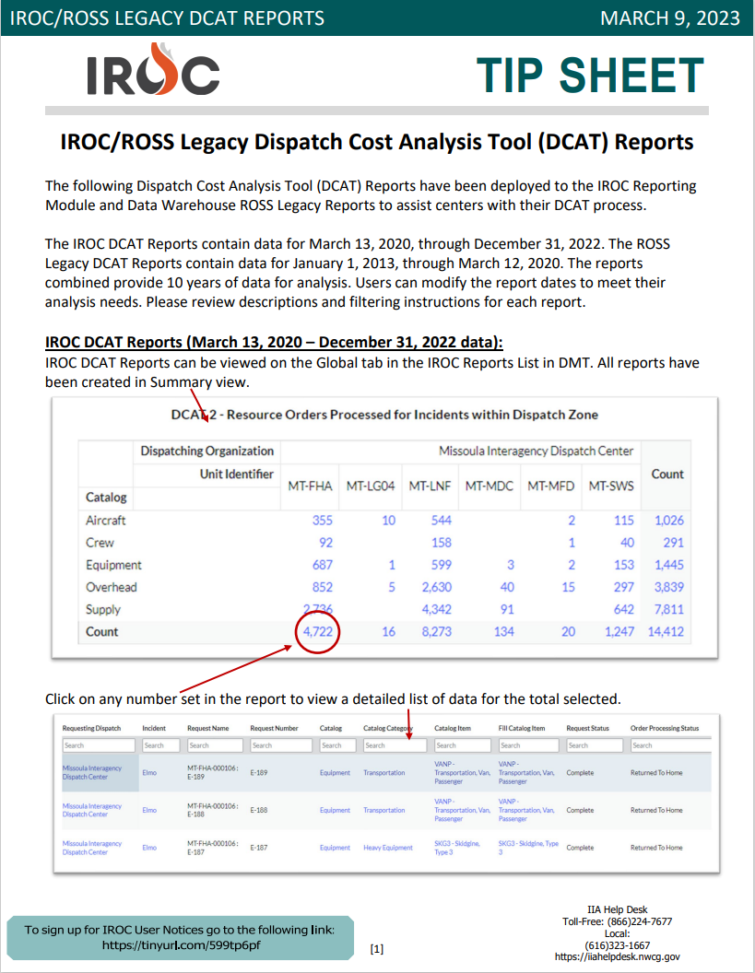
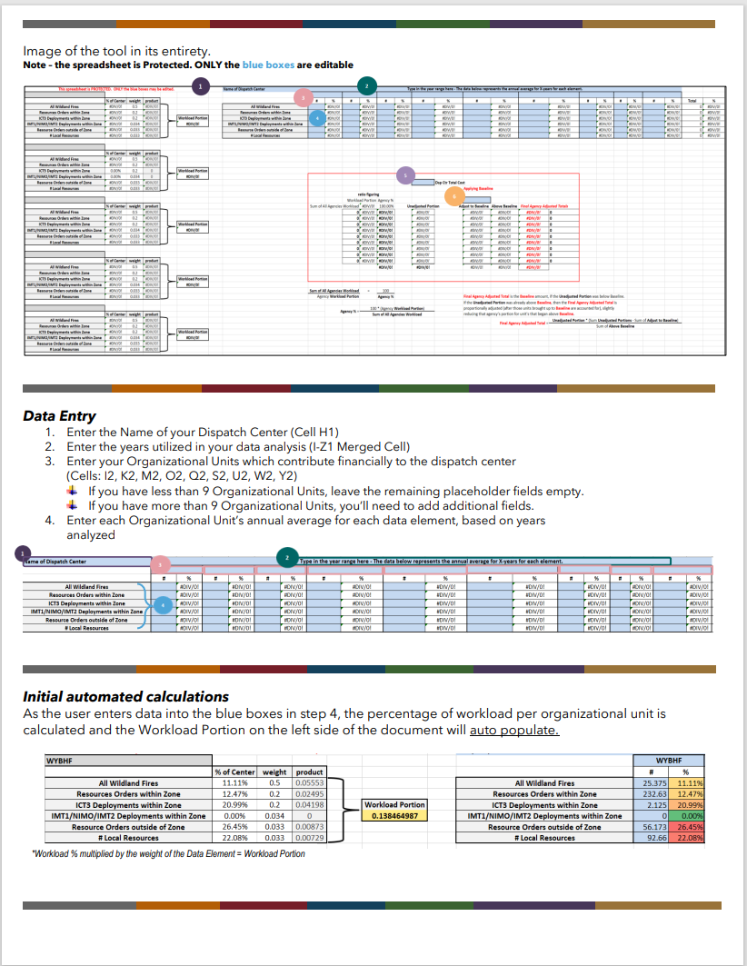
Helpful Tools

Slide 6

DEMO
Notes:
Demonstration

Slide 7
Dependencies and Challenges
Data Source
InFORM
IROC/ROSS
IRWIN
Notes:
Extensive discussions regarding the best data source. IRWIN incident data rather than InFORM data revealed some of the data in InFORM does not accurately reflect the dispatch center’s workload whereas IRWIN records directly corelate to dispatch center workload with rare exception (ERS) A possible solution is to use InFORM Data if the Fire Occurrence Record (FODR) has a corresponding IRWIN Identifier (IRWINID). Need to identify authoritative data sources, or ensure authentication of data accuracy, and reliability of the data.
The Data Management Program is working to combine ROSS historical data and IROC data. In the interim IROC will be maintaining User Community reports for pre-IROC data for IRWIN services. IROC and the CADs are currently integrating A, C, O, E – not supplies and services. Contract resources are not rostered – assumptions.

Slide 8
Questions?

