Slide 1

IRWIN
CDAT 2026

Slide 2



























Change Process for Integration
Technology Evaluation Subcommittee
IRWIN Core Team Review Idea
Brief Integration Management Committee (monthly)
Defer/schedule for next Build
NO
Q4
YES
Release
Q1
Collective Review of all Proposed Changes to IRWIN (Spring Meeting)
YES
Q2
NO
Business & Data, Technical Impact Documentation
Ongoing Q1,Q2, Q3
NO
Q3
Collective Review of all Proposed Changes to IRWIN (Fall Meeting)
Q4, Q1
Q4
Integration Testing
IRWIN Extended Community Review
Development/Implement changes
Program Board Brief
Notes:
Rule of thumb 2 or more applications

Slide 3
IRWIN V11
QAQC
Frequencies
Prescribed Fire Stages
NEW SYSTEM INTEGRATIONS
ViPR/IIPA/HEMS
Observer Enhancements Additional Dashboards
Wildland Fire Learning Portal
Resource Location
Unit ID Validation
Dispatch Center ID
Ownership Only
Current Frequency Inventory
EDG connection for Frequencies
Frequency Catalog
Ordering Process
Maintenance
Kneeboard & Incident Radio Communications Plan ‘27
Merged Incident Business Rules
Orange County
Owner Organizations
Operational Status Available At Incident
DART
Planned, Active, Patrol/Monitor, Complete
Current Structures Threatened
DCAT (prototype)
March 4th
On Hold
QAQC

Slide 4
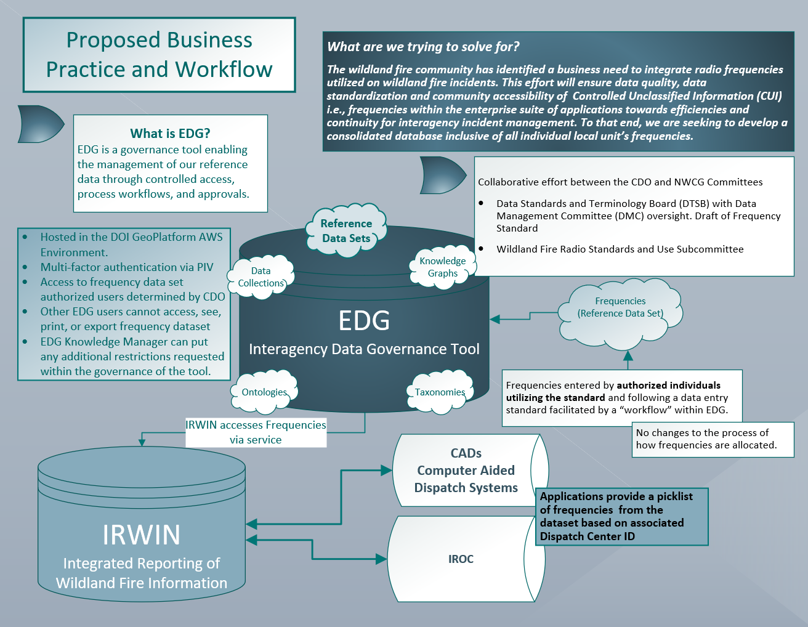

Slide 5
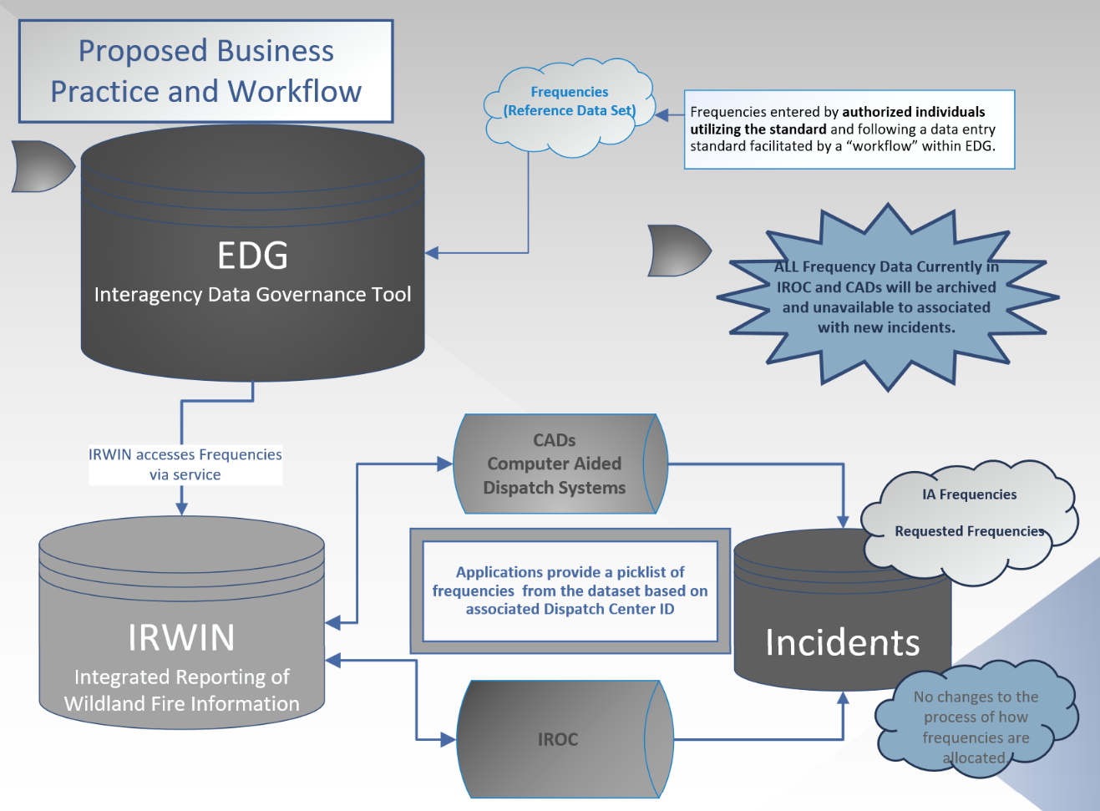
Business Practice & Workflow
F#

Slide 6
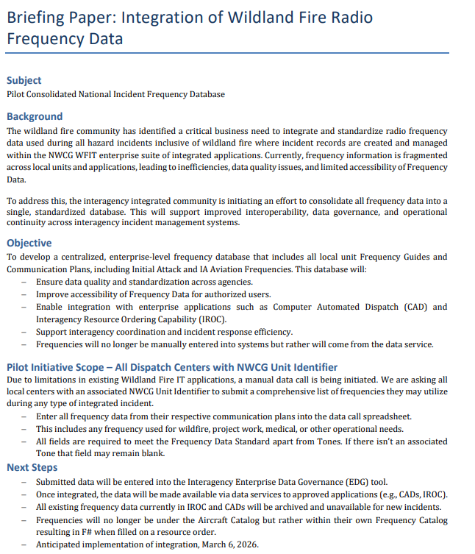

Slide 7
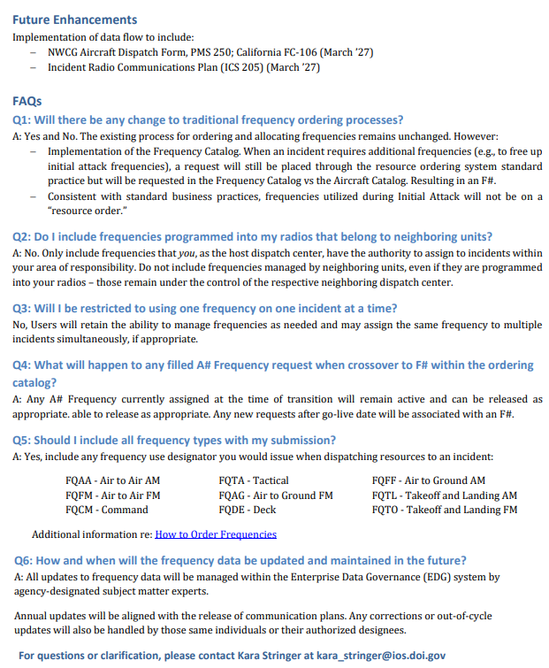

Slide 8
IRWIN V11
QAQC
Frequencies
Prescribed Fire Stages
NEW SYSTEM INTEGRATIONS
ViPR/IIPA/HEMS
Observer Enhancements Additional Dashboards
Wildland Fire Learning Portal
Resource Location
DCAT (prototype)
Unit ID Validation
Dispatch Center ID
Ownership Only
Current Frequency Inventory
EDG connection for Frequencies
Frequency Catalog
Ordering Process
Maintenance
Kneeboard & Incident Radio Communications Plan ‘27
March 4th
Merged Incident Business Rules
Orange County
Owner Organizations
Operational Status Available At Incident
DART
Planned, Active, Patrol/Monitor, Complete
Current Structures Threatened
On Hold
QAQC

Slide 9
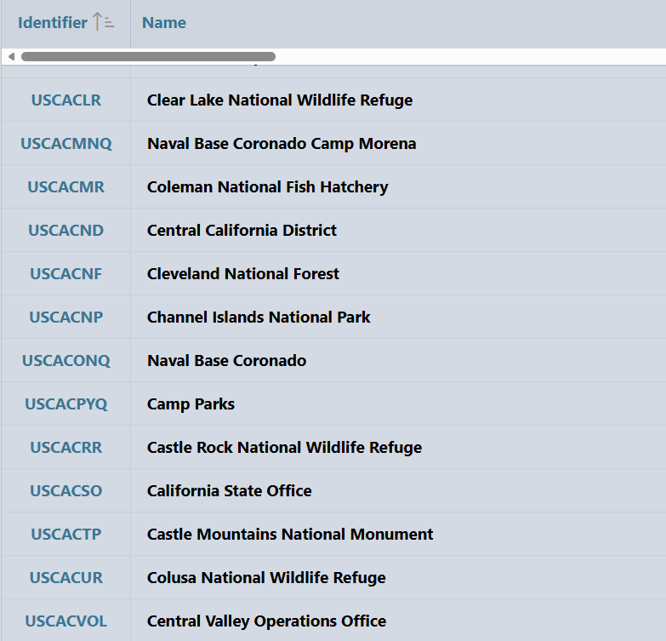
Wildland Roles
Dispatch/Coordination Center
Fire/Radio Caches
Incident Host Functional
Incident Host Geographic
Protecting Unit
Jurisdictional Unit
Landowner Only
Resource Provider Only
Training Facility
Validation

Slide 10
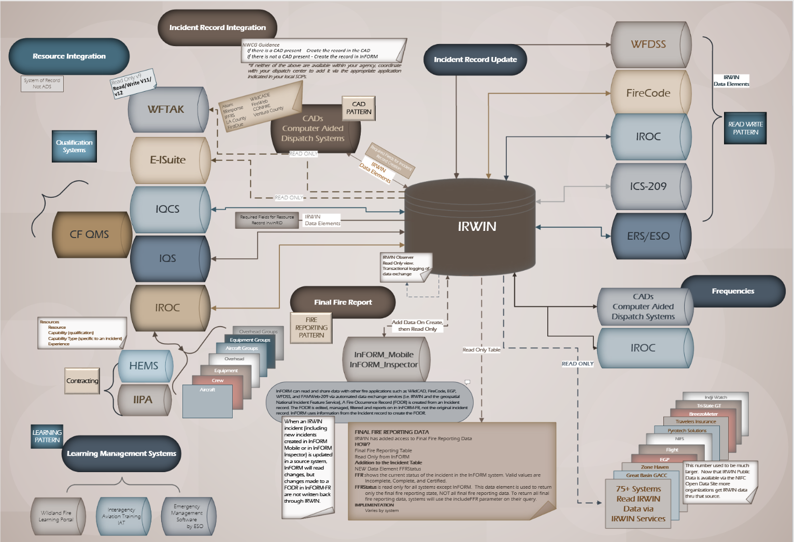


Slide 11
Integration Testing Jan 26-30
Go-Live March 4th
Recompete Contract Awarded

Slide 12
Observer Dashboard
https://kb.geoplatform.gov/gp-agol/creating-a-login-gov-account-and-signing-in.html

Slide 13
IRWIN V12
March 2027
Frequencies
NEW SYSTEM INTEGRATIONS
NERIS
Interior Fuels & Postfire Reporting System (IFPRS)
FBMS
Resource Location
UNIT ID VALIDATION
Resource Provider Only
Dispatch Center
RESOURCE STATUS
Kneeboard
PMS 250
CA FC-106
Santa Barbara County
Marin County
ViPR/IIPA/HEMS
Communication Plans
ICS 205
At Prepo Available
At Prepo Committed
Incident Host Protection
Jurisdiction
Observer Enhancements
INCIDENTS
Update Dispatch Center ID
Incident Type Endorsements
FET & JEMS (Fire Engineering Training) Integration (Learning)

Slide 14
Wildfire Application Information
Portal
https://www.wildfire.gov/application/irwin-integrated-reporting-wildfire-information

Slide 15
QUESTIONS?
asunderland@blm.gov
kara_stringer@ios.doi.gov

