Slide 1
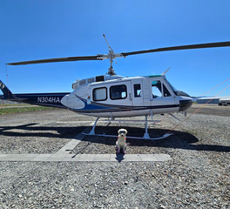
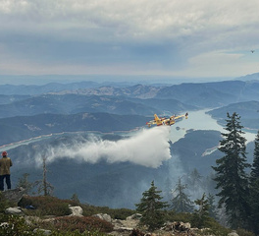
FireNet CDAT 2026
Tara Taylor Hartman & Lisa Sadowski
Updated 3/9/26
WWW.FIRENET.GOV

Slide 2
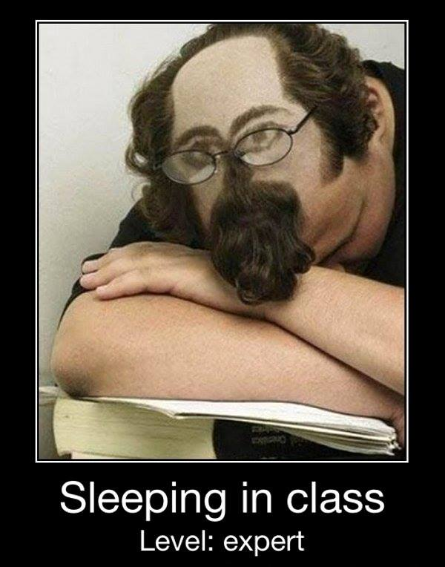
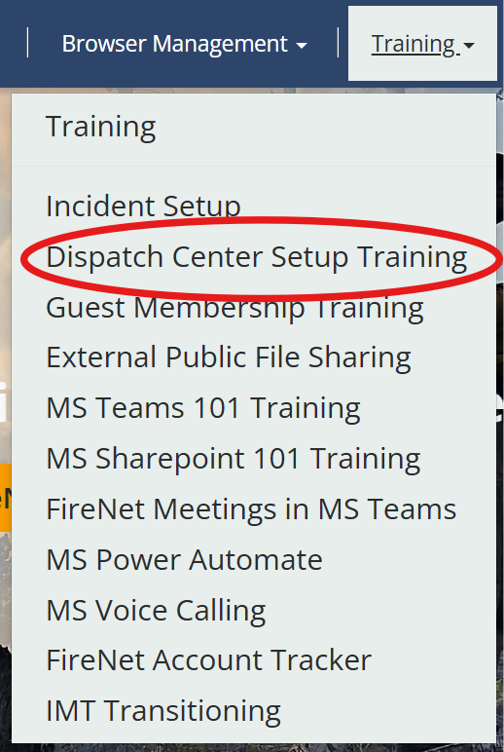
Training

Slide 3
Dispatch Center Setup 2026
The Season That Kept on Giving!
75
Incidents
223
Incidents
206
Incidents
278 Incidents
2019
2021
2023
2025
2018
2020
2022
2024
58
Incidents
157
Incidents
155
Incidents
307
Incidents

Slide 4
01
02
03
04
Accounts
Tech Tips
Browser
Dispatch Management
An overview of FireNet account request timelines, sponsorship requirements, renewals, guest access and best practices to ensure access throughout the season.
Practical guidance to help users work more efficiently in FireNet. Topics include file organization standards, SharePoint best practices, link sharing updates and key reminders.
Best practices for browser use covering agency browser conflicts, signing in and out correctly, supported use cases and tips for maintaining clean, reliable access in interagency environments.
Operational workflows and management within FireNet including post-incident processes, member removal and archive access, shared inbox delegation updates, collaboration spaces and upcoming training opportunities.

Slide 5
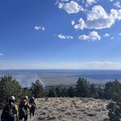
ACCOUNTS
TECH TIPS
BROWSER
IMT/DISPATCH MGMT
Account Request Reminders
NWCG Guidance​
Account requests run daily ​
In PL5, run twice a day and on weekends ​
If someone is in your center and needs to be set up, you can reach out to the incident helpdesk to expedite​ ​
If a user is waiting on an account in your center either the form wasn't filled out correctly OR missing sponsorship!! Reach out and we will assist! ​
WWW.FIRENET.GOV

Slide 6
ACCOUNTS
TECH TIPS
BROWSER
IMT/DISPATCH MGMT
Maintaining an Account
1
2
ALL:
Sign In Every 60 Days
Affiliate:
Yearly Renewal Process
Security cert-fs recommended
Sign ROB

Slide 7
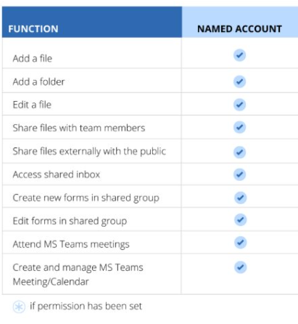
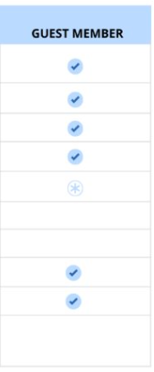
ACCOUNTS
TECH TIPS
BROWSER
IMT/DISPATCH MGMT
Account Comparison

Slide 8
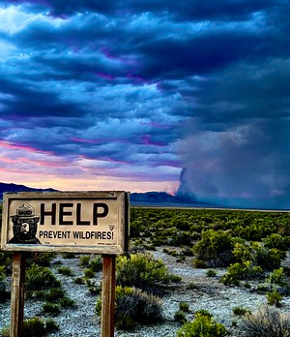
ACCOUNTS
TECH TIPS
BROWSER
IMT/DISPATCH MGMT
Guest Membership Reminders
MS Teams/SharePoint growth = expanded reach​​
Named FireNet Account is NOT needed​ ​
Off-season guest membership trainings​ ​
FireNet Account holders feedback on collaborating with guest members: ​
WWW.FIRENET.GOV

Slide 9
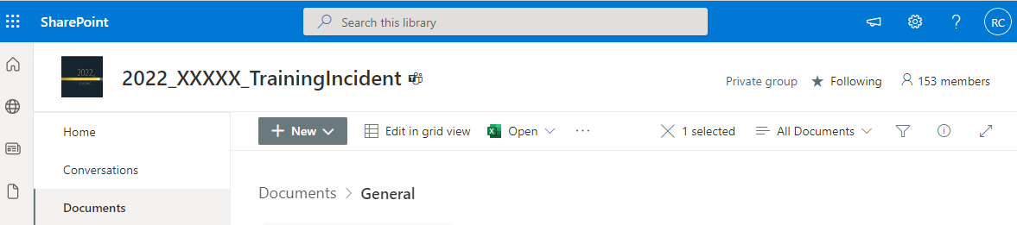
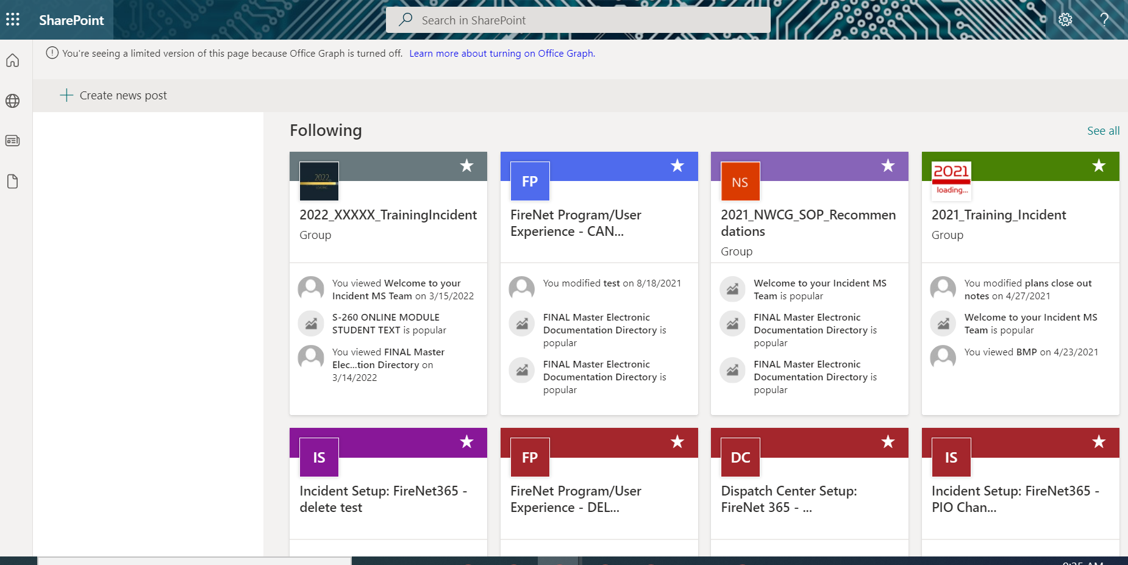
ACCOUNTS
TECH TIPS
BROWSER
IMT/DISPATCH MGMT
SharePoint Tech Tip: Star/Follow

Slide 10
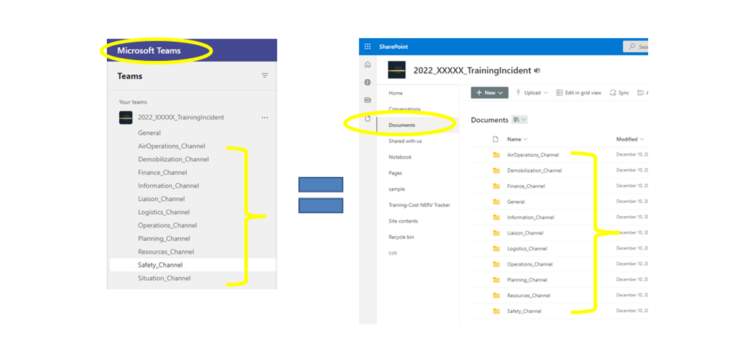
ACCOUNTS
TECH TIPS
BROWSER
IMT/DISPATCH MGMT
File EVERYTHING Under a Channel Folder

Slide 11
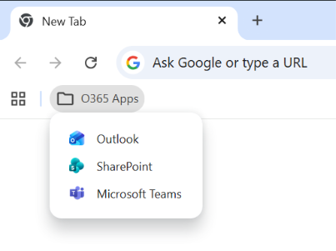
ACCOUNTS
TECH TIPS
BROWSER
IMT/DISPATCH MGMT
O365 App Shortcuts
Create a folder on your browser favorites bar
Open each app (Outlook, SharePoint, Teams, etc.)
Save each app into the folder
Provides organized, quick access
WWW.FIRENET.GOV

Slide 12
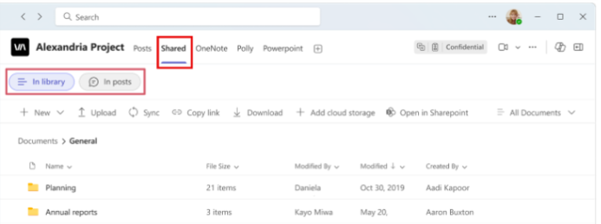
ACCOUNTS
TECH TIPS
BROWSER
IMT/DISPATCH MGMT
Teams Channels ‘Files’
‘Shared’ tab in MS Teams Channels (used to be ‘Files’)
‘Shared’ combines document library and files/links from posts
Use ‘In library’ for channel files; ‘In posts’ for shared content
New ability to sort/filter by date (Recent → ‘Shared on’)

Slide 13
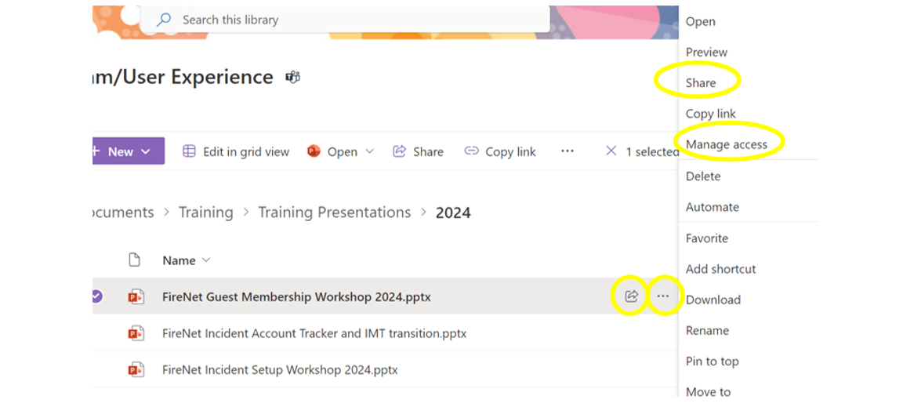
ACCOUNTS
TECH TIPS
BROWSER
IMT/DISPATCH MGMT
Put the Share in SharePoint

Slide 14
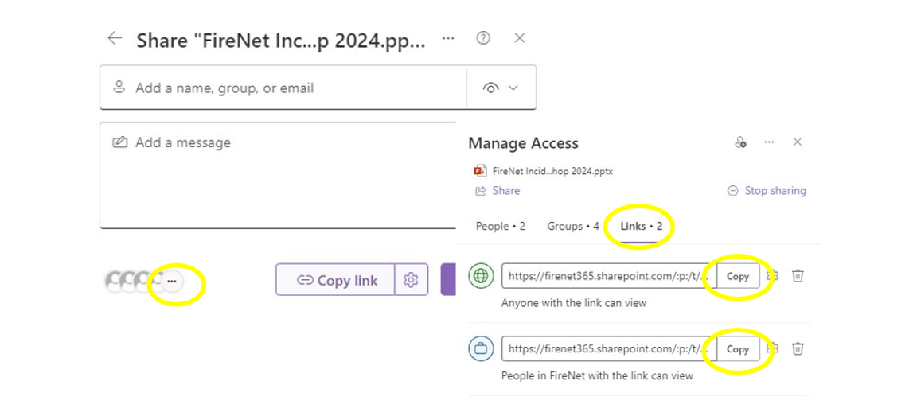
ACCOUNTS
TECH TIPS
BROWSER
IMT/DISPATCH MGMT
Update: Settings and Unique Links

Slide 15
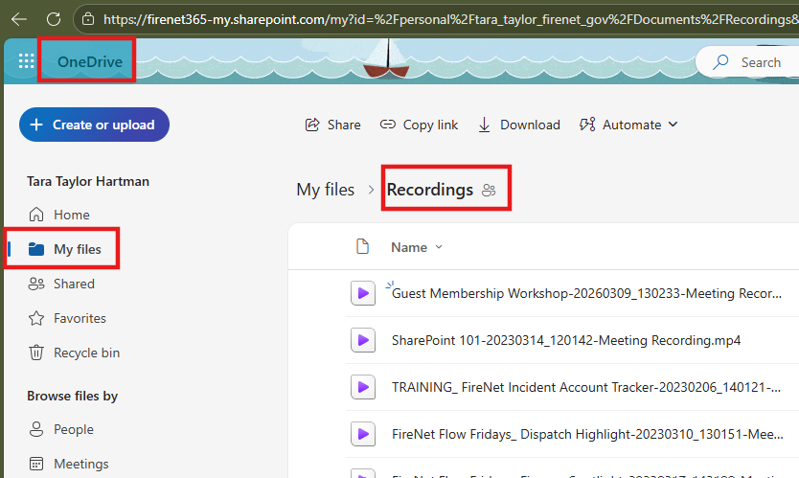
ACCOUNTS
TECH TIPS
BROWSER
IMT/DISPATCH MGMT
How To Find a Recording

Slide 16
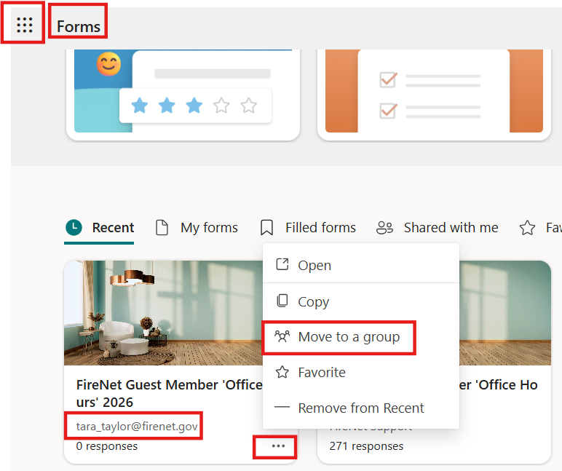
ACCOUNTS
TECH TIPS
BROWSER
IMT/DISPATCH MGMT
How To Move a Form to a Team

Slide 17
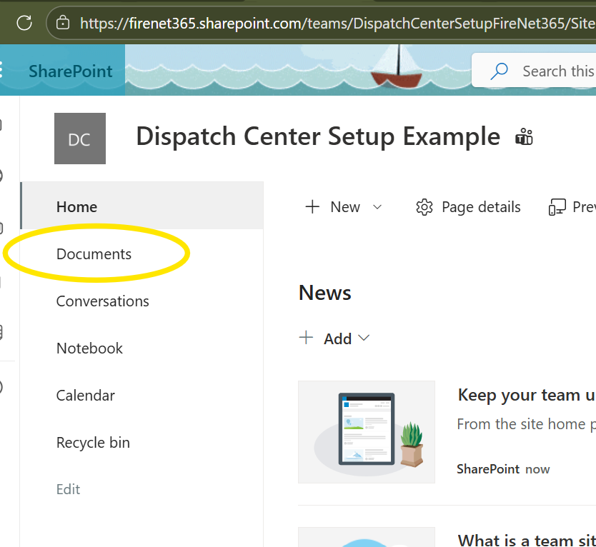

ACCOUNTS
TECH TIPS
BROWSER
IMT/DISPATCH MGMT
SharePoint "Internal Homepage"

Slide 18
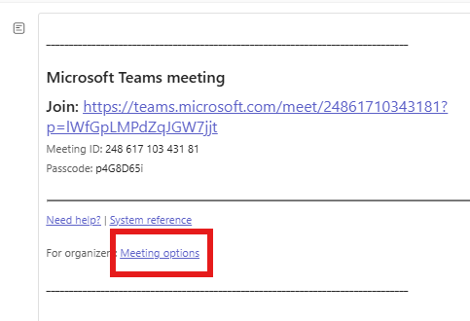
ACCOUNTS
TECH TIPS
BROWSER
IMT/DISPATCH MGMT
MS Teams Meetings: Options
Create meeting/event
Open meeting from shared calendar to edit!
CTRL + Clicking opens a new tab!

Slide 19
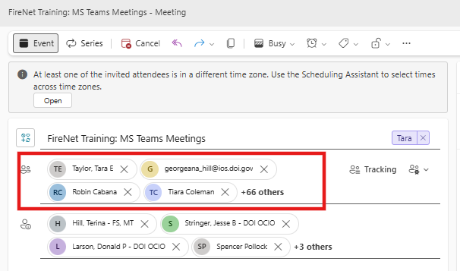
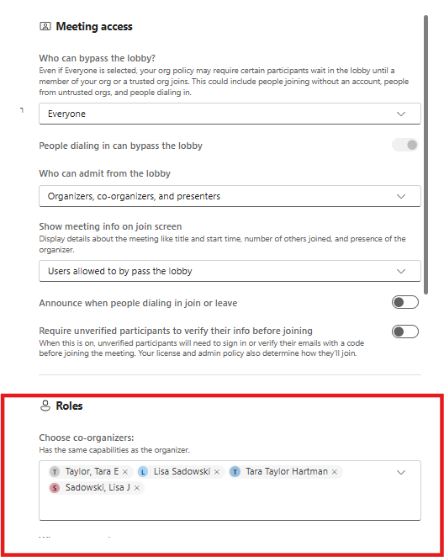
ACCOUNTS
TECH TIPS
BROWSER
IMT/DISPATCH MGMT
MS Teams Meetings
Must be added to the meeting
Mut be added to any additional roles

Slide 20

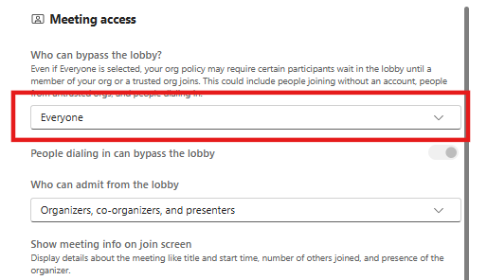
ACCOUNTS
TECH TIPS
BROWSER
IMT/DISPATCH MGMT
MS Teams Meetings
Don't leave people in the lobby if it's a big group OR not sensitive information!

Slide 21
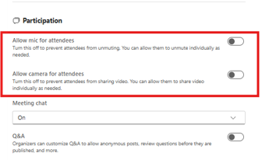
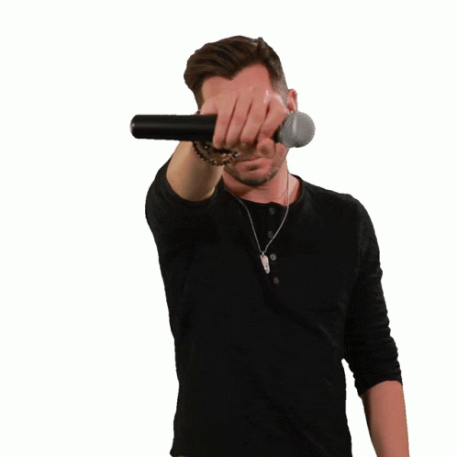
ACCOUNTS
TECH TIPS
BROWSER
IMT/DISPATCH MGMT
MS Teams Meetings
You can change this setting DURING (after large presentation for Q&A) a call

Slide 22


ACCOUNTS
TECH TIPS
BROWSER
IMT/DISPATCH MGMT
The Great Browser Battle
Fresh FireNet browser for all of your FireNet needs! ​
Agency accounts
will battle!!

Slide 23
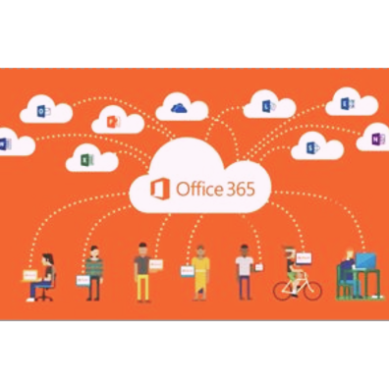
ACCOUNTS
TECH TIPS
BROWSER
IMT/DISPATCH MGMT
FireNet = Web = Browser!
Currently only one supported use case for OneDrive use: GISS and it's supported by that group​ ​
95% of the time the browser based O365 will do what our users need​​
Interagency = many different agency desktops​​
No desktop support​
WWW.FIRENET.GOV

Slide 24
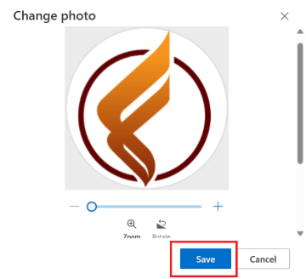
ACCOUNTS
TECH TIPS
BROWSER
IMT/DISPATCH MGMT
Use A FireNet Profile Picture
Multiple O365 accounts may cause agency account takeover after sign-in
Set your FireNet profile photo to the FireNet icon for quick visual confirmation
Verify account location (bottom left at office.com; top right in Teams/Outlook)
Use ‘Sign in with a different account’ if needed

Slide 25
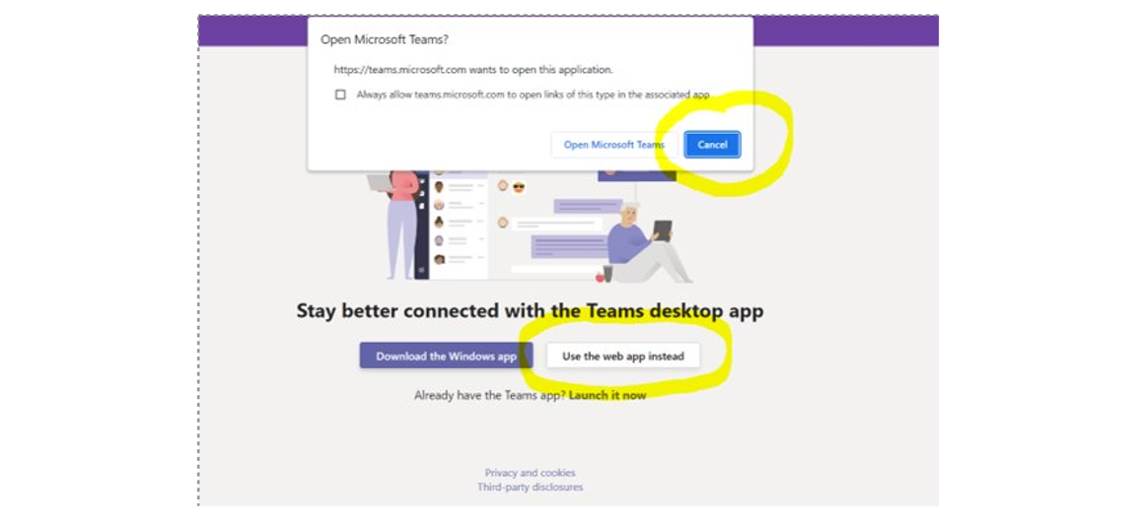
ACCOUNTS
TECH TIPS
BROWSER
IMT/DISPATCH MGMT
Browser Access Hint

Slide 26
ACCOUNTS
TECH TIPS
BROWSER
IMT/DISPATCH MGMT
Agency Account Sign Out
Go to https://portal.office.com and click 'Sign in'​
Profile picture or initials in top right, 'Sign out'​​
1
2
4
3
Sign in using named FireNet account: first_last@firenet.gov​
'Switch to a
different account'​​

Slide 27
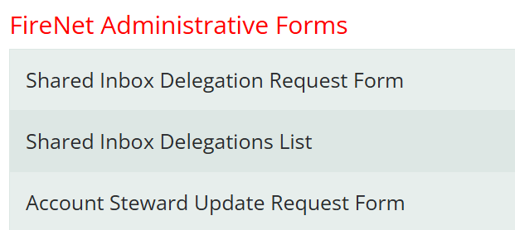
ACCOUNTS
TECH TIPS
BROWSER
IMT/DISPATCH MGMT
Dispatch Shared Inbox Delegation
Delegation Automation
Once approved, automatically updated to the master delegation list​ ​
Note: Evenings or weekends only in slow season reach out to incident.helpdesk@firenet.gov
WWW.FIRENET.GOV

Slide 28
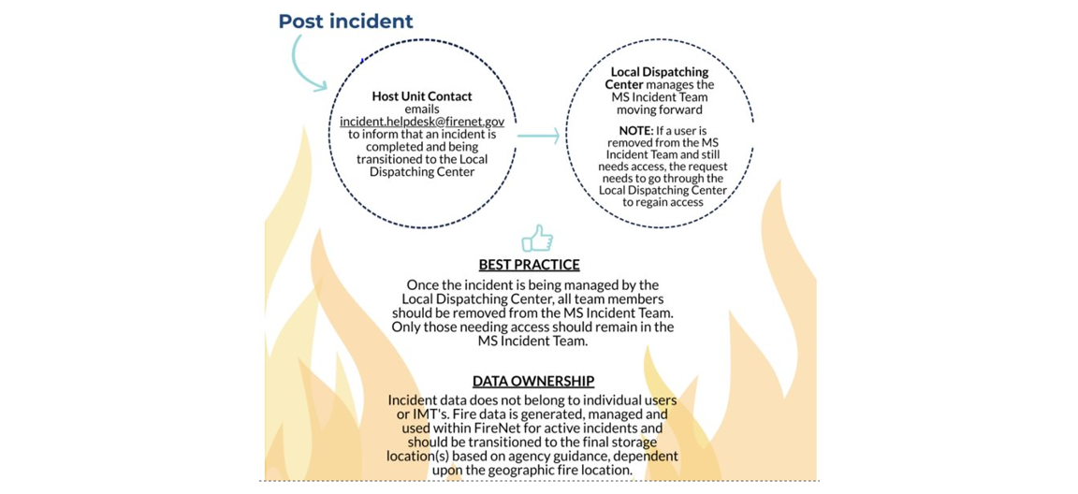
ACCOUNTS
TECH TIPS
BROWSER
IMT/DISPATCH MGMT
Post Incident Flow

Slide 29
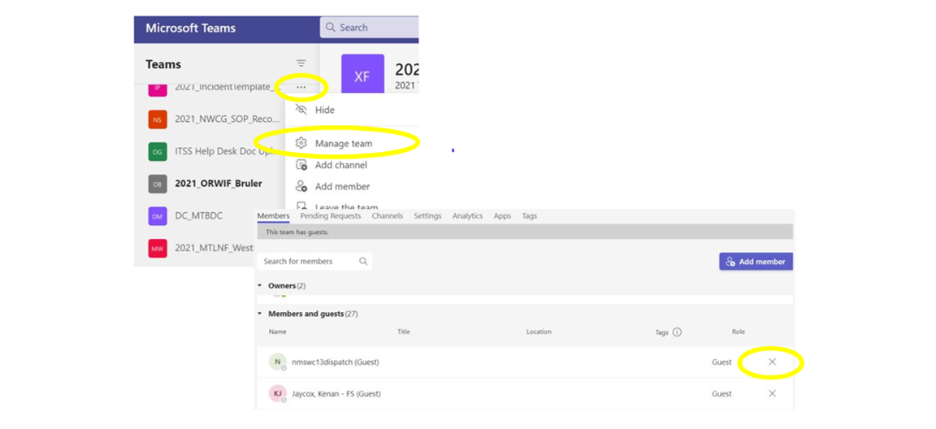
ACCOUNTS
TECH TIPS
BROWSER
IMT/DISPATCH MGMT
Post Incident: Remove Most Members

Slide 30
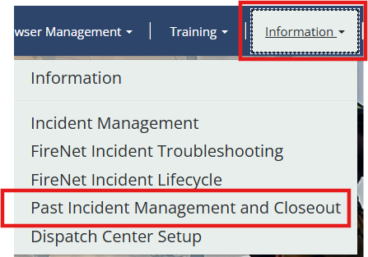
ACCOUNTS
TECH TIPS
BROWSER
IMT/DISPATCH MGMT
Post Incident Archived Access
Incident Business Noted
Stewards added
Acccess from SharePoint
Step by Step Archive Process
Master Incident List

Slide 31
ACCOUNTS
TECH TIPS
BROWSER
IMT/DISPATCH MGMT
GACC/Dispatch Support Collab Space
Use Cases
Use Cases
Ongoing/yearly events
Small fires with no IMT
1 IMT 16 fires
Mobilization efforts
ABC Severity
Miscellaneous
Continue with this setup, most often request coming from incident business specialists
CC: the center
Potentially have to share
Recommendation

Slide 32
ACCOUNTS
TECH TIPS
BROWSER
IMT/DISPATCH MGMT
Community Reminders
FireNet should be accessed from a unique web browser (Chrome) for the best user experience and limited confusion with other agency O365 setups.
Please encourage Dispatch Centers to attend trainings to optimize functionality and better the user experience.
Accounts must be signed into every 45 days to stay active!!
Affiliate management (yearly FISSA certs and RoB) to be updated for 2026 by non-federal users to maintain account.
Affiliate requests must follow each STEP or the request does not move forward. Turnaround for any user on an incident or on site at a dispatch center is processed immediately for approval.

Slide 33
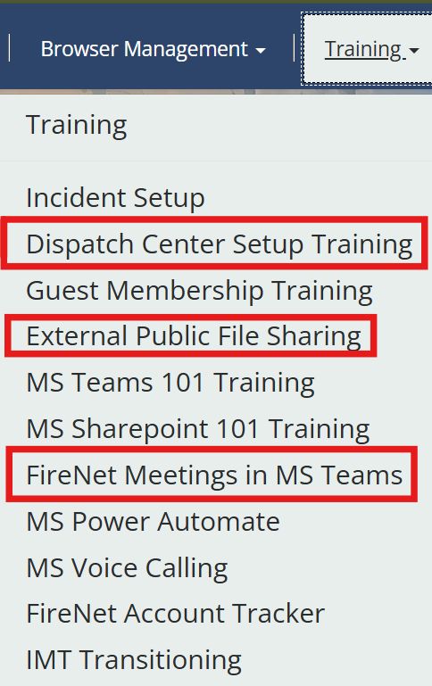
ACCOUNTS
TECH TIPS
BROWSER
IMT/DISPATCH MGMT
Training Opportunities

Slide 34
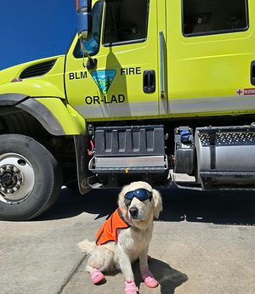
Questions?
WWW.FIRENET.GOV

