Slide 1
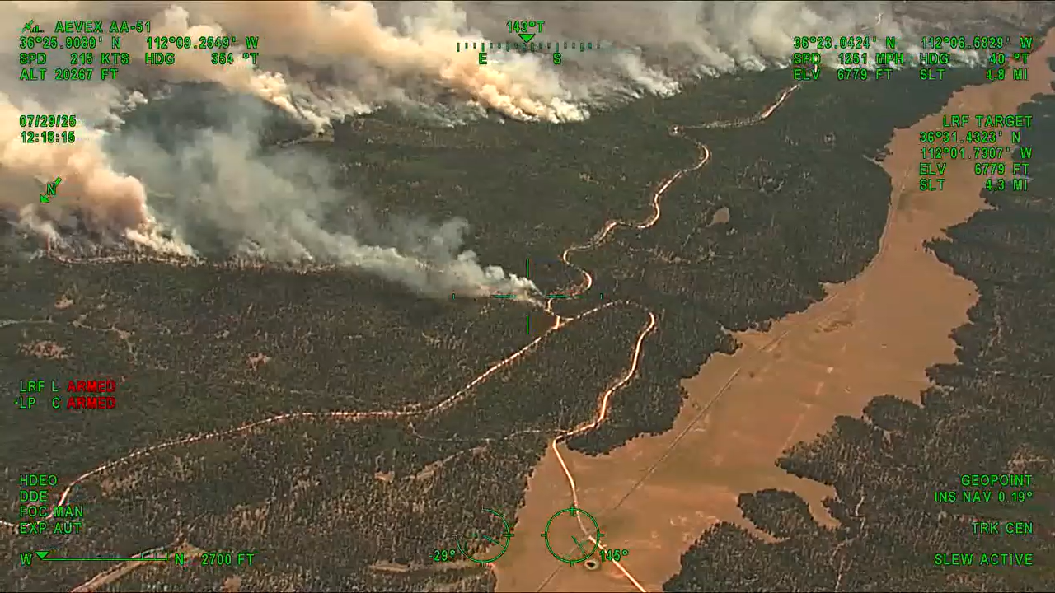
IAA
Incident Awareness & Assessment
Notes:
video from 2025 Dragon Bravo Incident.
Upper left corner you’ll see the aircraft is flying just above 20,000’ so easily above the TFR and no impact to aviation operations.
This is one of the top 4 products requested from the IAA Program.
Introduce yourself then outline presentation
Define the IAA program
Key features of the IAA ordering HUB
Look at 4 missions and derived products
View and download products from EGP

Slide 2




Defining IAA for Fire Operations
Product Delivery
Products upload inflight to EGP / FTP
Mission
Detect Collect Deliver
near-real time
geospatial intelligence products
for Decision Makers
Platforms
Utilize aerial, satellite-based assets, and ground cameras
Notes:
Mission: support dispatchers and Fire Management Officers in proactive resource allocation. Our mission is support for tactical and strategic fire decisions. Ultimately enhancing safety
Near-real time delivery of products means all our manned aircraft have SatCom systems which allow uploads in flight of maps, videos, detections directly to EGP and the dispatch center

Slide 3
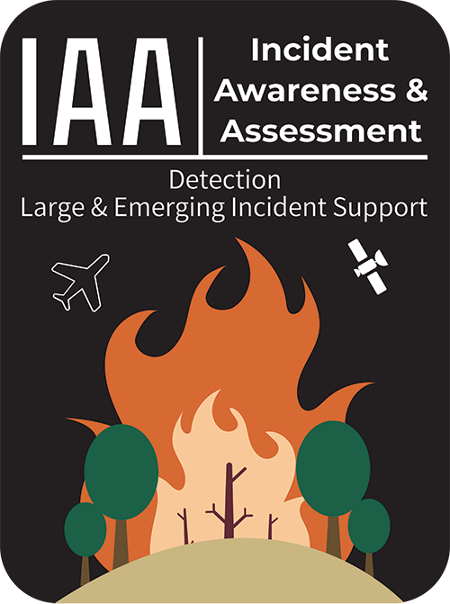
DETECTIONS
Priority Mission
Large Fire Mapping
NIROPS
CIMT Support
OPERATIONAL SUPPORT
IA and Emerging Fires
Maps, videos, hotspots, Images
FireGuard
SAR
Other

Slide 4
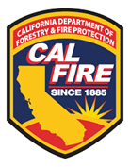

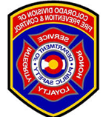





2026 Interagency Assets
N461DF
Cal Fire
N181Z (WCF)
N7HS
Large Fire Mapping (NIROPS)
N115Z (WCF)
N287AT (180-day EU)
N57B (Intel 12)
Cal OES
Aircraft 3
N44U (Intel 24)
N40Y
IAA Hub
N327SF (Wildland 27)
Colorado DFPC
STATES
Federal
N328SF (Wildland 28)
NEW N353M
Operational Support
N874EB (160-day EU)
NEW N361M
MT DNRC
NEW N362M
N880AG (180-day EU)
N391M
NEW N170Z (WCF)
TBD
Oregon ODF
FireWatch 51 (WCF)
*Utah DNR
N325FS (150-day EU)
N565E
Washington DNR
N879EB (150-day EU)
N216KQ
Notes:
9 FEDERAL and 14 STATE aircraft (+aircraft3 asset)
State of Utah are in final contract discussions and may have aircraft and sensor active later this season

Slide 5
New Heat Detection / Lightning Recon
Requestors identify priority areas; flt crew uses lightning data to refine area
DELIVERED PRODUCTS:
Size-up reported via radio/phone and email confirmation to dispatch
2. Detections are uploaded in-flight to HUB site
3. Imagery, videos, perimeter uploaded to EGP
Detection
Notes:
detection missions are our #1 priority
Accounts for about 20% of IAA requests
Detections are uploaded in-flight to the HUB site under Detections tab
Flight manager will call the local dispatch on the radio with report AND follow-up with an email to the center’s main email
Timing of request: If you know you want a detection for the following day, place request in HUB (this helps coordinators prioritize missions)

Slide 6
Large Fire Mapping
NIROPS for CIMTs
Large Fire Mapping
Night IR perimeter mapping supporting CIMT incidents
DELIVERED PRODUCTS:
1. Shapefile, PDF, KMZ posted to incident folder in FTP
2. Closeout email including total acres, growth and IRIN notes. Also posted to HUB
Detection
Notes:
40% of IAA Program requests
NIROPS Order Requirements:
Place a request in the IAA Hub
Submit an IROC order (A# Service, Infrared Night SIRN) no later than 1530 MT
NIROPS assets:
2 agency Aircraft (115Z, 181Z)
one 180-day EU contract
Aircraft 3 (DOD asset) supports incidents out of flight range for the manned aircraft
NIROPS delivered products are POST PROCESSED – which means the Infrared Interpreter IRIN works overnight to build the map and deliver prior to morning briefings.

Slide 7
Operational Support
Large Fire Mapping
Support of emerging incidents, including Initial Attack and Type 3/4/5
AVAILABLE PRODUCTS:
GIS Perimeter
Narrated/unnarrated Video
Imagery Overlay
Isolated Heat Identification
Detection
Operational Support
Notes:
35% of IAA Requests
GIS Perimeter: Targeted mapping of specific areas of concern based on incident priorities and Areas of Interest (AOIs); may not cover entire fire and typically excludes isolated, scattered, or intense heat delineation.
DIFFERENT from NIROPS maps – built in-flight, NOT post processed
Videos: MAX of 2-minute video. requestor will direct which division/area is priority. NO tactics/strategy focused on situational awareness only for decision makers.
Imagery Overlay: Geo-referenced snapshots in IR or EO. Requestor identifies priority divisions/areas. Request limited to 15 images
Isolated Heat Identification: isolated heat points identified within defined incident area

Slide 8
FireGuard
SAR / Other
Large Fire Mapping
FireGuard:
Heat detection and monitoring (>10 acres)
Focused on first 24-48 hrs.
Most valuable near/within WUI
Search and Rescue (SAR):
Availability depends on agency regulations
Assisted rescue utilizing IR capabilities
Other Missions:
Damage Inspection
Post Fire assessments
Forest Heath support
Detection
Operational Support
FireGuard
SAR/other
Notes:
1% of IAA requests drop into this category
FireGuard: interagency program (NIFC, National Guard, Federal/state partners) designed to enhance fire detection and monitoring. Provides 24/7 US coverage for new starts LARGER THAN 10 ACRES. Most valuable for fires near or within the WUI during early stages when information can be limited. Updates occur approximately every 10 minutes.
Other missions: Damage inspection (Non-federal mission/state assets only)

Slide 9
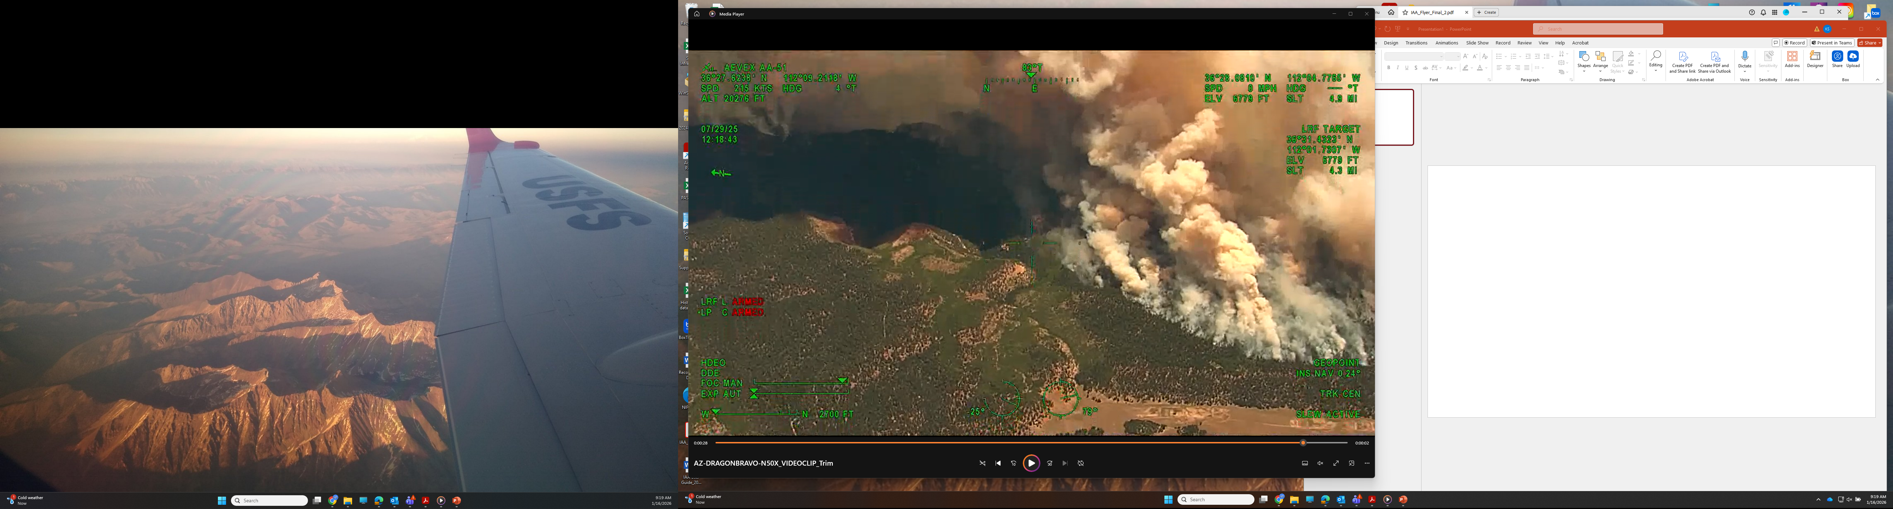
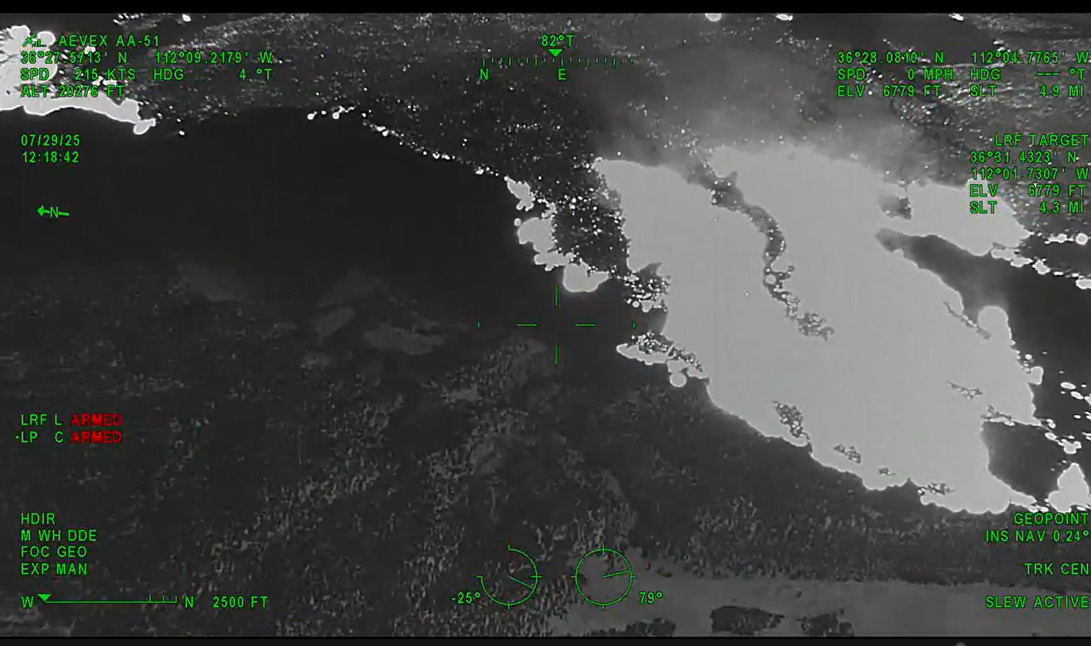
EO (Electro-Optical)
uses visible wavelengths – relies on sunlight to produce an image the human eye would see
Shows terrain, roads, fuels, and smoke columns
Notes:
Image taken from same Dragon Bravo video from title slide.

Slide 10
IR (Infrared)
Detects thermal radiation – heat from objects instead of visible light
Heat imagery shows temperature differences
Can ‘see’ through smoke and darkness
Notes:
TOGETHER EO and IR:
1) Increase SA for fire management
2) Supports efficient resource allocation

Slide 11
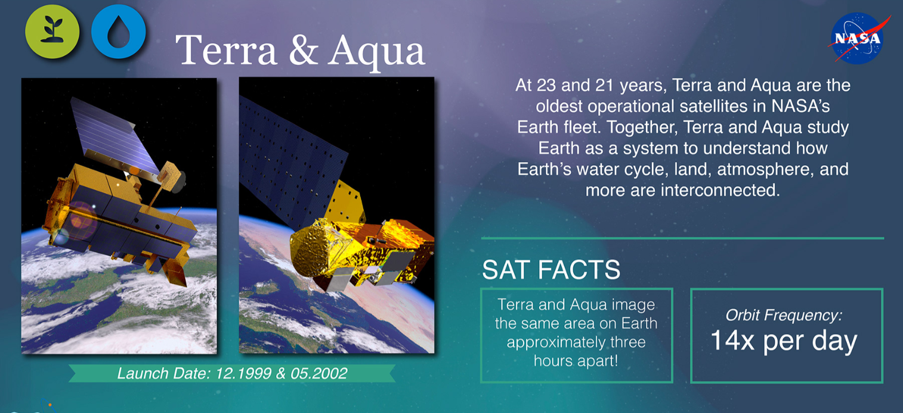
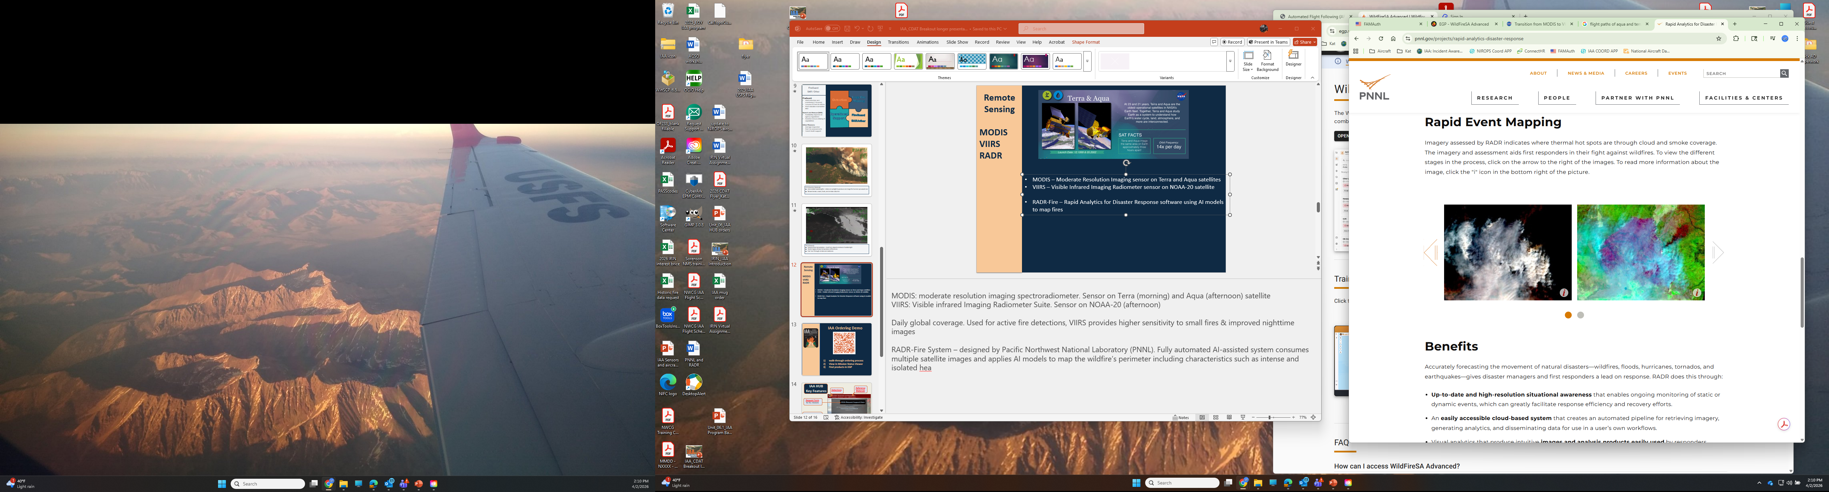
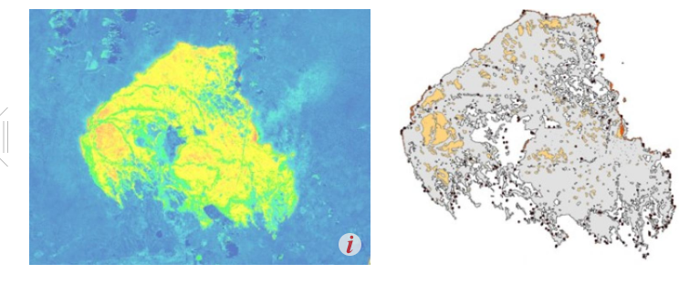
Remote Sensing
MODIS – Moderate Resolution Imaging sensor on Terra and Aqua satellites
VIIRS – Visible Infrared Imaging Radiometer sensor on NOAA-20 satellite
RADR-Fire – Rapid Analytics for Disaster Response software using AI models
Visit FIRMS:
Fire Information for
Resource Management
to learn more
Notes:
15 Satellites under operational control of NASA and NOAA. Some deliver fire data
MODIS: moderate resolution imaging spectroradiometer. Sensor on Terra (morning) and Aqua (afternoon) satellite
VIIRS: Visible infrared Imaging Radiometer Suite. Sensor on NOAA-20 (afternoon) VIIRS provides higher sensitivity to small fires & improved nighttime images
RADR-Fire System – designed by Dept of Energy/ acific Northwest National Laboratory (PNNL). Fully automated AI-assisted system consumes multiple satellite images and applies AI models to map the wildfire’s perimeter including characteristics such as intense and isolated hea

Slide 12

IAA Ordering Demo
walk-through ordering process
View in Mission Status Viewer
Find products in EGP
Notes:
Training IAA link: https://survey123.arcgis.com/share/feb4a81eb5fb476ca08f277e402eb510
- Need NIFC Org login
2) IAA Hub: https://iaa-nifc.hub.arcgis.com/
Mission status viewer
NEW reference Materials
Detections

Slide 13
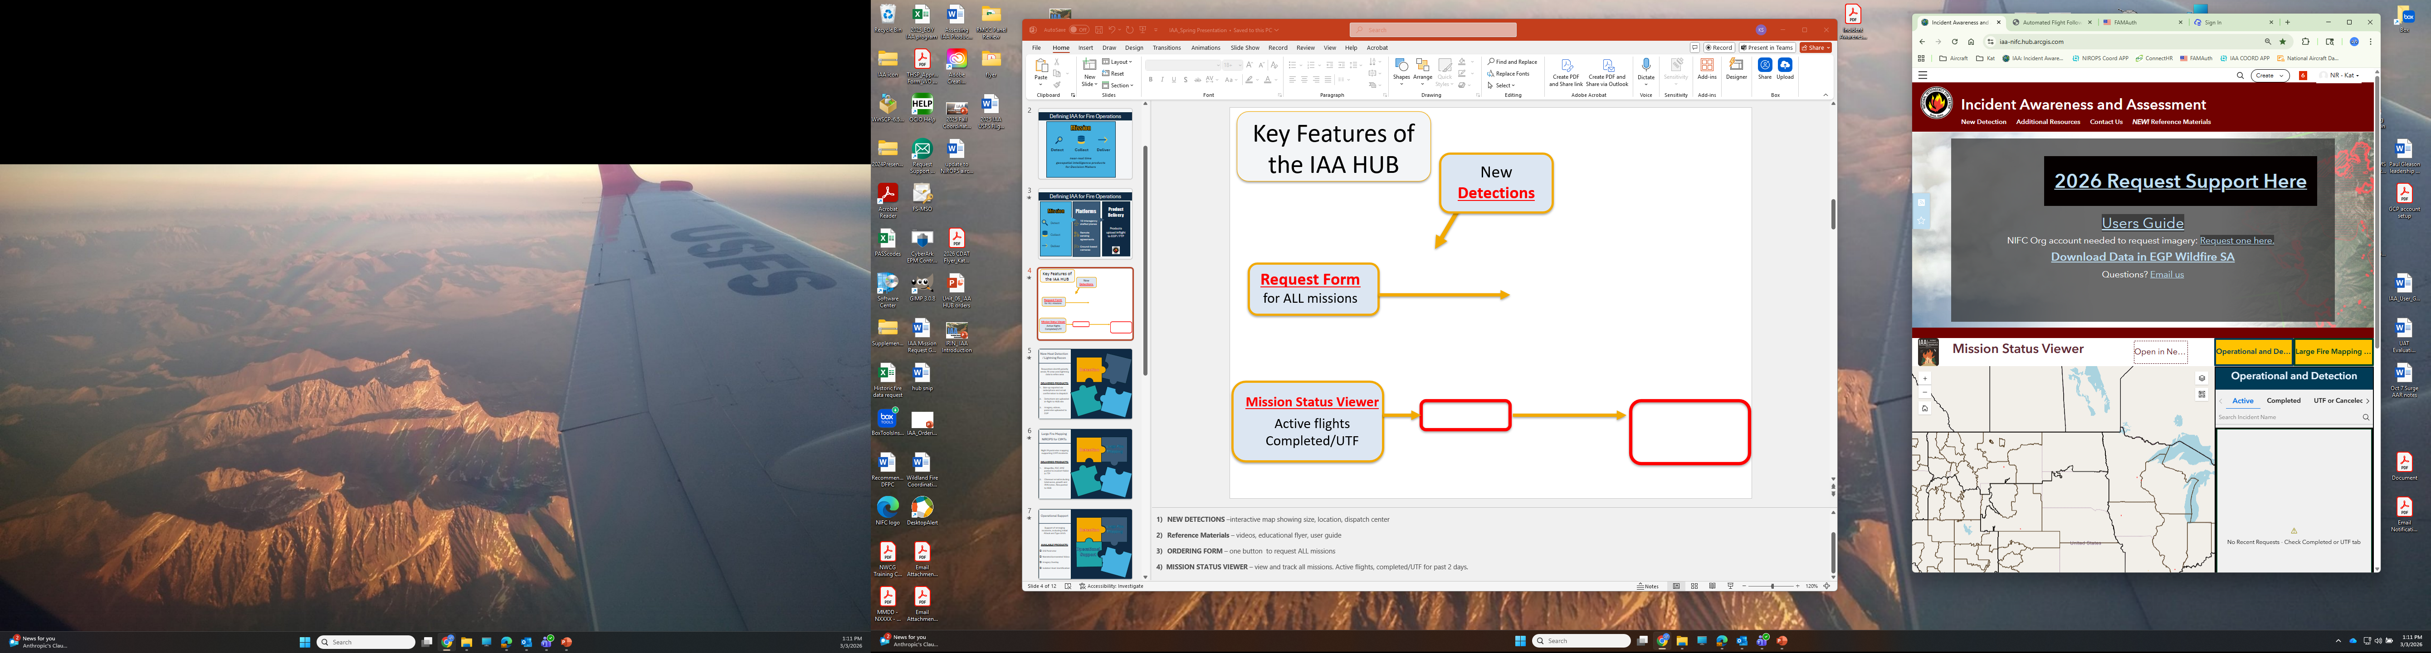
IAA HUB
Key Features
Reference Materials
Detections
Request Form
for ALL missions
Mission Status Viewer
Active flights
Completed/UTF
Notes:
Any search engine will pull up IAA HUB
- NICF AGOL log-in required for orders/viewing missions YOUR HOMEWORK: Find our page and bookmark, make sure your NIFC AGOL login is current
NEW DETECTIONS –interactive map showing size, location, dispatch center
Reference Materials – videos, educational flyer, user guide
ORDERING FORM – one button to request ALL missions
4) MISSION STATUS VIEWER – view and track all missions. Active flights, completed/UTF for past 2 days.

Slide 14
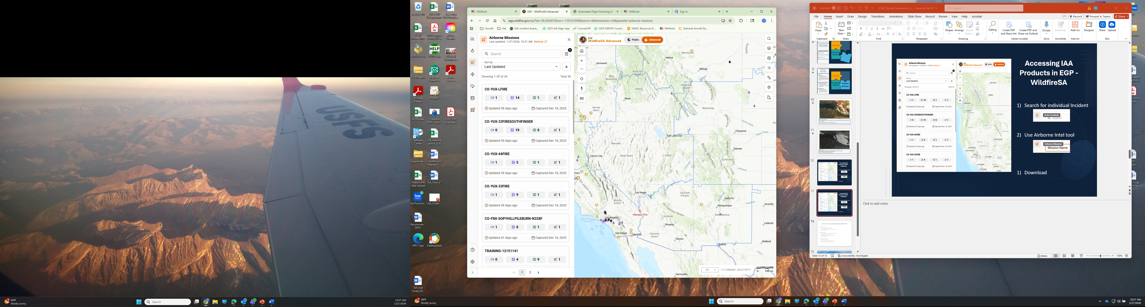
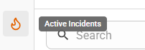
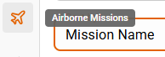



Accessing IAA Products in EGP WildfireSA
Search for Individual Incident
Search Airborne Intel tool
Notes:
If you are searching for a named incident use ACTIVE INCIDENTS search
If looking for detections, use AIRBORNE INTEL TOOL, filtered by LAST UPDATED

Slide 15
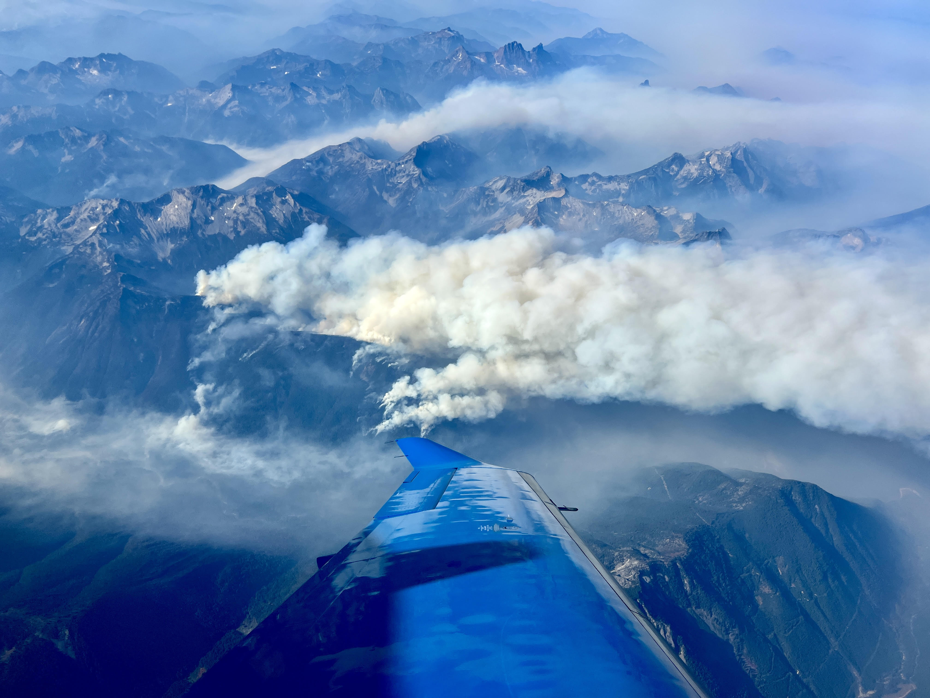
Kat Sorenson
National IR Coordinator
406-499-2701
iaa.support@firenet.gov

