Slide 1



Incident
Qualifications and
Certification
System
2026 CDAT – Redlands, CA
Mark Skudlarek
USWFS Training Specialist

Slide 2
Topics
IQCS Program Overview
Current Updates:
  User Roles
  Qualification Process
  Certification Process
  IRWIN

Slide 3
IQCS
Interagency Application
Implemented - Spring 2004
Track responder incident qualifications
Built for creation and delivery of the Incident Qualification Card
DOI joined with all-hazard positions in - 2011
US Air Force joined in - 2016
IQCS first connected to IRWIN - 2017
US Army joined in - 2019
DoD and Department of Energy – 2024
IQCS Application Software Update (PeopleSoft - Apex) – March 2026

Slide 4







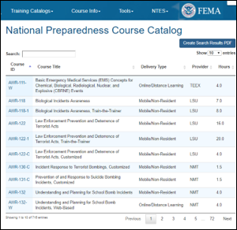


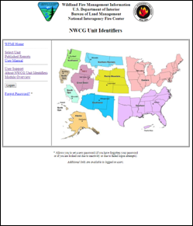
Business

Slide 5
Agencies and Organizations
Department of the Interior
Bureau of Indian Affairs (BIA)
Bureau of Land Management (BLM)
US Fish and Wildlife Service (FWS)
National Park Service (NPS)
Bureau of Reclamation (BOR)
Bureau of Ocean Energy Management (BOEM)
Bureau of Safety and Environmental Enforcement (BSEE)
Office of Surface Mining Reclamation and Enforcement (OSMRE)
US Geological Survey (USGS)
Department of Agriculture
US Forest Service (USFS)
Department of War
US Air Force (USAF)
US Army (USA)
US Marine Corps (USMC)
US Navy (USN)
Department of Commerce
National Oceanic and Atmospheric Administration (NOAA)
Other
The Nature Conservancy (TNC)
Department of Energy (DOE)

Slide 6
Agency | Responder Count
USFS | 31,808
BLM | 7,003
NPS | 7,203
BIA | 4,670
FWS | 2,257
USFWS | 21,133
Agency | Responder Count
BOR | 130
DOI EM | 197
NOAA | 154
DOE | 106
TNC | 764
US Army | 177
USAF | 1,260
Total Active | 55,819
Total Inactive | 216,902

Slide 7

Behind the Scenes
Agency Leads
IQCS Change Management Board (CMB)
IQCS Staff

Slide 8
IQCS Staff
Title | Name
IT Applications Program Manager | Shannon Tippett
Business Steward | Marley Marshall
IQCS Application Steward | Jacob Smith
IT Specialist – Programmer | Guy Colwell
Apex Developer | Alex Scharnhorst
IQCS Helpdesk - nifchelp@blm.gov

Slide 9
Roles
IQCS
Change Management Board (CMB)
IQCS reflects business requirements and needs of the user community.
Decisions on system changes.
Interpretation, implementation, and direction on business changes.
Provides agency-specific guidance.

Slide 10
IQCS - Agency Leads & Change Management Board (CMB)
Agency | Agency Lead | CMB Member
BIA | Garth Fisher | X
BLM | Mark Skudlarek | X
BOR | Paul Tranetzke
DOI Office of Emergency Management | Brent M. Ruggles | X
FWS | Michael Ellsworth | X
NOAA | Larry Van Bussum
NPS | Sara Sink | X
The Nature Conservancy (TNC) | Paulette Bolles
US Air Force | Rudy Gonzales | X
US Army | Ryan Sundberg
USFS | Joe Sean Kennedy | X

Slide 11
IQCS Updates
Software:
  IQCS Legacy - PeopleSoft
  IQCS Current - Oracle Application Express (APEX)
Smart device accessible
User Roles
Qualification Process
Certification Process

Slide 12
IQCS Updates – Intent
Provide a base package to perform:
  Responder training and qualification management, certification, and mobilization.
Training and qualifications focus
Inventory and modernize
Increase user capabilities (account managers/certifying officials)

Slide 13
IQCS Updates – User Roles
Viewer
Account Manager
Certifying Official
Regional Representative
National Agency Lead
Super User (IQCS Program Staff)

Slide 14
IQCS Updates – Qualification Process
Removed responder “Competencies”
Added qualification status “Expired Currency”
Group Award Training
Reporting Capabilities
  Active responders report
  Ability to customize reports

Slide 15
IQCS Updates – Certification Process
Responder certification performed “internal”
Account manager role “drafts” responder qualifications
Certifying official reviews and certifies in IQCS
Certified qualifications are sent to IRWIN
Incident qualification card emailed to responder

Slide 16
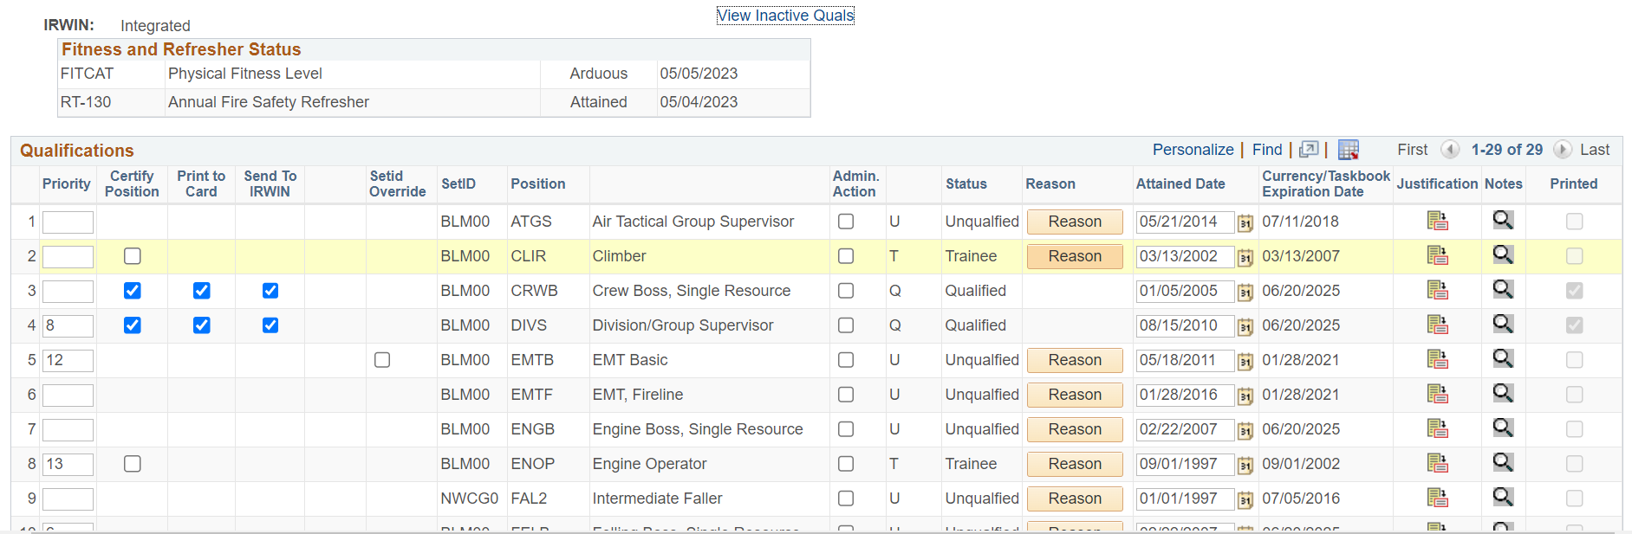
IQCS Legacy

Slide 17
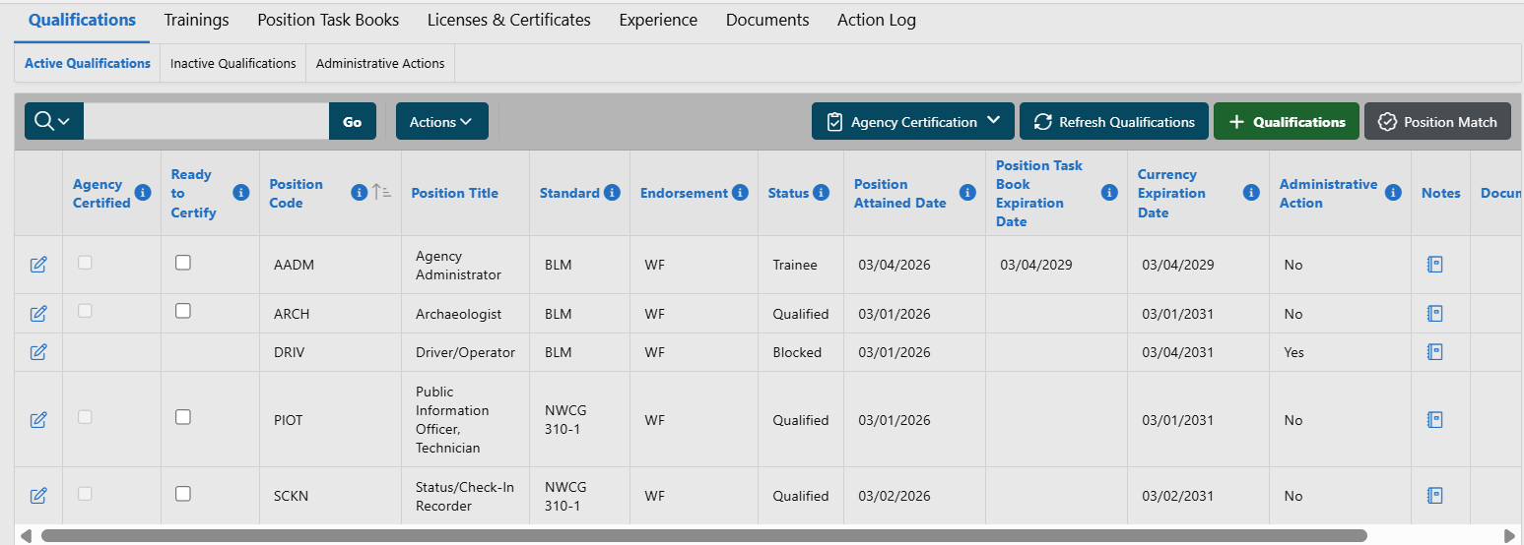
IQCS

Slide 18
Responder Log In
Responders can:
  Update Phone Numbers and Email Address.
  Download and view incident qualification card, master records, uploaded documents.
Responders can view:
  Incident qualifications
  Position task books
  Responder training
  Licenses and certificates
  Experience

Slide 19
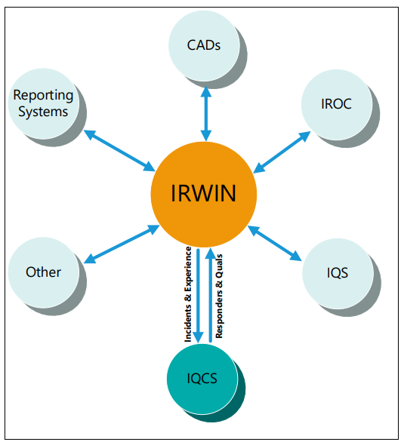
IRWIN and IQCS
Push:
  Responder Information
  Responder Qualifications
Pull:
  Responder Experience
  Training Completion - Wildland Fire Learning Portal

Slide 20
IRWIN Required Data
First Name
Last Name
Agency Provider Unit ID
Dispatch Unit ID
Employment Category
Primary Phone
Primary Email
Birthdates: Day/Month
Jetport
Manager Contact

Slide 21
IRWIN Integration Resources
“IRWIN Integration Conflicts”
  Forward-facing on IQCS application home page.
IRWIN Data Validation
  Account Manager can verify information sent to IRWIN
Integrate/Remove from

Slide 22
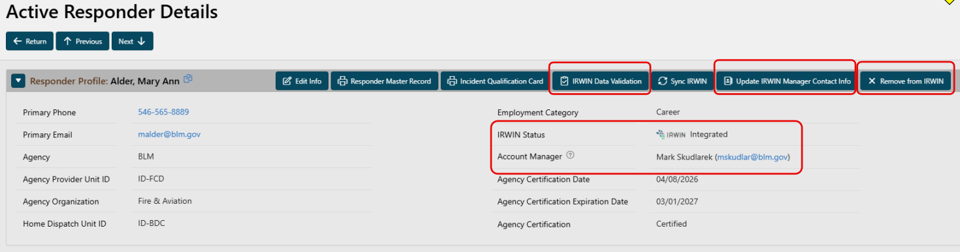
IRWIN Integration Resources

Slide 23
Questions

