Slide 1

Interagency Resource Ordering Capability
Consolidated Dispatch Applications Training
Redlands, CA - April 7, 2026

Slide 2

IROC Project Team
The IROC application project team is a specialized, collaborative group responsible for the design, development, testing, and deployment of the system.
Member | Role | Agency
Elise Hawes | IROC Project Manager | US Forest Service
Kymberli Hoffman | Project Management Specialist (Detailed) | USFS / Tennessee Interagency Dispatch Center
Julie Polutnik | IROC Business Lead | US Forest Service
Laurie Forni | NCCM Liaison | USFS / Northern California Coordination Center
Melinda Brogden | Subject Matter Expert (FamAuth, Integration, IQCS/IQS Qual Systems, Reports) | US Forest Service (Contractor)
Shayne Canady | Subject Matter Expert (FamAuth, Integration, Organizations, Reports, Training, Vendors/Contract Resources) | US Forest Service (Contractor)
Gina Papke | Subject Matter Expert (Organizations, Vendors/Contract Resources) | US Forest Service (Contractor)
Cynthia Carney | Subject Matter Expert (QMS Qual System, Reports, Training, CA Contracted Resources) | CAL FIRE
Notes:
Elise
Elise - 5 Years
Kymberli – 3 months
Julie – 5.5 years
Laurie – 8 years
Melinda – 10 years
Shayne – 8 years
Gina Papke – 10+years
Cynthia – 2 years

Slide 3
IROC Change Control Board
The IROC Change Control Board (CCB), a sub-committee to the National Coordination Center Managers (NCCM) group, provides national leadership and subject matter expertise, responsible for reviewing, evaluating, and approving or rejecting changes to the application.
To submit a change board request: https://tinyurl.com/bzje4nk8
Member | Title | Agency / Office
Ted Pierce | Change Control Board Chair | BLM / Northwest Coordination Center
Elise Hawes | IROC Project Manager | US Forest Service
Julie Polutnik | IROC Business Lead | US Forest Service
Bonny Johnson | Business Lead, Incident Business | US Forest Service
Elise Hawes / Kym Hoffman | Configuration Management Coordinator | US Forest Service
Sean Dunn | NICC Representative | BLM / National Interagency Coordination Center
Juan Ortiz | GACC Representative | USFS / Southwest Coordination Center
Brooke Deck | GACC Representative | USFS / Alaska Interagency Coordination Center
Leslie Zollinger | Local Dispatch Center Representative | USFS / Cody Interagency Dispatch Center
Vacant | Local Dispatch Center Representative
Carrie Moore | Local Dispatch Center Representative | USFS / Northern Utah Interagency Fire Center
Deric Strick | California Agency Representative (USFS/CALFIRE) | CAL FIRE / Northern California Coordination Center
Notes:
Elise
Group of representatives from all levels of dispatch to review all submissions.
Also rely on the NCCM and DEW groups and various NWCG sub-committees for expertise and oversight.
Ted – should be sending out a request for a new local level rep, could be from Southern, Eastern or Northern Rockies.
Great way to Affect Change:
Opportunity to Improve Processes
Provide input on strategic direction
Better visibility in IT application development and what goes into it
Improved communication and collaboration – can share info with you peers and GACC’s.
Help to learn the program better
Help to learn the program better

Slide 4
Project Management Updates
Contract 07/01/2024 – 06/30/2031
  July 2026 – 3rd year of current contract period
  Budget constraints – Plan to go into Operations & Maintenance
    Priority work will include
      Security
      Bug fixes
      Help Desk
      Platform upgrades
      Limited integration work
    Researching options to bring in additional funding
Notes:
Elise
3rd year of 7 year contract in July
List priority Work
With current funding – no to minimal enhancements
Additional Funding – outside of FS

Slide 5
2025 Accomplishments
Security Requirement
Added
Privacy Act Statement
Request Managing Dispatch
(IRWIN v10)
CALFIRE QMS Integrated
Pre-Orders
VIPR Disconnect –
IROC Data Admins
DPL management
until IIPA go-live
Numerous Bug Fixes, Backlog Items
Fixed Clicky!!!!
Contracts Management
Refinement
IROC & CAD SOR Incident Transfers (IRWIN v10)
ServiceNow Platform Upgrade to Xanadu
Nationally Contracted Resources
(NCR)
“Fill with Override”
&
“Fill with EFF/AD”
removed
POO State Financial Codes
(IRWIN v9)
National Emergency Rental Vehicle (NERV)
Tool
Foreign Incident & International Mobilization EKC (IRWIN v10)
Interagency Cache Logistics Inventory Program
(ICLIP)
Reports Data Management
Please see IROC Release Notes for more information
Notes:
Julie (maybe Maegen M)
Security Requirement – we now have the IROC Privacy Act Statement when logging into the system
ServiceNow Platform Upgrade to Xanadu
IRWIN v10
Added the new International Incident Types: (GF) Foreign Incident and (IM) International Mobilization
Update Dispatch ID (Incident Transfers)
Refined internal (IROC proper) non-CAD SOR incident transfers
Updating coding how we handle IROC SOR requests for incidents transferred within CADs
NEW functionality >> Request Managing Dispatch
Grant ordering capability of an incident to another center
Calfire QMS Integrated (11,867 responders unintegrated from IROC, re-integrated through CFQMS)
IRWIN v9
Completed the POO State Financial Code Integration
Exporting State Financial Codes added in IROC to IRWIN
Adding Imported State Financial Codes to the Incident Record
“Fill with Override” & “Fill with EFF/AD” removed
Benefit was to meet qual system responder requirements
Now we are getting more accurate responder records (who had what qual to fill requests
And using inventory resources not creating Temporary resources
Implemented NEW >> Interagency Cache Logistics Inventory Program (ICLIP), replacing the ICBS cache system
Implemented NEW >> National Emergency Rental Vehicle (NERV) Tool
Implemented NEW >> Nationally Contracted Resources (NCR) Module
Pre-Orders (only 42 pre-order templates have been created since deployment)
VIPR Integration Disconnect - IROC Data Admin users (JP, Elise, Gina & Shayne) have ability to inactivate/manage DPLs until IIPA go-live
Contracts Management Refinement (Coming Soon! Tentative Deploy Next Week) – work to set us up for IIPA/CFHEMS integration
IROC SOR Contracts will still be manually Enabled/Disabled but will automatically Activate/Deactivate/Expire on Begin/End Dates
Integrated contracts (IIPA/CFHEMS) will automatically be Enabled/Disabled once integrated, Begin/End Dates managed by those systems
Contract Line-Item (CLIN) resource records will automatically go to “Active” = True/False depending on contract Start/End Dates
Resources will no longer be deleted from contracts, now will be activated/deactivated Contract Line Items
Resource quals and resource items will automatically go to Active/Inactive depending on the Contract and Contract Line Items being Active/Inactive
For Exclusive Use contracts, implementing MAP (Mandatory Availability Period) dates by Contract Line Item
EU MAP dates will need to be manually managed unless the contract is integrated (IIPA & CFHEMS)
No more removing Exclusive Use contracts from resources when transferring to another center once EU is done.
→*Note, only need to transfer resources is if they are on EU contracts. Resources on CWN/etc can be filled by any Dispatch Org with Direct Access to the Contract.
→ A resource can be on multiple contracts at once, given the following conditions:
Resource can be on both EXU and CWN(s) at the same time, but while on an active EXU, the resource cannot be filled as a CWN. (Filled via EU Tab)
Resource can be on multiple CWN Contracts at the same time. (Filled by Contracts tab)
Resource can be on multiple EXU Contracts, as long as the MAP dates do not overlap.
Contract fields will become Read Only under certain dates to preserve historical records
Upon Begin Date - Contract Number, Procurement Type, Begin Date, Vendor Org and Contract Provider Org will become Read Only
Upon End Date – the End Date & Contract will become Read Only.
CRITICAL for Dispatch Managers to enter correct information up front and update Begin/End Date if adjusted.
Numerous Bug Fixes, Backlog & CCB Items completed
Clicky McClickerson’s – unfilling/refilling requests, creating dupe requests finally fixed!!
Providing messaging on overlapping travel and not allowing saves until the issue fixed
Some requests not being assigned a Fill Catalog Item, which caused reporting issues
Preventing Incidents to be created without a proper lat/long
Subordinate Compact Requests were not correctly copying the Compact Name and State Only Inclusion down from the parent request
Users can no longer roster a parent resource to its own roster
Fixed a bug where experience records were not being properly generated
Resolved several IRWIN import/export processing issues
Data Management Initiative - Reports
Reports created by users who are not active in IROC and have not been run in the past two years were deleted.
Sent out Email notifications to active users who had reports that have not been ran in two years to run the report(s) or delete the report(s).
Transitioned to Consolidated Release Notes that are now published within the system, and vendor has taken over management of them – less workload on IROC BL & PM
Implemented “Break the Glass”, IROC Alternative Authentication twice during FamAuth Outages
We go through several approval chains before we can implement Alternative Authentication, not as easy as just opening the side door like WCE or other apps.
Refined email messaging to users on directions from first outage to second outage
Will be looking to give PE Team ability to reset passwords in the future, not replying on Devs to do it

Slide 6
IROC Catalog Updates – January 5
NWCG Off-Highway Vehicle Types Added & VUTV Deactivated
  OHV1 - Off-Highway Vehicle, Type 1
  OHV2 - Off-Highway Vehicle, Type 2
  OHV3 - Off-Highway Vehicle, Type 3
  OHV4 - Off-Highway Vehicle, Type 4
Dispatch Centers should inactivate the VUTV qual on agency resources that were using the generic VUTV – Transportation, Vehicle, Utility Terrain (UTV) catalog item previously, and add the appropriate type to the resource item.
The standards are posted to the NWCG Equipment, PMS200 webpage: https://www.nwcg.gov/publications/pms200/equipment-pms-200
Notes:
Julie

Slide 7
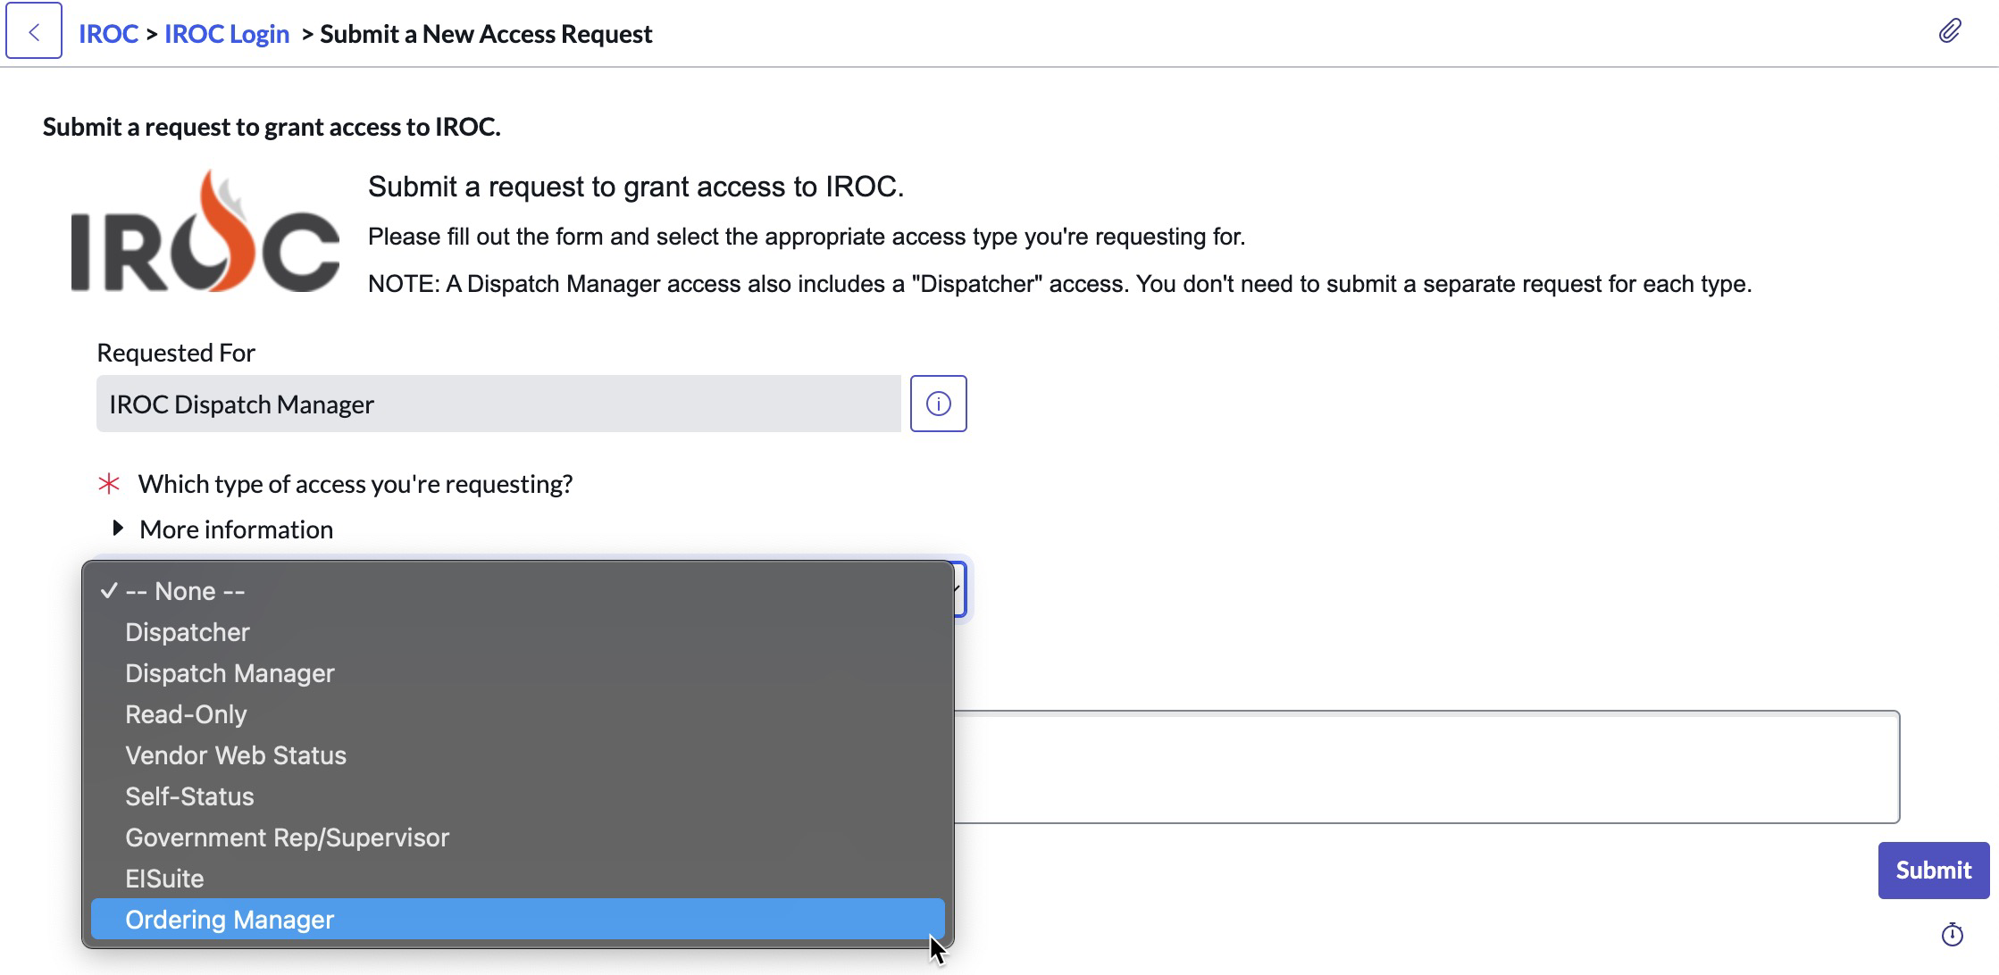
Sprint Series 21 [Release 21.2] Deployed Jan 7
User Roles – Ordering Manager
Users can now submit Access Requests for the “Ordering Manager” role
Notes:
Elise
“Ordering Manager” is now requestable

Slide 8
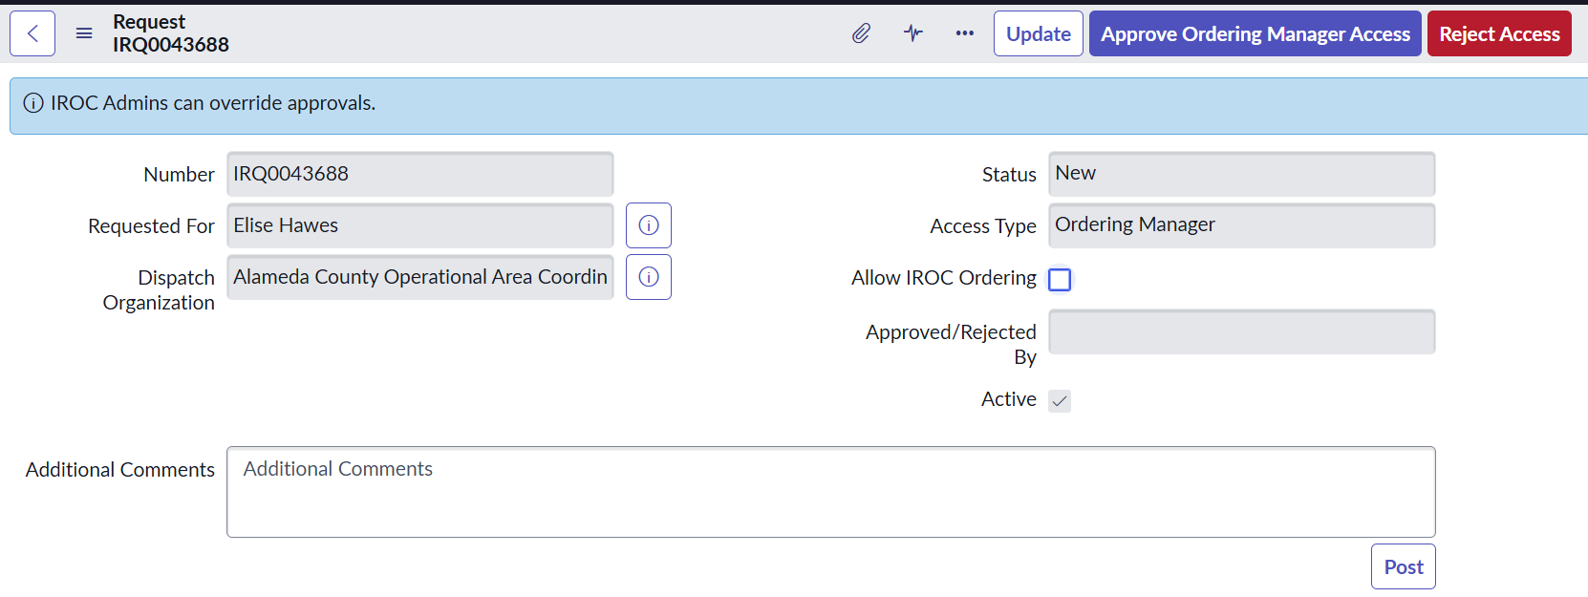
Sprint Series 21 [Release 21.2] User Roles continued
Dispatch Managers go to My Organization Approval to “Approve” or “Reject” roles
Notes:
Elise
When Dispatch Managers receive the request, in My organization Approvals queue approving the request will give the ORDM ICLIP ordering (NFES Supplies)
IF you click the allow IROC Ordering – will open up all catalogs for ordering.
Dispatch Managers will also be able to grant these roles via My Organization Access Roles in DMT.

Slide 9
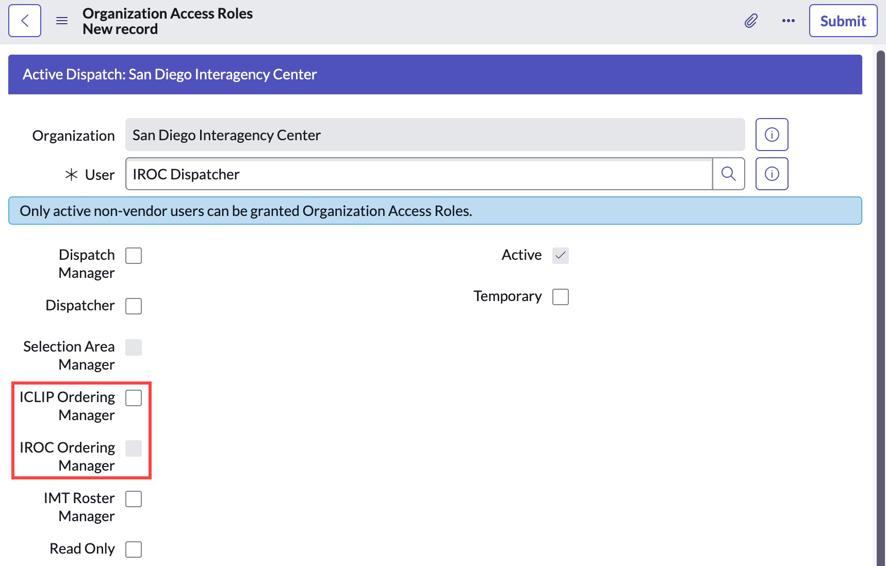
Sprint Series 21 [Release 21.2] User Roles continued
Dispatch Managers assign “IROC Ordering Manager” and/or “ICLIP Ordering Manager“ access
To assign a user “IROC Ordering Manager”, the “ICLIP Ordering Manager” must be assigned first
Note, not all Ordering Managers may get IROC Ordering Manager access, that level of access is up to the discretion of the Dispatch Center Manager and/or Expanded Dispatch CORD/EDSP which orders can be created by the ORDM
Notes:
Elise
Dispatch Managers will also be able to grant these roles via My Organization Access Roles in DMT.
ICLIP can be chosen independently, but you have to give ICLIP Ordering manager to be able to give IROC ordering manager.

Slide 10
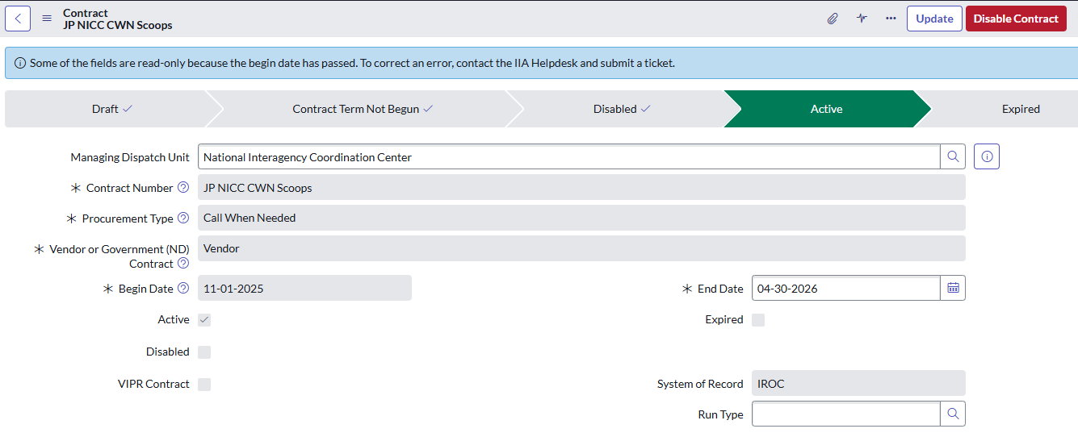
Sprint Series 21 [Release 21.2] Contract Management
Contract Number and Procurement Type will now be Read Only once contract Enabled & Start Date begins
Begin Date can be updated up until that date, then will become Read Only
End Date can be updated until that date and the contract expires, then will be Read Only
Contracts become “Active” once Start Date begins and “Inactive” after End Date and Contract Expires
Notes:
Julie

Slide 11
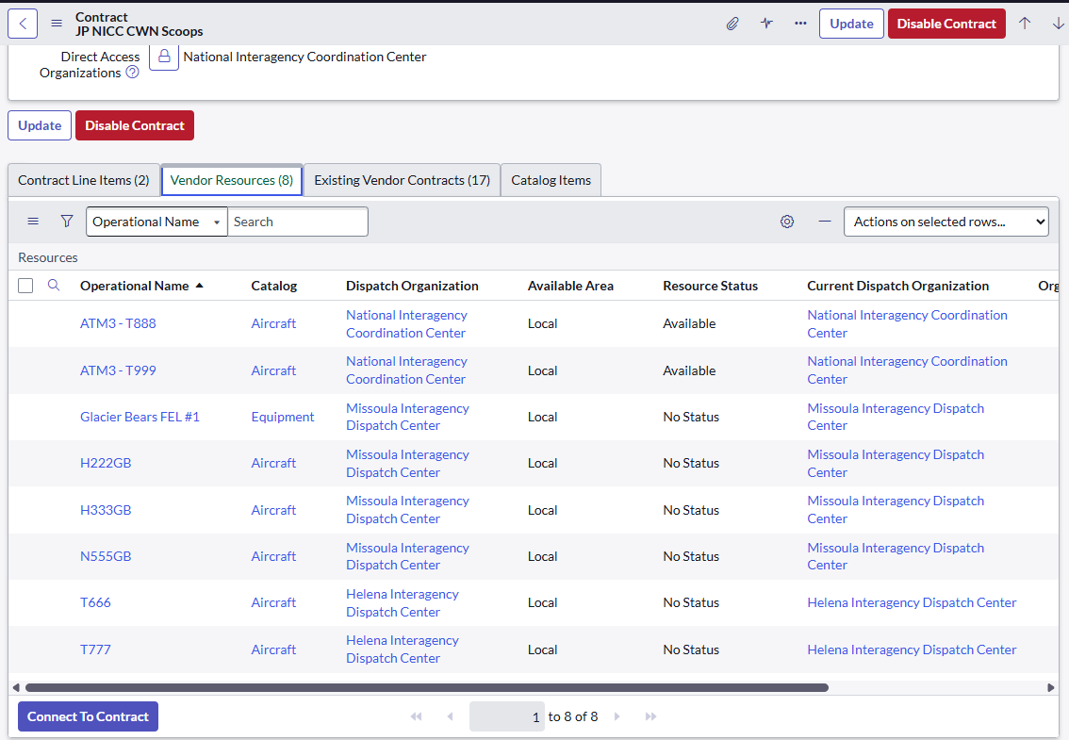
Sprint Series 21 [Release 21.2] Contract Management
By design to prevent mistakes, the system will only allow Vendor resources to be “Connect to Contract” one at a time
Users will receive an error message if trying to add multiple resources to the contract at the same time
Resources will no longer be able to be removed from the contract once added
Notes:
Julie

Slide 12
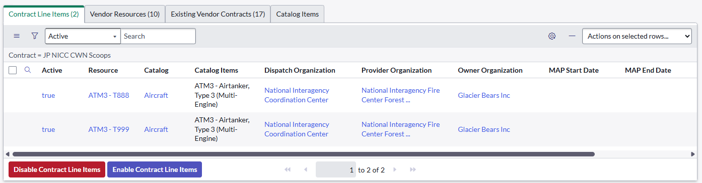
Sprint Series 21 [Release 21.2] Contract Management
Contract Line Items (CLINs) automatically Activate and Deactivate upon contract Start and End Dates for Agreement, Call When Needed and IBPA contract types
Users can manually Enable or Disable Contract Line Items while the contract is Active if needed
Notes:
Julie

Slide 13
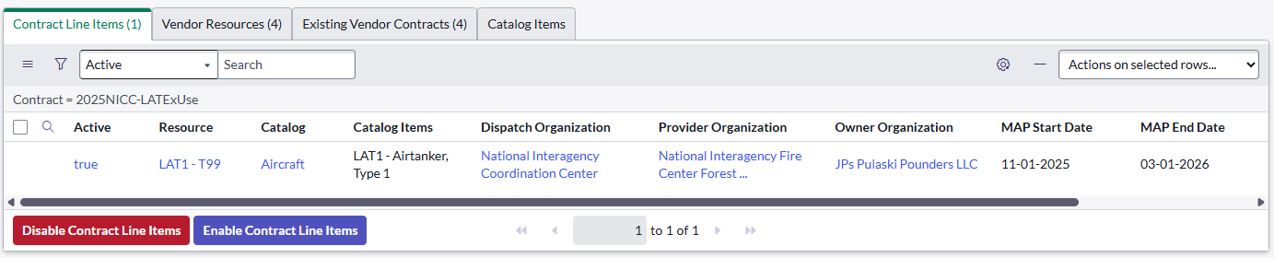
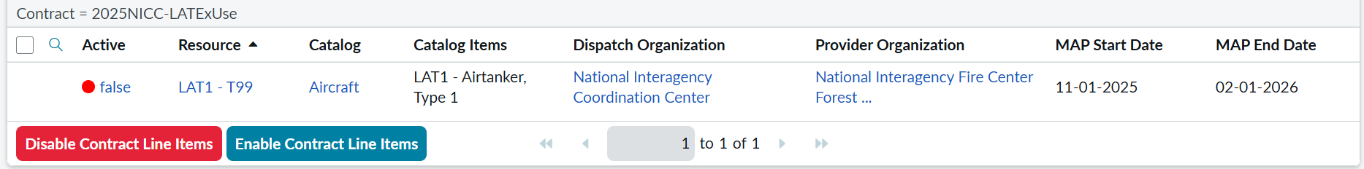
Sprint Series 21 [Release 21.2] Contract Management
Contract Line Items (CLINs) automatically Activate and Deactivate upon MAP Start and End Dates for Exclusive Use contract types.
Users can manually Enable or Disable EU Contract Line Items while the contract is Active if needed
Notes:
Julie

Slide 14
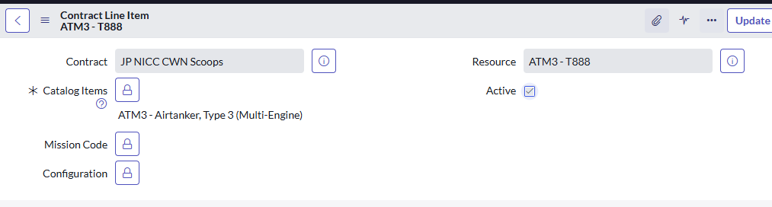
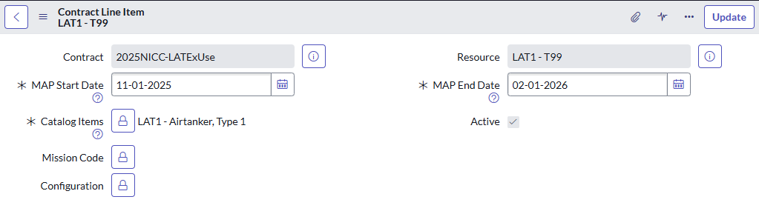
Sprint Series 21 [Release 21.2] Contract Management
Dispatch Managers at the CLIN resource’s Managing Dispatch can add/edit CLIN specific information
Appropriate qualifications (ie Catalog Items) will need to be added for each Contract Line Item
Mission Codes will be added for NCR Contracts/Contract Line Items when applicable
MAP (Mandatory Availability Period) Start Date and End Dates are required now for all Exclusive Use Contract Line Items
*Note, resources that may have split MAPs, will need to update MAP Dates to most current as needed

Slide 15
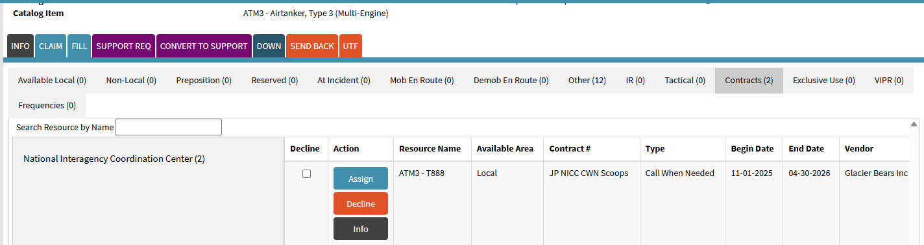
Sprint Series 21 [Release 21.2] Contract Management
Vendor resources display on appropriate Fill tabs based on Active Contract Type & Active CLIN
Resources on active Exclusive Use (EXU) contract in MAP will not show as a fillable resource for any other contract type
Resources on an active Call When Needed (CWN) contract will be fillable, as long as they are not on an active EXU
A resource can be on multiple contracts at once, given the following conditions:
  A resource can be on both EXU and CWN(s) at the same time, but while on an active EXU, the resource cannot be filled as a CWN
  A resource can be on multiple CWN Contracts at the same time
  A resource can be on multiple EXU Contracts, as long as the MAP dates do not overlap
What if a Vendor resource is sold to another company? The resources will need CLIN inactivated which inactivates quals and Releases SOR. Once SOR is None the center with the resource can update the Owner org to the new company. The resource will display on the resources tab under the new vendors contract(s) to add to the new contract.
Notes:
Julie

Slide 16
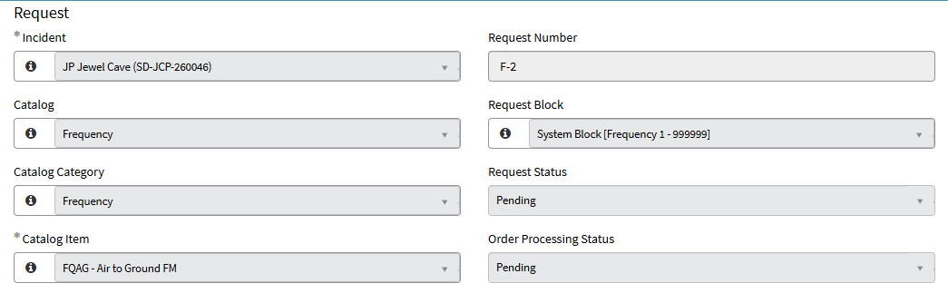
Plan For 2026 (so far)
IRWIN v11 (Sprint Series 22)
  Frequency Catalog (F#) & Integrated Frequencies
  Exporting Contract/Agreement Number on Filled Requests
  Importing IRWIN Derived Owner Organization (ie Agency Org) on Agency Resources
  IIPA/CFHEMS Integration
ServiceNow Platform Upgrade to Zurich
Historical Data Management (Archiving)
Notes:
Julie
Plan For 2026 – so far
IRWIN v11
New Frequency Catalog / Integrated Frequencies
No more creating Frequencies on the fly in IROC, all will be managed in EDG by approved agency frequency managers
Integrated frequencies come from CAD incidents will be available for use on the incident in IROC
Centers can add their own integrated frequencies to incidents
ROF Header Data -> active incident frequencies will populate on the ROF Incident Header section
NIICD and GACCs who manage frequencies will fill Requests with integrated frequencies
Contracts Integration – CFHEMS & IIPA (Integration of Incident Procurement Automation) Transition (for other integrated systems like IIPA, E-Isuite, Financial Systems, etc to use the data)
Importing Owner Organization (which will be the Agency Organization) derived from IRWIN from resource's Provider Unit
IIPA/IRWIN Integration Testing – February 25-26, 2026
V11 Deploy to Production – March 4, 2026
IIPA Deploy – Late May/early June
ServiceNow Platform Upgrade to Zurich (April 7th to Production)
Historical Data Management (Archiving) & Managing Data Footprint
Users will still have access to Incidents, Requests, Resources, ROFs
Deleting unnecessary data logs, attachments, emailed reports, etc that aren’t needed for NARA/Agency requirements.
Tentative Archive Schedule tbd
Still on the radar (funding dependent)
IRWIN v8 – Complete One Master Roster per resource
Complete fully integrated Read/Write rosters (currently Read Only)
Looking to locking down Transportation Category Catalog Items (PUPs, STKs, Auto, UTV, etc) to be excluded from catalog items to add to rosters
BUYT Spreadsheet Import (hold until furter notice / no BUYTs in 2026)
Variable Fill Requests (Porta Potties, etc)
Ability to add/release/track by location multiple quantities on one request
Continue to look at performance/speed issues (page loading, imports/exports)
Continue to work through Prior Year(s) Backlog & CCB Items
Updated User Interface (UI) / User Experience (UX)

Slide 17
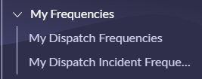
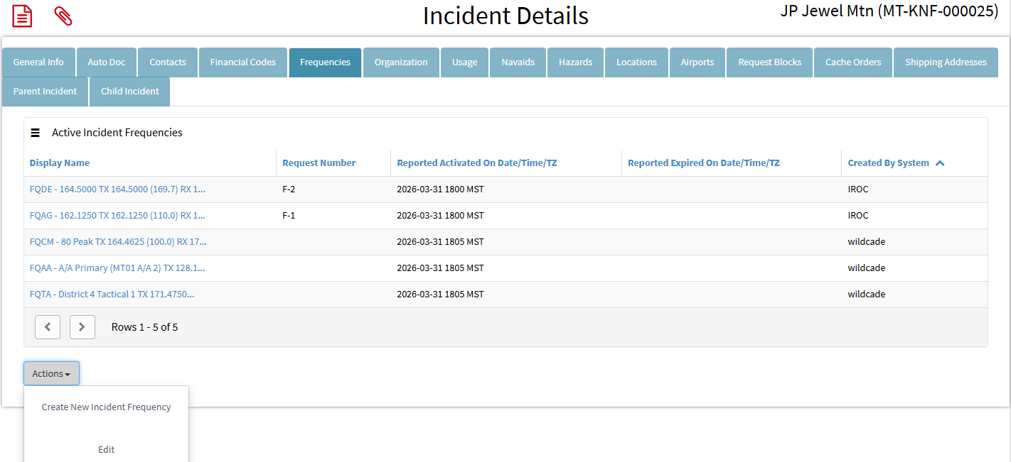
IRWIN v11 – Integrated Frequencies
Centers’ integrated frequencies will display under My Frequencies in DMT
Locally managed frequencies can be added to the Incident via the Frequencies tab in Portal or DMT
Active F# Frequencies will also display on the Incident Frequencies tab in Portal
The system will prevent a frequency from having overlapping Activation times.
Only “Activated” frequencies will display on the Frequencies tab in Portal and ROFs
Users can add IA frequencies or expire any IROC created incident Frequencies via the “Create New Incident Frequency” or “Edit” Actions
*Note, it’s recommended Centers with CADs that have integrated frequencies should primarily manage local IA frequencies in the CAD
Notes:
Kym
If added in CAD expire in CAD
If added in IROC expire in IROC

Slide 18
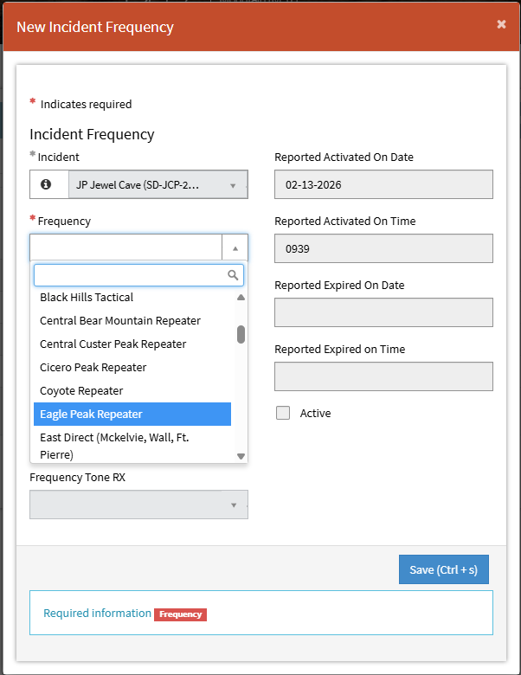
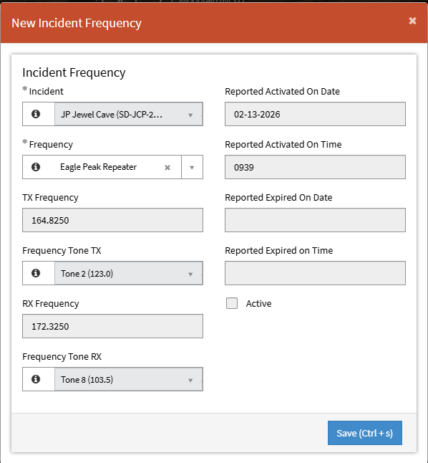
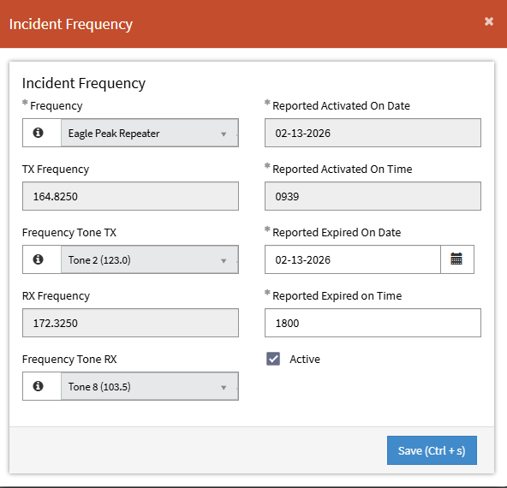
IRWIN v11 – Integrated Frequencies
  As needed, add local frequencies to the incident via the modal in Portal
  Users will “Expire” (Release) frequencies in the same modal
IA frequency list will display to select from
TX/RX/Tones will prepopulate
*Note, if no default tones are present, users can add from predefined tone list
Add Expired Date & Time to Release the frequency
Notes:
Kym
Portal Incident frequencies tab – Can add/expire using modals.

Slide 19
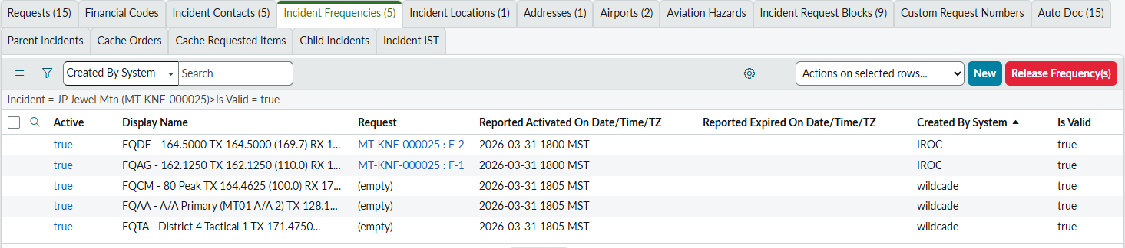
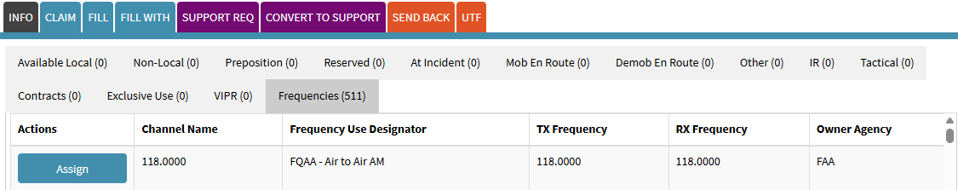
IRWIN v11 – Integrated Frequencies
  Frequencies can also be managed on the Incident Frequencies tab on the Incident in DMT
  National (NIICD) frequencies or frequencies your center doesn’t manage should be ordered through normal channels as F#’s and filled accordingly by the managing dispatch center
Notes:
Kym
Manage Requests – Would be to place up F#
Only NIICD, NOPS, SOPS can fill on the manage request screen

Slide 20
Just released March 31 > Sprint Series 23 [Release 23.1]
  NERV Modal & 2026 Billing Number updated
  Frequencies Management
    Can add integrated frequencies when creating an incident in IROC
    Added a prompt to auto-expire incident frequencies when closing an incident
    Added Request Number column to Frequencies tab on incident in Portal to track the F# requests
    Frequencies will remain attached to the incident when transferring the incident to another center
  Resources
  Can multi select responder quals in DMT to hide or unhide
  Dispatch Managers can only select active Provider Units when accepting resource transfers
Requests
  Dispatchers can only select active Provider Units for temporary resources filled as Fill With Agreement
  Fixed a bug on “Type Any” FWA requests that wasn’t allowing the page to be saved.
Catalog
  Updated the inactivated Aircraft catalog's Frequency category name and all respective aircraft catalog items with an (AC) trailing the names to help differentiate the Aircraft catalog items from the Frequency catalog items for report filtering assistance. For example:
    Aircraft catalog > Frequency (AC) category vs Frequency catalog > Frequency category
    Aircraft catalog > Air to Air (AC) catalog item vs Frequency catalog > Air to Air AM catalog item
Please see IROC Release Notes for more information
Notes:
Julie

Slide 21
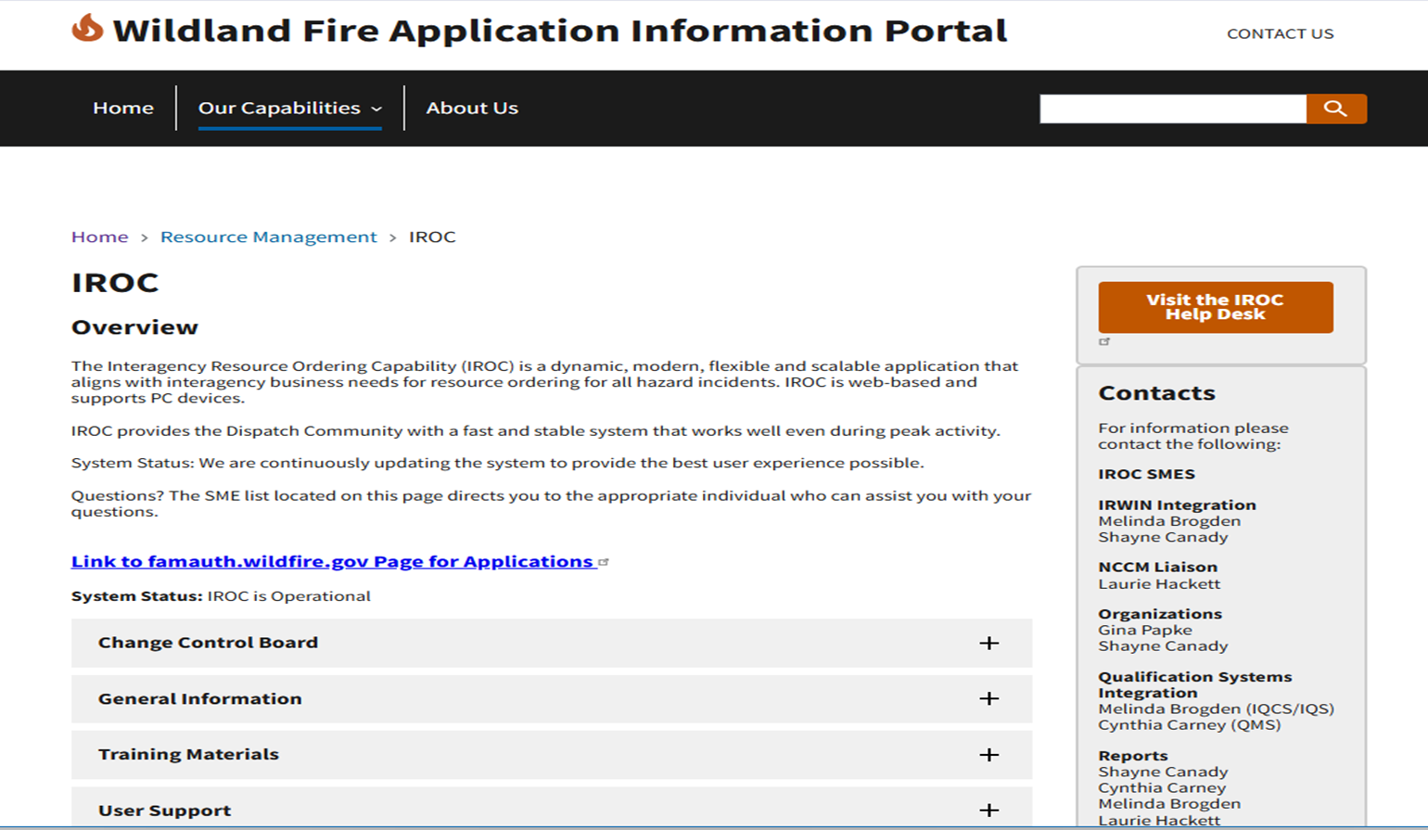
IROC Website
  https://www.wildfire.gov/application/iroc
Notes:
Shayne

Slide 22
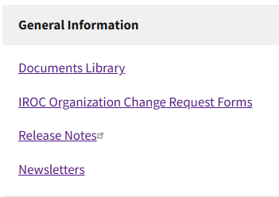
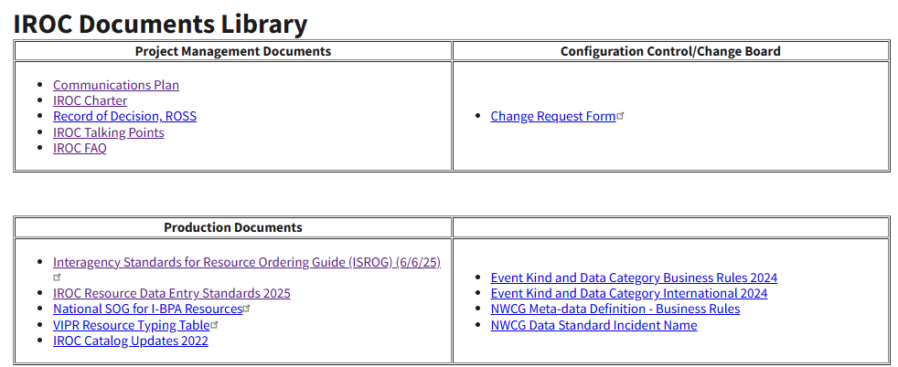
IROC Website
  General Information
Notes:
Shayne

Slide 23
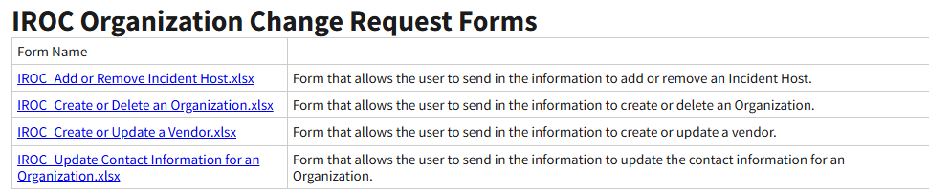
IROC Website
  General Information > Organization Change Request Forms
Notes:
Shayne

Slide 24
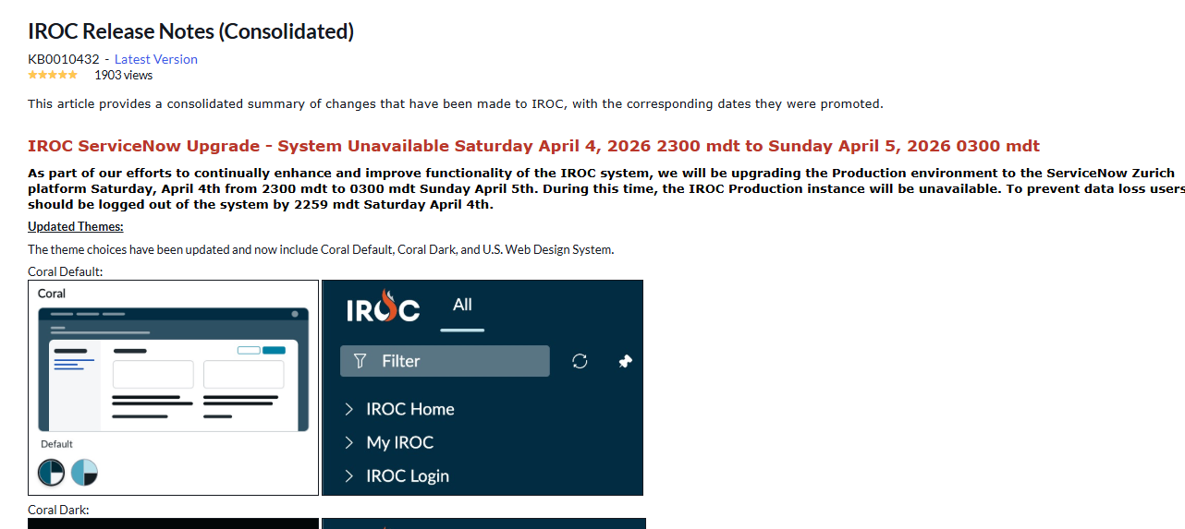
IROC Website
  General Information > Release Notes
  Note, the Consolidated Release Notes are also linked in the upper left menu in DMT & Portal Help – Release Notes
Notes:
Shayne

Slide 25
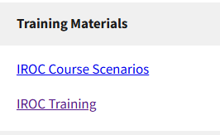
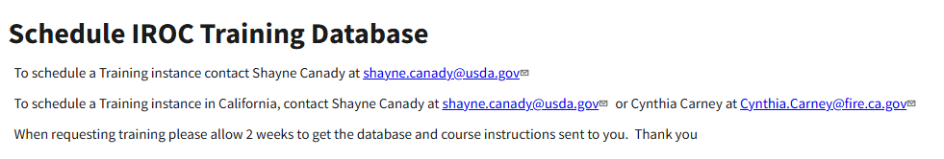
IROC Website
  Training Materials > Schedule IROC Training Database
Notes:
Shayne

Slide 26
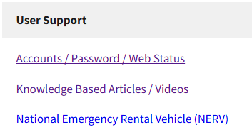
IROC Website
  User Support
Notes:
Shayne

Slide 27
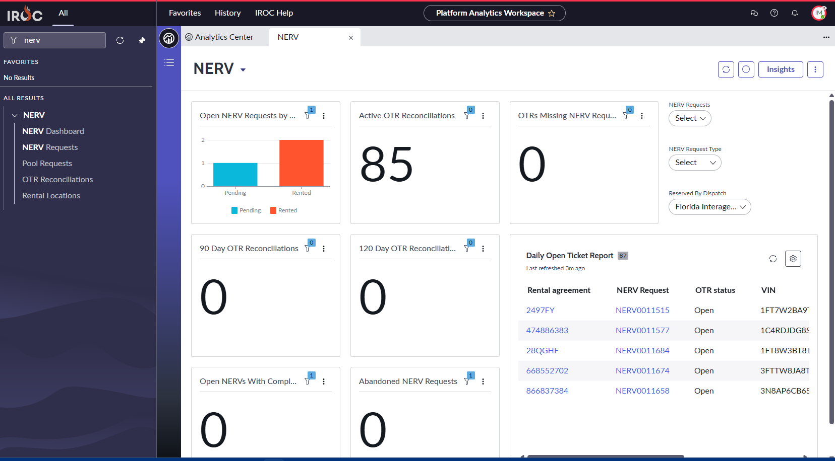
Helpful tool - NERV Dashboard
  How to get there? - Search by “NERV” in DMT filter
Search by:
NERV Request #
NERV Request Type
Reserved Dispatch Center
OTR Reconciliation Report
Notes:
Julie

Slide 28
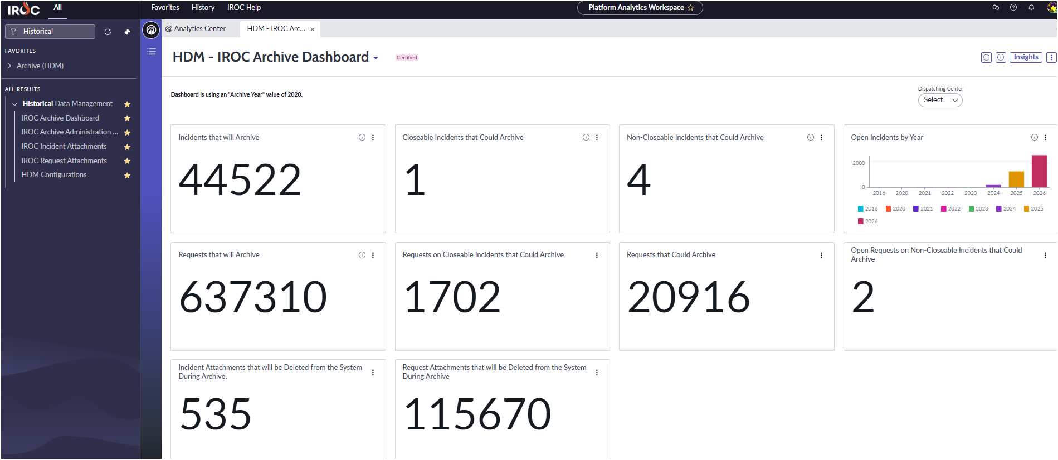
Helpful tool – Historical Data Management (HDM) Dashboard
  How to get there? - Search by “Historical” in DMT filter
Filter by Dispatch Center
Historical Data Management
Notes:
Julie

Slide 29
Thank You For Your Time

