Slide 1

InFORM – CDAT - 2026 Overview, Updates, Data & Statistics
Julie Osterkamp
USWFS InFORM Business Lead
NWCG Fire Reporting Subcommittee Chair
NWCG Geospatial Subcommittee Member
GISS on IMTs for 19 Years
Day Job: USWFS National Fire Geospatial Analyst, NIFC
Notes:
What kind of experience with InFORM
What agencies in the room

Slide 2





Overview
Interagency Fire Occurrence Reporting Modules (InFORM)
InFORM is the final fire reporting application used by all five federal fire management agencies and 16 state fire management agencies (so far).
Most other applications are for operational reporting, data exchange, ordering, information sharing, etc. (WildCADe, WFDSS, IROC, IAA, EGP, SIT-209)
InFORM is the application used for fire data QA/QC and certification after the operational phase of a fire is over.
Operational fire data is fed into InFORM via IRWIN and then is QA/QC’d, Certified, and becomes final fire data.

Slide 3
Some Recent’ish Updates
Merge Records: Previously had capability to splice duplicate records. New capability to merge incidents that merged on the landscape (make two records become one) so acres are not double counted. Splice and merge two different operations. (Merges come from IRWIN as a relationship between two records, but both records still exist).
Initial Response Agencies: new field that shows every agency that IA’d a fire. So can query for “all fires USFS IA’d”, etc.
Agency acres burned fields for each fire. How many acres of each agency’s lands burned within each fire (16 different fields).
Bulk Uploaded Records vetted for duplication much better and not allowed in. Also, no records allowed in with Incident Size NULL or 0.
Notes:
Mention new devs (Innovate, same as IRWIN) and reduced budget. Slow moving in smashing bugs and bringing enhancements because of reduced budget, but still amazing group to work with.

Slide 4
InFORM Demo
Notes:
Fed by operational data but can be updated.
Note colors of dots
Note incident sorting
Note number of records at top
Mention Resetting Filter
Show layers including user layers
Open Kayne 2026-MTBIP-000086
Mention Required Fields and auto derived
Show initial response agencies table
Show perimeter ownership breakdown
Show site descriptors spinning
Show fire cause
Open March 2026-MTLG09-000053
Show edit log
Mention ready to be certified (PoO cannot be outside perimeter, ownership acreage breakdown total cannot be >10% different than Incident Size)
Filter for 2024
Show filtering for data source = IRWIN
Show Monkey Creek 2024-ORPRD-050265
Show Merge details
Show Report
Show Pale Horse Fire 2025-OKOKS-250979 and splice

Slide 5
InFORM Hub
InFORM Hub
Contacts Tab: This is who you contact to get a new user account or update your privileges.
Known Issues Tab: Updated weekly with known bugs and issues. Check here first.
Change Log: All enhancement requests and bug fixes that have been processed and with which version.
Notes:
Mention best way to get help, upgrade roles, get new user accounts is to contact your state or region InFORM User Mgr.
Mention the National Business Leads at the bottom and to go to them direct if you can’t get ahold of your state/regional User Mgr. Great group of people always willing to help.

Slide 6
InFORM Roles
User roles:
Viewer: anyone who wants it who has a NIFC AGOL account.
Mobile Editor: anyone who wants to collect perimeter data out in the field; role grants them access to InFORM Mobile map to be used in Field Maps app. (note: many other ways to collect perimeters in the NIFS with local/state Field Maps maps)
Editor: all SMEs involved in a fire or a fire management unit who have information to QA/QC within a final fire report. Could be dispatchers, other SMEs, ICs, Fire GIS Specialists, Fire Planners, Divs, FOBS, etc. Often is dispatchers solely because they care about the data.
Certifier: dictated by agency policy.
BLM: District FMO
USFS: District FMO
USFWS: FMO/AFMO (not strict)
NPS: FMO
BIA: Typically, Field Level FMO (not strict)

Slide 7
Operational Fire Data vs Final Fire Data
It is OK to have operational fire data and final fire data and for them to have different values for data elements 😬.
Final Fire Data (InFORM FODR currently) is authoritative for:
Federal agency (and 16 states) acres burned
Federal agency (and 16 states) fire count
Fire cause (not trespass)
Fire occurrence chronology (start date, control date, etc)
Point of Origin location
When to use operational data:
Dispatch center workload
Fire chronology with resource assignments
What information was known during the operational phase of the fire
Best estimate out there of what happened yesterday (SIT-209 data)
Notes:
Mention Microsoft Data Engineers
Mention Deb Hammil and the Solicitors

Slide 8
Data Elements
Unique Operational Fire Occurrence Data Elements
Fire Behavior
Fire Strategy Confine or Full Suppression Percent
Fiscally Responsible Unit
ICS209 Remarks, Report Date Time, Status
Initial Response Acres
Is Multi Jurisdictional
Is Unified Command
Percent Perimeter to be Contained
Poo Legal Description Section, Township, Range
Total Incident Personnel
Weather Concerns
WFDSS Decision Status
Unique Final Fire Occurrence Data Elements
Acres BIA, BLM, NPS, USFS, USFWS, Private, State, etc.
Initial Response Agencies (single quarriable field)
Fire Cause General
Fire Cause Specific
Fire Cause Specific Detail
Fire Cause Activity Group
Fire Cause Age Category

Slide 9
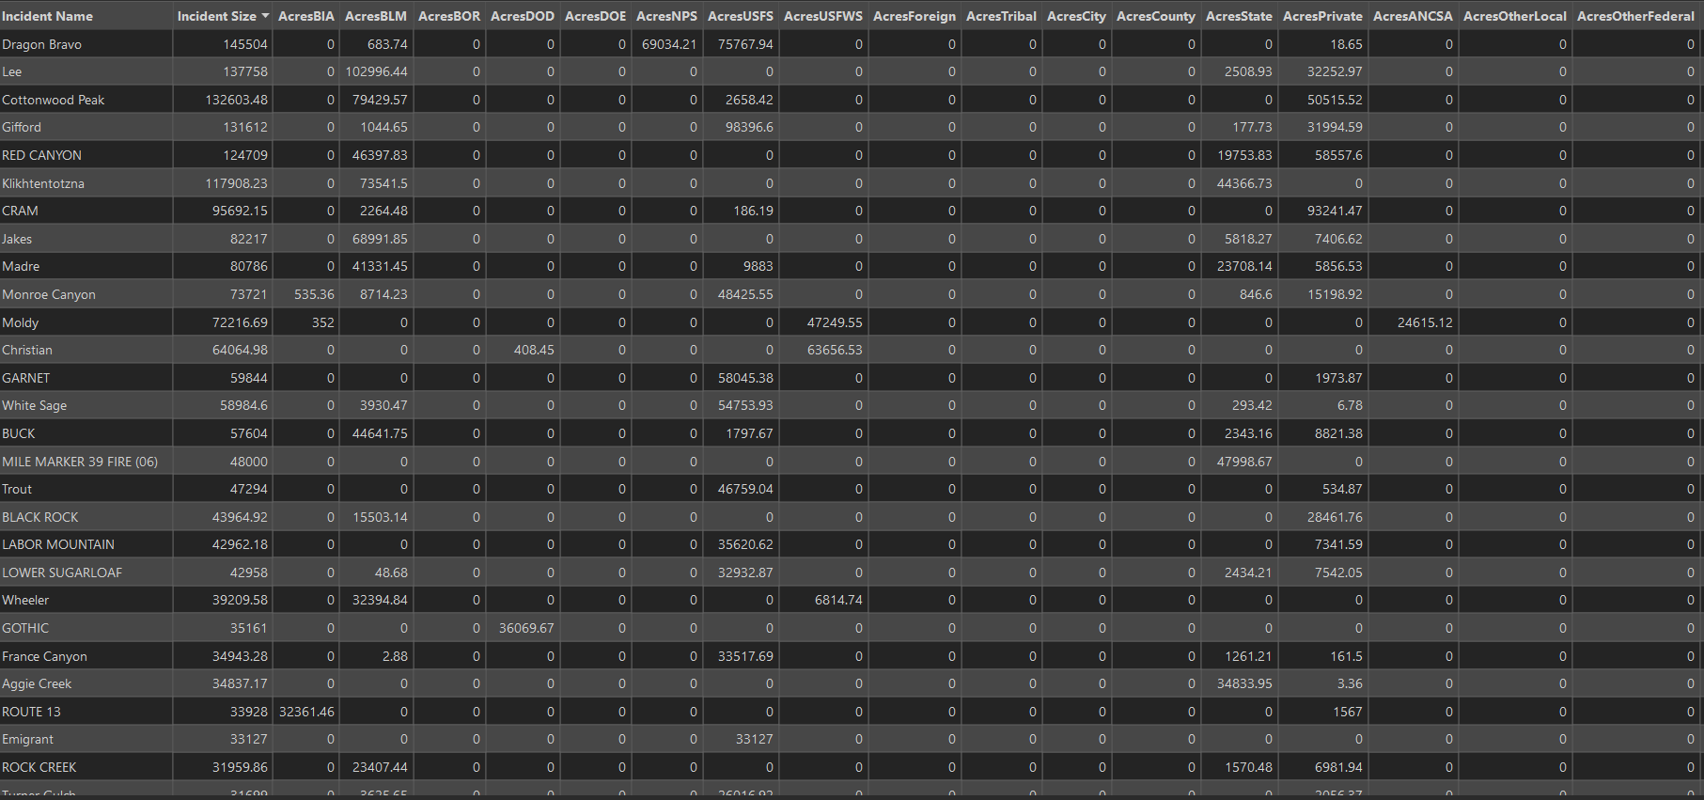
Notes:
Especially amazing to me as a GIS Specialist.
Every single fire even those without a perimeter.

Slide 10
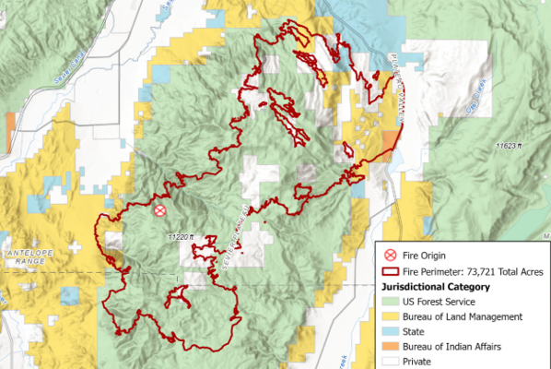
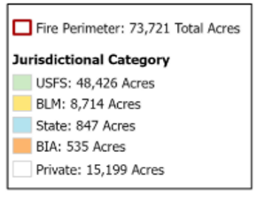
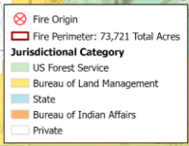
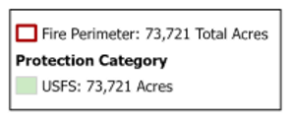
Acres Tabulation Differences
1. Acres Burned By Jurisdiction
Use the Acres BLM, Acres USFS, Acres NPS, etc. fields to see each agency’s acres burned. These fields are populated by intersecting the fire perimeter with the Jurisdictional Agency layer.
Accurate Acres Burned on the Ground
2. Acres Burned By Protection at Point of Origin
Identify the point of origin Protecting Agency, use field Incident Size showing total acres, assign all acres to that agency. This method will give the total amount of acres for fires under that agency’s protection.
Notes:
Mention NICC Annual Report and tables at the back of the IMSR (or SIT Report)
Monroe Canyon

Slide 11
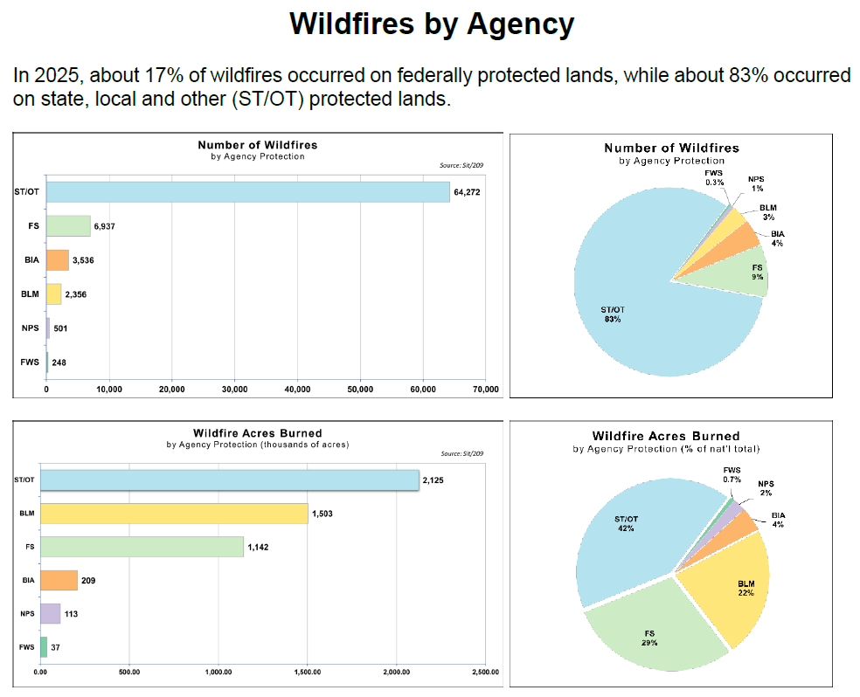
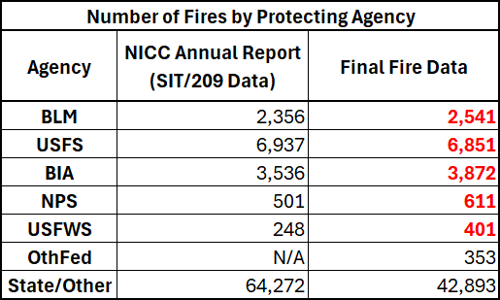
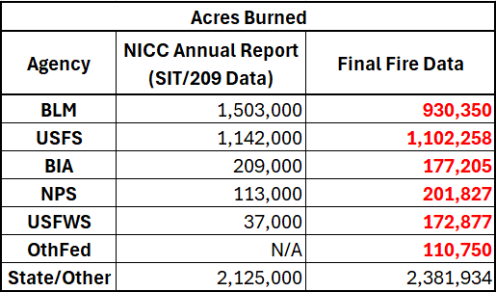
Increasing Data Literacy in What We Report
Red Text = Authoritative

Slide 12
How to Get Statistics from Final Fire Data
If final fire data is authoritative, where is the report?
2025 NIFC Final Wildfire Statistics Annual Report: Interagency Summary of Occurrence and Acres Burned prototype out any day now from FRSC.
Will sum stats by agency, state, GACC, etc.
Prototype because FRSC will be no longer (becoming IRSC) and USWFS will be new Protecting Agency and will the new GAs be the same as the GACCs?! 2025 is a terrible year to shoot for consistency in the future.
Many dashboards out there showing Final Fire Data stats.
2025 NIFC Final Wildfire Statistics Annual Report Dashboard
FRSC Fire History Dashboard 2020 - Present
Final Fire Data is publicly available on the NIFC Open Data Site for download as csv or can do directly through InFORM. Follow directions within SOPs in NWCG FRSC Wildfire Data User Guide.

Slide 13


Wildfire Data User Guide
NWCG FRSC Wildfire Data User Guide
SOP Acres Burned
SOP Fire Count
SOP Cost
SOP Resources
Fire Occurrence and Perimeters
Acres Tabulation Differences

Slide 14
Wildfire Data User Guide Bulk Uploaded Records
Very important when talking about InFORM Data: Bulk Uploaded Records.
Wildfire Data User Guide talks a lot about these.
Take very careful note of Created by System = Bulk Uploaded Records (within InFORM FODR). They are not authoritative records within InFORM and should often just be filtered out. Note this in any reporting you do.
Bulk Uploaded Records are a thorn in the side of InFORM FODR data, they are of very low data integrity, often “outside” fires in the middle of cities and contain many duplicates.
Amazing things are happening to get rid of this issue. NERIS is the new state/local/rural fire reporting system and all data will now come from NERIS instead of Bulk Uploads and NERIS might possibly integrate with IRWIN.

Slide 15
The End
Please use the Contact Tab on the InFORM Hub to reach out to your Agency Reps with any questions. Feel free to reach out directly to me too.

