Slide 1
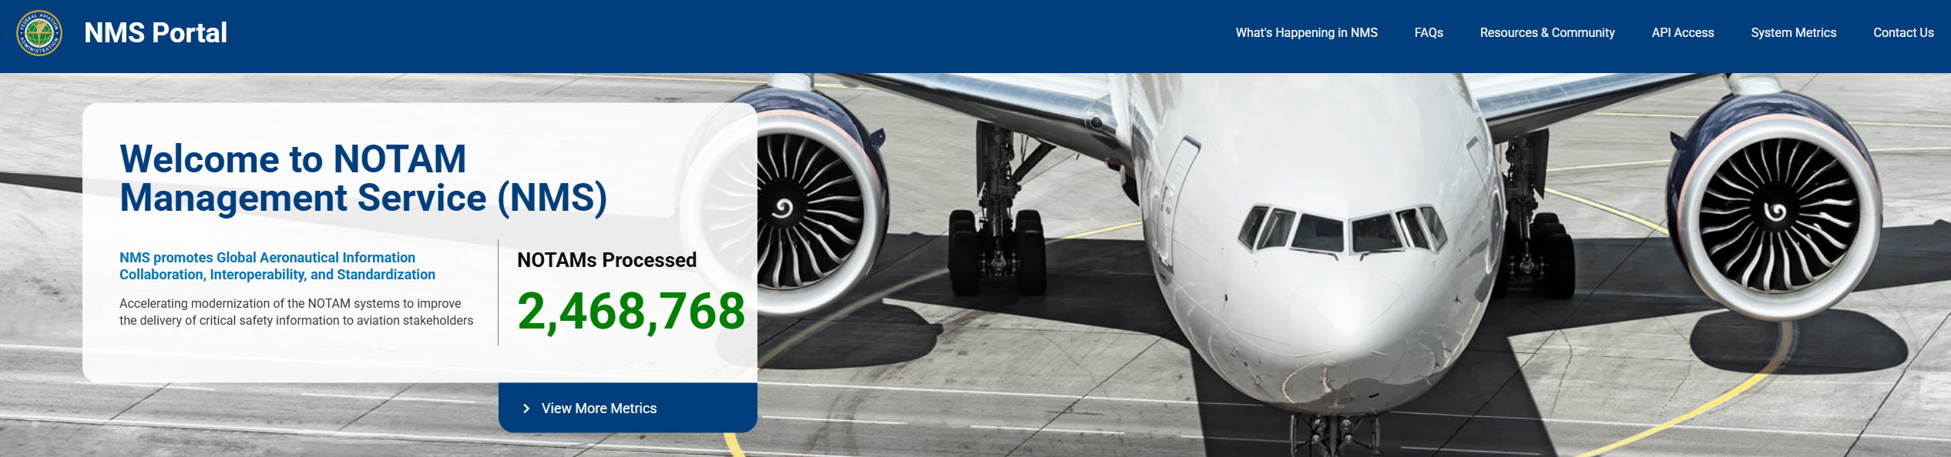
NOTAM Management Service (NMS)
Notes:
Welcome to NOTAM Management Service. Let me begin with this: I am not a spokes person for the FAA. This is from my lens as the National Airspace Coordinator. For those who don’t know me I’m Kim Owczarzak. Initially when I began hearing about NMS I thought it was going to be an application to replace NES, our current system to originate NOTAMs. Well, it is that, but I am learning that it is so much more. I believe today we will only begin the conversation on what NMS can potentially do for us. It also offers us a glimpse into the FAAs larger modernization efforts. I’m excited to be here, and I’m also very encouraged by the number of you all that are interested in AIRSPACE!

Slide 2

Overview of NMS
The NOTAM Management Service (NMS) is the FAAs new platform designed to replace the legacy U.S. NOTAM System, which was originally built in 1985
Notes:
The new service is securely hosted in the cloud with a streamlined interface, has a scalable and resilient architecture to accommodate current and future needs. It provides near-real-time data exchange, enabling efficient data flows and better stakeholder collaboration. The new system transforms the management of aeronautical information and supports the FAA's mission to improve airspace safety and efficiency.
The FAA's NMS migrates functionality from legacy systems (including FNS) to a single modernized platform with structured data formats and improved reliability.

Slide 3
NMS Key Features
Cloud-based and resilient architecture
Near-real-time data sharing
Graphical display and improved usability
Scalable for future needs
NMS will become the sole authorized source for all U.S. NOTAMs
Notes:
Key Features
Cloud-based and resilient architecture: Reduces system downtime and improves reliability compared to the legacy system.
2
Near-real-time data sharing: Enables faster dissemination of critical safety alerts, such as runway closures, airspace restrictions, and temporary hazards.
1
Graphical display and improved usability: Makes it easier for pilots, dispatchers, and other users to access relevant NOTAM information.
1
Scalable for future needs: Designed to accommodate growth in aviation operations and evolving technology requirements
NMS will become the sole authorized source for all U.S. NOTAMs.
The FAAs NMS represents a major modernization of the U.S. NOTAM system, providing a centralized, reliable, and efficient platform for distributing critical flight safety information to the aviation community.
I am excited to introduce it to you today.

Slide 4
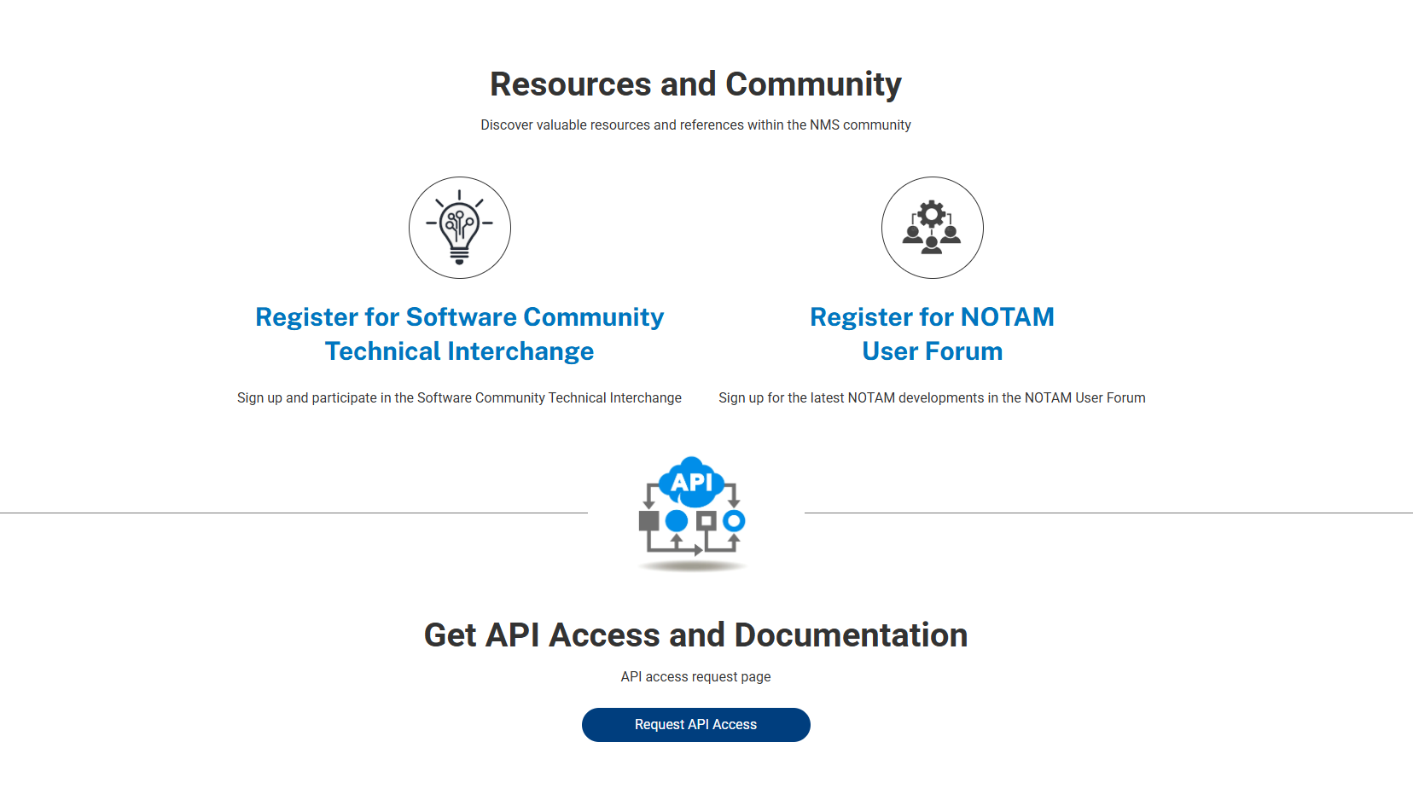
NMS Portal
What’s happening in NMS
System Metrics / Getting started

Slide 5
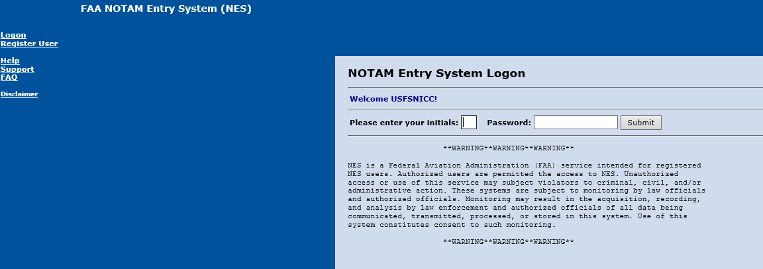
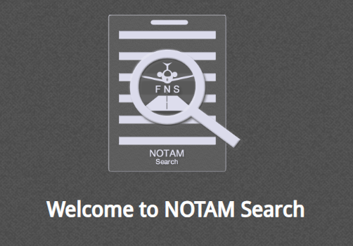
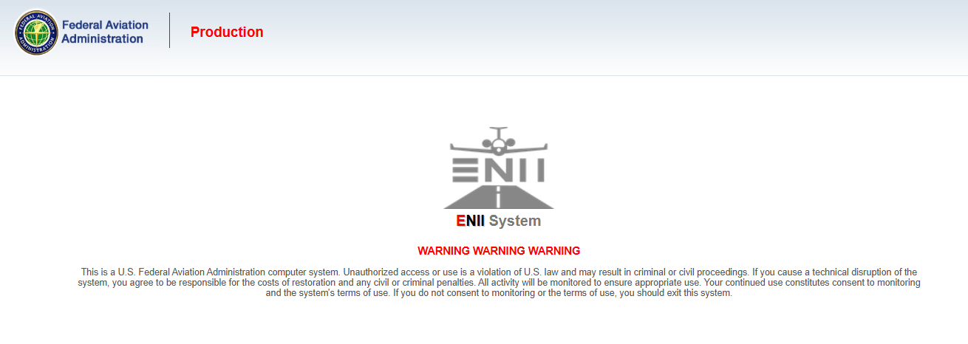
Systems that will be or have been deprecated
NOTAM Entry System (NES)
ENII
Defense Internet NOTAM Service
FNS NOTAM Search

Slide 6
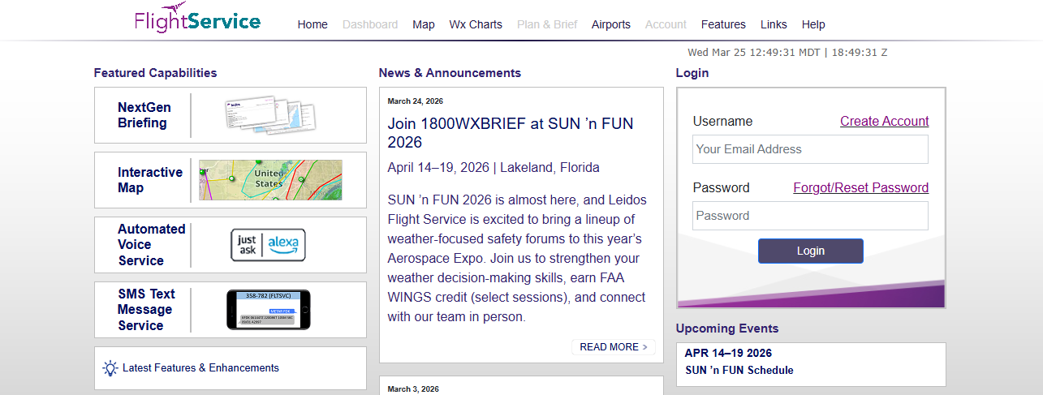
1800wxbrief.com is NOT going away
Notes:
This site will tie into the NMS API for authoritative data regarding NOTAMs

Slide 7
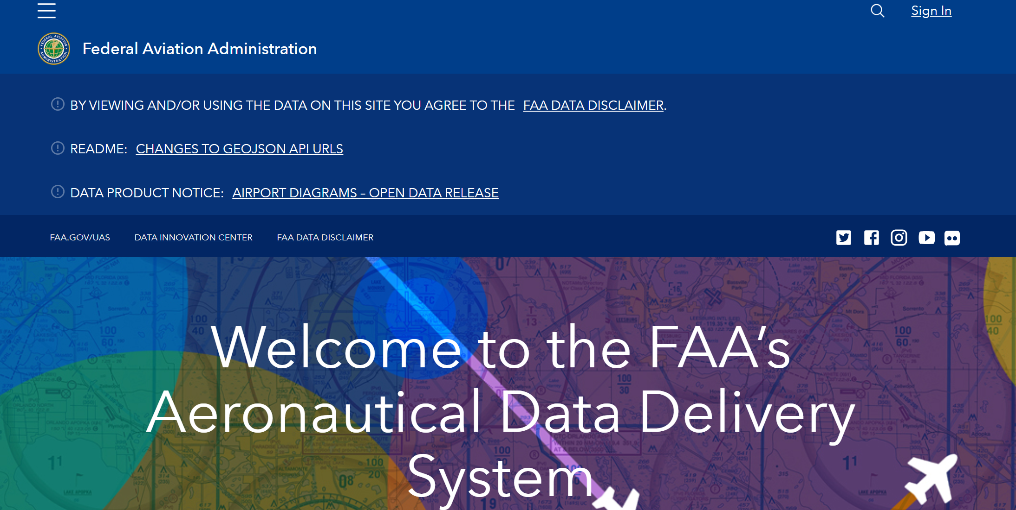
FAA Opendata is NOT going away
https://adds-faa.opendata.arcgis.com/maps/faa::vfr-sectional/about https://adds-faa.opendata.arcgis.com/datasets/dd0d1b726e504137ab3c41b21835d05b_0/about https://adds-faa.opendata.arcgis.com/datasets/faa::mtr-segment-1/about https://adds-faa.opendata.arcgis.com/datasets/faa::airports-1/about https://adds-faa.opendata.arcgis.com/datasets/faa::navaid-system/about
Notes:
NMS is specifically for NOTAMs and will become the authoraitive data source for all NOTAMS. The FAA has confirmed that it does not replace FAA Open Data arcgis URLs
WildcadE was concerned with : https://adds-faa.opendata.arcgis.com/maps/faa::vfr-sectional/about
https://adds-faa.opendata.arcgis.com/datasets/dd0d1b726e504137ab3c41b21835d05b_0/about
https://adds-faa.opendata.arcgis.com/datasets/faa::mtr-segment-1/about
https://adds-faa.opendata.arcgis.com/datasets/faa::airports-1/about
https://nifc.maps.arcgis.com/home/item.html?id=ea60ee8621204a81be945c9382b5a83b
https://adds-faa.opendata.arcgis.com/datasets/faa::navaid-system/about

Slide 8
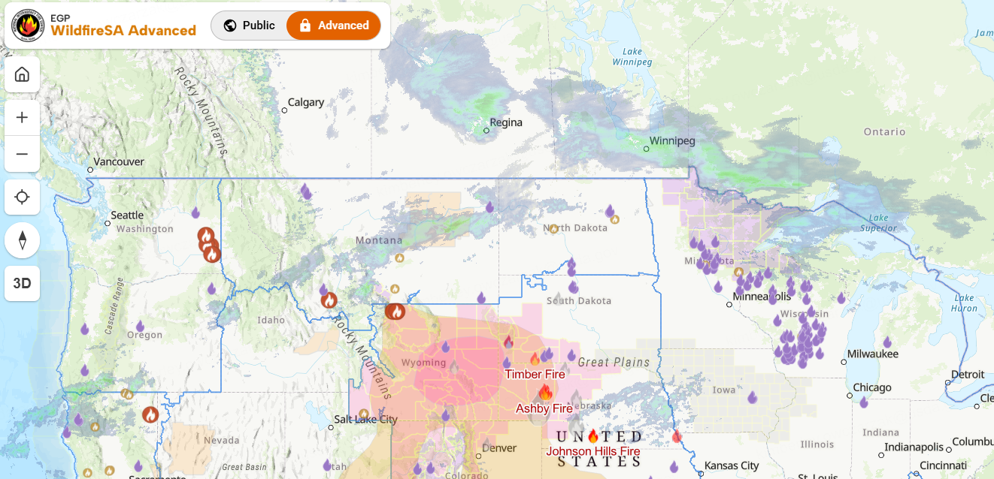
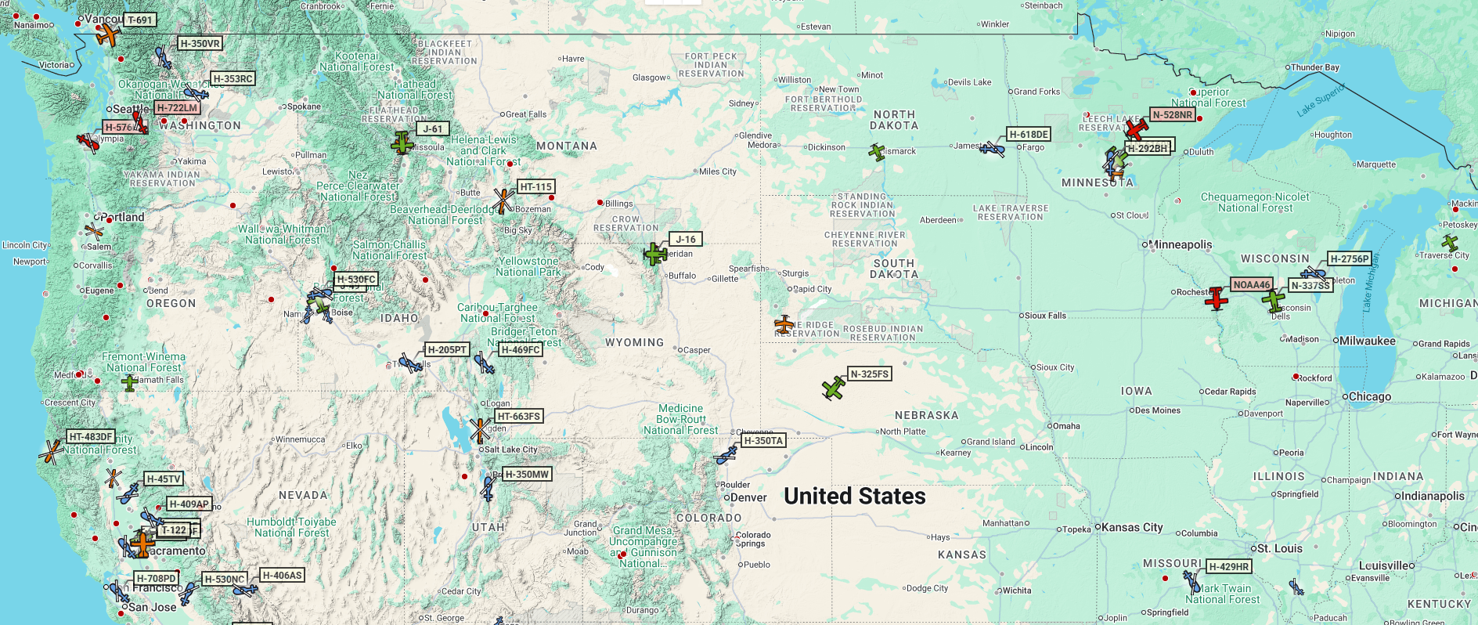
Applications that could use the NMS API
AFF
EGP
ASCOs
KEY API Capabilities & Data
Real-Time NOTAMs
Data Formats – JSON, GeoJSON, and AIXM
Easier to automate than older text-based formats.
API has been available since late 2025!
Notes:
For dispatchers the API could provide geospatial translation / clarity for all NOTAMs - not only TFRs, thereby increasing situational awareness for airspace coordination and airspace deconfliction.
Potentially it could reduce the cognitive load and help us quickly assess the spatial impact of multiple NOTAMs, instead of needing to use multiple disparate applications for decision making and situational awareness.
ASCOs are currently delving into how the API can be used with 3rd party programs currently being utilized, such as building TFR layers, building GPS Interference NOTAM layers, building DROTAM layers, enhancing SA, reducing cognitive load, for better decision making!
As we seek to enhanced performance and gain efficiencies through our applications, I believe use cases for the API will become clear.

Slide 9

NMS Familiarization For Originators
Notes:
As you can see the NOTAM MANAGEMENT SERVICE isn’t one thing, like the NOTAM ENTRY SYSTEM (NES) is/was.
This is all new news – any Great Heights Pod Cast fans out there? It’s time for New News – NES will be replaced with NMS on April 18th.
Let’s switch gears and get familiar with NMS Common Functions for originating TFRs. Rember this is not meant to be a hands-on training course but an introduction to NMS.

Slide 10
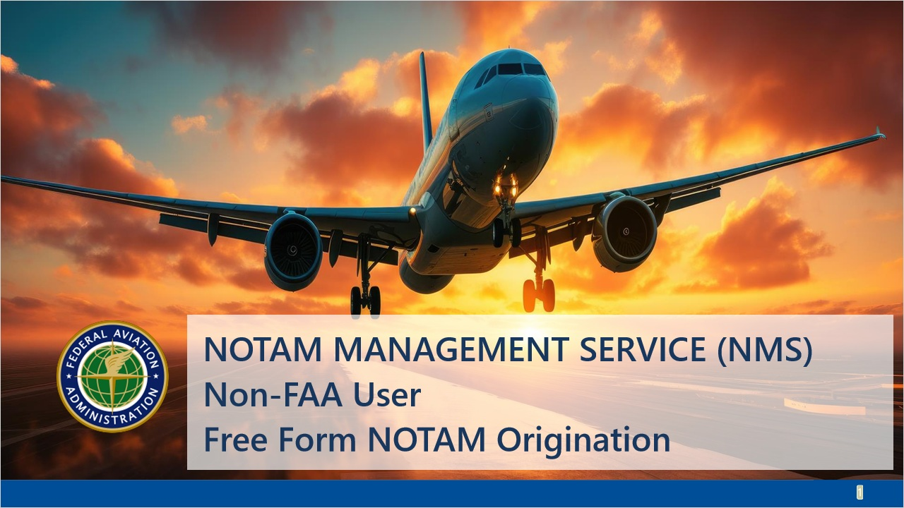
NMS / NES Built different
Flat Organization across LMAs vs. Certificate for each GACC
Robust Mapping in NMS vs degraded Mapping over the past few years in NES
Robust Features vs. NES > Draft > Preview >Submit

Slide 11
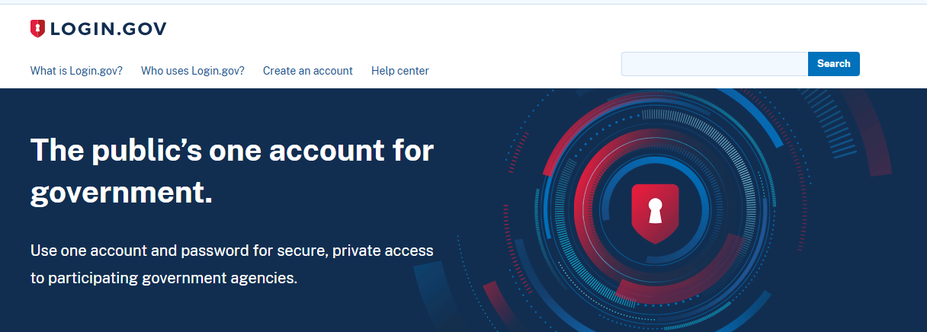
New Login Requirement – Login.gov
Secure Single Sign-on
No certificate required

Slide 12
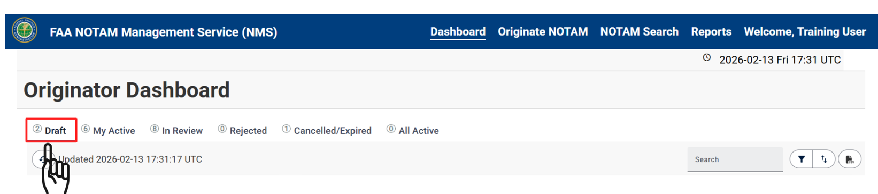
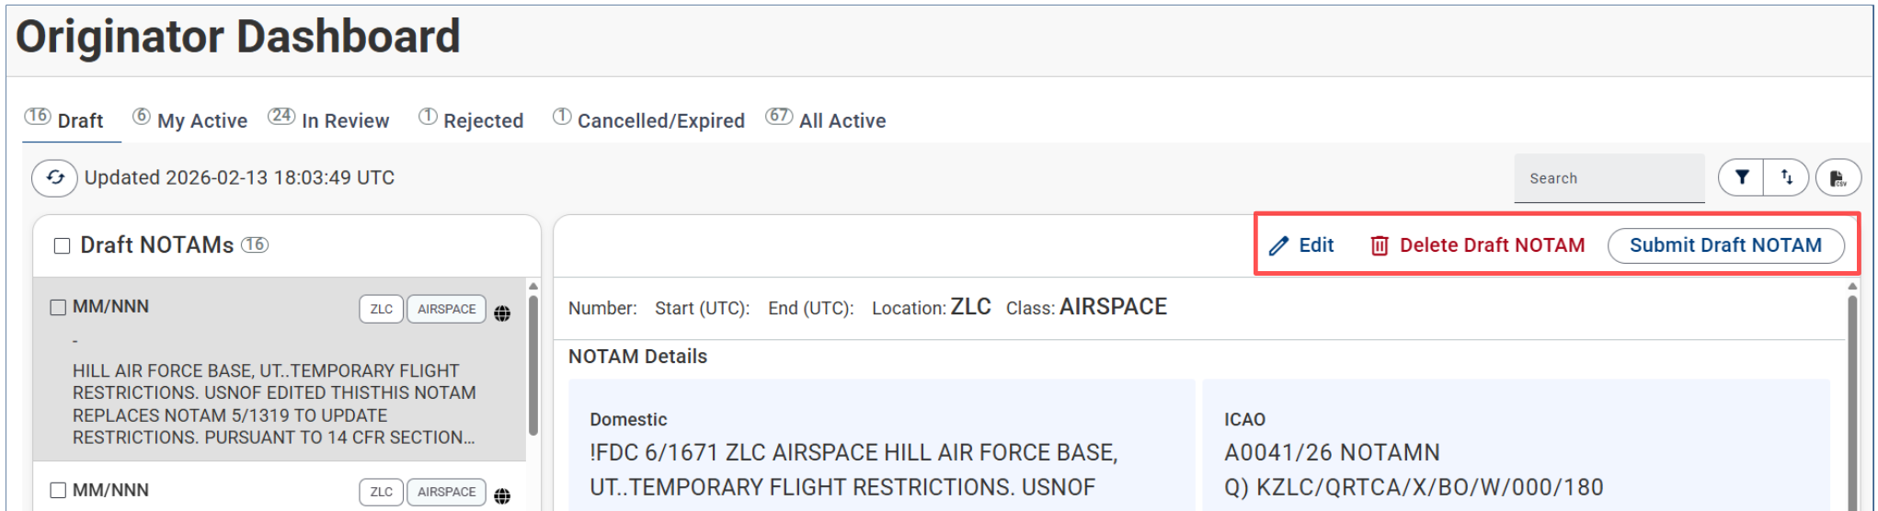
Common Functions in NMS
Notes:
Draft Shows Draft NOTAMS created and saved by originators across your organization – From here you can edit, delete or submit the TFR across our user group.

Slide 13
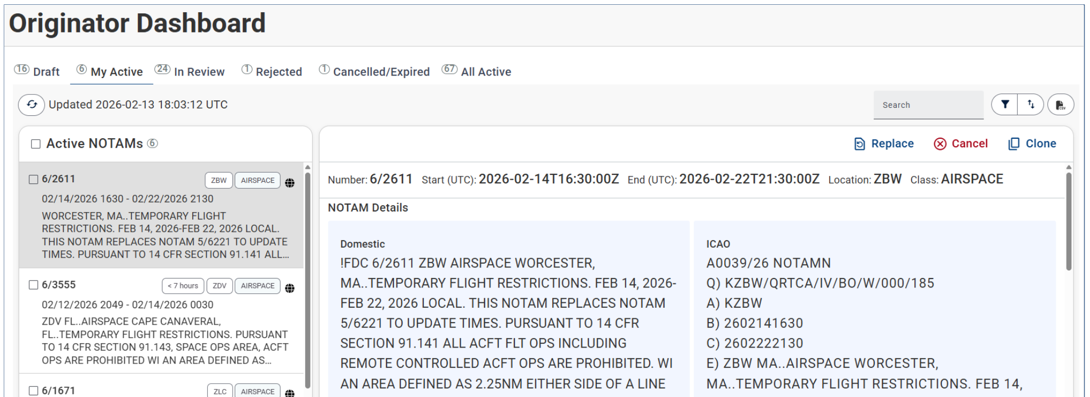
My Active Tab
Notes:
In the My Active Tab this shows NOTAMs across your organization that have been published, that are not cancelled or expired and NOTAMs that have a start time in the future. Essentially, when the TFR is published it will be in the My Active Tab.
In the My Active Tab, you can Replace the NOTAM to change it’s start or end time. You can also cancel the NOTAM in the My Active Tab and you clone the NOTAM as well.

Slide 14
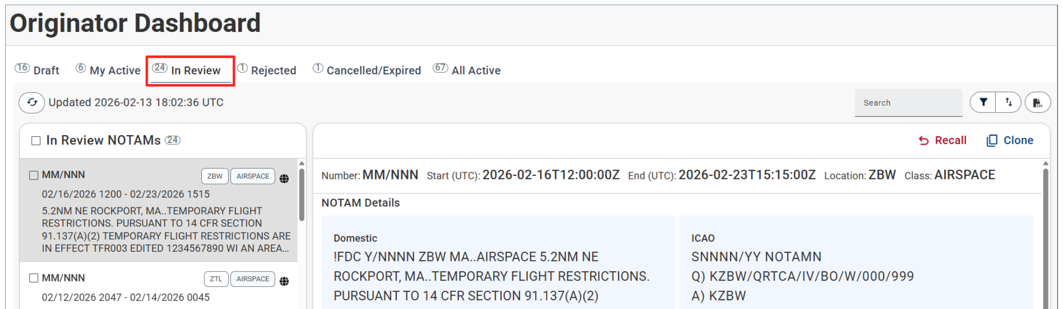
In Review Tab
Notes:
In the In Review Tab, you can review NOTAMs across your organization that are in Review by the ARTCCs, these drafts are not yet published, since they are not yet published and in the review phase by the ARTCC you can Recall the NOTAM to remove it from the ARTCC.
Or Clone the NOTAM to create a Draft based on the NOTAMs content.

Slide 15
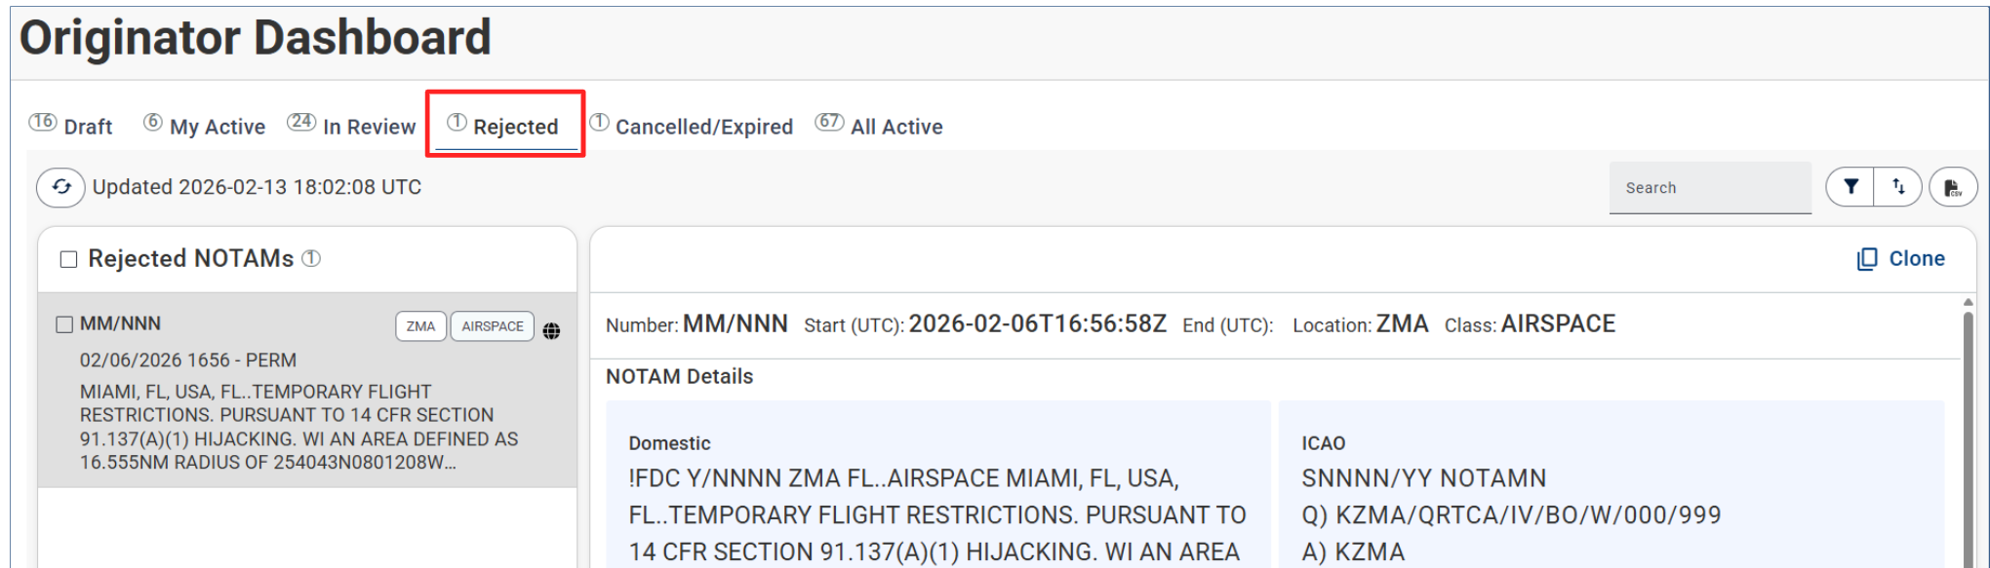
Rejected Tab
Notes:
If a NOTAM across our user group has been Rejected it will appear in the Rejected Tab, it will remain in the Rejected tab for 72 hours and will contain notes on why it was rejected.

Slide 16
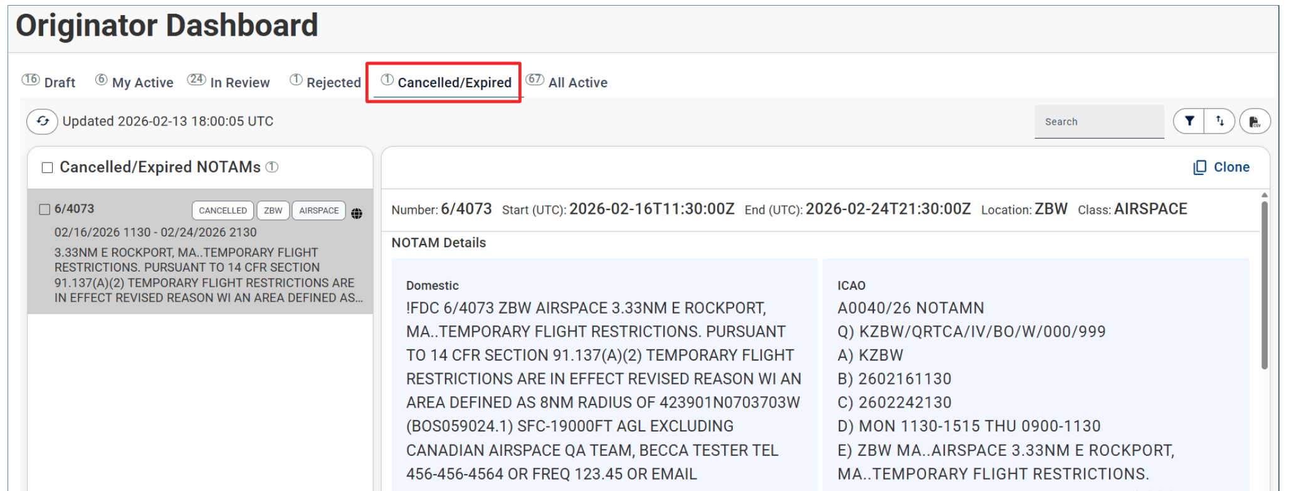
Cancelled / Expired Tab
Notes:
The Cancelled / Expired tab shows NOTAMs that have been cancelled by you or others in your organization in the past 12 hours.

Slide 17
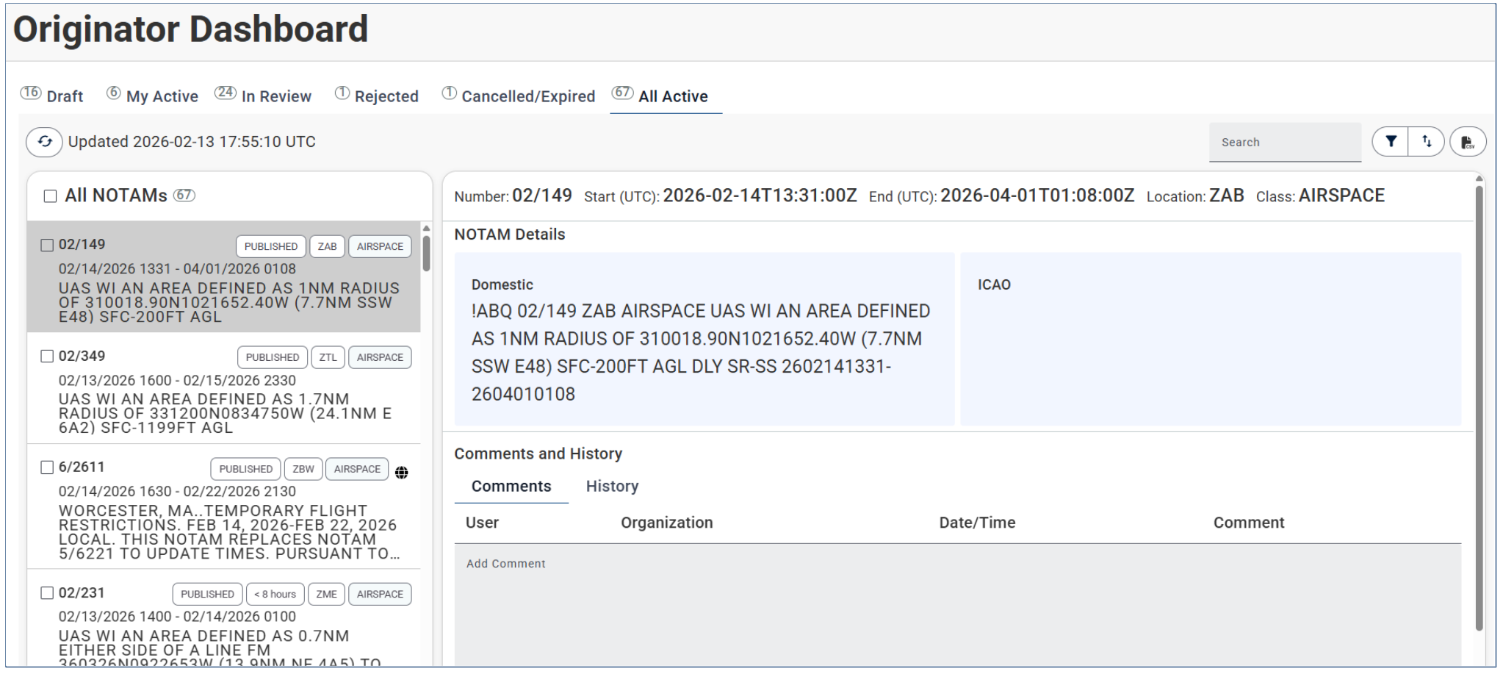
All Active Tab
Notes:
Displays all active NOTAMs and may contain NOTAMS across all organizations for your locations that you have the authority to originate NOTAMs. No Actions can be taken from the All Active Tab.

Slide 18
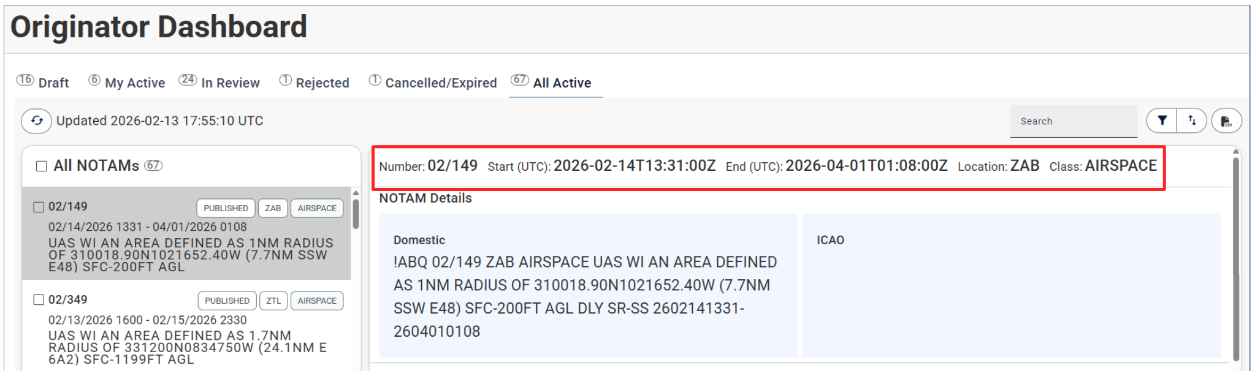
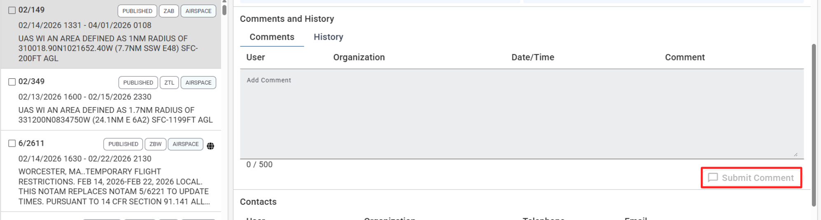
NOTAM Details
Notes:
NOTAM NUMBER, Period of Validity, Location and Class: All TFRs have the keyword “Airspace”
You will also see the Details for your you NOTAM in Domestic and ICAO formats.
Scroll down and you will be able to see Comments, and add comments, to add a comment you need to submit the comment.
You can also review the History.

Slide 19

NMS in Review
Authoritative Data Source
Cloud based
Near-real-time date
API
Replaces NES / DINS / ENII
Potential uses
Getting familiar with the Originator dashboad

Slide 20
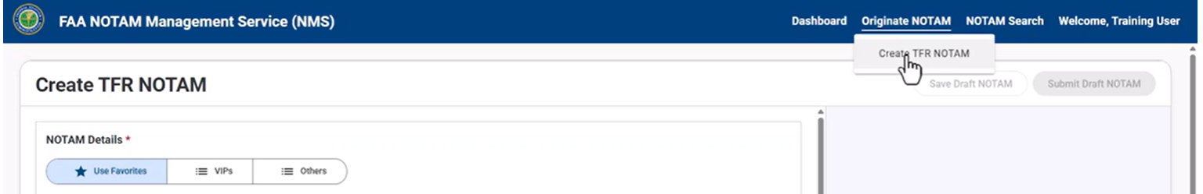
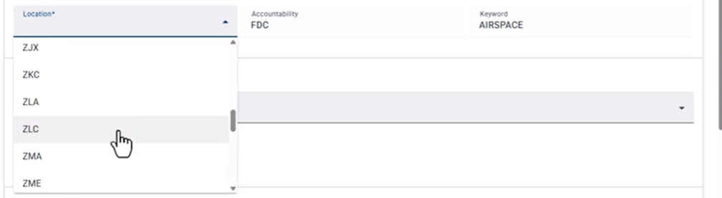

How To Originate a TFR NOTAM

Slide 21
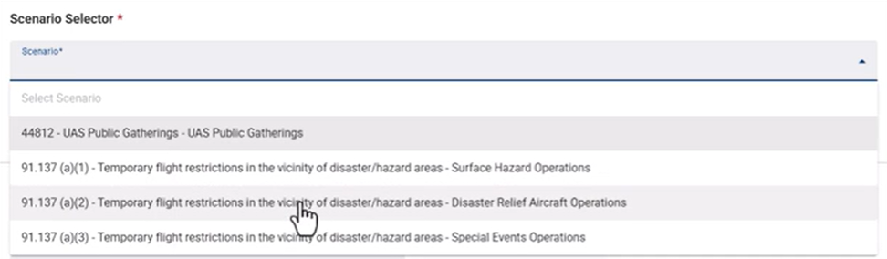
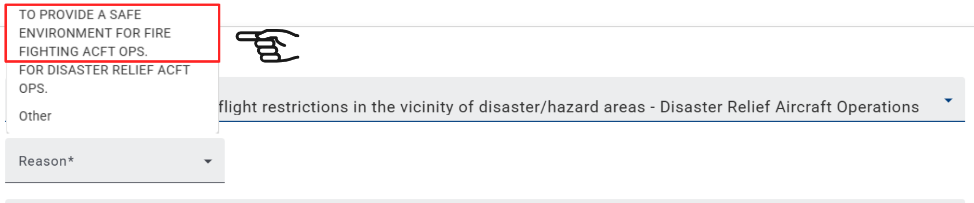
Scenario / Reason / Name

Slide 22
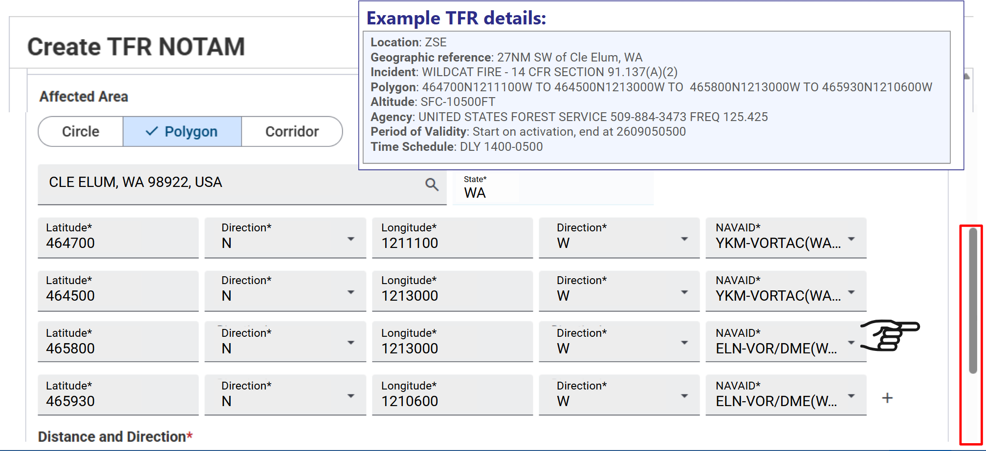
Affected Area

Slide 23
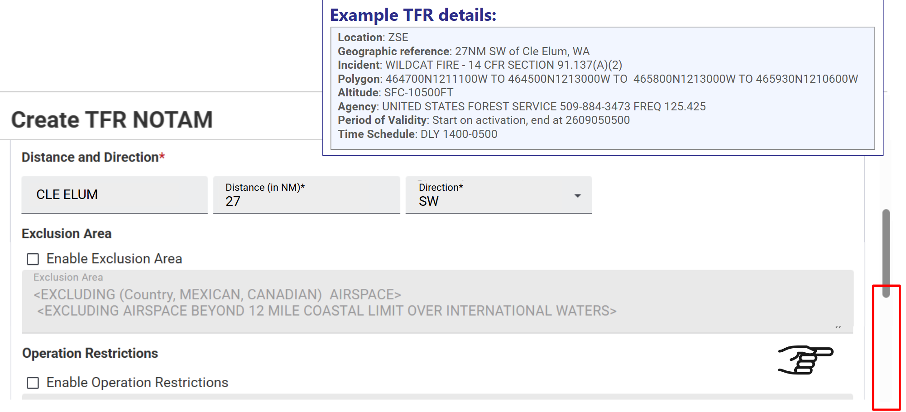
Distance and Direction

Slide 24
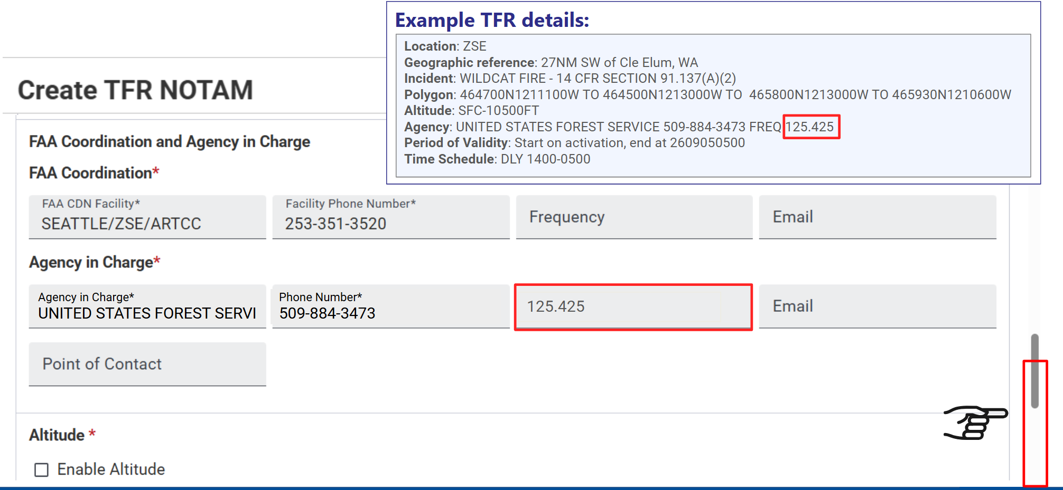
FAA Coordination Facility

Slide 25
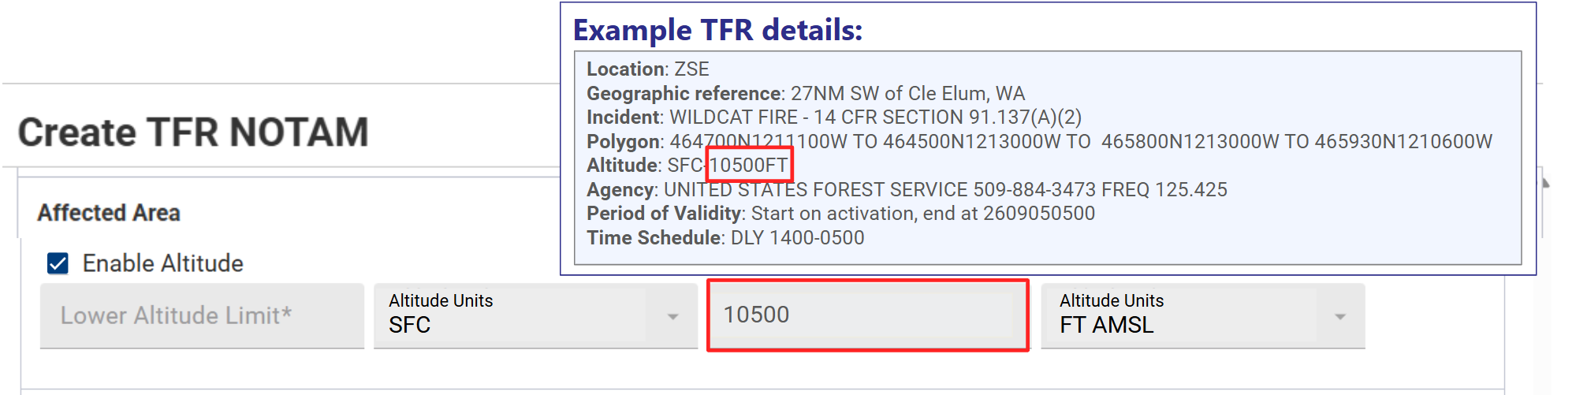
Altitude

Slide 26
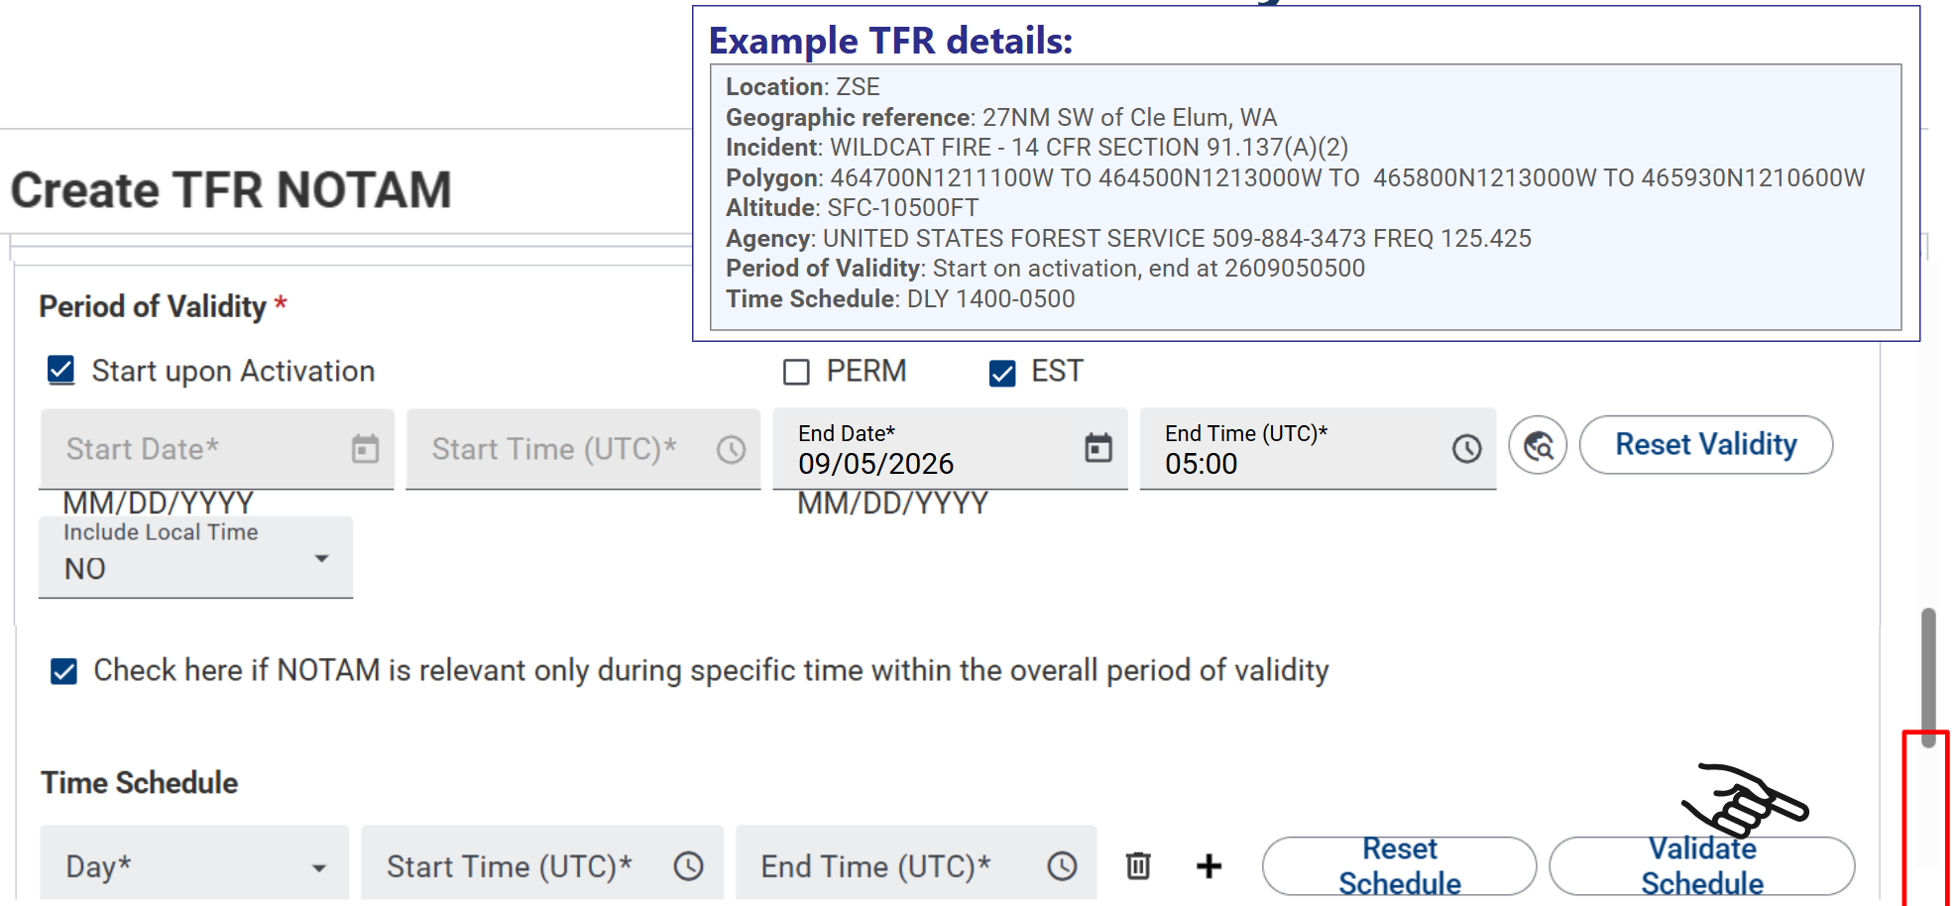
Period of Validity

Slide 27
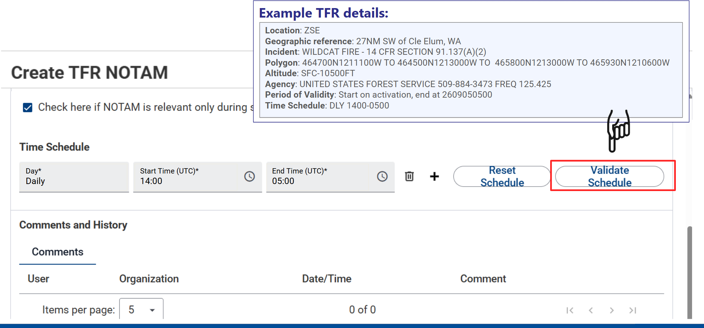
Time Schedule

Slide 28
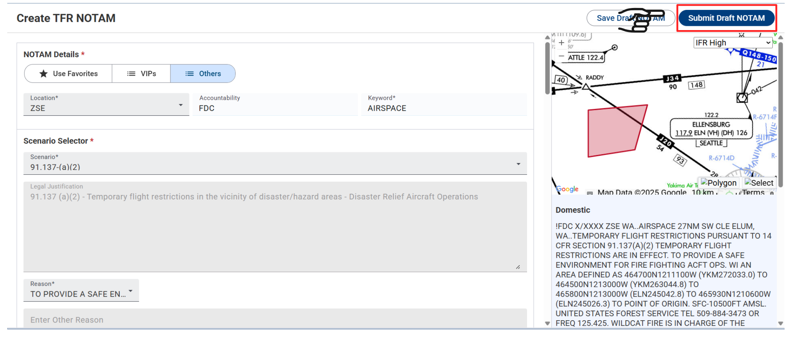
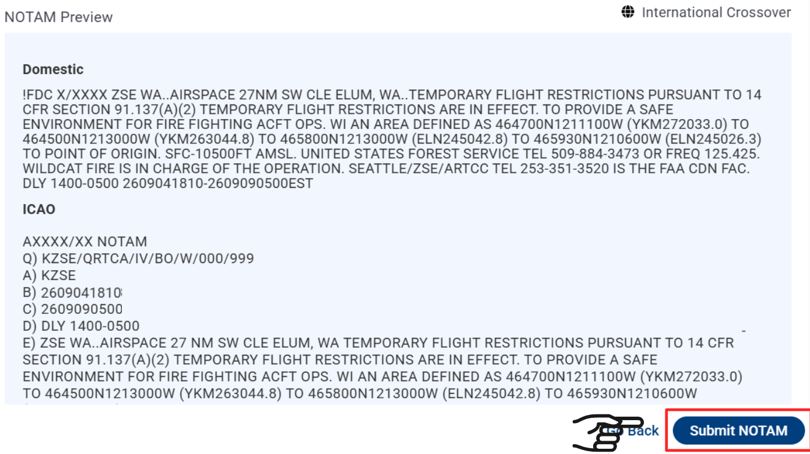
Submit TFR

Slide 29
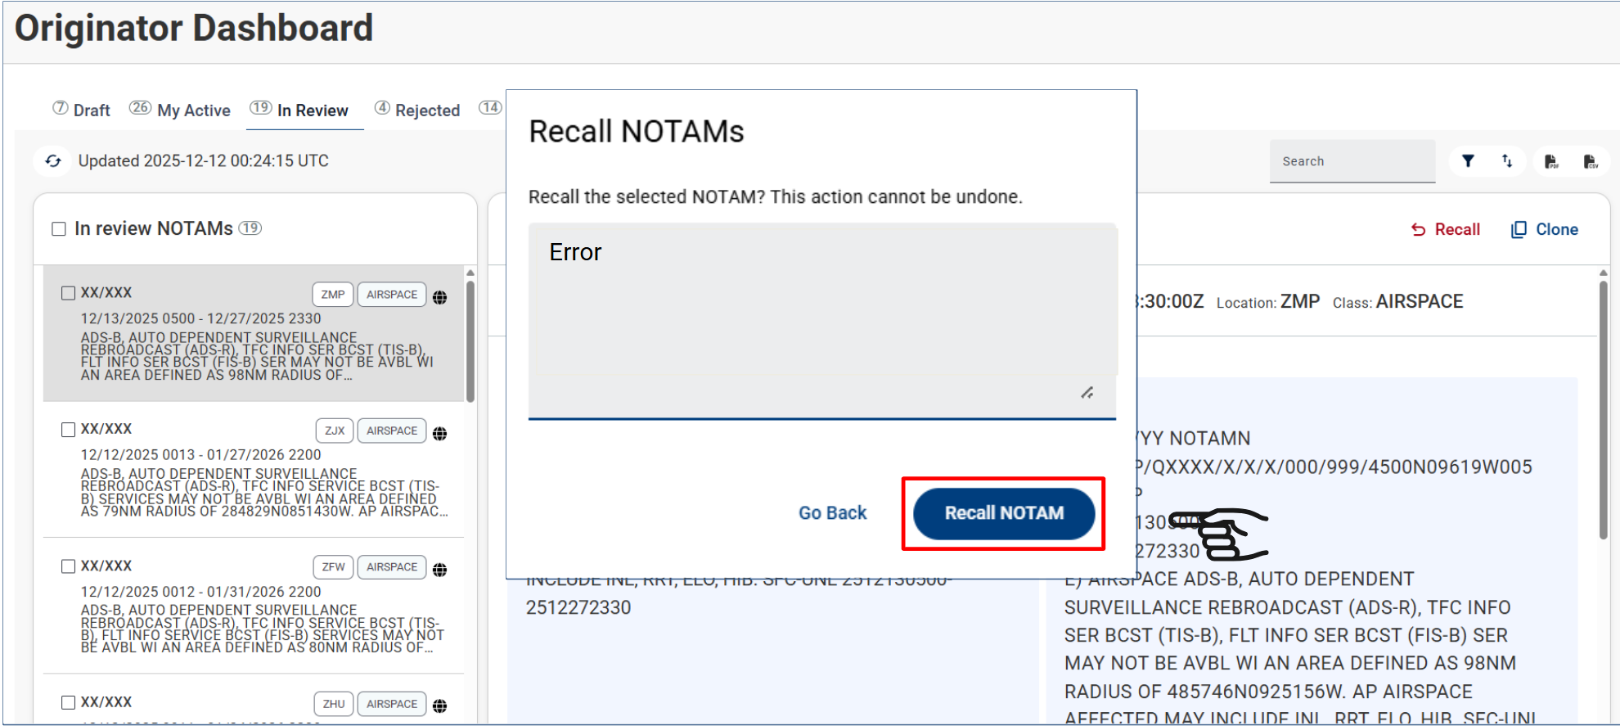
Managing NOTAMs after submission
TFRs in Review – can be recalled prior to ARTCC approval
Notes:
Once the TFR has been submitted to the ARTCC it can be found in the review tab, we talked about the review tab when we getting familiar with NMS

Slide 30
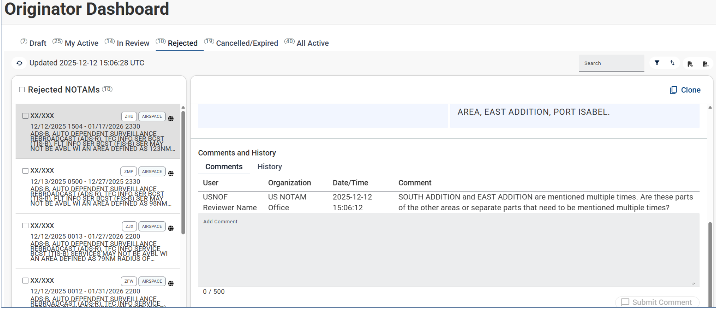

Rejected TFR

Slide 31
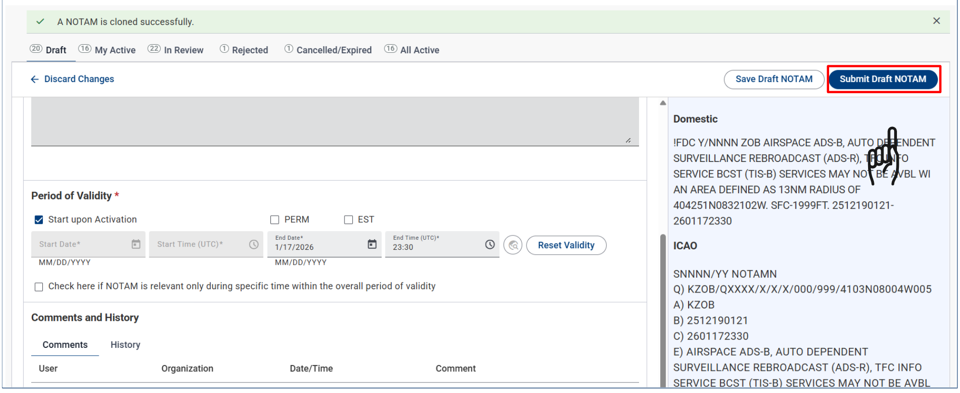

Slide 32
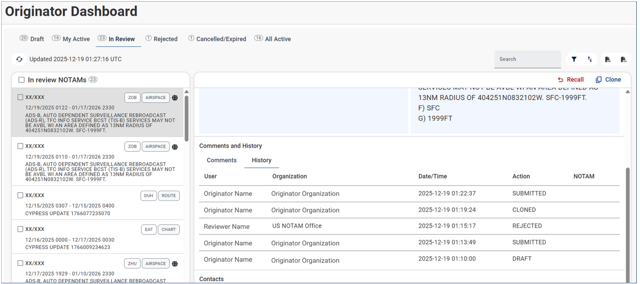

Notes:
Once you’ve cloned the TFR, Edited, Submitted it then it’s in Review and you can look at the History

Slide 33
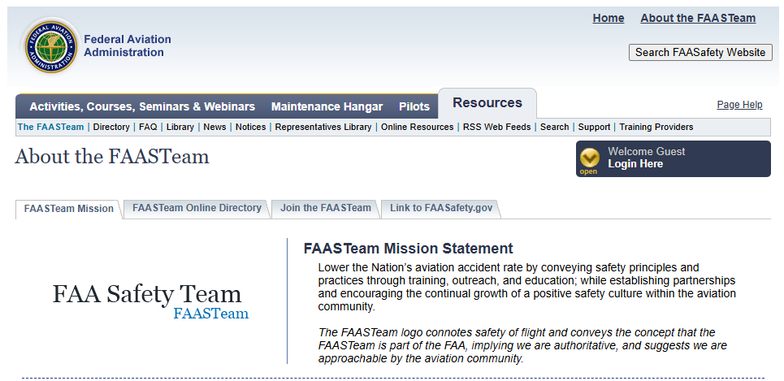
Want to learn more?
Notes:
Go over how to create an account
Go over how to enroll

Slide 34
What’s Next?
Agency Airspace Courses
A-103 – IAT
A-203 – IAT
Airspace Coordinator?
Future Policy changes to ICAO – NMS can handle it.
Enhanced Situational Awareness, reduced cognitive load, effective and efficient decision making
Notes:
International Civil Aviation Organization (ICAO) – we are already following NOTAM composition rules to ensure ICAO compliance per FAA JO and ICAO document 8400.
Sky is the limit – promote upwards.

