Slide 1

SIT/209
CDAT – April 2026

Slide 2
State of the program
Year 5 of 5 of the current O&M Contract.
New contract in motion.
Target start date October 1st.
Could see a 90-day transition period.
New contract does allow for Development, Modernization, and Enhancements (DME).
Not a full-blown Next Gen SIT/209, yet.

Slide 3

FMB Memo – Feb 2026
    The Fire Management Board released a memo in February creating two new fire suppression strategies:
      Direct Extinguishment
      Indirect Confinement
The Memos Intent:
  Replace the four previous suppression strategies
  Every fire is a fire – regardless of strategy – meaning daily reporting
  Removing historical “comp” language
  What Remains to be Seen:
  Whether or not NWCG approves the new definitions
  Depending on approval, potential application changes
Notes:
Fire Management Board – Federal Entities Only
This has caused a huge ruckus in the system. Has HUGE Implications.
Change to NWCG definitions, various dispatch applications, and all the way to fire management plans.
I personally feel like FMB didn’t realize that new definitions would affect so much.

Slide 4
Why Do I need to Submit a 209?
Required by the National Interagency Standards for Resource Mobilization.
One place to describe what is happening on the incident:
  Fire activity
  Critical needs
  Resources assigned
Utilized for upward reporting:
  Prioritize incidents and allocate resources.
  Data is used in several national products.
  FEMA utilize 209s for FMAGs.

Slide 5
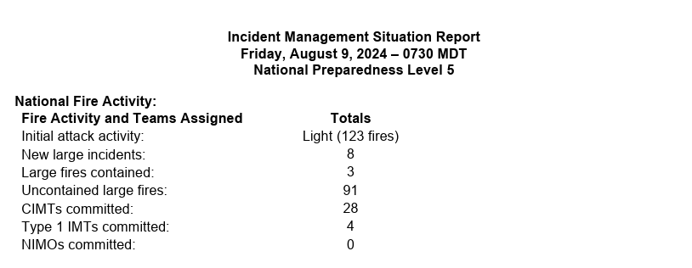
IMSR aka The National Sit Report

Slide 6
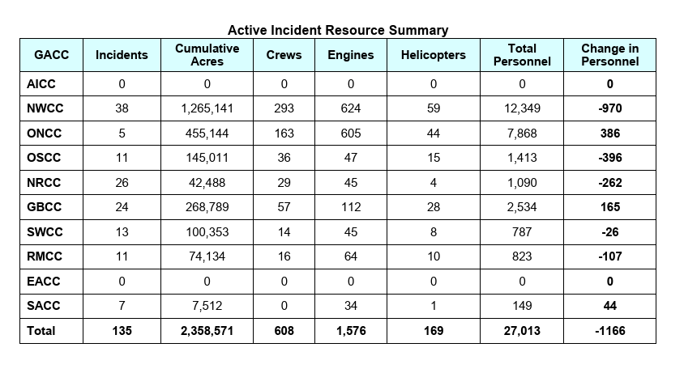
IMSR aka The National Sit Report

Slide 7
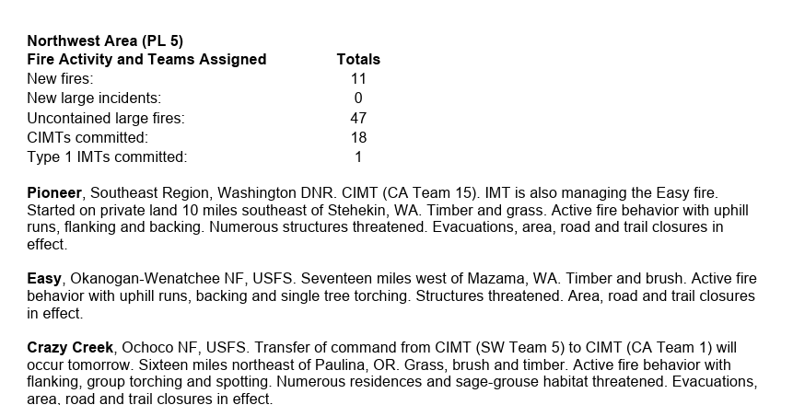
IMSR aka The National Sit Report

Slide 8
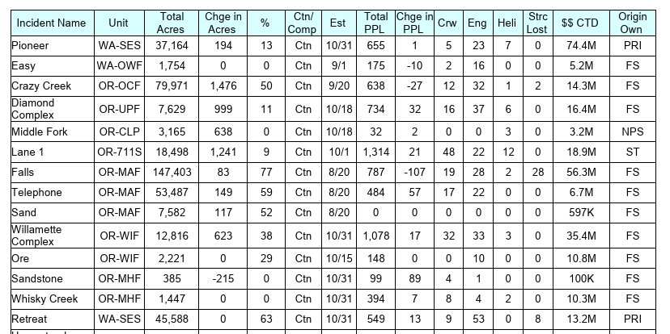
IMSR aka The National Sit Report

Slide 9
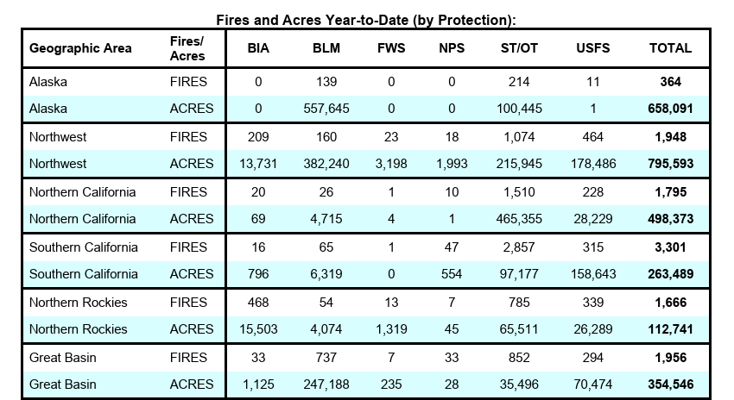
IMSR aka The National Sit Report

Slide 10
When to Submit a 209
    New DAILY reporting requirements starting May 1st:
      Meets large fire criteria
      CIMT or NIMO assigned
      Significant event has occurred
      Geographic Area requests a 209
      Weekly reporting for historical “comp” fires is gone.
      NMAC letter will be released this week describing the new timeframes.

Slide 11
Fuel models
100 Acre Minimum (timber)
Closed timber litter
Hardwood litter
Timber (litter and understory)
Light slash
Medium slash
Heavy slash
300 Acre Minimum (grass)
Short grass (1 ft)
Tall grass (2.5 ft)
Brush (2 ft)
Chaparral (6 ft)
Timber (grass and understory)
Dormant brush/hardwood slash
Southern Rough
Notes:
Biggest complaint I get is timber litter vs timber grass

Slide 12
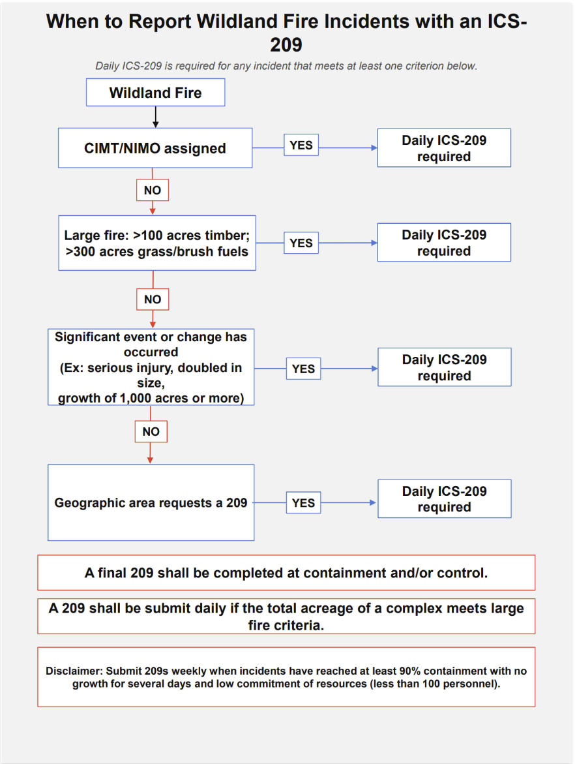

Slide 13
Who Fills out 209s?
Ultimately it is the Incident Commander’s responsibility
Local Dispatch Center
Local fire management officials
Incident Management Team personnel

Slide 14
Tips for getting 209 info
Get familiar with the form! If possible, set a firm time to talk with the IC.
Suggest creating a quick and dirty 209 form.
Know where to look for information:
  CADs
  IROC
  Other dispatchers
General Reminder: INITIALS DO NOT NEED TO BE PERFECT!

Slide 15
209 Demonstration

Slide 16
Complexes
Must have two distinct wildland fire incidents (aka children).
  Cannot convert an existing incident into a complex.
  Must create a new incident. The complex becomes the PARENT.
  All children incidents must have an IRWIN record.
  The complex name should NOT include a child fire’s name.
  Complex MUST be included in the name.
  Should NOT be used to avoid submitting multiple 209s.
  Any active 209s in the system MUST be finalized.

Slide 17

Complexes
Contact your GACC if complexing comes up!
If you have a CAD, create the complex in CAD. If not, create in 209.
How do I build a complex that crosses two dispatch centers?
  Decide which center is going to manage the complex.
  Add fires from the neighboring dispatch center in the complex incident widget in 209.
  Avoid de-complexing at all cost.
  When a fire is contained within a complex, put 100% in the complex incident widget.

Slide 18
Now onto “sit”
Why is entering data into SIT important?
  It is the one place where every land management agency can enter fire statistics.
  National fire statistics have utilized SIT data for over 20 years.
  Why not use INFORM?
    It’s great for federal fire statistics.
    Not every land management agency utilizes it, especially the states.

Slide 19
Protection vs ownership
Ownership: Where did the fire start?
Protection: Who is claiming the fire? What unit identifier is being used?
Ownership and Protection can be the same thing, but sometimes it’s not:
  Example: Fire starts on county land, and the Forest Service claims the incident
  How do I report that correctly in SIT?

Slide 20
SIT Demonstration

Slide 21
Where to go for help
SIT/209 user guides are excellent!!
Intel Toolbox
Next level up – Call your GACC!
IAA Helpdesk – we have excellent Tier 2 Support!
Can always call the intel desk @ NICC (208-387-5093)

Slide 22
Questions?
Megan Kephart
mkephart@blm.gov
megan.kephart@usda.gov

