Slide 1
WildCAD-E Business Leads
CDAT 2026

Slide 2
Representation
Recent Changes to the Government Team
Kara Stringer
Amber Sunderland (detail)

Slide 3
Responsibilities
Provides national programmatic level business oversight, leadership and guidance for the system ensuring development is in accordance with resource programs, fire suppression objectives, policies, and governance structure.
Evaluate business requirements for the system ensuring development supports “business” i.e., business processes, recommended business practice, standards and policy of wildfire operations and management to ensure fire management strategies, tactics, fire prevention, and mitigation procedures
Leads the review, interpretation, and refinement of documented business requirements for wildland fire operations.
Drafts and recommends standards, guidelines, and policies for the business areas affected due to the automation of business functions in fire operations and management.
Reconfigure business processes to meet WFIT data integration goals.
Primary spokesperson for Wildland Fire Operations and Management IT projects to leaders and representatives of other agencies and bureaus, other Federal wildland fire partners, State, Tribal and Private agency wildland fire partners, and non-Federal stakeholders.

Slide 4

Executive Order 14308
Sec. 5. Modernizing Wildfire Prevention and Response.
(ii) Develop performance metrics for wildfire response, including metrics related to average response times, annual fuels treatments, safety and cost effectiveness, and other subjects, as appropriate for inclusion in strategic and annual performance plans.
Notes:
Federal Register :: Empowering Commonsense Wildfire Prevention and Response
Section 1 . Purpose.
Sec. 2 . Streamlining Federal Wildland Fire Governance. Within 90 days of the date of this order, the Secretary of the Interior and the Secretary of Agriculture shall, to the maximum degree practicable and consistent with applicable law, consolidate their wildland fire programs to achieve the most efficient and effective use of wildland fire offices, coordinating bodies, programs, budgets, procurement processes, and research and, as necessary, recommend additional measures to advance this objective.
Sec. 3 . Encouraging Local Wildfire Preparedness and Response.
Sec. 4 . Strengthening Wildfire Mitigation. Within 90 days of the date of this order:
Sec. 5 . Modernizing Wildfire Prevention and Response.
Sec. 6 . General Provisions.
Average Response Time? Getaway Time - Elapsed time from receipt of notification by the personnel charged with initiating suppression action to the departure of the first attack unit.

Slide 5

Resource Type | Seconds | Minutes
Helicopter | 384.82 | 6.41
Engine | 112.65 | 1.88
Handcrew | 142.94 | 2.38
Dozer | 152.83 | 2.55
Water Tender | 168.40 | 2.81
Module | 79.33 | 1.32
Airtanker | 655.76 | 10.93
Operations | 101.58 | 1.69
Other Equipment | 99.63 | 1.66
Fixed Wing | 389.18 | 6.49
Resource Type | Seconds | Minutes
Helicopter | 384.82 | 6.41
Engine | 112.65 | 1.88
Handcrew | 142.94 | 2.38
Dozer | 152.83 | 2.55
Water Tender | 168.40 | 2.81
Module | 79.33 | 1.32
Airtanker | 655.76 | 10.93
Operations | 101.58 | 1.69
Other Equipment | 99.63 | 1.66
Fixed Wing | 389.18 | 6.49

Slide 6
Response Plans and Daily Resource Status
Response Plans Each local area will maintain and follow a documented pre-planned response plan (e.g., run cards); developed in coordination with land management leadership and in conjunction with a Fire Danger Operating Plan (FDOP) or other preparedness operation plan as required,
Plans must include notification protocols and identify initial attack resources.
Local dispatch centers will implement the response plan by mobilizing resources followed by notification of identified Duty Officer.
Daily Resource Status The status of all available initial attack resources must be updated daily in an integrated application by 1000 local time or within 30 minutes of the designated start time.
In Chapter 10 of the National Interagency Standards for Resource Mobilization and expect language in the Interagency Standards for Fire and Fire Aviation Operations

Slide 7
Operational Status Tracking
Resources and their parent units will be tracked throughout the incident lifecycle in an integrated application following the Operational Status workflow:
• Daily availability ~ available/unavailable
• Committed/Reserved
• Responding/Mob En Route
• On Scene/At Incident
• Returning/Demob En Route
• Returned from Assignment/Available Quarters
Notes:
Also included in the NISRM

Slide 8
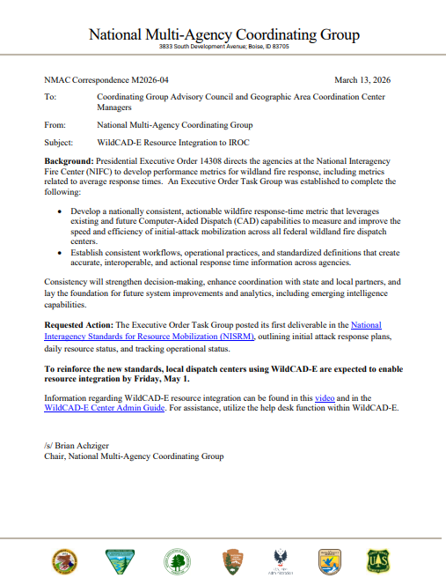
Resource Integration
Executive Order Working Group
Response Matrix
NMAC Correspondence M2026-04

Slide 9
On the horizon
Resource Location
Executive Order Compliance
Prescribed Fire Life Cycle
Planning
Active
Patrol/Monitor
Complete
FMB Directive regarding Suppression Strategy
NWCG Event Kind & Category Mutual Aid
Gaps or barriers
NWCG Operational Status Available at Incident
Committed (integration)
Closest Resource
Routing ETEs

Slide 10
Thank you

