Slide 1
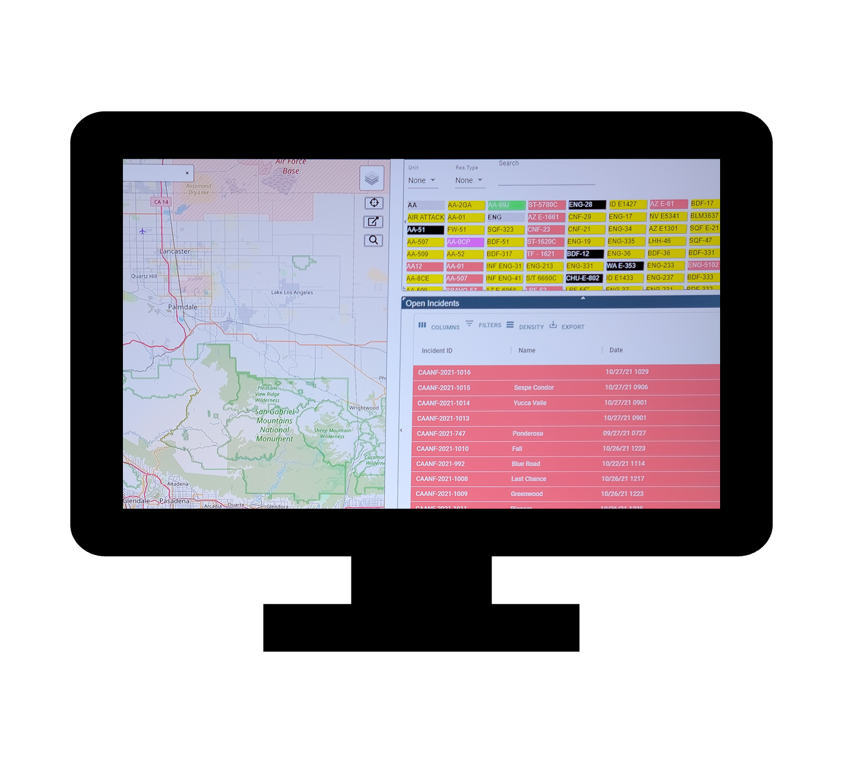
Center Admin Training
Welcome!
Using WildCAD-E v.2.1.0-CDAT-2026
Notes:
Bighorn Information Systems
Aaron Gelobter
Linda Lowe
Gary Maddux
Science Applications International Corporation ("SAIC")
Tani Converse
Will Nesbitt
Sam Marantan
Gabbi Adams
Connor Smith

Slide 2
Center Admin Training
Bighorn Information Systems
Aaron Gelobter
Linda Lowe
Science Applications International Corporation ("SAIC")
Tani Converse
Will Nesbitt
Sam Marantan
Gabbi Adams
Connor Smith
Using WildCAD-E v.2.1.0-CDAT-2026
Notes:
Bighorn Information Systems
Aaron Gelobter
Linda Lowe
Gary Maddux
Science Applications International Corporation ("SAIC")
Tani Converse
Will Nesbitt
Sam Marantan
Gabbi Adams
Connor Smith

Slide 3
Center Admin Topics
Home Page
Configure WildCAD
Center Operations
Maps
Dispatch Strategy
Resources
Frequencies
Incident Tabs
Texting

Slide 4
Let’s Look at Configure WildCAD and Parts of Center Operations
WildCAD-E

Slide 5
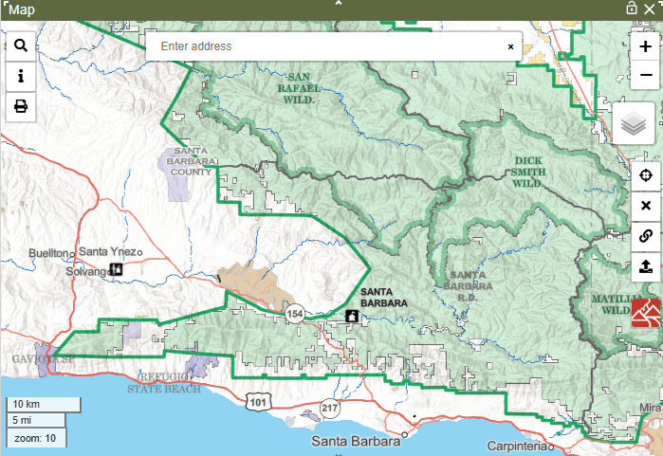
Maps with Sam

Slide 6
Dispatch Strategy Topics
Response Types
Resource Types
Response Levels
Dispatch Locations
Response Areas
Designing Dispatch Strategy

Slide 7
Quick Look at WildCAD-E
WildCAD-E

Slide 8
Objective of Dispatch Strategy
Recommend resources to send to an incident
Requires:
Incident occurs within a Response Area
Dispatch Strategy has been built for a Response Area

Slide 9
Response Areas
Response Areas are polygons with similar:
Types and numbers of resources to respond
Travel times from the different dispatch locations

Slide 10
Response Areas – Types and Numbers of Resources
Consider a large wilderness area near a roaded area with significant wildland urban interface.
Those 2 areas should not be in the same Response Area because the WUI roaded area might use primarily engines, dozers and other similar resources, whereas the wilderness might rely more on crews.

Slide 11
Response Areas – Travel Times
Next consider an area cut in half by a large north-south river with no roads crossing the river.
A dispatch location on the east side of the river is closest to the entire area, but vehicles cannot drive to the west side of the area.
Natural barriers like this river might require splitting this area into 2 Response Areas.

Slide 12
Response Areas
To summarize - Response Areas are polygons with similar:
Types and numbers of resources to respond
Travel times from the different dispatch locations
Look at LPF Response Areas 35 and 31
WildCAD-E

Slide 13
Dispatch Locations
Common examples:
Fire stations
Ranger stations
Airports, heliports
Work or project areas
Common staging areas
In WildCAD, for each Response Area, you will prioritize Dispatch Locations by travel times.

Slide 14

Dispatch Locations
Response
Area 35
River
We need to create a single prioritized list of dispatch locations to a fire in Response Area 35.
For Engines:
DL1
DL2
DL3
DL4
For Helicopters:
DL4
DL3
DL1
Engine
DL4
Engine
Helicopter
DL2
Engine
DL3
Engine
Helicopter

Slide 15



Dispatch Locations
Response
Area 35
River
Prioritized List:
DL4A
DL1
DL2
DL3
DL4
DL1
Engine
DL4
Engine
DL4A
DL2
Helicopter
Engine
DL3
Engine
Helicopter

Slide 16
Dispatch Locations
Consider Dispatch Locations for:
Work areas
Staging areas
Common move up locations
If Dispatch Locations include both ground and air resources, create 2 Dispatch Locations – one for ground resources and one for aircraft

Slide 17
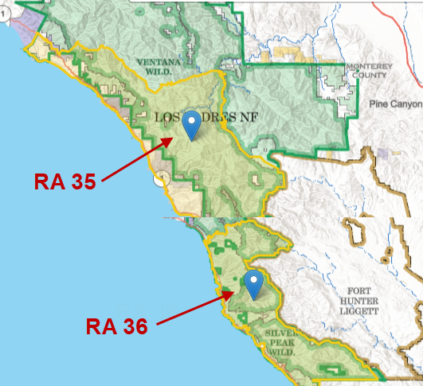
How Build Dispatch Strategy
WildCAD-E

Slide 18
Break

Slide 19
Match Resources & Frequencies with Will
Resources
Units and Subunits
Line Up Groups
Match Resources in IRWIN
Frequencies
Integrated Frequencies
Header Management

Slide 20
Resources Page with Conner
Resources
Active vs. Inactive
Search Functions
Add and or Edit Resource
Understanding the Inputs for a Resource

Slide 21
Incident Tabs & Texting with Linda
Configure Incident Tabs
Batch Comments Area Notifications
Fires Tab ICP Phone Categories
Numbers Questions
Contracts Move Ups
Text/Email Address
Text/Email Groups
Text Setup
Assign Text Email to a Group
Text/Email Preset Messages

Slide 22
Questions

