Slide 1
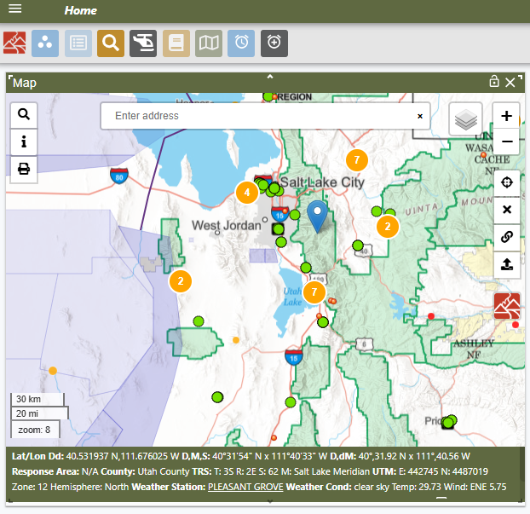
CAD Change Control Board
CDAT 2026

Slide 2
Representatives
Representative Location | Dispatch Center | Representative
National | ID-NICC | David Lee
Northern Rockies | MT-MDC | Rachel Simpson
Rocky Mountain | CO-NCC | Cambria Armstrong
Southwest | AZ-PDC | Barry Wallace
Great Basin | ID-EIC | Richard Wilson (Chair)
North Ops | CA-MICC | Mark Main
South Ops | CA-OSCC | Andrea Lannen-Littlefield
Northwest | OR-VAC | Andrew Robertson
Southern Area | TN-TNC | Kymberli Hoffman (Vice Chair)
Eastern Area | WI-EACC | Roman Watson
Alaska | AK-AICC | Amber Sunderland
Project Manager | N/A | Jaymee Fojtik
Business Lead | N/A | Kara Stringer
Notetaker | OR-RIC | Francesca Smith
The CAD Change Control Board has been established to monitor CAD change requests, prioritize, and recommend program enhancements received from WildCAD-E users through proper channels. The CCB is comprised of NICADs members from different agencies in different Geographic Areas and NICC involved in incident response and operate under an established set of Operational Guidelines.

Slide 3
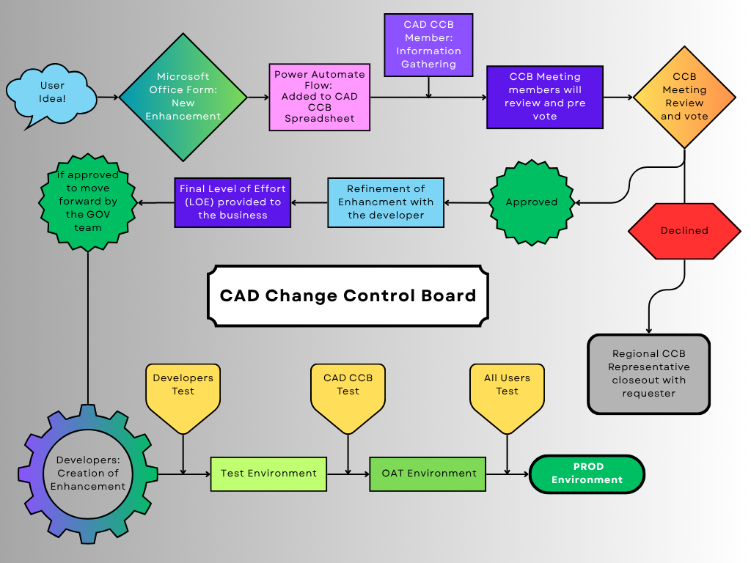
Enhancement Process

Slide 4
Current Statistics
In CCB Review | Count of Status
Total | 118
CCB Approved | Count of Status
Approved | 102
High | 19
Medium | 40
Low | 43
Planned | 7
Underway | 6
TOTAL | 115
Completed in 2025 | Count of Status
Total | 22

Slide 5
2026 CCCB Priorities
Expected in 2.1
Add Overhead Modules, UMOD, etc. to WildCAD-E as resource types
IRWIN Integrated future/updated resources.
Map Measurement tool
Multiple methods to determine closest resource response to incident
Timer reconfiguration (Fix timer document issue on wrong incident)
Contained, controlled, out and lat/long auto document in incident log to show history

Slide 6
2026 CCCB Priorities
Future Priority Enhancements
Add aircraft log and reconfigure AIR tab
Allow resources to go to an incident in WCE and still show available in IROC for out of area orders
National NAVAID / VOR list
Add UNDO button to undo the last action of a resource
Hazard layer include polygons, lines and points. Lines and points have a distance to hazard.
Rebuild the distance tab to have a dropdown by category and more categories
***Dark mode has been requested and is currently on the priority list. However, due to other higher-priority initiatives that impact business needs, Its development is currently postponed for a future phase.***

Slide 7
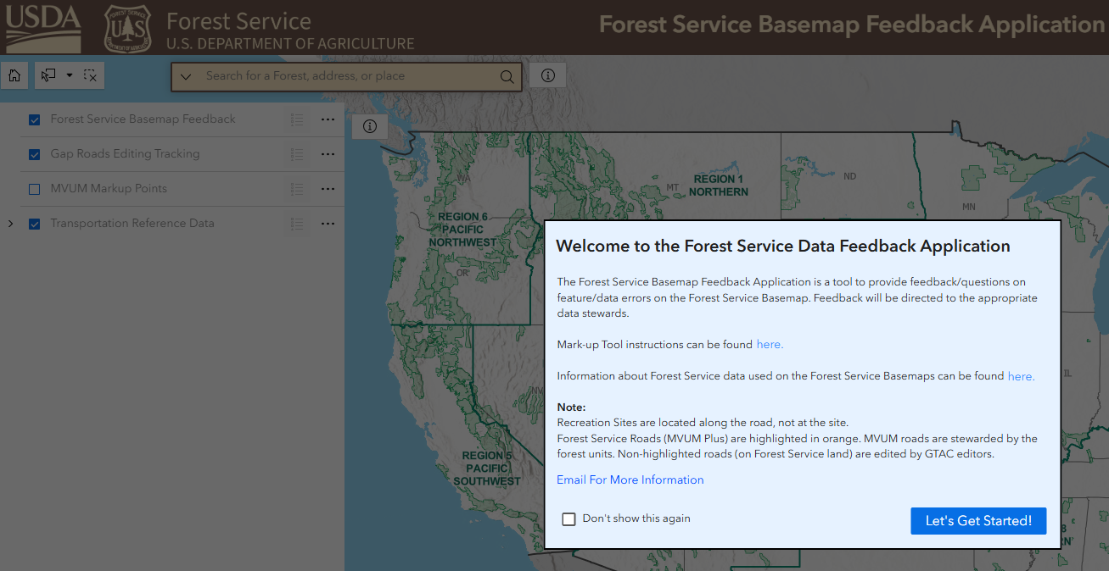
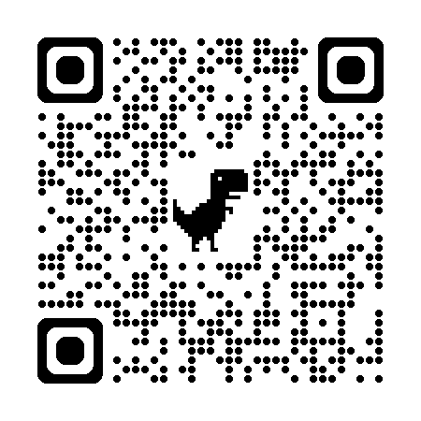
Layer Feedback
Map layers are not a service provided by the developers they are URLs provided by an authoritative data sources. To report outages or updates you will need to contact the appropriate service provider. Many of these layers are used nationally by many different types of users, so when the service is unavailable, they are aware so patients may be your best option. Sometimes these services also are unavailable for short periods of times due to maintenance.
If it is a long-term outage or updated needed, you will need to contact the service provider or work with your GIS Specialists to have them go through their appropriate channels to update or report long term outages of the sources.

Slide 8
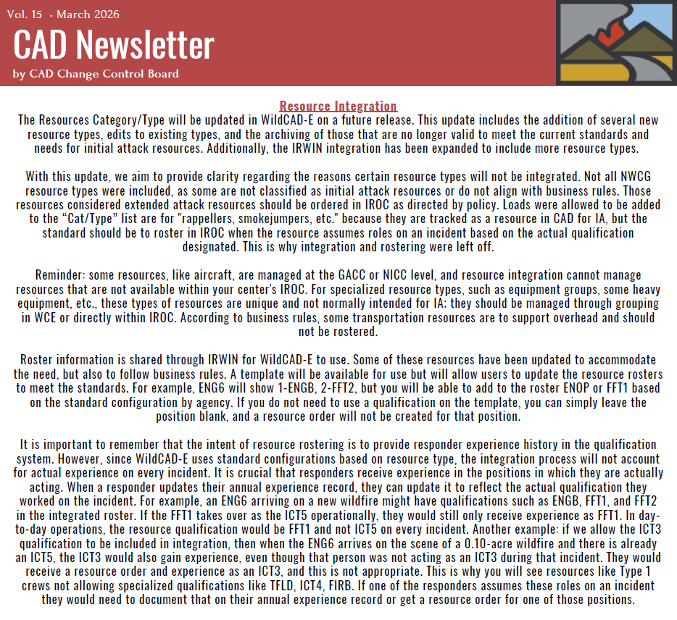
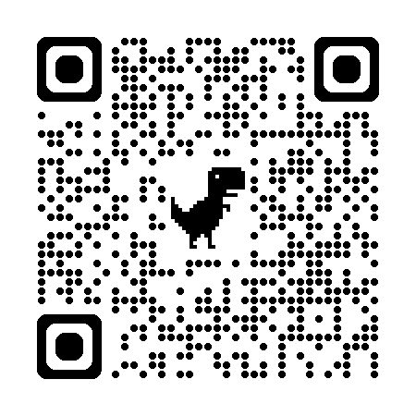
Resource Integration

Slide 9

Thank you
https://www.wildfire.gov/page/change-control-board-wildcad-e

