Slide 1
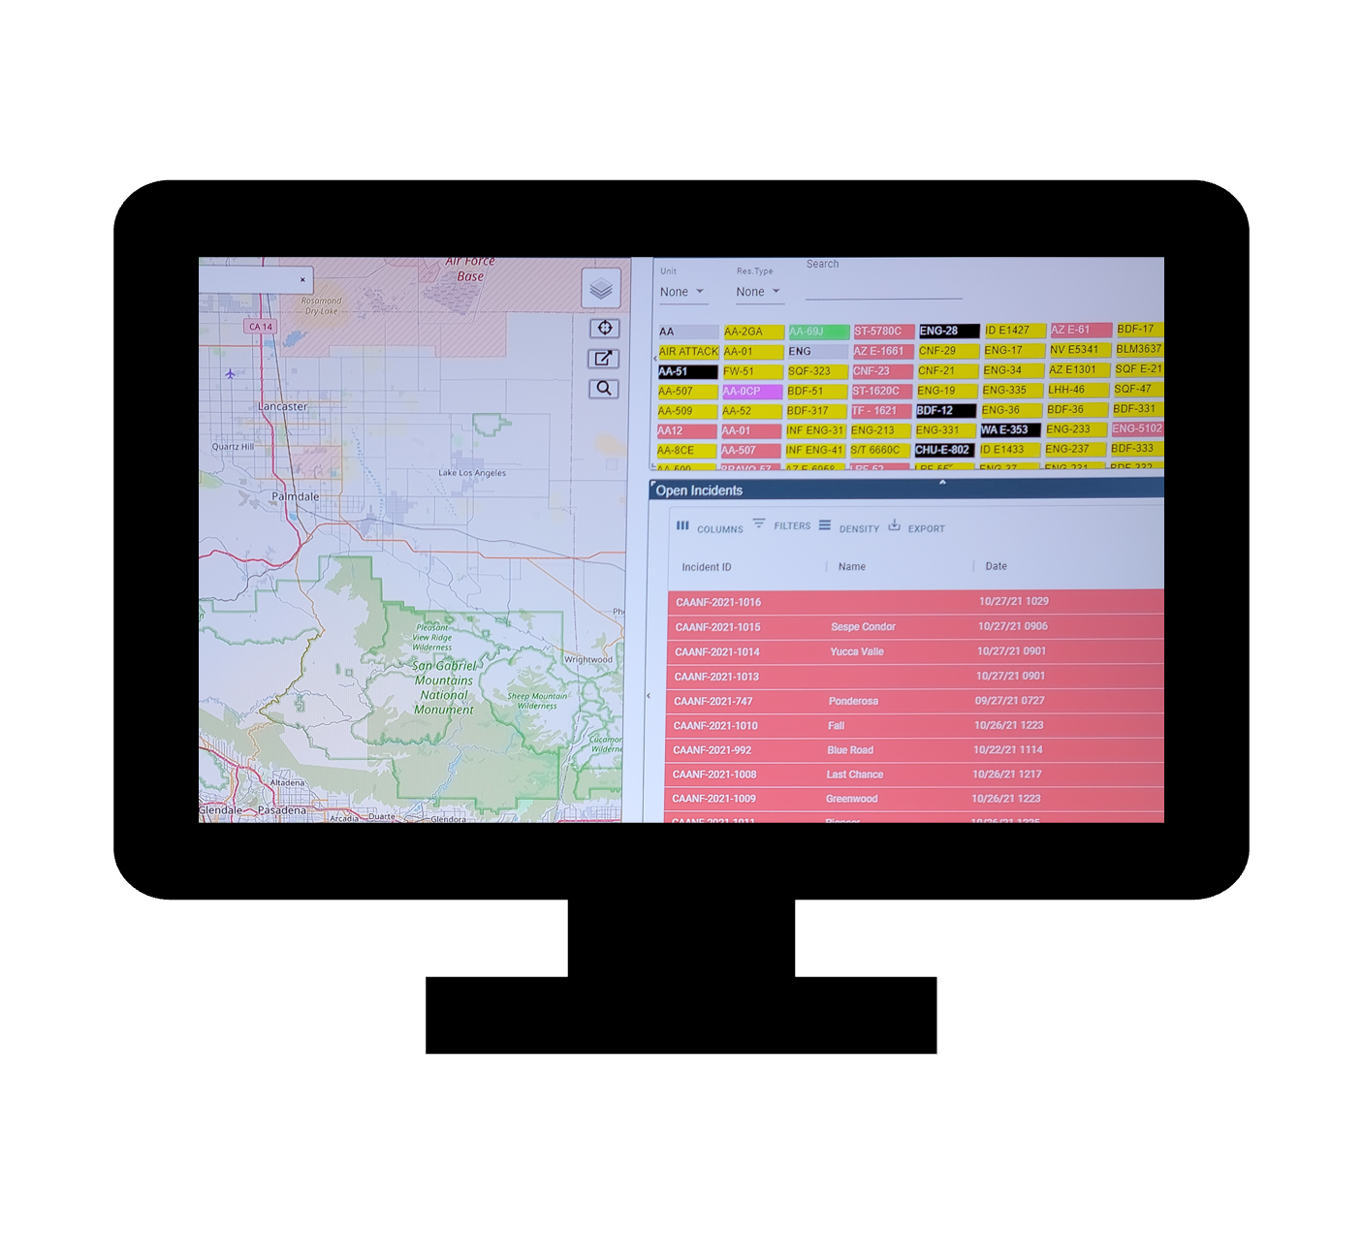
WildCAD-E Conference
Welcome!

Slide 2
WildCAD-E Conference
Bighorn Information Systems
Aaron Gelobter
Linda Lowe
Science Applications International Corporation ("SAIC")
Tani Converse
Will Nesbitt
Sam Marantan
Gabbi Adams
Connor Smith
Notes:
Bighorn Information Systems
Aaron Gelobter
Linda Lowe
Gary Maddux
Science Applications International Corporation ("SAIC")
Tani Converse
Will Nesbitt
Sam Marantan
Gabbi Adams
Connor Smith

Slide 3
Conference Topics
Updates From WildCAD-E Government Team
WildCAD-E Stats and Performance
New Features
Integration
Rostering
Maps
Frequencies (Integrated & Legacy)
Incident Panel
Reports
Question and Answers

Slide 4
WildCAD-E Conference
Government Team
Jaymee Fojtik
WildCAD-E Program Manager - COR
Kara Stringer
IRWIN Business Lead/DOI, WildCAD-E Business Lead
Great Basin Coordination Center Manager (detail)
Roman Watson
WildCAD-E Change Control Board (CCB) Chairperson
Eastern Area Coordination Center Logistics Coordinator
Notes:
Bighorn Information Systems
Aaron Gelobter
Linda Lowe
Gary Maddux
Science Applications International Corporation ("SAIC")
Tani Converse
Will Nesbitt
Sam Marantan
Gabbi Adams
Connor Smith

Slide 6
Questions

