Slide 1

Innovation
&
Performance

Slide 2
WildCAD-E Modernization
Secure/Resilient Initial Attack Dispatch Platform
Cloud-based serverless architecture
Support rapid response times, interoperability and real-time situational awareness
Robust user support

Slide 3
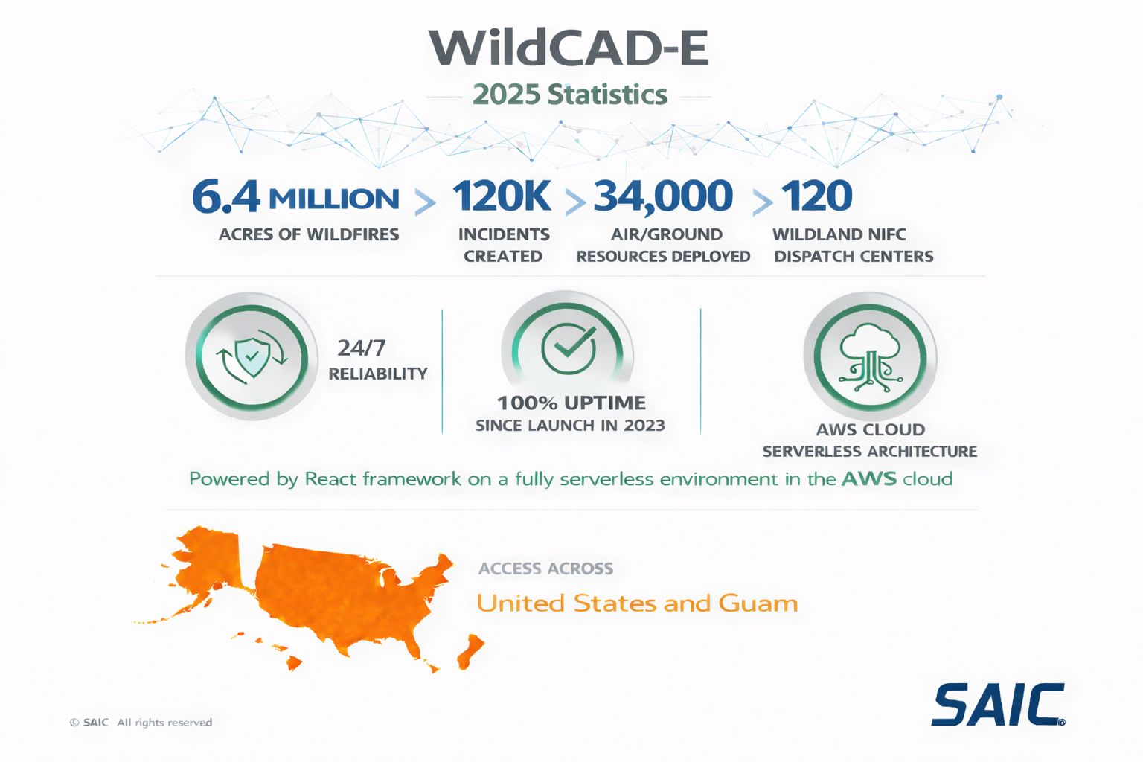

Slide 4
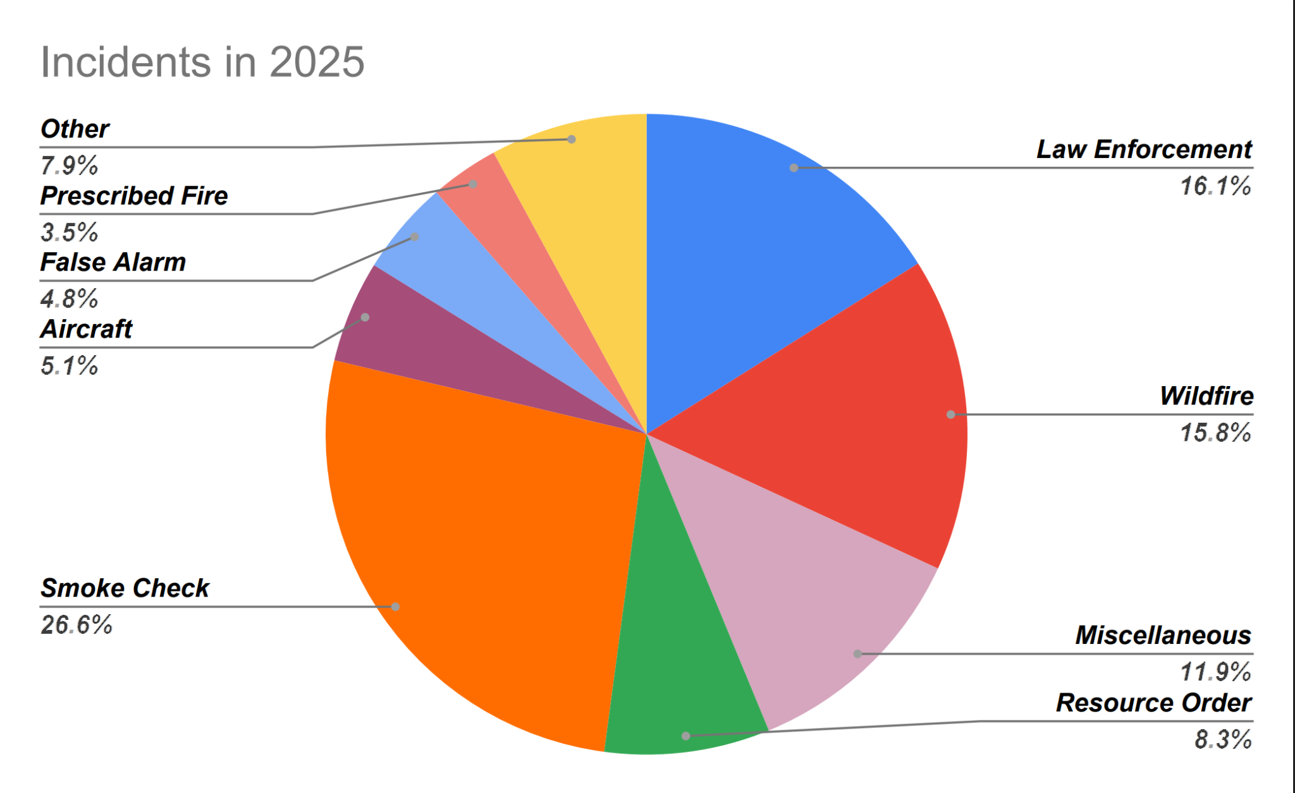

Slide 5
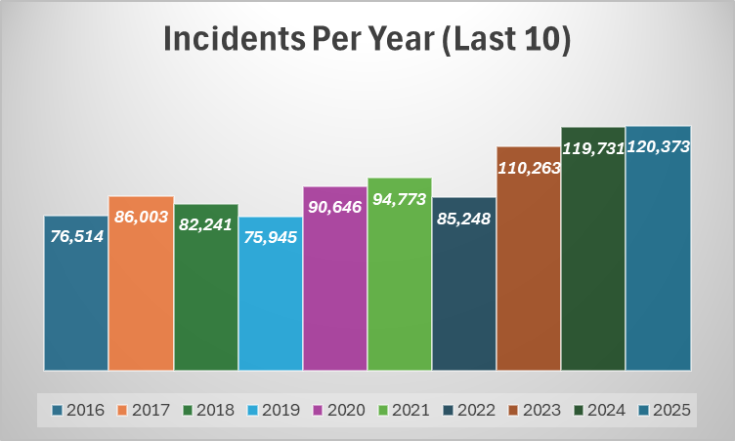
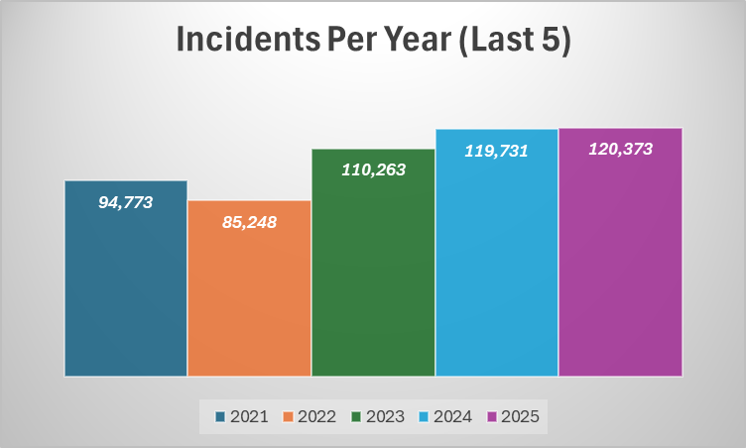

Slide 6
Incident Integration
WildCAD Incident
Integrated Type
Incident Name
Discover Acres
Integrated Applications
IROC
SIT/209
WFDSS
IQS
IQCS
Etc…
IRWIN
Integrated Data

Slide 7
Resource Integration
Integrated Applications
IROC
SIT/209
WFDSS
IQS/IQCS
etc…
WildCAD Incident
IRWIN
Integrated Data
Resources Assigned
Must have a standard Category/Type
Must be IRWIN Matched
Status is Responding
Rostered resources automatically integrated with the parent resource
Resource Experience
Starts in WildCAD
Maintains responder qualifications in IQS and IQCS

Slide 8
Coming soon…V2.1
Sparky - AI User Help
Resources
  Kind/Cat/Type Standard
  Standard Configuration for Rostering
  Roster User Interface improvements
  ETE (Estimated Time Enroute) Calculations
  Resource by Status Layer
Map Routing Tool
Map Measuring Tool

Slide 9

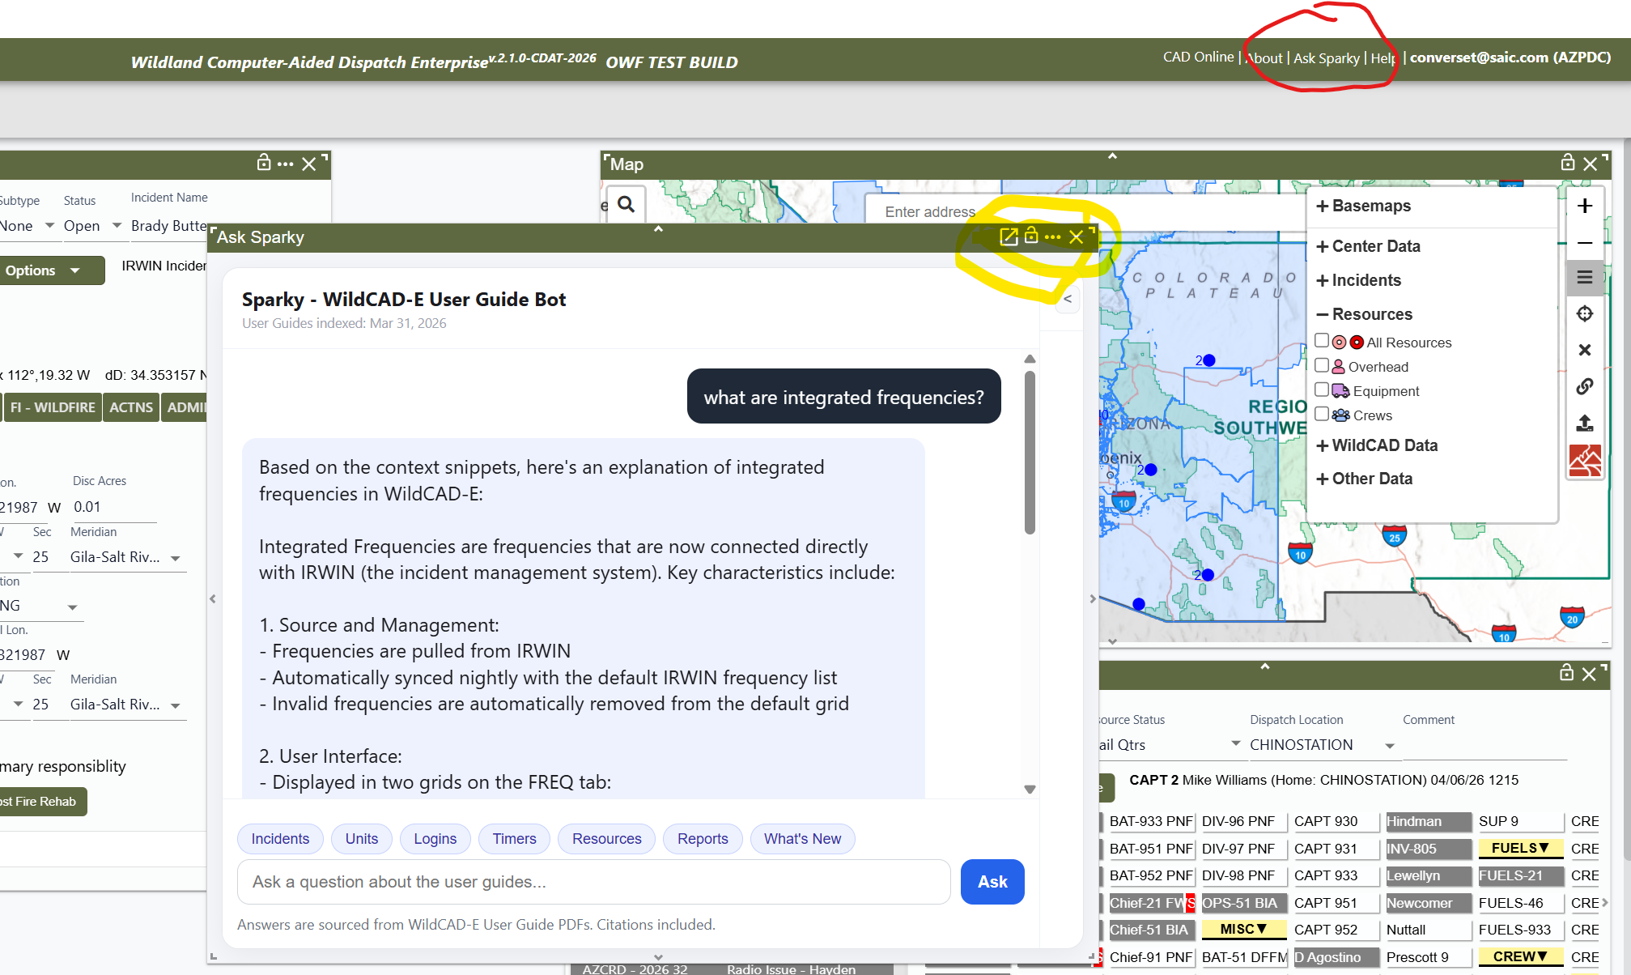
Introducing “Sparky”

Slide 10
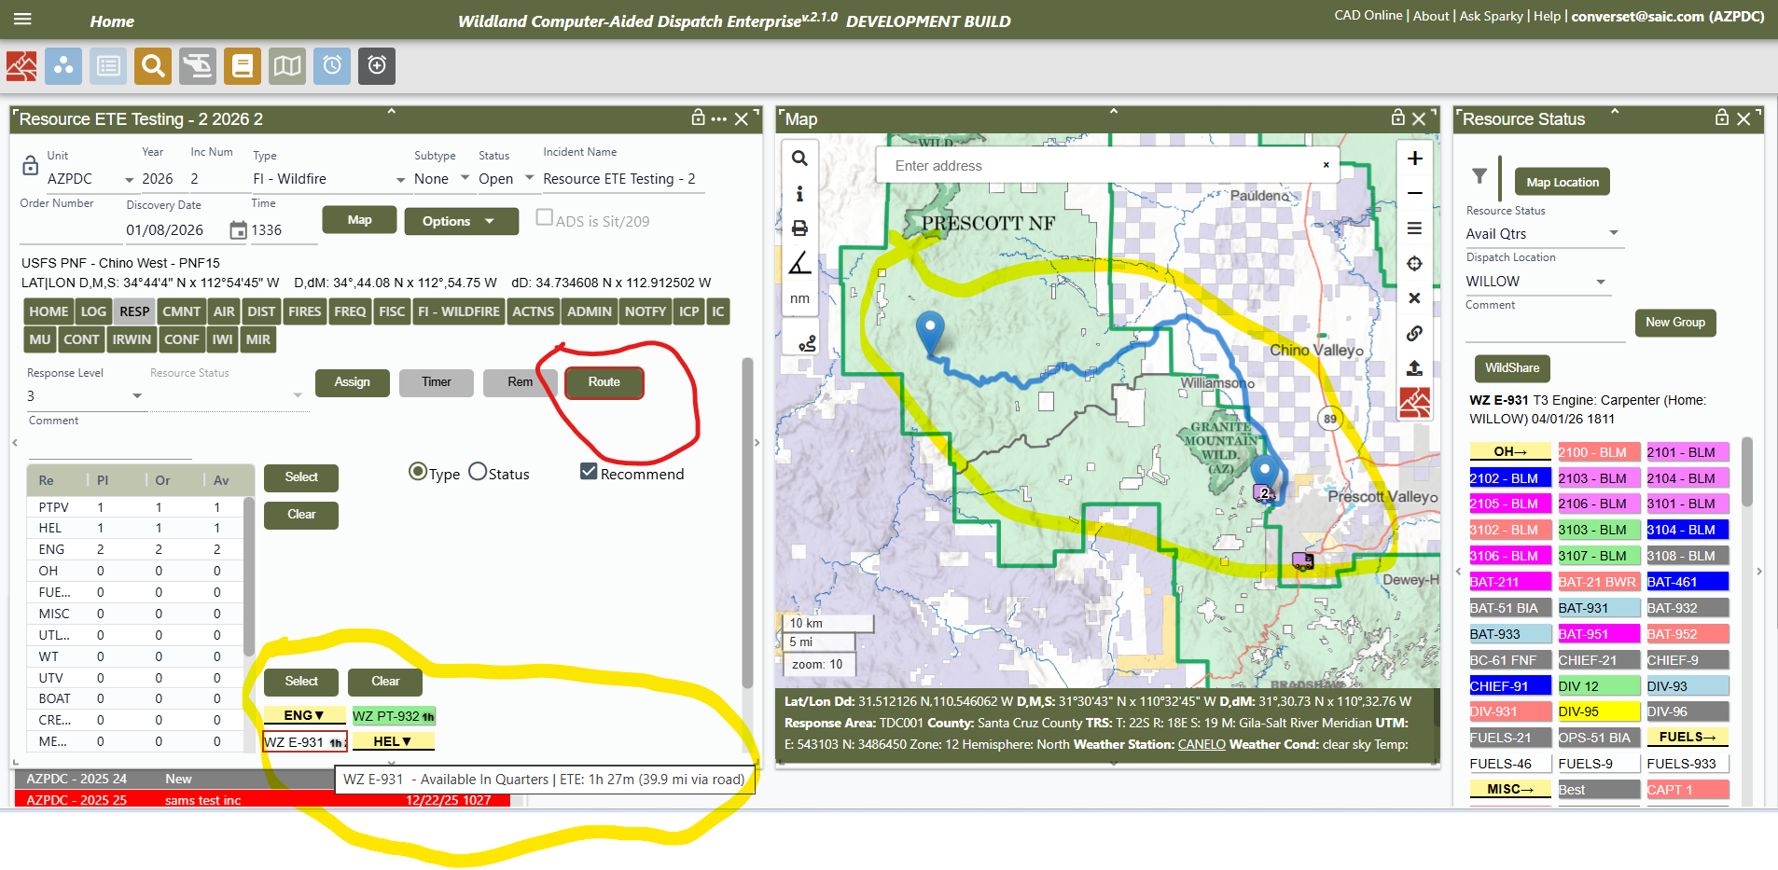

Slide 11

THANK YOU ALL
FOR ALL YOU DO

Slide 12
Committed
Responding
On Scene
Returning
Available
Overnight (On Inc)
etc…

