Slide 1
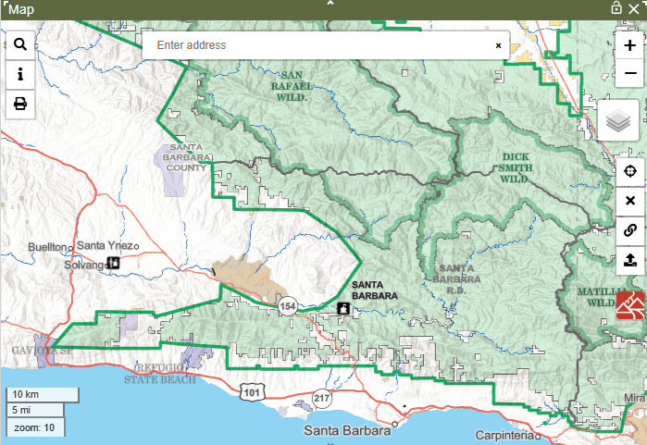
Maps with Sam

Slide 2
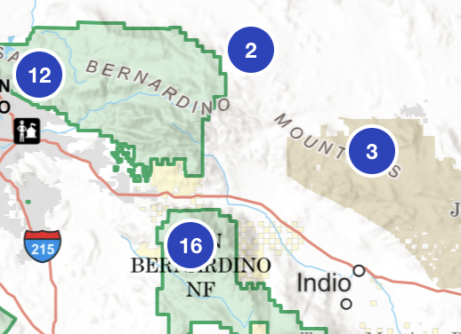
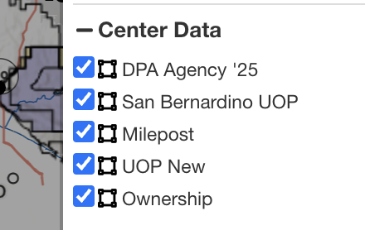
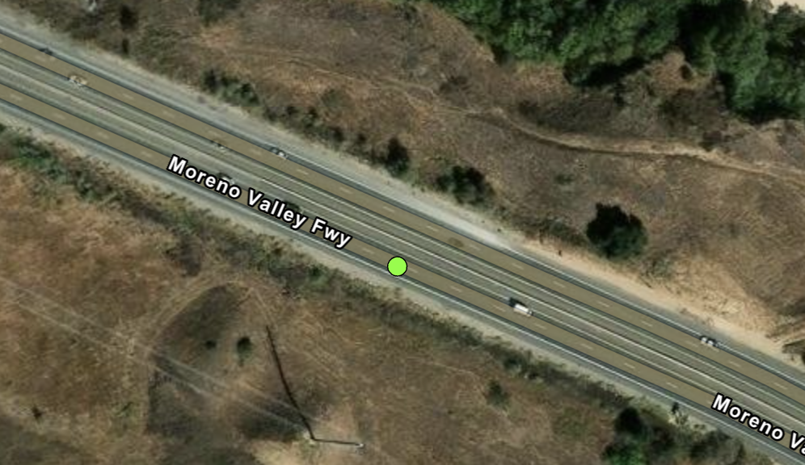
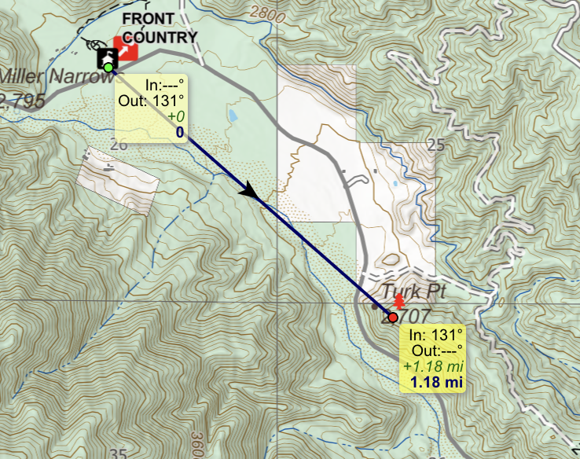
Map Topics
Other Data: Clustering Point Layers
Other Data: WFTAK & DART AVL
Center Data Layers
Measurement Tool
Notes:
I'll be covering 4 map topics in this session, I'll go over some main points then do a quick demo in wildcad, and I can take questions after each topic

Slide 3
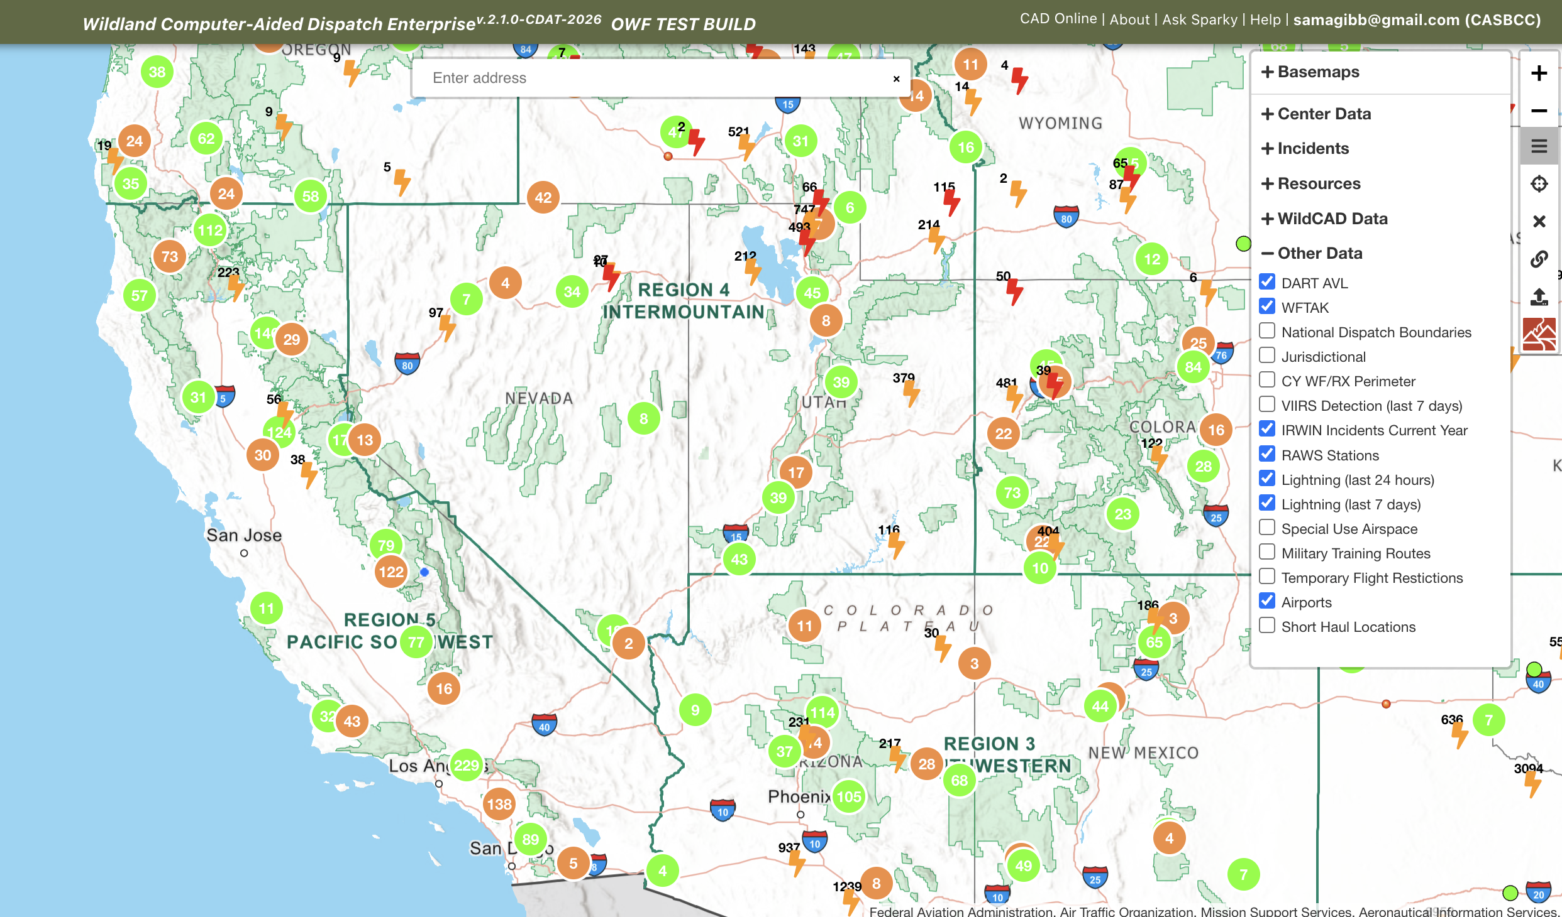
Clustering Point Layers
DART AVL & WFTAK
IRWIN Incidents
RAWS Stations
Lightning
Airports
Notes:
all of the point-type layers under Other Data are clustered with the exception of VIIRS. That data is best viewed as unclustered points, gives a heat-map type of effect

Slide 4
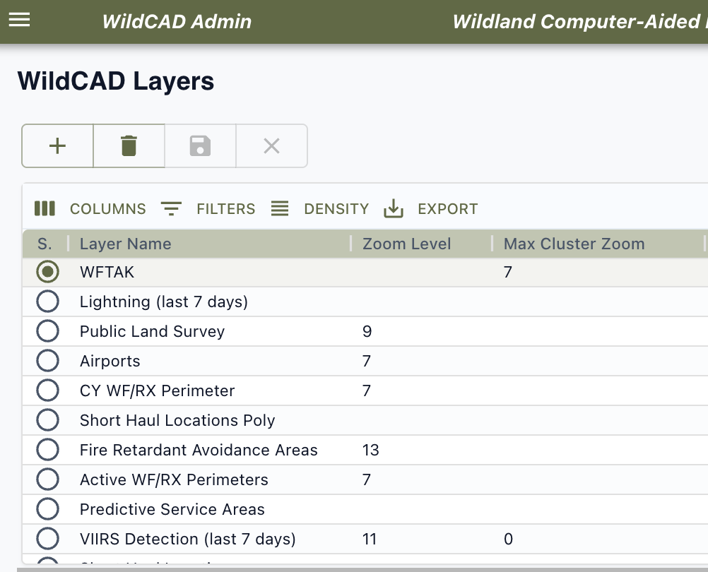
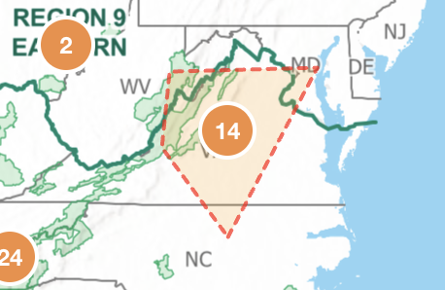
Clustering Point Layers
Why cluster the data?
Max Cluster Zoom
Hover over clusters
Notes:
Why cluster the data - Cluster to improve map performance, do not have to load all points while panning/zooming can crash, lock up
Max Cluster Zoom – zoom level at which clustered points explode into their individual points
Hover over clusters - Hovering over shows extent of indiviual points,
Demo:
the number in the circle indicats how many points are in the group, changes as you zoom
Hover over
Clicking cluster zooms to it and explodes it

Slide 5
WFTAK & DART AVL Layers
The Wildland Fire Team Awareness Kit (WFTAK)
Dingell Act Resource Tracking (DART AVL)
View near real-time locations of vehicles
Auto-refreshes every 1 minute
(video to demo)
Notes:
There are 2 layers that will automatically refresh on the map, showing real-time locations of vehicles
The Wildland Fire Team Awareness Kit (WFTAK)
Dingell Act Resource Tracking (DART AVL)
View near real-time locations of vehicles
Location is refreshed every 1 minute – this is controlled by the wildcad admin

Slide 6
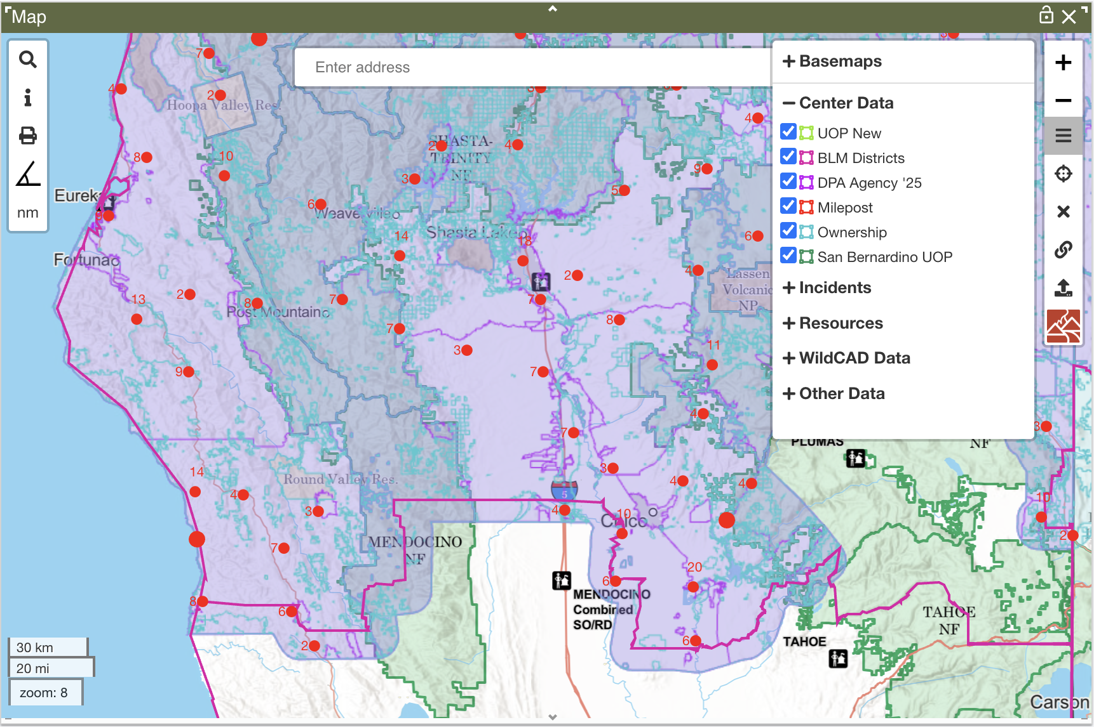
Center Data Layers
Controlled by the center admin
Shapefiles and ESRI-hosted map layers
2 Ways to View Info:
Map Footer
Point Info panel
Notes:
Controlled by the center admin – this is where they control the color, opacity, line thickness, point size, and display field, display order
View specific attributes in the map footer – must have a display field set by the center admin, does not need to be actively turned on, will only show attribute of 1 field
View all attributes in the Point Info panel – layer must be turned on
Shapefiles and ESRI hosted map layers- this can be tested by dispatchers using the 2 upload buttons on the map
Close layers list, then demo url upload, Use counties - https://services.arcgis.com/P3ePLMYs2RVChkJx/arcgis/rest/services/USA_Census_Counties/FeatureServer/0

Slide 7
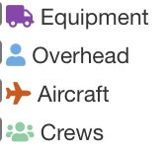
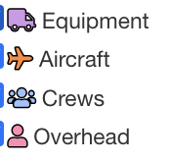
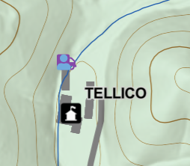
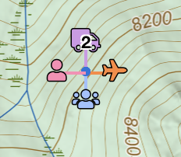
Resource Layers
New Look for Resource Icons
Improved Icon Visibility – no stacking of icons
VS
(Overhead Group is now combined with Overhead)
VS
Notes:
Larger icons, outline, contrasting colors

Slide 8

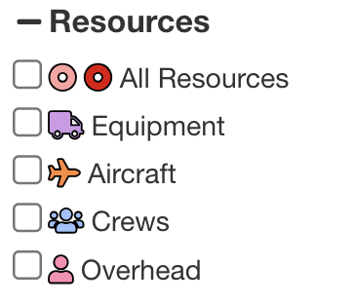

Resource Layers (cont)
New Layer - "All Resources"
Clusters of resources at different locations
Clusters of resources at the same location
Notes:
Clusters of resources at different locations – the classic clusters that are used everywhere else
Clusters of resources at the same location – shows icons

Slide 9

Measurement Tool
How to start and end a measurement
In, Out and Distance
Changing Units

Slide 10
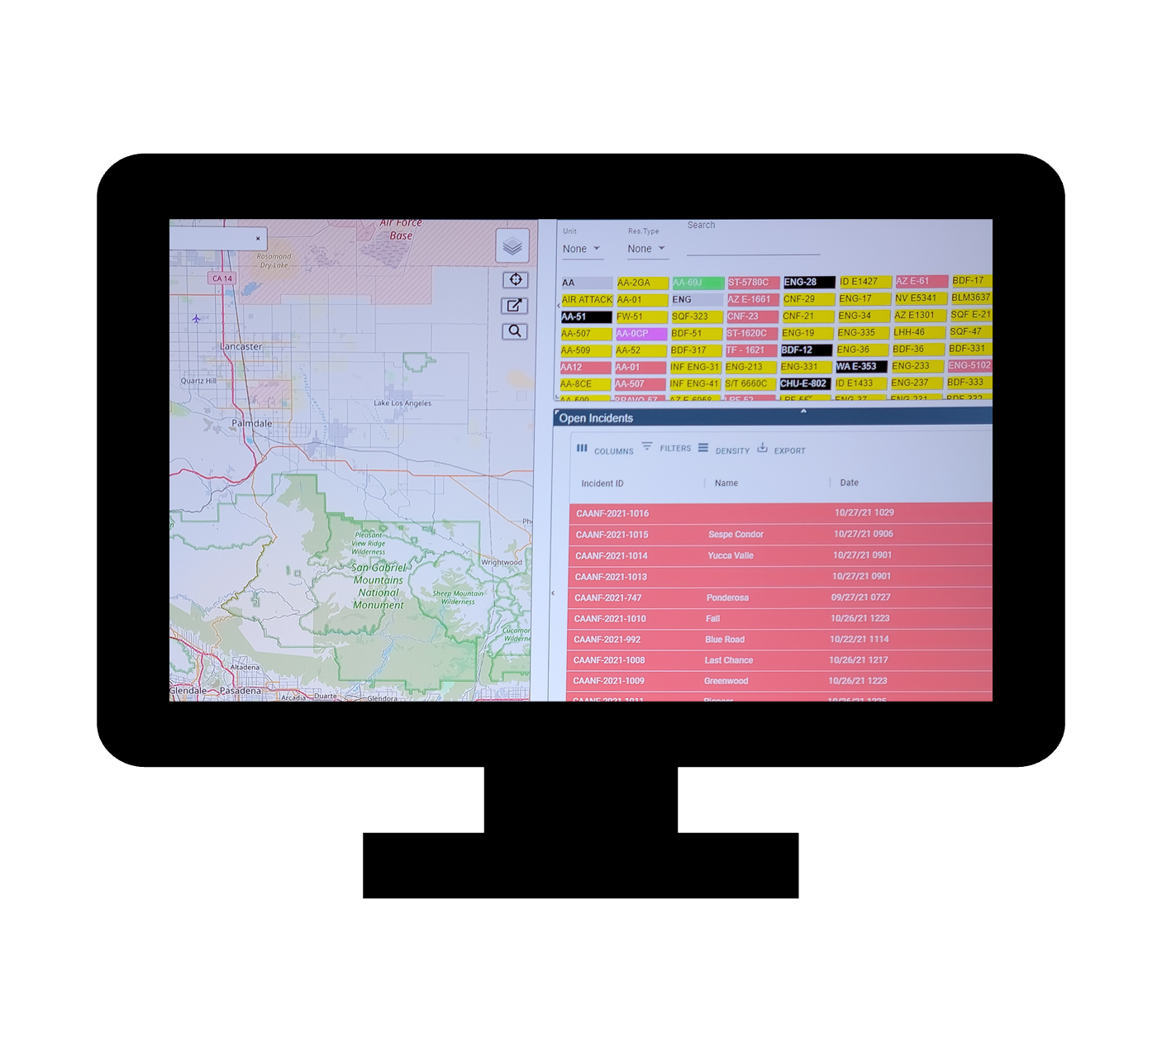
Questions

Slide 11
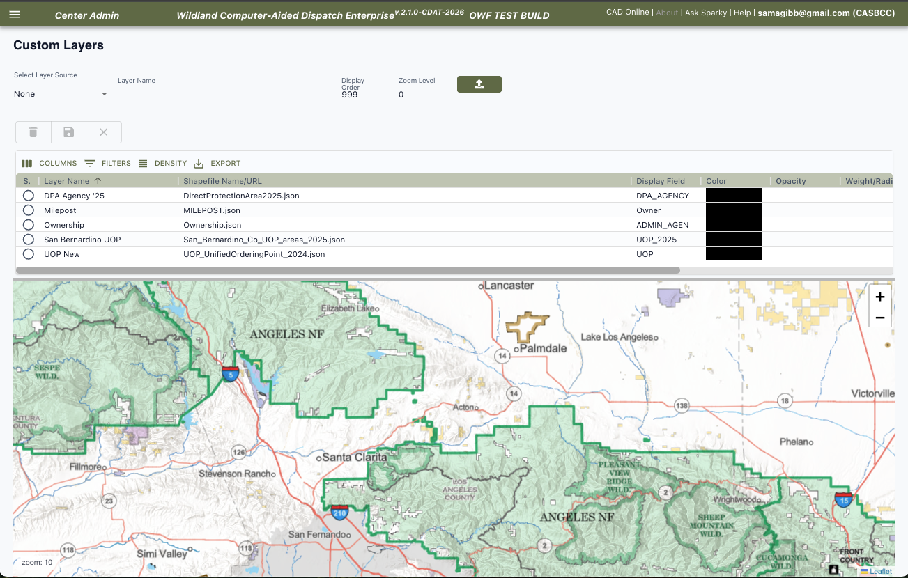
Center Admins – Configure the Map
Topics:
Point Data
Custom Layers
Map Cache
Hazards
Place Names
Milepost
Response Area GIS Layer
Notes:
Center admin topics:
Point Data
Hazard
Place Names
Custom Layers
Milepost
Response Area GIS Layer (Zip File)

Slide 12
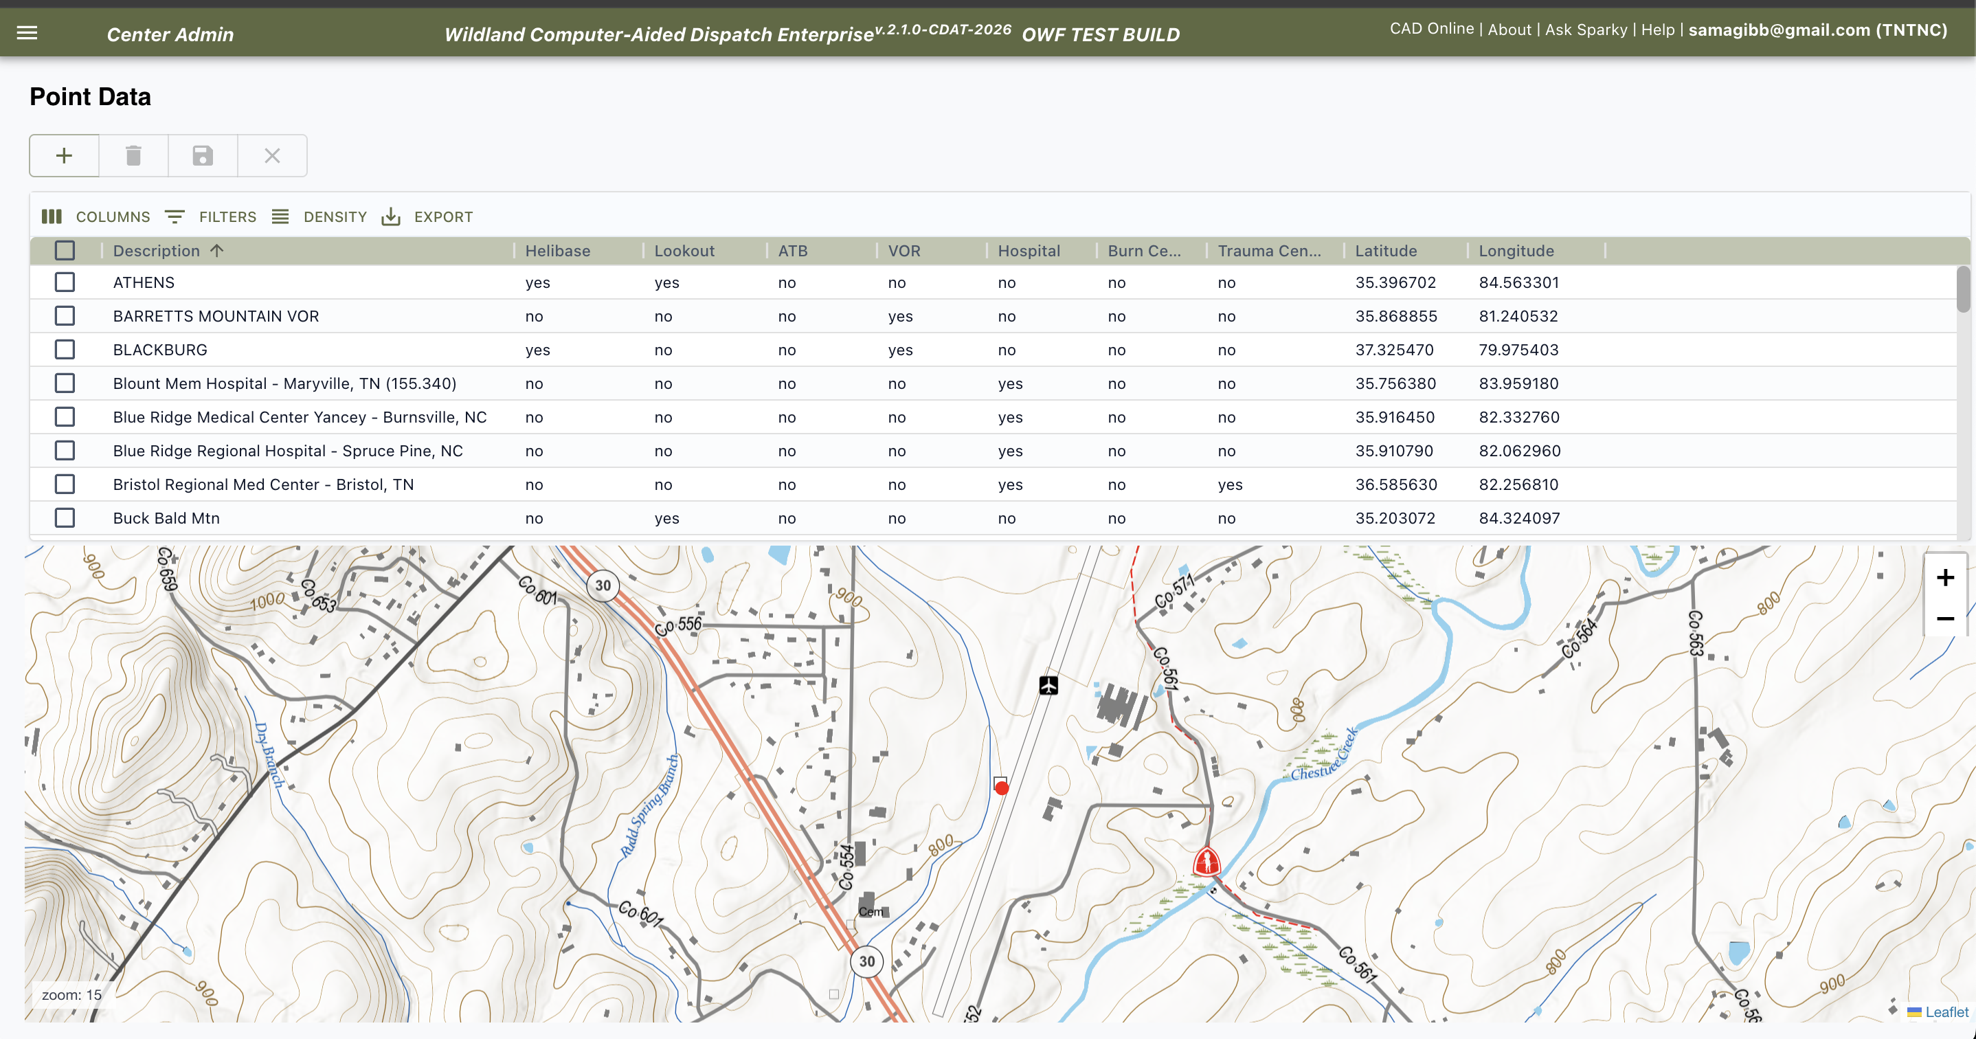
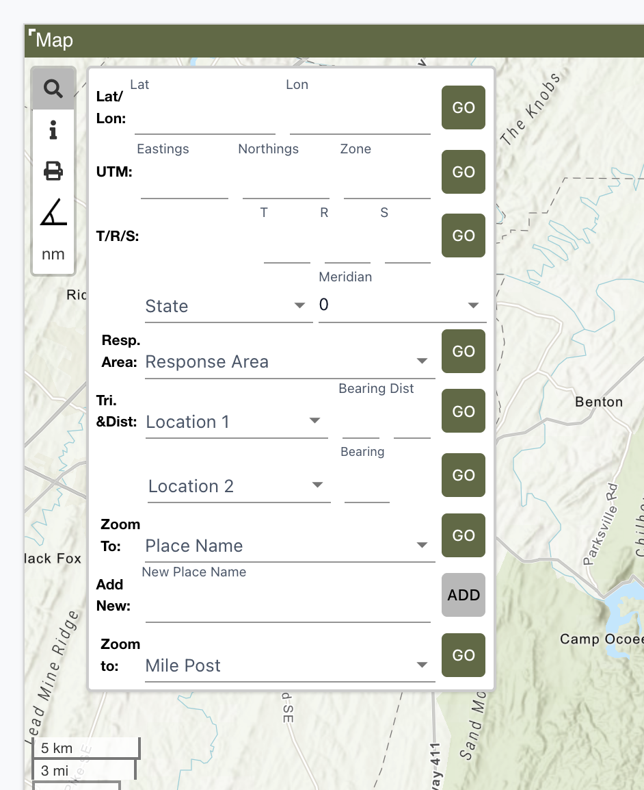
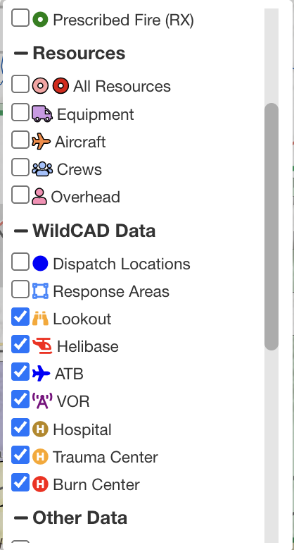
Point Data
View the Data:
"Triangulation and Distance" section of the find panel
WildCAD Data section on the map
Notes:
Demo –
On these pages, click the row (not the check box) to view it on the map.
Check box is to select to delete rows
add a point. Tab out of the row then click to to preview it,
refresh the app, turn the layer on, then zoom to it

Slide 13
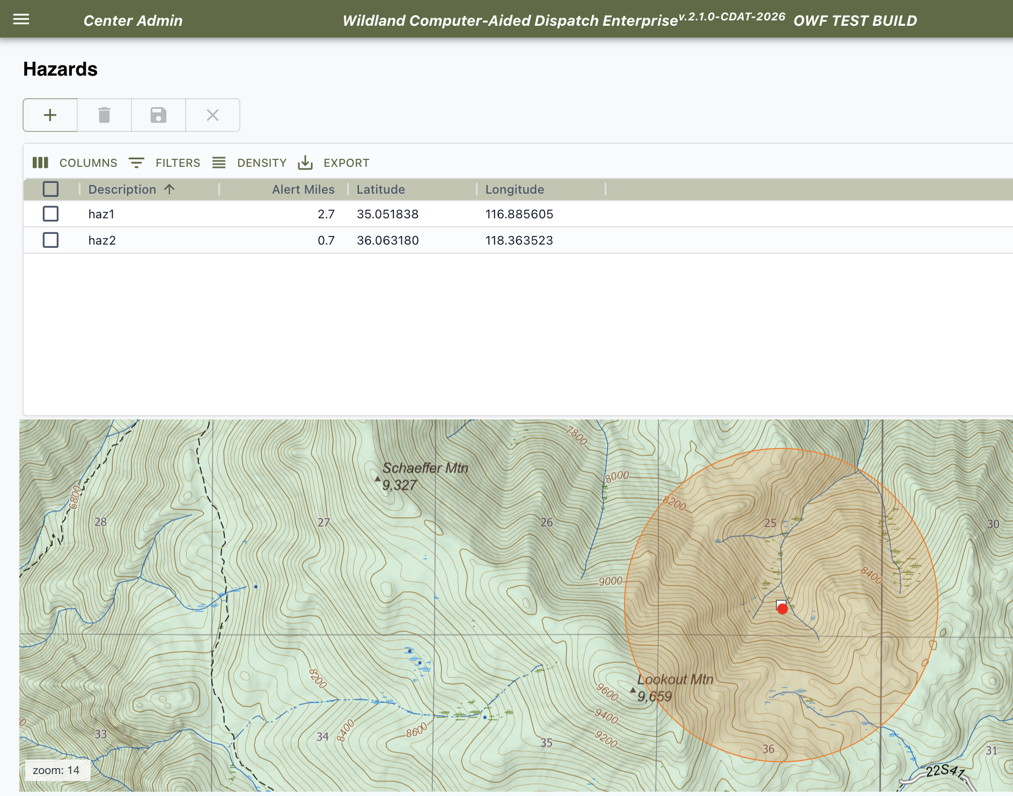
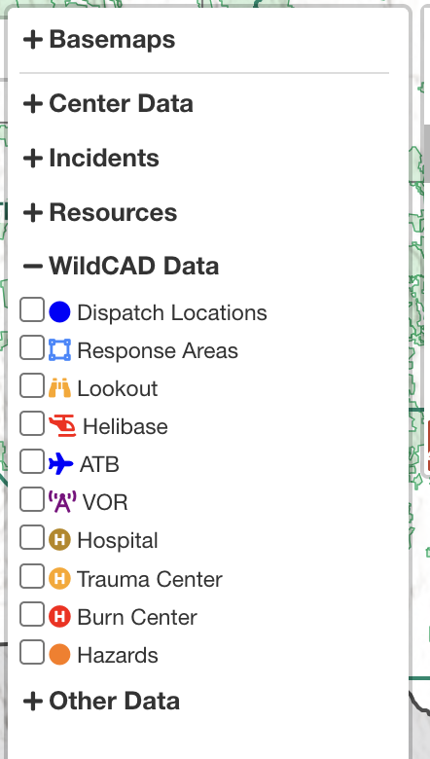
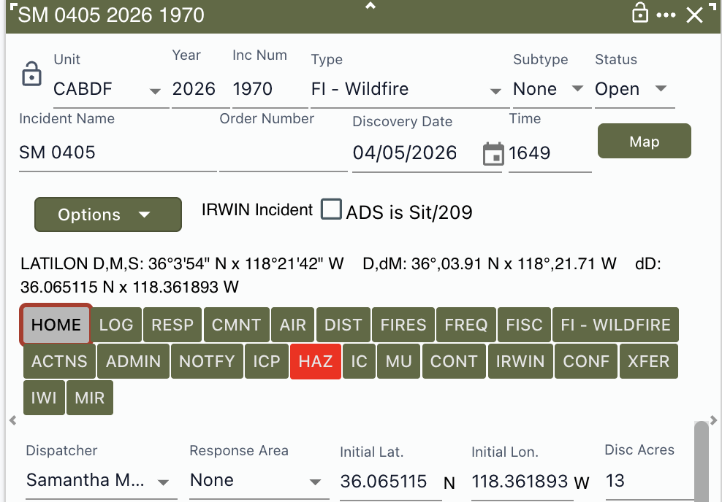
Hazards
View the Data:
WildCAD Data section on the map
HAZ tab on the incident
Notes:
Demo –
Add the point's lat/lon and alert miles. If incidnet falls within the radius, the HAZ tab will appear
Refresh the app, then open incident. HAZ tab appears IF incident is inside radius

Slide 14
Custom Layers
Notes:
Failing file
Double click to launch again
Resize screen

Slide 15
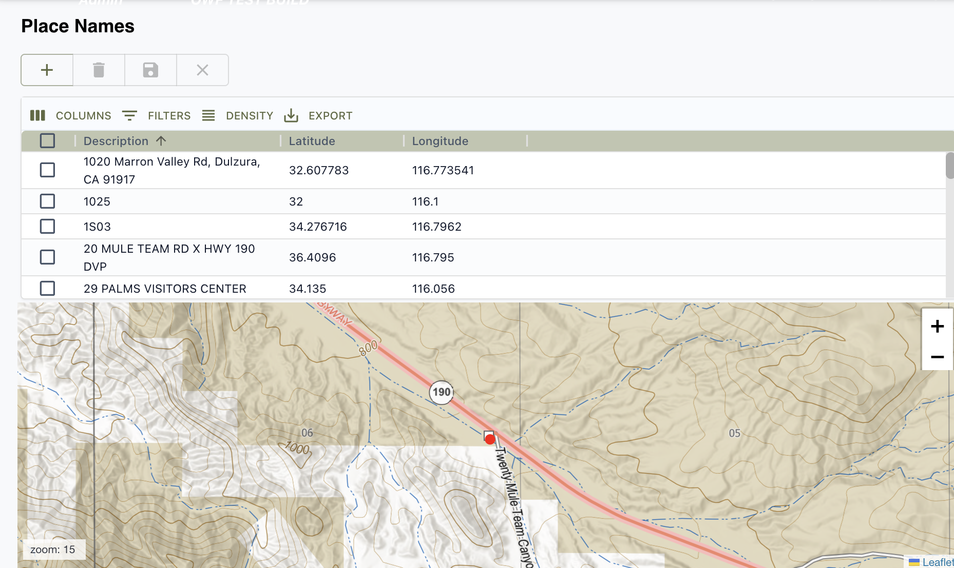
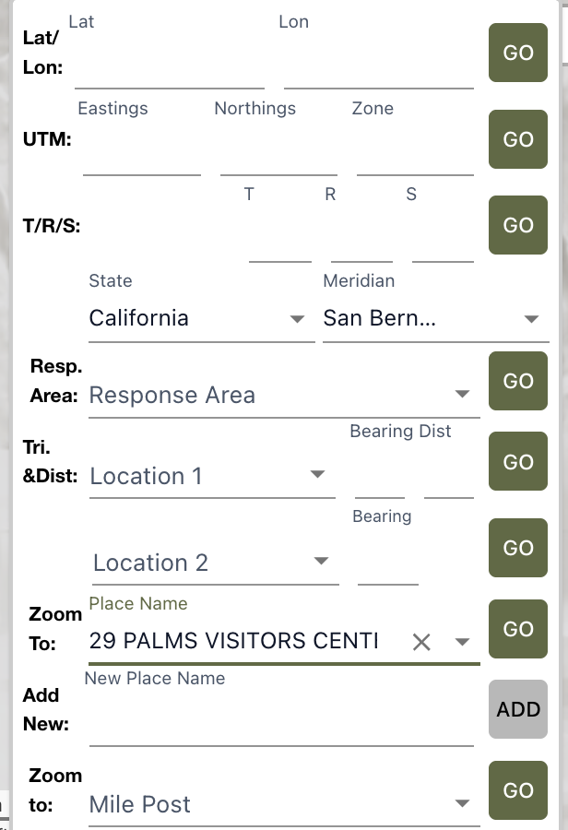
Place Names
View the Data:
The "Find Panel" on the map
Notes:
Demo –
Add placename
Go back to the map's fine panel, select and zoom to

Slide 16
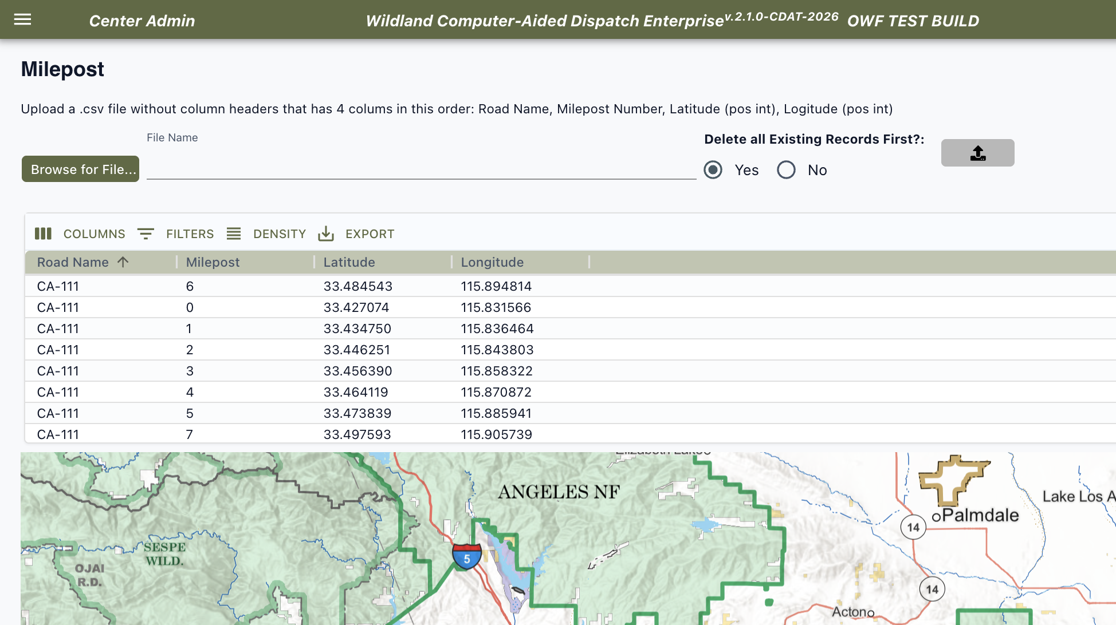
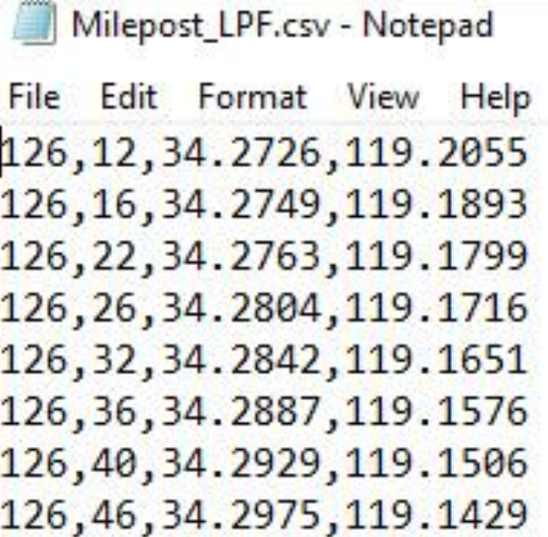
Milepost
File Format:
CSV
no header
4 columns in specific order -
Road Name
Milepost Number
Latitude
Longitude (positive value)
Append to existing list OR
Replace existing list
Notes:
Demo –
CSV – comma separated values, order is: road name, milepost number, latitude, longitude (forced to be positive value)

Slide 17
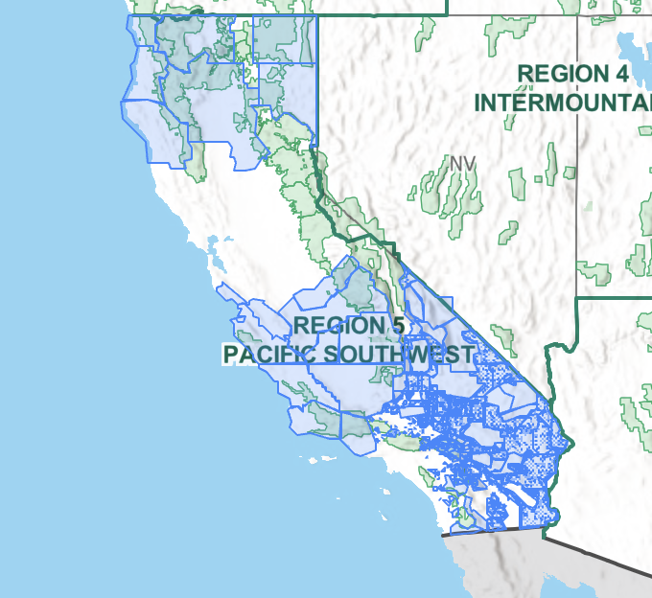
Response Area GIS Layer
Ties the incident location -> response area -> dispatch strategy
Display field must match Code column on response areas page
Zipped file must includes: .shp, .dbf, .prj, .shx
Accepts any defined coordinate reference system (NAD83, WGS84, State Plane, etc)
Notes:
Check in GIS for correct data, overlapping polygons, etc.

Slide 18
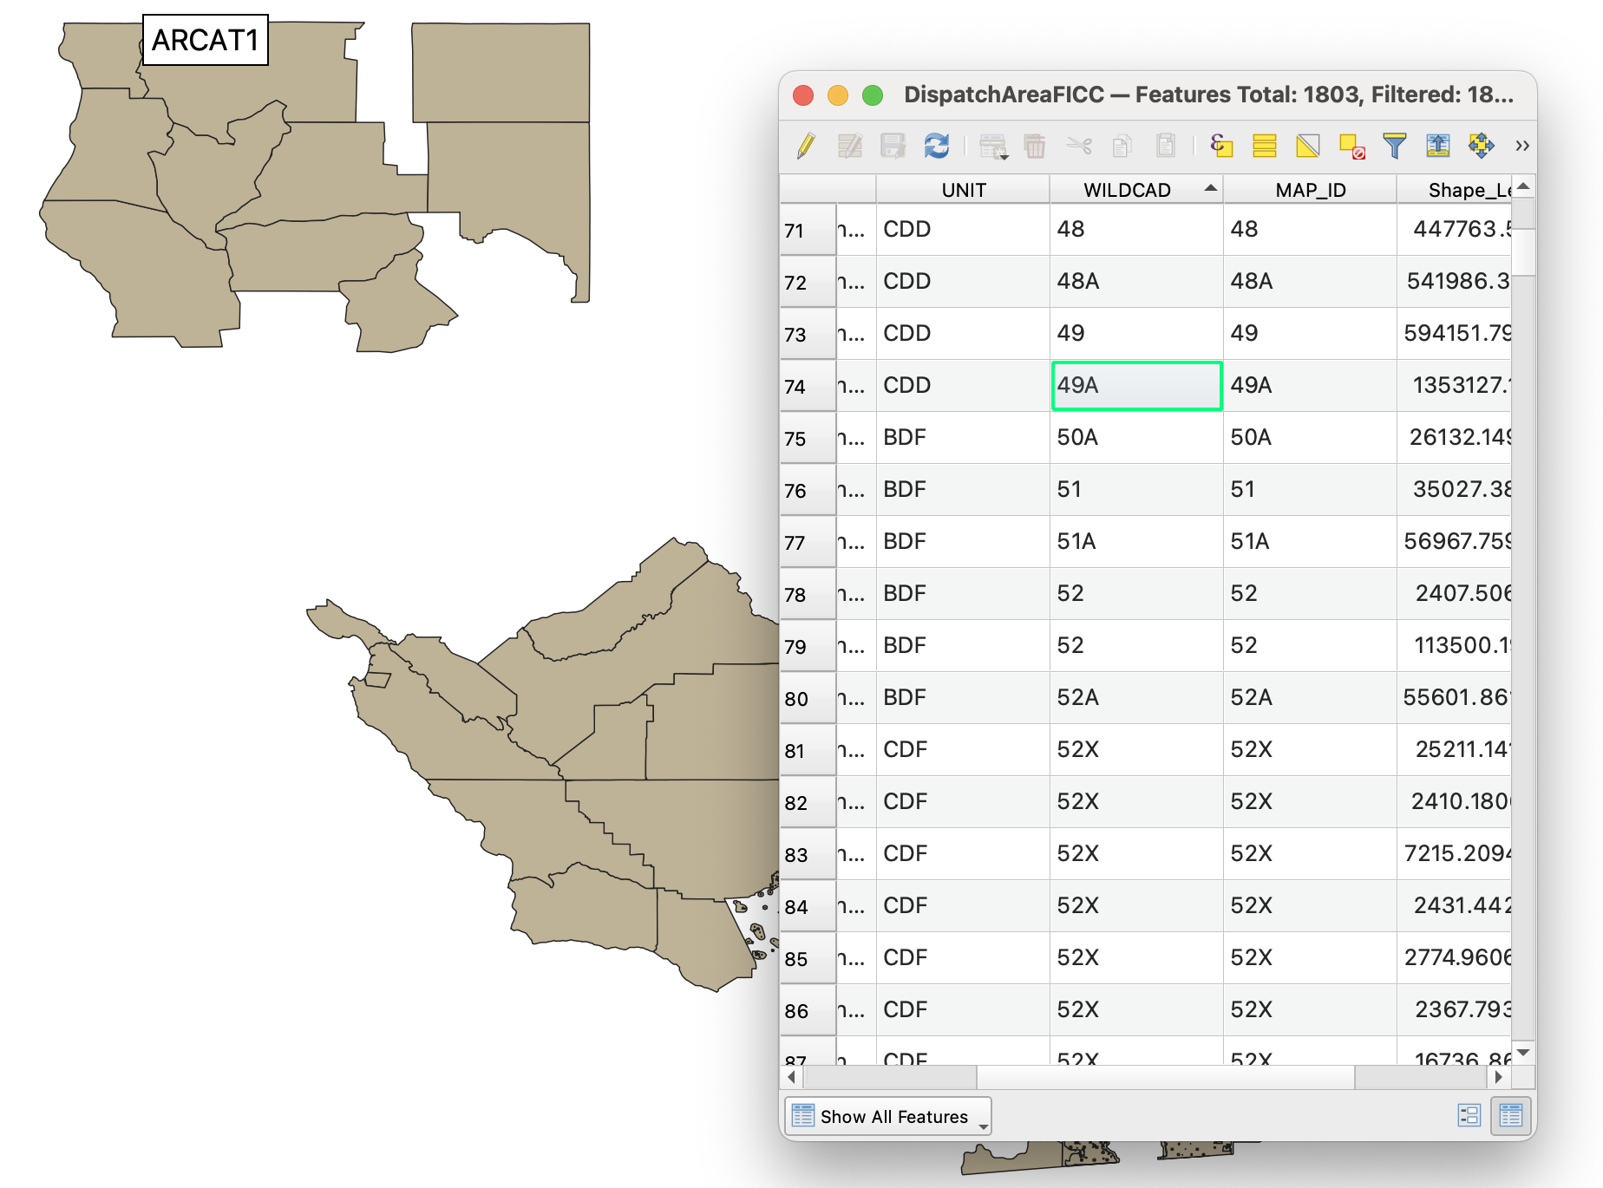
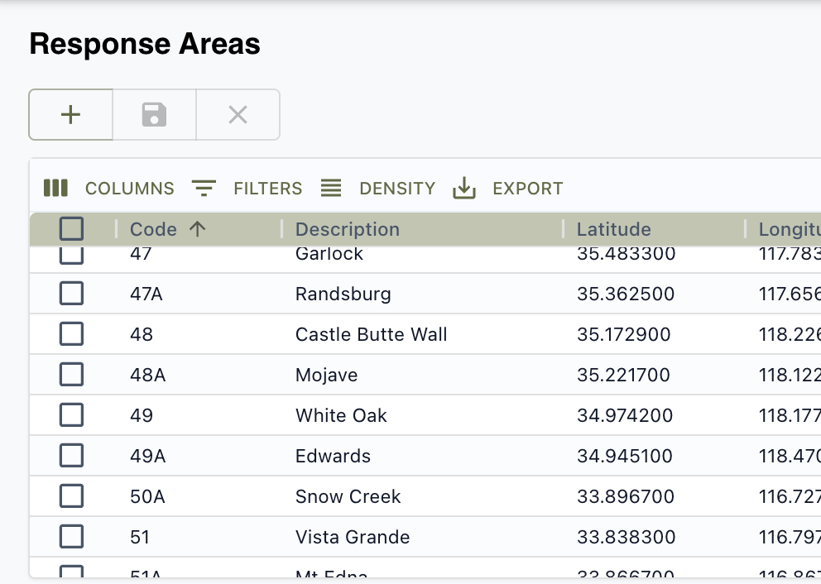
Response Area GIS Layer (cont)
The column in the GIS file must match up with...
...the column in the Resonse Areas table
GIS software

Slide 19
Questions

