Slide 1
In order to get the full benefit of this training, please run this PowerPoint as a slideshow.
For the full effect, have your sound turned ON.
Run the presentation
NIFC-NIICD-NIRSC Basic Radio Operations Training
It would be helpful to have a BK DPH or KNG2 portable radio handy too!

Slide 2
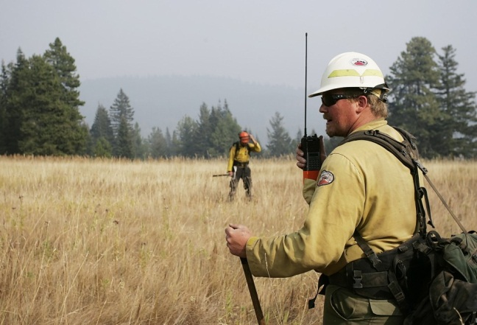
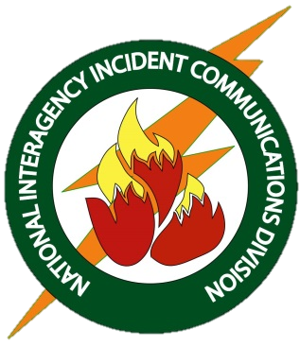
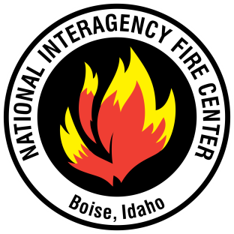
National Incident Radio Support Cache
Basic Radio Operation Training
NIFC – NIICD – NIRSC
NIFC-NIICD-NIRSC Basic Radio Operation Training
Kim Albracht 03/11/2021

Slide 3
INTRODUCTION
This training relates to NIFC National Incident Radio Support Cache (NIRSC) radio equipment and systems. A system that is not a NIFC-NIRSC system may work differently. As the BK DPH and KNG2 are the primary NIFC-NIRSC incident handheld radios, they will be featured in this training presentation.
It is the responsibility of each user to understand the radio system and how to use it effectively and efficiently.
YOUR HEALTH AND SAFETY
AND THAT OF OTHERS MAY
DEPEND ON IT.
NIFC-NIICD-NIRSC Basic Radio Operation Training

Slide 4










MAIN MENU
If you are viewing this presentation for the first time, it is important that you continue through to the next slide, completing the entire presentation.
If you are here to get a refresher on a particular concept, however, please click on one of the options below and you will be taken to the beginning of that section.
Pressing the home button ( ) in the upper right corner of each slide will bring you back to this menu.
KEY THINGS
PROPER RADIO USE, PROTOCOL, LINGO
RADIO THEORY BASICS
NIFC-NIICD-NIRSC Basic Radio Operation Training
CHANNEL GROUPS
FUNCTION KEY
SCAN
SQUELCH
PRIORITY SCAN
KNOW YOUR RADIO
CHANNEL GUARD TONES

Slide 5


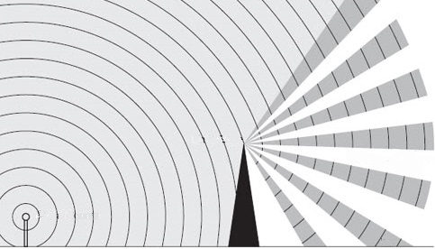

RADIO THEORY BASICS –
How does radio work?
Radio waves are a type of electromagnetic radiation, the same as light waves, so they can be thought of in a similar way. If you want light to reach a certain object, a light source needs to be in that object’s “line of sight” with nothing blocking its path. Radio waves are the same. In order to communicate with a certain radio, you need to be in that radio’s general line of sight.
NIFC-NIICD-NIRSC Basic Radio Operation Training

Slide 6
RADIO THEORY BASICS –
How does radio work?
When you have line of sight between two radios and enough power to cover the distance, those radios should be able to speak directly to one another on a simplex channel without the use of intermediary equipment. Simplex channels use the same frequency to transmit and receive and are also known as direct or car-to-car channels.
Air-to-Ground and Tactical
channels are examples of
simplex channels.
NIFC-NIICD-NIRSC Basic Radio Operation Training

Slide 7
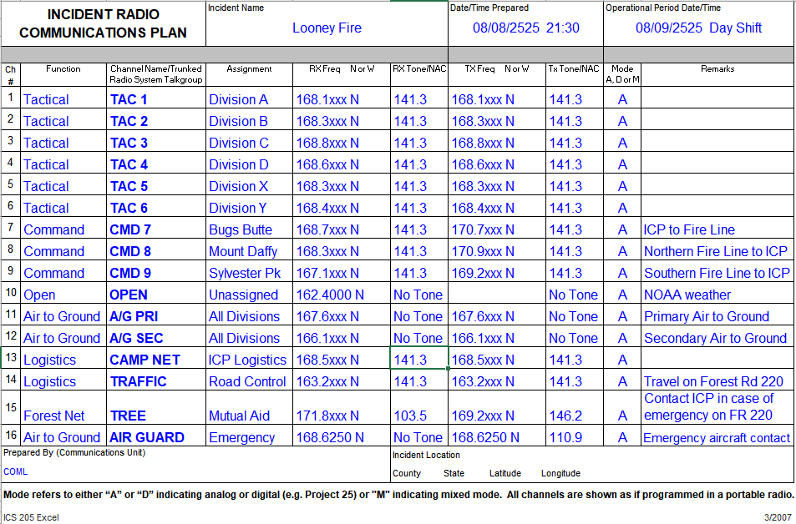
RADIO THEORY BASICS –
ICS-205 Incident Radio Comm Plan
Simplex Channels
EXAMPLE
TX and RX frequencies are the same
NIFC-NIICD-NIRSC Basic Radio Operation Training
TX = Transmit RX = Receive

Slide 8
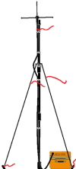
RADIO THEORY BASICS –
Repeaters
When two radios are not able to talk directly to one another due to distance or terrain, a repeater is needed.
A repeater is a radio which is used to increase the range and coverage of mobile and handheld units. It is usually located on higher terrain such as a mountain top.
Repeaters receive on one frequency and simultaneously re-broadcast (repeat) the signal on a different frequency.
They extend your “line of sight”.
“Command” channels are repeater channels.
NIFC-NIICD-NIRSC Basic Radio Operation Training
168.7xxx MHz
170.9xxx MHz

Slide 9
RADIO THEORY BASICS –
ICS-205 Incident Radio Comm Plan
Repeater Channels
EXAMPLE
TX and RX frequencies are different
NIFC-NIICD-NIRSC Basic Radio Operation Training
TX = Transmit RX = Receive

Slide 10



RADIO THEORY BASICS –
Repeaters
NOTE: NIFC-NIRSC repeaters are designed to be linked together. If you key up one repeater, all repeaters in the system will be keyed. Use the repeater that works best for the area in which you will be working.
NIFC-NIICD-NIRSC Basic Radio Operation Training
LINKED

Slide 11
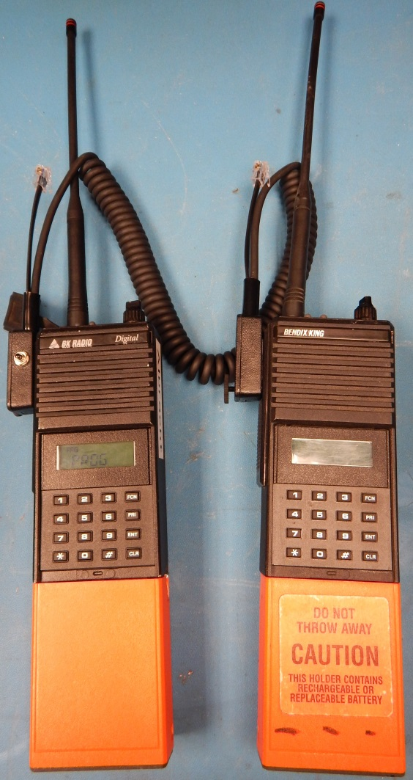
RADIO THEORY BASICS –
Cloning & Programming
NIFC-NIRSC DPH and KNG2 radios are keypad-programmable. If you do not have the training to do so, it is better to have your radio programmed by someone who does. Better still, have your radio “cloned” from a radio that has already been programmed. You can always find able programmers willing to help in the Communications Unit.
You can also find help here: https://www.nwcg.gov/publications/training-courses/rt-130/communications
Clone - copies the programming (frequencies, tones, names, etc.) from the current group of the master radio to the current group of the radio receiving the clone.
Make sure you always have the latest programming/clone to match the current ICS-205 Incident Communications Plan.
PROGRAM YOUR RADIO WITH AUTHORIZED FREQUENCIES ONLY.
Radios connected for cloning
NIFC-NIICD-NIRSC Basic Radio Operation Training

Slide 12
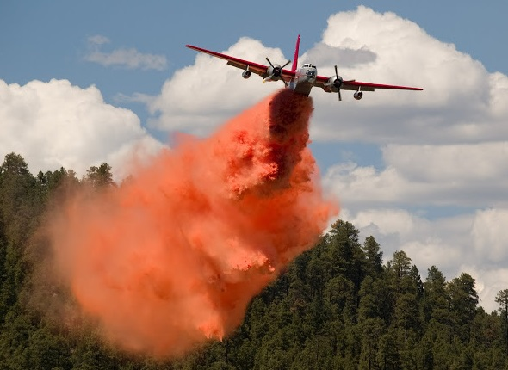
RADIO THEORY BASICS –
Air Guard
All aircraft operating on federal incidents are required to have a radio devoted exclusively to the continuous monitoring of the AIR GUARD frequency: 168.6250, with a TX tone of 110.9 Hz.
AIR GUARD is an emergency aviation communications channel. It must be used only for:
  Emergency air-to-ground communications
  Emergency air-to-air communications
  Initial call, recall, and re-direction of aircraft when no other contact frequency is available
AIR GUARD is not to be used for tactical communications, local dispatching, administrative, flight-following or logistical use.
All Incident Radio Communications Plans (Form ICS-205) on federal incidents are required to have AIR GUARD programmed in the last available channel on the channel knob of all portable radios. If you are in an emergency situation and need to reach aircraft, you can quickly turn your radio to this channel to make emergency contact.
NIFC-NIICD-NIRSC Basic Radio Operation Training

Slide 13
RADIO THEORY BASICS –
ICS-205 Incident Radio Comm Plan
Air Guard
EXAMPLE
NIFC-NIICD-NIRSC Basic Radio Operation Training
TX = Transmit RX = Receive

Slide 14
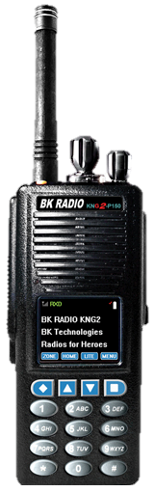
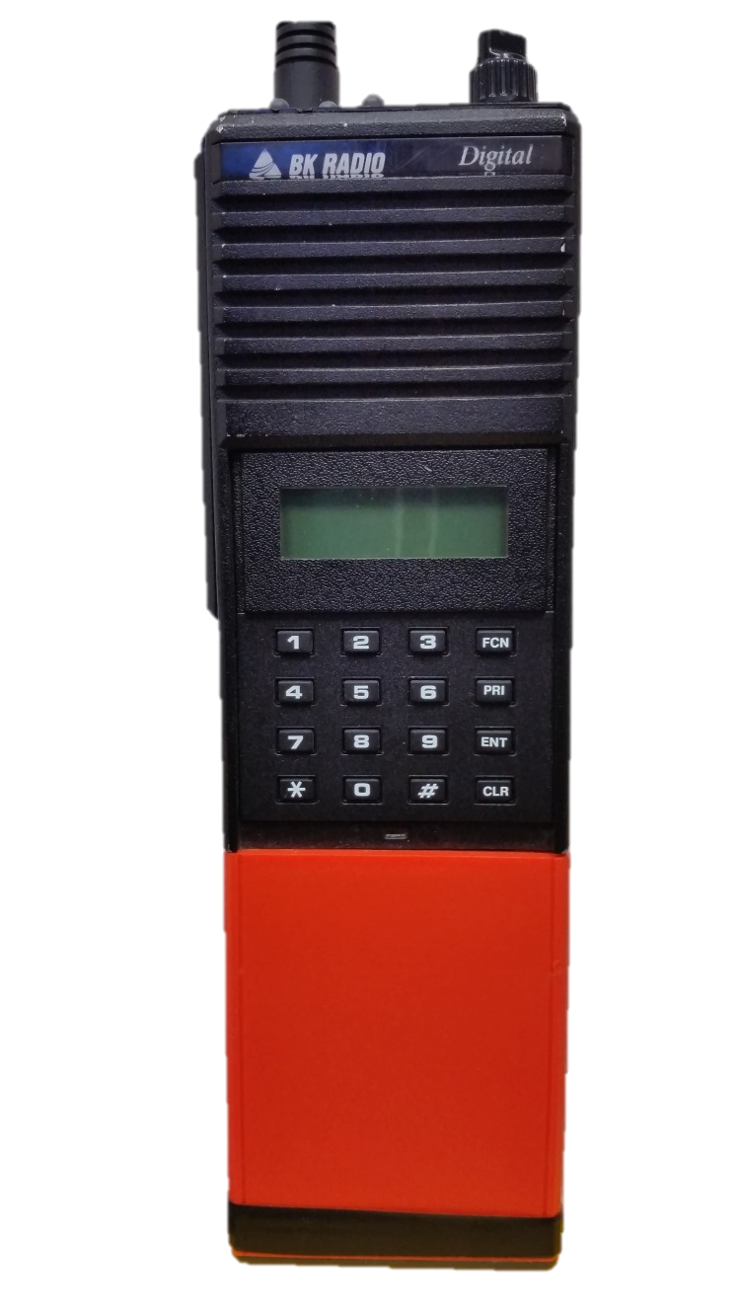
KNOW YOUR RADIO-
Select Your Radio to Continue
KNG2
If you want to go through both radios, continue to next slide. You will see some redundancy.
If you want to only look at one, click on the picture of that radio.
DPH

Slide 15
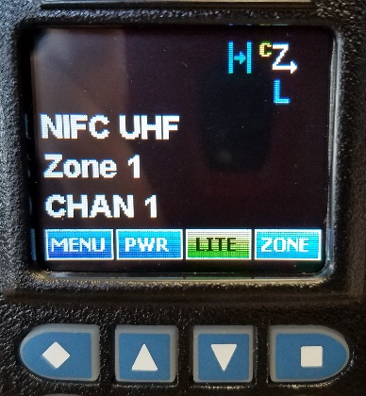
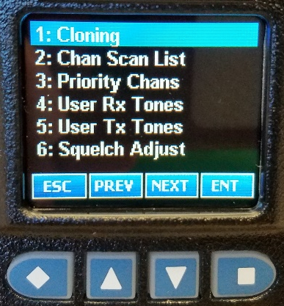
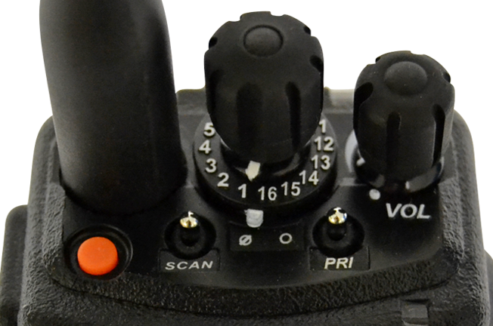
KNOW YOUR RADIO-
BK KNG2 Handheld
Antenna
Indicator Light:
RX - Busy Channel
Transmit
Indicates simplex channel – if not present, it is a repeater channel
Programming, Cloning, and Accessory Jack
H – TX High Power
L – TX Low Power
Internal Speaker & Mic
Indicates scan is on
Channel Selector Knob
PTT
Push-to-Talk
These buttons select the options on the screen.
To find more options, select MENU.
NIFC-NIICD-NIRSC Basic Radio Operation Training
Monitor Button
ON/OFF
Volume Knob
Menu Access & Entry Keypad
- used to access key features that have been programmed into the radio
Scan Switch
Priority Scan Switch

Slide 16
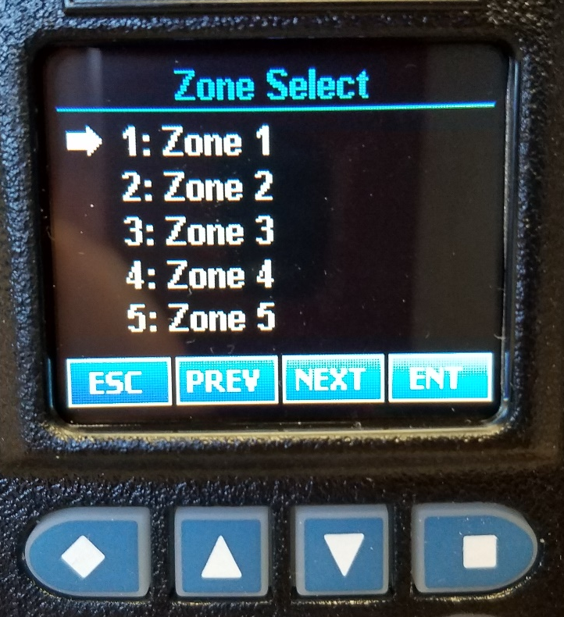
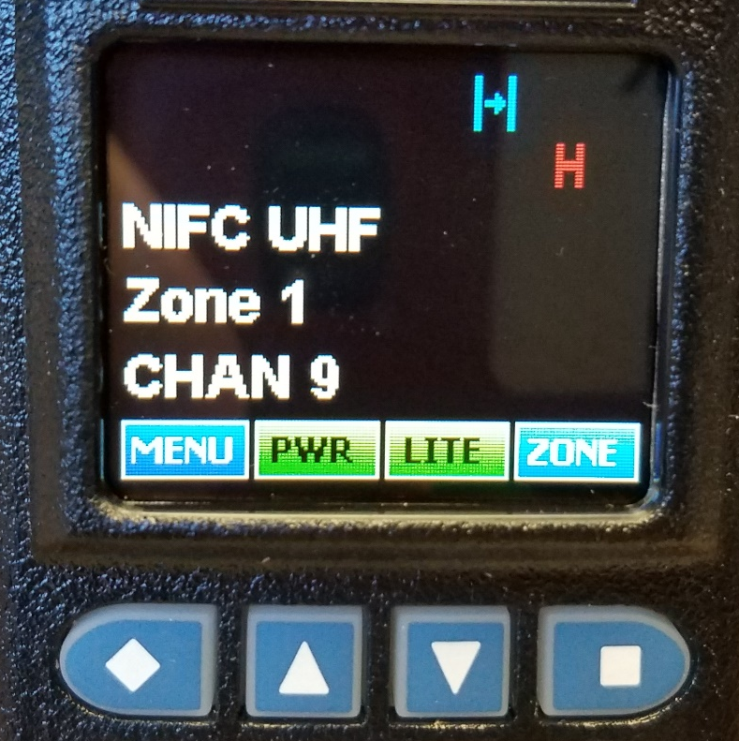
KNOW YOUR RADIO – KNG2 Changing Channel Zones
The channels in your radio are organized into groups or zones.
In the BK KNG2 radios, there are 16 channels per zone.
NIFC-NIICD-NIRSC Basic Radio Operation Training
Zones are selected and changed through the menu screen. Push the Zone button and you will be given a list of zones from which to select.

Slide 17

KNOW YOUR RADIO –
Channel Guard Tones
Code guard (CG) tones are known by many names: channel guard tones, Private Line (PL) tones, CTCSS tones . . . They are sub-audible signals that are transmitted along with the transmit frequency to perform special functions like accessing specific repeaters, or to protect a channel or system from outside interference. They act like a key; you need to use the correct key to activate the radio.
On an incident, all repeaters will use the same tone for transmit and receive and will not operate unless the proper tone is transmitted by your radio and received by the repeater.
On an incident, this tone should be programmed into the channel.
See the ICS-205 Incident Radio Communications Plan for correct programming on an incident.
NIFC-NIICD-NIRSC Basic Radio Operation Training

Slide 18
KNOW YOUR RADIO –
ICS-205 Incident Radio Comm Plan
EXAMPLE
CG Tones
NIFC-NIICD-NIRSC Basic Radio Operation Training
RX Tones
TX Tones
TX = Transmit RX = Receive

Slide 19

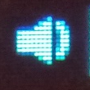
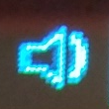
KNOW YOUR RADIO –
The Mysteries of SQUELCH
The SQUELCH circuitry in a radio is designed to keep the radio quiet unless there is a proper signal present.
When a signal of a certain strength and property is detected, the squelch opens (i.e. turns on the audio). High ambient noise levels may provide enough signal to open the squelch (e.g. power lines, fluorescent lights).
If adjusted too tightly, valid signals may not be strong enough to open the squelch. If adjusted too loosely, ambient noise will become annoying audio. Levels are user-adjustable.
Open squelch can be used to hear a very weak signal.
  To fully open squelch on a KNG2, press and hold the Monitor button until you hear static (below the PTT – scan must be turned off).
  (NOTE: pushing the Monitor button once will turn off the receive tone for all channels. You’ll hear all traffic on that frequency whether from a legit incident source or not.)
  The squelch level is otherwise adjusted through the menu.
NIFC-NIICD-NIRSC Basic Radio Operation Training
Monitor On
RX CG Off

Slide 20
KNOW YOUR RADIO - Scanning
The Scan function allows the user to monitor several channels at one time in addition to the current selected channel. Scan operates only when the radio is not transmitting. When a scanned signal is detected, the radio stops scanning, locks onto that channel, and receives the message.
The received channel will be shown on the display if different from the current transmit channel. Once the signal ends, the radio continues to monitor that channel during a certain scan delay time before it resumes scanning.
To respond to a message received on a scanned channel other than the selected transmit channel, you must first turn the channel knob to that channel.
NOTE: Scanning takes more power and drains batteries more quickly.
PRIORITY SCAN – this can be programmed to work many ways. Contact your Comm Unit for more info. Until then it suggested that you leave Priority Scan off.
NIFC-NIICD-NIRSC Basic Radio Operation Training
KNG2
Scan Switch

Slide 21

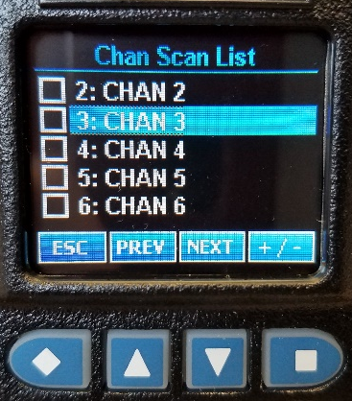
KNOW YOUR RADIO – KNG2 Scanning
You can set up you scan list through the menu.
Toggle the channels you want to add to the scan list.
NIFC-NIICD-NIRSC Basic Radio Operation Training
Move the Scan Switch to On and the radio will begin scanning the channels in your scan list.
KEY THINGS
PROPER RADIO USE, PROTOCOL, LINGO
Click above to skip past the DPH radio or click enter to continue.
NOTE: To avoid the possibility of missing calls because of increased radio traffic and to avoid rapid battery depletion, NIFC-NIRSC recommends scanning no more than three channels.

Slide 22
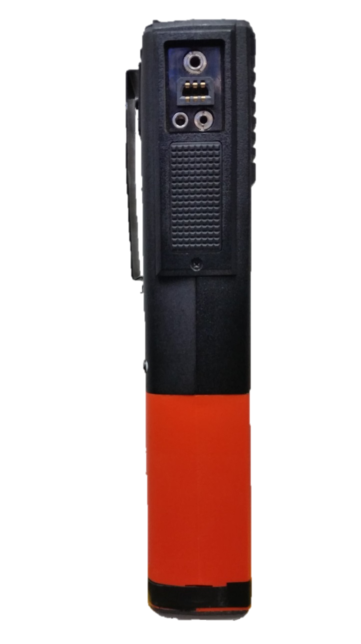
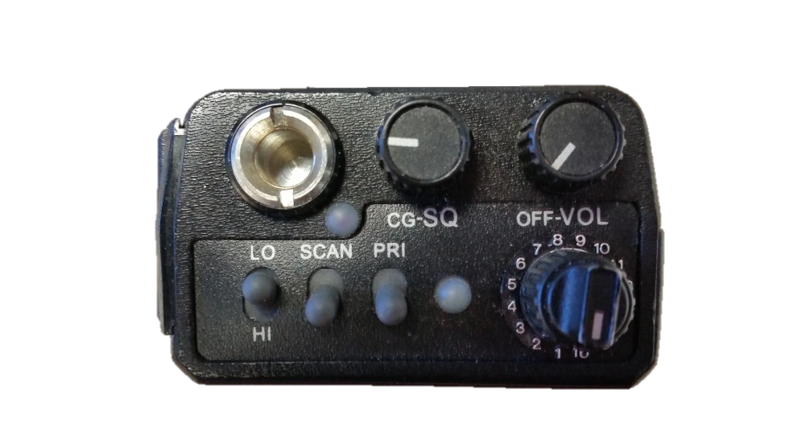
KNOW YOUR RADIO-
BK DPH Handheld
External Antenna Jack
Internal Speaker & Mic
Squelch Knob
ON/OFF
Volume Knob
Programming and Accessory Jack
Antenna Connector
Mounting Jack
Entry Keypad
- used to access key features that have been programmed into the radio
Earphone Jack
PTT
Push-to-Talk
NIFC-NIICD-NIRSC Basic Radio Operation Training
A – HI/LO Power
B – Scan
C – Priority Scan
Indicator Light:
Priority Channel
RX - Busy Channel
Low Battery (flash on TX)
Channel Selector Knob
TX Indicator Light:
Transmit
Battery Clamshell

Slide 23
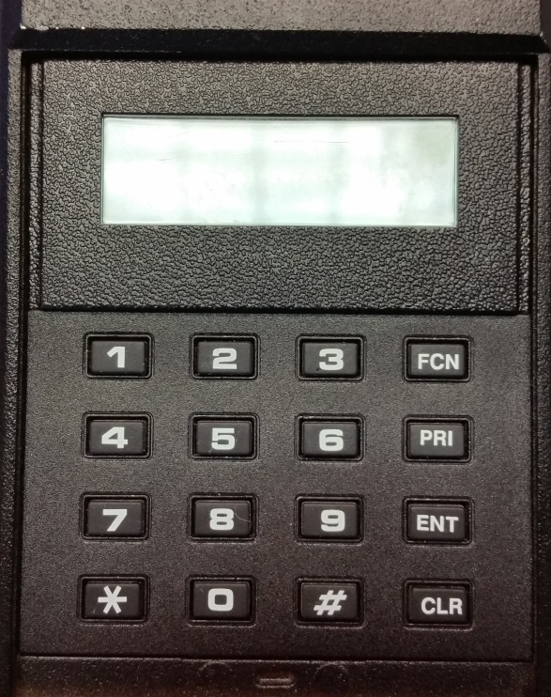
KNOW YOUR RADIO – DPH Changing Channel Groups
The channels in your radio are organized into groups.
In the BK DPH radios, there are 16 channels per group and 25 groups.
Press the # key on the keypad to display the current group number.
Press the new number for the desired group (up to two digits).
GRP 02
GRP 05
CMD 8
GRP
TAC 5
Press the ENT key or wait five seconds.
The radio returns to normal operation in the new group and the selected channel is displayed.
NIFC-NIICD-NIRSC Basic Radio Operation Training
NOTE: When changing groups, invalid entries will not be accepted and the radio will remain in the previously selected group.

Slide 24
KNOW YOUR RADIO –
Channel Guard Tones
Code guard (CG) tones are known by many names: channel guard tones, Private Line (PL) tones, CTCSS tones . . . They are sub-audible signals that are transmitted along with the transmit frequency to perform special functions like accessing specific repeaters, or to protect a channel or system from outside interference. They act like a key; you need to use the correct key to activate the radio.
On an incident, all repeaters will use the same tone for transmit and receive and will not operate unless the proper tone is transmitted by your radio and received by the repeater.
For BK DPG radios, if the incident has a tone assigned, the squelch knob should be set fully counterclockwise to the CG squelch position (the knob will click as if in the “off” position) so that the radio’s receiver will only open if it receives the correct code guard. This protects your radio from receiving non-incident-related traffic and interference.
See the ICS-205 Incident Radio Communications Plan for correct programming on an incident.
NIFC-NIICD-NIRSC Basic Radio Operation Training

Slide 25
KNOW YOUR RADIO –
ICS-205 Incident Radio Comm Plan
EXAMPLE
CG Tones
NIFC-NIICD-NIRSC Basic Radio Operation Training
RX Tones
TX Tones
TX = Transmit RX = Receive

Slide 26

KNOW YOUR RADIO –
The Mysteries of SQUELCH
The SQUELCH circuitry in a radio is designed to keep the radio quiet unless there is a proper signal present.
When a signal of a certain strength and property is detected, the squelch opens (i.e. turns on the audio). High ambient noise levels may provide enough signal to open the squelch (e.g. power lines, fluorescent lights).
If adjusted too tightly, valid signals may not be strong enough to open the squelch. If adjusted too loosely, ambient noise will become annoying audio. Levels are user-adjustable.
There may also be times you will want to fully open the squelch:
  Open squelch can be used to hear a very weak signal – Monitor.
  For DPH radios, open squelch can be used to set the listening volume level (demonstrated on the next slide).
NIFC-NIICD-NIRSC Basic Radio Operation Training

Slide 27
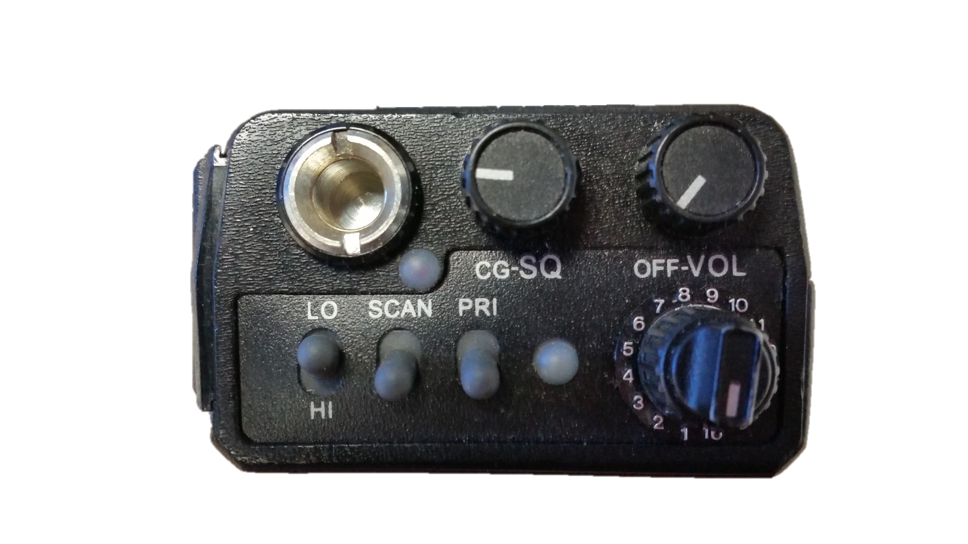
KNOW YOUR RADIO –
BK DPH Squelch Adjustment
Or turn the squelch knob all the way counterclockwise until you hear a click (“off” or detent) to set the radio to CG Squelch operation.
The radio will then only receive traffic that is transmitting the proper code guard (CG).
As previously mentioned, NIFC-NIRSC systems will have an assigned CG on TX and RX; radios should ALWAYS be set to the CG Squelch mode unless you need to monitor.
Adjust squelch and volume by turning the squelch knob clockwise until you hear noise.
Then turn the squelch knob counterclockwise until the noise stops.
This is called the Threshold Squelch setting.
Set the volume to a comfortable level.
NIFC-NIICD-NIRSC Basic Radio Operation Training

Slide 28

KNOW YOUR RADIO - Scanning
The Scan function allows the user to monitor several channels at one time in addition to the current selected channel. Scan operates only when the radio is not transmitting. When a scanned signal is detected, the radio stops scanning, locks onto that channel, and receives the message.
The received channel will be shown on the display if different from the current transmit channel. Once the signal ends, the radio continues to monitor that channel during a certain scan delay time before it resumes scanning.
To respond to a message received on a scanned channel other than the selected transmit channel, you must first turn the channel knob to that channel.
NOTE: Scanning takes more power and drains batteries more quickly.
PRIORITY SCAN – this can be programmed to work many ways. Contact your Comm Unit for more info. Until then it suggested that you leave Priority Scan off.
NIFC-NIICD-NIRSC Basic Radio Operation Training
DPH
Scan Switch

Slide 29
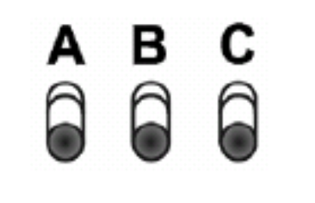

KNOW YOUR RADIO –
BK DPH Scanning
TO ENABLE SCAN
Flip up the switch labeled SCAN.
The LCD display will indicate that SCAN is active by flashing SCN on the display.
TAC 1
SCN
TO DISABLE SCAN
Flip down the switch labeled SCAN.
The LCD display will indicate that SCAN is disabled by displaying SCN as steady letters – not flashing – if on a scanned channel, or blank if on an un-scanned channel.
NIFC-NIICD-NIRSC Basic Radio Operation Training
LO
SCAN
PRI
HI
All KNG2 scanning and priority scanning is simple to set up and edit through the menu. Please skip ahead to the Key Things section.

Slide 30
KNOW YOUR RADIO –
BK DPH - Edit the Scan List
ADD CHANNELS
To add a channel to the scan list, first be sure SCAN is turned OFF. Then turn the channel selector knob to the desired channel to be scanned.
Press the ENT button. The radio will beep and you will see SCN in the display above the channel label.
TAC 5
TAC 6
CMD 8
SCN
CMD 7
A/G 1
RANCH
CMD 9
To add more channels to the scan list, repeat the previous steps.
You can see which channels are in the scan list by scrolling through the channels and looking for SCN to appear on the display.
NIFC-NIICD-NIRSC Basic Radio Operation Training
NOTE: To avoid the possibility of missing calls because of increased radio traffic and to avoid rapid battery depletion, NIFC-NIRSC recommends scanning no more than three channels.

Slide 31
KNOW YOUR RADIO –
BK DPH - Edit the Scan List
DELETE CHANNELS
To delete a channel from the scan list, first be sure that SCAN is turned OFF. Then turn the channel selector knob to the desired channel to be deleted from the scan list.
SCN indicates the channel is in the scan list.
TAC 5
SCN
RANCH
A/G 1
TAC 6
CMD 7
CMD 8
CMD 9
Press the CLR button. The radio will beep and you will see the SCN above the channel label disappear.
NIFC-NIICD-NIRSC Basic Radio Operation Training
To delete more channels from the scan list, repeat the previous steps.

Slide 32
KNOW YOUR RADIO –
BK DPH Function Key
FCN:
The Function Key
GOOD feature – Pressing and holding the FCN key will “lock” the keypad. Press and hold again to “unlock”. This prevents the radio from changing groups, functions, etc., if you accidentally bump the keypad. If you press the keypad and it beeps and reads “LOCKED”, this is what happened.
BAD feature (for our purposes anyway) – Pressing the FCN just once will put you into the function menu. Continuing to press FCN will step you through the menu. Pressing PRI will toggle the displayed function on and off. The function flashes when enabled. If you accidentally hit FCN and find yourself in this menu, either hit the ENT button to escape or wait 5 seconds and the radio will return to normal.
TX DIG
CMD 8
LOCKED
TRN DIR
GRP SCN
NIFC-NIICD-NIRSC Basic Radio Operation Training
*All functions are disabled in NIFC-NIRSC radios but may be active in radios that are not NIFC-NIRSC radios or those that have been reprogrammed. More information on following slide . . .

Slide 33




KNOW YOUR RADIO –
BK DPH Good To Know
  COMMON FUNCTIONS IN THE FCN MENU
  DO NOT ENABLE THESE FUNCTIONS!
  TRN DIR* – Transmit Direct – this puts the radio into repeater talk-around mode. It changes repeater channels to simplex channels by using the channel’s receive frequency for both transmit and receive. If this is toggled on, you will NOT be able to talk through the repeater and only users within range of you will hear you. When this function is activated, there are no visual indicators on the display.
  GRP SCN* – Group Scan – causes the radio to scan all channels, group by group, that are programmed into the radio’s various group scan lists, as well as the current group. When group scan is enabled, priority scan is disabled. This feature also causes a more rapid battery depletion. Regardless of the channel you are on, the display will read as on left if this function is activated.
  TX DIG* – Transmit Digital – causes the radio to transmit in digital mode. NIFC-NIRSC systems are not set up in digital mode; the repeaters and other radios will not recognize the signal if your radio has this enabled. When this function is activated, there are no visual indicators on the display.
FCN:
The Function Key
CMD 8
GRP
-- --
-- --
RX 170.9xxx MHz
TX 168.7xxx MHz
NIFC-NIICD-NIRSC Basic Radio Operation Training
RX 168.7xxx MHz
TX 168.7xxx MHz
RX 168.7xxx MHz
TX 170.9xxx MHz
Radio in repeater talk-around mode.
*All functions are disabled in NIFC-NIRSC radios, but may be active in radios that are not NIFC-NIRSC radios or those that have been reprogrammed.

Slide 34
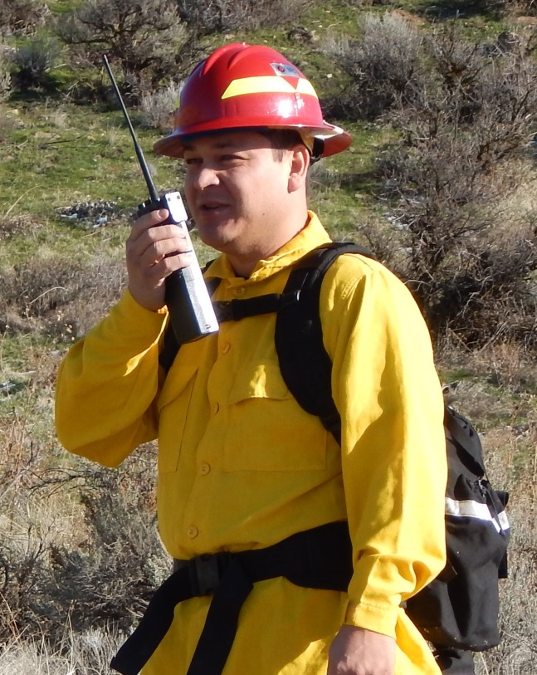
KEY THINGS –
Basic Elements for Radio Communications
Radios must be powered on and operating on the same channel to hear one another.
Be sure you always have the most current clone or programming.
  The Comm Plan may change from one shift to the next, creating the need for a re-clone.
Antennas must be present and properly oriented for best coverage:
  As vertical as possible
  Not blocked by the body or other obstacles
  If you are using a handheld radio inside a vehicle, most of its signal will be blocked. It is best to use an external, mag-mount antenna.
Batteries must be good. Be sure to change them each shift. Depending on how often you transmit, you may need to change them twice per shift.
Units must be “line of sight” and within a practical range of one another.
Use a repeater if “line of sight” to the other unit is blocked.
NIFC-NIICD-NIRSC Basic Radio Operation Training

Slide 35
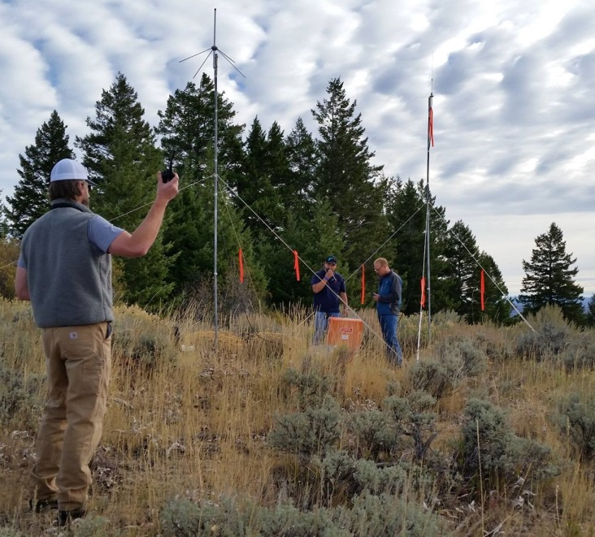
KEY THINGS –
Knowledge is Power
Know which repeaters cover the area in which you will be traveling/working.
Know which radio channels access the repeaters.
Know the simplex channels and what they’re used for (tactical, air-to- ground, etc.). Will you need to use them where you are heading; e.g. checking in with a Division?
If limited or no radio coverage, do you have an alternative form of communications?
  Cell phone
  Satellite phone
  Human repeater
For extended work in areas with no coverage, contact your Communications Unit Leader or Communications Technician for possible solutions.
NIFC-NIICD-NIRSC Basic Radio Operation Training

Slide 36
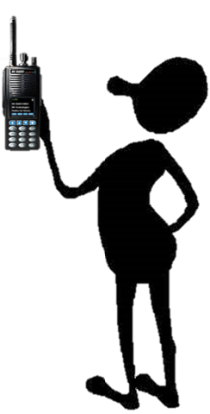
KEY THINGS –
Check your Equipment
Is your radio working?
  Call someone before departing… be sure you get a response.
  Are you using fresh batteries?
  Do you have extra batteries? You should have at least two sets: one in the radio and one spare.
  Perform a quick check when you arrive at your work area to be sure you have good comms from that location.
Is the radio system operational?
NIFC-NIICD-NIRSC Basic Radio Operation Training
Report any problems with the radio system or portable radios to the Communications Unit.

Slide 37
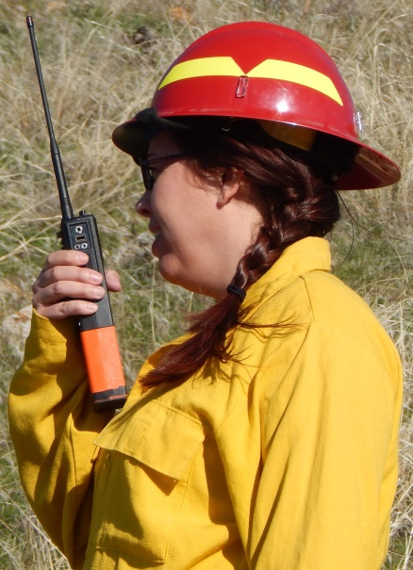
KEY THINGS –
Proper Radio Protocol
Listen first – you don’t want to “walk” on someone else’s traffic. Do not interrupt unless you have an emergency.
When initiating a call, use a to/from format and identify the channel you are using. This way, whoever you are calling knows on which channel to answer back. EXAMPLE: “Communications Unit, Medic Matt on Command.”
Know what you’re going to say before you press the PTT. Remember, PTT stands for push-to-talk, not push-to-think. ☺
Key the mic, pause, then speak. A pause allows the radio system components to link properly.
Hold the mic within a few inches of your mouth with your antenna aligned vertically.
Use a normal voice; don’t whisper or shout.
Speak slowly and distinctly; enunciate, don’t mumble.
Unkey the mic and wait for a response. If you do not receive a response within 10-15 seconds, repeat your call.
Confirm that relayed information is received and understood.
NIFC-NIICD-NIRSC Basic Radio Operation Training

Slide 38
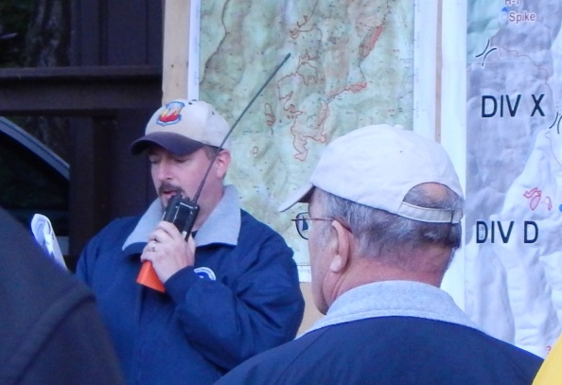
KEY THINGS –
Learning the Lingo
RADIO CHECK – What is my signal strength? Can you hear me?
LOUD & CLEAR (or “5-by-5”) – A response to “radio check” meaning your transmission is readable.
GO AHEAD – Said if another party calls you and you are ready to receive their transmission.
STAND BY – You acknowledge the other party’s call but are unable to respond immediately.
COPY – You understood the transmission.
SAY AGAIN – You are requesting the other party re-transmit their message.
NEGATIVE – Same as “no”, but easier to understand over the radio.
AFFIRMATIVE – Same as “yes”, but easier to understand over the radio.
REPEAT – Used before you repeat something. Example: “There are cattle on the 409 road. Repeat, there are cattle on the 409 road.”
BREAK – Radios have time-out timers, so during long transmissions you need to unkey your radio every 1-2 minutes to reset, say “Break”, and then rekey to resume your message.
Use plain English.
Do NOT use 10-Codes!!!
NIFC-NIICD-NIRSC Basic Radio Operation Training

Slide 39

Thanks, and REMEMBER …
NIFC-NIICD-NIRSC Basic Radio Operation Training
Final Slide

