Slide 1
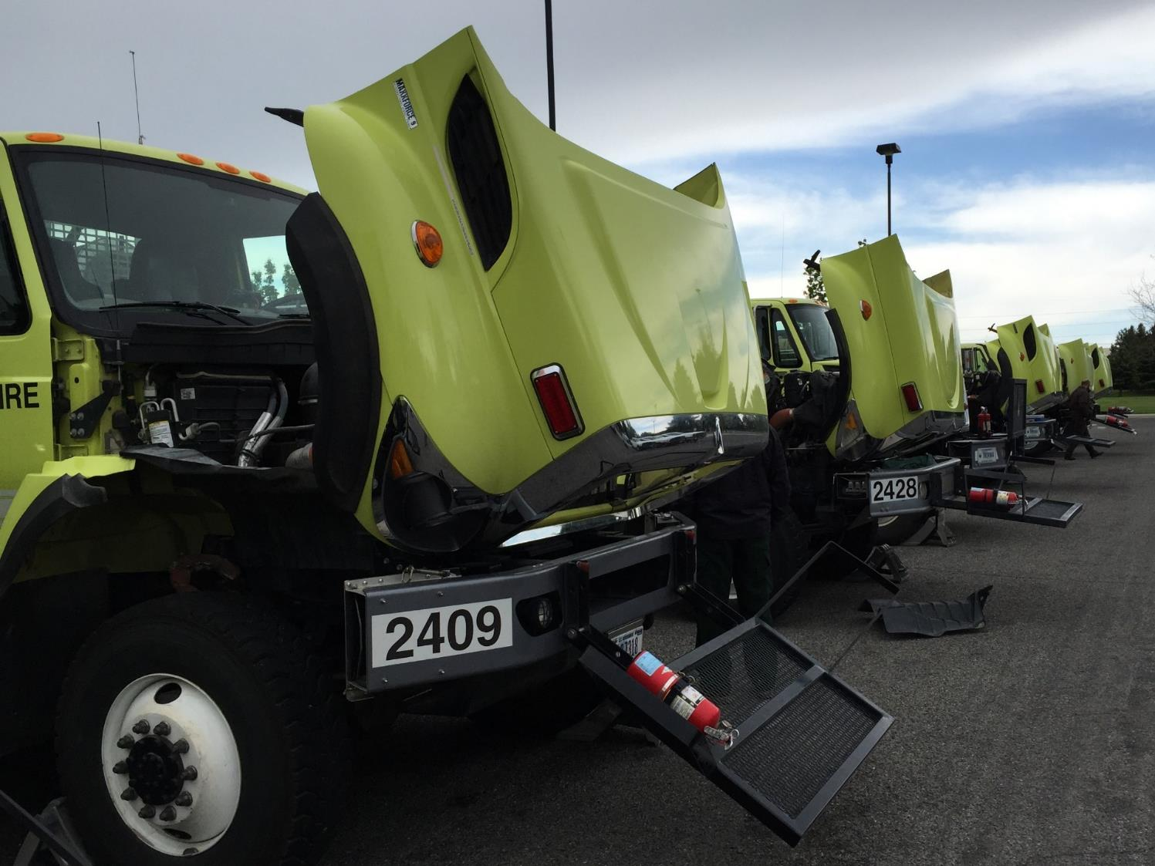

Fire Engine Maintenance
Unit 1B
Vehicle Inspections
1

Slide 2
Objectives
Complete all fire engine and post off-road inspections as identified in the Fire Equipment Maintenance Procedure Record (FEMPR).
Correctly enter all information in the Fire Equipment Maintenance Procedure Record (FEMPR).

Slide 3
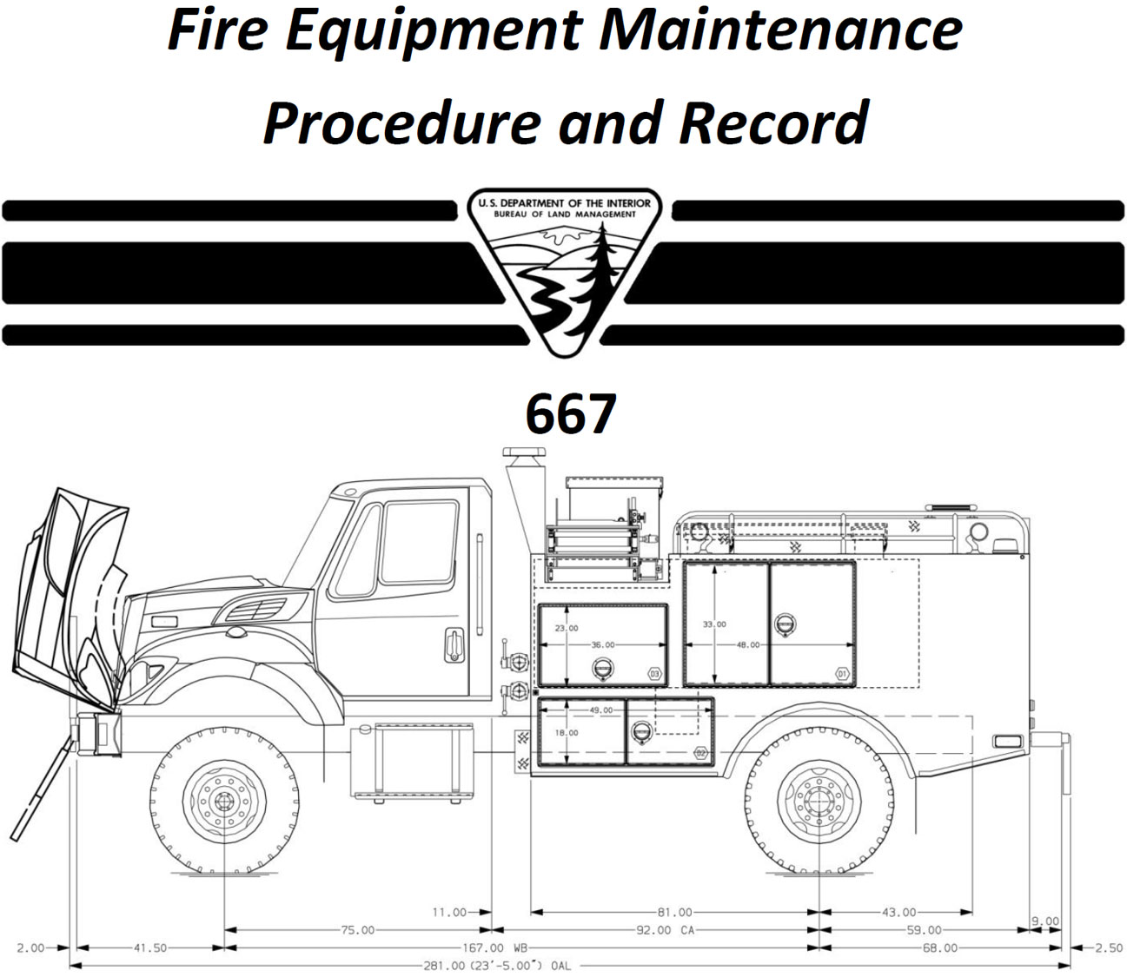

FEMPR
o
3
Notes:
Fire Equipment Maintenance Procedure and Record (FEMPR)
The FEMPR is the documentation tool required by the BLM to record various mechanical procedures that the engine operator performs on the equipment.

Slide 4
What is it?
The FEMPR is the documentation tool required by the BLM to record various mechanical procedures that the engine operator performs on the engine.
The FEMPR is also an information resource on how to perform various mechanical procedures on the engine.

Slide 5
Items that need to be recorded in the FEMPR are:
Vehicle Data
Pump Package Data
Fire Engine Weight
Equipped Fire Engine Weight
Fire Engine Inspection
Test Record
Diesel Particulate Filter (DPF) Regeneration
Engine Service
Pump Service
Pump Performance

Slide 6
FEMPR as an
Information Resource
Determining Gross Vehicle Weight (GVW)
Fire Engine Inspection Instructions
Performing and Air Brake Check
Jump Starting Procedures
Pump Performance Instructions

Slide 7
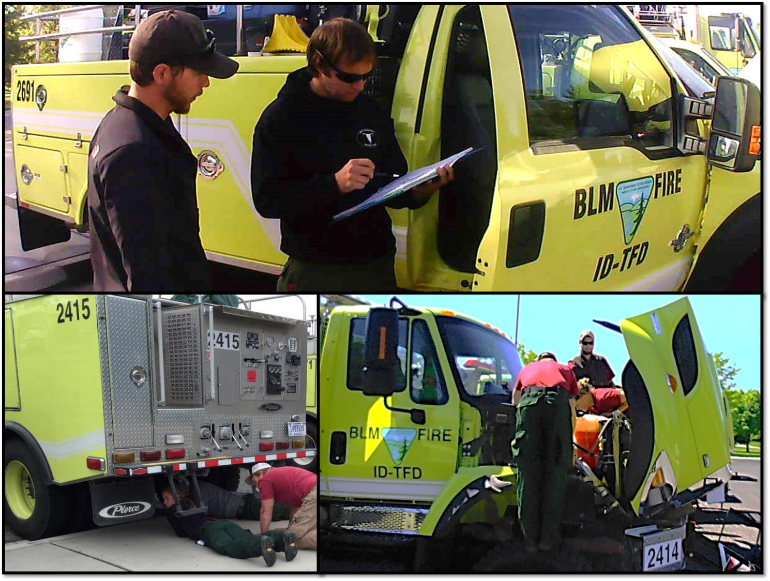
Fire Engine Inspection
7
Notes:
Some personnel refer to the fire engine inspection as the daily preventative maintenance (PM) check. The two terms can be used interchangeably. This inspection should be documented in the Fire Equipment Maintenance Procedure and Record (FEMPR).
Provide for safety first!
Set the brakes.
Chock vehicle.
Remove keys from the ignition while working under or around the vehicle.

Slide 8
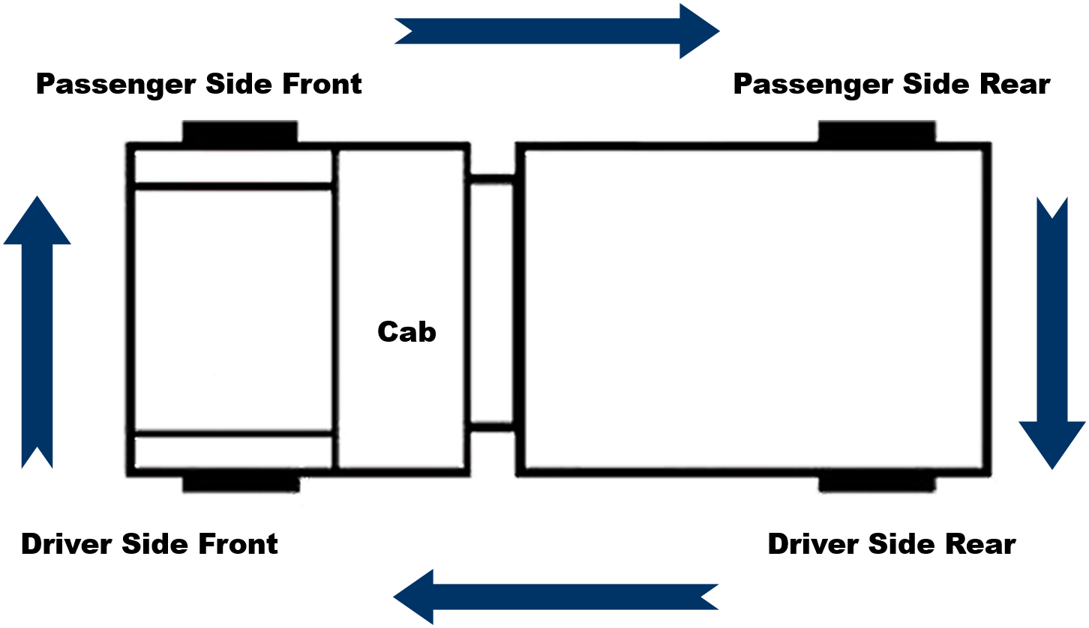
Inspection Walk-Around
Notes:
Performing the preventative maintenance inspection in the order it is listed in the Preventative Maintenance Checklist and inspection instructions is not critical. Chassis manufacturers change the location components are mounted every year so there is not one correct order to perform the inspection. An operator should perform an inspection in an order that works for the vehicle and includes all items on the list as well as any additional items they deem necessary.

Slide 9
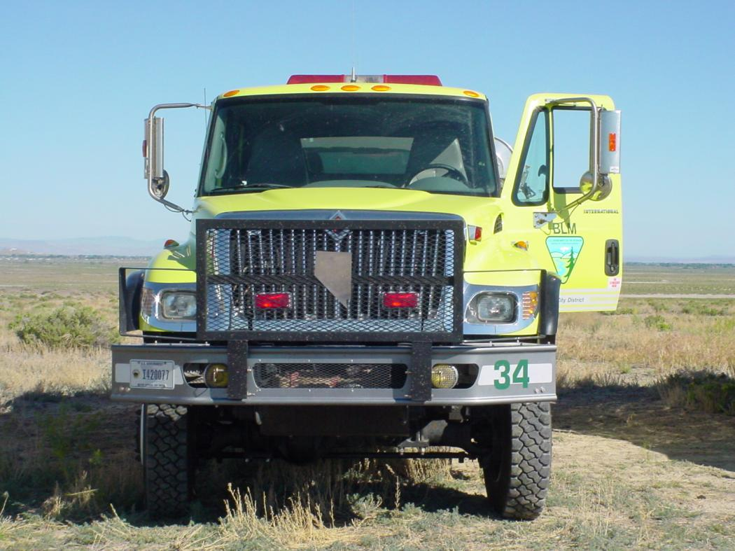
Approach
9
Notes:
Approach and Initial Walk-Around
Check the overall appearance of vehicle stance. Is the vehicle sitting level?
Leaning may indicate broken leaf springs or shocks or low tire air pressure.
Check for dripping fluids or puddles under the vehicle.
Look as you approach the vehicle and as you walk around the vehicle.
Signs of dripping may indicate bad seals, gaskets, or broken hoses.
You can also include unlocking the cab and compartments into this step.

Slide 10
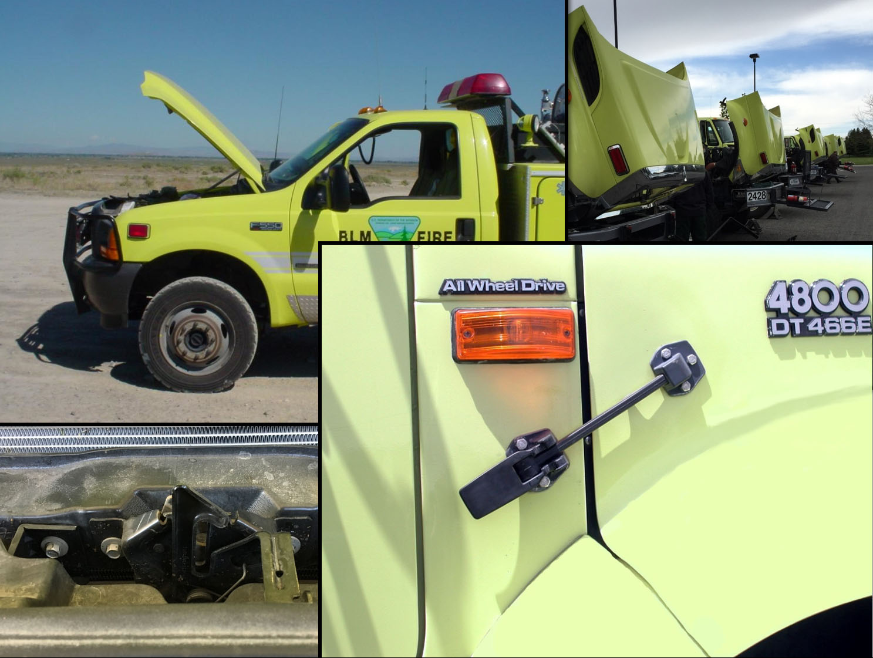
Hood
10
Notes:
Hood and Hood Latches
Check the springs, hinges, stops, and hood latches.
Weathering of rubber latches can cause latch failure.
Ensure the hood is in the closed and latched position when finished with the inspection.

Slide 11
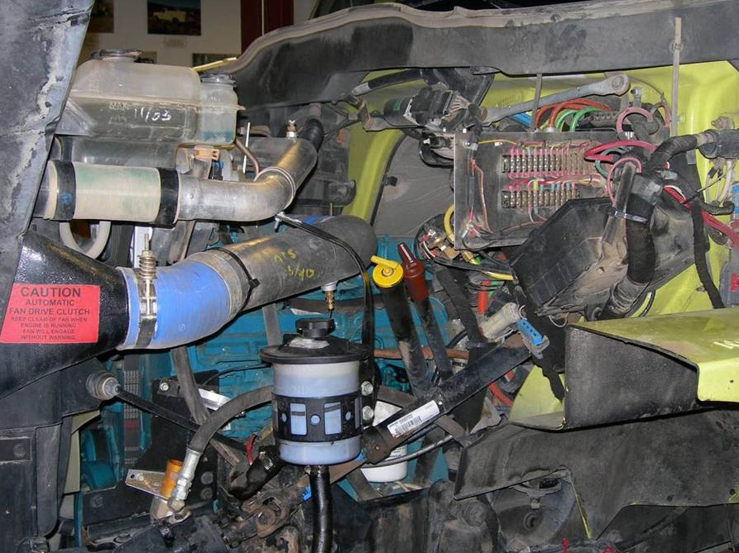
Engine Oil
11
Notes:
Engine Oil
With the engine on level ground, check oil level; add additional oil if needed.
Low oil levels will cause excessive wear on internal engine parts resulting in a shortened engine life.
Increases in oil levels (dipstick reading) between daily PM checks could indicate an internal fuel/coolant leak.

Slide 12
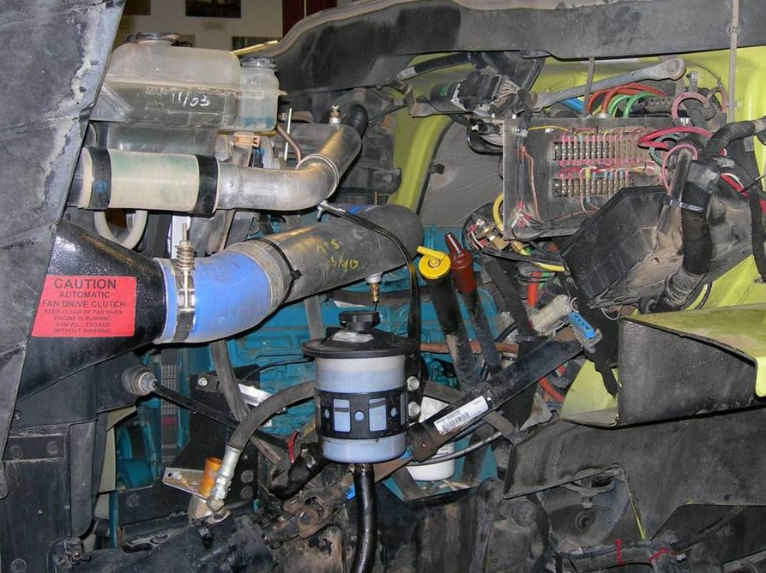
Power Steering Fluid
12
Notes:
Power Steering Fluid Level and Hoses
The power steering system is a closed system, meaning it should not use or lose any fluid.
If the fluid levels are low, add fluid and thoroughly check the system for leaks.
Low levels can overheat the pump and/or cause steering failure.

Slide 13
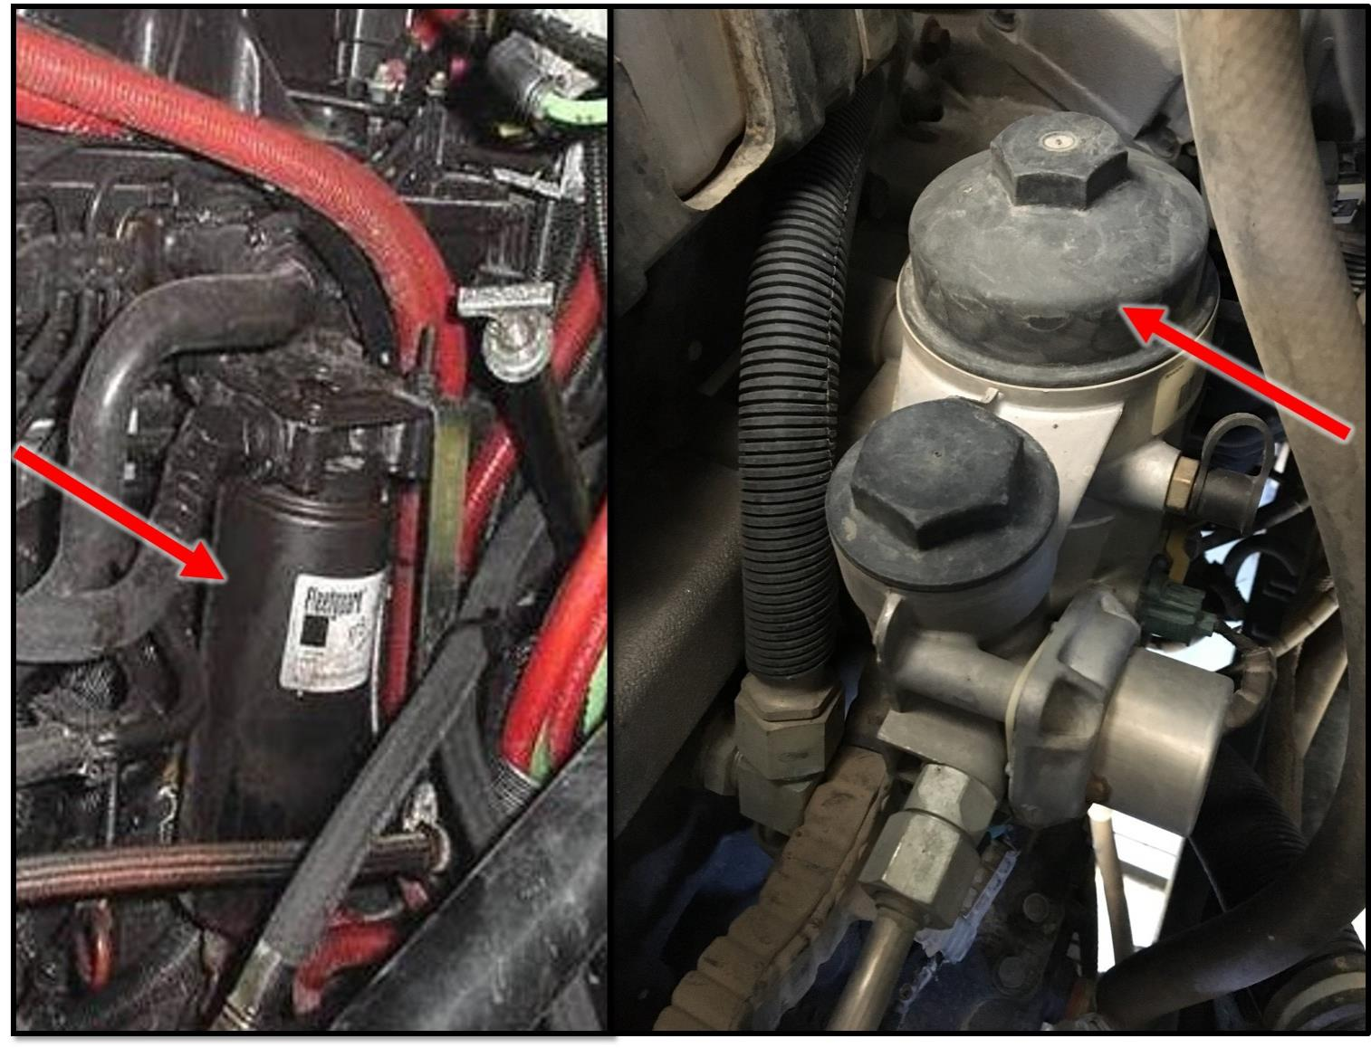
Fuel Filter
13
Notes:
Fuel Filter
Engines may have more than one fuel filter. On most Type 6 engines, the fuel filter and water separator are one component.
(Refer to the fuel/water separator section for inspection information.)

Slide 14
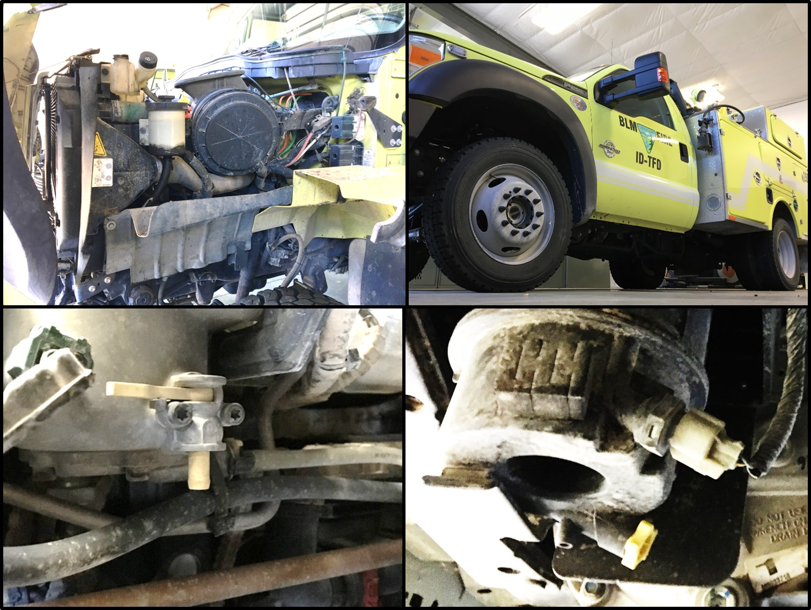
Fuel/Water Separator
14
Notes:
Fuel/Water Separator
Water can severely damage components within the fuel injection system.
Ensure there are no leaks.
Drain at standard intervals or follow manufacturer’s recommendations.

Slide 15
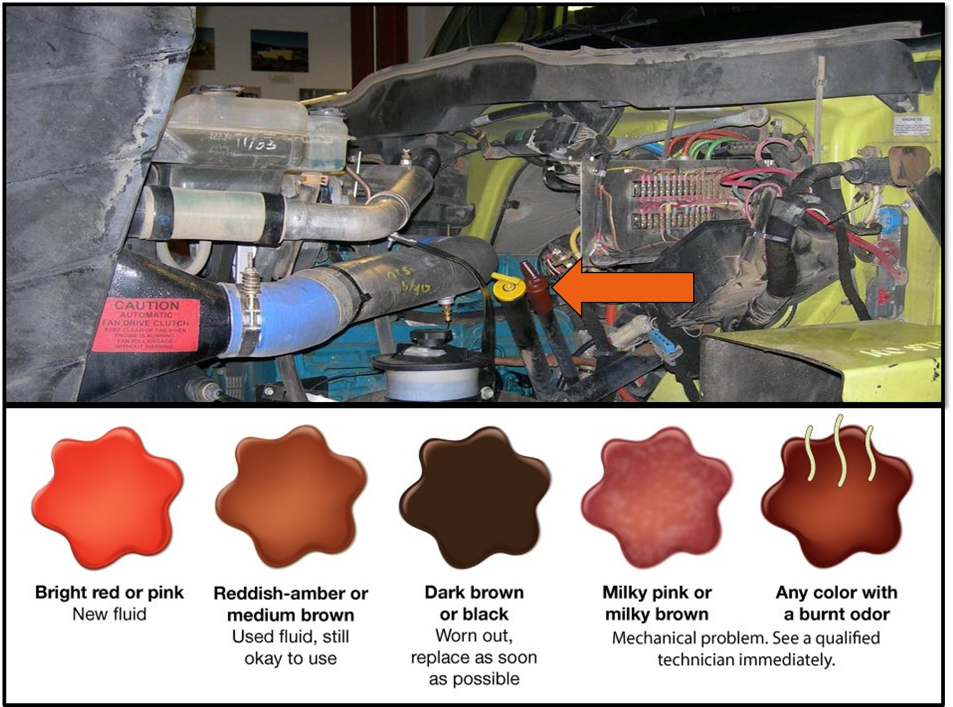
Automatic Transmission Fluid
Notes:
Automatic Transmission Fluid
With the vehicle on level ground,
Ensure the transmission fluid level meets manufacturer's recommendations.
Ensure fluid is the correct consistency, color and does not have a burnt smell.
There are different procedures for checking the transmission fluid depending on manufacturer.
Some models need to be checked when the vehicle is off and the fluid is cold, some it needs to be running and at operating temperatures.
Check the vehicle operator's manual for the correct procedure for your vehicle.

Slide 16
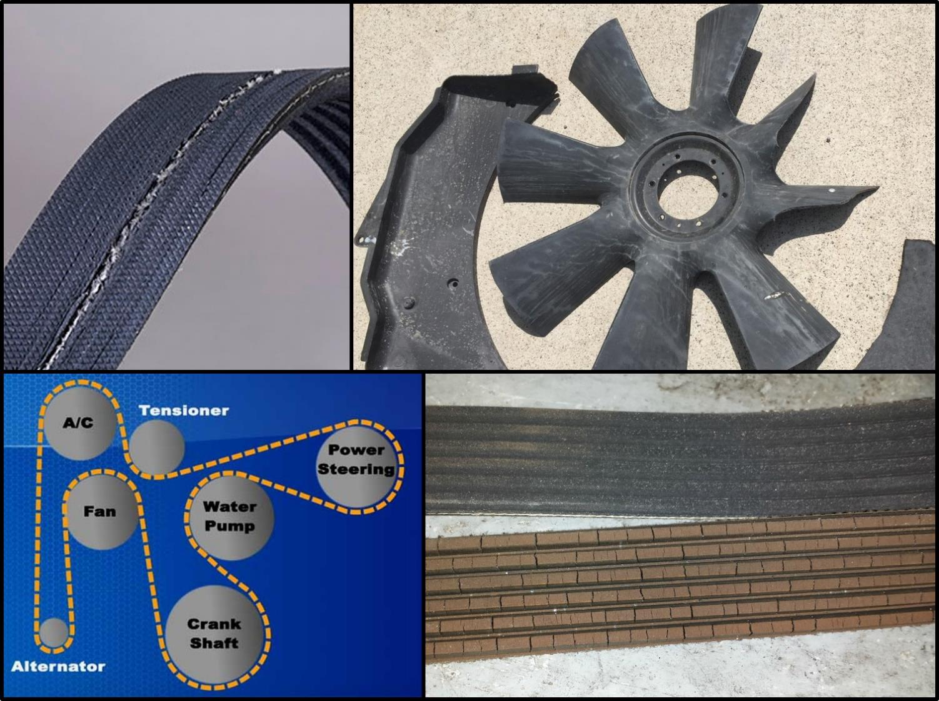
Fan and Fan Belts
16
Notes:
Fan and Fan Belts
Ensure the fan moves freely, has no cracks, and blades are tight.
Look for chips where the fan may have contacted the shroud.
Check tension of belts.
Some vehicles have a tensioner gauge built into the system.
Visually inspect belts for wear, frays, or cracks on the drive side of the belt.
Worn fan belts can brake without warning.
A loose belt can slip, causing steering, cooling, and charging problems.

Slide 17
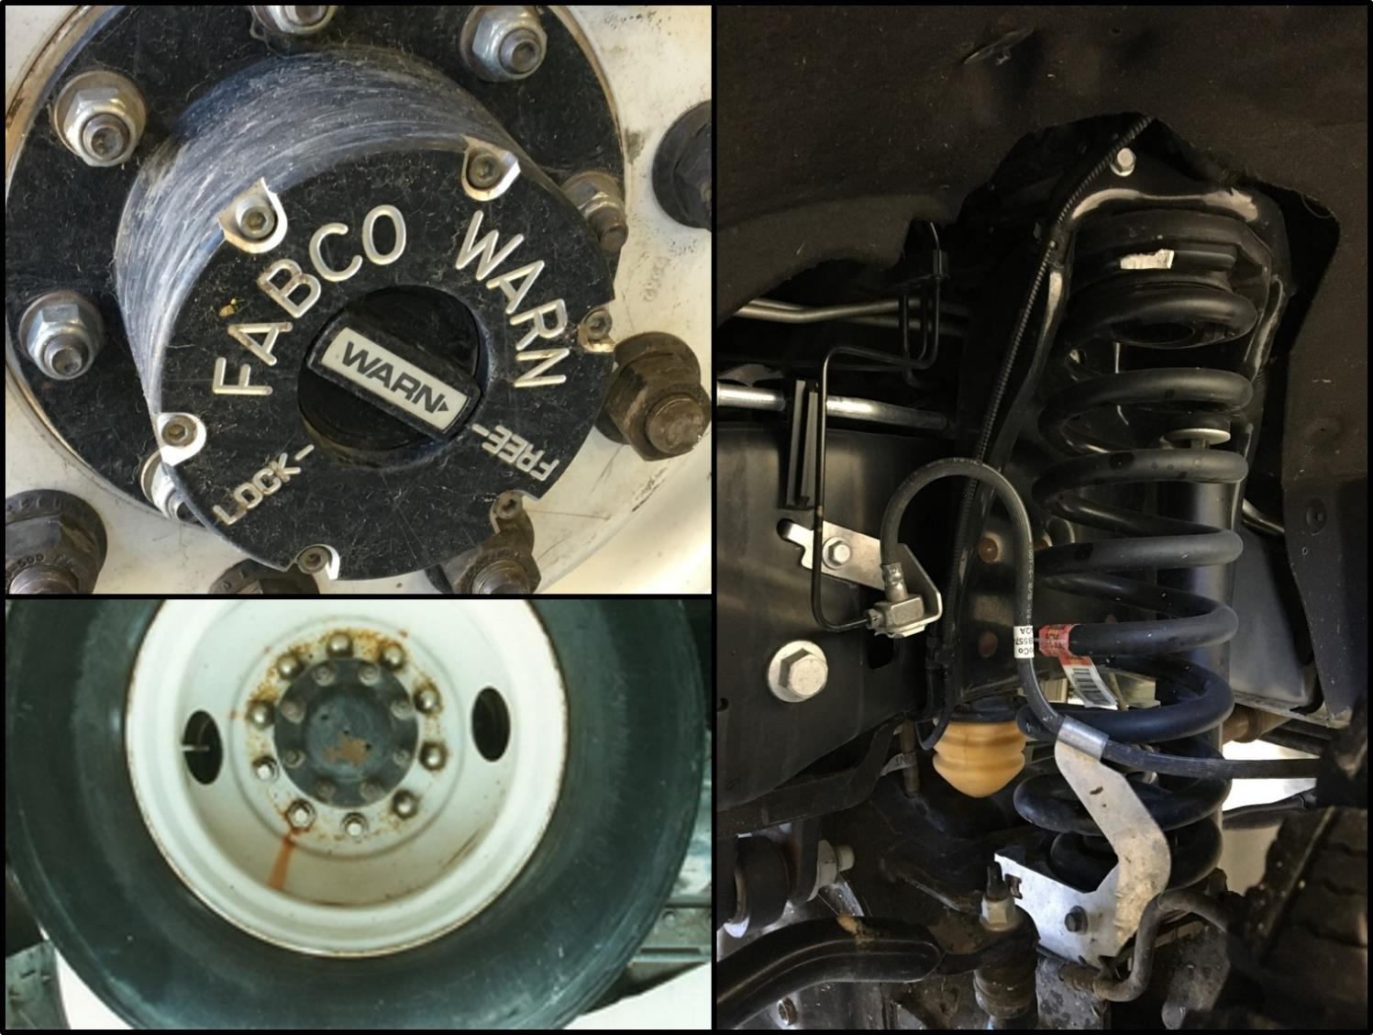
Driver Side Front Tire
Rim, Hub and Suspension
Rust Streak
17
Notes:
Driver Side Front Tire, Rim, Hub and Suspension
Ensure lug nuts are present and tight.
Look for rust stains on steel wheels and black streaks on aluminum wheels; stains indicate a loose lug nut.
Loose lug nuts can cause severe stress and wear on the wheel studs, not to mention the potential for loss of control while driving.
Inspect rims for damage and proper mounting.
Ensure valve stems of “inside” duals are lined up and accessible.
Look for dents and cracks.
Check manual hubs, if equipped.
Look for lubrication leaks.
Ensure hub is in the “free” position.
(Brakes will be discussed later.)

Slide 18
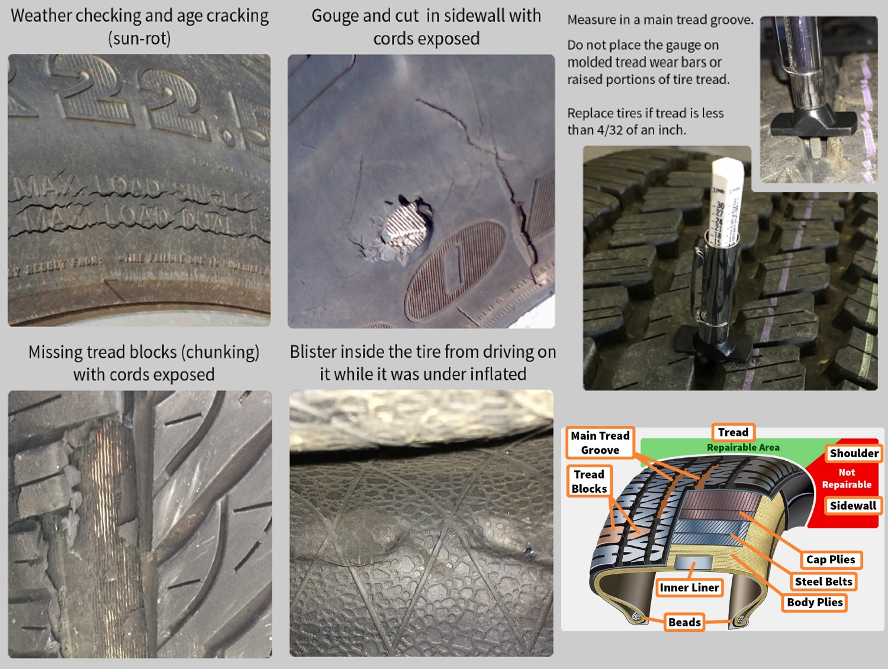
Tires
18
Notes:
Tire Damage, Wear, and Inflation
Operators will perform exterior visual inspections of tires daily and prior to release from any incident. Visual inspections will include identifying signs of tire deterioration related to age, weather cracking, separation, bulges, holes, sidewall damage, tread depth, tread condition and uneven wear.
The WCF 600-series fire fleet vehicle tires that meet any of the following criteria will be replaced using WCF or benefiting activity funds as appropriate:
Any tire in service six calendar years from the Department of Transportation (DOT) tire identification number (TIN) date of manufacture. Sidewall is cut, worn, or damaged to the extent that the steel or fabric ply cord is exposed. Excessive tread damage including cuts, holes or excessive numbers of missing tread lugs. Tread depth less than 4/32 of an inch. Visible bumps or knots related to tread or sidewall separation. Tire service technician recommendation.
Comprehensive tire inspections of all tires—including spare tires—will be completed during required annual inspections/service and at 10,000-mile intervals. Comprehensive inspections will be completed by tire service technicians and will include interior and exterior visual inspection.
All daily, post-incident and comprehensive tire inspections and tire replacement will be documented in the FEMPR. Replacement tires must meet vehicle specifications for size, load rating, speed rating and mission. For more information, refer to the FEMPR, manufacturer owner manuals, BLM Equipment Alert EA-2017-01, and the National Fire Equipment Program’s website (http://web.blm.gov/internal/fire/fire_ops/nfep.htm).

Slide 19
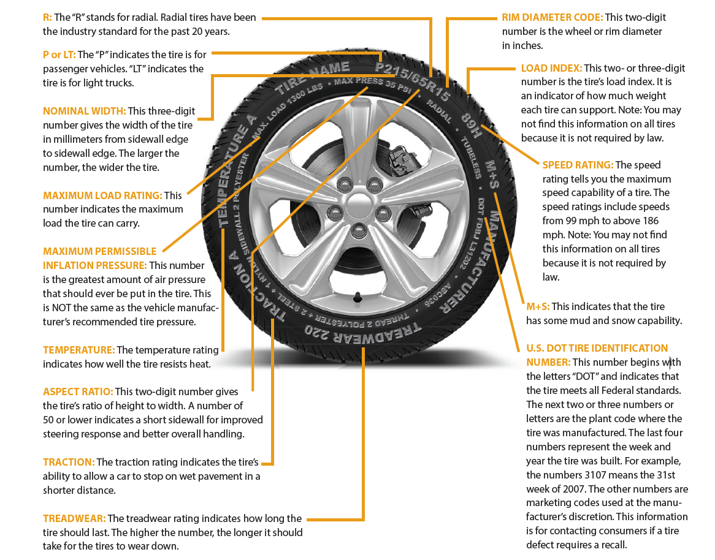
Tire Information
19
Notes:
There is a lot of information on your tires telling you how they affect performance. Understanding the tire labels for your vehicle is important for maintaining and buying new tires.
As tires age, they are more prone to failure. Some vehicle and tire manufacturers recommend replacing tires that are six to 10 years old, regardless of tread wear. You can determine how old your tire is by looking on the sidewall for your DOT Tire Identification Number (TIN). The last four digits of the TIN indicate the week and year the tire was made. If the TIN reads 0308, the tire was made in the third week of 2008. Look on both sides of the tire. The TIN may not be on both sides. – National Highway Traffic Safety Administration

Slide 20
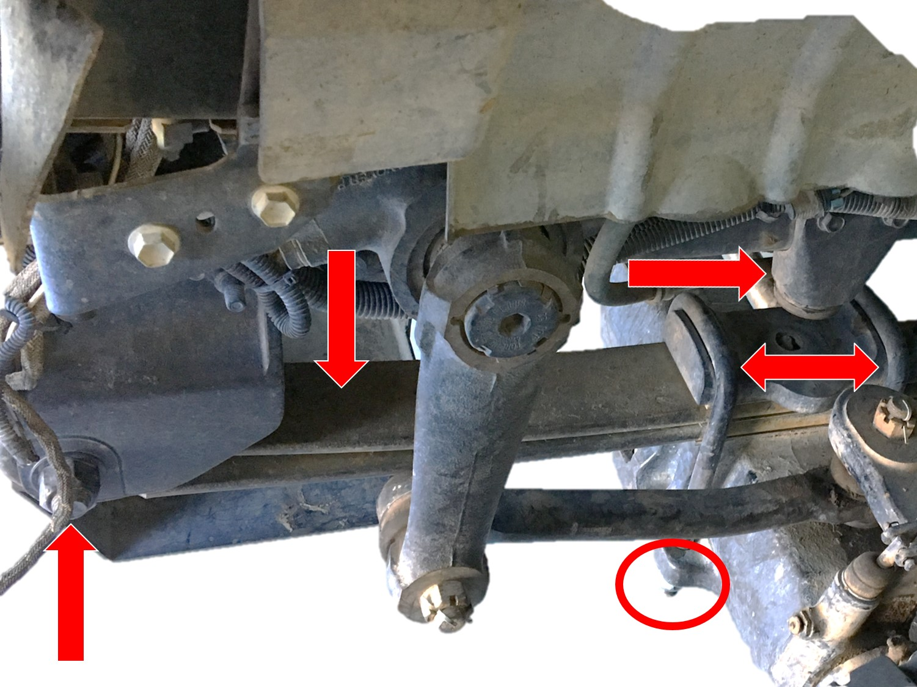
Leaf Springs & Mounts
20
Notes:
Leaf Springs and Mounts
Look for cracked, broken, missing leaf springs.
Inspect U-bolts and springs for proper alignment (out of align springs could be a broken center bolt).
Ensure U-bolts are tight.
Check spring hangers, shackles, and bushings for wear as well as cracks or breaks.
Check bump-stops for wear and damage.

Slide 21
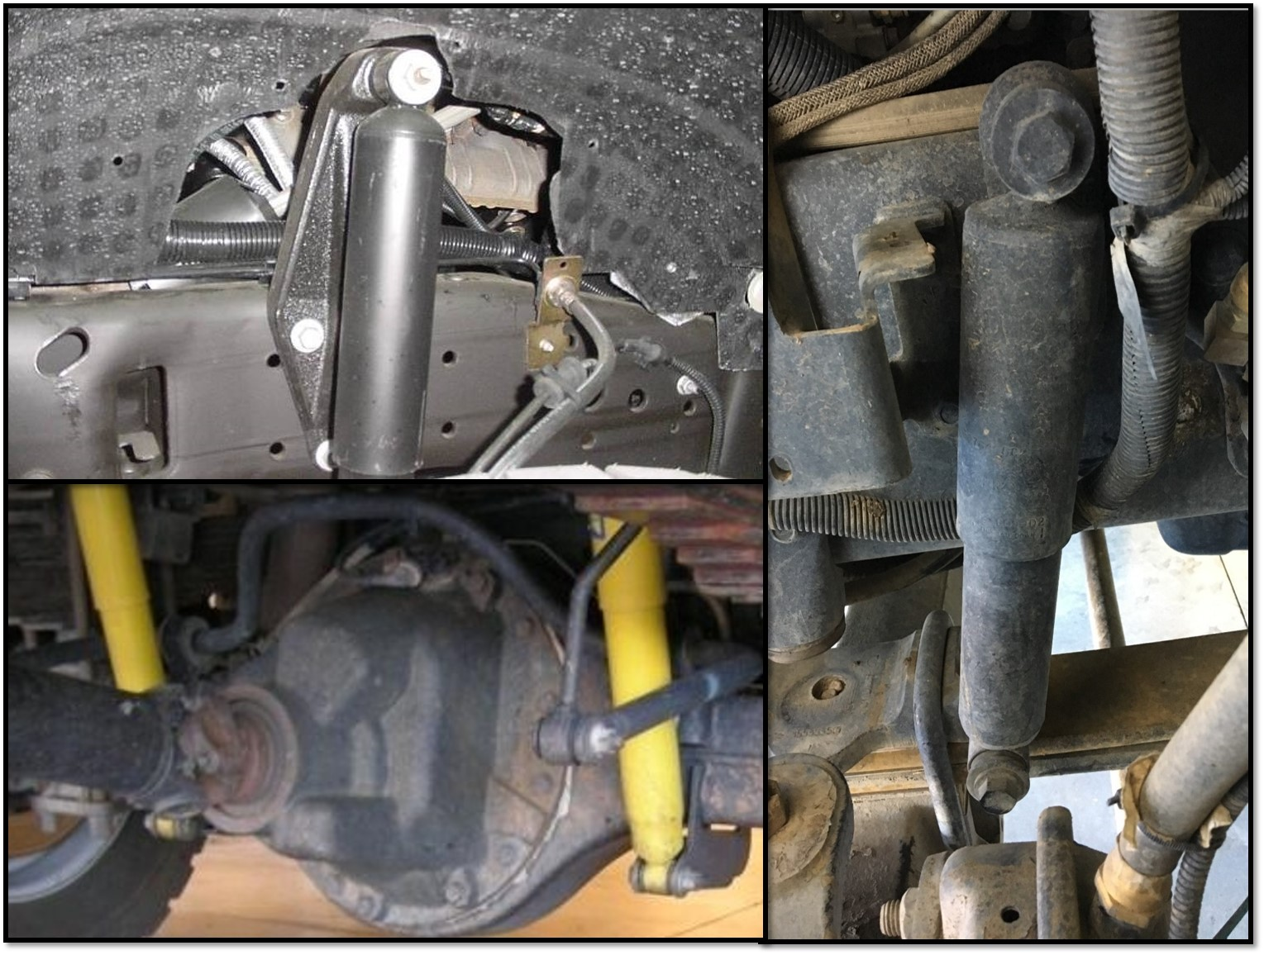
Shock Absorber
21
Notes:
Shock Absorber
Inspect shock absorber mounting hardware for tightness.
Ensure shock absorber is free from fluid leaks, and dents.

Slide 22
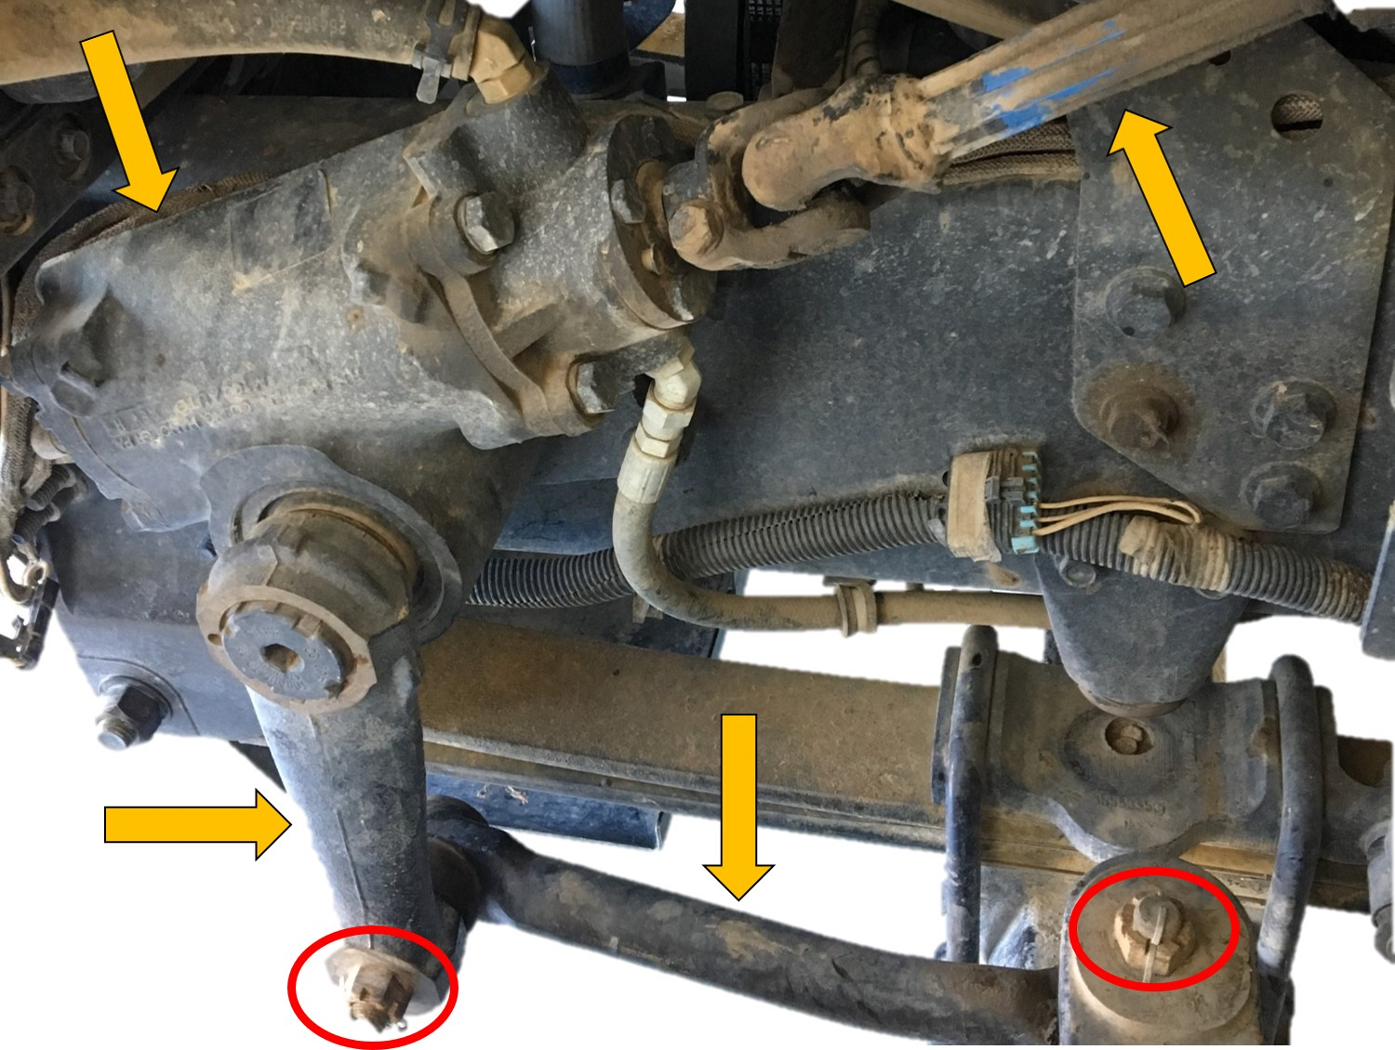
Steering Components
Notes:
Steering Components
Check steering column for play in the slip joint and universal joint.
Steering box should be free of leaks and cracks where the box bolts to the frame.
Ensure the Pitman arm and draglink are not cracked or bent.
Check the steering knuckle for play.
Ensure joints and sockets are not worn or loose.
Check joints and sockets for loose or missing nuts, bolts, or cotter pins.

Slide 23
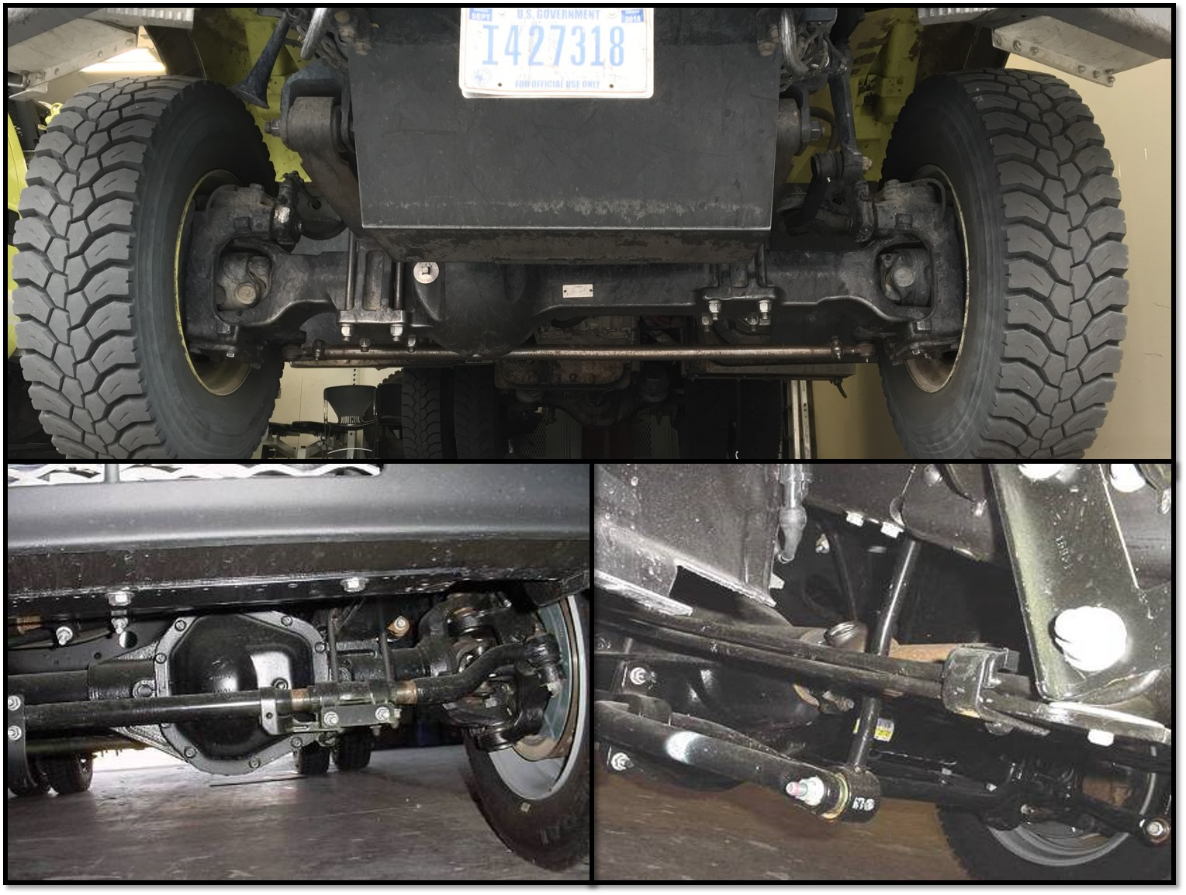
Tie Rods and Sway Bars
23
Notes:
Tie Rods and Sway Bars
Tie rods and sway bars are some of the lowest parts on the vehicle and are susceptible to damage.
Ensure tie rods and sway bars are not bent.
Ensure bushings and joints are not worn or loose.

Slide 24
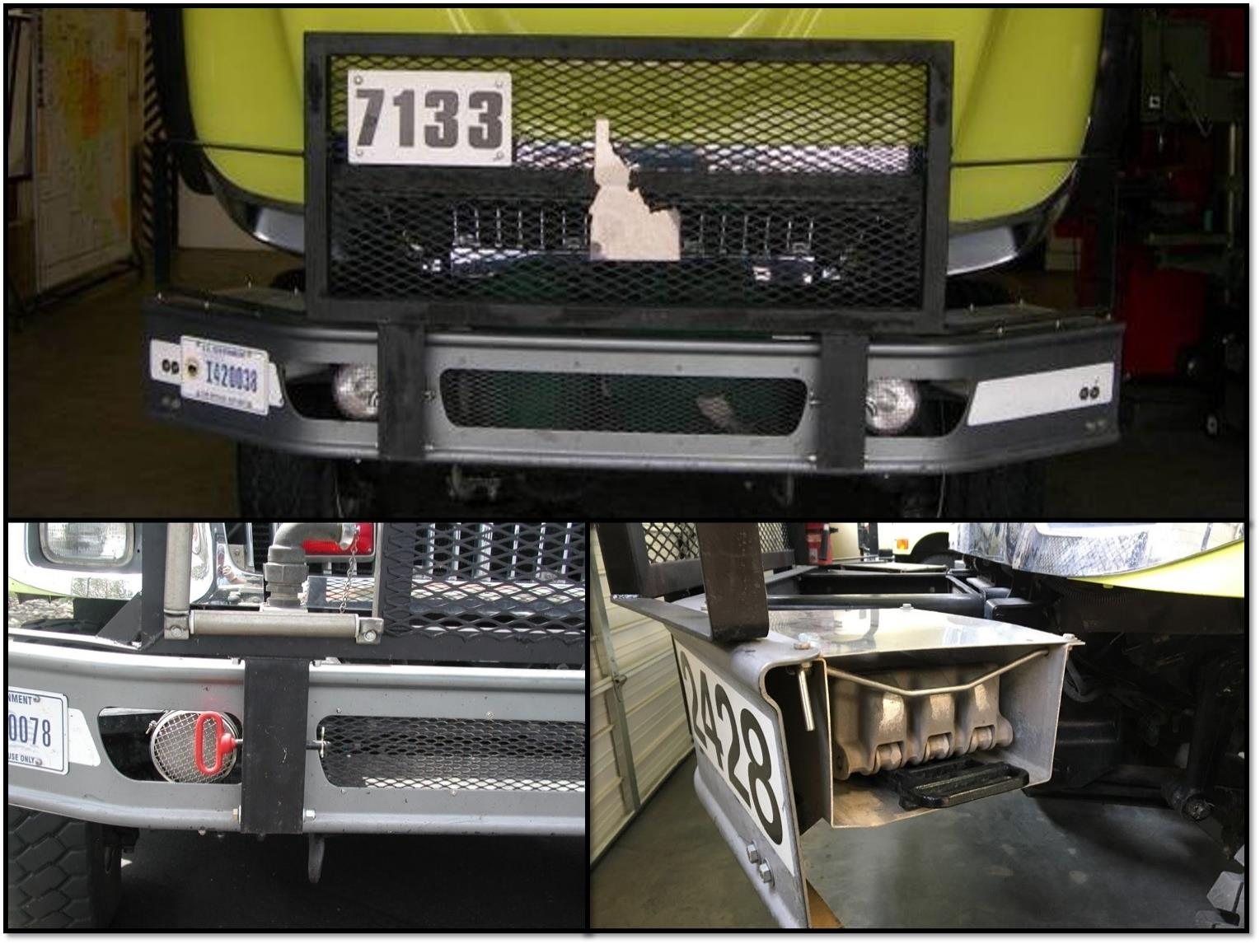
Front Bumper and Wheel Chocks
24
Notes:
Front Bumper and Wheel Chocks
Ensure brush guard, license plate, and skid plate are present, free of damage, and all mounting hardware is tight.
Ensure both wheel chocks are present and the retention mechanisms on the wheel chock holders function properly.

Slide 25
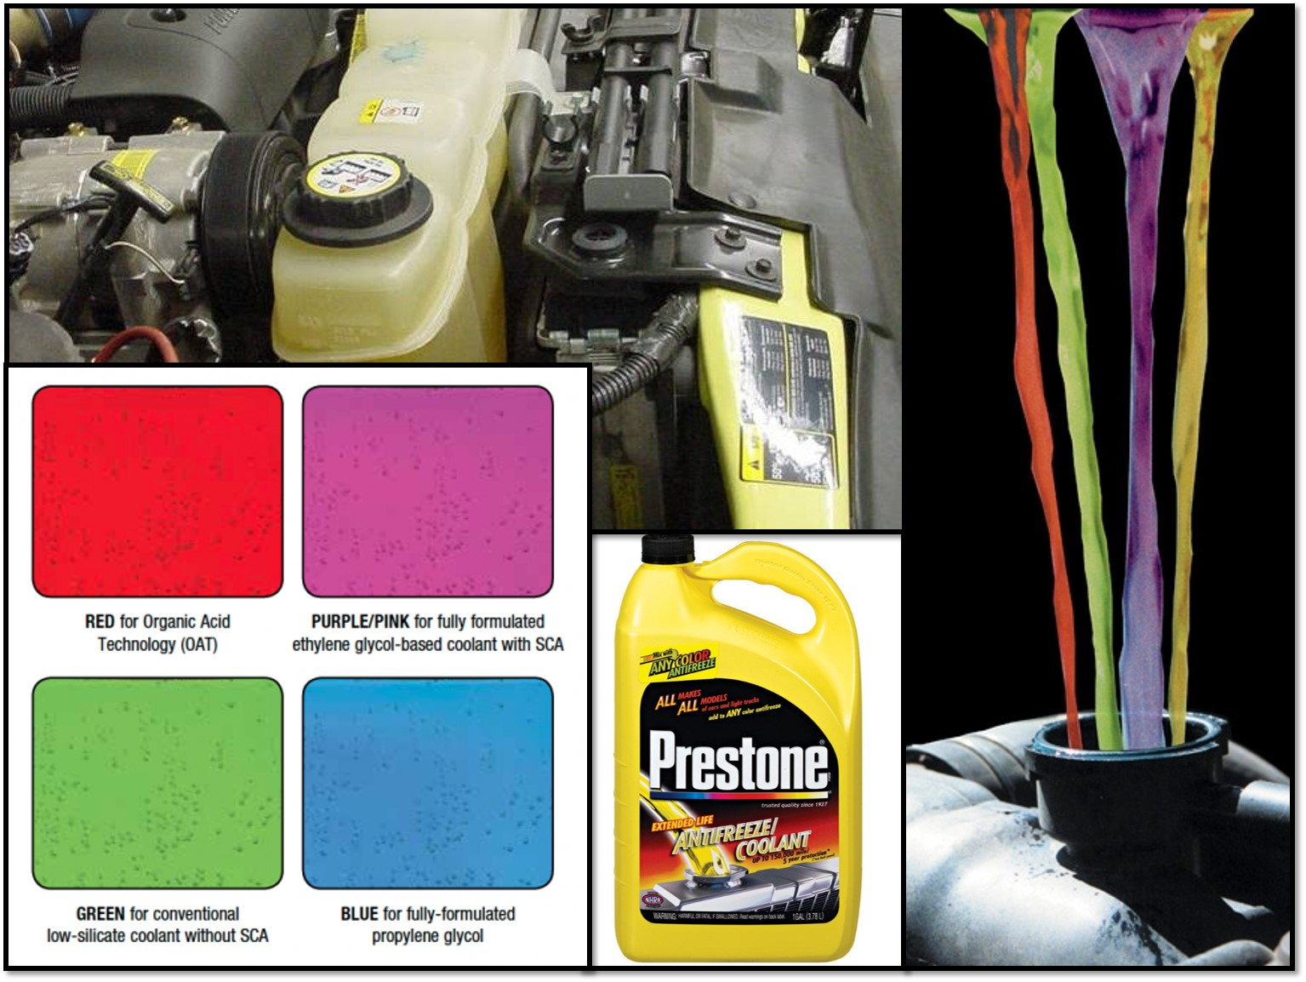
Coolant
25
Notes:
Coolant Level, Radiators, and Hoses
Check the coolant level and add if needed.
Frequently adding coolant could be a sign of an external leak or an internal motor problem.
Check coolant color.
Check hoses for leaks, signs of wear, bulging, or cracking and hose clamps for tightness.
Check for signs of pooled or evaporated coolant around major engine components.
Chassis manufacturers have started using different coolant with very specific requirements. DO NOT mix different types of coolant! Check the chassis operator's/owner's manual to ensure you are using the correct coolant to prevent damage and voiding the warranty.
Without proper coolant levels the motor may overheat causing numerous problems.

Slide 26
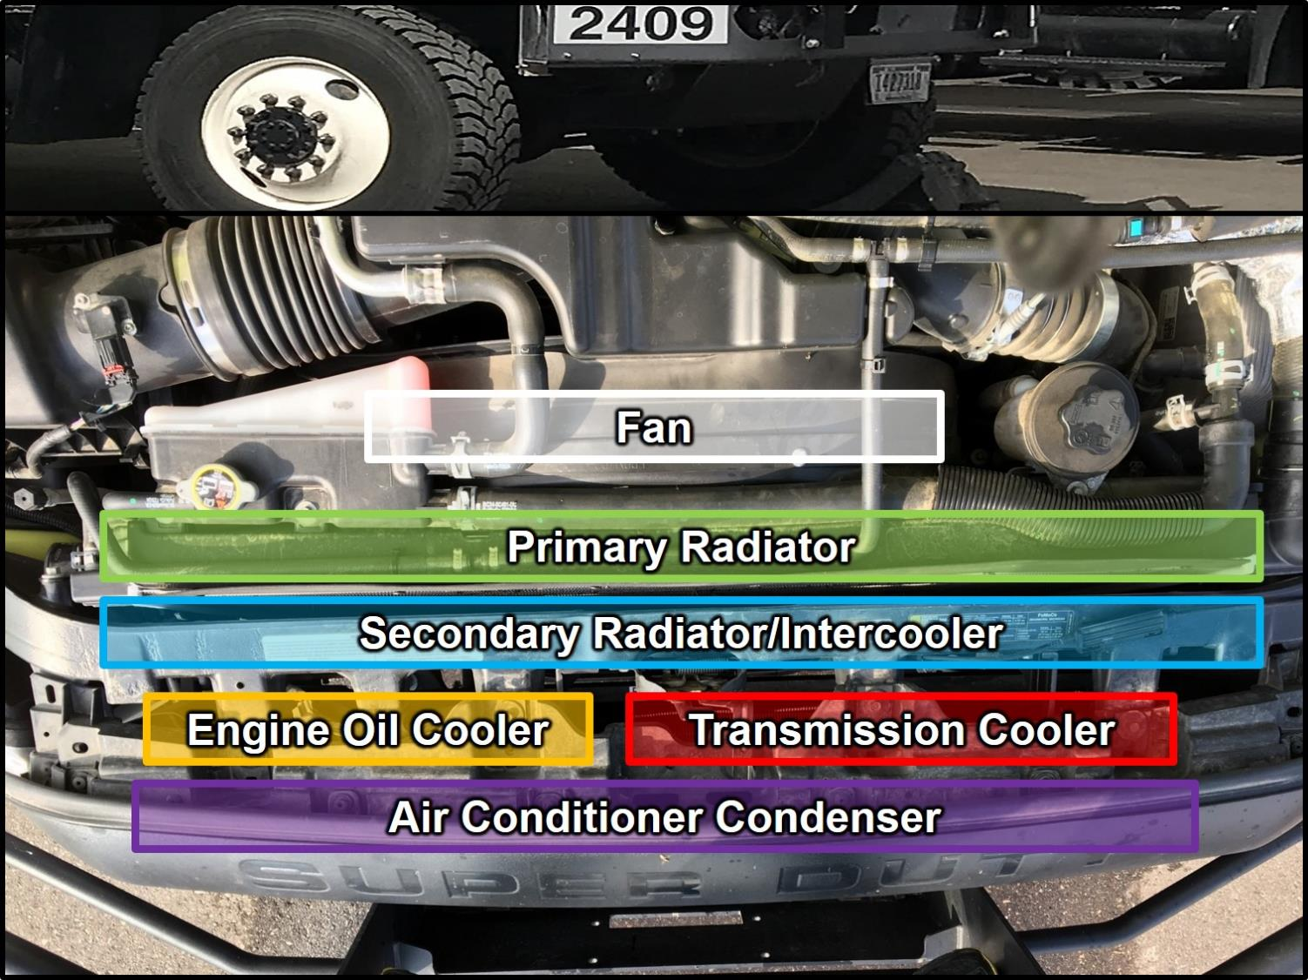
Radiator/Cooling
26
Notes:
Radiator/Cooling System
In modern vehicles, the radiator/cooling system is comprised of various components. Aside from the primary radiator, other components or groups of components include the fan, secondary radiator/intercooler, engine oil cooler, transmission cooler, and air conditioner condenser.
These coolers are constructed with aluminum fins that can become plugged with sagebrush, plant seeds, dust, dirt, and other contaminants. Debris can become lodged between stacked fins.
Periodically check the radiator/cooling system for the buildup of foreign matter, and have it removed.

Slide 27
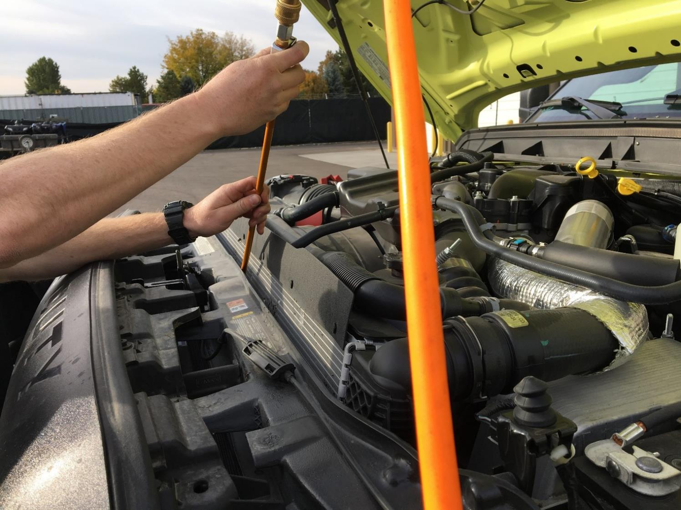
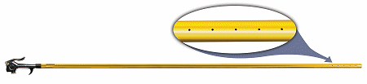
Cleaning the Radiator
27
Notes:
You can use compressed air to clean the radiator/cooling system with a variety of tools that can be store bought or homemade. The tool in this picture can be found by a simple internet search using the term “air comb.”
DO NOT use pressurized water to clean the radiator as the force is too great and will flatten the aluminum fins, reducing the system’s ability to cool.

Slide 28
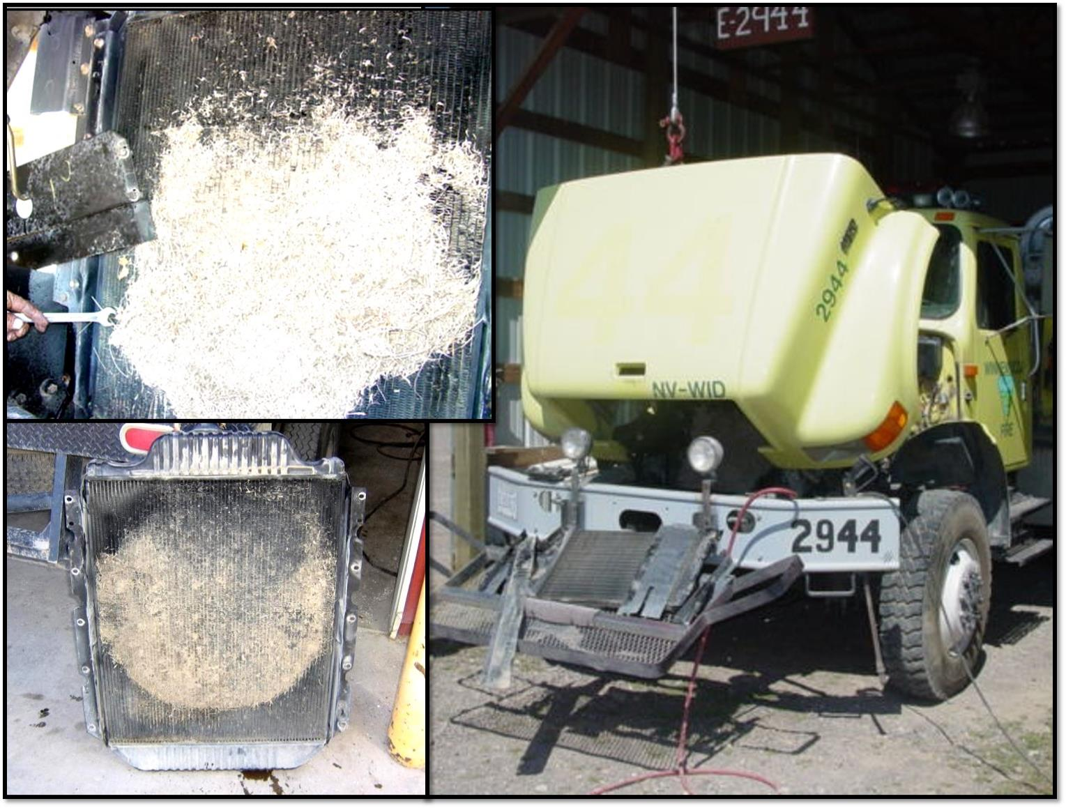
Radiator
28
Notes:
This radiator was pulled off a Nevada engine that was overheating after only one and a half seasons.

Slide 29
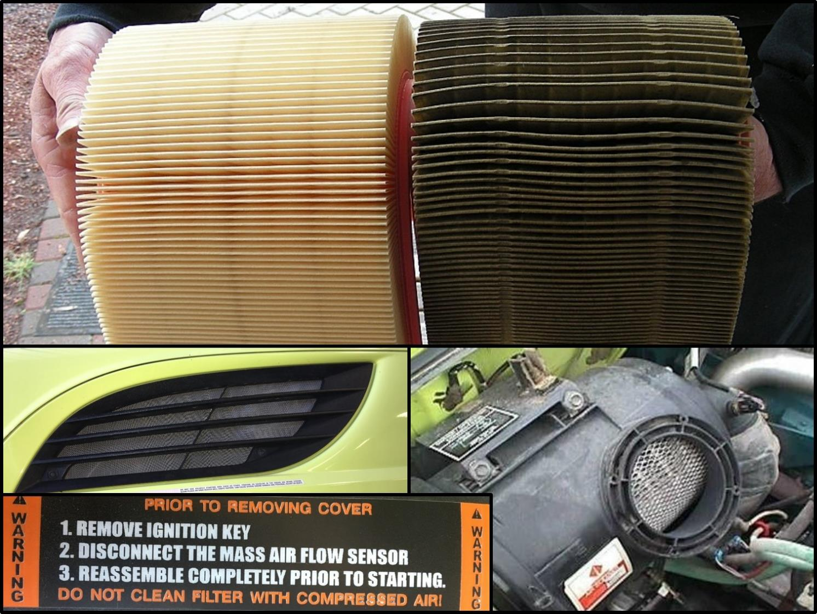
Air Filters
29
Notes:
Air Filters (including air conditioner, cabin, and ember separators)
Follow manufacturer’s instructions for disassembly of the air filter assembly.
Carefully inspect filters, mounting brackets, inlet hose connections, and fittings.
Dirty air filters can cause loss of power and engine damage.
Inspect gasket and sealing surface areas.
Replace service element, if needed.
Ensure ember separators are clear of debris.
If the ember separator is plugged, the engine may fail to start.
DO NOT USE COMPRESSED AIR TO BLOW OUT THE AIR FILTER.
Doing so will create small unseen holes that allow dust to slip through and damage the engine components.
Filter elements can be lightly tapped to dislodge the dust and/or vacuumed out to extend the service life. If in doubt, replace the filter.

Slide 30
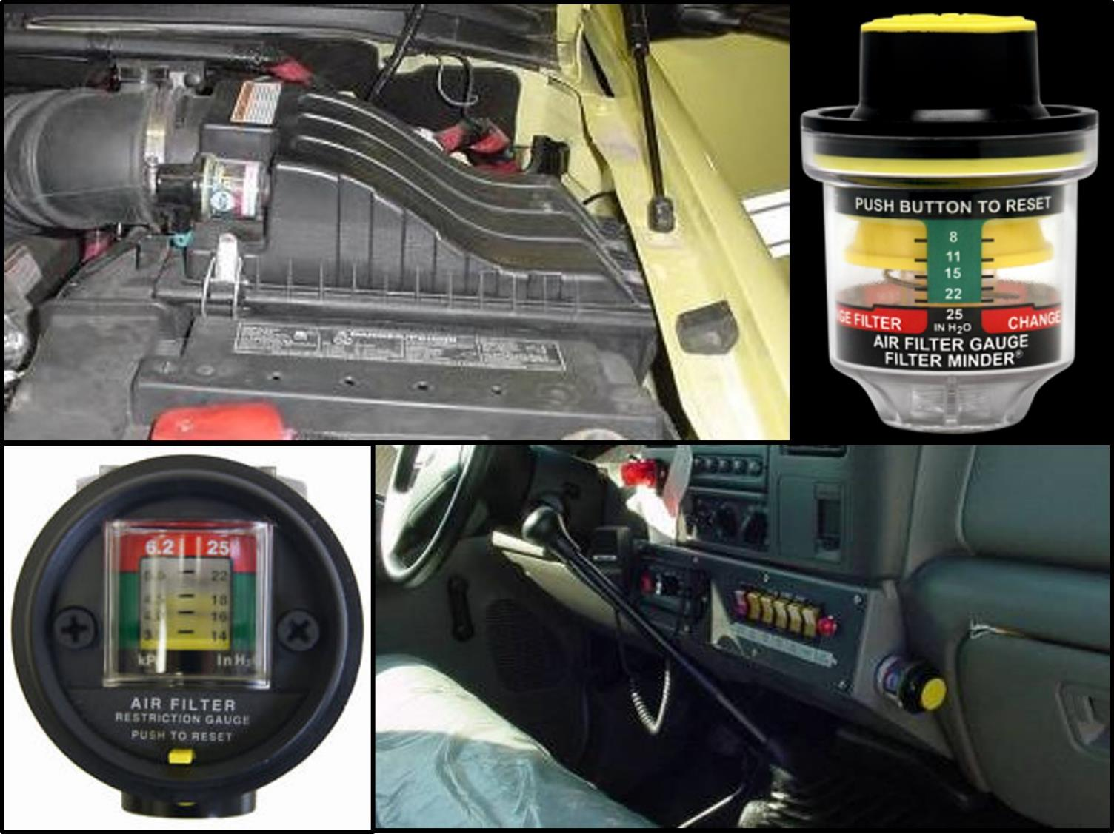
Air Filter Restriction Gauge
30
Notes:
Air Filter Restriction Gauge
Check air filter restriction gauge.
Reset the air filter restriction gauge after a filter change.

Slide 31
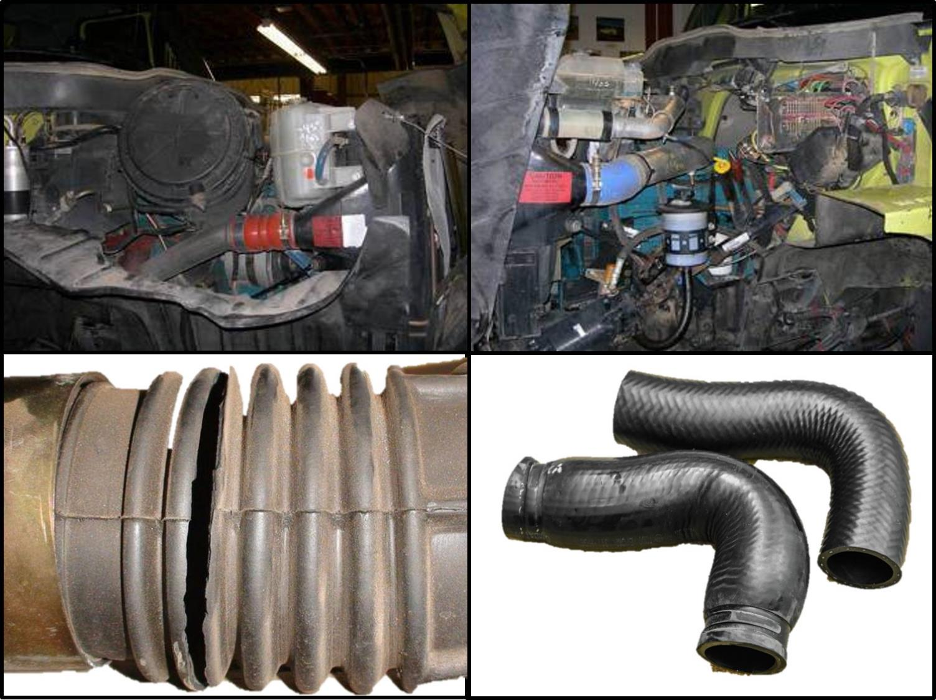
Hoses
Notes:
Hoses
Check hoses for leaks, signs of wear, bulging, or cracking.
Check hose clamps for tightness.
Check for signs of pooled or evaporated coolant around major engine components.

Slide 32
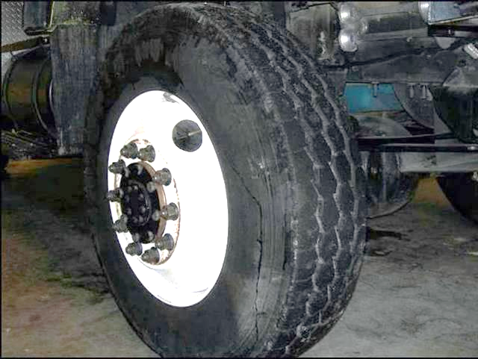
Passenger Side Front Tire, Rim, Hub and Suspension
32
Notes:
Passenger Side Front Tire, Rim, Hub, and Suspension
The procedure is the same as inspecting the driver side front tire, rim, hub, and suspension.
Refer to slides 17 through 24.

Slide 33
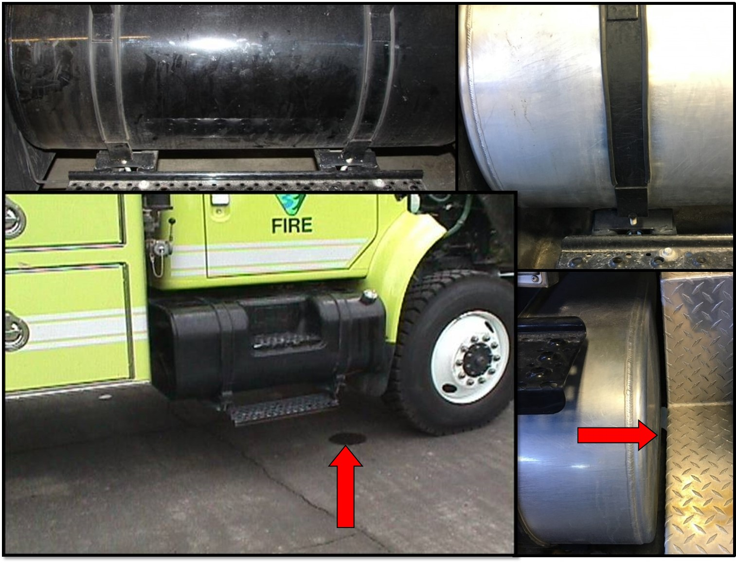
Fuel Tank and Brackets
33
Notes:
Fuel Tank and Brackets
Ensure fuel tank is full and securely mounted.
Tank straps can break or loosen causing the tank shifting, possibly rubbing on other components.
If accessible, look inside the tank to ensure gauge is reading correctly.
Ensure the fuel tank is free from leaks.

Slide 34
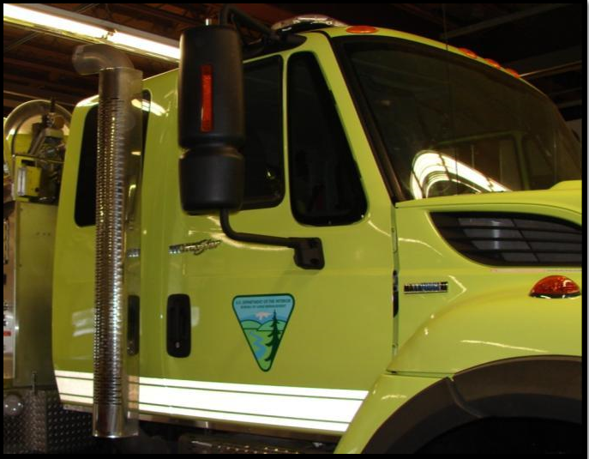
Passenger Side Door(s)
34
Notes:
Passenger Side Door(s)
Check latch, lock, handhold, mirror, hinges, and window regulator.

Slide 35
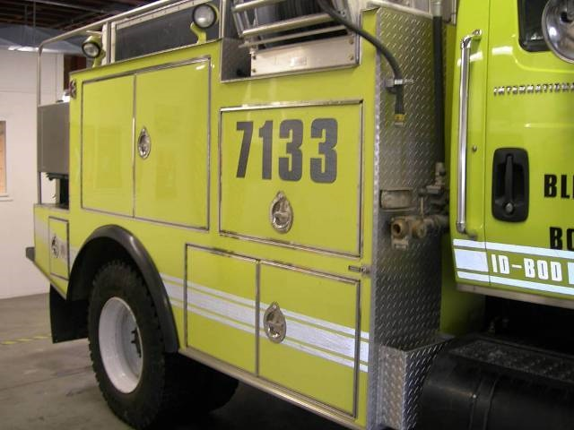
Passenger Side
General Condition
35
Notes:
Passenger Side General Condition
Ensure the fire engine is clean and orderly in appearance.
Ensure agency emblems, decals, and, equipment numbers are present and in good condition.
Ensure cabinet latches, hinges, and locks are in good working condition.
Users must be able to get into the cabinets without much effort and be able to lock cabinets to secure equipment.

Slide 36
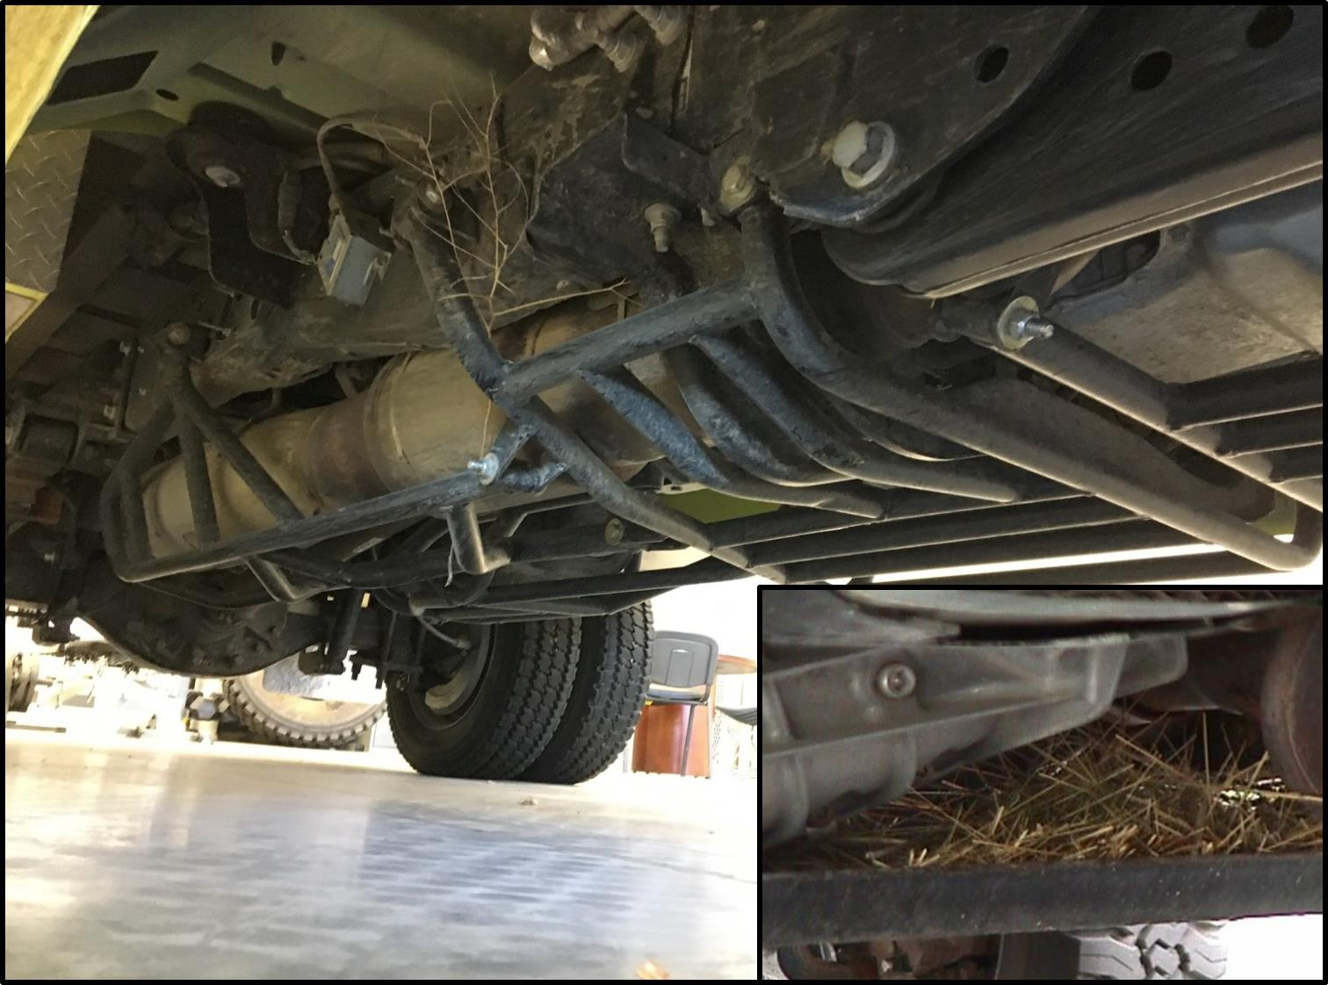
Passenger Side Undercarriage
36
Notes:
Passenger Side Undercarriage
Check for loose bolts, hanging wires, leaks, and broken parts.
Ensure the undercarriage is free of debris. Clean out debris if found.
Inspect steering components, drive train, body mounts, and cross members for functionality and damage.
Check the package mounting brackets and bolts.

Slide 37
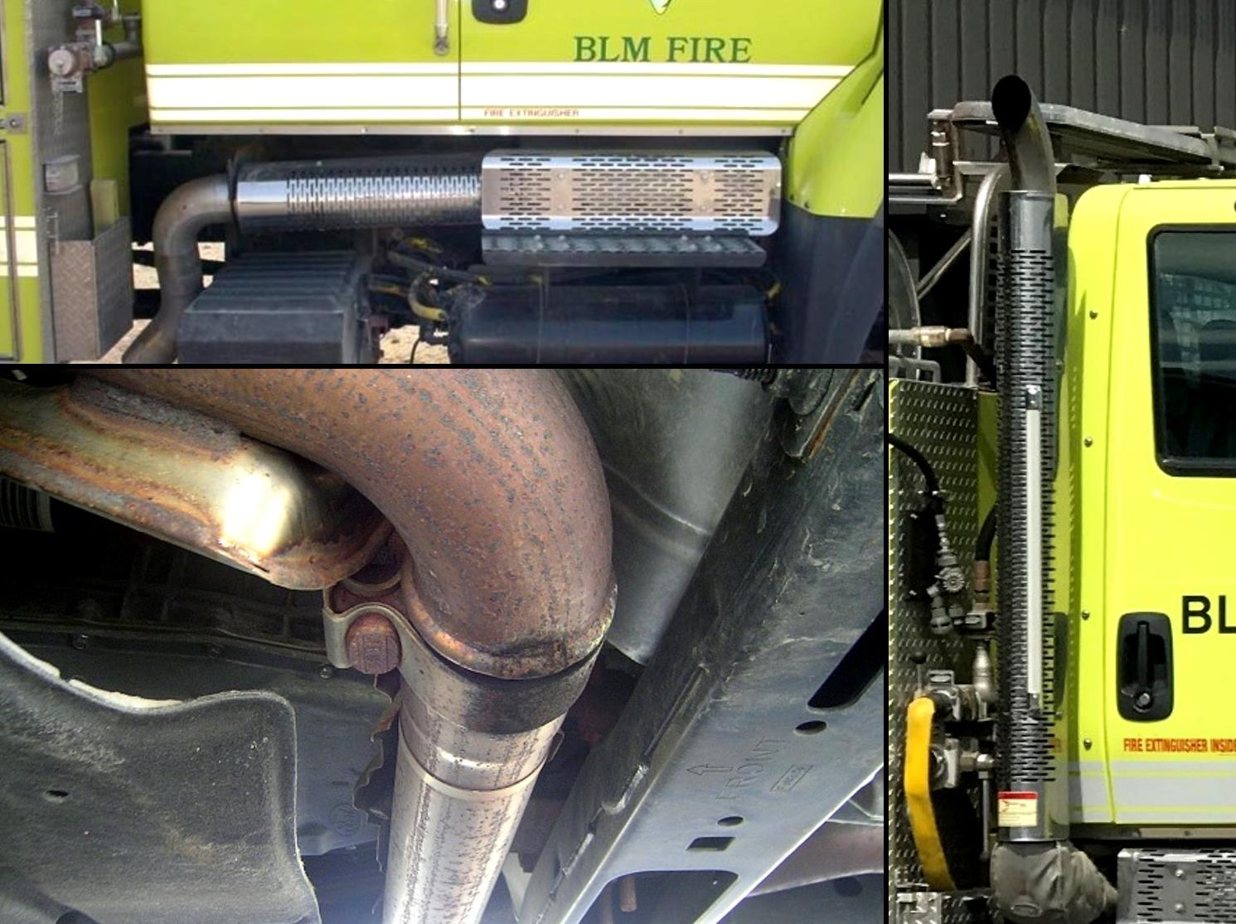
Exhaust
37
Notes:
Exhaust
Ensure the exhaust system is leak-free and all heat protection shielding is in place.
Inspect all the exhaust mounting brackets and guards.
Black carbon buildup is a sign of an exhaust leak.

Slide 38
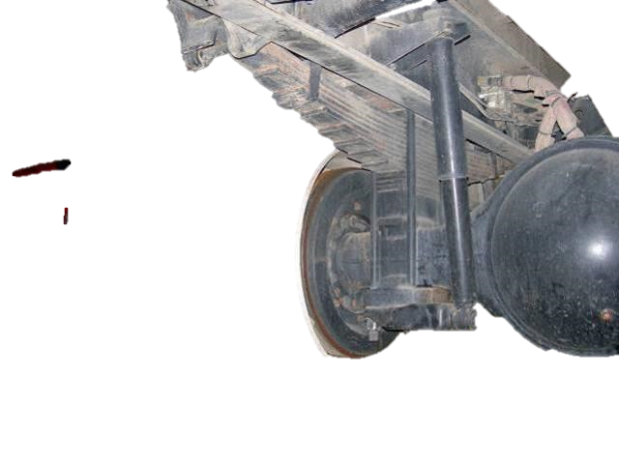
Passenger Side Rear Tire,
Hub, and Suspension
Notes:
Passenger Side Rear Tire, Rim, Hub, and Suspension
The procedure is the similar to inspecting the driver side front tire, rim, hub, and suspension.
Refer to slides 17 through 24.

Slide 39
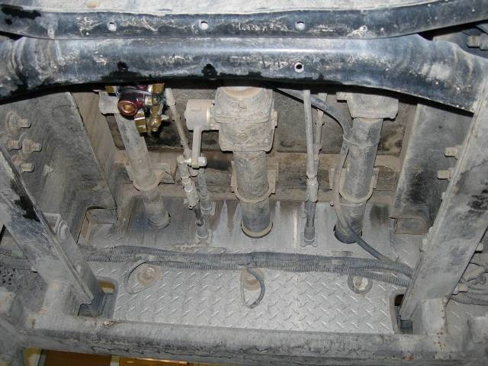
Rear Undercarriage
39
Notes:
Rear Undercarriage (Plumbing)
Check for loose bolts and plumbing hanger brackets.
Check for leaking plumbing hoses and pipes.
Check for damage to rear differential and axle.
Check for loose, or damaged wiring.
Inspect frame, cross members, and underbody protection for cracks, damage; ensure the area is free of vegetation and other debris.

Slide 40
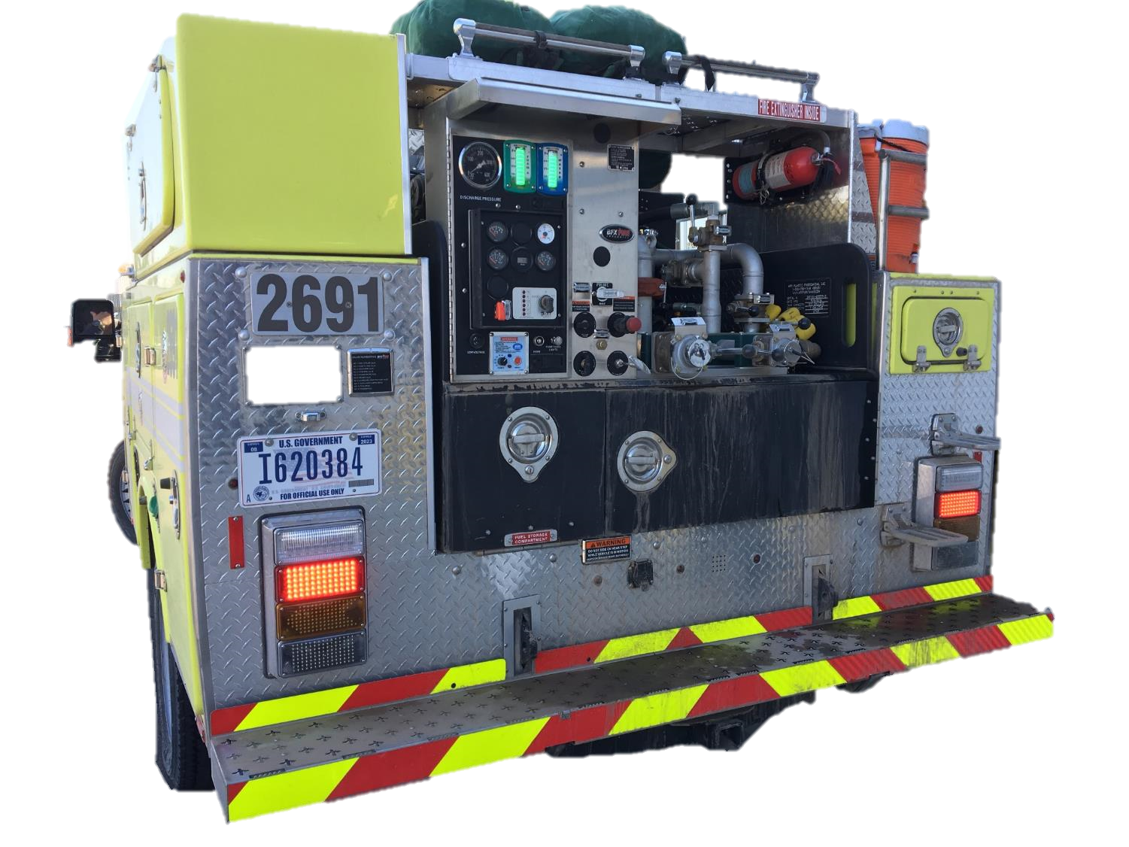
Vehicle Rear
Notes:
Vehicle Rear
Ensure no loose items are on the back platform.
Ensure the bumper, step(s), and license plate are securely fastened.
Ensure spare tire is present and properly inflated.
Ensure the mud flaps are present and in good condition.
Ensure the reflective tape, decals, license plate, and lights are clean and visible.

Slide 41
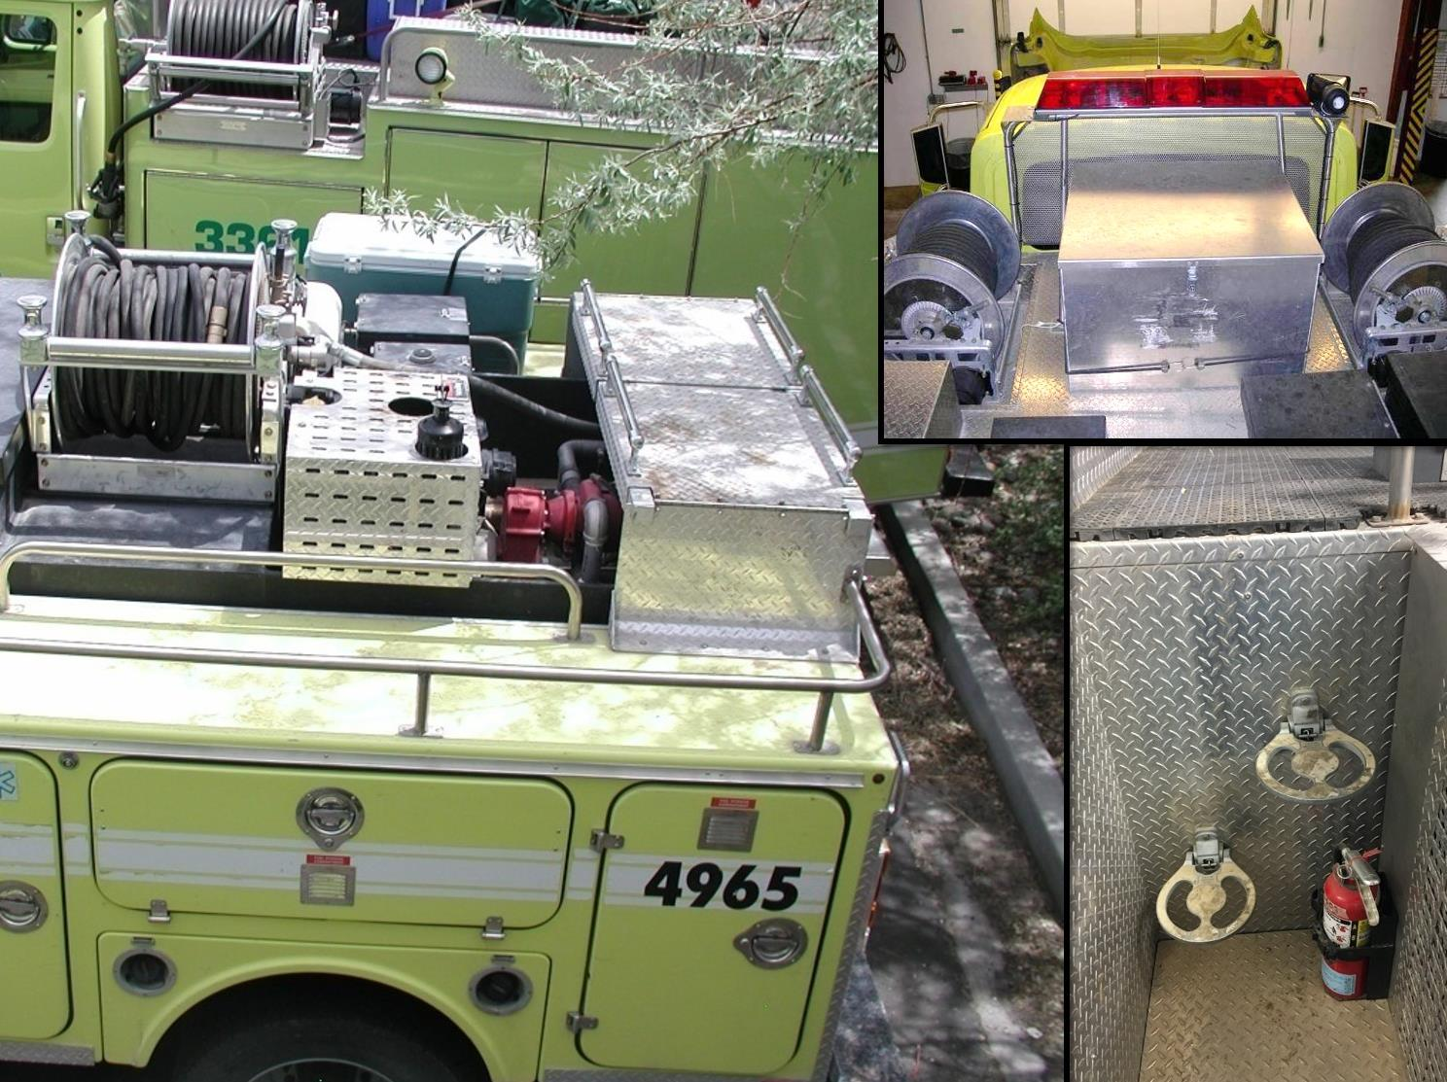
Top Deck, Handrails, and Steps
41
Notes:
Top Deck, Handrails, and Steps
Ensure all equipment (coolers, bladder bags, hose packs, etc.) transported on the top deck is secured.
Ensure handrails, storage boxes and hose reels are mounted securely and all compartment latches are secured.

Slide 42
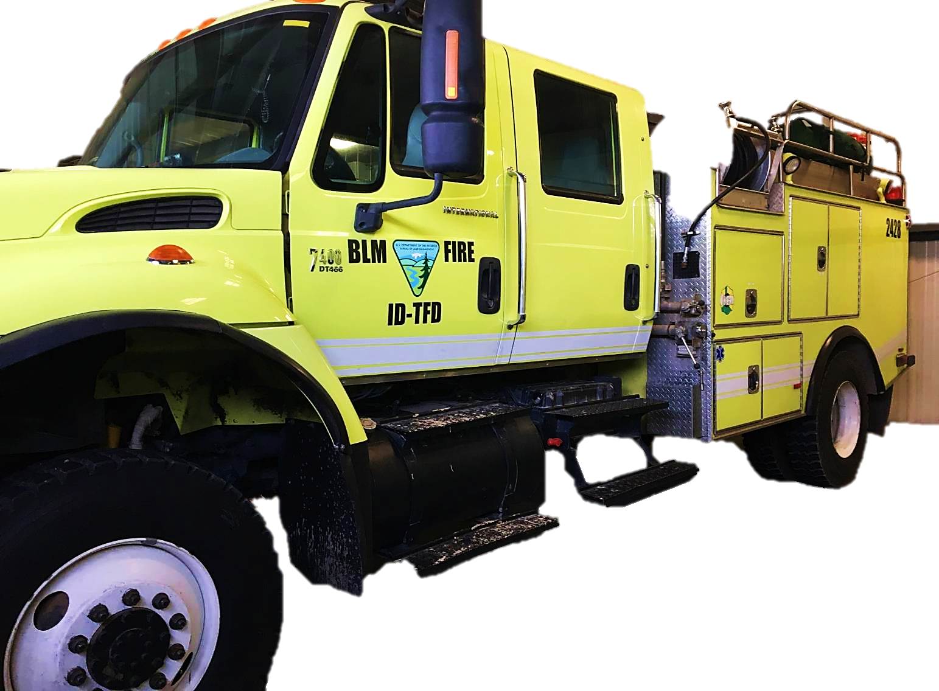
Driver Side General Condition
42
Notes:
Driver Side General Condition
The procedure is the same as inspecting the passenger side general condition.
Refer to slide 35.

Slide 43
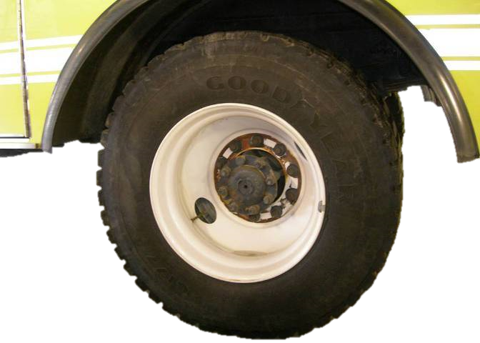
Driver Side Rear Tire, Rim,
Hub and Suspension
Notes:
Driver Side Rear Tire, Rim, Hub, and Suspension
The procedure is the similar to inspecting the driver side front tire, rim, hub, and suspension.
Refer to slides 17 through 24.

Slide 44
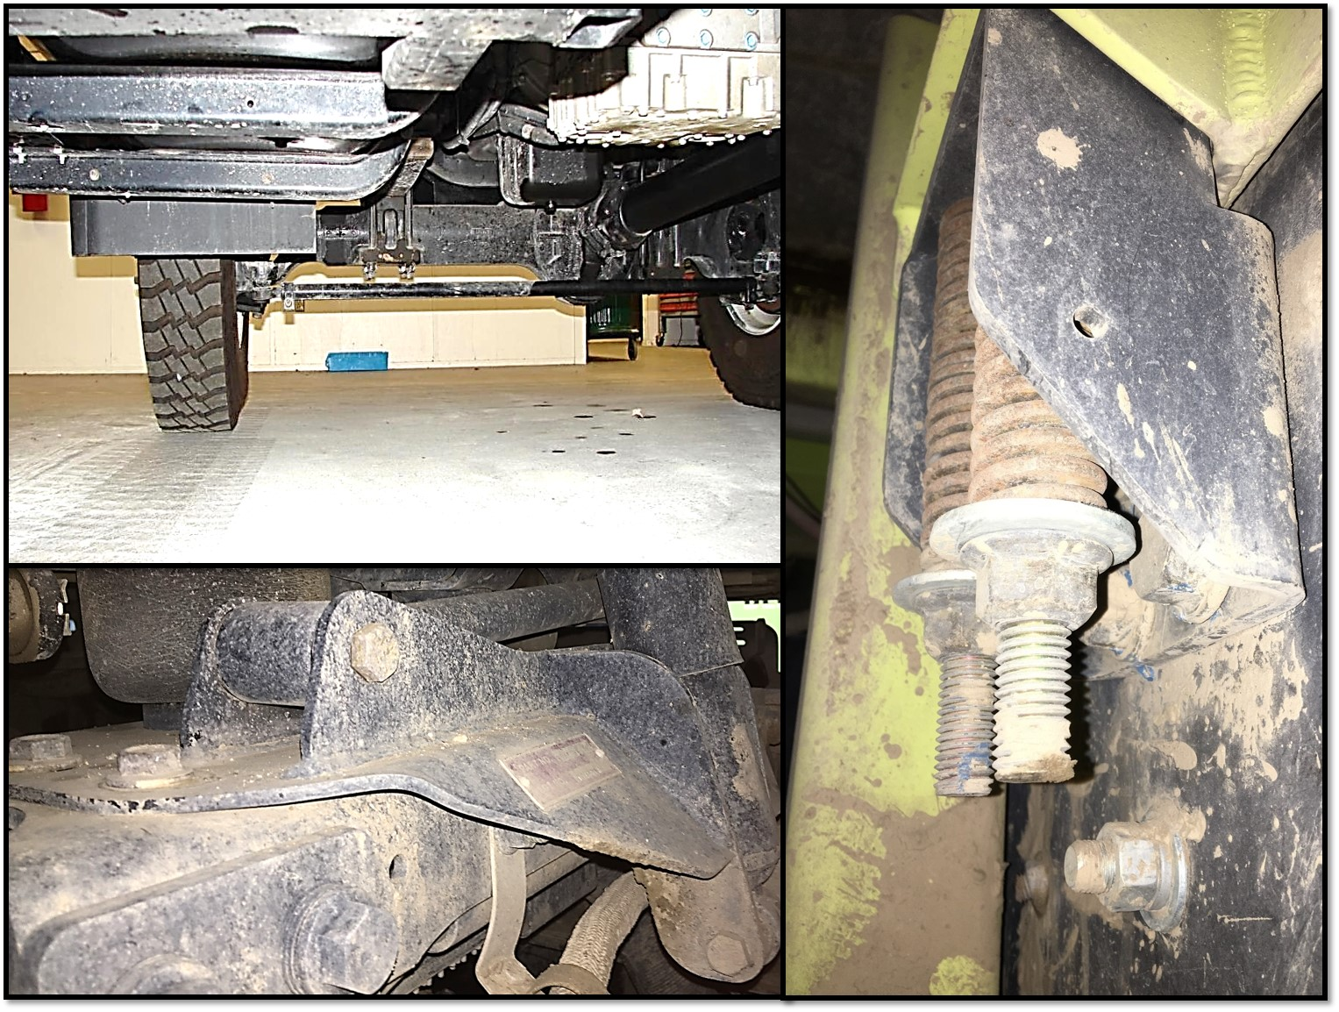
Driver Side Undercarriage
44
Notes:
Driver Side Undercarriage
The procedure is the same as inspecting the passenger side undercarriage.
Refer to slide 36.

Slide 45
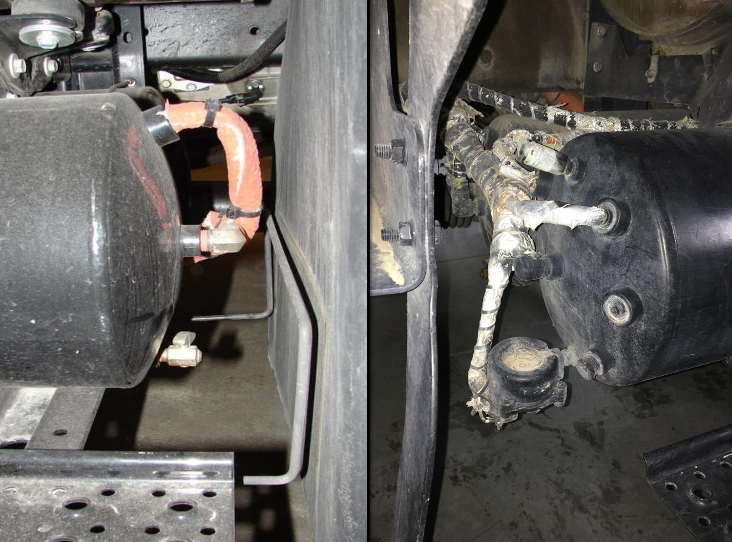
Air Tanks and Lines
45
Notes:
Air Tanks and Lines
Open air tank drains and bleed off moisture and oil.
Excessive moisture or oil could signal a problem with the air drier or compressor.
Inspect mounting brackets.
Ensure air lines are secure.
Ensure air lines are free of leaks, cracks, bulging, or chafing.

Slide 46
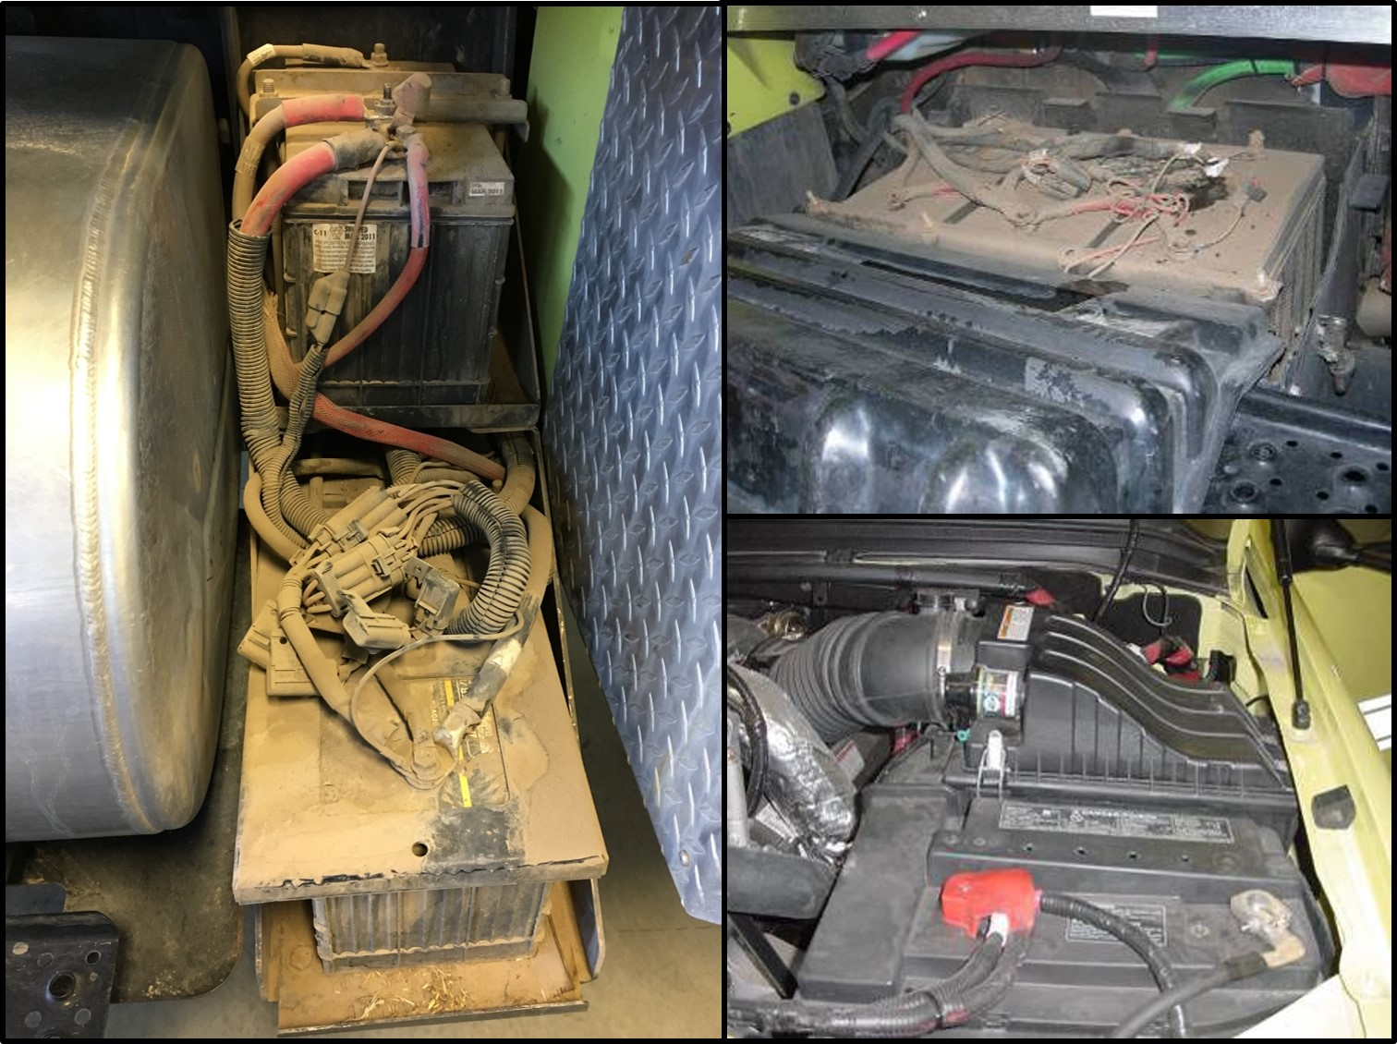
Batteries
46
Notes:
Batteries
Ensure batteries are secure, connections are tight, and cell caps are in place.
Ensure battery connections are not excessively corroded
Corroded battery connections can cause starting and charging problems.
Ensure the battery box and cover are secure.

Slide 47
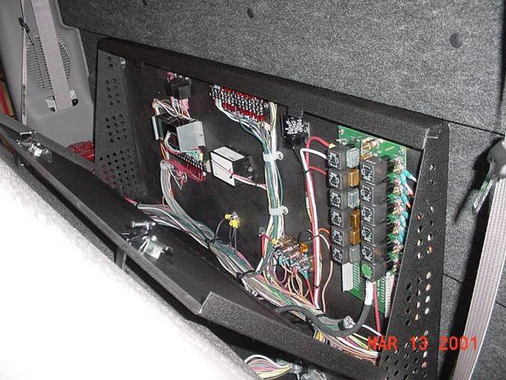
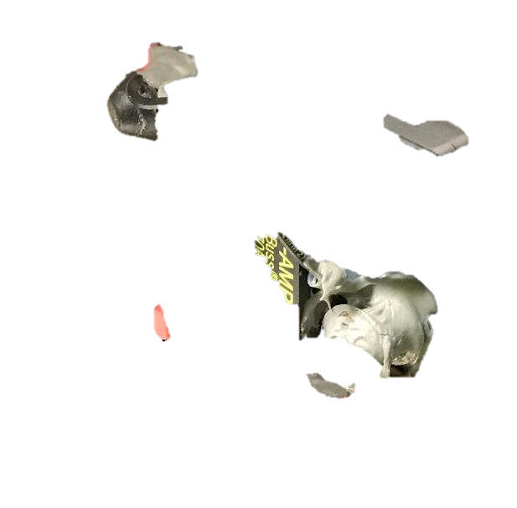
Fuse/Electrical Panels
47
Notes:
Fuse/Electrical Panels
Know the location(s) of all fuse panels, electrical junction boxes, multiplexed terminal blocks, and circuit breakers.
Common locations include behind the passenger seat, behind dashboard panels/covers, under the hood near the battery and/or on the firewall, on the frame near the driver’s side steps, hose reels, hidden panels within package compartments, and behind or below the pump panel.

Slide 48
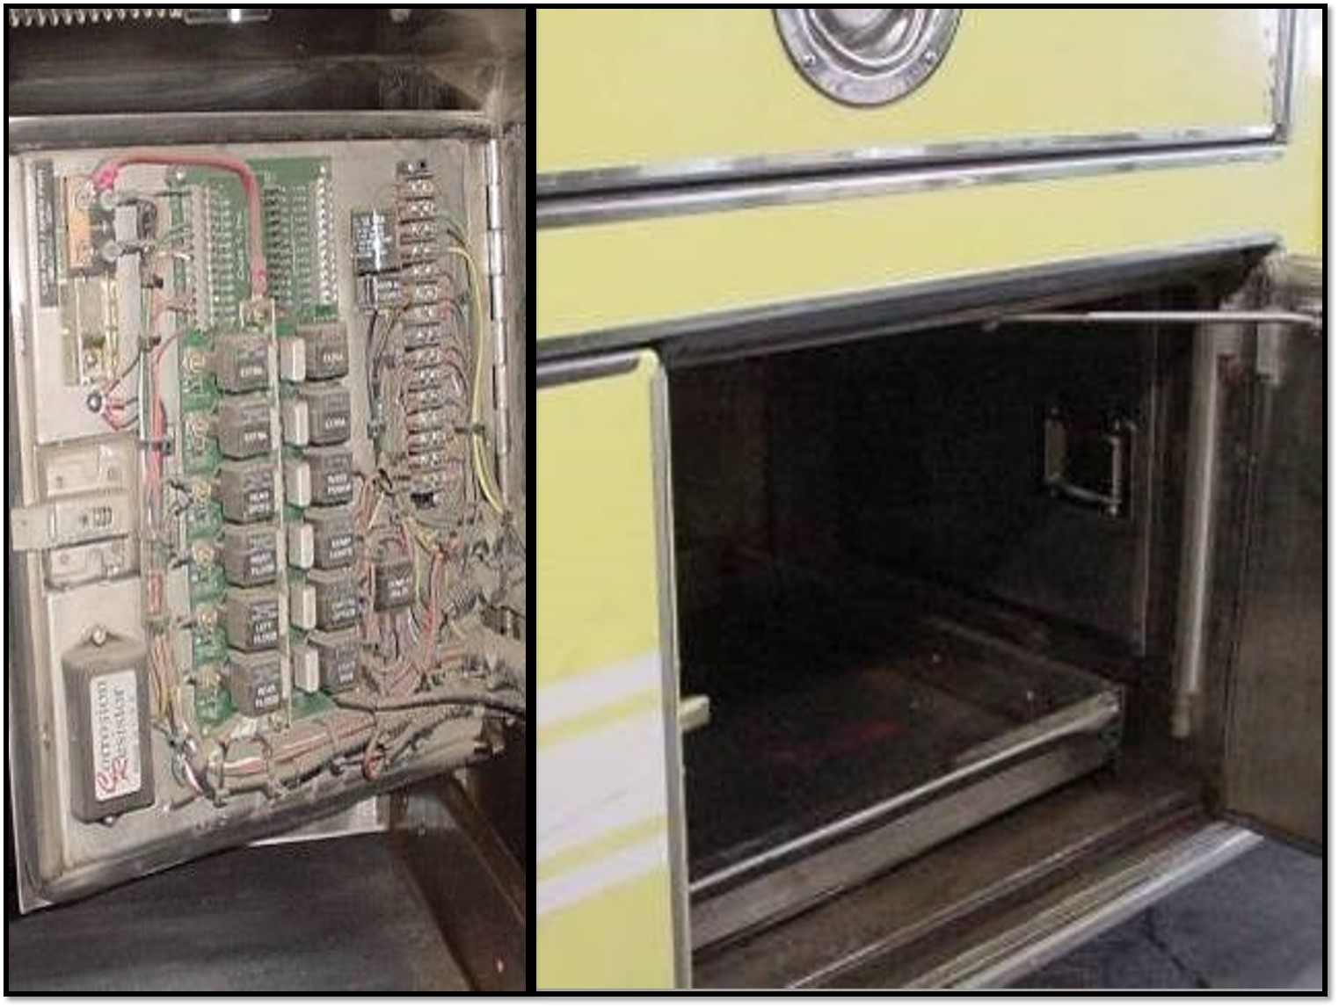
Electric Circuit Box
48
Notes:
Some components may be hidden within compartments.

Slide 49
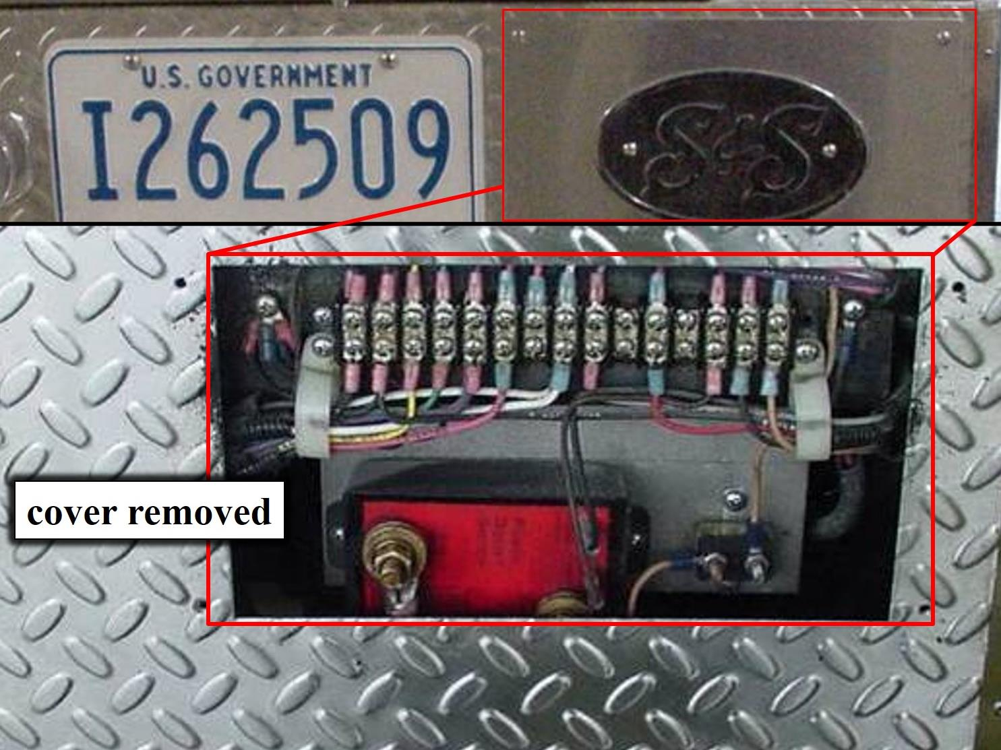
Rear Electrical Junction Terminal
49
Notes:
Some components may be hidden behind the license plate or other covers on the rear of the vehicle.

Slide 50
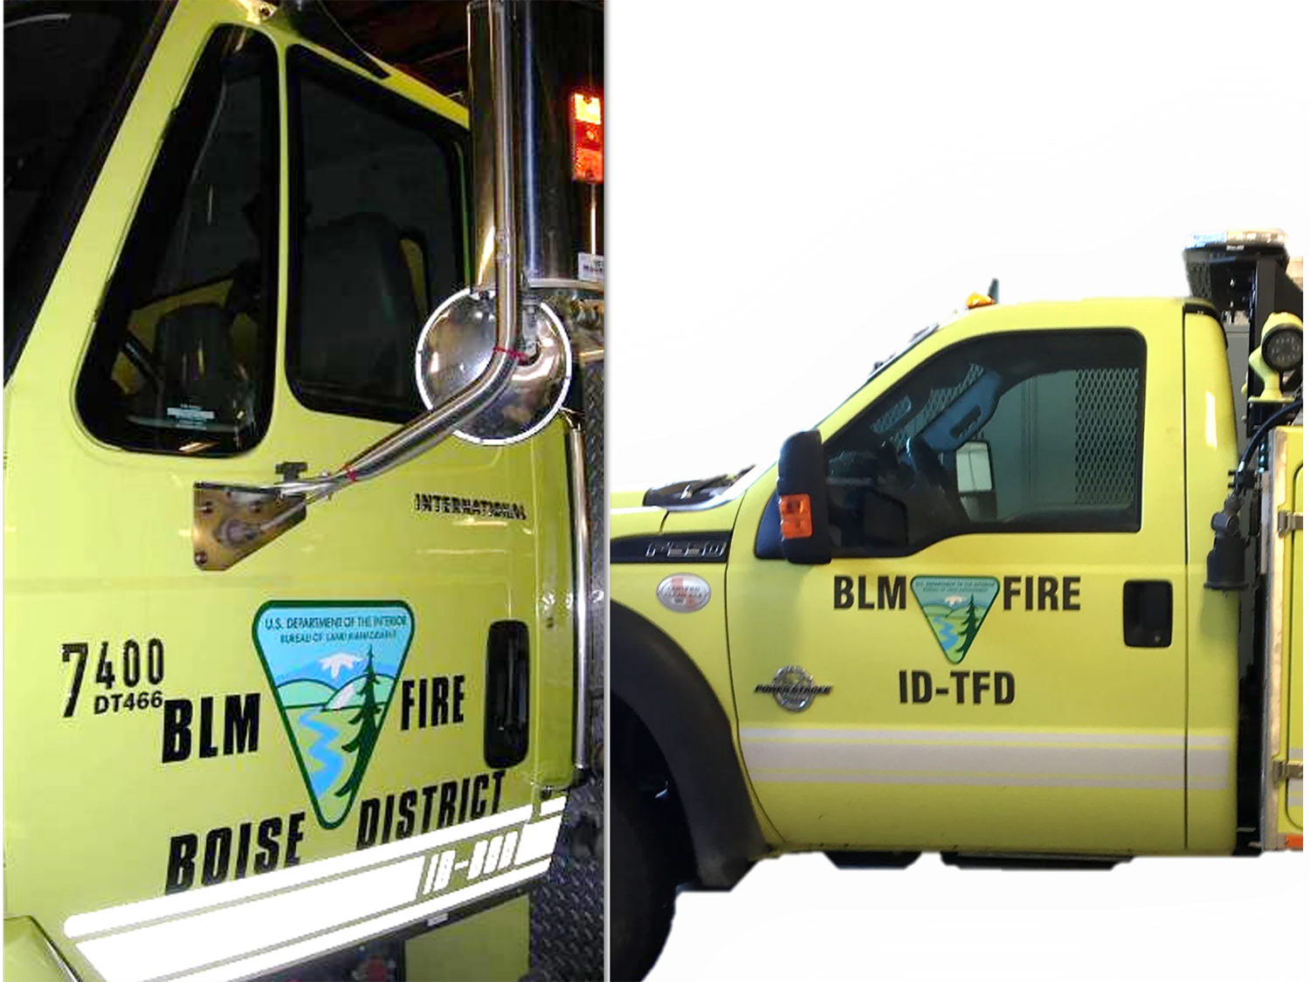
Driver Side Door(s)
Notes:
Driver Side Door(s)
Same as passenger side door(s).
Refer to slide 34.

Slide 51
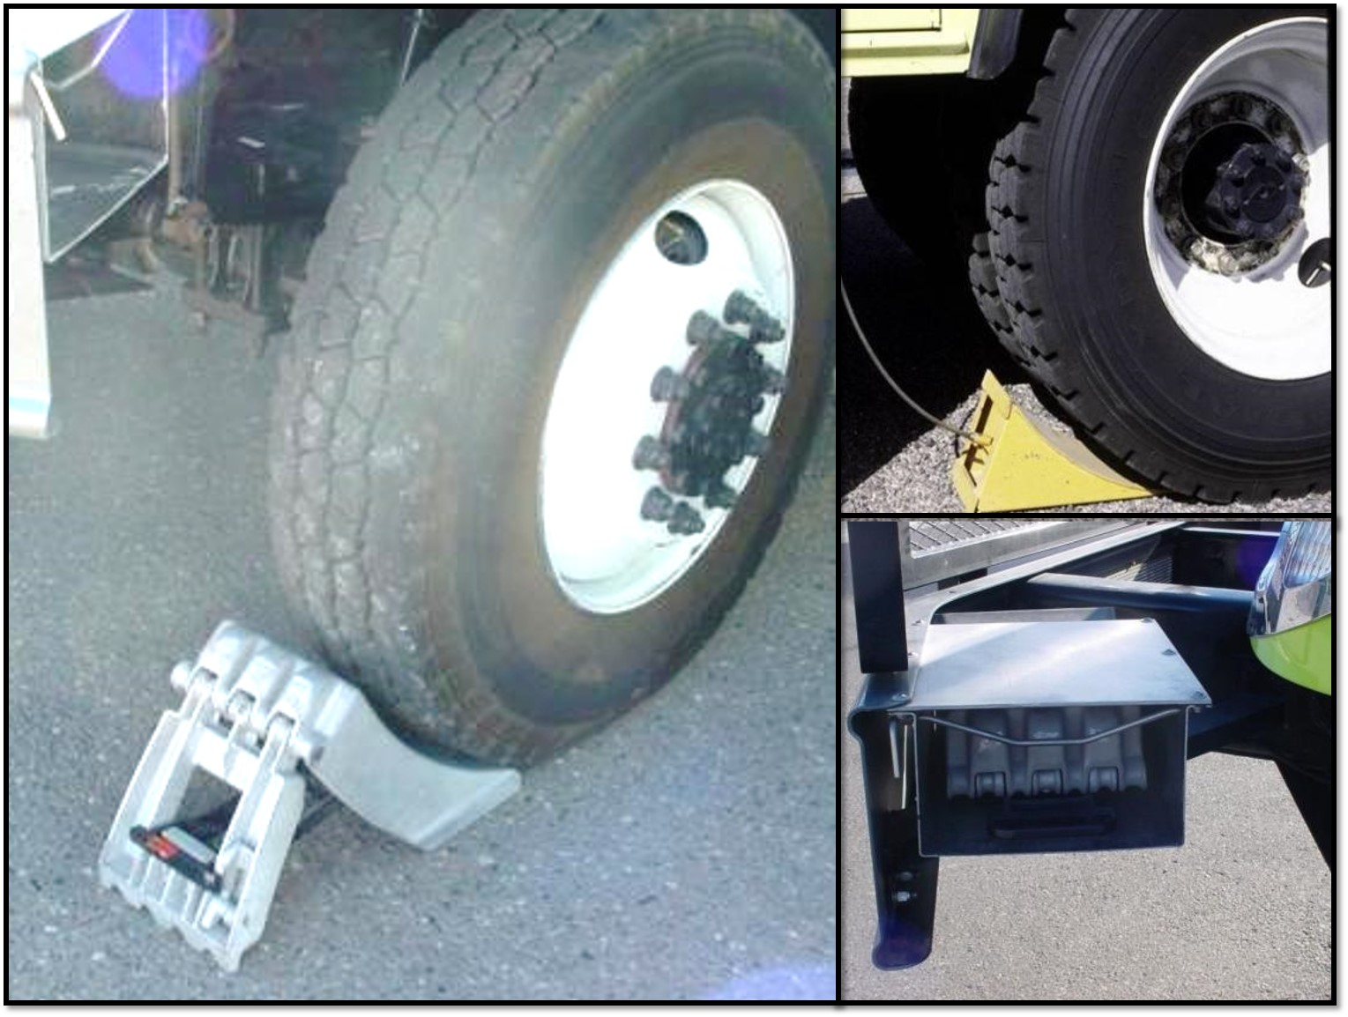
Wheel Chocks
51
Notes:
Wheel Chocks
Ensure wheel chocks are available and easily accessible.
Ensure wheel chocks are secure when the vehicle is traveling.
Ensure latches and hinges on folding wheel chocks are functioning properly.
As a safety precaution, wheel chocks must be used whenever people are under the vehicle, the vehicle is left unattended, or during engine operations in a stationary mode.

Slide 52
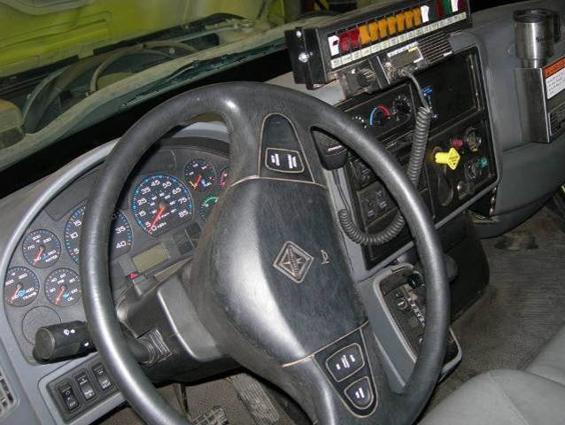
Inside Cab
52
Notes:
Inside Cab
Ensure the apparatus is neat and orderly, secure loose items that can interfere with the operation of the vehicle.
Start Engine:
Allow engine to reach operating temperature and leave running for electrical checks.
Ensure the “water in fuel” light goes off after engine starts.
If light stays on, water needs to be drained from fuel/water separator.
Water in fuel can damage engine.
• If engine fails to start:
Ensure the master switch is on.
Ensure fuel tank has fuel.
Check for and tighten loose battery connections.
Check for dead battery. If the battery is dead, follow jump starting procedures. (Refer to the FEMPR or the vehicle owner’s manual.)
When jump starting, ensure that battery voltage systems are compatible (12-volt to 12-volt or 24-volt to 24-volt).
Never jump a lower-volt battery system with a higher-volt battery system.

Slide 53

Lights and Signals
53
Notes:
Lights and Signals
Turn on and check the operation of all lights on the chassis and fire package which includes, but is not limited to, headlights, off-road lights, turn signals, running lights, brake, reverse, hazard, license plate, light bar, emergency, scene or work, pump panel, compartment, step, cab, and dashboard.
Replace burned out bulbs as necessary.
Most fire vehicles are equipped with an intelligent electrical multiplex system. This system is programmed to "shed" or turn off certain lights if the battery voltage drops to a predetermined point. It is recommended that you have the vehicle started and high idle engaged while checking the lights.
If the vehicle has a light bar equipped with white or clear forward facing lights, those lights will only function if the vehicle transmission is not in neutral and the parking brakes are not engaged.

Slide 54



Mirrors, Windows, & Wipers
54
Notes:
Mirrors and Windows
Ensure all mirrors and windows are clean.
Inspect mirror and windows for cracks or chips.
Inspect mirror mounts for damage or looseness.
Ensure mirrors are properly adjusted.
Clean glass and properly adjusted mirrors can prevent accidents.
Windshield Wipers and Washer
Ensure windshield wipers work on all speeds, and rubber is free of cracks, splits, and weathering.
Ensure the washer system functions correctly and has adequate fluid.
Replace wipers and fill reservoir as necessary.

Slide 55

Gauges and Switches
oval
55
Notes:
Gauges
Ensure all gauges are operational.
Document any non-functioning gauges; ensure the problem is fixed before putting the vehicle into service.
Most manufacturers illuminate all warning lights for a few seconds after the key is turned on. Operators should check to see if any lights are not functioning. Some manufacturers “sweep” the gauges when the key is turned, this is also to assess functionality.
Switches
Ensure switches are functioning as designed.

Slide 56

District Mobile Radio,
Siren, & PA
56
Notes:
District Mobile Radio, Siren and P.A.
Perform a radio check to ensure that the radio receives and transmits.
Ensure the radio and microphone are securely mounted and speakers are functional.
Ensure the siren and public address (PA) system are functioning properly.

Slide 57

Horn and Backup Alarm
57
Notes:
Horn and Backup Alarm
Check the electric chassis horn and air horn.
Ensure the reverse alarm is operational.

Slide 58

Seat Belts
58
Notes:
Seat Belts
Ensure seat belts are clean, secure, accessible, and operational.
There should be no wear or fraying.

Slide 59

Heater and A/C
59
Notes:
Heater and Air Conditioner
Check fan, defroster, vents, and controls.
Since the defroster helps to maintain outward visibility, its functionality is vital.
Periodically check the cabin filter and ember screen, if equipped.

Slide 60

Log Book/Accident Forms
60
Notes:
Vehicle Use (Log) Book
Ensure the vehicle use book is current, neat and accessible.
Check for the vehicle credit card, receipts, proper charge codes, and weight ticket.
Ensure a signed copy of the self-insurance documentation is included in the log book.
Accident Forms
Ensure that the DI-135 Accident Packet contains the following forms:
“Report of Accident/Incident” (DI-134)
“Operator’s Report of Motor Vehicle Accident Report” (SF-91), 2 copies
“Investigation Report of Motor Vehicle Accident” (SF-91A), 2 copies
“Statement of Witness” (SF-94), 2 copies

Slide 61

Fire Extinguisher
61
Notes:
Fire Extinguisher
Ensure the fire extinguisher is securely mounted, pins are in place, reflective marker is attached, and unit is charged.
Ensure the fire extinguisher has a tag indicating the current annual service date, as well as monthly inspections.

Slide 62

First Aid Kit(s)
62
Notes:
First Aid Kit(s)
Ensure the first aid kit(s) is maintained, updated, and clearly marked.

Slide 63

DOT Warning Triangle Kit
Notes:
DOT Warning Triangle Kit
Ensure the reflector warning kit is available and operational.

Slide 64

Jack and Lug Wrench
64
Notes:
Jack and Lug Wrench
Ensure a properly-sized jack and lug wrench are present and compatible with the vehicle.
Ensure cribbing is strong and large enough to safely support the weight of the vehicle.
A leaning or leaking jack may fail to properly raise or support the vehicle.

Slide 65

Brakes
65

Slide 66

Parking Brake
66
Notes:
Parking Brake (both hydraulic and air brakes)
Ensure the parking brake will hold the vehicle by gently trying to pull forward with the parking brake engaged.

Slide 67

Service Brakes
67
Notes:
Service Brakes (hydraulic and air brakes)
Check for proper operation.
Pull forward at approximately 5 mph. Apply service brake firmly. Check to see that brakes are working properly and to see if the vehicle pulls to one side or the other. Listen for any abnormal grinding or squeaking noises.
Any unusual brake pedal "feel" or delayed stopping action can also be a signal mechanical issues.
If you find anything unsafe during the vehicle inspection, repair before operating. Federal and state laws forbid operating an unsafe vehicle.

Slide 68




Hydraulic Brake Check
68
Notes:
Hydraulic Brake Check (if equipped)
Test for hydraulic brake leaks.
Pump the brake pedal three times, then apply firm pressure to the pedal and hold for five seconds.
The pedal should not move. If it does, there may be a leak or other problem. Repair before driving.
Hydraulic Brake Reserve (Backup) System, if equipped
Ensure the hydraulic brake reserve system is functioning properly.
With the key off, depress the brake pedal and listen for the sound of the reserve system electric motor.

Slide 69
Air Brake Video
[Note to the Instructor: Select an appropriate video.]
69

Slide 70

Slack Adjusters
70
Notes:
Slack Adjusters
Ensure the slack adjuster is securely mounted.
Check slack adjuster and pushrod for bent, broken, loose, or missing parts.
With brakes released and wheels chocked, pull the slack adjuster by hand using a large screwdriver as leverage.
The pushrod should not move more than approximately 1 inch.
The angle between the pushrod and the slack adjuster should not be less than 90 degrees.
You should not be able to see the overstroked indicator.

Slide 71

Brake Chamber/Canister
& Brake Lines
71
Notes:
Brake Chamber/Canister and Brake Lines
Inspect canisters for any physical damage.
Ensure the emergency release key is secured in the external mount.
Ensure the dust cap is covering the hole on top of the canister.
Check air lines and ensure there are no cracks, chafing, or bulging.

Slide 72

Brake Drums & Linings
72
Notes:
Brake Drums and Linings
Brake drums are located on each end of the vehicle’s axles. The wheels are bolted to the drums. The braking mechanism is inside the drum. To stop, the brake shoes and linings are pushed against the inside of the drum. Disk brakes use a caliper to clamp two brake pads against a rotor. Both of these cause friction, which slows the vehicle (and creates heat).
Ensure there are no cracked drums (or disks).
Ensure shoes or pads are not worn dangerously thin, missing, or broken.
Shoes should have a lining no less than ¼-inch thick.
Ensure shoes or pads do not have oil, grease, or brake fluid on them.
Axle hub seal or hydraulic wheel cylinder leaks can result in oil or brake fluid spraying on braking surfaces. The porous friction material will absorb the oil, acting as a lubricant on the brake surfaces and causing the other brakes to work harder to compensate for the faulty brake. If this occurs, the friction material must be replaced. Oil soaked linings and pads can also catch fire due to the heat generated by friction.

Slide 73
Air Compressor Governor Pressure Test
Pumping by the air compressor should start at about 100 PSI and stop at about 125 PSI (check manufacturer’s specifications).
Run the engine at a fast idle.
  The air governor should cut-out the air compressor at about the manufacturer’s specified pressure. The air pressure shown by your gauge(s) will stop rising.
With the engine idling, step on and off the brake to reduce the air tank pressure.
  The compressor should cut-in at about the manufacturer's specified cut-in pressure. The pressure should begin to rise.
Notes:
Air Compressor Governor Pressure Test
Pumping by the air compressor should start at about 100 PSI and stop at about 125 PSI (check manufacturer’s specifications).
Run the engine at a fast idle.
The air governor should cut-out the air compressor at about the manufacturer’s specified pressure. The air pressure shown by your gauge(s) will stop rising.
With the engine idling, step on and off the brake to reduce the air tank pressure.
The compressor should cut-in at about the manufacturer's specified cut-in pressure. The pressure should begin to rise.
If the air governor does not work as described above, it may need to be fixed. A governor that does not work properly may not keep enough air pressure for safe driving.

Slide 74


Parking Brake Leak Test
Notes:
Parking Brake Leak Test
Chock the wheels.
Build up air pressure until the governor cuts out (120 – 140 PSI).
Test the leakage rate without the foot brake applied.
Ensure the Ignition is in the “OFF” position.(You need to be able to listen.)
Turn the Ignition to the “ON” (not “START”) position. (Most vehicles need to have the ignition on for the gauges to work.)
Release the parking brake. (Push knob in.)
Monitor the air pressure gauge for 1 minute.
Listen for audible air leaks.
The system should lose no more than 2 PSI after the initial drop when the parking brake system is charged.
If the air loss rate exceeds 2 PSI, check for air leaks and fix before driving the vehicle. Otherwise, you could experience brake failure while driving.

Slide 75

Service Brake Leak Test
Notes:
Service Brake Leak Test
Continuing from the parking brake leak test, check the leakage rate with foot brake applied.
Ensure the Ignition is in “ON” (not “START”) position.
Keep the parking brake released. (Push knob in.)
Fully apply the foot brake. (Never apply the service brake when the parking brake is set; the compound forces can damage components.)
Monitor the air pressure gauge for one minute.
After the initial drop when the service brake system is charged, you should lose no more than 3 PSI in one minute.
Listen for audible air leaks.
If the air loss rate is too much. Check for air leaks and fix before driving the vehicle. Brake failure could occur.

Slide 76


Low Pressure
Warning Signal Test
BEEP!
Notes:
Low Pressure Warning Signal Test
Continuing from the service brake leak test, perform a low pressure warning signal test.
Ensure the Ignition is in “ON” (not “START”) position.
Keep the parking brake released. (Push knob in.)
Fan (pump) the foot brake to bleed off air pressure. (Never apply the service brake when the parking brake is set; the compound forces can damage components.)
Monitor the air pressure gauge.
Ensure both the low air pressure warning light and audible alarm must come on when the air pressure drops below 60 PSI.
The low air pressure warning light and audible alarm are powered independent of each other for added safety.

Slide 77

Parking Brake Check
Notes:
Parking Brake Check
Continuing from the low pressure warning signal test, ensure the parking brake comes on automatically.
Ensure the Ignition is in “ON” (not “START”) position.
Keep the parking brake released. (Push knob in)
Continue to fan (pump) the foot brake to bleed off air pressure.
Monitor the air pressure gauge.
Continue to fan off the air pressure. At approximately 20 - 45 PSI, the parking brake valve should close (pop out).
When the parking brake is set (pulled out) it requires no air pressure. Powerful springs hold the brakes by mechanical force (because air pressure can eventually leak away). When driving, the springs are held back by air pressure. If the air pressure is removed, the springs put on the brakes.
Do not wait for the brakes to come on automatically. When the low air pressure warning light and buzzer first come on, bring the vehicle to a safe stop right away, while you can still control the brakes. The braking power of spring brakes depends on the brakes being in adjustment. If the brakes are not adjusted properly, neither the regular brakes nor the emergency/parking brakes will work correctly.

Slide 78

Air Pressure Buildup Rate Test
78
Notes:
Air Pressure Buildup Rate Test
Check the air pressure buildup rate.
Start the engine.
Increase engine RPMs to a “high idle.”
Watch the air pressure gauge.
Time how long it takes the air pressure to build from 85 to 100 PSI. The pressure should build from 85 to 100 PSI within 45 seconds. (If the vehicle has larger than minimum air tanks, the buildup time can be longer and still be safe. Check the manufacturer’s specifications.)
If you experience low air pressure while driving, make an emergency stop. Don't drive the engine until the problem is fixed.

Slide 79

Post Off-Road Inspection
79
Notes:
Post Off-Road Inspections
Post off-road inspections are intended to identify any damage that may have occurred during fire suppression operations and require a more in depth look at major chassis components.
These inspections should be completed immediately after traveling off-road, before returning to maintained roads, both during and after suppression operations, project work, or training.
Document the inspection findings and corrective actions on the Preventive Maintenance Checklist in the “Notes” section.

Slide 80

Post Off-Road Inspection Checklist
Steering
Tires/Rims
Brakes
Drive train
Suspension
Noxious weeds
80
Notes:
Post Off-road Inspection Checklist
When leaving post off-road driving conditions and before driving onto a solid road surface, perform a quick visual vehicle inspection addressing the items below.
Steering - Ensure there are no bent or broken tie rod, tie rod ends, steering stabilizer, and sway bar.
Tires/Rims - Ensure there is no rock(s) in the duals, no bent or broken rims, loose lug-nuts, and no cut/gouged/bulging/underinflated tires.
Brakes - Ensure brake pods are not bent/dented/broken, brake lines are not broken/bulging or dangling, and the vehicle does not pull when braking.
Drive Train - Ensure drivelines are not dented/bent, carrier bearings and driveline hoops are in place, disengage 4X4 and low range, disengage locking hubs (if equipped).
Suspension - Ensure there are no bent/broken spring/shock mounts, no cracked or shifting springs, no dented or leaking shock absorbers, and no bent/broken U-bolts.
Noxious Weeds – Ensure the undercarriage is free from debris buildup or noxious weeds.

Slide 81
Post Off-Road Inspection
81
Notes:
This incident was caused by loose lug nuts.

Slide 82

Post Off-Road Inspection
82
Notes:
This tire blew while driving at highway speeds. Was it damaged on a fire and missed on the post-fire inspection?

Slide 83

Post Off-Road Inspection
83
Notes:
This incident was caused by leaving the hubs locked in and driving at highway speeds. Eventually the drive-train failed catastrophically, igniting a fire and destroying the vehicle.

Slide 84

Post Off-Road Inspection
84
Notes:
This vehicle has a broken main leaf spring. Is this vehicle safe to drive?

Slide 85

Post Off-Road Inspection
85
Notes:
This is a broken air brake push rod. Would this vehicle pull to one side?

Slide 86

Post Off-Road Inspection
86
Notes:
This is a broken axle plate. Is this vehicle safe to drive?

Slide 87

Post Off-Road Inspection Noxious Weeds
87
Notes:
Noxious Weeds
Check the undercarriage for debris.
When working in noxious weed infested areas, ensure the vehicle is cleaned according to local policy.

Slide 88

Engine Fire Readiness
(Post-Incident)
Items to clean and inspect
  Engine
  Undercarriage
  Tools
  PPE
88
Notes:
Engine Fire Readiness
Inspect and clean the following items following an incident:
Engine
Undercarriage
Tools
PPE

Slide 89


Normal Unit Stocking (NUS)
http://web.blm.gov/internal/fire/fire_ops/engine_policy.htm
89
Notes:
Normal Unit Stocking (NUS)
The NUS is the official documentation of items on board the engine.
Check for missing or damaged items; replace or repair at the appropriate site.
Ensure the NUS items are documented and kept current.
Ensure the vehicle meets the NUS (Normal Unit Stocking) found on the BLM Fire Operations internal website (http://web.blm.gov/internal/fire/fire_ops/engine_policy.htm)
Equipment/NUS Replacement
In-District/Local Area Process
Understand the in-district/local area equipment/NUS replacement process.
Agency-specific damage/loss forms
Local purchases, approval process, charge codes, etc.
Off-District/Out-of-Area Process
Understand and become informed on off-district/out-of-area processes.
BLM engine modules should follow the Interagency Incident Business Management Handbook (NFES 2160) – property loss/damage process.

Slide 90

Incidents With a Supply Unit
To obtain general supply items, fill out a “General Message” form.
  Line supervisor signature may be required.
For fire replacement and damaged items:
  Fill out an “Incident Replacement Requisition”
  (OF-315).
  Compare the NUS to items being replaced or are damaged.
  Line supervisor and/or supply approval process must be met.
  Supply Unit personnel approve/deny replacement and assign “S” numbers.
90
Notes:
Incidents with a Supply Unit
To obtain general supply items, fill out a “General Message” form.
Line supervisor signature may be required.
For fire replacement and damaged items:
Fill out an “Incident Replacement Requisition” (OF-315).
Compare the NUS to items being replaced or are damaged.
Line supervisor and/or supply approval process must be met.
Supply Unit personnel approve/deny replacement and assign “S” numbers.
Many incidents require more documentation for tracking purposes. You may need to fill out a “Property Loss or Damage Report” (OF-298) and have Compensation/Claims, Ground Support, Communications, or Supply Unit approval, as well as you line supervisor’s approval (sometimes Division/Group Supervisor or above).

Slide 91

Incidents Without a Supply Unit
Fill out an “Incident Replacement Requisition” (OF-315).
Obtain line supervisor approval for use of the OF-315 and obtain “S” number(s) for expanded dispatch.
91
Notes:
Incident Without a Supply
Fill out an “Incident Replacement Requisition” (OF-315).
Obtain line supervisor approval for use of the OF-315 and obtain “S” number(s) from expanded dispatch.
Many units also require the use of a “Property Loss or Damage Report” (OF-289).

Slide 92

Damage or Repair Reporting and Documentation
Report and document damage to the engine or repairs to a fireline supervisor.
Complete proper documentation for the severity of damage before leaving any incident.
  “Incident Replacement Requisition” (OF-315)
  “Property Loss and Damage Report” (OF-289
  “Report of Accident/Incident” (DI-134)
  “Motor Vehicle Accident Report” (SF-91)
  “Motor Vehicle Accident Statement of Witness” (SF-94)
92
Notes:
Damage or Repair Reporting and Documentation
Report and document damage to the engine or repairs needed on the engine to a fireline supervisor.
Complete proper documentation for the severity of damage before leaving any incident. Forms may include:
“Incident Replacement Requisition” (OF-315)
“Property Loss and Damage Report” (OF-289
“Report of Accident/Incident” (DI-134)
“Motor Vehicle Accident Report” (SF-91)
“Motor Vehicle Accident Statement of Witness” (SF-94)

Slide 93

Vehicle Watch Out Situations
Skid plate/diesel particulate filter (DPF)
Radiator screen
Rock(s) between the duals
93
Notes:
Vehicle Watch Out Situations
Skid Plates/DPF
Brush and grass debris buildup can and has caused fires, resulting in loss of vehicles.
Radiator Screens
If not cleaned, the plugged screens can cause overheating and damage to the engine.
Rocks in the Duals
Rocks can cause flat tires, damage to other vehicles, and body damage to your vehicle.

Slide 94
Objectives
Complete all fire engine and post off-road inspections as identified in the Fire Equipment Maintenance Procedure Record (FEMPR).
Correctly enter all information in the Fire Equipment Maintenance Procedure Record (FEMPR).
94
Notes:
Objectives:
Complete all fire engine and post off-road inspections as identified in the Fire Equipment Maintenance Procedure Record (FEMPR).
Correctly enter all information in the Fire Equipment Maintenance Procedure Record (FEMPR).

