Slide 1
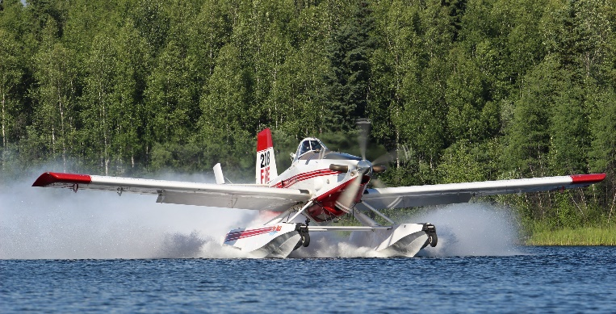
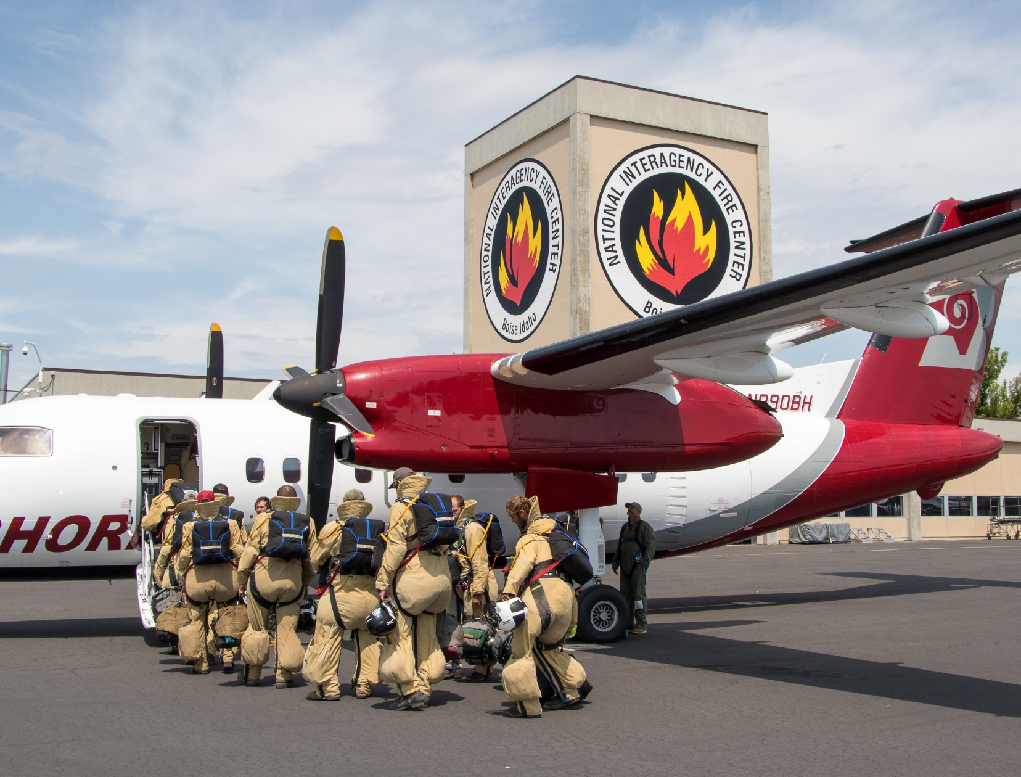
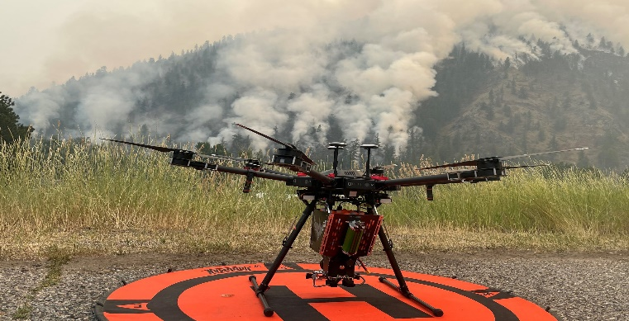
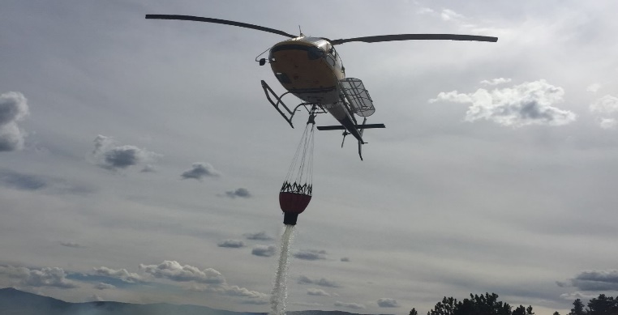
Bureau of Land Management
Fire and Aviation

Slide 2
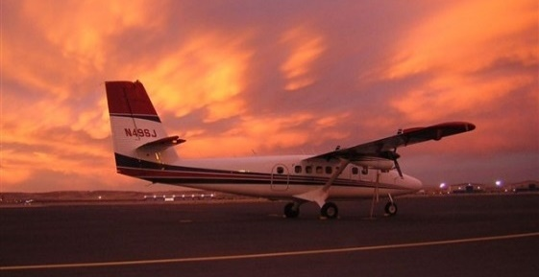
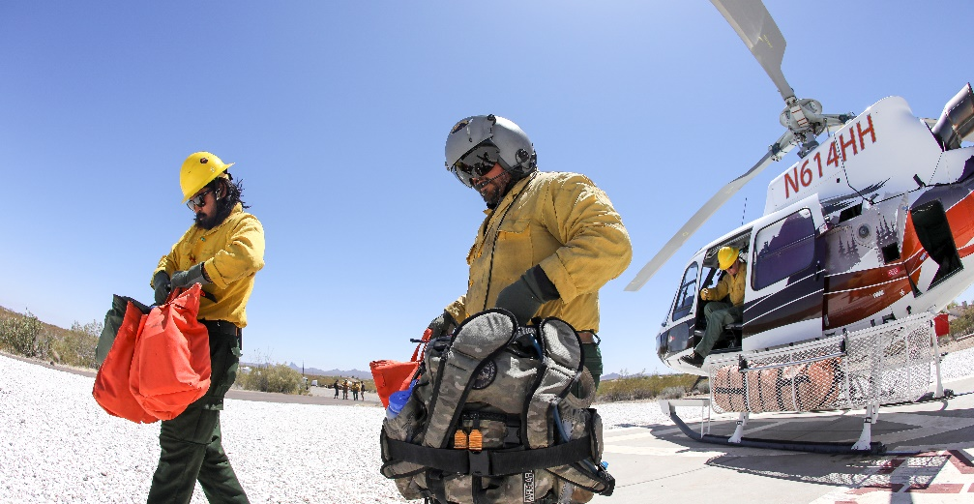
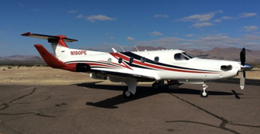
Overview
The BLM Fire and Aviation program is the largest and most complex fire program within the U.S. Department of the Interior.
BLM Fire is directly responsible for fire management on more than 245 million acres of public lands nationally.
Aircraft are a mix of bureau-owned, contracted, or obtained on a call-when-needed basis.
Aircraft operations support the BLM mission for wildfire and resource management needs.
  When aircraft are not being used to support wildland fires, they help other BLM programs.

Slide 3
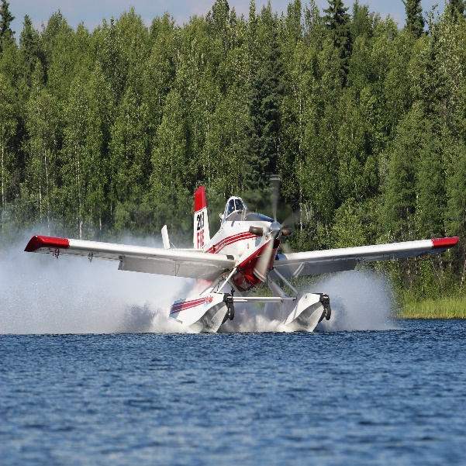
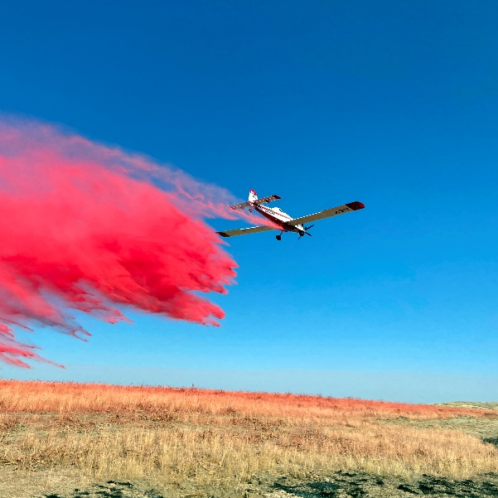
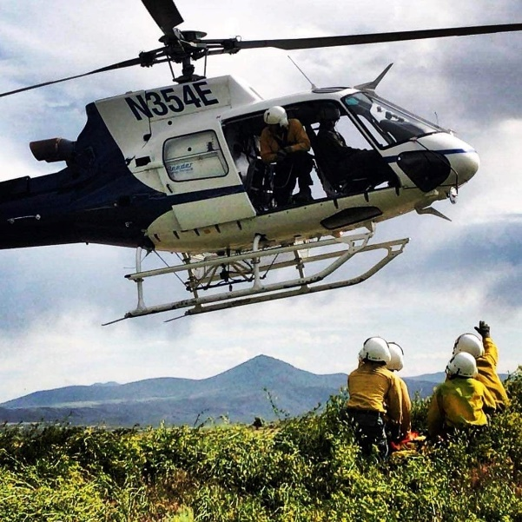
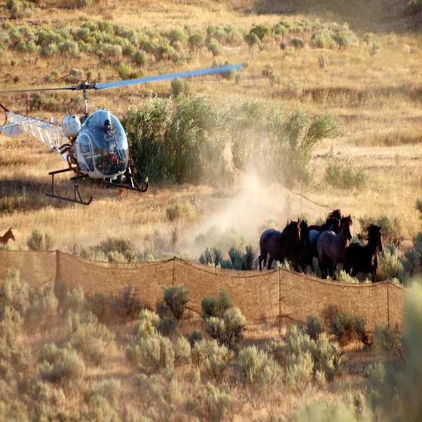
BLM Aviation Flight Hours
10- year average of
22,623 flight hours per year
(2013-2022)
67%
Fixed wing
84%
Fire
related
Type of aircrafts
Program supported
33%
Rotor
wing
16%
Natural resources/ law
enforcement

Slide 4
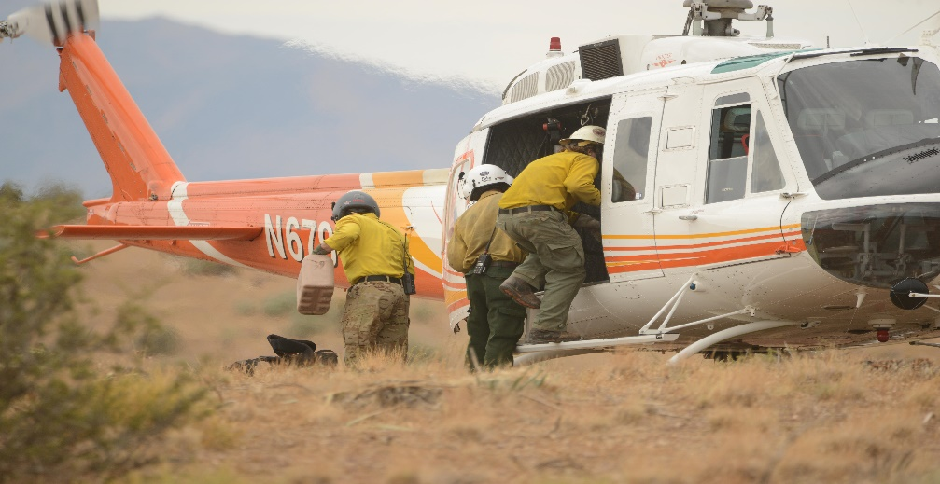



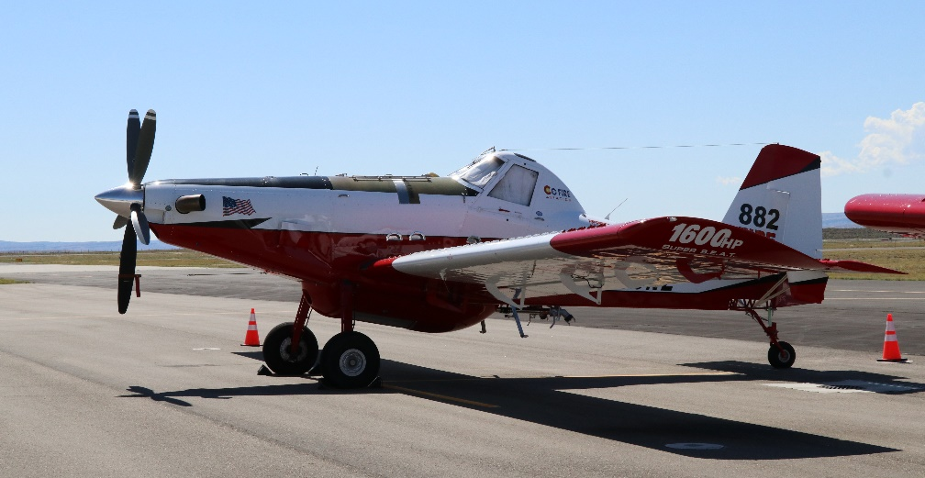


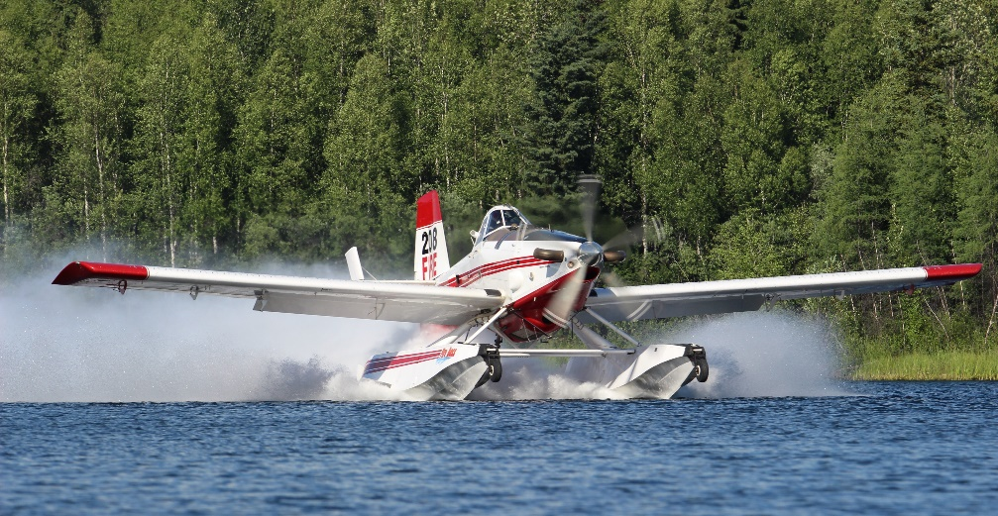
BLM Fire Aircraft Types
25
Helicopters
34
Single engine
airtankers
4
Fire bosses
26
Tactical
aircraft
30
Remote aircraft systems
Notes:
-add # for UAS

Slide 5
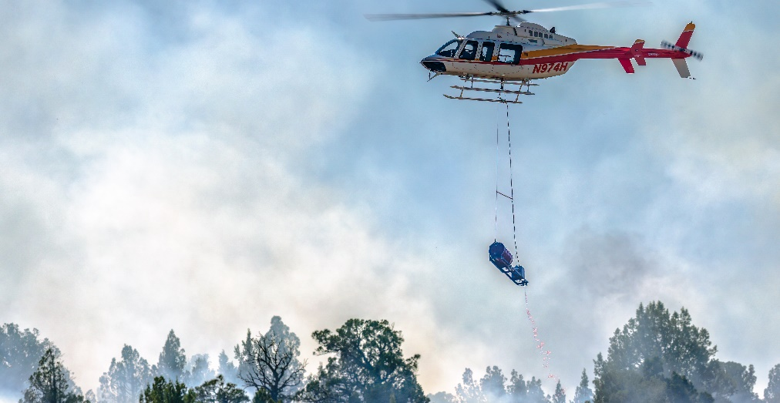
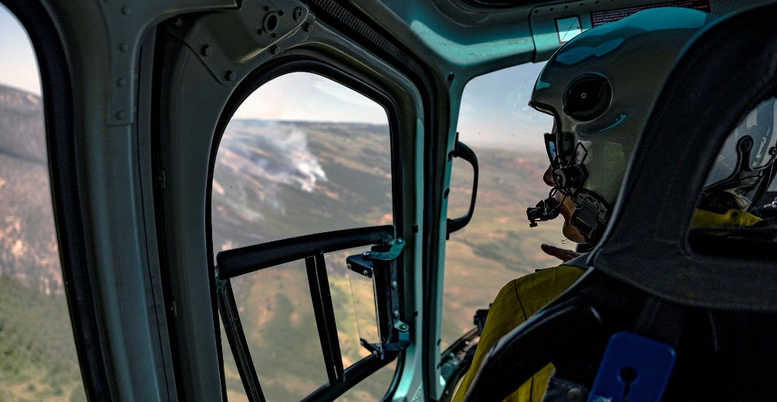
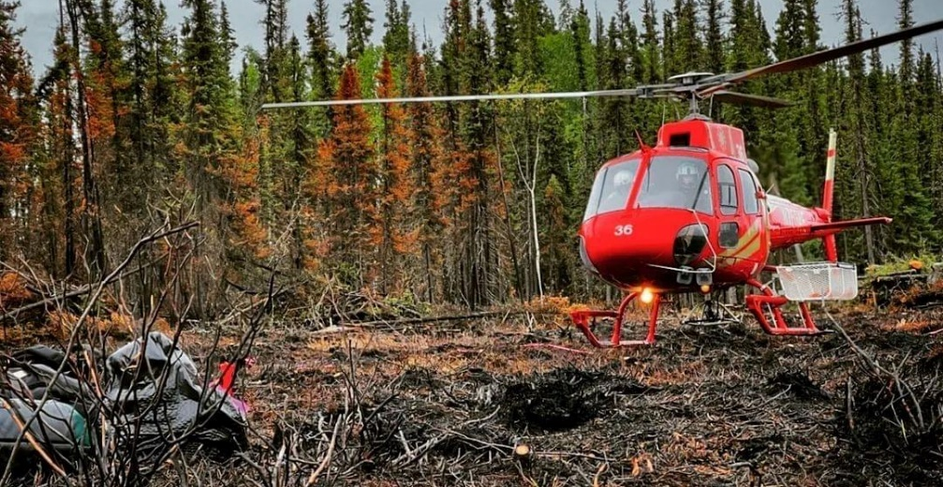
BLM Helicopters
  Help with initial attack as first resources on a fire to bring firefighters or cargo to remote locations.
  Can drop water on wildfires.
    Nearly 3 million gallons of water delivered during fire year 2022.
  Provide fire reconnaissance.
  Assist with aerial ignition support for prescribed fires or wildfire incidents.
  Support non-fire missions in remote locations.
    Examples: BLM Wild Horse and Burro program, cadastral services in Alaska

Slide 6
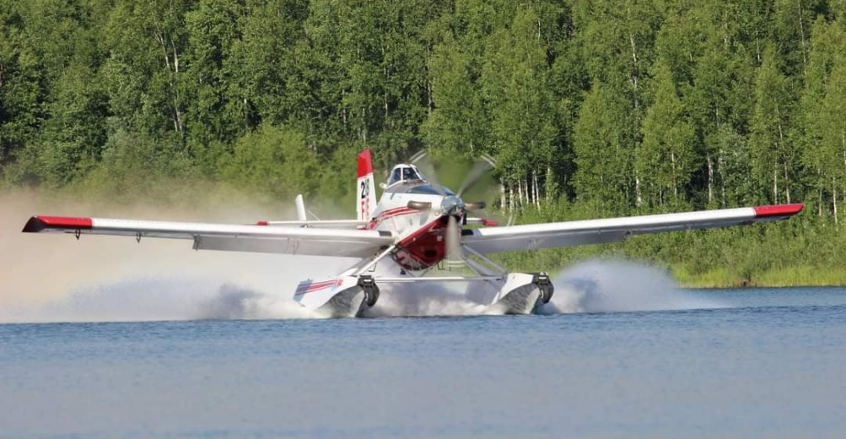
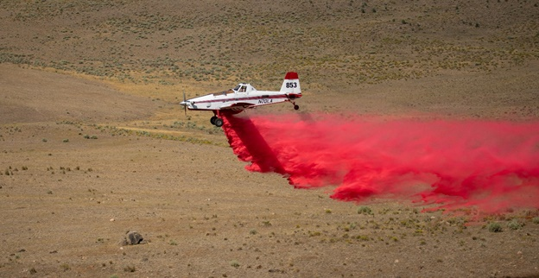
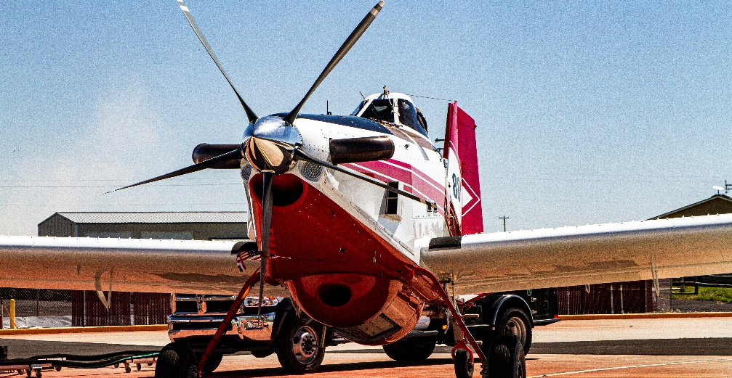
Single Engine Air Tankers (SEAT) and Fire Bosses
  Single engine air tankers are land-based aircraft are used to drop retardant on wildfires.
  Fire bosses are amphibious aircrafts that can float. These aircraft scoop water to drop on wildfires.
  There are a number of airtanker and SEAT bases to support operations across the country from Alaska to Arizona.
  Typical SEAT and Fire Boss loads are 600-800 gallons depending on the amount of fuel on board.

Slide 7
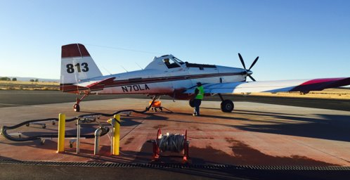
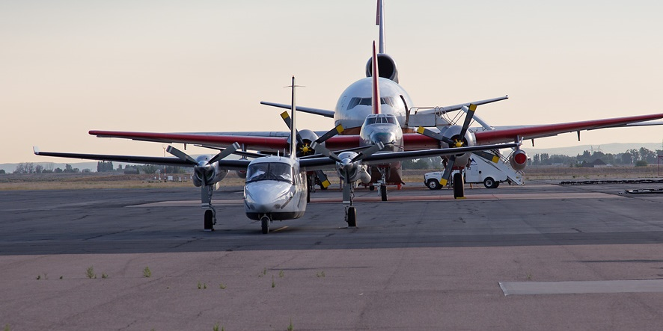
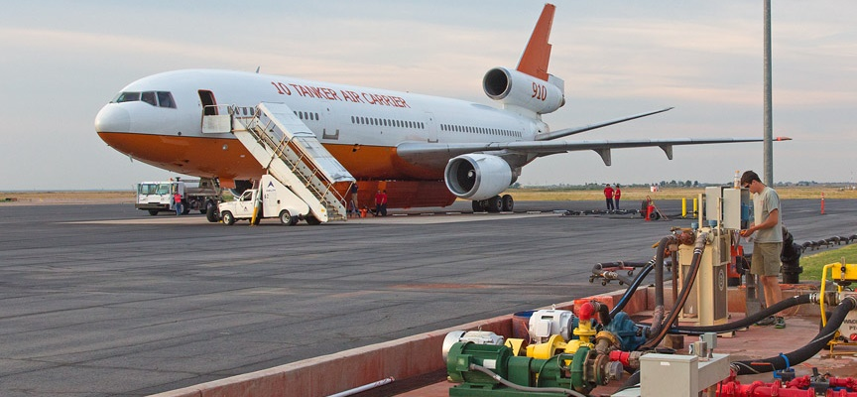
Airtanker/SEAT Bases
  BLM hosts 8 permanent large airtanker bases around the country.
  BLM hosts around 16 permanent SEAT bases. SEATs utilize smaller airports that assists in a broader response and coverage area.
  Temporary Mobile Retardant Bases (MRBs) may be set up at strategic locations to support initial attack or extended attack incidents.
  Airtanker/SEAT Bases host many other aerial fire resources that can include air attack, leadplanes, helicopters, and other tactical aircraft.
    They provide retardant, fuel, and other logistical support needs.

Slide 8
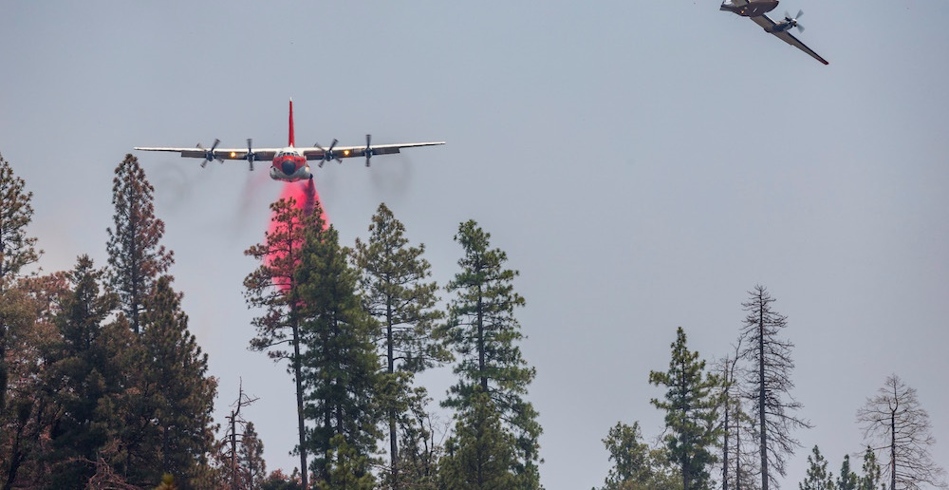
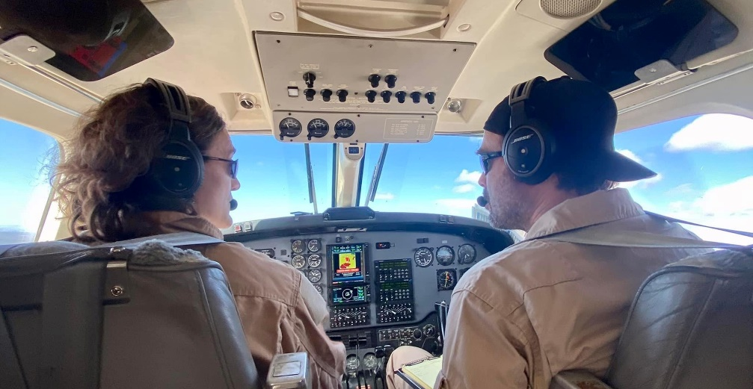
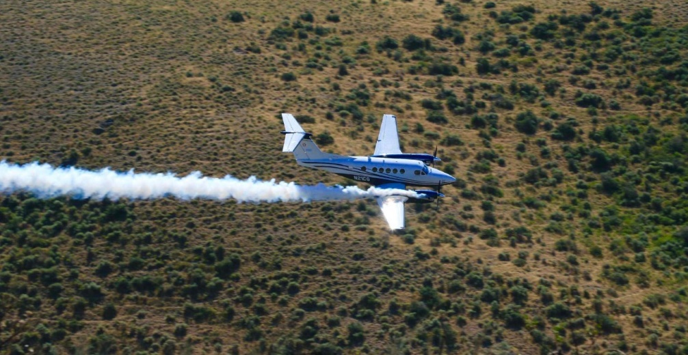
BLM Leadplanes
Leadplanes fly ahead of larger aircrafts like airtankers to assist them with retardant drops. They also check the route and plan the exit path since these smaller planes are easier to maneuver.
  Leadplane pilots utilize smoke to indicate where the larger aircraft should drop retardant. The smoke deployed by the leadplanes also helps airtankers gauge what the wind is doing.
  BLM operates 3 contracted leadplanes and owns two aircrafts.
  Unique to BLM’s program: All BLM pilots have a background in wildland fire. Every pilot started as wildland firefighters and have worked their way towards leadplane pilot certification.

Slide 9
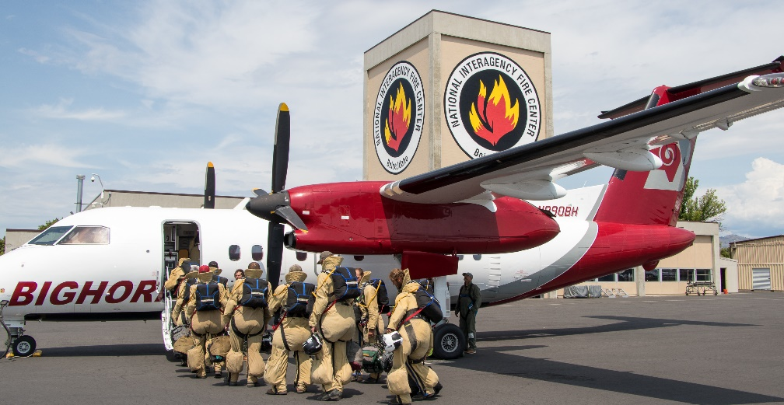
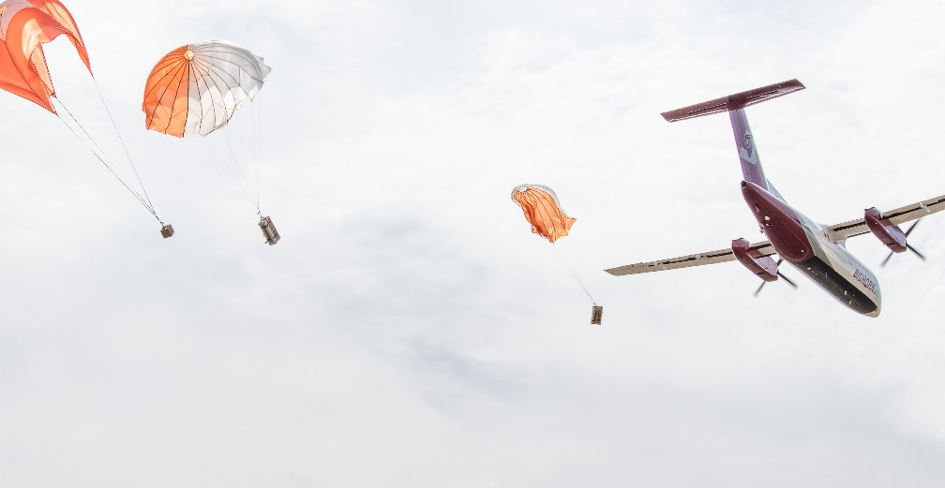
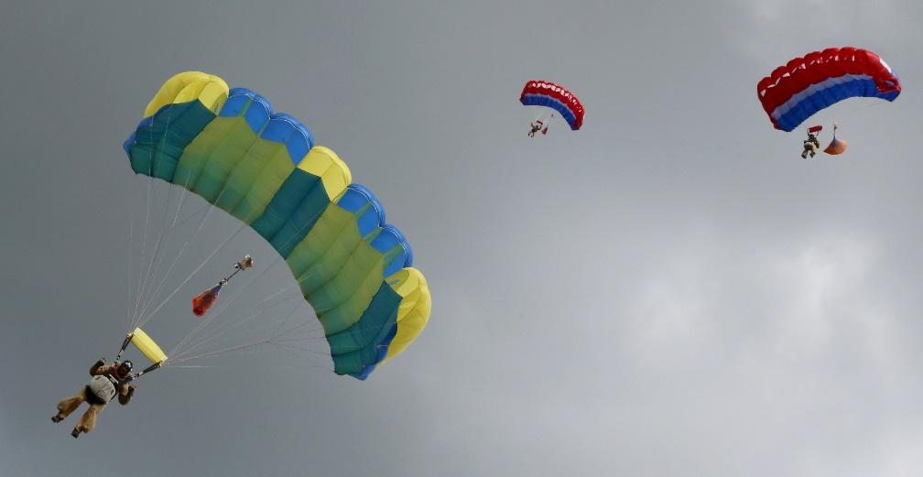
BLM Smokejumper Planes
Deliver smokejumpers and cargo by parachute to remote fire locations in Alaska and the lower 48.
Aircrafts fly at 3,000 feet above ground level, allowing smokejumpers to safely exit the plane near a wildland fire.
Two BLM smokejumper bases:
  Great Basin Smokejumper base in Boise, Idaho
  Alaska Smokejumper base in Fairbanks, Alaska.

Slide 10
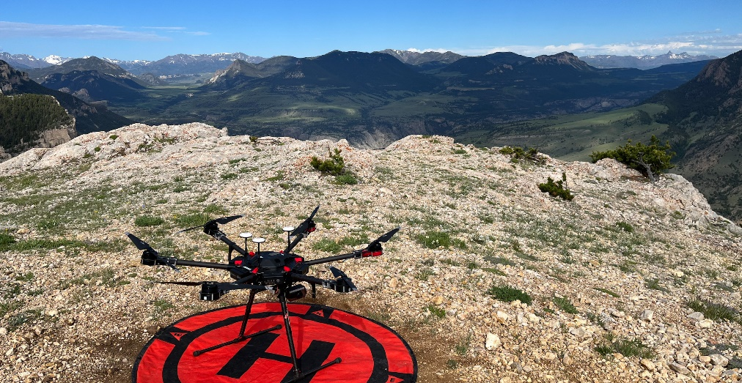
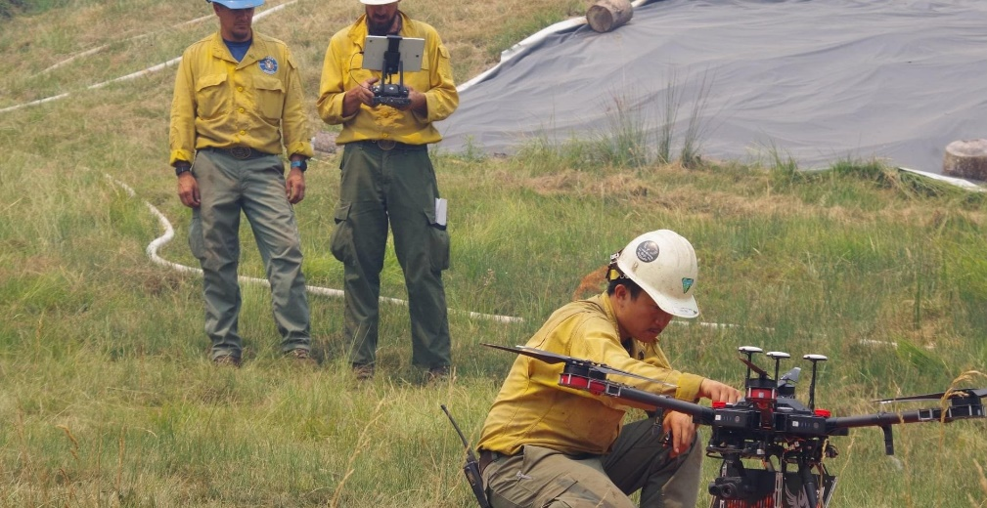
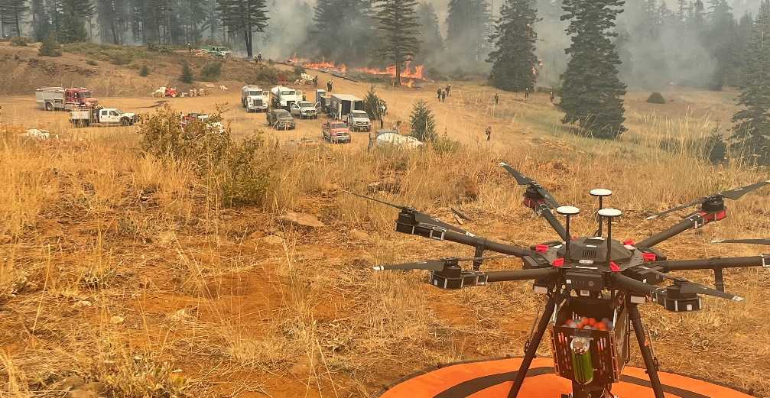
BLM Remote Aircraft Systems
Offers a bird’s eye view for operations, increasing safety and efficiency.
Aircraft have the unique ability to fly low, slow, and for long periods of time while collecting high-resolution imagery and data.
Used to identify possible hazards and learn more about the fire’s activity to help make informed decisions:
  Collect near real-time video
  Assist with intelligence, surveillance, and reconnaissance information
  Help with fire mapping, detecting hotspots (active parts of a fire) and spot fires (fires ignited outside the perimeter of the main fire)​
  Infrared sensors help at night
Notes:
-check aviation update

Slide 11
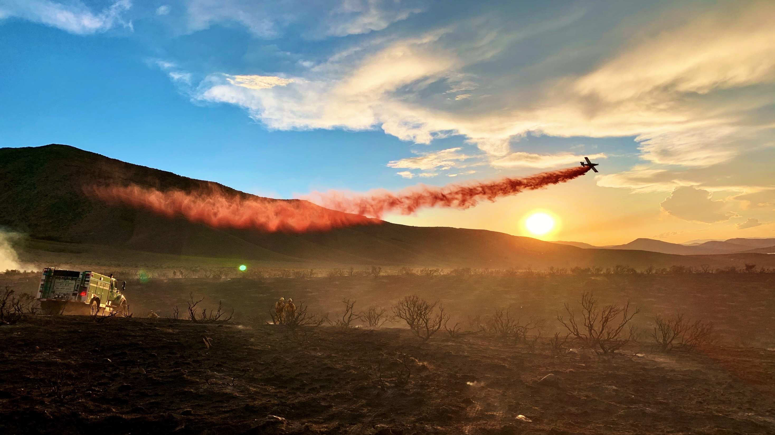
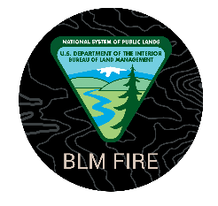
Questions?

