Slide 1
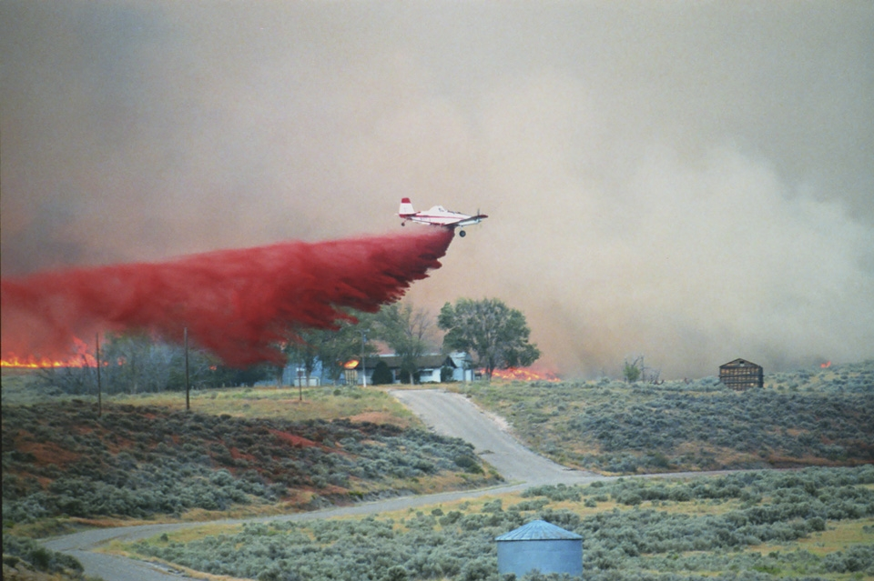
  SEAT Drop Evaluation
and Feedback
A Briefing for Ground Firefighters

Slide 2
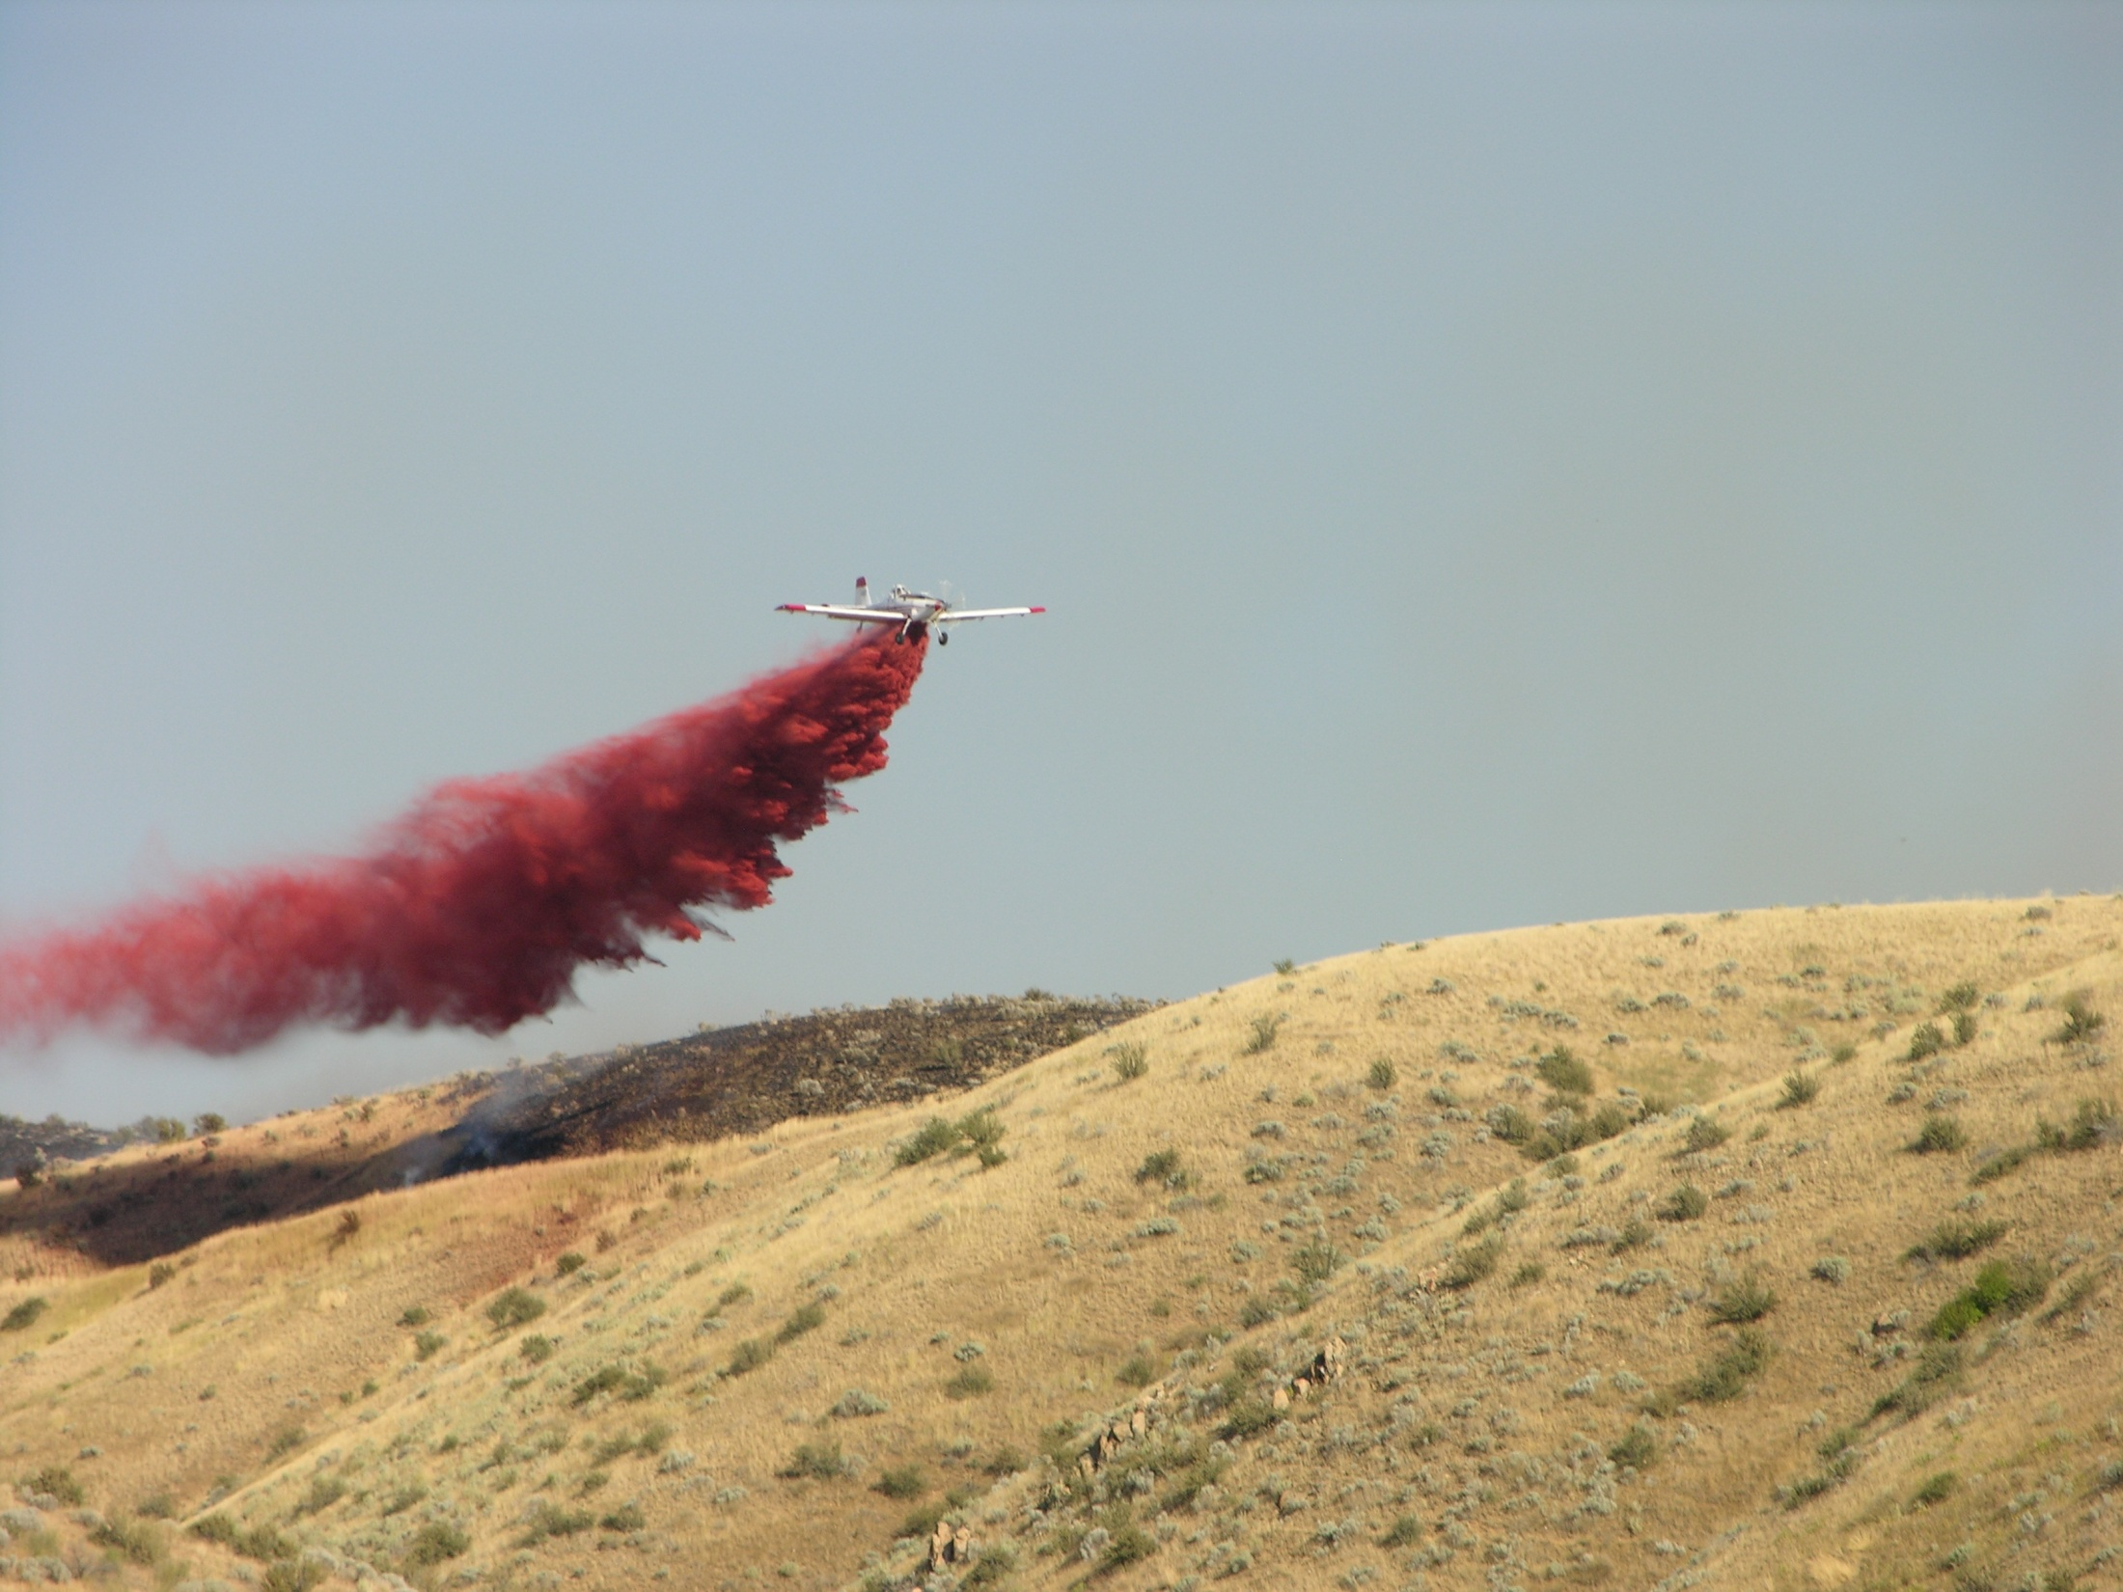
Objective
Employ standard criteria and terminology to evaluate and provide feedback on SEAT drops.

Slide 3
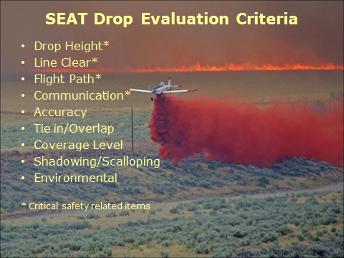

Slide 4
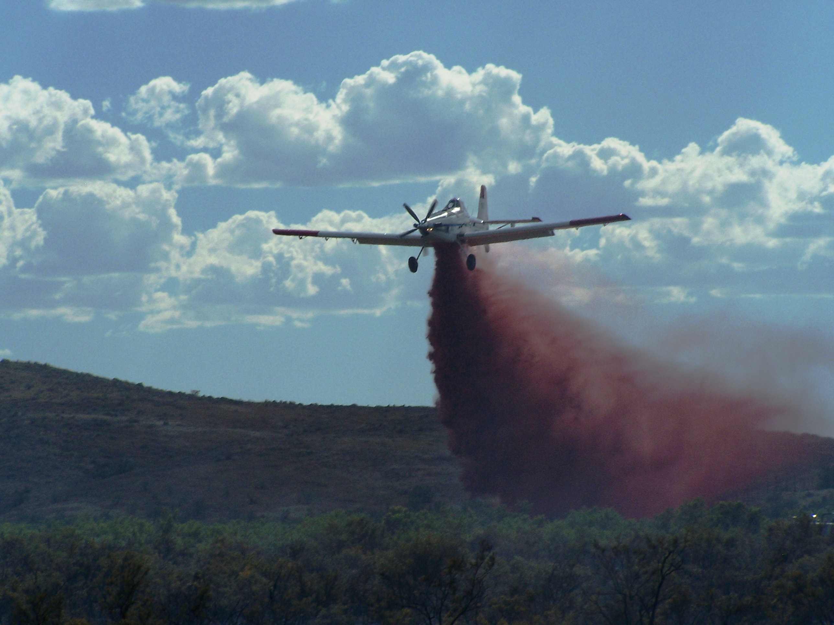
SEAT Drop Height
Minimum: 60’
Ideal: 90’
Too high: 120’
Visual cue
of drop height: AT802 wingspan is 59’
This drop is approximately 60’ above the vegetation.
SEATs should never drop lower than 60’ above the vegetation. It is unsafe and compromises the fire chemical effectiveness.

Slide 5
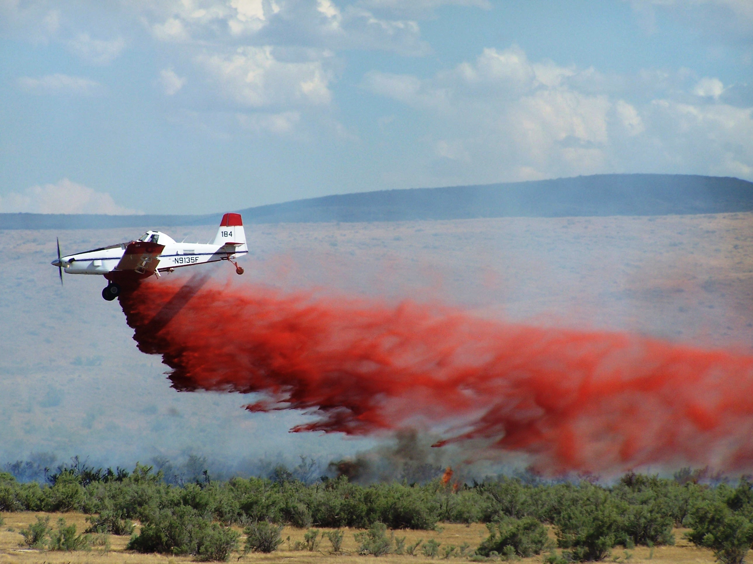
SEAT drop from 60’
The fire chemical column maintains forward momentum as it descends to the surface. Although easier to be more accurate from this drop height, fire chemicals lose effectiveness because of :
Shadowing – coating one vertical side of fuels and not the other. This may allow fire to burn through the line.
A narrower line, which increases the potential of the fire to spot across the line.
Matting down fuels (e.g. – thick grass) allowing the fire to burn underneath the fire chemical line.

Slide 6
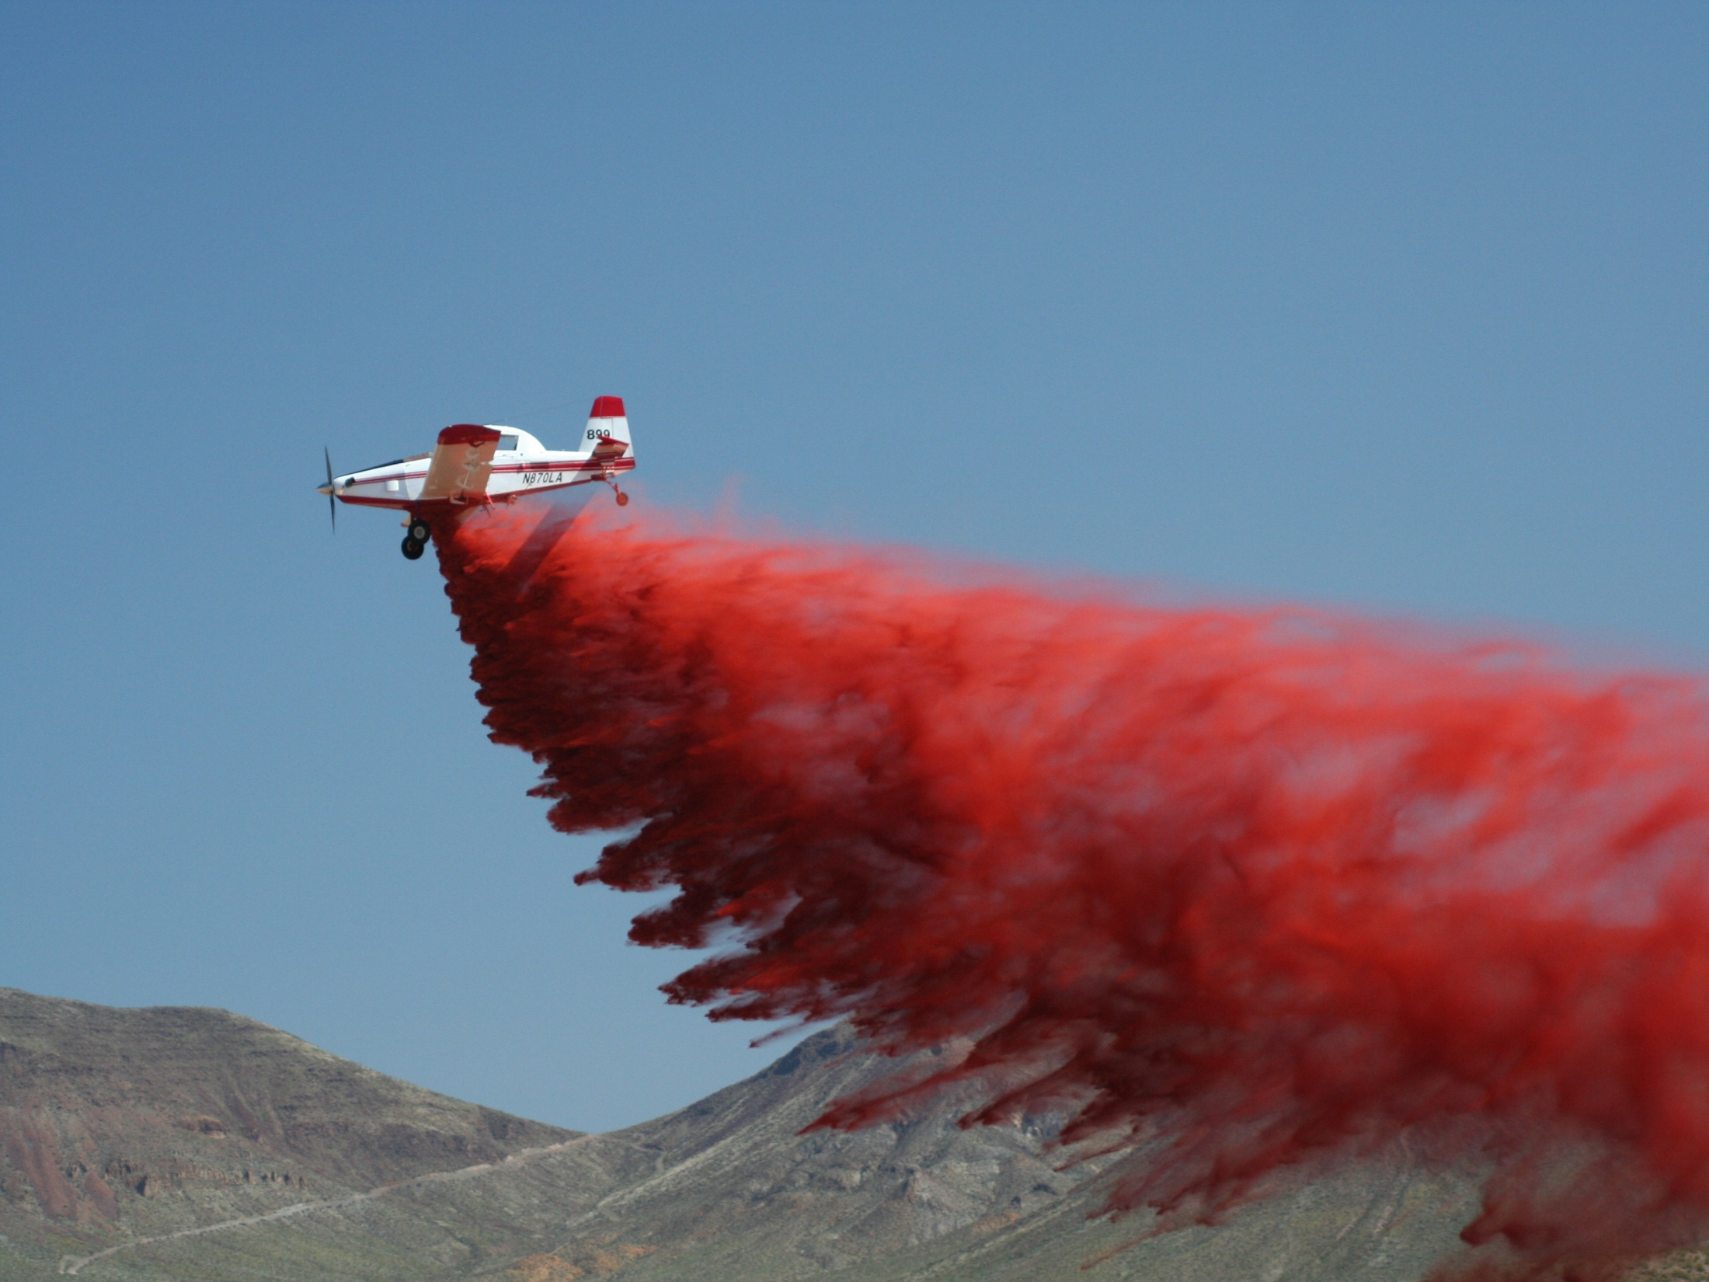
SEAT drop from 90’
Retardant’s forward momentum has slowed.
Retardant has begun to drop in a more vertical direction prior to hitting ground.
Facilitates proper application of the retardant to the fuels.
Creates a “raining down” condition that applies uniform coverage to vegetation.
*

Slide 7
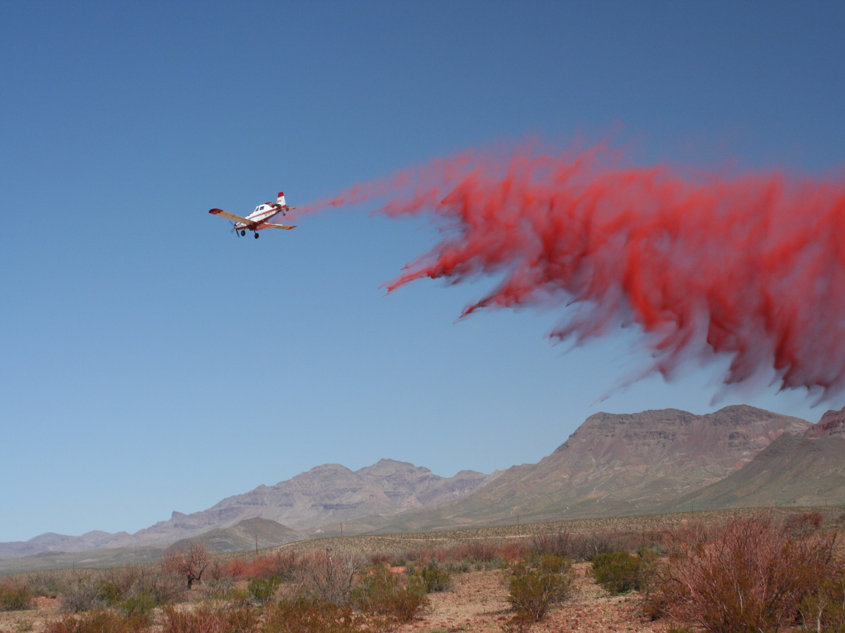
SEAT drop from 120’
Retardant has begun to disperse and lose it’s cohesion and density, which leads to “scalloping”.
Scalloping – Uneven edges of the applied retardant; inconsistent coverage; areas of no coverage.
Retardant effectiveness significantly degraded.

Slide 8

Definitions/explanations of SEAT drop evaluation criteria
Drop height:
Minimum: 60’
Ideal: 90’
Too high: 120’
Line clear: No personnel or equipment in target drop area.
Flight path: Aircraft avoids flight pattern over ground crews and/or equipment.
Communication: Effective ground/air coordination on when/where drops occur.
Accuracy: On-line or on-target ; left, right, long or short of intended drop area.
Tie in/overlap: Drops are continuous. No gaps from starting too soon/too late.
Coverage level: Effective for fuel type and conditions.
Shadowing: Coverage on only one side of vertical fuels, often from low drop.
Scalloping: Uneven, inconsistent coverage, often from high drop.
Environmental: Drop avoids waterways or other resource concerns.

Slide 9
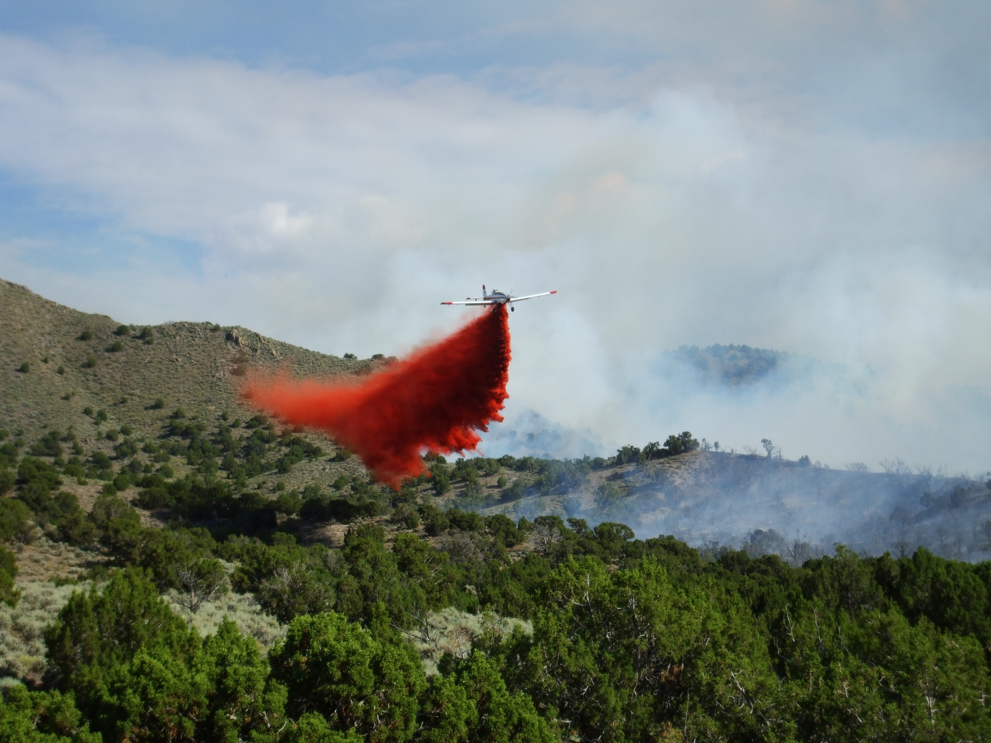
How to provide effective drop feedback to SEATs or any aircraft (fixed wing or helicopter)
State safety concerns immediately (too low, line not clear, etc).
State overall judgment of drop clearly (effective or not effective).
Be clear, concise, brief.
Describe deficiencies that you want corrected for future drops.
Use standard criteria and terminology.

