Slide 1
RT-273
Note to Instructors:
Download the power point and add your own graphics to the presentation.
Additional info can often be found in the “notes” section of each slide.

Slide 2
RT-273
Retardant Review
2018 Season

Slide 5
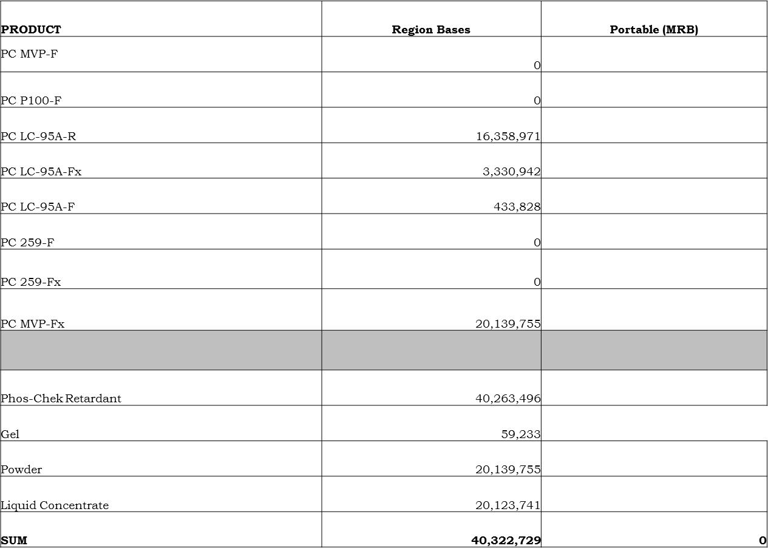
2018 Product Totals
TOTALS |  | GALS. PUMPED
Fixed-Wing Bases
Retardants only |  | 40,263,496
Gels only |  | 59,233
Portable Bases (MRB)
Fixed Wing |  | 5,654,551
Rotor (259 Products)
All Bases/All Products |  | 45,977,280
Notes:
MTDC did not receive all reports from all the bases in 2018. Numbers may vary and Regional stats not entirely correct.

Slide 6
National Long-Term
Fire Retardant Contract 2018
Contracting Officer
Larry Robillard (USFS)
larryrobillard@fs.fed.us
208-387-5682
Points of Contact
USFS – Regional Aviation Representative
BLM – State Aviation Manager and BLM National Aviation Office
States – Appropriate Aviation Manager or Representative

Slide 7
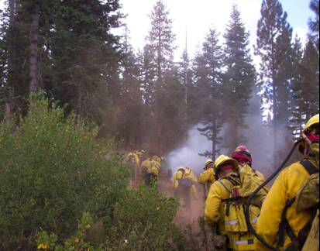

Retardant Program Team
Dave Haston – USFS Program Lead
Glen Claypool – BLM Program Lead
Joel Kerley – BIA Program Lead
Larry Robillard – USFS Contracting Officer
Caleb Berry – USFS Contracting Officer Rep. (COR)
Shirley Zylstra – USFS Contracting Officer Rep (COR)
Andrea Marks-Cash – USFS Contracts Specialist

Slide 8
Current Retardant Contracts
AG-024B-C-17-9001 – Bulk Long-Term Retardant
  Ordering period ends 30 June 2018
AG-024B-C-17-9002 – Full Service Long-Term Retardant
  Ordering period ends 30 June 2018
13-9010 – FOB Origin
  Ordering period ends 25 April 2019
  New solicitation underway
14-9042/43/44 Mobile Retardant Base (MRB)
  Three contracts: ICL, Pecos Valley, GelTech
  Contracts ends 25 April 2019
  New solicitation underway

Slide 9
Contract Update
12024B18C9025 – National Long-Term Retardant
  Award for combined bulk supply and full service
  Sole source – Perimeter Solutions LP, via one source on QPL
  5 Year requirements contract – 1 base yr and 4 1yr options
  Type A (Full Service) and Type B (Bulk) combined into one contract
  Tiered pricing approach for retardant out the hose Type A Bases
  Bulk pricing for product delivery only Type B Bases
  Award – 0900 Mountain Time Friday, 29 June 2018

Slide 10
Contract Update Con’t.
Miscellaneous Items
  Base year period of performance 1 July 2018 through 30 June 2019
  Option years exercised each 1 July
  Pricing is based on calendar year – prices effective 1 January, annually
  Meals no longer a requirement, even for extended hours

Slide 11
Other 2018 Retardant Updates
Fugitive LC (LC95A-Fx) and LC-95A-R are the 2 liquid concentrates.
A number of bases are switching over from LC95-AR to fugitive LC95-Afx.
An improved fugitive colorant for powder products are now available (MVP-FX).
The phase-out of the higher viscosity (P-100) powder with the medium viscosity (MVP-F) powder product completed.
BLM bases are mostly LC bases (Roswell to convert to powder); Cal-Fire mostly powder; FS is a mix.

Slide 12
Types of Retardants and Suppressants
Water:
When it converts into steam, has a great capacity to absorb and carry away heat. It also has a strong surface tension that causes it to bead up and roll on most fuels before it can absorb its full heat capacity.
Notes:
Review with SEMGs.

Slide 13
Types of Retardants and Suppressants
Foams:
Fire suppressants foams are combinations of wetting and foaming agents added to water to stretch out the water droplet into bubbles.
The bubbles help cool and smother fires, and increase the heat absorbing surface.
Foam helps break down the surface tension of water and allows the water to penetrate deeper into fuels.
Foam has some ability to cling to vertical surfaces. This can help hold water on fuels longer, allowing moisture to soak in more effectively.
Foams are no longer effective once the water has evaporated.
> 99% water
1% = surfactants (wetting agents), foaming agents, corrosion inhibitors, dispersants
USE: Direct Attack
Notes:
Review with SEMGs.

Slide 14
Types of Retardants and Suppressants
Gels:
Water enhancers are products added to water to improve one or more of the physical properties of water.
Gels are made from super absorbent polymers and surfactant.
Water in gel is held by a three-dimensional network of cross-linked polymers designed to absorb many times their weight of water.
The gel encapsulates water, absorbs heat and sticks to most every surface that would need fire protection including vertical surfaces and structures.
95% - 99.5% = Water
0.1% - 3%Other (thickeners, stabilizers, other minor ingredients)
USE: Direct Attack & Structure Protection
IMPORTANT NOTE: GELS are not retardants
Notes:
Review with SEMGs.

Slide 15
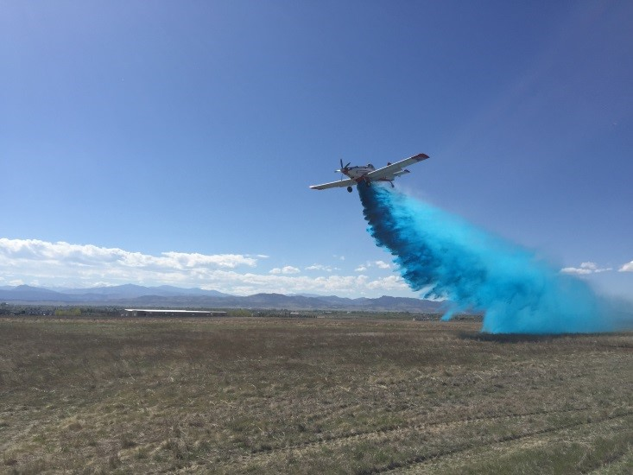
Water Enhancers (Gels)
Refer to the QPL for approved products.
Approved products can be found at: https://www.fs.fed.us/rm/fire/documents/qpl_we_2017-Sept.pdf
Review Water Enhancers fact sheet at: https://www.fs.fed.us/rm/fire/wfcs/documents/WE_FactSheet_2017-0328.pdf
Keep in mind water quality - particularly water hardness can greatly affect mixing.

Slide 16
Types of Retardants and Suppressants
Retardant:
Long term retardants contain fertilizer salts that change the way fuel burns.
Retardant reacts to heat causing a different chemical reaction in fuel other than normal combustible gases and tars.
This reaction is independent of the water content of the retardant, so they are still effective after the water has evaporated.
Long-term retardant will remain effective as long as the salts cling to the grass or woody material.
85 % water
10% fertilizer
5% minor ingredients: Colorant (iron oxide, or fugitive) thickener (natural gum or clay), corrosion inhibitors, stabilizers, bactericides.
USE: Direct or Indirect Attack
Notes:
Review with SEMGs.

Slide 17
Retardant Critical Properties
Three critical characteristics of retardant that have the greatest effect on fire control are:
Salt Content: Salt content is directly related to the ability of the retardant to decrease the rate of spread of the fire and retard combustion. Salts clinging to fuel will retain effectiveness after the water it originally contained has evaporated.
Elasticity: Determines the ability of the retardant mass to remain intact (resist breakup) during aerial delivery. The elasticity also affects the extent to which the retardant clings to fuels or flows off the fuels onto the ground.
Viscosity: Viscosity can be considered "thickness." The viscosity of a specific retardant formulation serves as an indicator of retardant elasticity. The viscosity and elasticity have a major impact on the characteristics of a retardant drop. Viscosity and elasticity affect how the fire retardant will spread over the fuel surface building a retardant coating and how much will run or drip off, and come into contact with ladder fuels or the ground.
Notes:
Review with SEMGs.

Slide 18
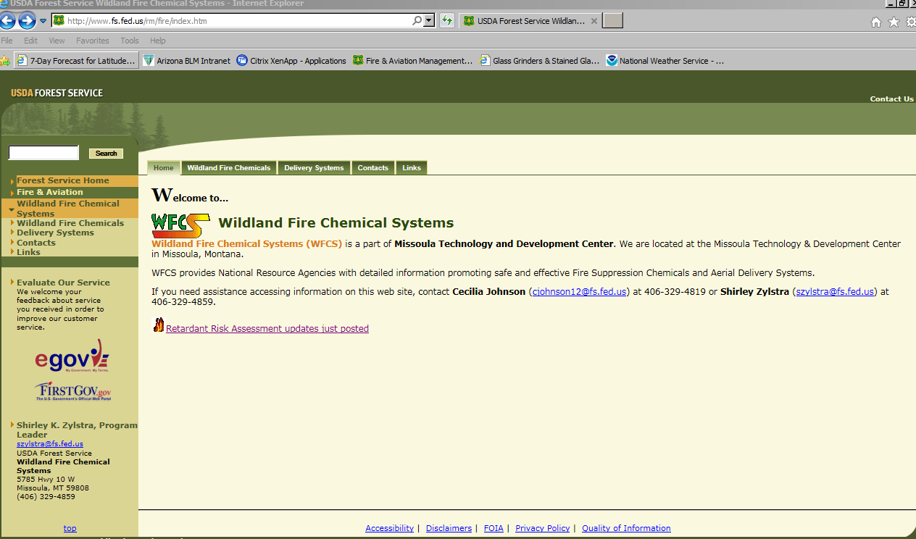
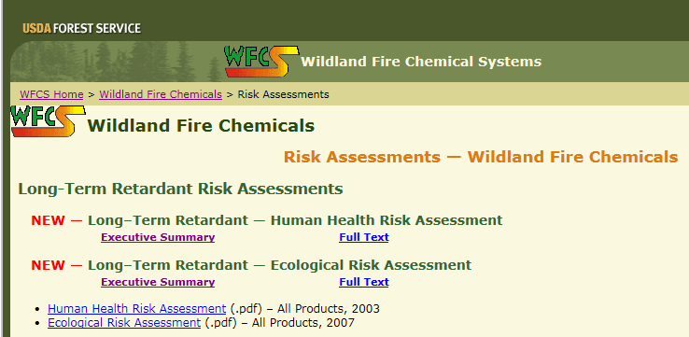
USDA Forest Service / Wildland Fire Chemical System (WFCS) http://www.fs.fed.us/rm/fire/
One stop shopping for all retardant reference materials !
Select
Risk Assessments available for review!
Notes:
One stop shopping for all retardant reference materials. New 2015 Risk assessments available to everyone to review.

Slide 19
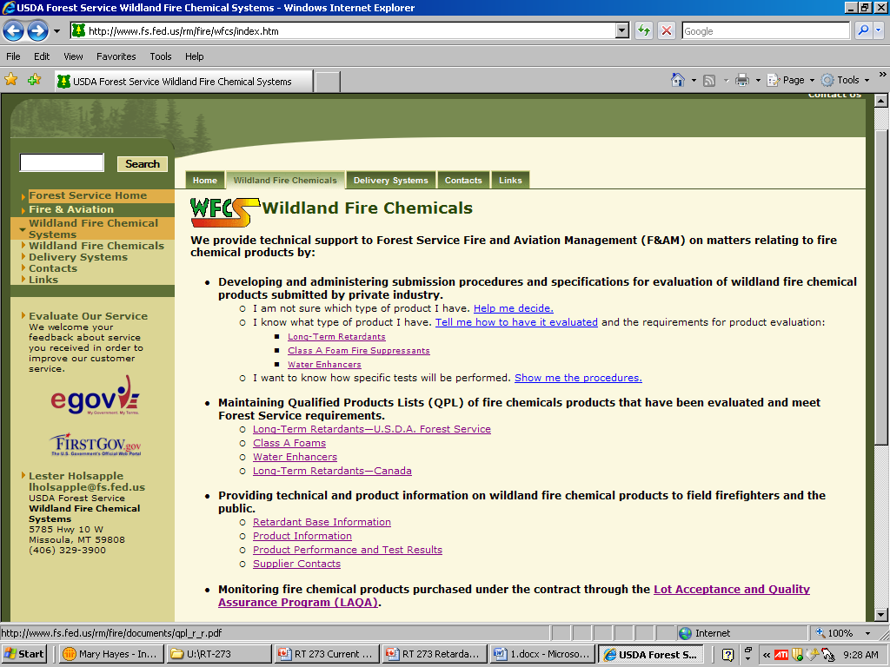
http://www.fs.fed.us/rm/fire/
Click on the icons to download the products qualified to use.
Notes:
Explain the Quality Products List (QPL) and what it means to the SEMG.
Have of copy of the most current QPLs for each SEMG.

Slide 20
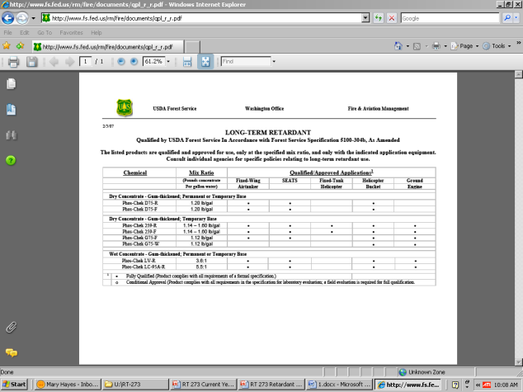
http://www.fs.fed.us/rm/fire/
Make sure to check the date on the QPL list for all retardants and suppressants. They can change during the year !
Notes:
Check for the most current date prior to an assignment. Updated on the 5th of each month, if there are any changes.

Slide 21
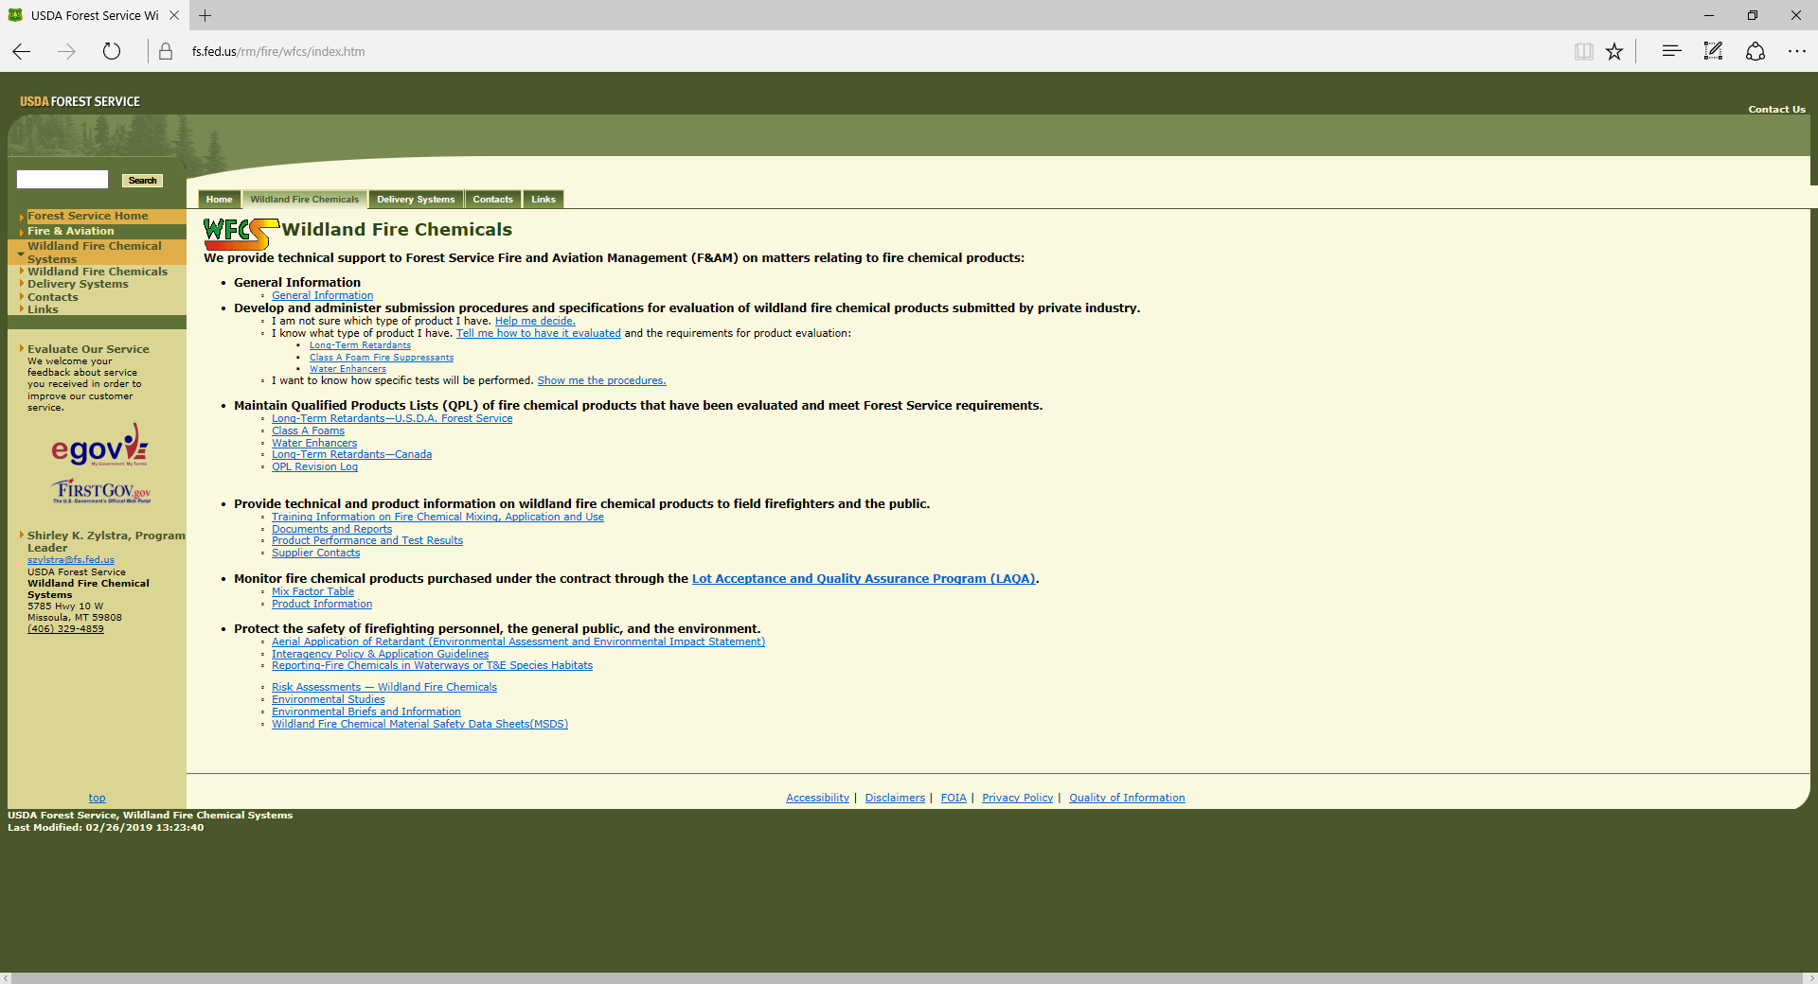
This document is a MUST for SEAT Managers! It contains a list of approved products, mixing ratios and refractometer readings for each type of retardant. It is a good idea to take multiple copies with you in the field to post at your base or provide loaders with a copy.

Slide 22
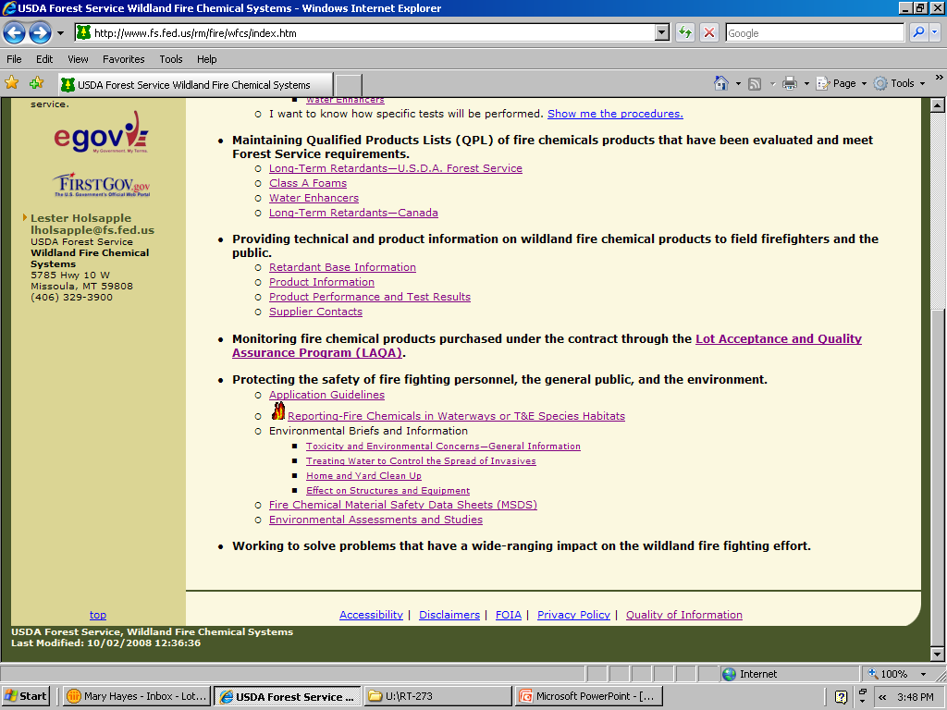
http://www.fs.fed.us/rm/fire/
This section can provides the SEAT Manager with very good reference material associated with retardant effects and clean up can be used as talking points or handouts to the public if there are questions concerning the use of retardant from the local community.
Guidance on the 300 ft clearance around waterways
Reporting instructions and form
Notes:
Three key items in this section:
Guidance on the 300 ft buffer
Reporting information
Place to find inforamtion on clean up, MSDS, etc

Slide 23
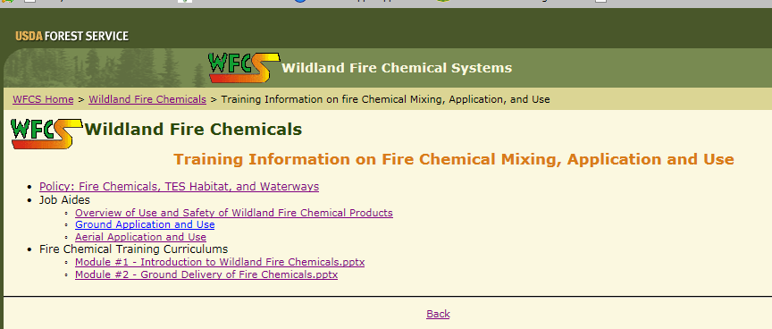
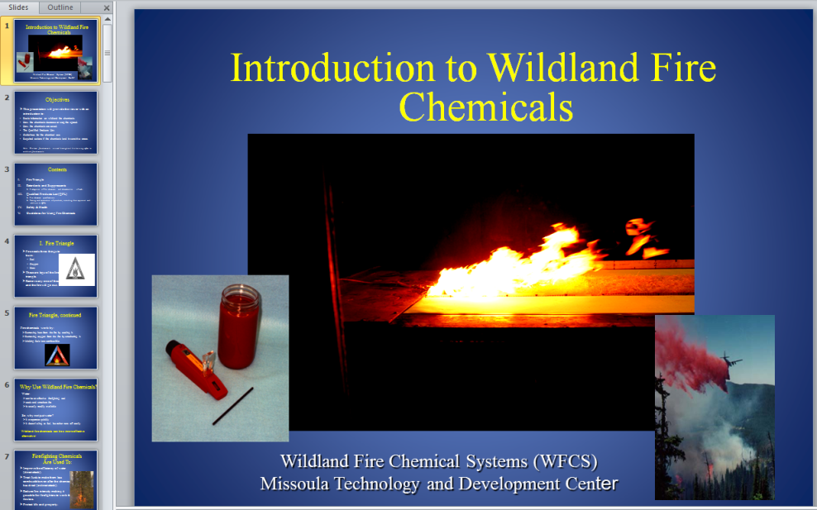
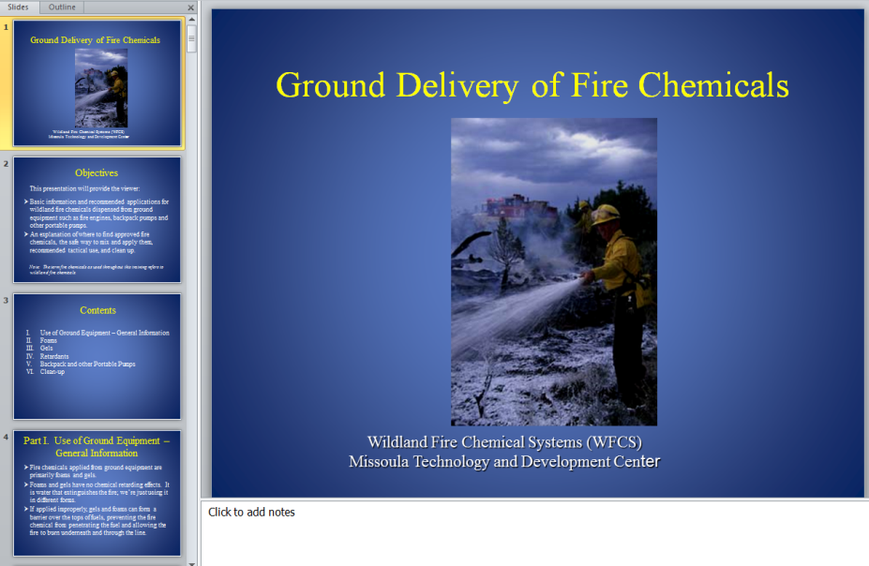
Training for Fire Chemical Mixing, Application and Use
Two Power points available for training!

Slide 24
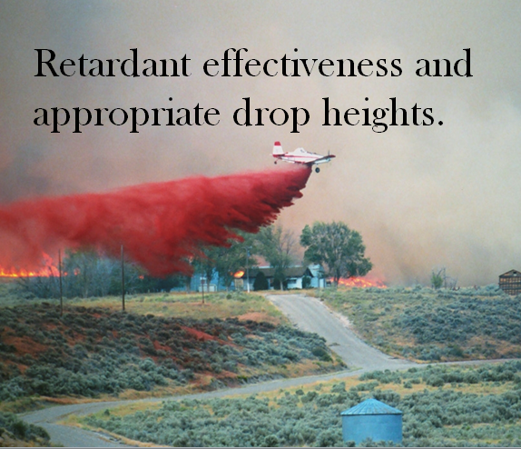
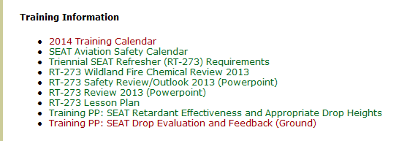
Power Training Power Points Available
Training power points available to download from the National SEAT Base Web Site.
Multiple cameras were attached on the aircraft and at ground level to record the effects of retardant being dropped at different heights. (Goldilocks theory: too low, too high and just right. )
- Too Low…retardant shadowing vegetation, covering only one side.
- Too high…high degree of varying retardant coverage on veg and ground.
- Just right…uniformed coverage covering vegetation and reaching ground.
Notes:
Two power points available, one for aerial resources and one for ground firefighters. Instructors should download the PP and review with SEMGs. PP were developed with NTDC partnership.
Can be found under “Training Information at: http://www.blm.gov/nifc/st/en/prog/fire/Aviation/Airops/seat.html

Slide 25
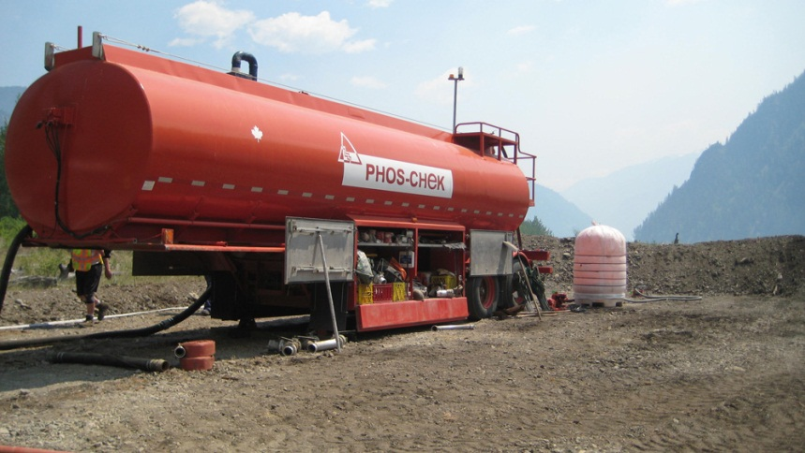
USFS Wildland Fire Chemicals Contracting http://www.fs.fed.us/fire/contracting/retardant/retardant.htm
Note: The individual BPAs for equipment changed to one national contract with multiple line items to order specialized equipment like mobile retardant bases, LC trailers, etc.
The national contract for retardant equipment will have a multiple line items of equipment and personnel to assist with SEAT operations.
Mobile Retardant SEAT Base
LC Trailers
Mix Master type position that can be ordered on call.
Loader position that can be ordered on call.
Notes:
Variety of good tools available for mobile bases. Note the change from BPA to one national contract in 2014.
Note..the new on call positions can be mobilized within a 24 hour period.

Slide 26
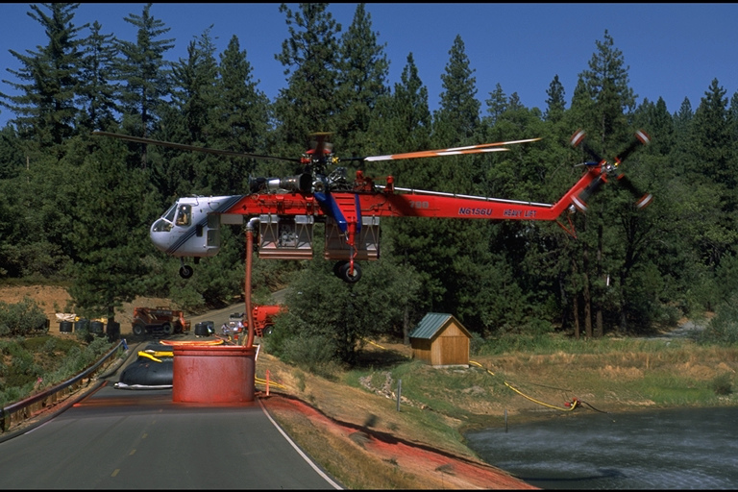
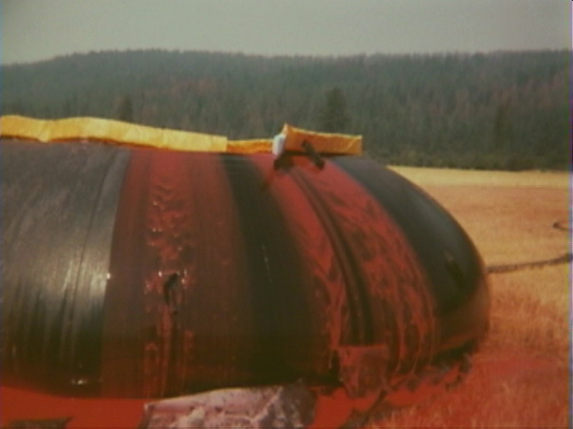
Environmental Reporting
Standards for Fire and Aviation Operations (Red Book) Chapter 12
Incident Response Pocket Guide -2018
Notes:
Can find reporting information in the Red Book and 2010 version of the Incident Response Pocket Guide.

Slide 27
Retardant Reporting
Heads Up !
SEAT Managers should make sure they receive a complete briefing from the using agency on the established requirements for reporting Retardant drops.
May be required to provide the agency personnel with
Lat / Long of drops.
Notes:
Depending on the agency the SEMG is working for the reporting requirements may be different.

Slide 28
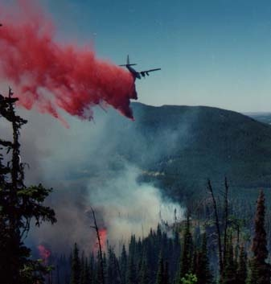
Minimum Reporting Requirements
(all agencies)
If aerial: chemical intrusions within 300 foot buffer zone
If ground: chemicals enter the waterway or have potential to enter the waterway.
Notes:
ANYONE who sees chemicals dropped within 300’ (or in any T&E habitat for FS) should notify their fireline supervisor. Should be passed up the chain to the IC. The AA is ultimately responsible for the evaluating and reporting process.
ATGS should pass info (and coords when possible) on to appropriate fire personnel (IC/Ops/Div/etc).

Slide 29
ENVIRONMENTAL REPORTING PROCESS
Field notification through chain-of-command to Incident Commander.
IC notifies the agency administrator (AA)
The incident or host authorities immediately contacts appropriate regulatory agencies and specialists within the local jurisdiction.
Assigned resource advisor documents and fills out the Interagency Chemical Reporting form.
Notes:
Review what the SEMG should do if they need to report an intrusion drop. SEMG will note have to complete the form, but may be required to provide input as requested.

Slide 30

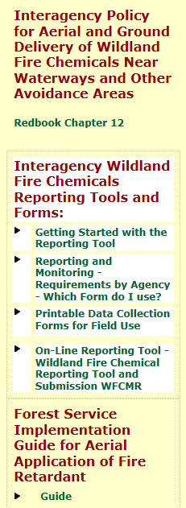
USFS Aerial Application of Fire Retardant Web Site http://www.fs.fed.us/fire/retardant/index.html
Reporting Forms
Primary Web Site for the aerial application of fire retardant on federal lands.
Notes:
Primary web site used for any type of aerial application of fire retardant. Forms, policy documents, etc.

Slide 31
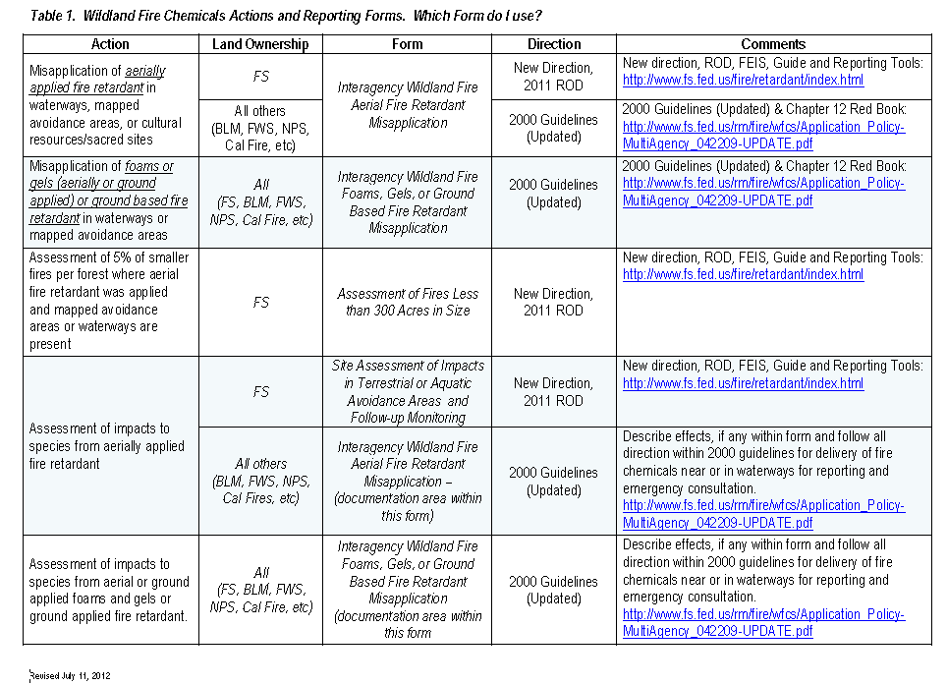
Retardant Reporting
Policy was adopted in 2000 establishing guidelines for aerial delivery of retardant or foam near waterways.
Guidelines developed to mitigate the impact of fire retardant application on aquatic species/habitat by establishing a retardant-free buffer zones 300 feet from waterways that are visible to the pilot.
Definition of Waterway: Any body of water including lakes, rivers, streams and ponds whether or not they contain aquatic life.
  Additional reporting requirements are in place for USFS when wildland fire chemicals adversely affect any threatened, endangered, or proposed species, or designated or proposed critical habitat, regardless of the 300’ waterway buffer zone. (FS requirements)
Notes:
The guideline for SEATs has been identified as: When approaching a waterway visible to the pilot, the pilot shall terminate application of wildland fire chemical approximately 300 feet before reaching the waterway. When flying over a waterway, the pilot shall not begin application of wildland fire chemical until 300 feet after crossing the far bank or shore. The pilot shall make adjustments for airspeed and ambient conditions such as wind to avoid the application of wildland fire chemicals within the 300-foot buffer zone. Ensure SEMG understands that the Forest Service has different reporting requirements and the agency may require the SEMG to provide them with additional information.

Slide 32
Retardant/Fire Chemical Use
300’ Buffer Zone has been expanded in some areas to protect TEPCS species. (Note: waterway buffer zones account for ~30% of FS lands)
Mapped avoidance areas, terrestrial and aquatic, to protect TEPCS species in addition to the buffer zones. New avoidance areas = approx. 1% of FS lands.
Avoidance areas include important heritage, cultural and tribal sites & resources.
Each Forest has produced quad level maps outlining avoidance areas (~12,000 maps).
“Incidental Take” number established for individual TEPCS species in defined areas. If take is exceeded in those areas, then no further fire chemical use will be permitted until recovery of affected TEPCS species.
Now only 1 “exception” instead of 3 exceptions for use of fire chemicals in buffer zones and avoidance areas: “Life & Public Safety.”
Annual monitoring of 5% of IA fires <300 acres where retardant has been used to determine if misapplications are being under-reporting.
Notes:
TEPCS – Threatened, Endangered, Proposed, Candidate or Sensitive species

Slide 33
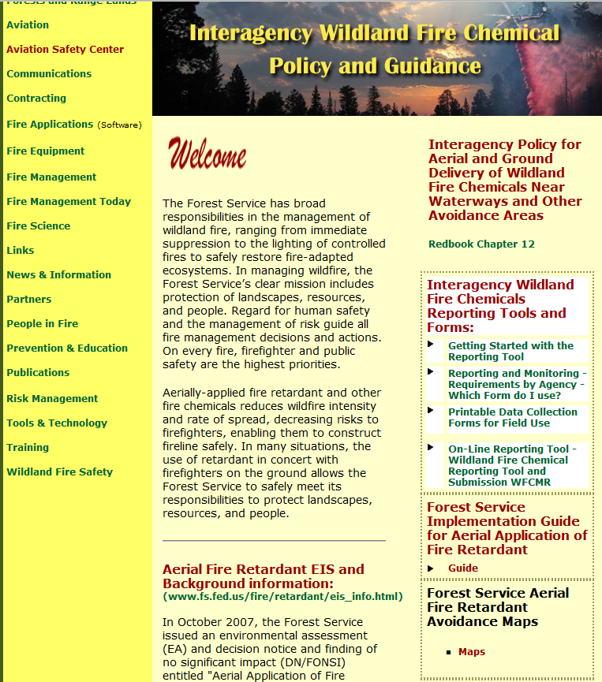
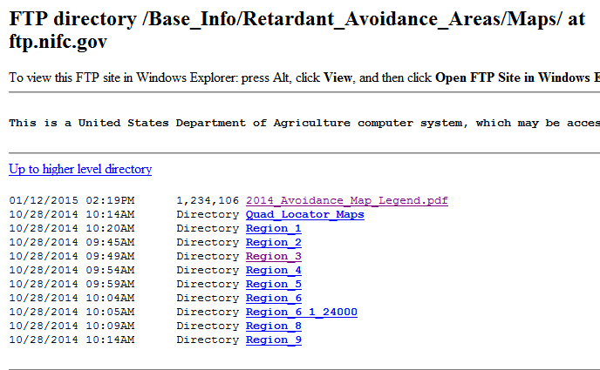
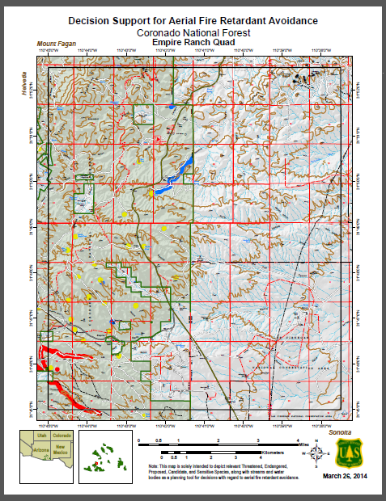
Forest Wide Aerial Fire Retardant Avoidance Maps
Information about avoidance maps for each Region.
Notes:
These forest-wide avoidance maps may include: all areas identified as avoidance areas for Threatened, Endangered, Proposed, Candidate or Sensitive (TEPCS) species and the 300’ waterways (note: a few forests have buffer zones that exceed the standard 300’), or only those TEPCS areas identified through the Retardant EIS decision exclusive of waterways, or just terrestrial avoidance areas. This site has each Region’s PDF maps available for downloading.

Slide 34

Notification Process for Aerial Assets
Avoidance maps are available in a variety of formats, including hard copy maps and electronic maps, to all Lead Plane, ASM, ATGS, and IA qualified Air Tankers, Helicopters, FMOs, AFMOs, Line Officers, Incident Commanders, and all resource specialists; such as wildlife biologists, fisheries biologists, botanists, and cultural resources specialists. Fire Management Offices will distribute as necessary to the appropriate fire personnel.
All retardant avoidance area mapping information has been put into a GIS layer that can be overlaid into moving map applications and WFDSS. These map products can be tailored to be down-loadable to GPS units that aviation assets can utilize with the existing technology used in the aircraft.

Slide 35
Lot Acceptance/Quality Assurance (LAQA) Program
There is a contractual requirement in the National Retardant Contract for all retardant bases (permanent and temporary/portable) to participate in a quality assurance program.
The program was designed to spot-check fire retardants to assure that a high standard of quality is maintained by the retardant manufacturing companies and the air tanker bases.
All SEAT bases fall under the contract requirement for sampling. The SEMG must ensure that samples are taken at their base.
Notes:
Review the importance of the LAQA program. The program applies to ALL SEAT bases.

Slide 36
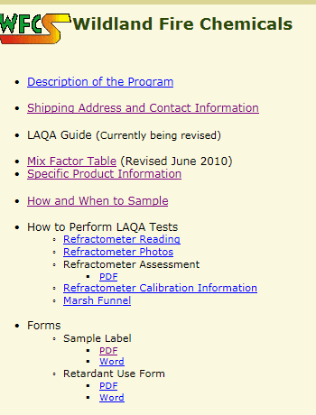
(LAQA) Program
Bases are required to take and submit samples of all retardant received as a part of
the inspection and quality assurance process. Four types of samples
  Overwinter Samples
  Truckload Samples
  End of Season Samples
  Trouble Shooting Samples
  Send samples to:
  Wildland Fire Chemical Systems Program (WFCS) at Missoula
  Technology and Development Center (MTDC)
Notes:
The SEMG may not be present for the opening or closing of the SEAT base, but if retardant is ordered and delivered to the base during their assignment, they are responsible for completing the sampling requirements.
Address and mailing instructions are listed on http://www.fs.fed.us/rm/fire/
Mailing labels can be obtained form MTDC

Slide 37
(LAQA) Program
As a part of the LAQA program, retardant should be sampled and tested frequently during the mixing operations to ensure the retardant is being mixed according to specifications.
Because the effectiveness of the mixed retardant solution is dependent on its concentration of active salt, it is important to maintain the salt content within prescribed limits.
Salt content can be measured in the field by a hand-held refractometer. This instrument is required by the national SEAT contract and is relatively easy to use.
This daily sampling of retardant with a refractometer does not need to be sent to WFCS unless problems are encountered.
Notes:
The contractor is responsible for mixing the retardant to specifications, checking the salt contents with a refractomer, and documenting their readings on their logs. The contractor will provide the SEMG with the readings from each load they have mixed to be documented on the SEAT Tanker Log for their records. Periodically, the SEMG should randomly check one of the loads mixed with the contractor to confirm the contractor’s readings.

Slide 38
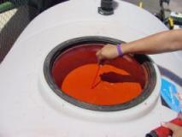
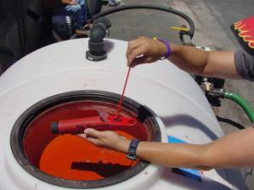
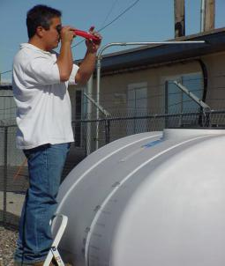

LC-95A
Refractometer Reading:
12.0 – 14.5
(Revised May 2016)
How do you determine what
the reading should be ?
SEMG should strive for a reading in the middle range of the refractometer scale for the product being mixed.
(Example: Use 13.25 for LC-95A with a range of 12.0 – 14.5)
Notes:
Most common reason for a sample to refract low is not enough circulation of the product. Especially the preseason sample. Often several days are required if it has not been circulated regularly through-out the winter.

Slide 39
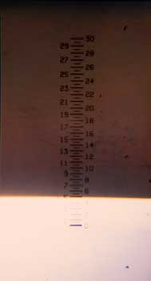
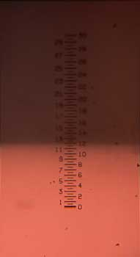
Refractometer Photos
Refractometer 1: Example of low reading (meaning there’s not
enough salt—too dilute).
This sample is at 5 on the scale.
Refractometer 2: Example of a reading that’s in the box. This sample is at 11.5 on the scale.

Slide 40
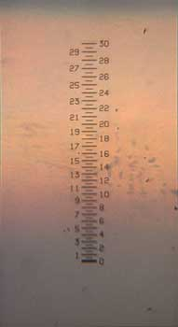
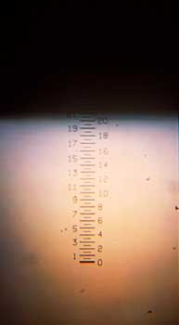
Refractometer Photos
Refractometer 3: This is an example of straight concentrate. Sample is very fuzzy. Although there is some definite shading, there is no clear line. The whole scale is still visible.
(This is what the base personnel would have seen at the Fillmore accident, had they used the refractometer).
Refractometer 5: Example of a high reading. This sample is at 21 on the scale (this means there ’s too much salt —too concentrated).

Slide 41
Notes:
Review with SEMG, provide a copy of the document to the SEMG to take with them this season.
This document and other information can be found on the SEAT web site under the Wildland Fire Chemical Inforamtion

Slide 42
Documentation
If SEAT base is on the Long-Term Fire Retardant Contract (including MRB if in place), document and relay to appropriate Aviation Manager; product, equipment, and personnel issues.
Keep retardant use summary (example).
Submit Retardant use Report to MTDC at end of season.
https://www.fs.fed.us/rm/fire/wfcs/documents/use_rep.pdf

Slide 43
Example Daily Base Activity Log
Log Events
Used to document:
Base open and close
Retardant delivery
Significant events at base
Issues
Repairs
Recap information from year

Slide 44
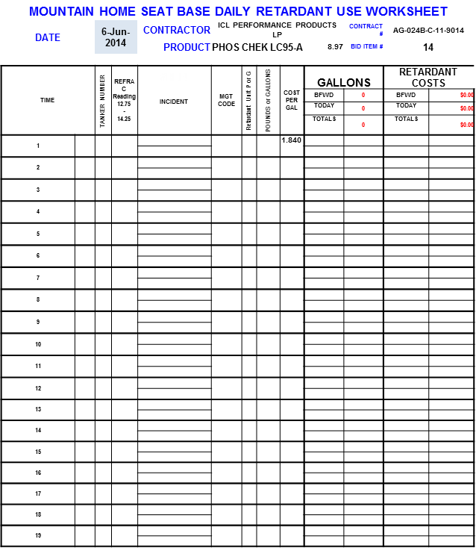
Example – Retardant Use Summary
Used to record all retardant being sent out from base and includes visiting aircraft
Can be given to Procurement for charge coding information
Used to report year end use

Slide 45
Retardant Spill Prevention and Coordination
Include best management practices to ensure fire retardant spills and/or water from washing SEATs does not flow onto unprotected areas, soils, or into storm drainage ditches, swales, or sewers. (Clean Water Act - CWA).

Slide 46
Retardant Spill Prevention and Coordination
  Place a bucket under the loading port and valve connection during loading to contain spills and minimize exposure. Recycle uncontaminated retardant.
  On site container or recycle method for hose flushing (salvage drum).
  On site spill prevention kit to contain retardant spills (use of berms, drain covers, socks, pads). Research online examples of spill kits & spill control.
  On site disposal container for contaminated retardant (includes dirt or gravel).
  Storage tanks, transfer/loading pumps located in secondary containment to retain a spill.
  Agency responsible for site cleanup and restoration to pre-incident or pre-season conditions.
  Work with hazmat coordinator to identify proper cleanup and disposal of retardant spills. Identify in SEAT operations plan and brief personnel.

Slide 47
Retardant Spill Prevention and Coordination
Note that discarded, unused fire retardant should be disposed or recycled appropriately. It should never be discarded by applying to the ground surface to function as “fertilizer”. ICL Performance Products, manufacturer of Phos-Chek, states that while the components in Phos-Chek retardants are safe for land application when applied in the recommended manner as a fire retardant, its uncontrolled application for other than its intended purpose (i.e., as fertilizer) is not recommended. This recommendation was taken from ICL’s report regarding toxicological and environmental safety. [http://phoschek.com/product/phos-chek-lc95a/, and click on Environmental Q&A]

Slide 48
Retardant Spill Prevention and Coordination
Per SEAT Contract
C7.2.2 The Contractor is responsible for handling and clean-up of fuel, oil, and retardant contamination on airport ramps, retardant sites, parking areas, landing areas, etc., when caused by Contractor aircraft or personnel.
C7.2.4. The Contractor shall immediately report any spill of fuel, hazardous chemical, regulated waste, or hazardous substance to the CO and spill-reporting authority.

Slide 49
Retardant Spill Prevention and Coordination
Per National Long-Term Fire Retardant Contract
Page c-8 (d) The Contractor shall be responsible for cleaning up all spillages caused by mixing and loading operations. The contractor shall wash spillage from loading ramps and shall keep retardant washed off the equipment. [See Solicitation - Hazardous Material Identification and Material Safety Data, FAR52.223-03] The contractor shall clean up any concentrate or mixed solution that leaks, drips, or runs where equipment is set-up, including all tanks, hoses, nozzles, concentrate containers, etc. which creates an unsafe area or unsightly appearance. The agency manager is responsible for wash-down effluent disposal procedures.

Slide 50
What’s on the
BLM National SEAT Web Site ?
“Wildland Fire Chemical Information”
The intent of this section is to help provide the SEMGs with some of the most important reference material should have with them when they are on assignment including:
  Effective Use of SEATs
  Principles of Retardant and Coverage Levels
  Wildland Fire Chemicals: Qualified Product Information
  Wildland Frie Chemicals: Reporting Information
  Wildland Fire Chemicals: Lot Acceptance / Quality Assurance
Notes:
Remind students that there is a new section on the National BLM Web Site that was added to help SEMGs find information related to wildland fire chemicals.

