Slide 1
RT-273
Note to Instructors:
Download the power point and add your own graphics to the presentation.
See the notes section of each slide for additional information on the lesson plan.

Slide 4
Lesson Learned
Observation: Changes with the national RAMP frequency.
The FAA reviews and engineers all aviation Air-to-Air AM frequencies for all Airtanker Bases each year. Usually, the frequency 123.975 MHz is assigned for this purpose. However, if the frequency is not available at a given location, the FAA will engineer an alternative frequency. Due to engineering restrictions there are several new frequency assignments/changes to the National Airtanker Bases.
Changes from the standard 123.975 to an alternate frequency are published in the Interagency Airtanker Base Guide, and an Interagency Aviation Information Bulletin is issued each year as needed.
Bottom Line…make sure the SEAT pilot knows what RAMP frequency is assigned to their designated re-load base when they are dispatched.
Notes:
Additional slides are available on this subject on the RT-273 Retardant Review Power Point.

Slide 5
Lesson Learned
Observation: Conflicts reported with SEAT rotation protocols at different types of bases and contracts.
On May 26, 2015 the National Multi-Agency Coordination Group (NMAC) developed guidance on ensuring consistent utilization, rotation and management of the national airtanker fleet including all LATs, VLATs and SEATs.
This guidance applies to both Exclusive Use (EU) and On Call airtankers.
Link to the 2015 letter https://www.nifc.gov/nicc/administrative/nmac/NMAC2015-4.docx
The guidance is now in the Interagency Standards for Fire and Aviation Operations (Red Book): chapter 16, “Airtanker Rotation”.
Notes:
Download a copy for the students and review the context.

Slide 6
Lesson Learned
Observation: Differences between Government Retardant Programs.
Currently there are many different standards and protocols being used in government retardant loading programs.
Below is a list of minimum qualifications and certifications that need to be in place in order to have a government retardant loading program:
Candidates must meet all the training requirements outlined in Appendix-A(B) of the ISOG.
The unit must have a written operating plan and the candidate must receive training.
Candidates must be approved by their agency’s Certifying Official, and the qualification will be listed on their agency qualification card.
Loader Qualification: RTCM
Mix Master Qualification: MXMS
Agency RTCM/MXMS programs should be approved by the Unit Aviation Mgr.
These positions are also listed in the Federal Wildland Fire Qualifications Supplement
Notes:
Qualifications can be found in Appendix (B)

Slide 7
Lesson Learned
Observation: Aircraft being asked to operate out of airports that compromise safety, performance and efficiency.
SEMG can be asked to operate out of small airports with short runways, or high elevations involving high temperatures. Many conditions can compromise performance and safety.
Learn your aircraft’s capabilities and limitations for your current base of operations. The SEMG needs to work with PIC on preplanning on the safe/effective load given environmental conditions. (Reference performance charts. Section B6.6.3 National On-Call contract.)
In addition to working with the pilot, the SEMG needs to keep the using agency apprised of any safety or performance issues that may be present at the airport they have been directed to work from.
Notes:
Discussion !
When operating at high elevations (8000’), expect downloading to occurr.

Slide 8
Lesson Learned
Observation: Increased geographical use of SEATs
The last several seasons have showed an increase in sharing of SEATs within a large geographic area, and a willingness to pre-position aircraft to increase the effectiveness of initial attack. Continue the good work in the 2018 season !
One of the biggest challenges that we face with sharing resources is making sure that all the required paper work is being completed and routed to the assigned SEAT Manager. There are many times when a SEAT will be working out of an alternate base for a re-load or even pre-positioned to another base for a few day. Every effort must be made to provide the regular assigned SEAT Manager the paper work so they can complete the Aircraft Use Report, OAS-23’s on time.
Notes:
If a SEAT comes into your base, make sure you find out who the regular assigned SEMG is, and how the required paper work will be completed and routed.

Slide 9
Lesson Learned
Observation: PIC Preforming Preventative Maintenance
Many questions were asked about pilots performing preventative maintenance on SEATs during operating hours.
New language has been added to the contracts that requires the contractor to identify what type of preventative maintenance a pilot is authorized to perform.
SEMG can reference B-19 Operations (B.19.6) to review the new contract language.
Each pilot will have their own individual list that identifies what they have been authorized to perform.

Slide 10
Lesson Learned
Observation: Separate locations for the aircraft and support vehicle.
As we work to pre-position aircraft and support vehicles to increase the effectiveness of initial attack, some concerns have surfaced that we need to be aware of.
The aircraft and support vehicle can work a separate locations for a limited time. As a rule of thumb, the general time frame is between 48 – 72 hours. After that time frame aviation and fire managers, contractors, and SEMGs need to work together to establish a plan to reunite the aircraft with the support vehicle. Support vehicle personnel provide critical equipment, tools, logistical operations, and aircraft cleaning.
While the support vehicle personnel are stationed at separate locations, the extended hours will be paid as actual hours worked at the separate locations.
Remember! Please make every effort to reunite the pilot with his support vehicle as soon as possible.
Notes:
Emphasis to the SEMG the need to try to reunite the pilot and support vehicle when ever possible. When working in separate locations the pilot and the driver are paid what they actually worked. If the pilot is working at a different location than the driver, and is extended for 2 hours but the driver is released at the end of the 9 hour day at their location… the driver does not get extended.

Slide 11
Lesson Learned
Observation: There is an increase in different types of SEAT contracts that SEMG may be asked to administer.
The two major SEAT contracts most SEAT Mangers will be working with are the:
State Exclusive Use Contract
DOI National On Call Contract
There is an increase in different types of contracts surfacing each year that are awarded directly between a SEAT contractor and individual counties, cities, states or other entities.
These types of contracts are considered non-federal cooperator aircraft. Direction for using these types of SEAT contractors are outlined in the Interagency Standards for Fire and Aviation Operation (Red Book)
Chapter 16 “Cooperator Aircraft”
Some of the contracts may have a Letter of Authorization (LOA) issued by a federal agency and they are allowed to fly on federal fires.
If you are assigned as a SEAT Manager to one of these contracts what are some of the things you would want to know about administrating the contract ?
Notes:
Have students identify concerns like; Contracting Authority, technical support, pay documents and routing, limitations on flying on federal lands, etc. What do they need to know to administer the contract.

Slide 12
RT-273
Current Year Outlook for the SEAT Program
2018
Notes:
The rest of the power point targets the updates of the 2014 season.

Slide 13
Contracting Officer
Steve Etzel, the Contracting Officer for the SEAT contracts moved to a new job at the end of 2017.
Steve has been re-placed by:
Chris Bothwell: 208-433-5021
Chris_Bothwell@ibc.doi.gov
Notes:
Steve will not be available until April 1st, Glen will help facilitate questions concerning the contracts.

Slide 14
What’s New with Aircraft 2018 ?
No new aircraft introduced into the fleet.
Majority of the AT 802s in the fleet will be Type III, with the constant flow gate systems.
Fire Boss have their own separate solicitation and awarding process through OAS separate from the National On-Call contract
SEAT Numbering System
All Scooper airtankers have been transitioned to the 200 series. This includes the Amphibious AT-802. (Fire Boss) Fire Bosses will be between numbers 201-249.
Anything with a 800 tanker number is a Type III airtanker. For SEATs the gate system determines airtanker typing
Anything with a 400 tanker number is a Type IV, and is carded between 500- 799 gallons.

Slide 15
Interagency SEAT Operations Guide (ISOG)
The ISOG dated April 2014 is the current policy document for the SEAT program. The new Policy document is currently in the final revision process
The ISOG can be download from the BLM National SEAT Web Site, or ordered through the cache system: NFES 001844
A comprehensive list has been made summarizing the changes to the new 2014 ISOG and is available on the web site for review.
The next revision to the ISOG is scheduled for late spring of 2018.
Notes:
SEMG should only be using the 2014 ISOG.

Slide 16
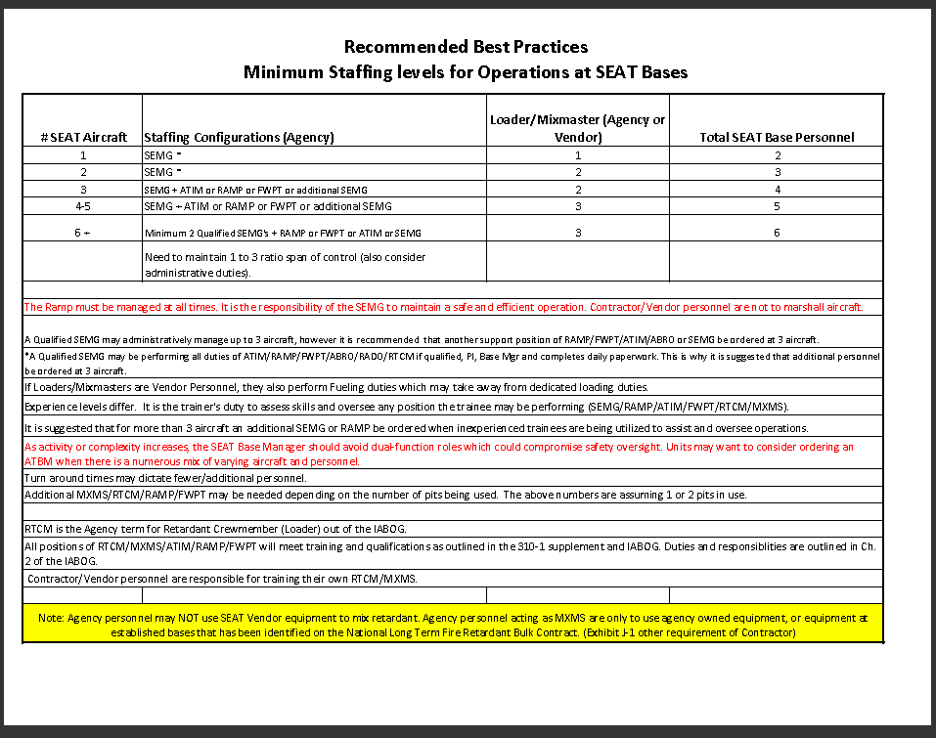
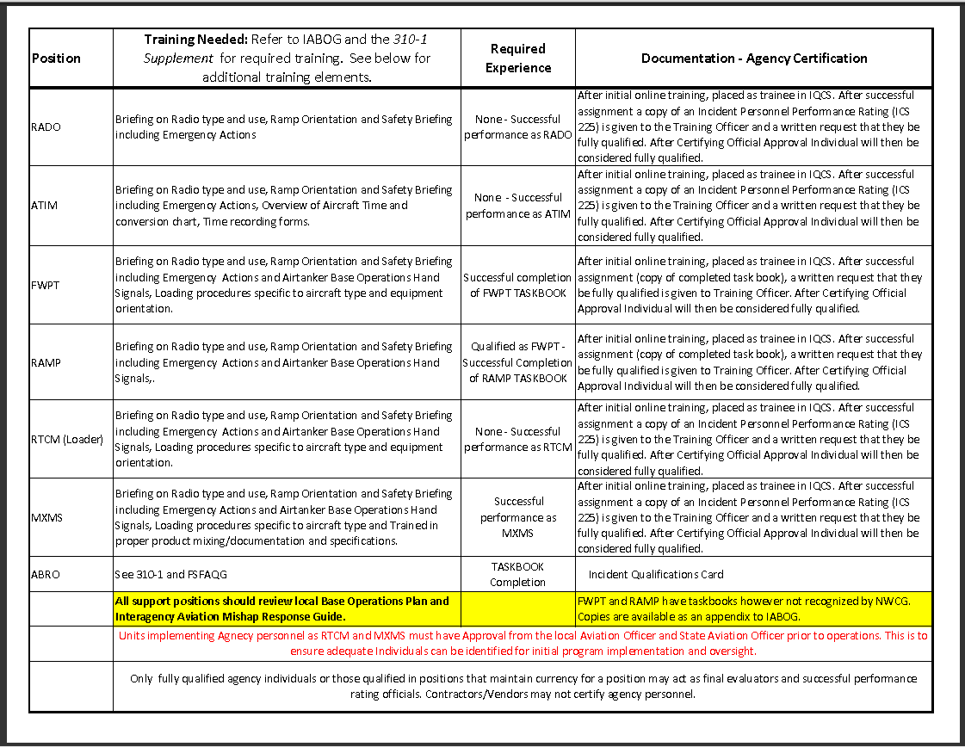
ISOG Appendix
Appendix A: Part One
SEAT Base Staffing Best Practices
Appendix A: Part Two
SEAT Base Training Elements
Job Aid to help you determine what staffing levels are needed for your SEAT operation.
Job Aid to outline the required experience and agency certification for identified positions.
Notes:
Review the contents of the Appendices with the students.
*** Tell Students to watch out for Multiple SEATs that may be assigned to your base as a reload base. Reference Safecom 2016 16-0339

Slide 17
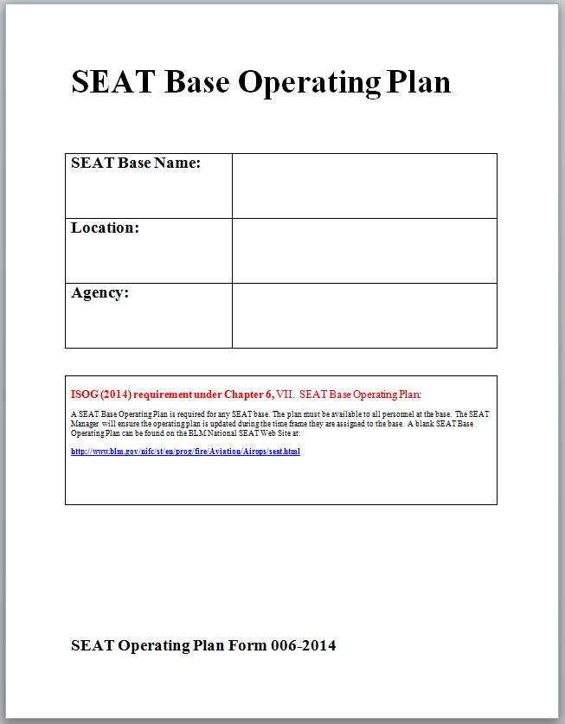
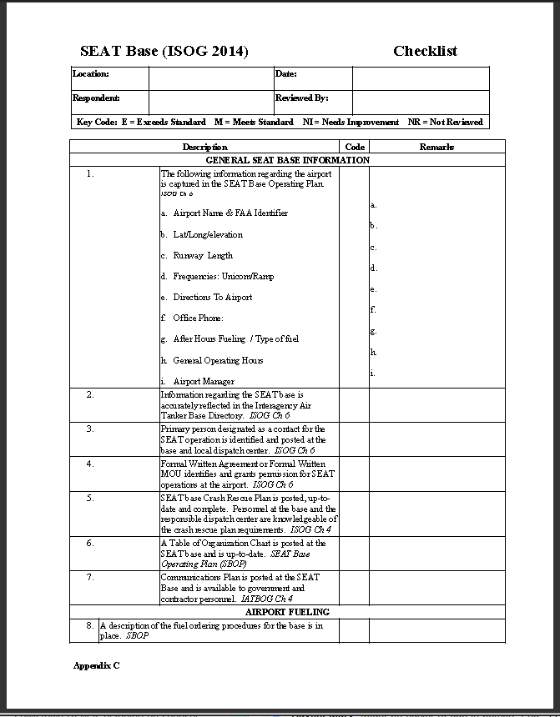
ISOG Appendix
Appendix B:
SEAT Base Operating Plan Form 006-2014
Appendix C:
SEAT Base Checklist
The new updated SEAT Base Plan, required for every base.
Checklist used in preparedness reviews for the established Category 1 and 2 type bases.
Notes:
Review the contents of the Appendices with the students. This checklist is only used for Category 1 & 2 type SEAT Bases.

Slide 18
2018 Contracts
Types of SEAT contracts:
DOI National On Call Contract
USFS has a single Exclusive Use contract in Oregon
Multiple States have their own Exclusive Use
Notes:
Numbers are not know at this time (March), but information will be posted to the web site.

Slide 19
USFS / State Exclusive Use Contracts
The USFS and the individual States are anticipating having their own contracts SEATs for their use.
These contracts and price lists will not be posted to the BLM National SEAT Web Site. SEMG will obtain this information from the USFS or the individual States.
States that have had Exclusive Use contracts are OR, ID, WA and CO. SEMGs can expect to see the same Exclusive Use State SEATs in 2018. Additional States may look at Exclusive Use contracting this year.
USFS has historically had an Exclusive Use contract at John Day, and are currently assessing their needs for additional SEATs.
Notes:
Flight hours for these Exclusive Use SEAT are tracked through the National SECO desk along with the DOI National SEATs and the On-Call. The National SECO may be able to help identify tanker numbers and vendors if SEMGs have questions during the season.
SEMG will need to work directly with the individual States and USFS with their questions.

Slide 20
On Call SEAT Contract
208-433-5021
No changes from last year 2017
Contracting Officer – Chris Bothwell christopher_bothwell@ibc.doi.gov 208-433-5021
COR – Glen Claypool gclaypoo@blm.gov 208-387-5160
SECO – Kristina Curtis blm_fc_seat@blm.gov 208-850-2780

Slide 21
On Call Contract
Some highlights and changes for the On-Call contract:
Daily Availability (AV) will be paid on initial Mob / Demob days.
No per diem will be paid. The cost was figured into the daily availability when the contractor bid the contract.
Service miles will only be paid when dispatched to support the SEAT. Mileage will not be paid for transportation to and from lodging or meals.
Relief pilot is required for the contract. Transportation costs will be documented on the Transportation Worksheet.
Flight time will end when aircraft comes into the blocks. Previous contract said “engine stop”.
P55 is only appropriate when the contractor loads retardant into another companies aircraft using their equipment.
Notes:
This slide represents some of the highlights and changes, check the National SEAT Web Site for a summary of changes to the new 2014 contract (not developed at the time of this presentation)

Slide 22
SEAT Contract Review
B6.7.2 Emergency dump feature - Operational check of emergency dump must be accomplished every 30 days while performing on contract. SEMG should ask when it has been done and document on daily diary.
B11.2.3.2 A maximum of 42 hours of flight time during any 6-day period. When a pilot acquires 36 or more flight hours in a consecutive 6-day period the pilot will be given the following 1 calendar day off duty for rest, after which a new 6-day cycle will begin.
SEMG should maintain pilot duty day log and communicate with pilot. Relay status to fire staff, dispatch, and any bases that aircraft/pilot may be working out of.

Slide 23
SEAT Contract Review
C24.1 Availability – One half day availability will be paid for days in which 4 hours or less of flight occurs. Flight hours in excess of 4 hours in any day will result in payment of the full daily availability. No availability will be paid on day sin which no flight occurs.
C24.3 Mobilization – Payment for availability, flight time and FSV mileage begins when the aircraft starts its mobilization flight from the Contractor’s Base of Operations or the Aircrafts Point of Hire, whichever is less to the assigned work location.
C24.4 Demobilization – Payment for availability, flight time, and FSV mileage begins when the aircraft is released from the assigned work location. Demobilization costs will be paid back to the original point of hire or the contractors base of operations, whichever is less, provided that is the aircraft’s immediate destination after release.
C24.4.1 If the aircraft does not immediately return to the original point of hire or base of operations, demobilization costs will only be paid as they actually occur but shall not exceed the cost nor be further than the location used at the time of hire.
SEMG should verify before releasing the aircraft and completing payment documents the aircrafts point of hire location.

Slide 24
SEAT Contract Review
C25.5.4 Unless approved in advance by the CO, payment for crew member exchanges is limited to one round trip for 2 crew members once every 12 days. Additional payment may be appropriate for circumstances such as personnel reaching flight, driving or duty time limits including agency imposed temporary flight or duty restrictions as specified in section B.
C25.5.5 Examples of Acceptable expenses are airline tickets, car rentals, privately owned vehicles at the government FTR rate; and Contractor aircraft and/or privately owned aircraft at the government FTR rate (per statute mile). * This is paid for use of the aircraft only and does not pertain to how many passengers. For current FTR rates go to https://www.gsa.gov/travel/plan-book/transportation-airfare-rates-pov-rates-etc/privately-owned-vehicle-pov-mileage-reimbursement-rates
Chartered aircraft must be approved by the CO at the beginning of Fire Season.

Slide 25
Documentation
SEAT Daily ops worksheets are required per the ISOG. They document daily activity and are a document of record. Time must be taken to fill them out completely and correctly and document any operational and availability issues.
SEAT daily ops worksheets are submitted to the SECO at blm_fc_seat@blm.gov by 10:00 am (MST) regardless of flight activity when on contract.

Slide 26
Tips When Completing Evaluations
Ask for input from the field. Check with the ATGS, ground personnel and dispatchers.
Always take the time to complete the forms, your input does count towards making the program stronger and safer.
Try to provide examples of why you rated the vendor the way you did. (both high and low ratings)
It is a MUST to fill out an evaluation when working with the National On-Call contracts at the end of your assignment !
How many completed an evaluation last year ?
Notes:
Ask SEMGs how many completed an evaluation last year ? Emphasis to the SEMG that it is a MUST to send in an evaluation at the end of their assignments

Slide 27
Documentation
AQD-136A – Evaluation Report on Contractor Performance CPARS
Evaluations should be done at the end of any contractors performance period.
AQD-136A’s should be reviewed by the appropriate Aviation Manager.
AQD-136A’s can be submitted to gclaypoo@blm.gov or blm_fc_seat@blm.gov.

Slide 28
Documentation - CPARS
Review form
Review Rating and Definitions
https://www.doi.gov/aviation/library/forms#aqdforms

Slide 29
DOI National Funded SEATs under the DOI On Call Contract
SOP’s Include:
Roles and Responsibilities
PI Duties
SEMG Duties
Invoice Processing
Cost Coding Requirements
Personnel / Equipment Requirements
Notes:
Instructors need to download a copy and review with the students.

Slide 30
Contract Language for DOI On Call SEAT Contracts
Some highlights and changes for the 2018 contracts:
The language for measurement of flight time has changed. Current language is:
“Flight time will be measured when the aircraft moves under its own power for the purpose of flight and ends when the aircraft come to rest after landing at the airport.”
Start time means …the time at which the aircraft begins taxing to the runway with the intent to takeoff. Start times are the time at which the aircraft; leaves the pit or begins taxing from the ramp.
Stop time means … the time at which the aircraft comes to a stop for the purpose of parking. Taxi time and time spent hot loading or hot refueling is considered flight time.
A Flight Time FAQ is available for review on the BLM National SEAT Web site.
Notes:
Both the On Call and BLM National Exclusive Use contract now have this language.

Slide 31
Measurement of Flight Time
Recording Flight Time on the Daily Ops Worksheet
SEMG will record the flight time on the Daily Ops Worksheet for each load the contractor takes out of the pit. The sortie must be recorded to reflect the correct refractometer reading, gallons delivered, correct charge codes for multiple fires, and to track cumulative flight time.
Example of how to document the flight time on the Daily Ops Worksheet.
When a pilot departs the pit for the 1st load, the SEMG will record their start time in Line #1 of the Daily Ops Worksheet, and complete all the other required columns on that line. When the SEAT comes back into the pit for a second hot load of retardant, the SEMG will record the stop time for that line.
The SEMG will use the same stop time recorded in Line #1 as their start time for Line # 2 or the second sortie.
Notes:
See example for Daily Ops Worksheet next slide.

Slide 32
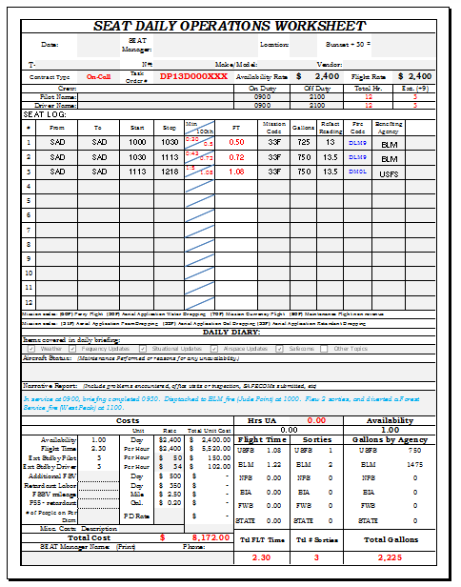
Example of How to Record Flight Time
Note the start time will be the same as the strop time for the previous sortie if the SEAT is hot reloading.
Notes:
Note the End time on the first leg is the start time for the second leg. This allows SEMG to capture the refract reading, gallons, correct fire and helps them be able to run cumulative flight time.

Slide 33
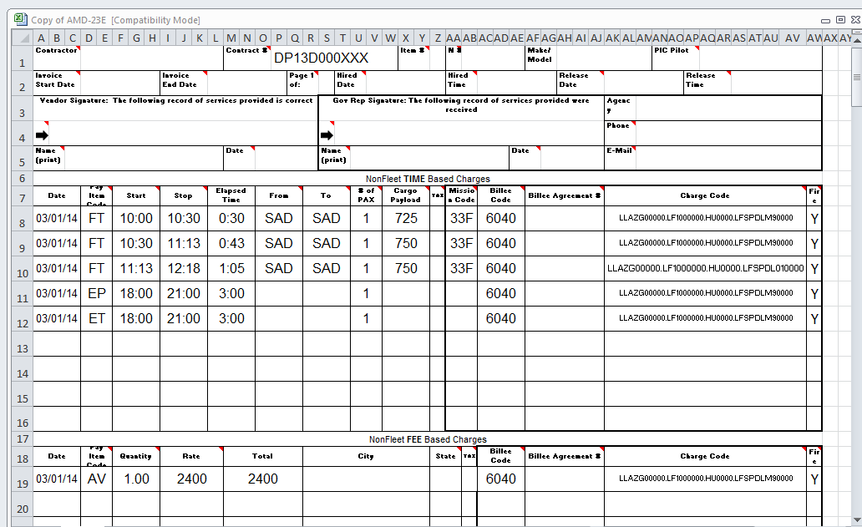
Example of How to Record Flight Time
Notes:
Note the End time on the first leg is the start time for the second leg. This allows Reviewers or Projector Inspectors to match the Daily Ops sheet with the OAS 23 for review.

Slide 34
Task Orders for All DOI Contracts
Task Orders are generated each year for every contractor by the Contracting Officer (CO).
Each Task Order has a Purchase Order/Request with hard dollars behind it. The Task Order authorizes the company to expense against the contract.
Task Orders are recorded in the “Contract #” column of the
OAS 23.
Cost Coding Guides for On Call SEAT contracts have been developed to help the SEMG choose the correct Task Order number for the different types of contracts. The guides are posted on the BLM National SEAT Web Site.
Notes:
Introduce the concept of the Task Orders. The next slide outlines differences in the types of contracts.

Slide 35
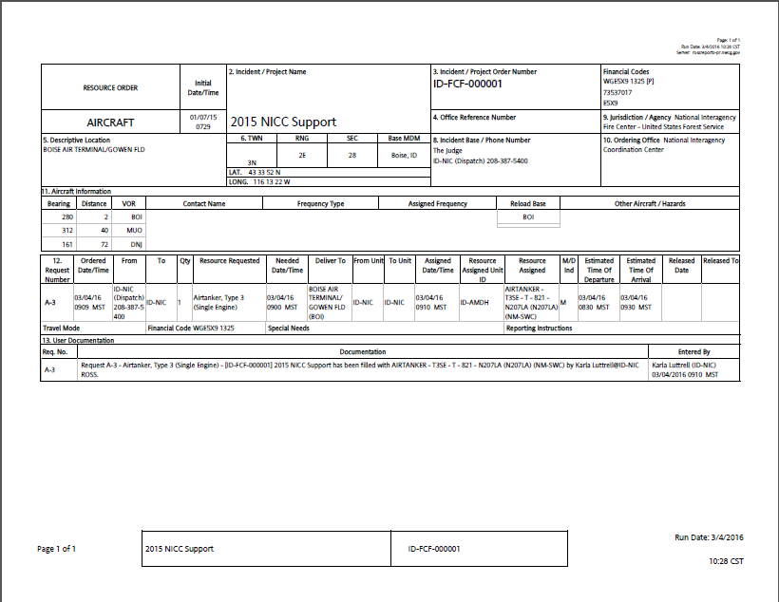
“Block 9” Shows the Jurisdiction / Agency as the United States Forest Service. The USDA Fire Suppression Order Number (Task Order) would be used on the OAS 23.

Slide 36
Contract Task Orders
On Call Task Order Numbers
Each SEAT contractor is issued a specific Task Order number for DOI fire Bureaus and a
separate Task Order number for the USFS.
Block Nine of the Resource Order indicates the Ordering Agency. The Ordering Agency
(either USFS or a DOI Bureau) will determine which fire suppression task order to use.
A list of Task Orders can be found on the OAS and BLM National SEAT Web Sites.
A Cost Coding Guide can be found on the BLM National SEAT Web Site.
USFS / State Exclusive Use Task Order Numbers
The USFS and State Exclusive Use Contracts may or may not have a Task Order. SEMGs will need to receive direction for completing the invoice or pay document from the individual State of USFS contacts.
Notes:
Instructor will download the cost coding guides available and review with the students.

Slide 37
Do You Have the Correct Charge Code Formatting ??
The number one problem with the OAS 23 is errors in the charge code formatting. It is
extremely time consuming for OAS when trying to process payment.
How Can You Help ??
Always confirm the charge coding format with your direct supervisor.
Understand formats change with severity and wildfire incident.
Always a good idea to put the name of the fire and the Fire Code in the comments section.
Never copy the formatting from another manager at your base. They may be managing a different type of contract and their formatting may not apply to you.
If you are managing more than one SEAT, do not assume the formatting is the same for both SEATs. They may be different contracts that require a certain type of formatting.
Always make sure your name and contact information is easy to read so OAS can contact you with questions.
Bottom line…..ALWAYS CHECK WITH YOUR DIRECT SUPERVISOR !!!
Notes:
This is a critical problem that plagues OAS when processing for payment. Make sure students need to make themselves available to answer any questions OAS may have about the charge codes.

Slide 38
Cost Coding Information
On Call Cost Coding
The SEMG will need to obtain the correct Billee Code from the unit ordering the SEAT.
The SEMG will use the appropriate charge code format for the agency that ordered the aircraft for all Time and Fee Based charges.
Leave the Item# column blank.
A Cost Coding Guide can be found on the BLM National SEAT Web Site.
USFS / State Exclusive Use
Cost Coding
The SEMG will need to obtain a briefing from the USFS or the individual State contacts on the correct cost coding formats.
Notes:
Instructor will download the cost coding guides available and review with the students.
The OAS 23 can have multiple dates on them or one set filled out for each individual day.
See examples on the next slides.

Slide 39
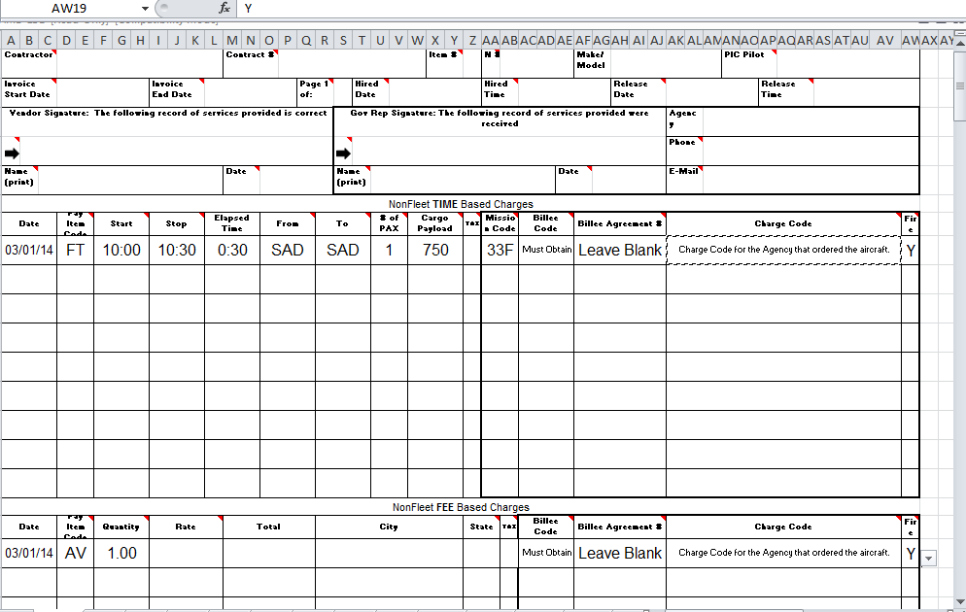
Example OAS 23 for On Call SEAT Contracts
Leave Blank
SEMG must obtain correct Billee Code
Use the appropriate charge code format for the agency that ordered the SEAT.
Notes:
Review and discuss the blue highlighted areas. Billee Code must match the agency charge code format. Example: When using a BLM charge code format, the Billee Code has to be a BLM code. Can not use a P# with a BLM Billee Code.

Slide 40
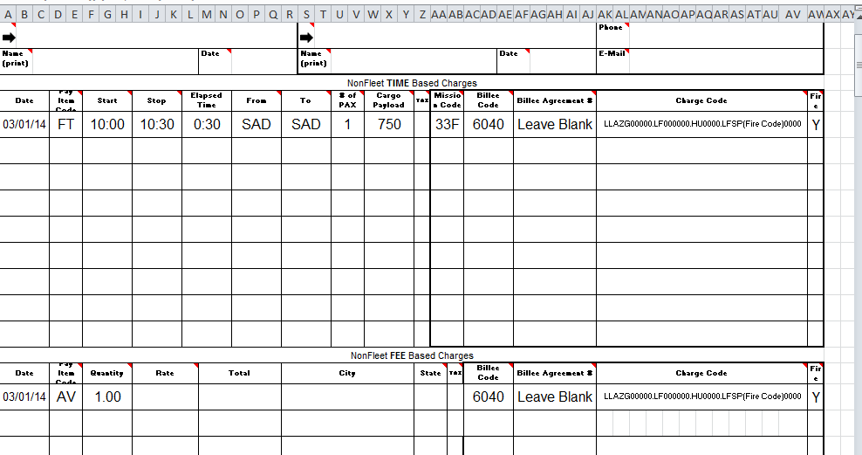
Example OAS 23 for On Call SEAT Contracts
Example of on On Call OAS 23 with a BLM Billee Code and the 4 digit Fire Code in the correct BLM charge code format.
Notes:
Review the cost coding format guide showing students the other agency charge code formats

Slide 41
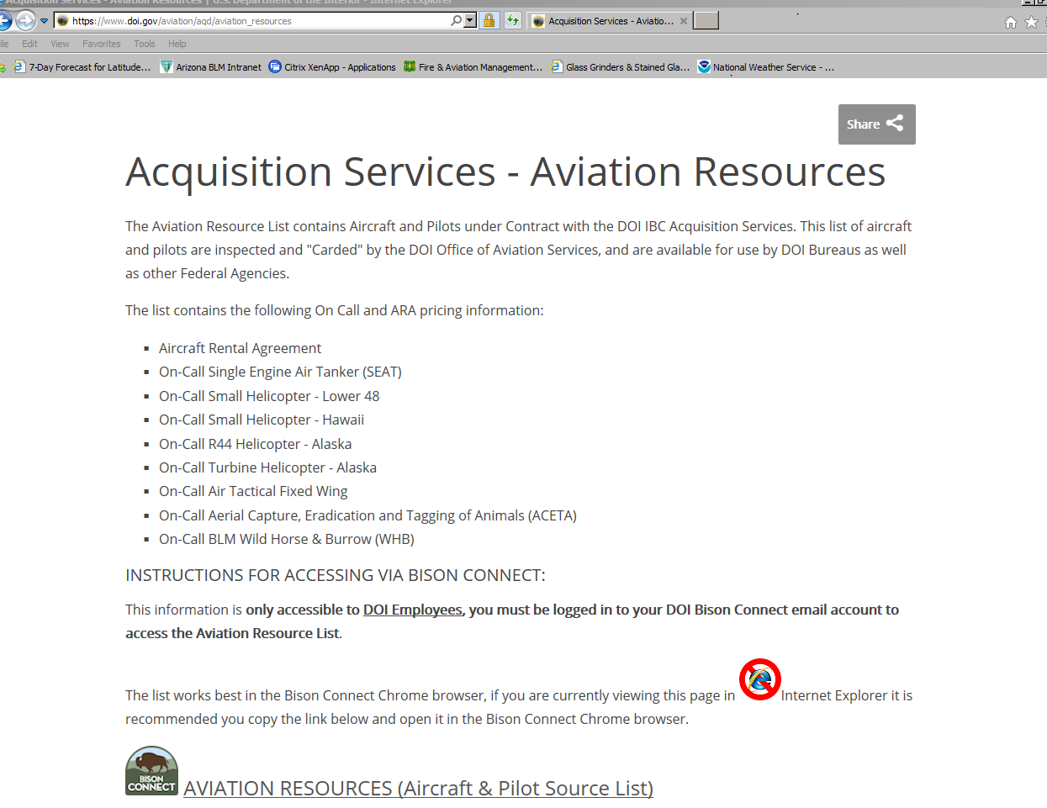
Where can I get the Price List for On Call SEATs ?
If I am not a DOI employee how do I get the pricing for the On Call contract ?
Pilot is required to have a copy of the contract with them when mobilized for an assignment.
If the pilot does not have the contract with them, call the Contracting Officer :
Chris Bothwell: 208-433-5021
The On Call pricelist is only accessible to DOI Employees through their DOI Bison email.

Slide 42
Review of Contract Language for DOI On Call SEAT Contracts
Mission Currency Training Flights
(MCTF)
Must have COR approval prior to conducting MCTF.
May be conducted every 14 days for pilots if not fire mission have been flown.
Pilot and aircraft will not be considered unavailable if the MCTF can not be conducted.
The pilot and aircraft will remain available for dispatch , and be paid availability and flight time.
Contractor is paid for their flight time from the unit that has order the SEAT.
Proficiency Flights
Proficiency flights may be conducted while the pilot and aircraft are under contract.
Proficiency flights will be approved by the local Government managers.
SEMG should notify the COR when a proficiency flight will take place.
Availability will be paid for the flight, but the flight time will not be paid by the Government.
Remember, the flight time does count towards the 8 hour flight time limitations, and make sure Dispatch / Fire Management are notified of the flight.
Unscheduled Maintenance
The contractor may request to remove the aircraft for unscheduled maintenance with the approval of the COR or PI.
The contractor may be required to resume services with 60 minutes or any other agreed upon time frame by the COR or PI.
Availability will be paid to the contractor for this authorized removal.
Remember to notify Dispatch and Fire Management personnel if a request has been made by the contractor for unscheduled maintenance.
Notes:
Common treads: Availability will be paid. Make sure to notify Dispatch and local Fire Managers.

Slide 43
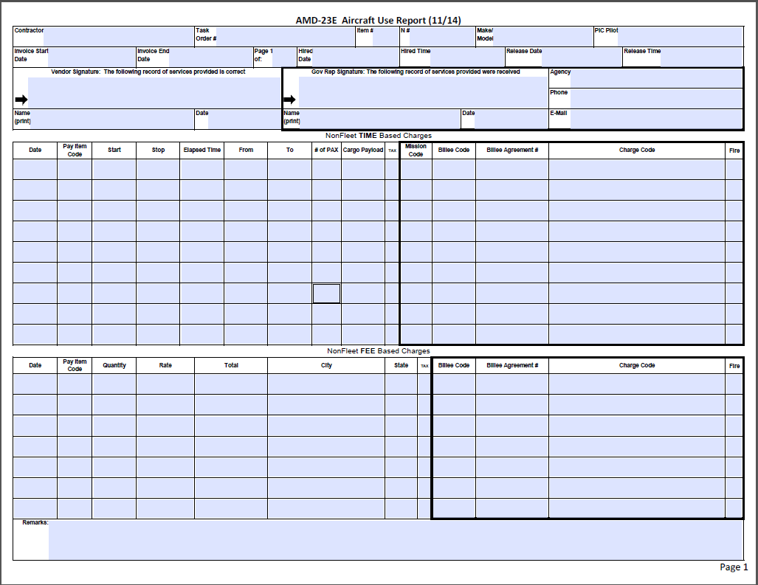
Completion of the OAS 23E
What should I do if I can’t find the Billee Code?
Who should I contact to find the correct charge codes?
Should I keep a copy of the OAS 23E?
Pilot completes the sections highlighted in blue.
SEMG completes the sections highlighted in yellow.
Notes:
Emphasis to the students that the pilot is responsible for completing the sections highlighted in yellow. Both the SEMG and Contractor sign the OAS 23E. Involve students in discussion about where to find Billee codes, correct charge codes, etc.

Slide 44
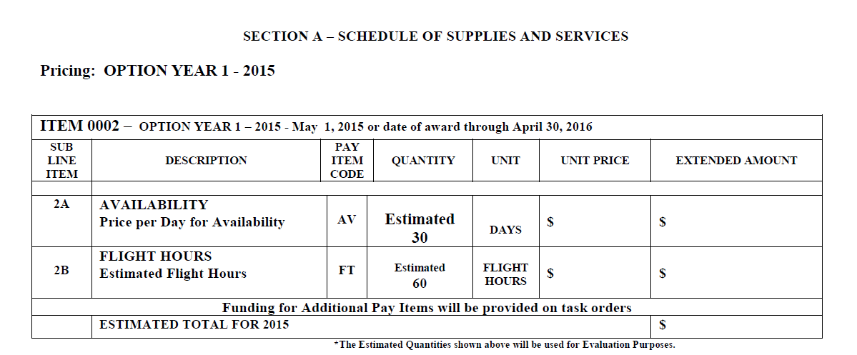
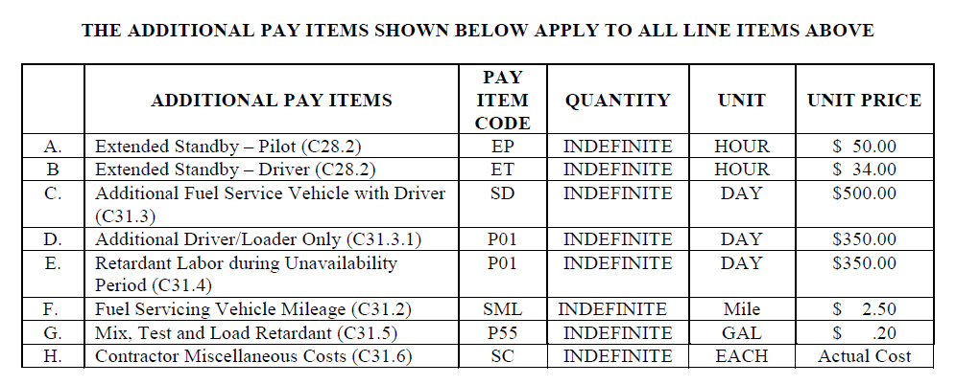
How do I know what Pay Item Code to use ?
Section-A
Pay Item Codes can be found in Section “A” of the contract.
Use only the Pay Item Codes list in the contract.
A list of Pay Item and Mission Codes can be found on the OAS Web site.

Slide 45
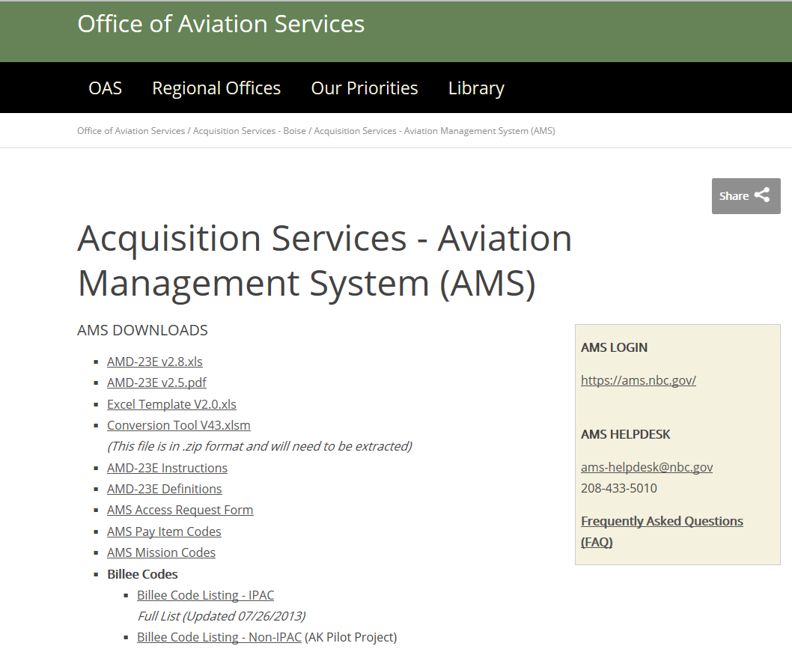
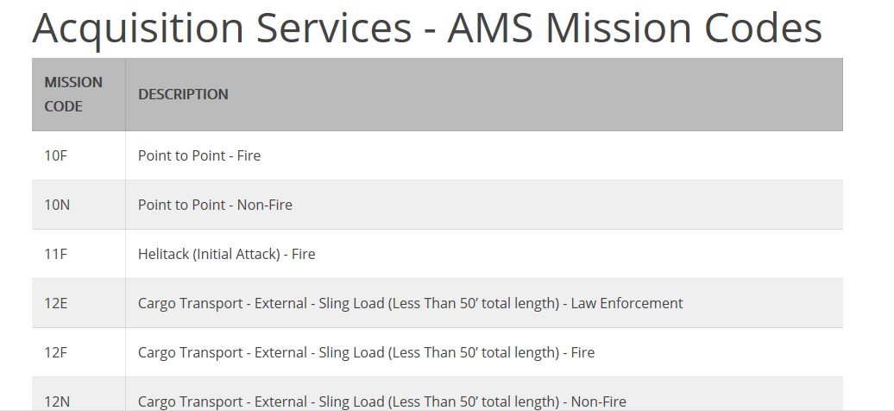
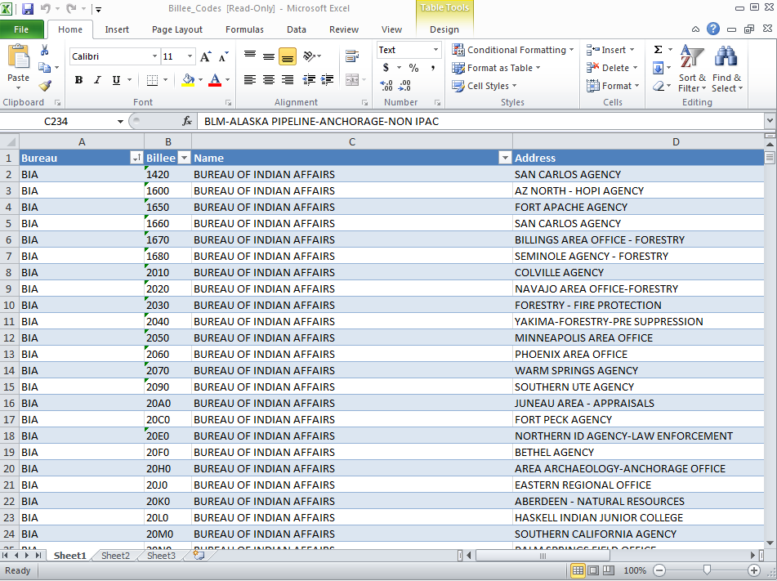
Where can I find Mission, Pay Item, and Billee Codes ?
You can find information about OAS 23E, Billee Codes, Pay Item Codes, etc. on the OAS web site under “Acquisition Services”.
Notes:
Show students the different links to access the codes and OAS 23.

Slide 46
Tips for Completing the OAS 23E ?
Contractor is responsible for documenting flight and use information (the left side of the form). The government reprehensive is responsible for completing the cost coding information (right side of the form).
The OAS-23 must be filled out completely using correct order number, pay item codes.
Aviation user and Contractor must both signOAS-23E form.
Signed original is provided to the Contractor to report services in AIRS and invoice in IPP
The OAS-23E becomes the official receiving report.
Remember ! There are some differences in completing the OAS 23 between On Call and the DOI National Exclusive Use SEATs. Consult the Cost Coding Guides developed for both contracting types.
New Requirement ….
When using the On Call contract, the SEMG needs to clearly identify who the Agency / Jurisdiction was that ordered and used the SEAT in the remarks section of the OAS 23E. This information can be found on “Block” 9” of the Aircraft Resource Order. Recording this information in the remarks section allows OAS to access the proper agency’s financial payment system for processing. When it is either unclear who the ordering agency is or it is a State that is ordering the SEAT- Contact the aviation manager to determine the correct task order number to use.(DOI or FS)
Notes:
Instructor should have all students complete a OAS 23E to become familiar with the form. Show students an Aircraft Resource Order and go over the information in Block 9.

Slide 47
RT-273 Requirement
SEAT Triennial Re-fresher = RT-273
New filters have been put into the Interagency Qualifications and
Certification System (IQCS) program to flag individuals who are not
current with their re-fresher requirements.
Heads Up !…..
Make sure your RT-273 re-fresher certificates are put into IQCS or your agencies qualification program.
Your currency depends on the date of the last re-fresher….your qualifications may expire in the middle of the season depending on the re-fresher date. Plan ahead !

Slide 48
RT-273 What’s New ?
A new section has been developed on the BLM National SEAT Web
Site for instructors to download course materials for RT-273. The intent
of the new section is to:
Provide standardized information given at any RT-273
Promote more re-freshers at a local or geographic level.
Provide annual updates for all SEAT Mangers in between the triennial re-fresher.
Downloads Include:
Lesson plans for each of the 8 elements required for putting on RT-273
1. National season Review
2. New Year Outlook
3. OAS Contracting Updates
4. ISOG Updates
5. Reference Material Updates
6. Safety Review
7. Security Review
8. Retardant Review
Three developed Power Point presentations for selected elements.
Heads Up ! Remember….all re-fresher and instructors still need to be approved at a State or Regional level depending on the hosting agency.

Slide 49
What’s New on the BLM National SEAT Web Site ?
Make sure to check the National BLM Web Site often during the season to obtain the most current updates and information about the program.
NEW LINK- https://www.nifc.gov/aviation/av_BLMseat.html
Notes:
Instructors need to bring the web up in class and briefly review each section with the students.

Slide 50
Initial Pilot / Loader In-Briefing
Replaces the old form.
ISOG requirement.
Three Section:
Facility Related Items
Operational Related Items
Read File Information
Notes:
Instructor should have a copy for each SEMG to review. Make sure they understand that this is the required form that is to be used when documenting a pilot and loader in-briefing.
Includes the relief pilots / loaders.

Slide 51
SEAT Manager’s Briefing Checklist Great Job Aid !
Items to review during the agency in-briefing.
Items to review during a briefing with the FBO.
Notes:
Instructor should have a copy for each SEMG to review.
Not a requirement, job aid.

Slide 52
SEAT Managers Daily Briefing Worksheet Great Job Aid !
Designed to help the SEMG document their daily briefing.
Notes:
Instructor should have a copy for each SEMG to review.
Not a requirement, job aid.

Slide 53
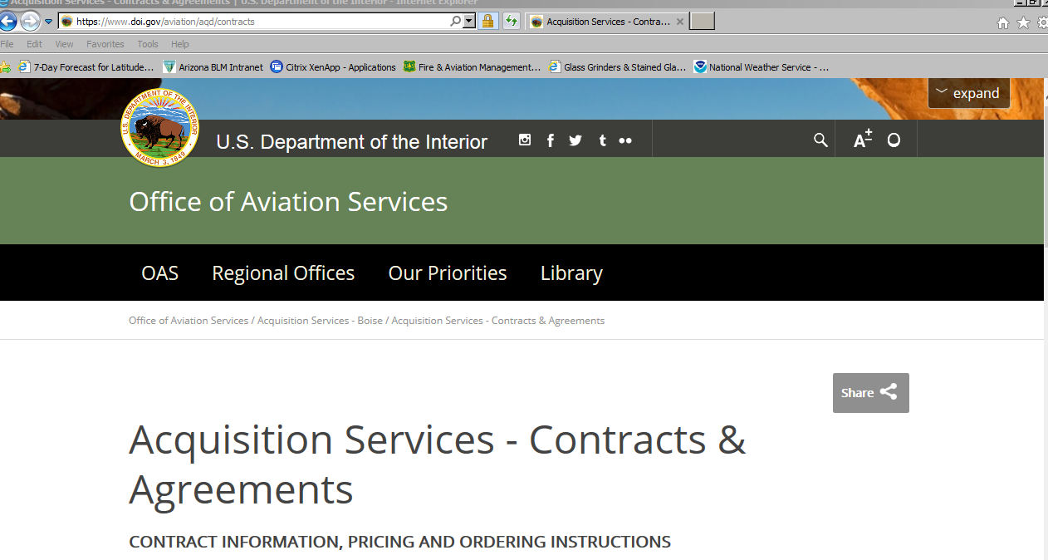
AQD-136 (10/14) Evaluation Report on Contractor Performance
ISOG requirement to complete after each assignment !
Has established rating criteria.
Sent directly to the Contracting Officer.
Download Here !
Notes:
Note the current date on the AQD-136 (10/14) . Can be downloaded from OAS web site.
Emphasis to the SEMG that it is a MUST to send in an evaluation at the end of their assignments.

Slide 54
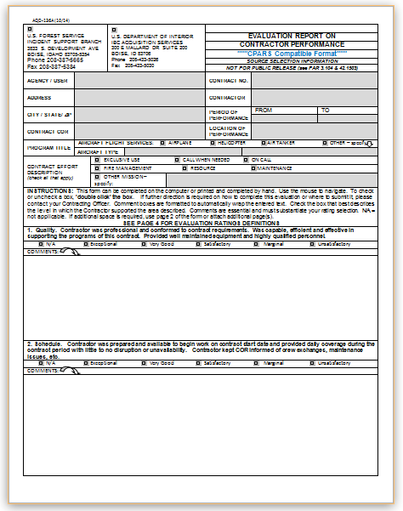
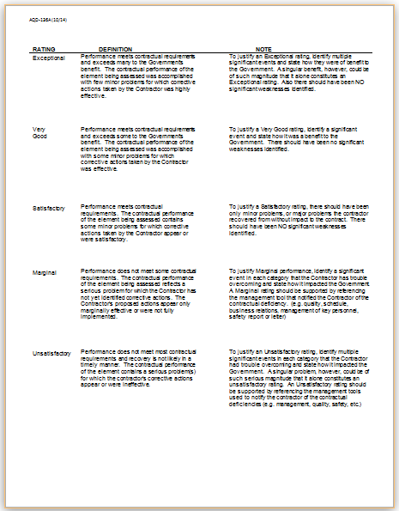
AQD-136 (10/14) Evaluation Report on Contractor Performance
Notes:
Download a copy of the evaluation and review the rating definition notes with the students.

Slide 55
Routing Requirement for the SEAT DAILY OPERATIONS WORKSHEET
In order to nationally track flight hours, aircraft and pilot status, etc. the SEMG will need to provide the National SECO Desk with a copy of their Daily Operations Worksheet each day. This can be done by a fax or email.
SEMG must fax or email the worksheet in each day even if there was not flight time recorded. The sheet can be sent at the close of business, or early the next morning. Worksheets will be submitted no late than 10:00 MST on the next day.
In order to comply with the new retardant reporting requirements for the USFS The SEMG will still fill in the Fire Code, but identify which fires are USFS fires in the Daily Diary section.
National SECO Desk:
Office: 208-387-5419
Cell: 208-850-2780
Fax: 208-387-5199
Email: BLM_fc_seat@blm.gov
Remember…please send in the worksheet each day, whether you fly or not !!
Remember to always record the refract reading .
ISOG Requirement!
Identify which fires from the Fire Code column are USFS fires.
Notes:
Information from the Worksheet will be put into national program that will be able to help the National SEAT Desk Coordinator with their reporting requirements.
Make sure to tell the students to fax or email in the worksheet whether they fly or not.
This is a new important requirement for SEMG to help comply with the retardant reporting requirements for the USFS. SEMG need to note which fires listed from the Fire Code column are USFS fire in the Daily Diary section.
The SECO Desk should be staffed from Mid- May to the end of September. If the SECO Desk is not staffed, fax in the worksheet each day to the fax number listed above.

Slide 56
New Routing Requirement for the SEAT DAILY OPERATIONS WORKSHEET SEAT-002 2014
Why is it important to fax or email the worksheet into the National SECO desk ?
One of the primary duties for the National SECO is to input the SEAT current location and availability status into the Wild NICC resource tracking program each day.
Daily input into the program allows:
NICC to be able to use the information for their national planning purposes.
National SECO calculates a Best Value Determination (BVD) comparison whenever an order is placed for a SEAT.
Notes:
Instructors should relay to students that anyone can call the National SECO desk, provide them with a Lat / Long or an FAA airport location and the SECO will be able to fax or email them a BVD or their order.

Slide 57
National SEAT Desk Coordinator
Position in Boise working for the National SEAT
Program Manager (Glen Claypool) for the 2018 Season !
General time Frame: Mid April to End of September depending on activity.
Duties Include:
Talking to the SEMG each day, inputting their flight hours, aircraft location and availability status into a national program.
Assisting with Best Value Determination (BVD) for SEAT orders.
Compiling daily reports used by NICC and the national office to monitor activity and facilitate the movement of SEAT aircraft.
Assisting NICC, GACCs and local agencies with identifying the closest resource for filling an order for SEAT aircraft.
Assisting NICC, GACCs and local agencies with possible available SEAT Managers.
Compiling year-end stats for the SEAT program.

Slide 58
Staffing
RTCM and MXMS Agency programs approved by Local and State Aviation Management. Programs should be identified in the SEAT Base Operating Plan and reviewed or approved by appropriate Aviation Manager.
These are IQCS (Redcarded) positions – refer to the Federal Wildland Qualifications Supplement for 2018 for position requirements.
October of 2018 these positions will be moving to the 310-1.
The 310-1 will be the reference for all ATB positions ATBM, FWBM, SEMG, MXMS, RTCM, RAMP, FWPT, ATIM.
All of these support positions are in the 2018 AD pay plan.
2018 Fire Season - Encourage SEMG (t) to open FWPT and RAMP task books.
Utilize ISOG appendix A to supplement base personnel elevated base use or higher complexity level.
https://www.nifc.gov/aviation/BLMseat/ISOG_AppendixA1.pdf

