Slide 1
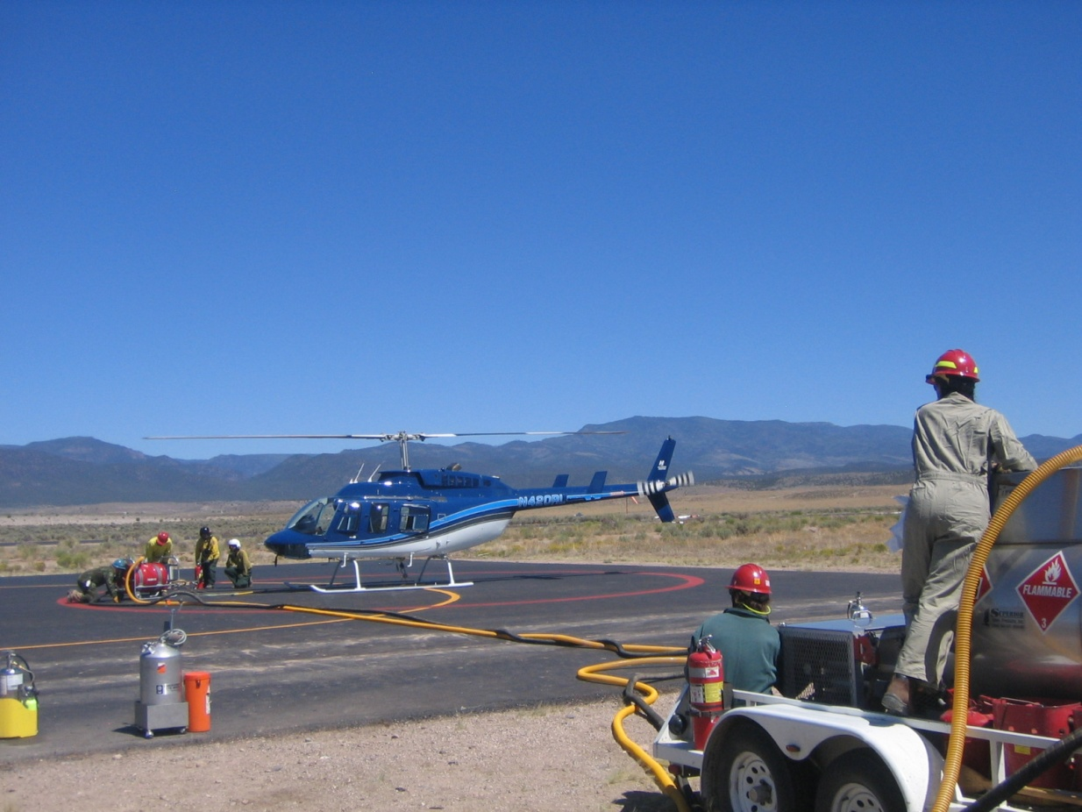
Unit 2
Personnel Qualifications and Responsibilities

Slide 2
Unit Objectives
Become familiar with:
Prescribed and wildland fire organizational structures.
Qualifications and responsibilities.
Initial training and certification, annual re-certification requirements.

Slide 3
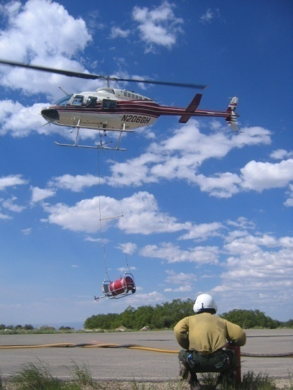
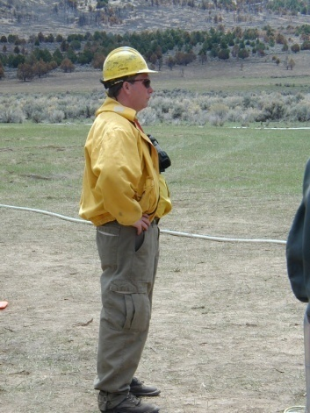
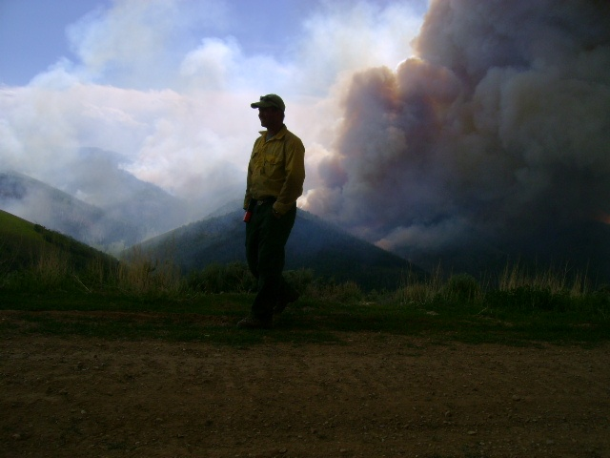
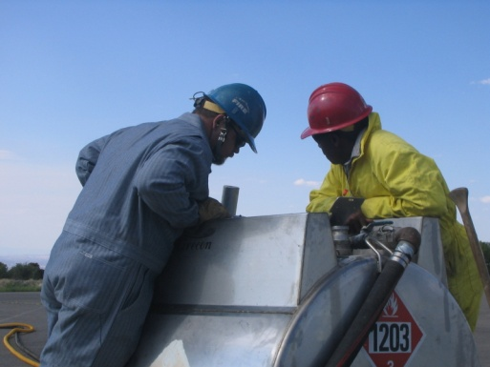
Helitorch Positions
Burn Boss/Firing Boss
Helitorch Parking Tender
Helitorch Manager
Helitorch Mixing Crew
Helitorch Mixmaster

Slide 4
Helitorch Organization Chart –Prescribed Fire

Slide 5
Helitorch Organization Chart –Wildland Fire

Slide 6
Pilot - Qualifications
Pilot must have completed helitorch ground school (this power-point training).
Pilot must have an endorsement for helitorch operations on their current pilot qualification card.
Helicopter must be carded for helitorch operations.

Slide 7
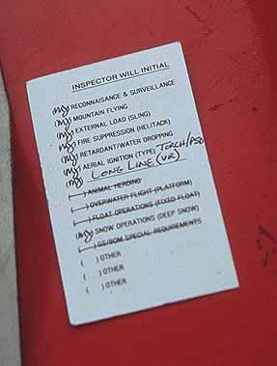
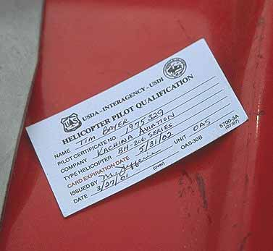
Pilot Qualification Card

Slide 8
Pilot - Responsibilities
Basic knowledge of wildland and prescribed fire operations.
Communicates and coordinates with Burn Boss/Firing Boss and Parking Tender.
Knows aircraft limitation section of flight manual.
Knowledge of procedures for helitorch installation and operations.
Maintains desired flight profile to meet burn unit objectives.
Pilot is responsible for all helicopter operations and flight safety.

Slide 9
Burn Boss - Qualifications
Prescribed Fire Burn Boss.
Received helicopter safety training.
Knowledgeable of ICS organization concepts and is familiar with aerial ignition operations.
Knowledge of weather & fire behavior.

Slide 10
Burn Boss - Responsibilities
Coordinates development of firing plan and has overall responsibility for firing operations.
Performs the initial briefing and covers assignments.
Briefs pilot and personnel on the plan and firing sequence.
Observes helitorch operations and adjusts firing patterns by communicating with pilot.

Slide 11
Firing Boss - Qualifications
Qualified as Firing Boss.
Received helicopter safety training.
Knowledgeable of ICS organization concepts and is familiar with aerial ignition operations.

Slide 12
Firing Boss - Responsibilities
As requested by Burn Boss, directs the aerial firing operation.
Instructs pilot as to the plan and firing sequence.
Observes helitorch operations and adjusts firing patterns by communicating with pilot and Burn Boss.

Slide 13
Helitorch Manager - Qualifications
Helicopter Manager
Exclusive-use
CWN
Project
HTMM qualified
Aerial ignition annual re-certification
Minimum HEB2(T)

Slide 14
Helitorch Manager - Responsibilities
Provides technical assistance to Burn Boss/Firing Boss.
Assigns qualified personnel and monitors all helitorch operations.
Assures all required equipment is on site, tested and operational.
Provides technical assistance on helibase location and operation.
Briefs pilots and helitorch base personnel.

Slide 15
Identifies hazards and safety considerations at operational briefing.
Aviation Safety Plan and Go/No Go checklist is approved/posted & followed.
Establish communications between helitorch base, dispatch and firing personnel.
Utilizing only one helitorch helicopter the HTMG may also serve as the Helicopter Manager.

Slide 16
Helitorch Mixmaster – Qualifications
Helicopter Crewmember
Helitorch Parking Tender
Helitorch Mixmaster
Aerial ignition annual re-certification

Slide 17
Helitorch Mixmaster – Responsibilities
Reports to the Helitorch Manager.
Attends briefings.
Supervise mixing/filling operation and manages time frames to maintain availability of gel.
Assure bonding procedures are followed.
Places equipment and assures it is operational.

Slide 18
Conduct drills and assure coordination prior to operation.
Oversees hookup of helitorch to helicopter and preflight tests of helitorch with pilot.
Perform maintenance and cleaning of all helitorch equipment daily.
Supervise helitorch fire protection.

Slide 19
Helitorch Parking Tender – Qualifications
Helicopter Crewmember
Helitorch Parking Tender
Aerial ignition annual re-certification

Slide 20
Helitorch Parking Tender – Responsibilities
Reports to the Helitorch Manager.
Attends briefings.
Directs all movements of personnel and equipment around the helicopter.
Checks hookup of helitorch to helicopter.
Must have a radio equipped headset and hardhat or ALSE approved flight helmet with a remote transmit switch during takeoffs and landings during helitorch operations at the landing pad.

Slide 21
Has fire protection/crash rescue responsibility for the primary helitorch helipad.
Ensures electrical switches are “on” prior to takeoff and “off” after landing and inspects helitorch.
Ensures all personnel/equipment are clear of safety circle during takeoff/landing.
Maintains communications with helicopter while within the helitorch base.

Slide 22
Mixing Crew - Qualifications
Must attend B-3 (basic aviation safety training) and/or S-271 (helicopter crewmember training).
Helitorch operations instruction – can be on the job training.

Slide 23
Mixing Crew – Responsibilities
Report to Mixmaster.
Attend briefings.
Assist Mixmaster with operations of mixing systems.
Assists with the filling of the helitorch.
Assists with fire protection.

Slide 24
Helitorch Base Radio Operator - Qualifications
Air Base Radio Operator
For complex burns or on multiple aircraft helibase use qualified aircraft base radio operator (ABRO).

Slide 25
Helitorch Base Radio Operator - Responsibilities
Reports to Helitorch Manager.
Attends briefings.
Primary contact for helitorch base to relay information to Helitorch Manager from Burn Boss, Firing Boss, and Dispatch.
Maintain communication with appropriate aircraft.
Maintain a flight following and helitorch use log.

Slide 26
Helitorch Fire Protection Personnel - Responsibilities
Reports to HTMM.
Attend briefings.
Familiar with crash/rescue operations.
Familiar with fire extinguisher operation.
Charge hoses and attend nozzles during operations (when applicable).

Slide 27
Training Requirements
Initial training will consist of the following topics:
Organization and communication.
Special safety procedures and concerns.
Dealing with hazardous materials.
Equipment testing, troubleshooting, and maintenance.
Briefing and checklist requirements.
Operational procedures and requirements.
To complete initial training students participate in a live fire operation.

Slide 28
Position Task Sheet
Helitorch Parking Tender must complete one assignment successfully prior to being certified.
Helitorch Mixmaster must complete three assignments successfully, plus an additional assignment for each specific equipment model prior to being certified.
Helitorch Manager must complete one assignment successfully prior to being certified.

Slide 29
Re-certification
Each helitorch module member shall review the applicable sections of the Interagency Aerial Ignition Guide, as well as agency-specific guidance and direction.
The following positions must go through sections 1-6 in chapter 2 of the Aerial Ignition Training Guide annually.
Helitorch Parking Tender
Helitorch Mixmaster
Helitorch Manager

Slide 30
Certification Authority
Certification is the responsibility of the applicable Regional / State Aviation Manager or designee.

Slide 31
Currency Requirements
Must perform in the position at least once every three years to maintain currency and remain eligible for re-certification training.
If individual does not meet the currency requirement, they must repeat the completion of the initial certification and training.

Slide 32
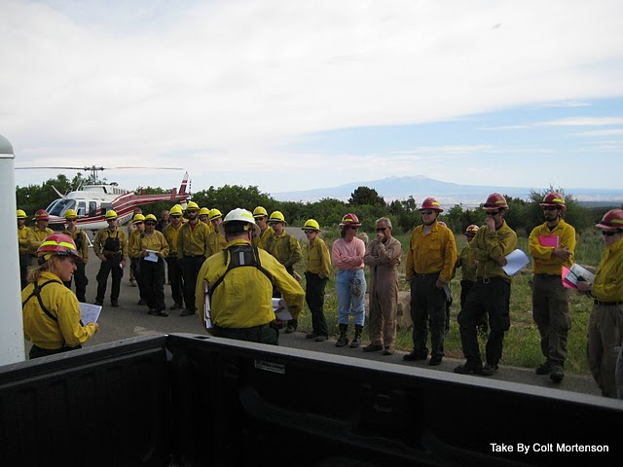
Review
Burn Boss
Firing Boss
Pilot
Parking Tender
Mixmaster
Mixing Crew
Helitorch Manager
Air Base Radio Operator
Fire Protection Personnel

Slide 33
Unit Objectives
Become familiar with:
Prescribed and wildland fire organizational structure.
Qualifications and responsibilities.
Initial training and certification, annual re-certification requirements.

