Slide 1
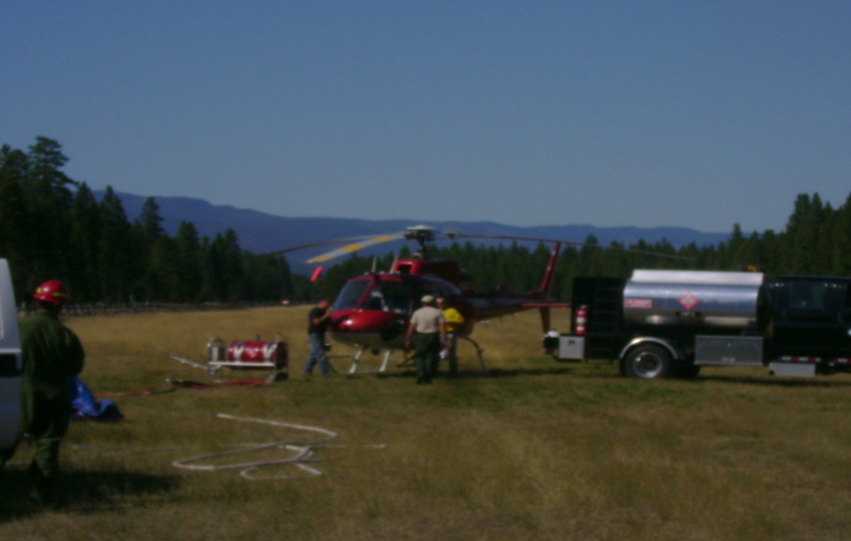
Unit 4
Helitorch, Batchmixer and Modular Mix Transfer Components

Slide 2
Unit Objectives
Become familiar with:
Basic parts and mechanics of helitorch
Various mixing systems

Slide 3
The purpose of a helitorch is to dispense ignited gelled fuel utilizing a helicopter.

Slide 4
Various Torch Models
Barrel Torch
Simplex torch

Slide 5
Helitorch Primary Parts
Frame
Fuel tank with sight glasses, (no sight glass on barrel torch)
Ignition system
Pump and positive shut-off nozzle
Clay & Bailey relief valve (exception barrel torch)
Cam-lock and dry break fittings
Single point suspension with adjustable attachment point and electrical cable

Slide 6
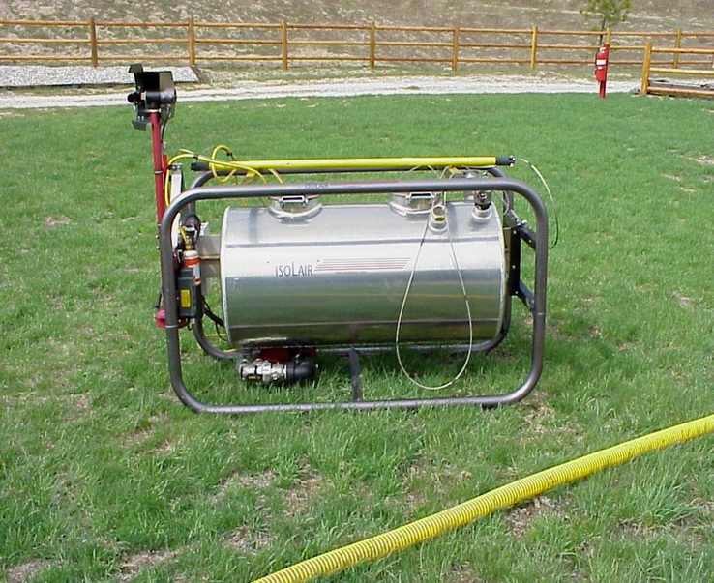
Simplex 5400 & Isolair Torches

Slide 7
Barrel & Spec 2000 torches

Slide 8
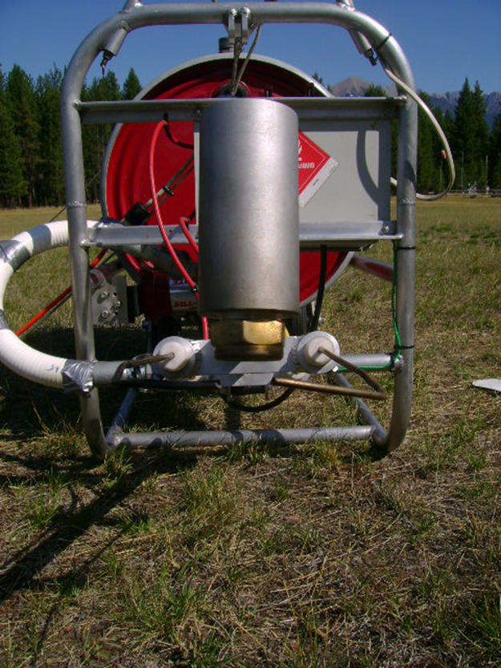
Barrel & Spec 2000 Torches

Slide 9
Mixing Systems
Basic function of mixing system is to combine fuel with a gelling agent to create a thickened mixture, then transfer it to the helitorch.

Slide 10
Batchmixer
Designed to mix gelling agents and fuel to a thick, consistent mix
Tank designed to meet U.S. DOT regulations
Capable of mixing large quantities of fuel & pumping to helitorch drums

Slide 11
Batchmixer Components
Motor
Pump
Pressure gauge
Plumbing
3-way valve
MC 306 or DOT 406 tank
Fuel fill port
Mix/re-circulation tank
Discharge hose with dry break valves
Suction dry break fitting port
Suction hose with dry break valves
Emergency shut off handle with minimum 20 foot emergency lanyard

Slide 12
Modular Mix Transfer System
Same purpose as a batchmixer.
Not hard plumbed to a mix tank.
Pumps gelled fuel from one drum to another.
Less costly to purchase/manufacture.
Easier to comply with DOT regulations for public highway transportation.

Slide 13
Modular Mix Transfer System Components
Motor
Pump
Pressure gauge
Approved drums
Fuel fill port
Clay & Bailey relief valve
Powder dispenser
Sight glasses
Discharge hose with dry break valves
Suction/re-circulation dry break fittings
Suction hose with dry break valves

Slide 14
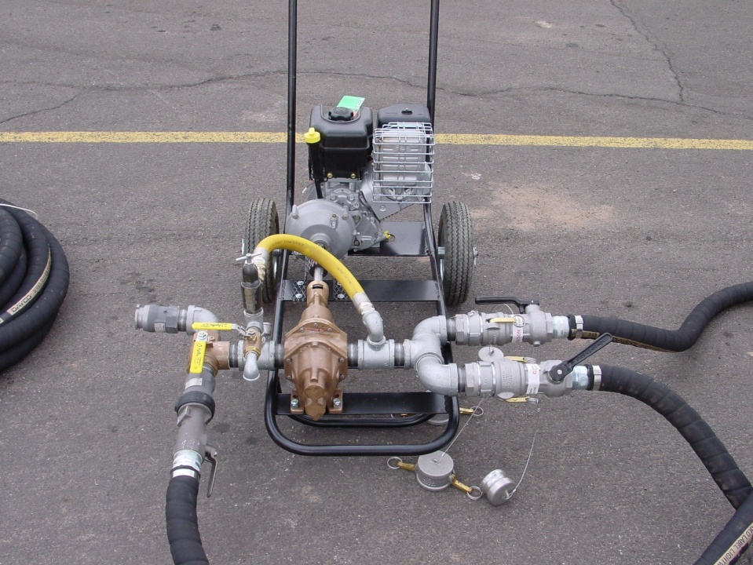
Transfer System Components

Slide 15
Helitorch Support Kit Contents -PPE
Nitrile , leather and cotton gloves
Cotton or non-static clothing
NIOSH approved dust masks
Chemical splash goggles
Ear plugs

Slide 16
Helitorch Support Kit Contents (cont) -Mixing Equipment
Scale
Aluminum container for powder measuring
Non-ferrous mixing paddle
Commercial gelling agent
Fuel thermometer

Slide 17
Helitorch/Mixing System Misc. Supplies and Parts
Extra drums
24 volt system for bench testing equipment
Extra parts: spark plug, drive belts, solenoid valve, single pole guarded electrical switch, propane regulator, dry break (male and female)
Propane bottles
O-ring
Grease Gun w/grease
5 gal. of diesel or jet A
Cotton rags, hand cleaner, steel wool, duct tape, wire brush, wire ties, garbage bags, etc.
Cubies of water
Tools and 2 large non-ferrous pipe wrenches
Spare drum seal(s)
Notes:
Reference syllabus for complete parts list

Slide 18
Non-ferrous Pipe Wrench With Brass Teeth

Slide 19
Static Bonding Equipment
Bonding cables with clamps and clips
Approved transparent vapor hose
Approved gasoline transfer hose
Both the vapor and fuel transfer hose should have wire helix and be continuity tested prior to use

Slide 20
Helitorch Base Equipment
40-B:C fire extinguishers
Pad marker w/nails
Wind indicator, wind meter and thermometer
Helibase, No Smoking and Flammable signs
Barrier flagging with stakes
First Responder Medical Kit w/burn blankets and eye wash
Crash Rescue Kit
Evacuation Kit
5-Gallon Class B foam w/ inductor (optional)
Fiber tape
Fire shelters (pilot)

Slide 21
Unit Objectives
Become familiar with:
Basic parts and mechanics of helitorch
Various mixing systems

