Slide 1
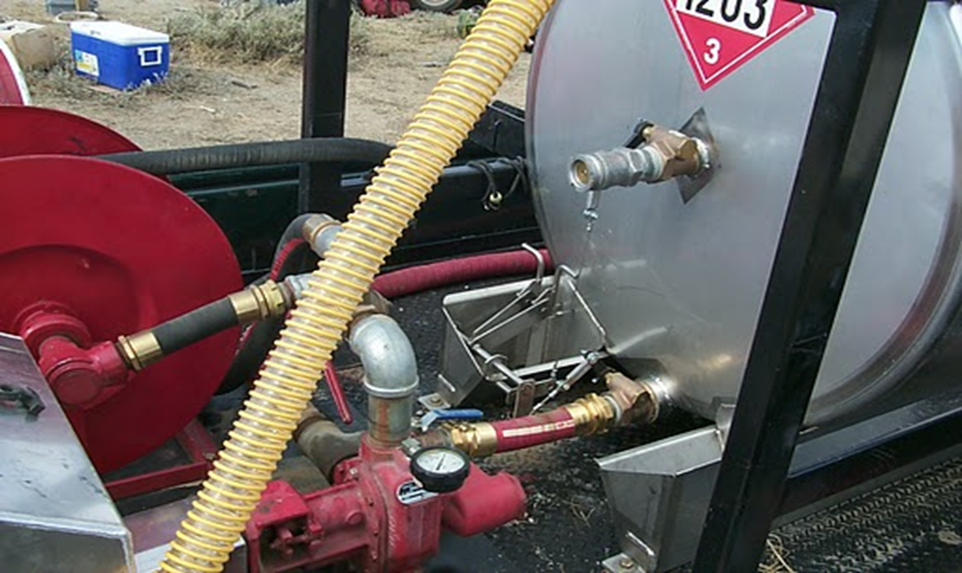
Unit 5
Bench Testing, Maintenance, and Troubleshooting

Slide 2
Unit Objectives
Identify three primary steps in bench testing a helitorch.
Identify six considerations in maintaining helitorch and mixing systems.
Given a typical problem encountered during helitorch operations; troubleshoot potential solutions.

Slide 3
Helitorch Bench Testing
Prior to helitorch operations, a bench test will be conducted.

Slide 4
Helitorch Bench Testing
Helitorch should be empty.
40-B:C fire extinguisher available.
Ensure switches are off and propane bottle is installed.
Connect 24 volt power source to helitorch with the 9 pin adapter.

Slide 5
With the pump switch off, turn on the igniter switch, check for spark and if applicable, propane ignition.
With the ignition switch off, turn on the pump switch, check pump to ensure it is moving gel and/or air.
Do not run pump dry for more than a few seconds.
Ensure polarity is correct.
Turn switches off and unhook power source.
Remove 9 pin adapter.
Check suspension cables, wire ties, bolts, nuts, connectors, and drum tie down straps for tightness and serviceability.

Slide 6
Helitorch Maintenance

Slide 7
Disassemble torch tip and clean.
Check electrical cable.
Service & repair dry break coupler.
Check motor brushes periodically (Simplex).
Keep components clean & free of moisture.
Reference helitorch inspection checklist (IAIG APP B).
Flush system with diesel or Jet A for storage.
Do not store helitorch with gel remaining in plumbing.
Remove propane bottle and install empty cylinder.
Store in a sheltered, clean, dry area.
Apply service tag after maintenance performed with name, date and any needed repairs.

Slide 8
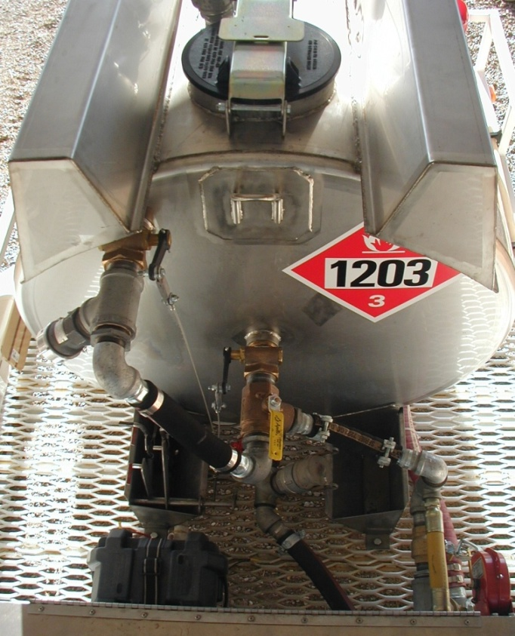
Batch Mixing System
Simplex batch mixer
FireCon batch mixer

Slide 9
General Mixing System Maintenance
Batch mixers that meet MC306 or DOT 406 design specs must comply with DOT regulations.
Annual visual inspection by DOT certified inspector.
Hydrostatic pressure test every 5 years by a DOT certified inspector.
Maintain trailer brakes, wheel bearings, electrical system, engine oil, air filter, spark arrestor, and general integrity of the unit.

Slide 10
Batch Mixer Maintenance
Keep 2” male plugs in place when not in use.
Store hoses out of sunlight.
Use fuel stabilizer in gasoline tanks of pump when stored for more than 2 weeks.
Where 2” dry break attaches to tank, coat with gasoline pipe dope.

Slide 11
Before storing, wash inside of tank and hoses with clean diesel.
Leave 3-5 gallons of diesel in tank to keep parts lubricated while storing.
Disarm emergency release controls on DOT 406 or 306 tanks before storing or transporting.
Turn off all valves prior to mobilization or storing the batch mixer.

Slide 12
Mix Transfer Maintenance
Store hoses out of sunlight.
Keep 2” male plugs in place when not using.
Use fuel stabilizer in gasoline tanks of transfer pump when stored for more than 2 weeks.
Where sight glasses, 2” camlock , dry break parts attach to barrel/ drum coat threads with gasoline type pipe dope.
Before storing flush barrel/drums with clean diesel or clean barrel by removing drum lid and wiping barrel clean.
Leave a small amount of clean diesel in hoses and barrels before storing.

Slide 13
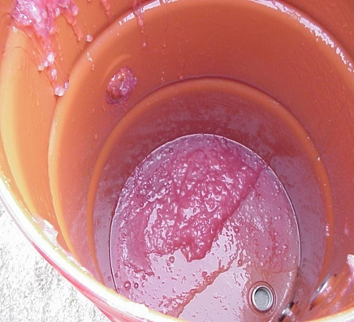
Drum Maintenace
Keep drum purged of gelled fuel.
Paint as needed to prevent rust.
Store in clean, dry environment.
Keep dry break valve clean of dirt & debris.
Keep Clay & Bailey, site glasses and cam-locks free of gel residue.

Slide 14
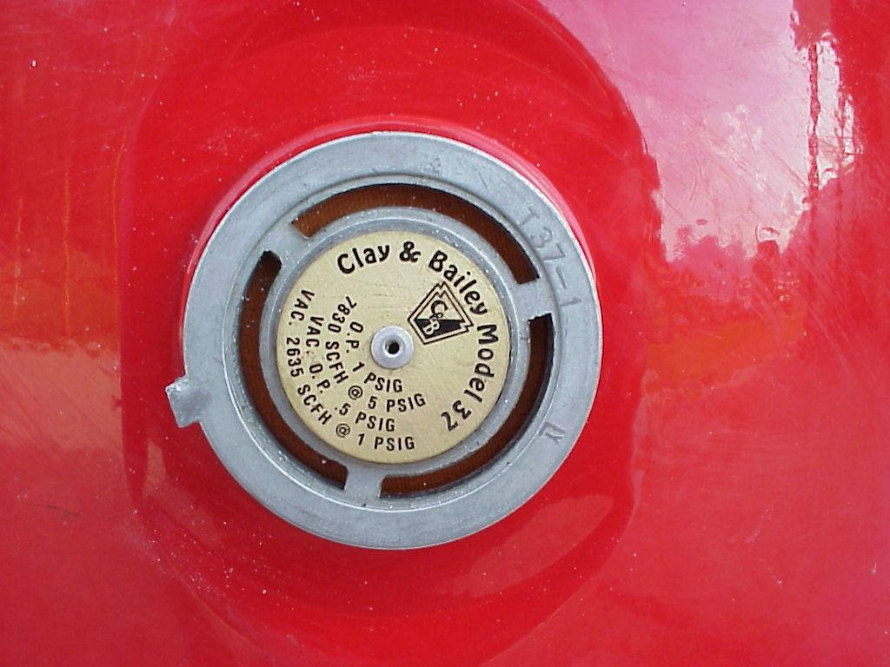
Associated Hardware Troubleshooting -
If gel makes contact with venting marble un-equalized pressure may occur, causing the motor to drag and pop circuit breaker of helicopter.

Slide 15
Associated Hardware Troubleshooting -
2” female cam-lock with Clay & Bailey inserted for more clearance

Slide 16
Vapor Hose Maintenance
Store hoses in dry location away from sunlight.
Keep 2” cam-lock on hose while being stored.
Perform continuity test.
Replace brittle/cracked hoses.
Clean all vapor recovery hoses of any gel residue.

Slide 17
Mixing Agents
Keep all gelling agents in a cool non-freezable dry storage area.
Ensure MSDS requirements are met.

Slide 18
Helitorch Troubleshooting
Problem:
circuit breakers on helicopter stay tripped open
Solution may include the following:
Check polarity of plug between helicopter and torch
Check for electrical shorts in wiring
Check motor for short
Check Clay & Bailey
Notes:
Instructor Hand out “Helitorch troubleshooting List” to students (Instructor Syllabus Unit 5 pages 5 & 6)

Slide 19
Helitorch Troubleshooting Tip-
Before testing helitorch with the helicopter, disconnect pear-link from the aircraft cargo hook. Failure to follow this procedure can result in damage to the helicopter wiring if polarity is incorrect.

Slide 20
Problem:
No spark from igniter
Solution may include the following:
Check igniter switch
Check electrical connection from helicopter
Check vibrator (Simplex & Spec 2000)
Check coil & coil wiring (Simplex & Spec 2000)
Check wire connection on igniter rod (Spec 2000)

Slide 21
Problem:
Propane does not light
(Simplex, Isoliar, and Barrel torches)
Solution may include the following:
Check propane quantity and pressure gauge
Check that solenoid valve is opening
Check for plugged propane torch orifice
Replace propane bottle
Ensure propane torch tip slit is in line with the ignition rod

Slide 22
Problem:
No gel being pumped
Solution may be one of the following:
Check pump switch
Make sure valves are open
Check pump for obstructions
Check hose for obstructions
Check thickness of gelCheck motor and drive belt (Simplex).
Pump pulley turning in correct direction (Simplex).
Helicopter or 9 pin plug on the helitorch is wired backwards, polarity is wrong (Check the helitorch first).

Slide 23
No Ignition?
Notes:
Instructor should test what the students have just learned by providing a scenario that would require troubleshooting

Slide 24
Unit Objectives
Identify three primary steps in bench testing a helitorch.
Identify six considerations in maintaining helitorch and mixing systems.
Given a typical problem encountered during helitorch operations, troubleshoot potential solutions.

