Slide 1
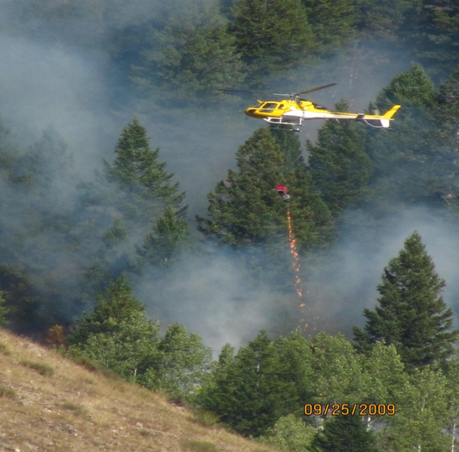
Unit 6
Helitorch Operations/Exercises

Slide 2
Unit Objectives
Identify four considerations when choosing a helitorch site.
Given the proper equipment, demonstrate ability to connect helitorch to helicopter.
Given the necessary forms, go through the appropriate checks required before each operational period.
Identify six steps associated with filling the helitorch.

Slide 3
Helitorch Site Considerations
Helitorch site large enough to safely accommodate all necessary equipment.
Establish clear approach and departure paths
Over flight of personnel, vehicle traffic and structures are not allowed.
Maintain safety circle.
Consider proximity to burn site.
Consider impacts from smoke/embers.

Slide 4
Accessibility for bulk fuel vehicles.
Establish alternate landing area.
Separation of helitorch operations from helibase.
Establish escape routes and safety zones for personnel & equipment in the event of an escaped fire.
Consider dust abatement needs.

Slide 5
Helitorch Installation Procedures
Complete the helitorch check lists.
Place helitorch in front of ship with nozzle tip to the pilot’s side.
Make sure switches are in the off position.
Layout suspension system under helicopter between skids.
Assure suspension system attachment point is configured for cargo hook, DO NOT hook up suspension system until test completed.

Slide 6
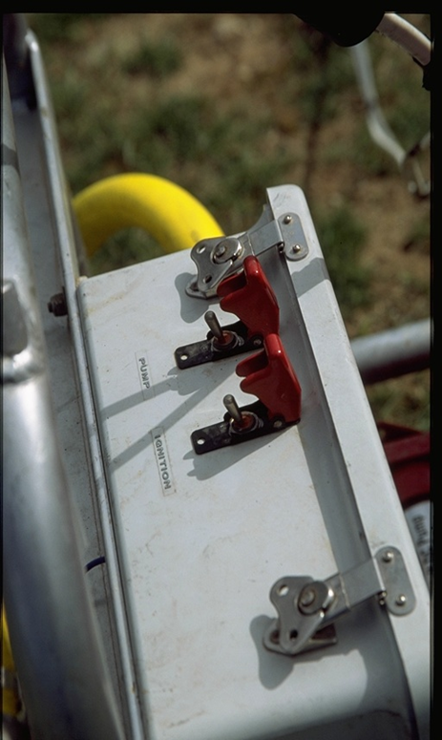
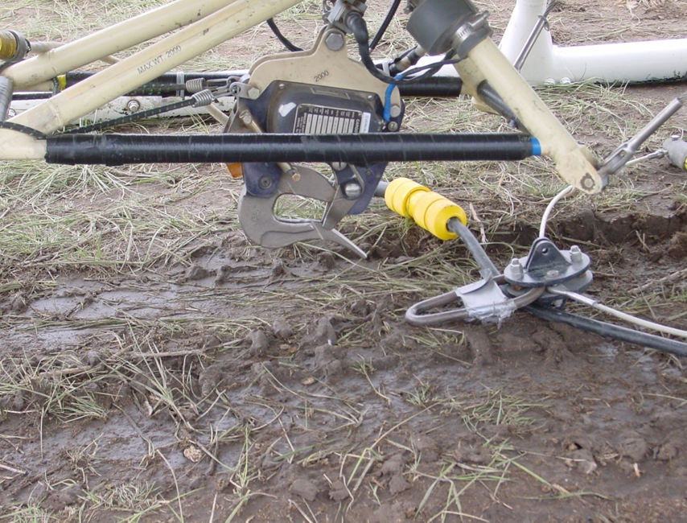
Connect the 9 pin plug only

Slide 7
Install propane bottle (if applicable) and adjust pressure (7-10 psi while activated).
Have pilot activate helicopter electrical power to helitorch.
Test electrical and pump systems.
Do a manual and electrical test of cargo hook release.
Attach suspension system to helicopter cargo hook.

Slide 8
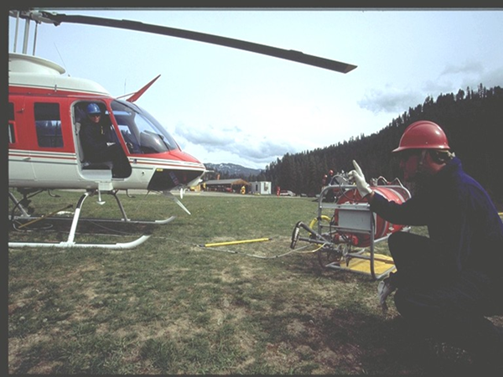
Helicopter – Helitorch Test

Slide 9
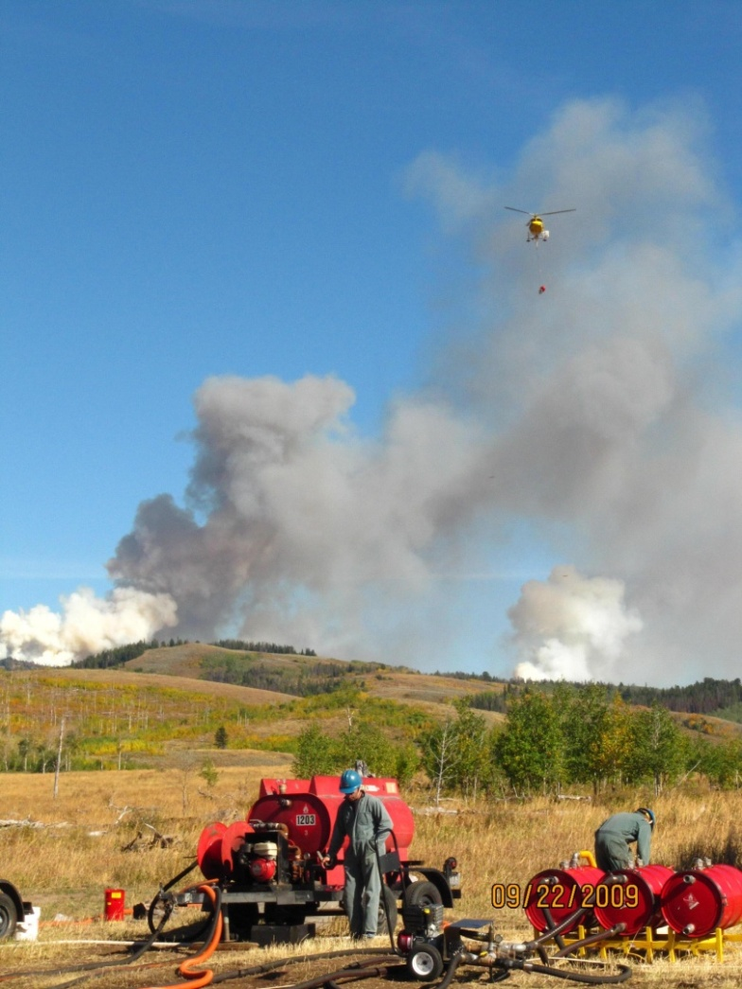
Torch Base Operations
Mixing Area

Slide 10
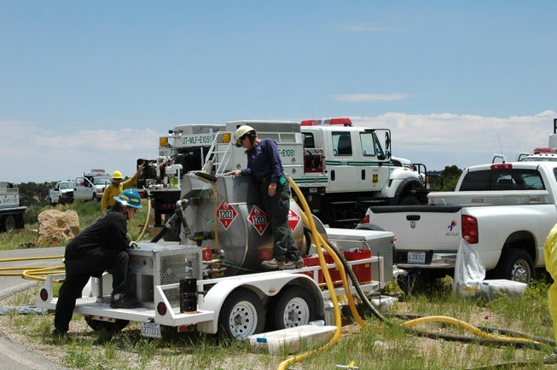
Above: Helitorch Mixmaster and initial recon of unit with Burn Boss/Firing Boss.
Below: Helitorch mixing personnel with Fire Protection personnel in background.

Slide 11
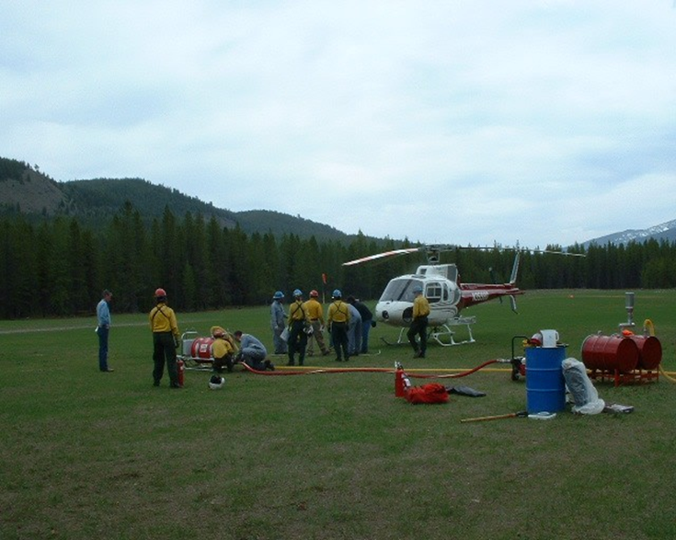
Helitorch Mixmaster and Trainees at mix transfer site

Slide 12
Mixing Area
Located outside of the helicopter safety circle.
During the mixing operation fire protection will be on-site.
Restricted to helitorch personnel only.
No smoking within 50 feet of any operation on the helitorch base, including the vapor removal discharge hose outlets.
Precautions must be taken to eliminate sources of ignition.

Slide 13
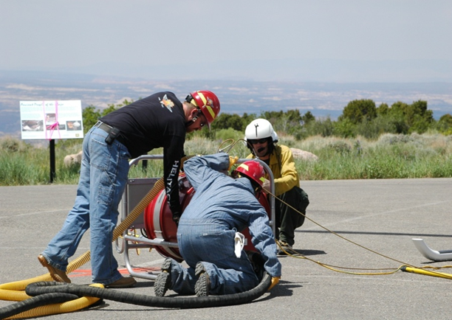
Above: Gel burn blanket and 3lbs Trimax extinguisher.
Below: Looking through site glasses while filling barrel.

Slide 14
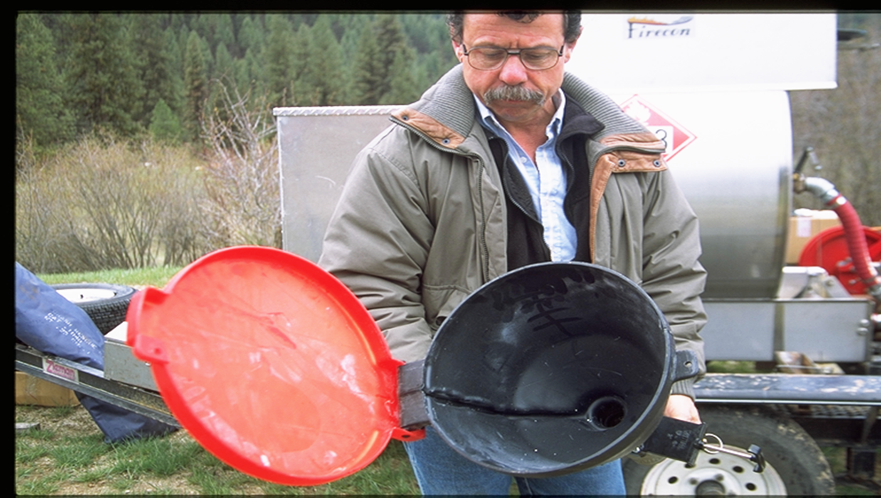
Avoid Static Electricity
NO PLASTIC of any kind should be used in mixing powder gelling operations.

Slide 15
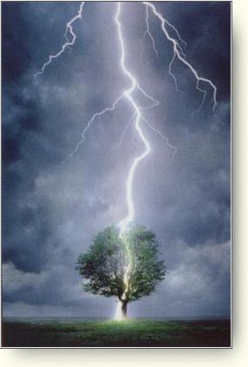
Bonding Sequence

Slide 16
Bond to bulk fuel source

Slide 17
Bonding Mixing Systems, Helitorch & Bulk Fuel Source
Connect bonding cable from bulk fuel nozzle to the mixing system or a common bonding point
Connect vapor removal hose
Open fueling port and begin fueling
When fueled remove nozzle, close port
Remove bonding cable
Note: The goal is to provide bonding continuity

Slide 18
Helitorch Filling Procedures
Parking Tender marshals helicopter to filling pad
Parking Tender/Mixmaster ensures helitorch switches are turned off
Parking Tender is positioned between torch and helicopter with fire extinguisher
Notes:
Note: Post a pad marker for a target for the pilot to place the torch to assure hoses will reach each time

Slide 19
1. Connect vapor recovery hose.
2. Connect fuel transfer hose.
3. After filling disconnect fuel transfer hose.
4. Remove vapor recovery hose.

Slide 20
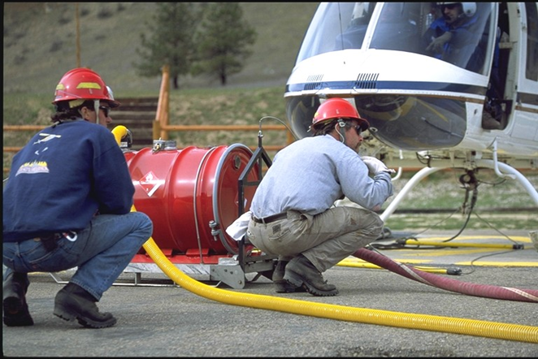
Helitorch Filling Procedures
Mixmaster turns on helitorch ignition and pump switches.
Parking Tender ensures switches are turned on and completes visual inspection.
Parking Tender marshals helicopter off filling pad.

Slide 21
Helitorch Filling Visual Inspection
Suspension and frame visual check
Cam lock caps secured
Visual check of Drum straps
Propane pressure check (if applicable)
Dry break valve open (duct taped open)
Ignition and tip components properly adjusted & cleaned
Notes:
Note: Recommend using duct tape to prevent inadvertent closure of valve on helitorch. Propane bottle typically lasts three to six drums/loads.
Replace before it becomes empty during flight (usually after fourth trip).

Slide 22
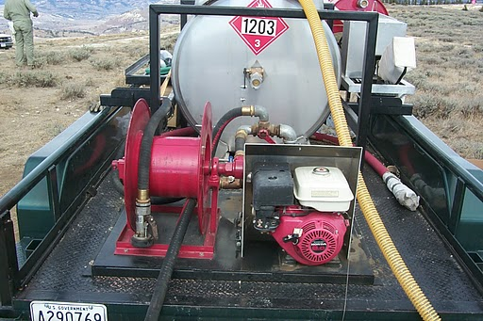
Mixing Systems

Slide 23
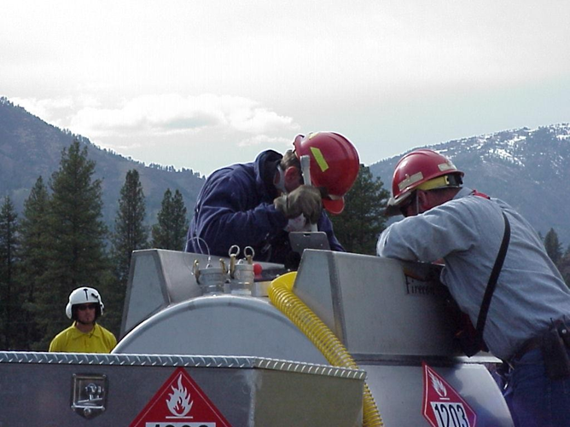
Mixing Systems

Slide 24
PAY ATTENTION !!

Slide 25
Unit Objectives
Identify four considerations when choosing a helitorch site.
Given the proper equipment, demonstrate ability to connect helitorch to helicopter.
Given the necessary forms, go through the appropriate checks required before each operational period.
Identify six steps associated with filing the helitorch.

