Slide 1
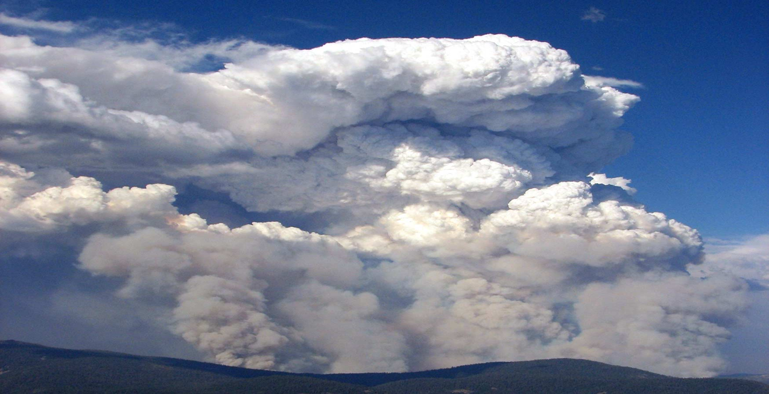
Unit 7
Fuels and Fire Behavior

Slide 2
Unit Objectives
Identify key elements of the fire environment:
Fuels
Weather
Topography
Fire behavior

Slide 3
Pre-burn Reconnaissance Fuels
Targeted participants:
- Pilot
- Burn Boss/Firing Boss
A thorough recon of the burn area and a discussion of the burn objectives are essential to a successful firing operation
Fire environment elements to consider during the recon include:
Fuel type and loading
Fuel moisture
Chemical properties
Fuel size, shape and compactness
Vertical arrangement and horizontal continuity

Slide 4
Pre-burn Reconnaissance Weather Factors
Temperature
Relative humidity
Inversions
Wind
- Direction
- Speed
- Duration
- Local influences
Recent and expected precipitation

Slide 5
Pre-burn Reconnaissance Topography
Slope
Aspect
Elevation
Local influences
- Canyon
- Lakes
- Mountains
- Glaciers

Slide 6
Pre-burn Reconnaissance Fire Behavior
Fire types
- Surface
- Crown
Fire growth characteristics
- Head fires
- Backing fires
- Flank fires

Slide 8
Aerial Firing Ignition Patterns
Strip-head
Spot
Chevron
Center
Backing fire
Or a combination of the above

Slide 9
Fire Interaction
Fuels, weather, topography, fire behavior, and ignition patterns all interact to create fire effects.
Adjustments to firing patterns can be made to produce fire effects that will meet burn objective.

Slide 10
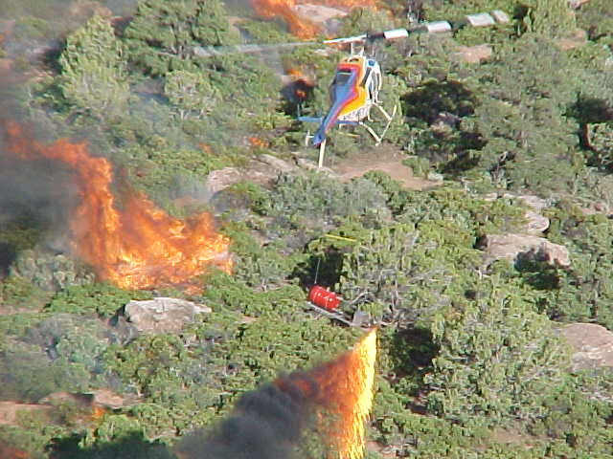

Slide 11
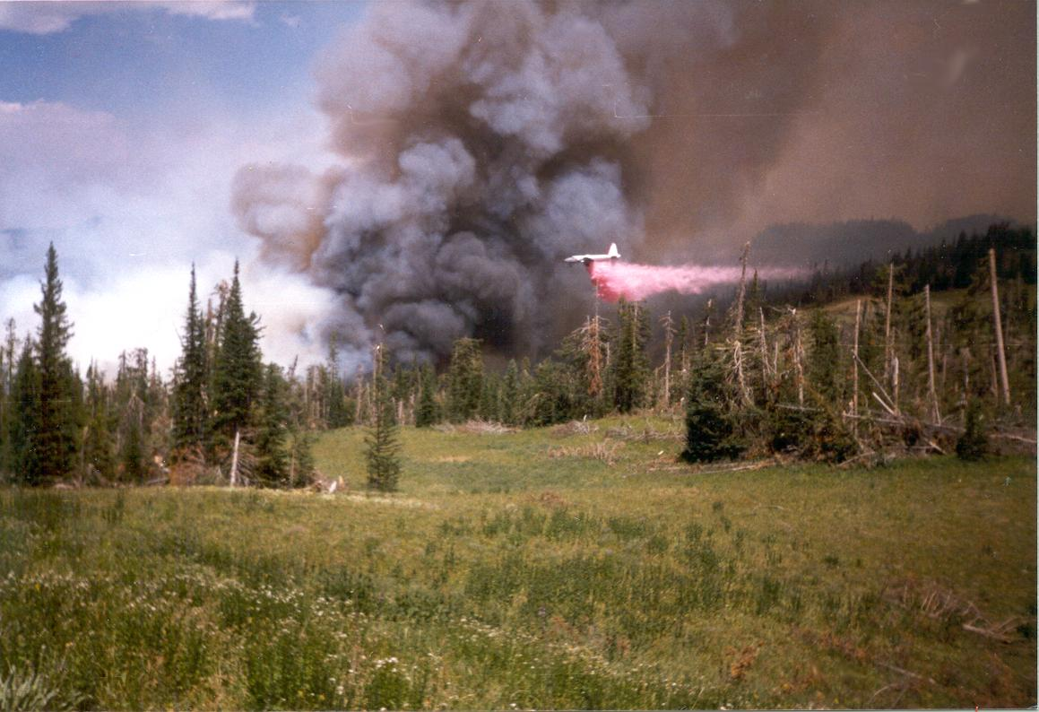

Slide 12
Unit Objectives
Identify key elements of the fire environment:
Fuels
Weather
Topography
Fire behavior

