Slide 1
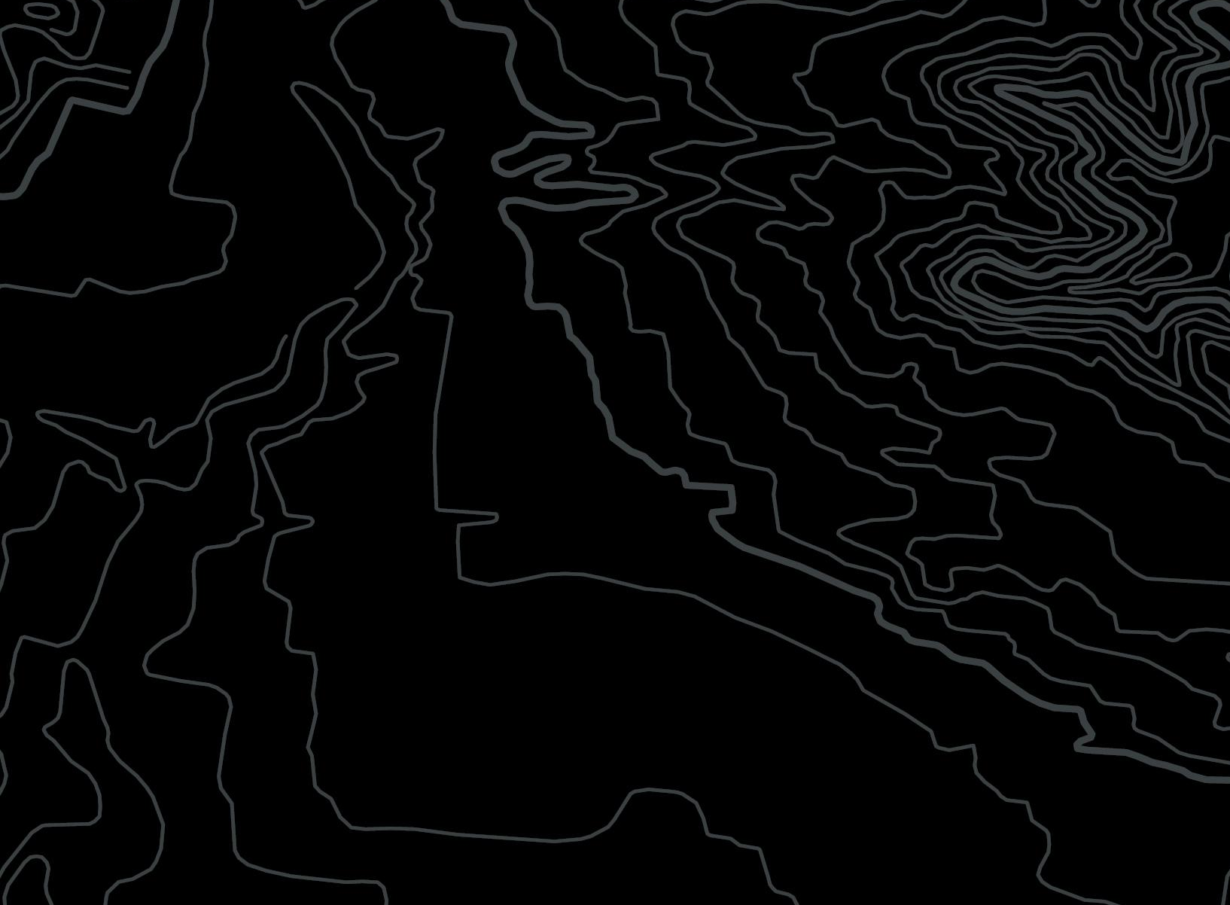


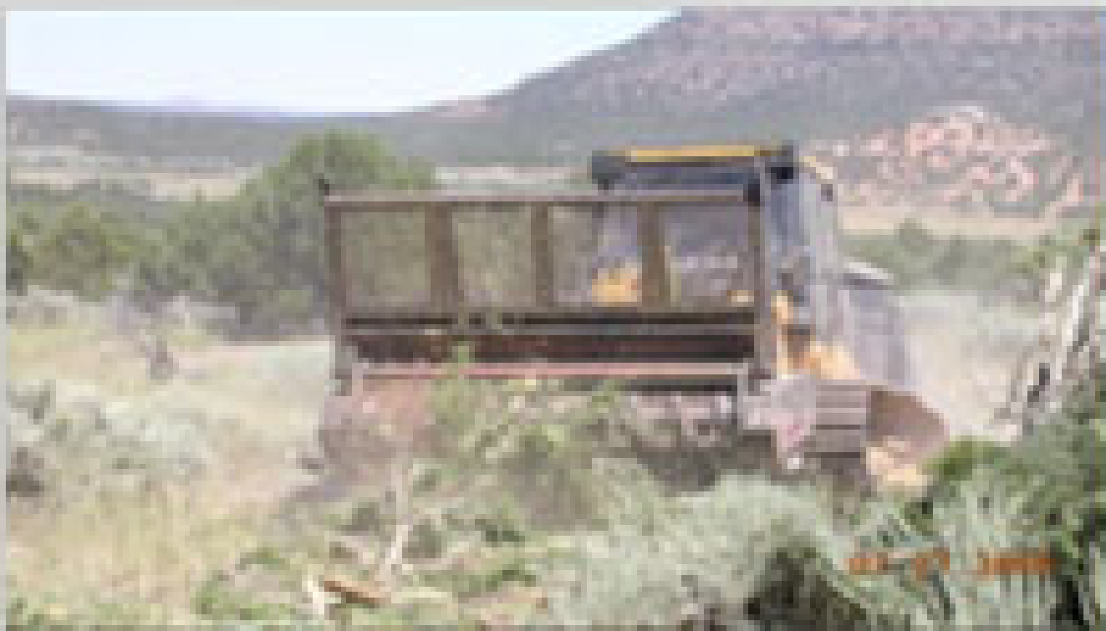
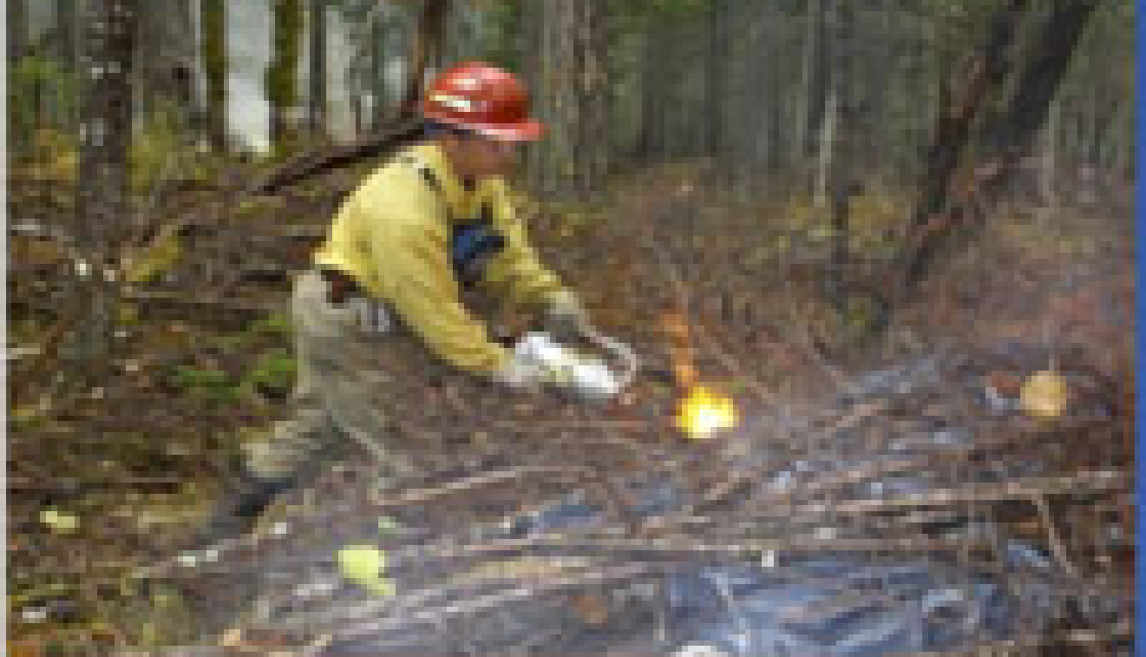
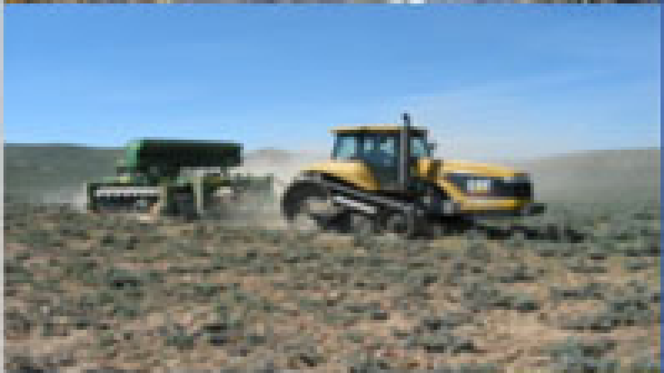
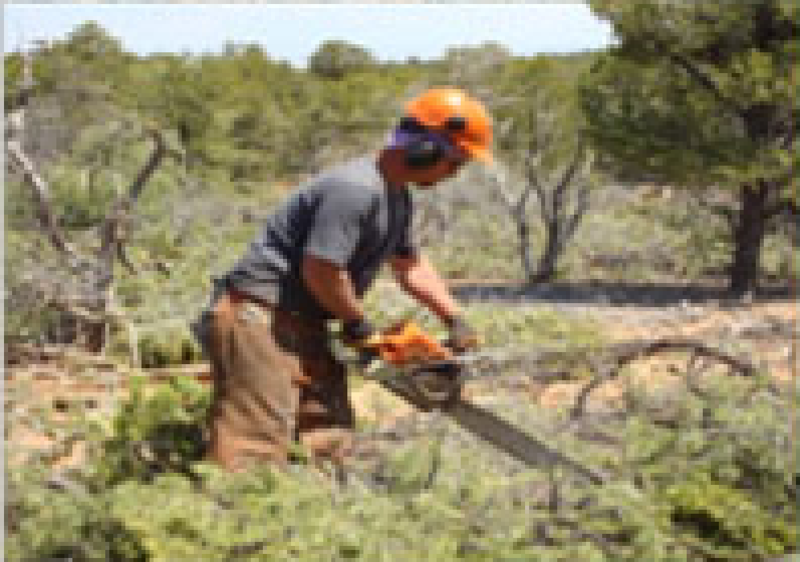
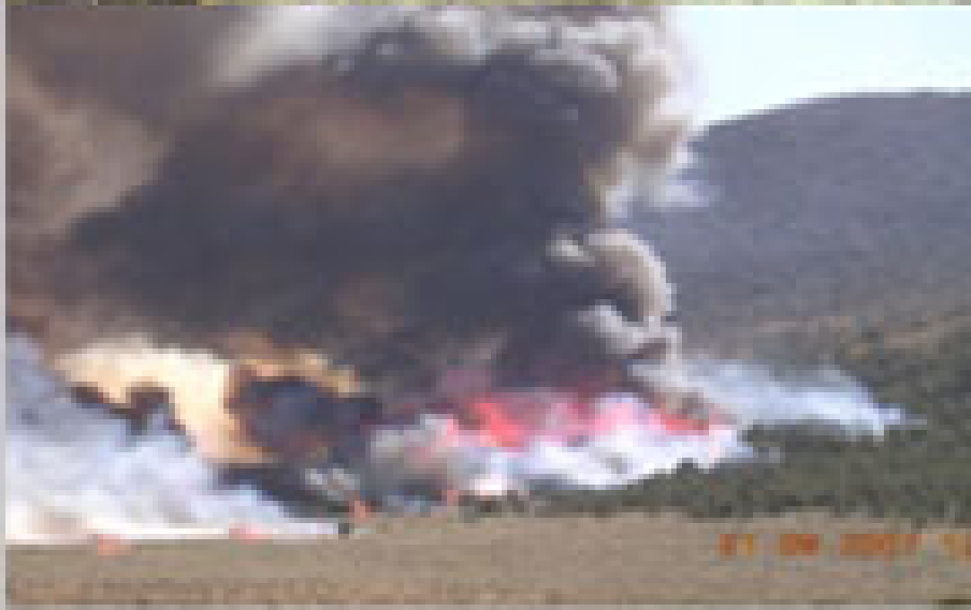
Examples of Mechanical Items
Fuels Management Contract Tasks
The following slides provide visual examples of Fuels Management contracting tasks and equipment used. They are meant to provide just a few visual descriptions of the type of treatments and equipment used to complete BLM fuels reduction. The descriptions are not inclusive. Contract and Contract Task orders may identify specific types of machinery, techniques or operational specifications.

Slide 2
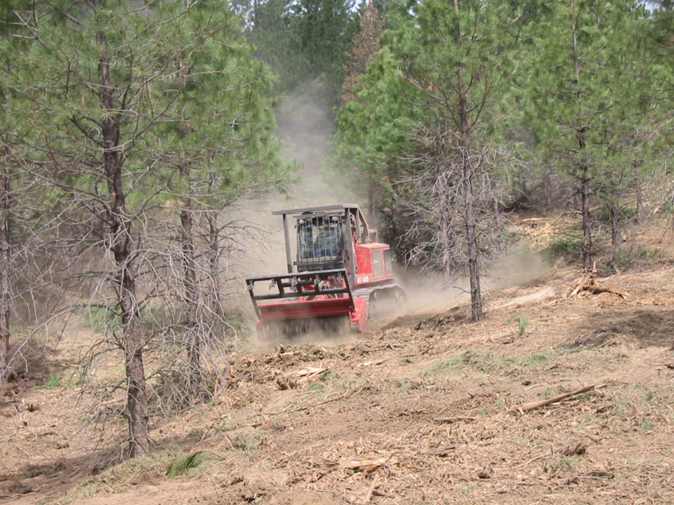
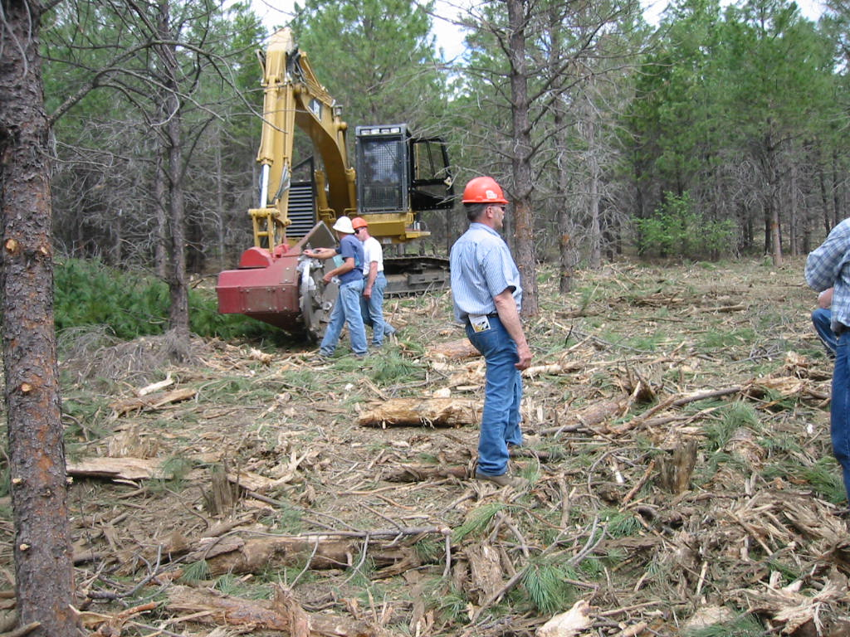
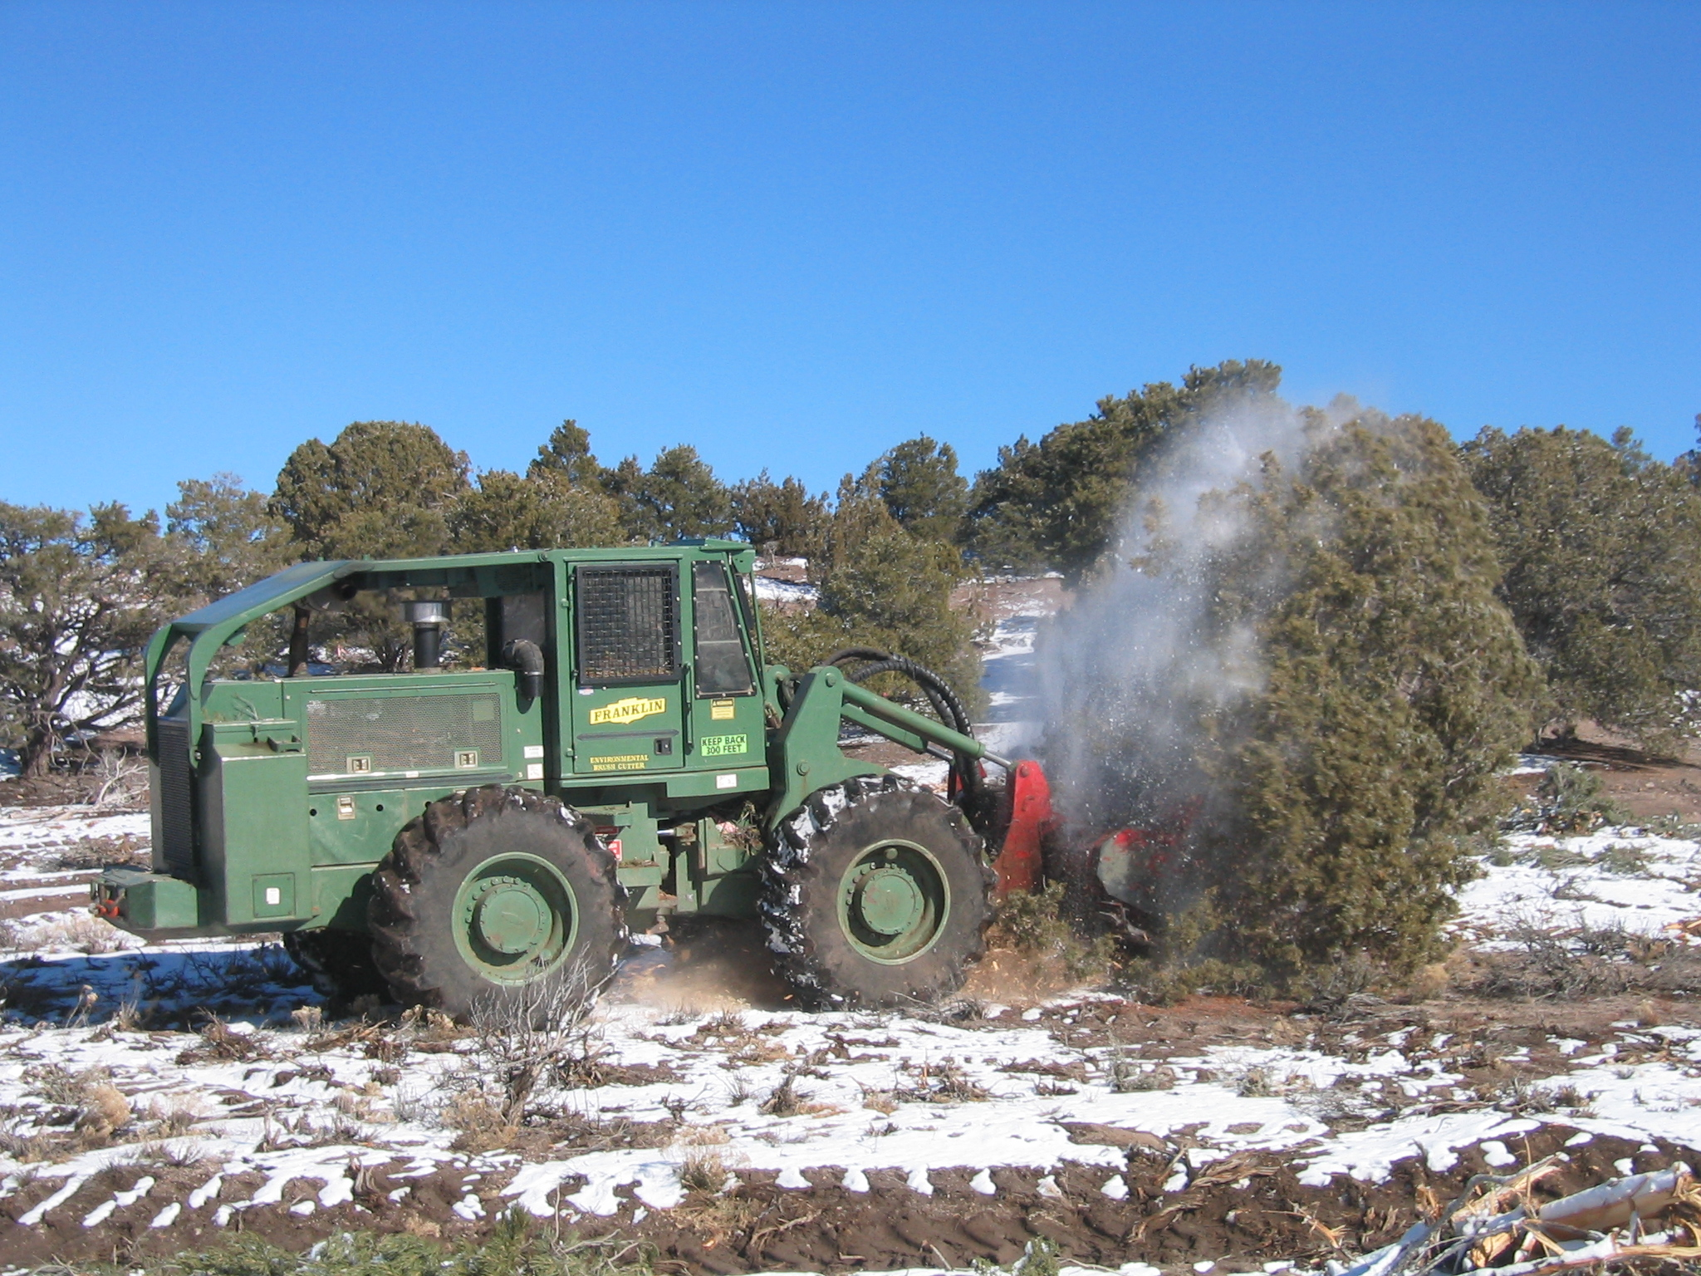
General Mastication
Examples of Mechanical Items
Notes:
Grinding/shredding of material by Contract/Task Order specified equipment with a minimum head lift height of 12.5 feet. Either tracked or wheeled machines may be used and will be specified in the Task Order. The level of difficulty is based on the total percent cover of material to be treated and slope.

Slide 3
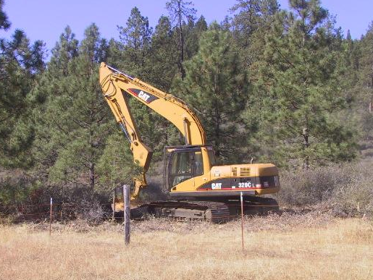

Mechanical Thinning with Created Openings-
Examples of Mechanical Items
Notes:
Masticate all trees, leaving islands and stringers for wildlife corridors. Selection of leave areas will be coordinated with the COR to leave “natural” appearance of stringers and islands throughout the project area. Steep or rocky outcrops may be incorporated into the leave areas. The level of difficulty for thinning with created openings is determined by Contract/Task Order.

Slide 4
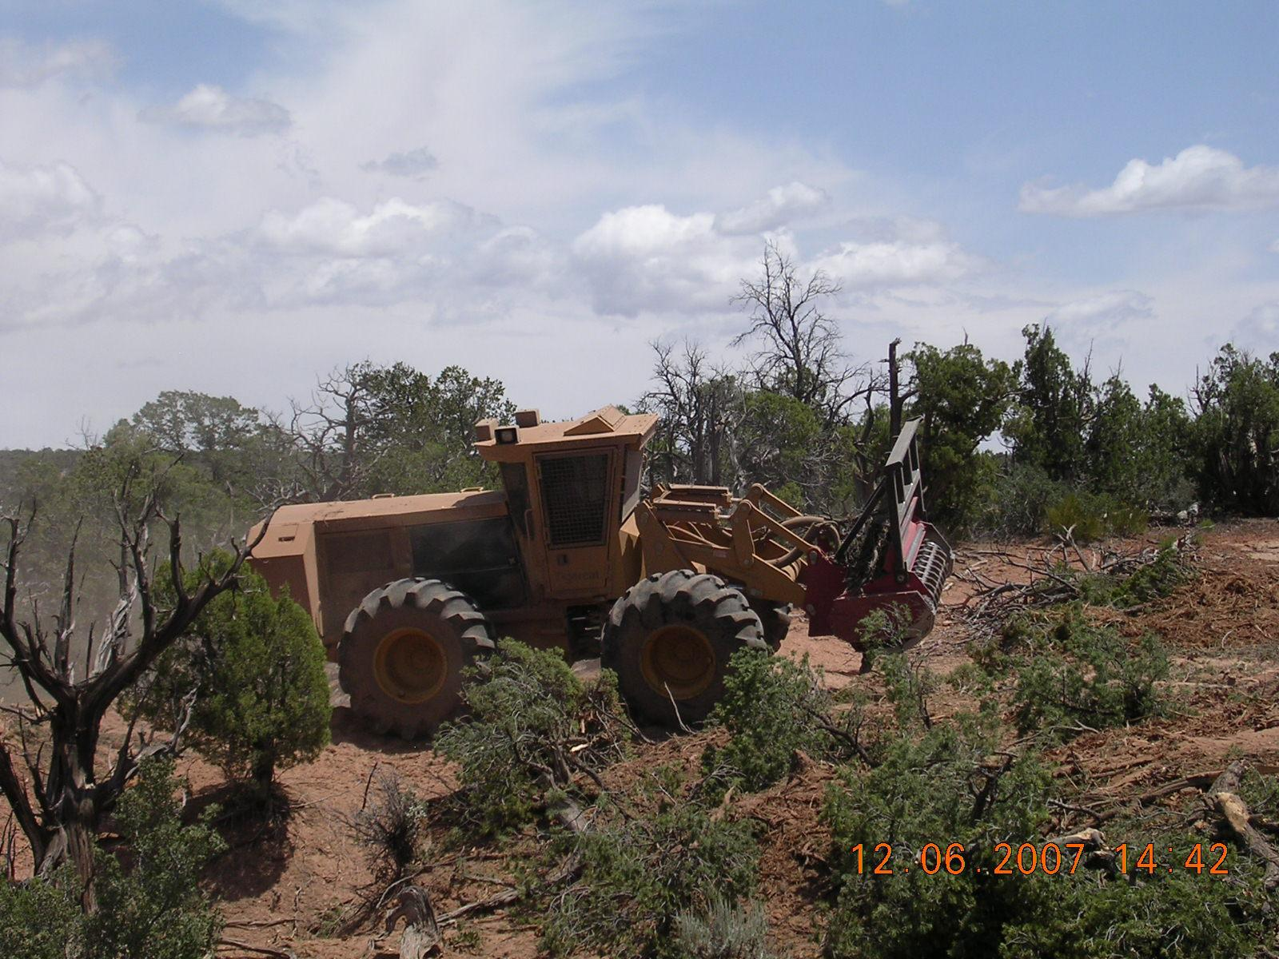
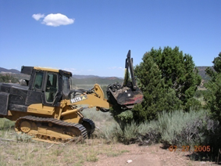
Mechanical Woodland Maintenance
Examples of Mechanical Items
Notes:
Mastication thinning and or grinding of Juniper woodlands, hardwoods and shrubs. The level of difficulty for woodland maintenance is determined by the Contract/Task Order.

Slide 5
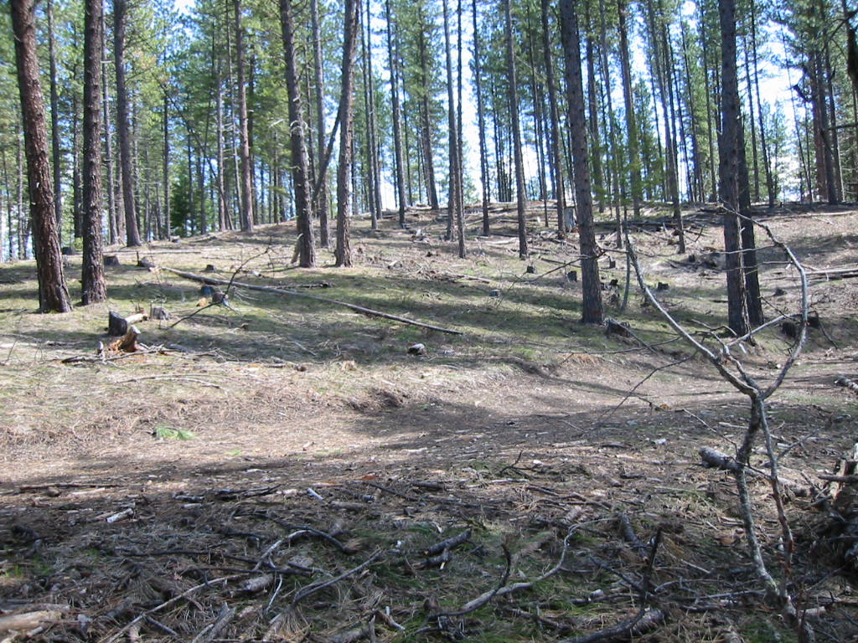
Mechanical Plantation Maintenance
Example of completed thinning
Notes:
Thinning of selected trees and hardwoods by mechanical means (mastication, severing, other). The level of difficulty for plantation maintenance is determined by the Contract/Task Order.

Slide 6
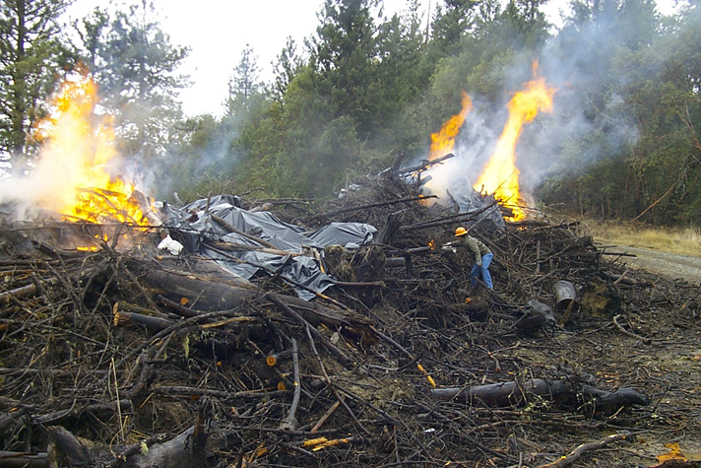
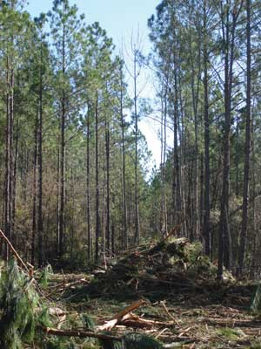
Piling
Examples of Mechanical Items
Notes:
Piling of already down woody material is determined by the Task Order. The level is based on the unit density or amount of the material to be piled and slope. Specific equipment requirements shall be specified in the Task Order. Does not include burning the piles. The picture is for information purpose only.

Slide 7
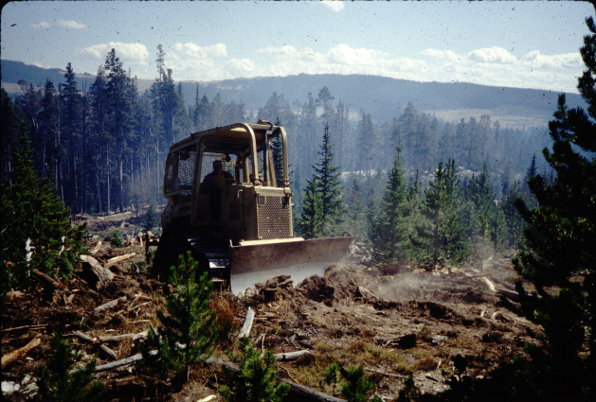
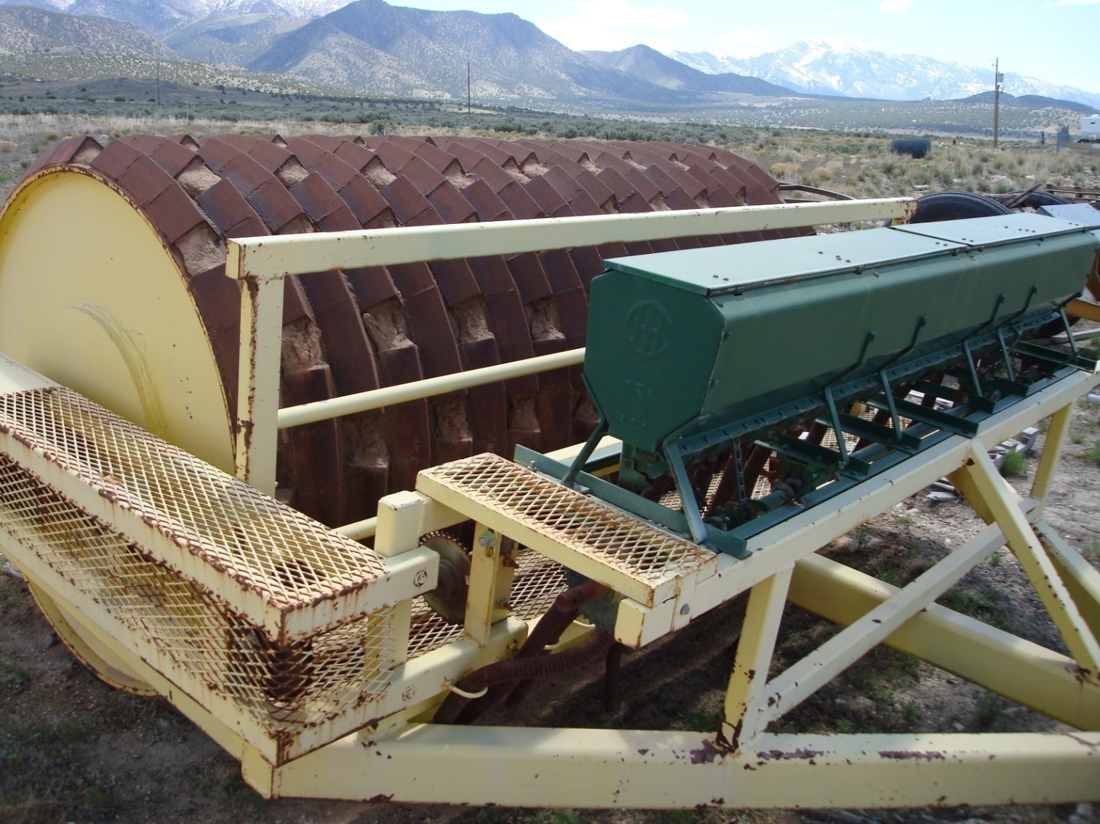
Slash Crushing
Examples of Mechanical Items
Notes:
The level of difficulty and equipment requirements for crushing are determined by the Task Order. Material to be treated by crushing may be alive or dead standing, as stated in the Task Order. Individual species may be specified as reserved from crushing on individual units.

Slide 8
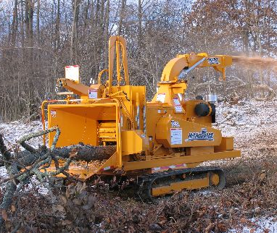
Mechanical Fuels Treatment: Chipping
Examples of Mechanical Items
Notes:
Mechanically chip all slash and brush including any cut vegetation or existing natural (dead and down) woody debris. The level of difficulty for chipping is determined by the Task Order. The level is based on the total percent cover of material to be chipped and slope. Chipping shall occur at the location of the material to be treated and by equipment specified in the Contract/Task Order.

Slide 9
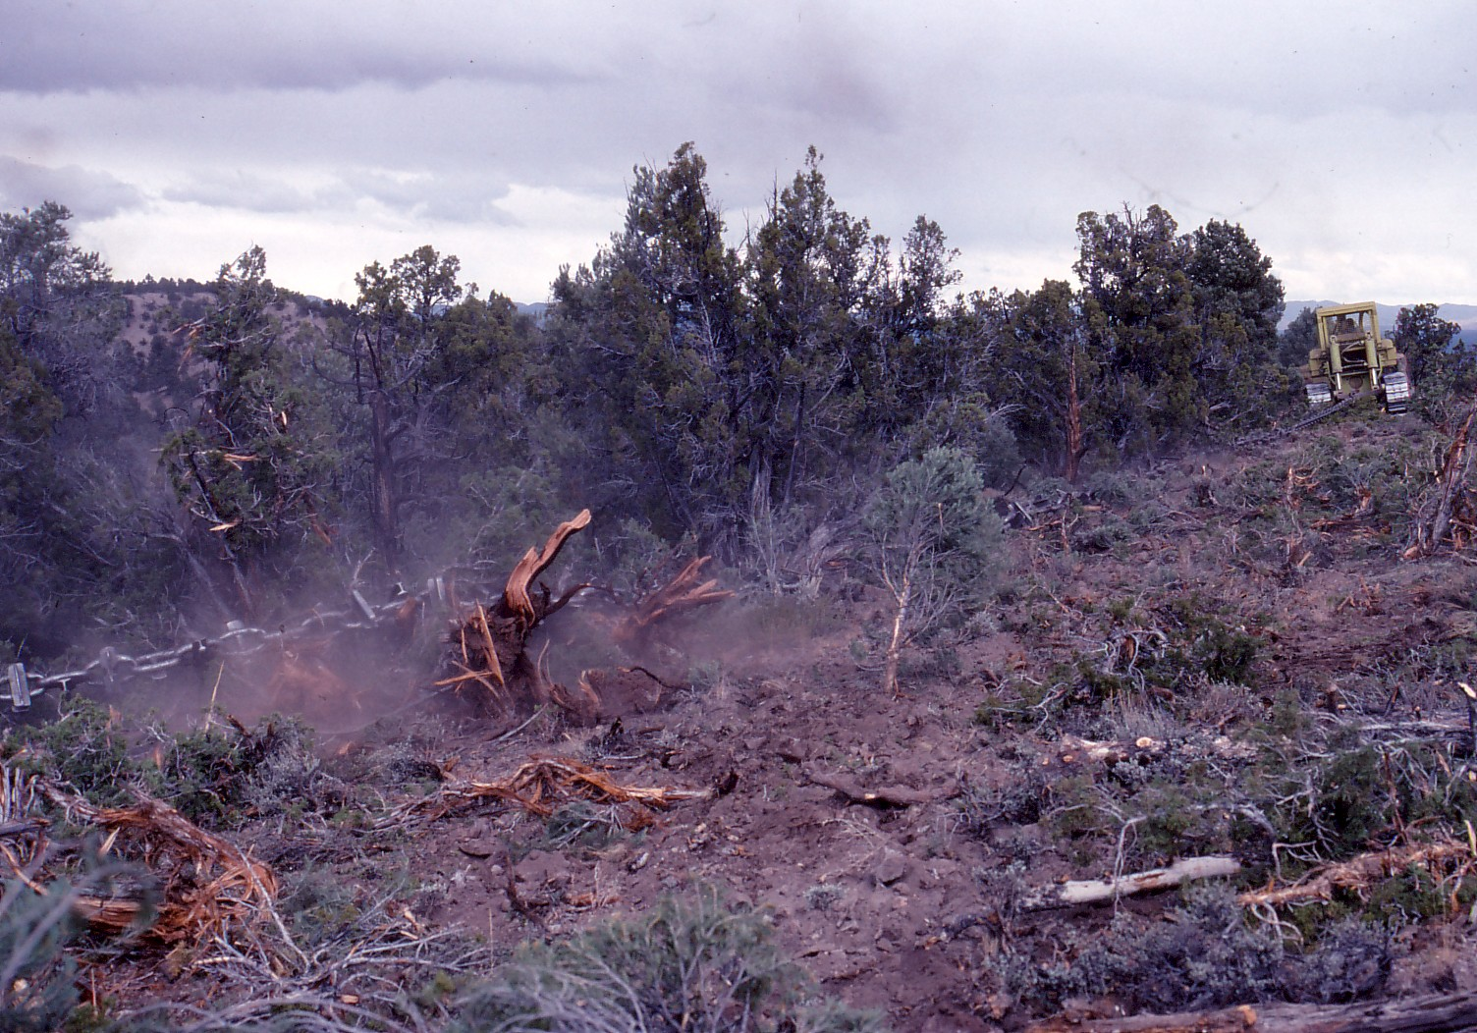
Mechanical Fuels Treatment: Chaining
Examples of Mechanical Items
Notes:
The two tractors shall operate as a unit with one on each end of the chain. The tractors shall generally be operated parallel to each other, in an offset, or “J” pattern, although there may be occasions when a "seesaw" type operation shall be necessary. Dribblers may be required for seeding/dispersing seed. Seeding of some shrub species may be required simultaneously during chaining. The dribblers and seed shall be furnished by the Government, and will need to be mounted on the Tractor/Dozer and operated to disperse 1-3 LBS/acre. The total dribblers to be mounted on the tractor/dozer and seeding rate would be specified in the task order. Example: Seed dribblers (two on each dozer) shall be attached to the dozers on the second pass to disperse bitterbrush seed at a rate of approximately 1 pound per acre. The contractor shall ensure the dribblers are working and maintain sufficient seed in the dribblers.
When working on the contour, the tractors shall stay close enough together to maintain the chain configuration specified. The chain shall not be permitted to straighten out between the pulling units. Chain shall not be pulled at a speed in excess of 4 mph. Chains maybe 180 to 500 feet in length with approximate weight of the chain ranging from 15,000 to 30,000 LBS. Chain weight will be specified in the Contract/Task order. Draw bar horsepower of the tractors will be sufficient to pull the chain effectively and will be specified in the Contract/Task Order. The Contract/Task Order will define type of chain (i.e. smooth or Ely Chain (links with railroad iron cross bars welded to the links)). Trees and snags identified in level of difficulty are 12 inches in diameter at the base of the tree.

Slide 10
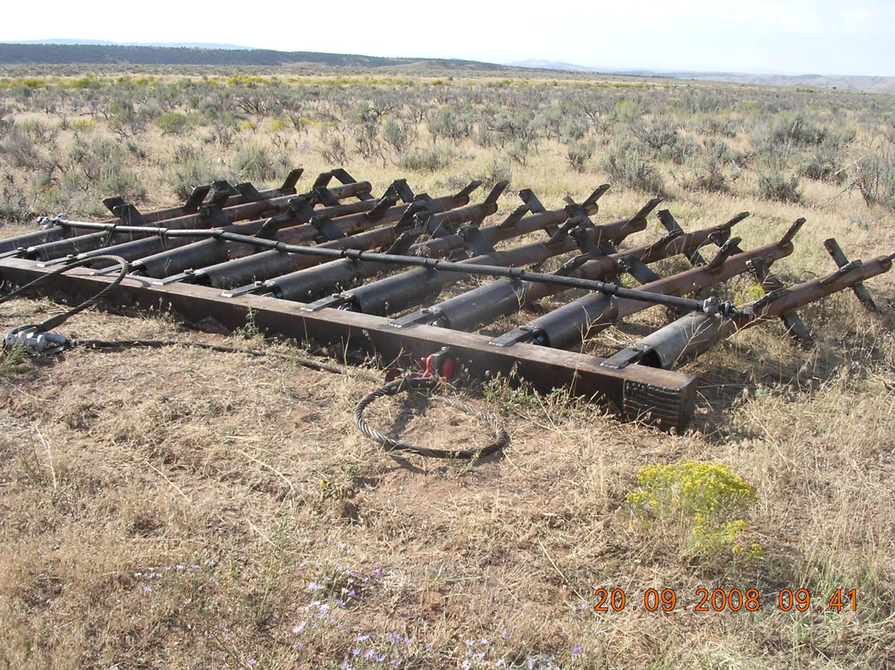
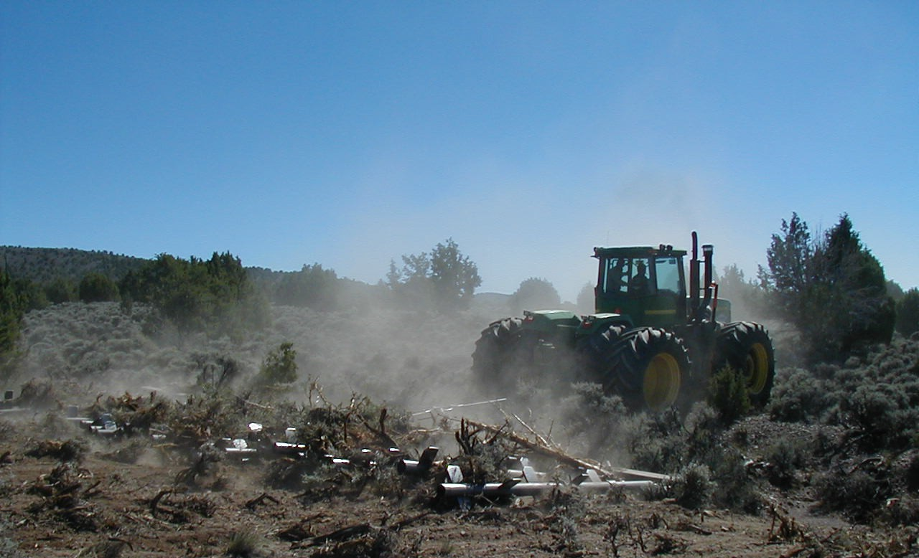
Mechanical Fuels Treatment: Dixie Harrow
Examples of Mechanical Items
Notes:
Using specified equipment (Dixie Harrow or equivalent pulling a 40 foot wide 12,000 lb. harrow), treatment shall be done on the contour where possible to reduce or remove brush. The pipes on the harrow shall be removable/adjustable to allow thinning densities adjustments. Number of applications and direction of treatment shall be specified in the Contract/Task Order. The final resulting cover after treatment will be specified in the Contract/Task order. A broadcast seeder may need to be mounted to the equipment and seed dispersed during application at rates from 3-12 LBS acre. Broad cast seeder need and availability will be identified in the Contract/Task Order. Seed shall be furnished by the Government, and the seeding requirement and specifications shall be specified in the Contract/Task Order.

Slide 11
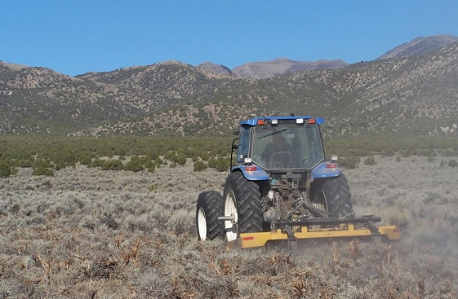
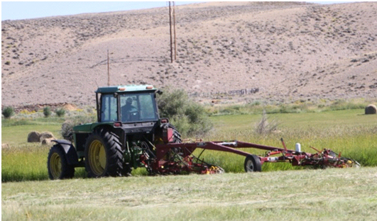
Mowing
Examples of Mechanical Items
Notes:
Mowing of perennial and annual grasses and/or brush by mechanical method. Beating or chopping is also included of brushy vegetation ½ to 3 inches in diameter at the base and up to 3-5 feet in height. Level of difficulty for mowing treatment is determined by the Contract/Task Order.

Slide 12
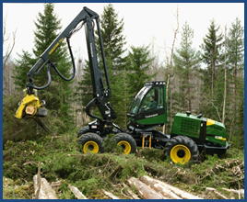
Severing and Piling
Examples of Mechanical Items
Notes:
Use mechanical severing techniques as specified in the Contract/Task Order to sever all trees and brush and pile in determined locations. The level of difficulty for severing is determined by the Contract/Task Order. The level is based on the crown closure and slope of the area to be mechanically severed and piled on slopes.
Specifications for piles (size, spacing etc. may be stipulated.

Slide 13
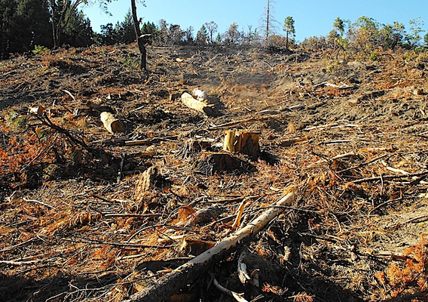
Clear Cut and Scatter
Examples of Mechanical Items
Notes:
Use mechanical cutting techniques as specified in the Contract/Task Order to sever all trees and brush over 2 inches in diameter and scatter it over the area. The level of difficulty is determined by the Task Order. The level is based on the relative amount of the material to be cut.

Slide 14
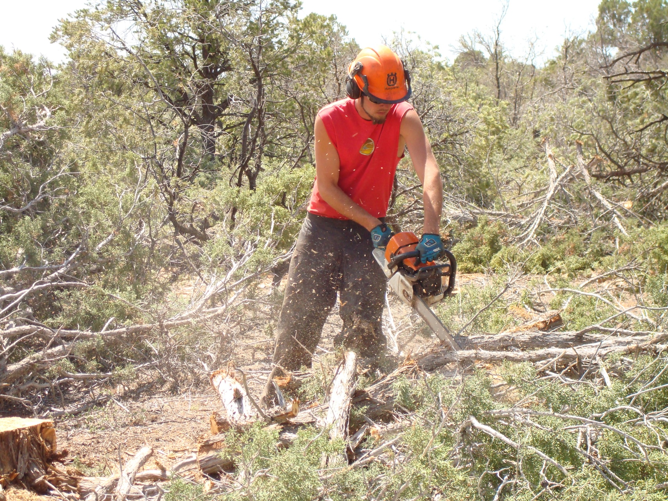
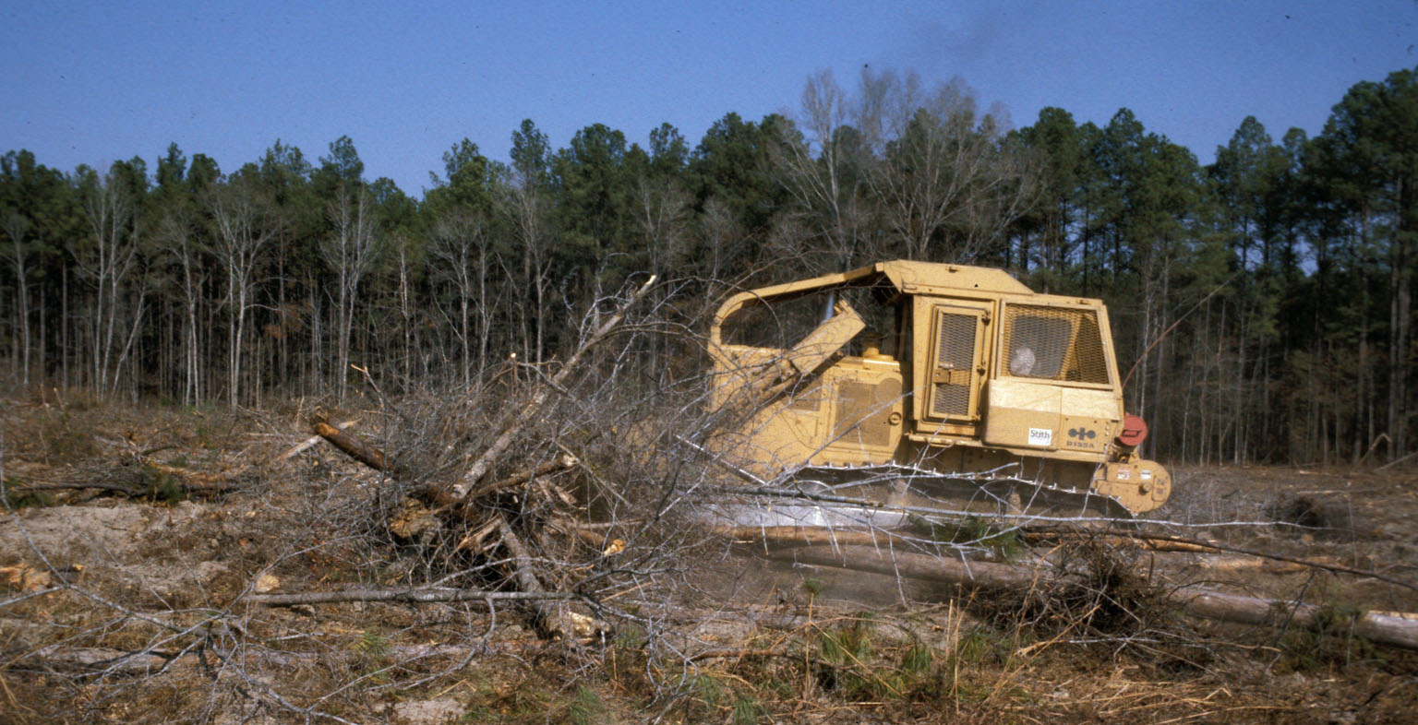
Hand Cutting and Mechanical Piling
Examples of Mechanical Items
Notes:
Hand cutting and mechanical piling of forest and woodlands. The level of difficulty for cutting is determined by the Contract/Task Order. The level is based on the crown closure and slope of the area to be hand cut by power tools and mechanically piled.

Slide 15
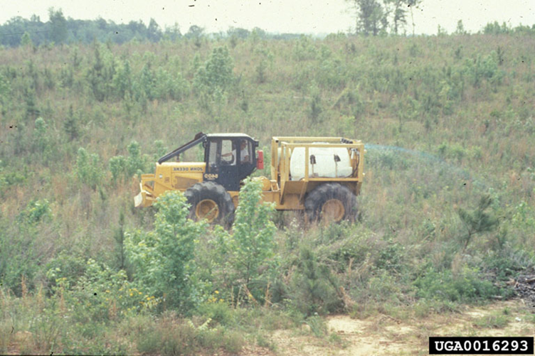
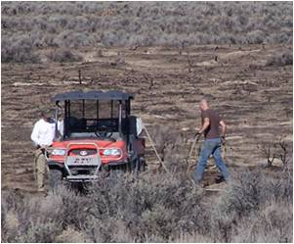
Broadcast Application of Herbicide Item
Examples of Mechanical Items
Notes:
The level of difficulty for broadcast application of herbicide is determined by the Contract/Task Order. The level is based on per acre of treatment and number of treatments. A second application shall only be done if further control is required. Specific application techniques, season of application, herbicide formulations and species to be sprayed shall be outlined in the Task Order. The Government shall provide the herbicide required for the treatment. The Contractor must meet the required State Pesticide Application certification/license requirements and present documentation when bidding on tasks. These certification requirements shall be outlined in the individual Contract/Task Orders.

Slide 16
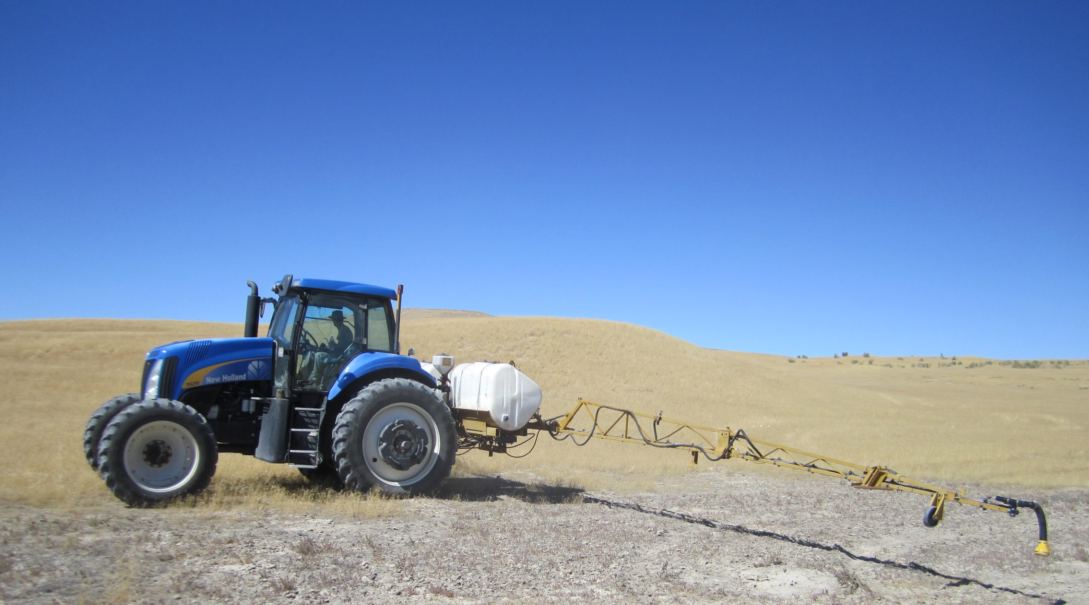
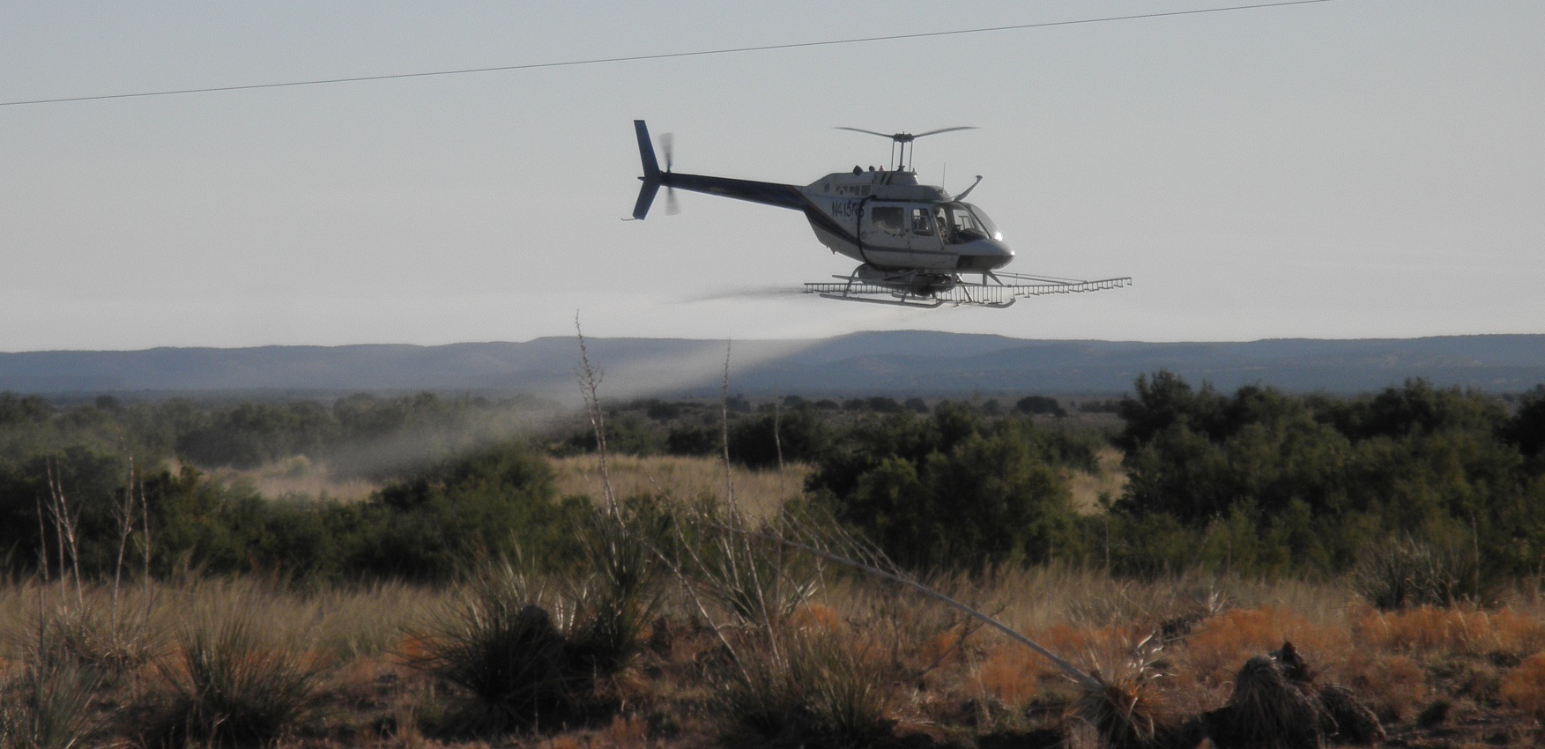
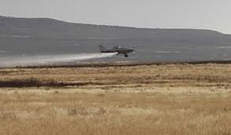
Landscape Level Application of Herbicide
Examples of Mechanical Items
Notes:
The level of difficulty for large scale application of herbicide (approximately 10,000 or more acres) is determined by the Contract/Task Order. The level is based on per acre of treatment and number of treatments. A second application shall only be done if further control is required. Application will be made on large landscape scale over varying flat to rough terrain which will limit some vehicle application. Specific amount per acre, size, season of application, herbicide formulations and species to be sprayed shall be outlined in the Contract/Task Order. Herbicide application equipment type will be determined by the contractor to meet application specifications and terrain requirements. The Government shall provide the herbicide required for the treatment. The Contractor must meet the required State Pesticide Application certification/license requirements and present documentation when bidding on tasks. These certification requirements shall be outlined in the individual Task Orders. The Contractor must comply with all applicable federal, state and local regulations.

Slide 17
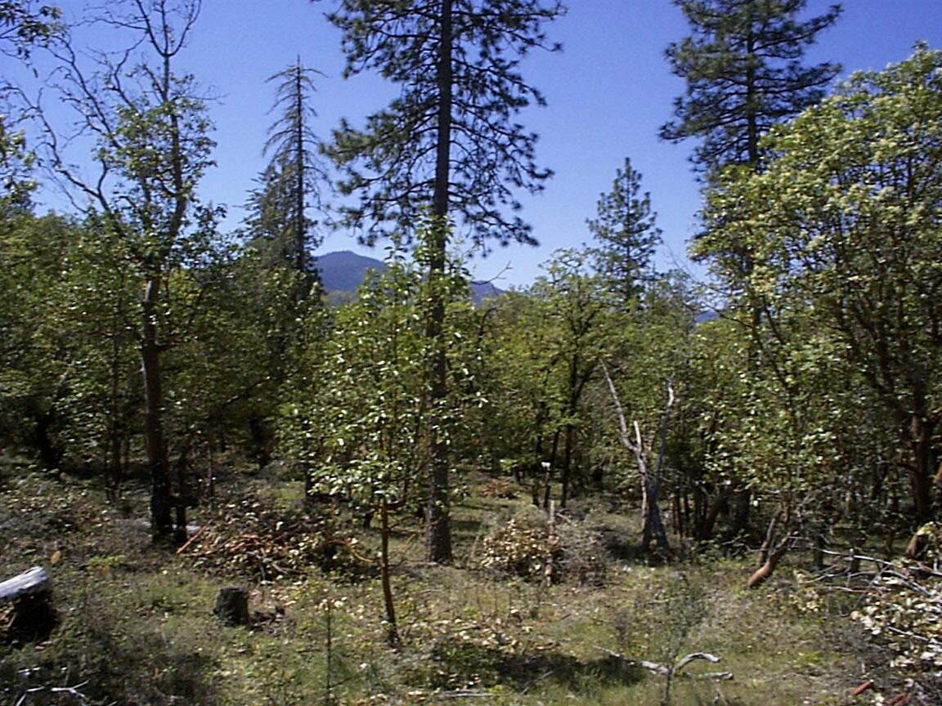
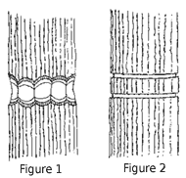
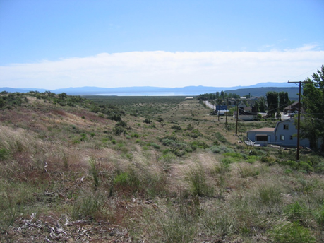
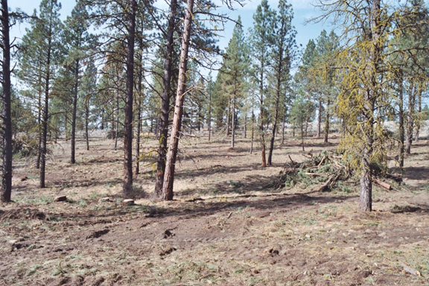
Fuel Modification Zone
Examples of Mechanical Items
Notes:
Fuel modification zones (FMZs) shall be created to reduce adverse wildfire effects, limit rate of spread, and/or establish defensible areas for use during fire suppression activities. Flammable material shall be treated and removed from the surface, understory, and canopy. Treatments required in this sub-item include cutting of trees, slashing of shrubs and small vegetation, girdling, pruning of residual trees, and snag felling. FMZs shall normally be created in whole or portions of stands, along ridgelines, between separate stand and vegetative types, or adjacent to private property. The level of difficulty for FMZs is based on percent cover of material to be treated. Difficulty Level is determined by the Contract/Task Order.

Slide 18
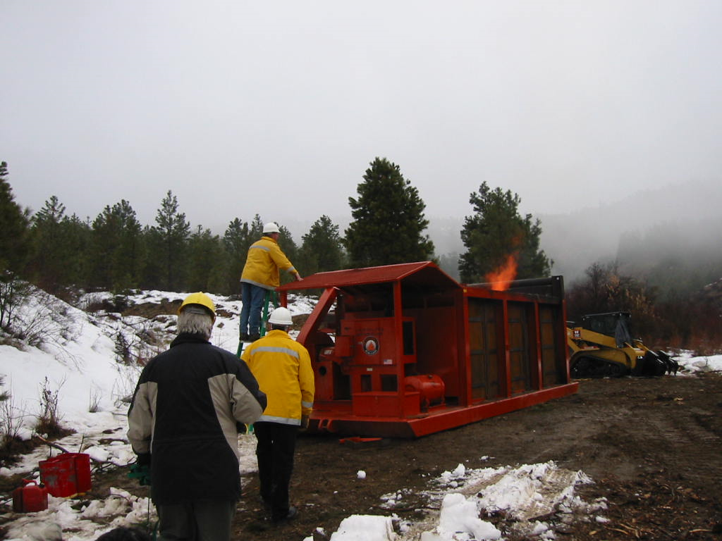
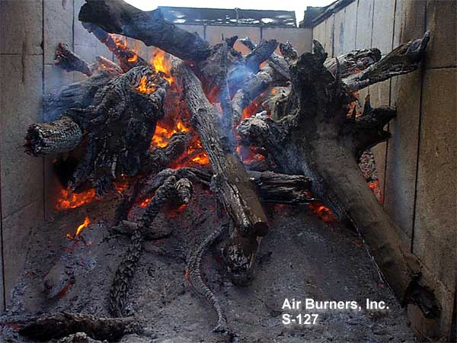
Air Curtain Burner
Examples of Mechanical Items
Notes:
Air curtain burners are used in areas where smoke production is a concern as the burner provides for more efficient levels of combustion. The level of difficulty for air curtain burners is determined by the Contract/Task Order. The level is based on the relative tonnage of the material to be incinerated and access to the slash material.

Slide 19
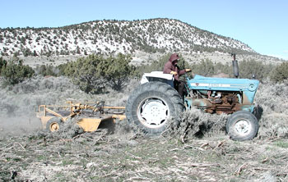
Tractor/Dozer/Other Equipment
Examples of Mechanical Items
Notes:
Operations such as roadblock removal, operations restoration, fireline construction and other. Type of operation and
level of difficulty will be determined by Contract/Task Order.

Slide 20
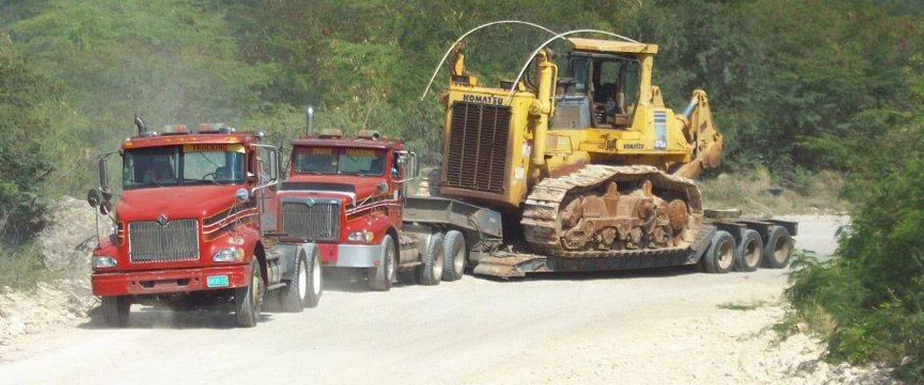
Lowboy Transport
Examples of Mechanical Items
Notes:
Provide transport for equipment to and from the general area of the work site. When many moves are required (as constructing a number of widely separated road blocks) and the distance between work sites prohibits walking the machine the Contractor shall be paid by the move.

Slide 21
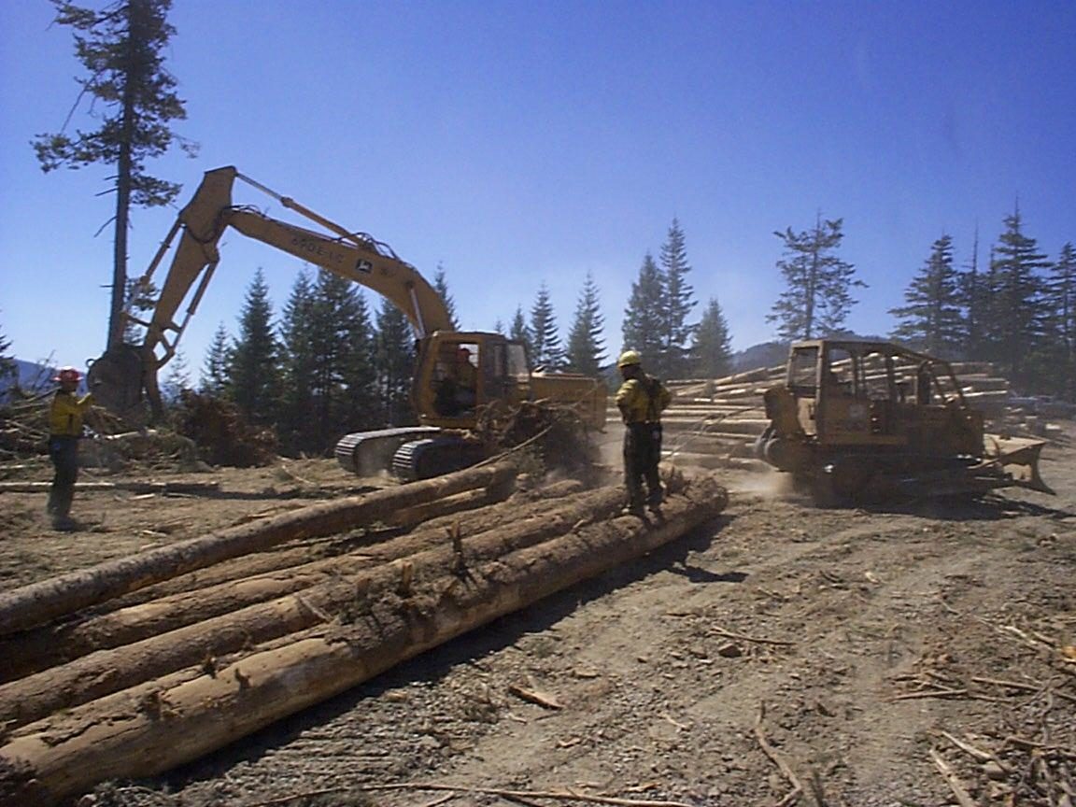
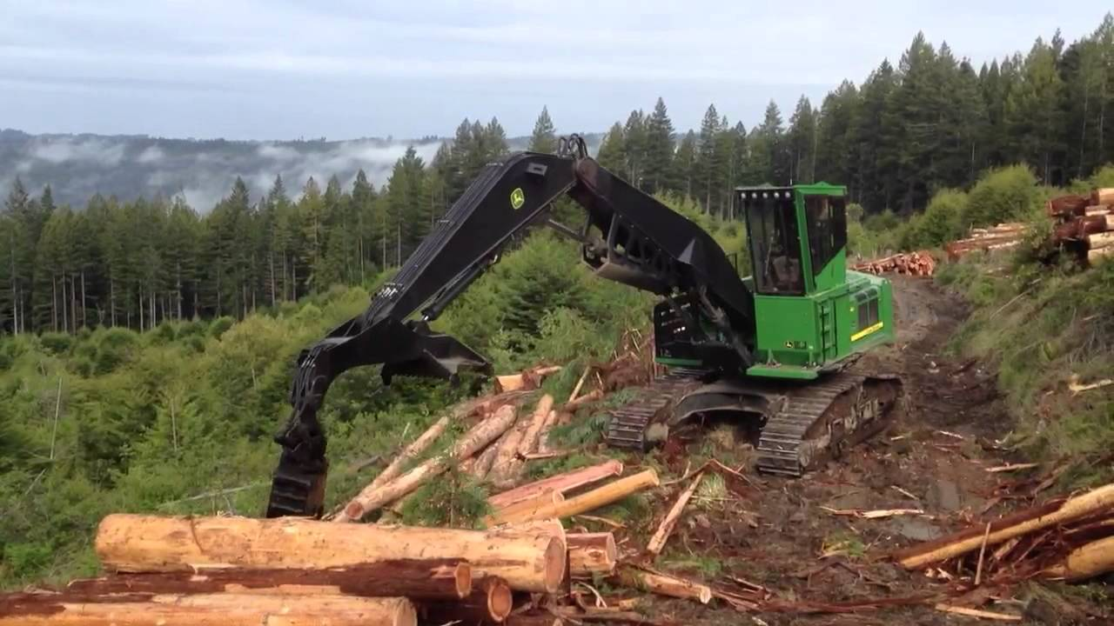
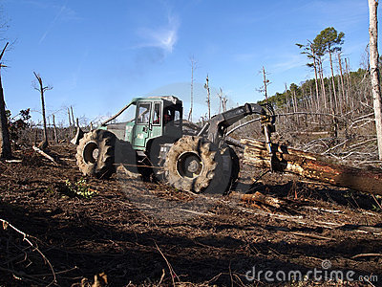
Yarding
Examples of Mechanical Items
Notes:
Yarding of cut or severed material to determined landing pile location. Level and degree of difficulty will be determined by the Contract/Task Order.

Slide 22
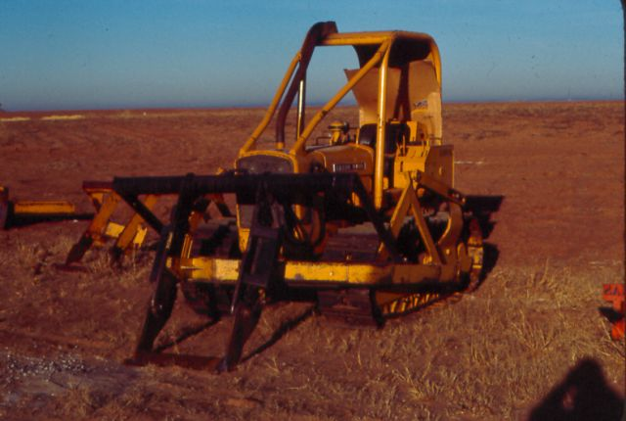
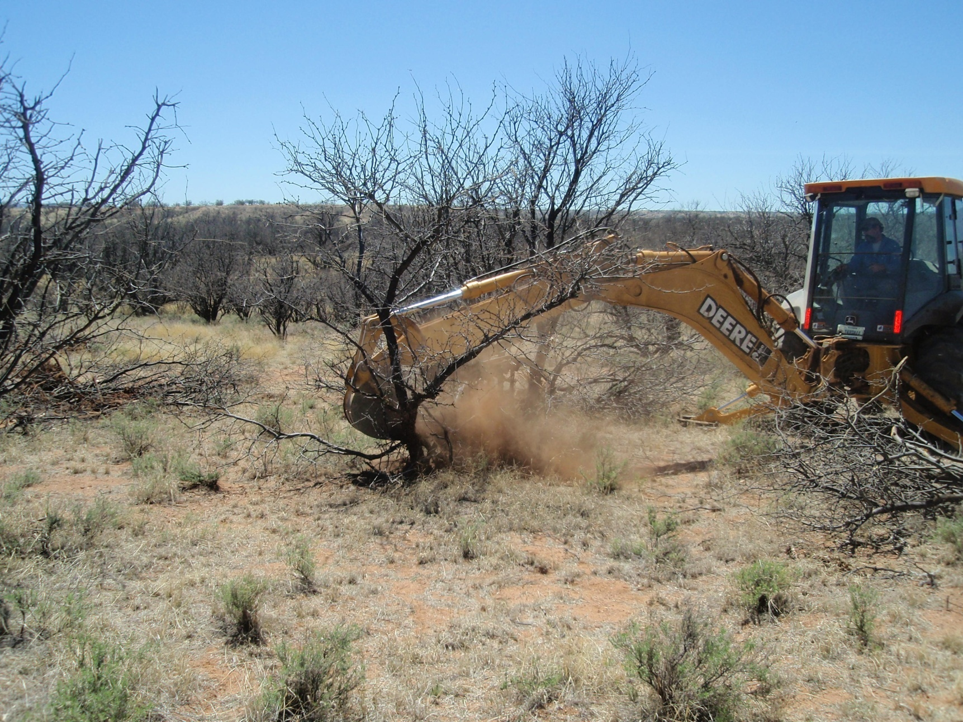
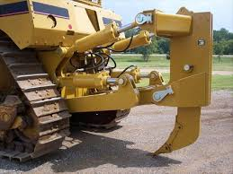
Grubbing and Root Knife
Examples of Mechanical Items
Notes:
Removal of tree/stump by mechanical means, utilizing dozer with root knife attachment, backhoe/trackhoe utilizing hoe, or any other tracked or rubber tired equipment. The level of difficulty and equipment requirements for grubbing/root knife are determined by the Contract/Task Order.
.

