Slide 1
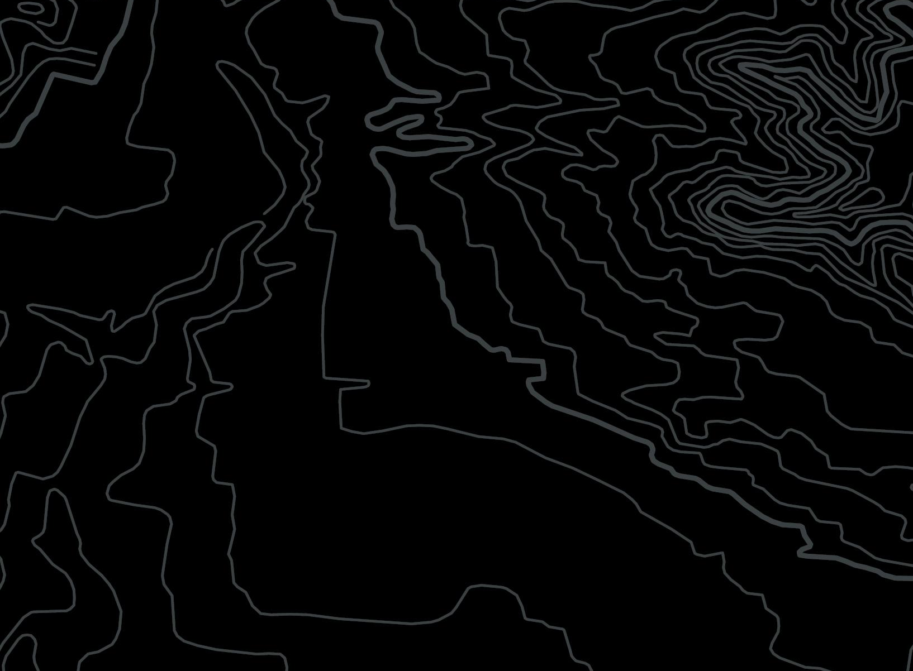
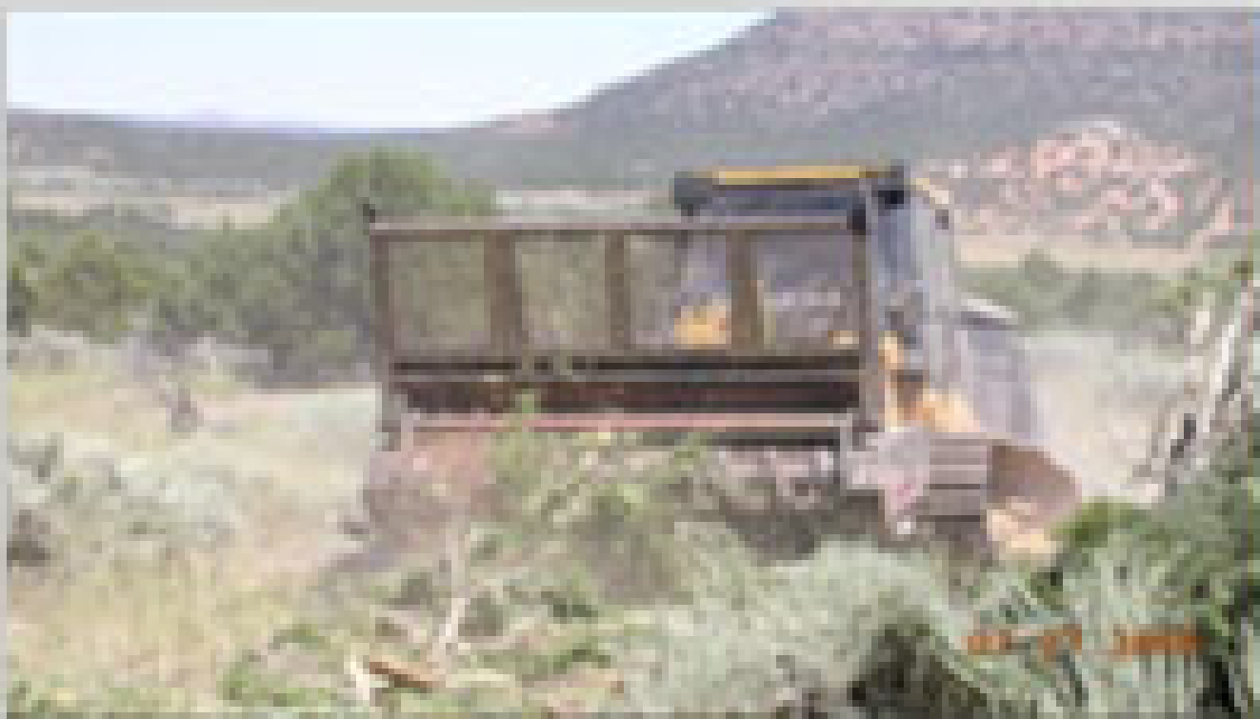
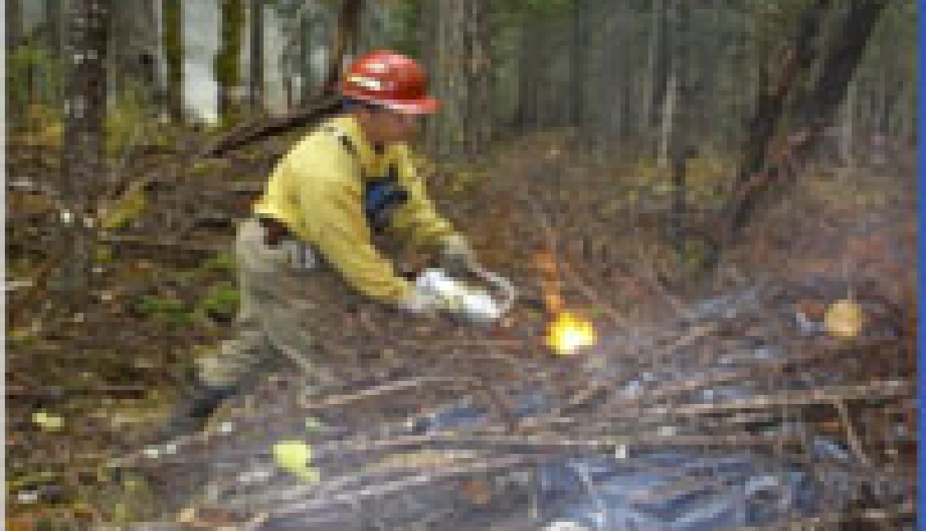
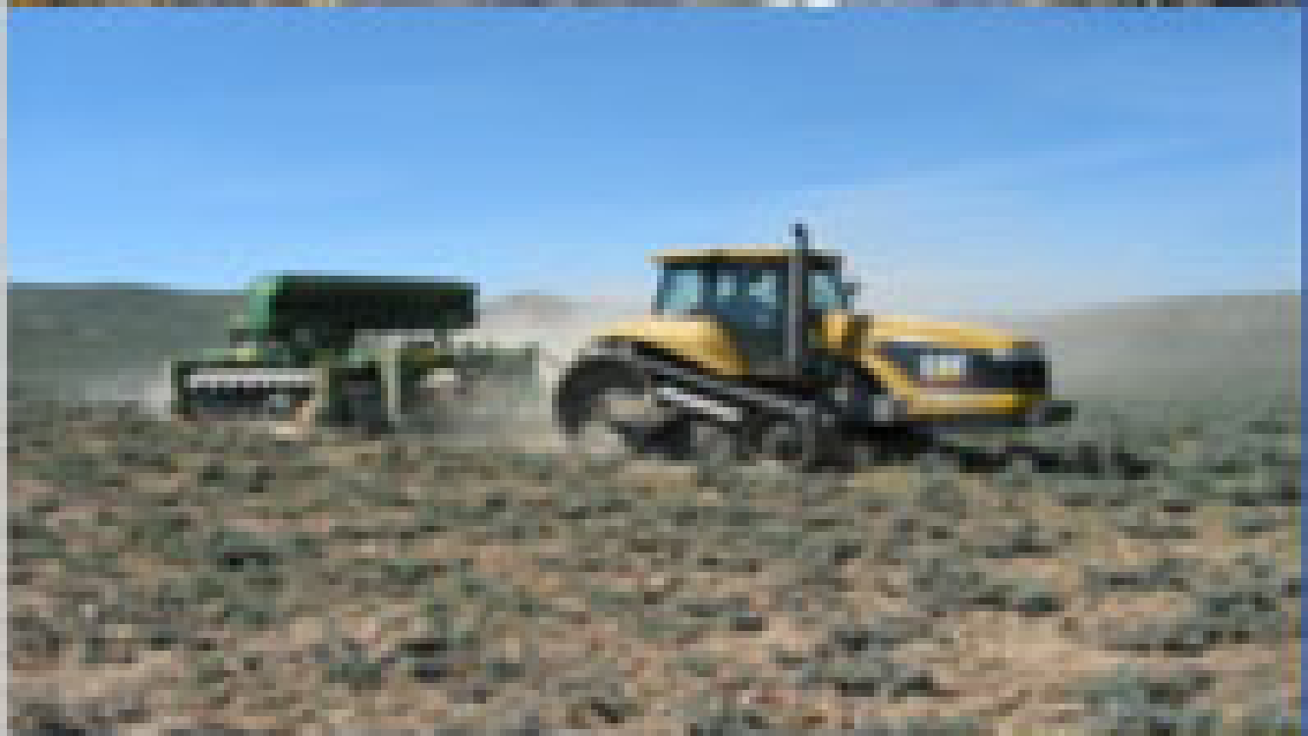
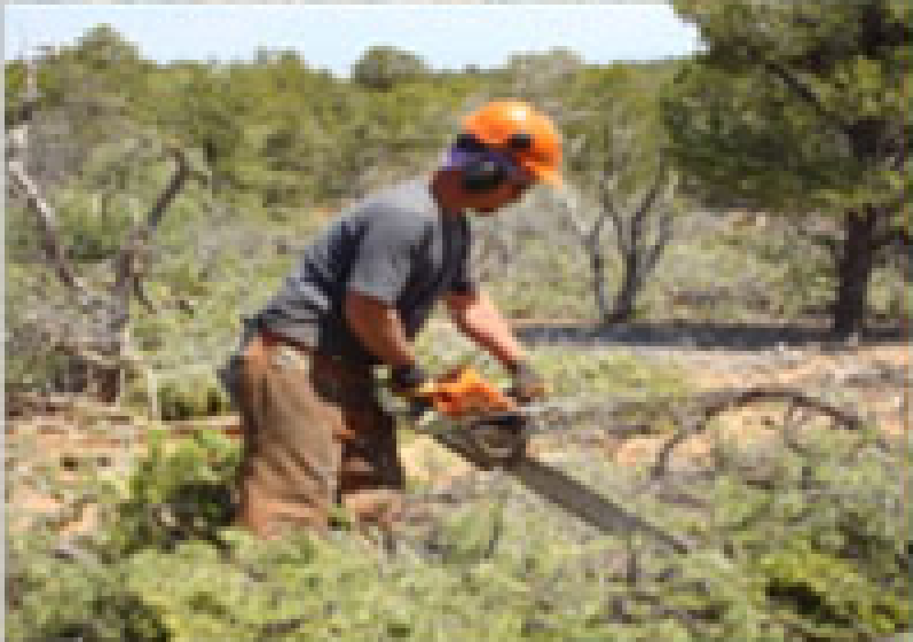
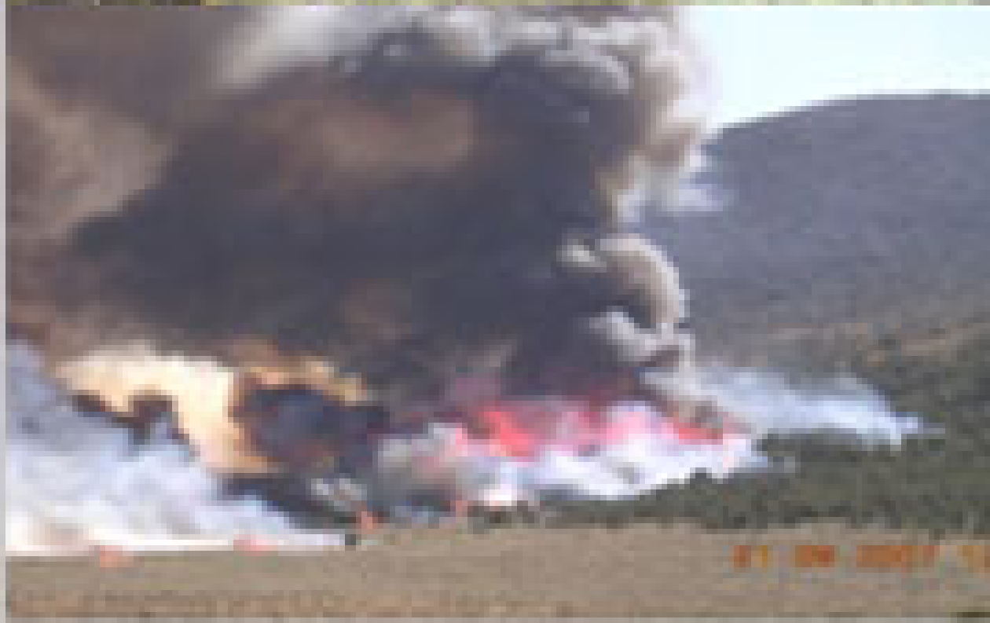
Examples of Manual Items
BLM Fuels Management contracting Tasks
The following slides provide visual examples of the AZ, NM, and NV IDIQ tasks. They are meant to provide just a few visual descriptions of the type of equipment used and operations for manual tasks 1 - 10. The descriptions are not inclusive. Task orders may identify specific types of machinery, techniques or operational specifications as identified in B.1 - Section 2 - Fuels Management Manual Pricing Schedule.
Notes:
The following slides provide visual examples of the AZ, NM, and NV IDIQ tasks. They are meant to provide just a few visual descriptions of the type of equipment used and operations for manuall tasks 1 - 10. The descriptions are not inclusive. Task orders may identify specific types of machinery, techniques or operational specifications as identified in B.1 - Section 2 - Fuels Management Manual Pricing Schedule.

Slide 2
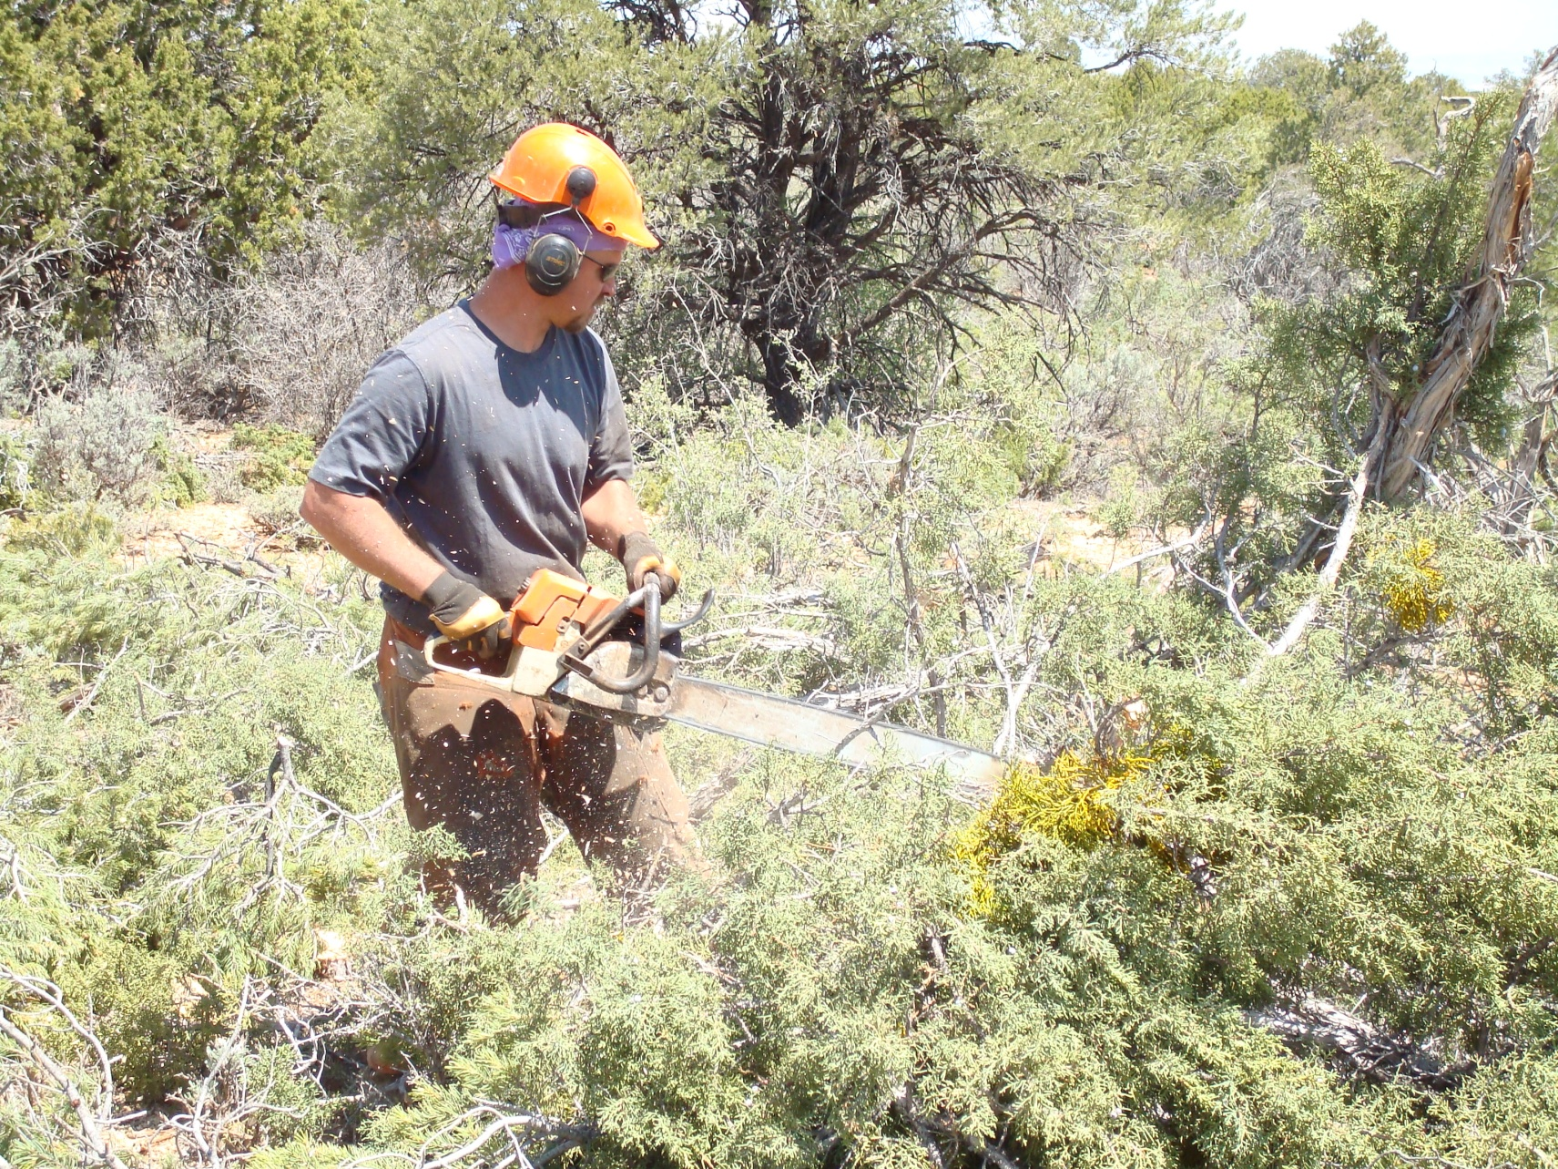
Slashing
Item 01
Notes:
Cutting down trees and brush with the use of hand operated tools (i.e. chain saw). No live limbs can be left on the stump of any cut stem. Percent cover of total cover primarily determines levels with Levels 1-4 for forested stands and 5-8 for brush.

Slide 3
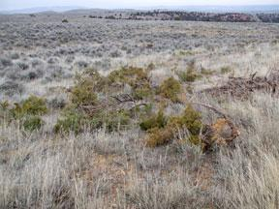
Lop and Scatter
Item 02
Notes:
The level of difficulty for lop and scatter is determined by the Task Order. The level is based on the amount of the dead or alive vegetation to be treated and scattered as specified in the Task Order.

Slide 4
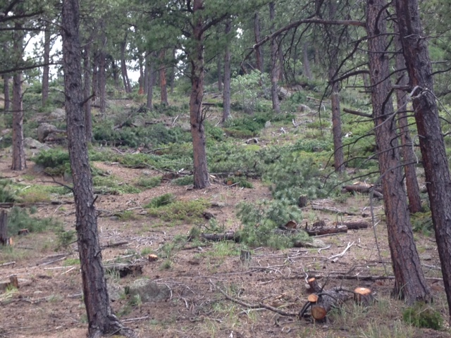
Lop and Drop
Item 03
Notes:
Lop and drop all existing dead or alive vegetation identified by the Task Order. The level of difficulty is based on the amount of the dead or alive vegetation to be treated.

Slide 5
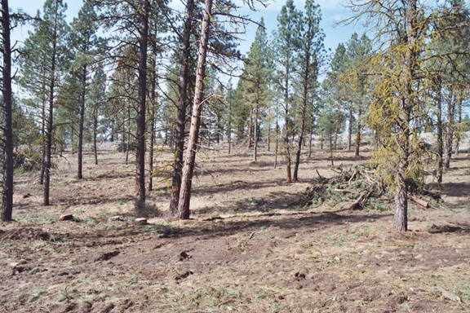
Selective Slash/Thinning
Item 04
Notes:
The level of difficulty for selective slashing/thinning is determined by the Task Order. Treatments under this item are completed by hand operated power tools. The level is based on the expected number of leave trees per acre to be treated and/or spacing between leave trees, or the relative amount of material to be slashed.

Slide 6
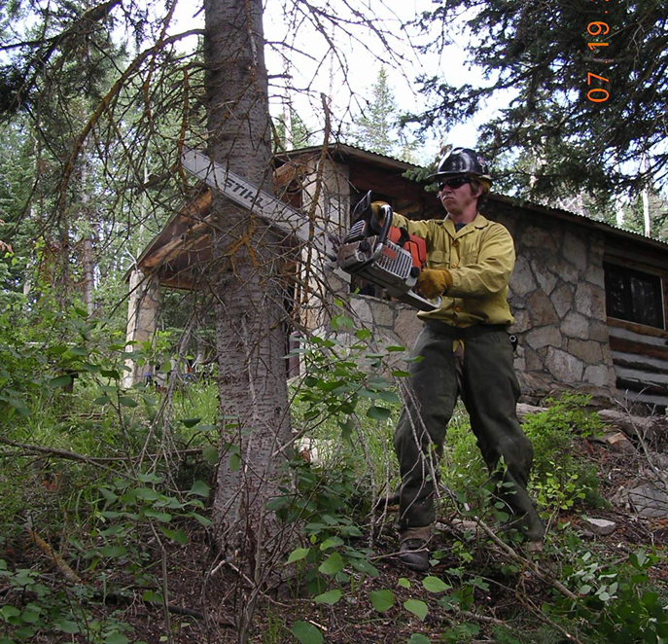
Pruning
Item 05
Notes:
The level of difficulty for pruning is determined by the Task Order. The level is based on the expected number of trees per acre (TPA) requiring treatment.

Slide 7
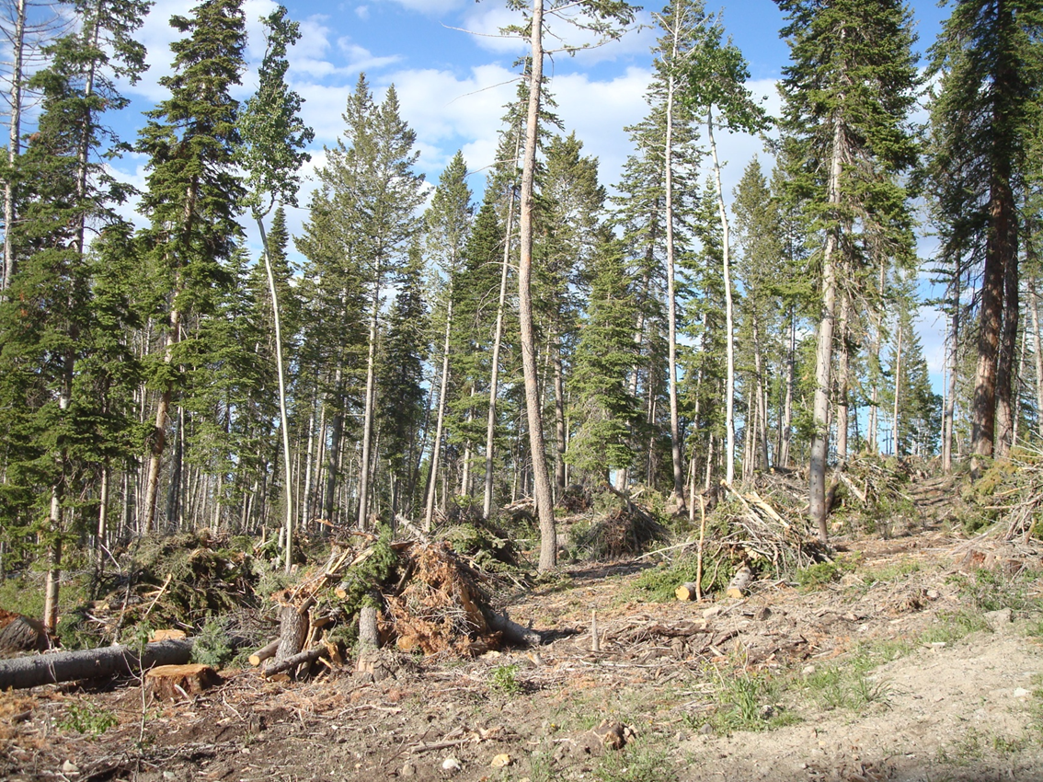
Hand Pile and Cover
Item 06
Notes:
The level of difficulty for hand piling and covering is determined by the Task Order. The level is based on the number of piles per acre expected, based on the amount of slash on the unit meeting specifications from items 1,3,4 or 5. The Government shall designate which specification for size of material and spacing of piles with each Task Order.

Slide 8
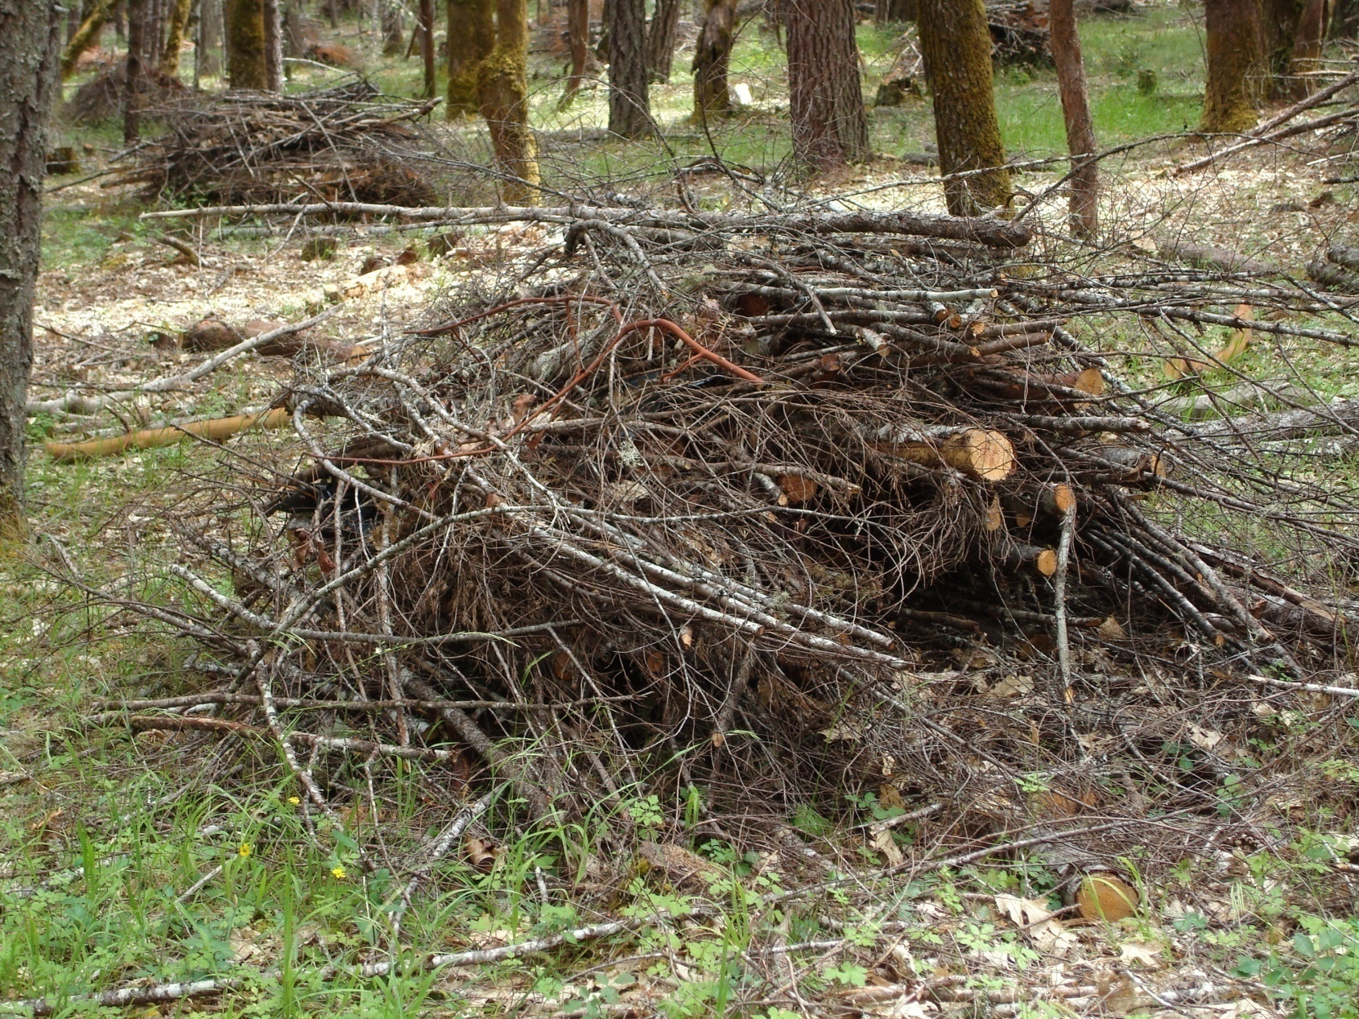
Slash, Hand Pile and Cover
Item 07
Notes:
The level of difficulty and requirements for hand severing, piling and covering are determined by the Task Order. The level of difficulty is based on the crown closure of the material to be severed and the expected number of piles per acre.

Slide 9
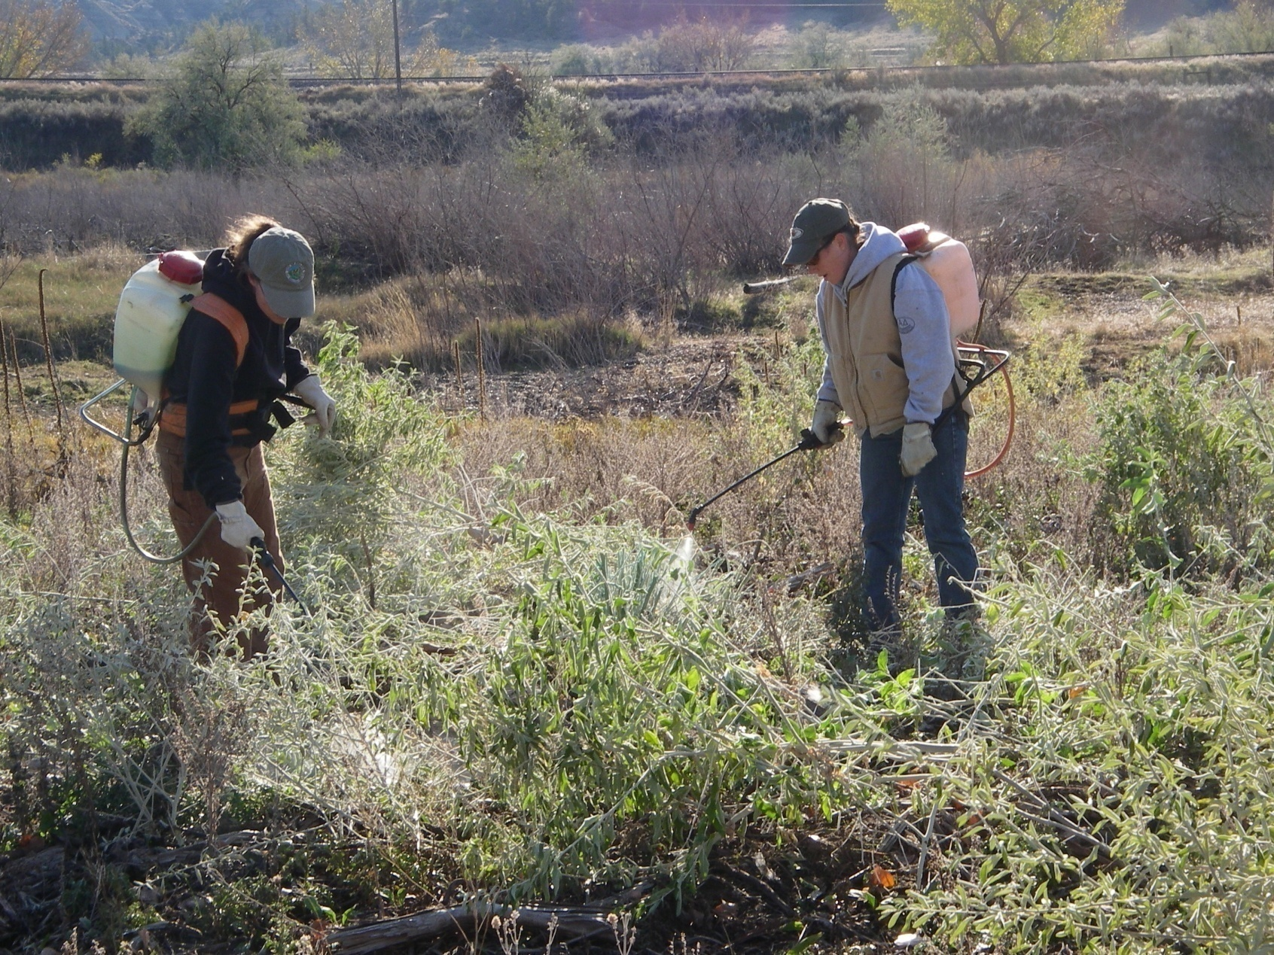
Spot Application of Herbicide
Item 08
Notes:
The level of difficulty for spot application of herbicide shall be established in the Task Order. The level is based on the expected number of trees or clumps per acre to be treated with herbicide, and whether the treatment is cut stump or basal bark application.

Slide 10
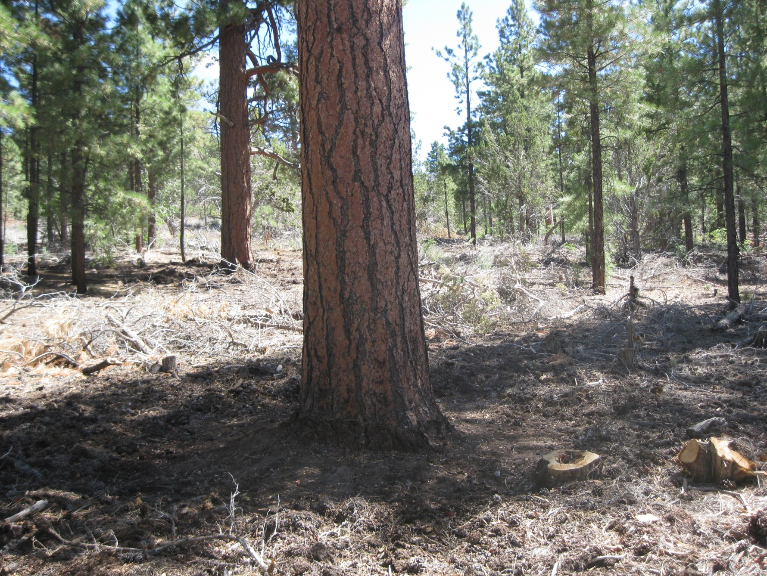
Fuels Pullback
Item 09
Notes:
Each tree/snag designated for pullback shall be cleared of all surface fuels, including litter, and aerial fuels from a 2-foot wide area, 8 feet in height, around the tree/snag. Material greater than 3" diameter within the clearing zone shall be pulled/rolled at least 4 feet from the bole. Levels are based upon number of trees per acre to be treated.

Slide 11
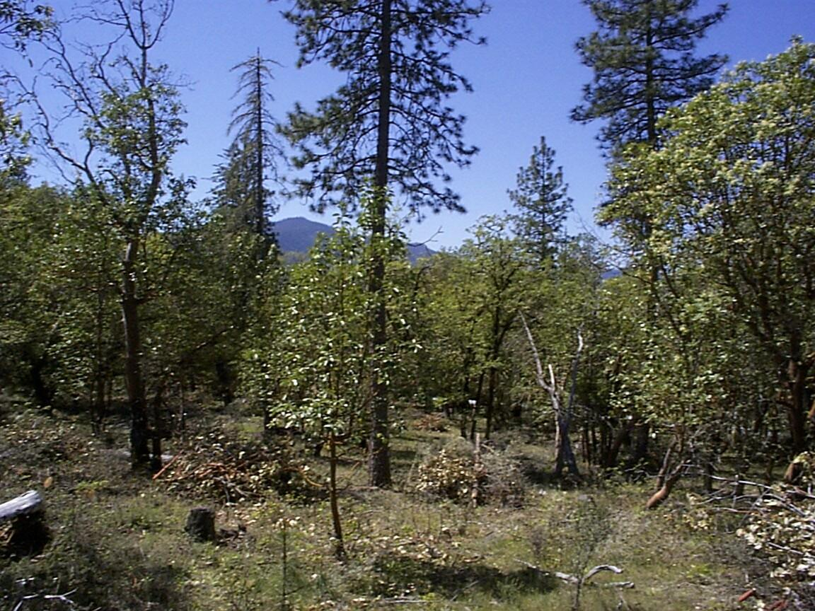
Fuel Modification Zone
Item 10
Notes:
Fuel modification zones (FMZs) for woodland/shrubland. Treatments include cutting of trees, slashing of shrubs and small vegetation, girdling, pruning of residual trees, and snag felling.

