Slide 1
BLM Fire Recruitment Toolkit #WeAreBLMFire

Slide 2
Tell the BLM Fire story
These graphics are designed to provide a way to customize recruitment materials to be used for promoting BLM Fire jobs in your state, district or field office. We want to highlight “why” people want to work for BLM Fire. It’s not just a job, it is a community. Careers in BLM Fire can take employees out of the office, working in outdoor recreation areas and traveling to places many people will never see. The natural resources we are charged to protect and the people we work with make this job great! Let’s promote that.

Slide 3
A new series
With the rollout of the new 0456 Wildland Firefighting series and the intense competition for highly skilled and qualified individuals, the BLM Fire program is looking to fill numerous vacancies and continue building a strong workforce. Many of the entry level positions are steppingstones towards a long-term fire career and provide opportunities to gain qualifications and experience.

Slide 4
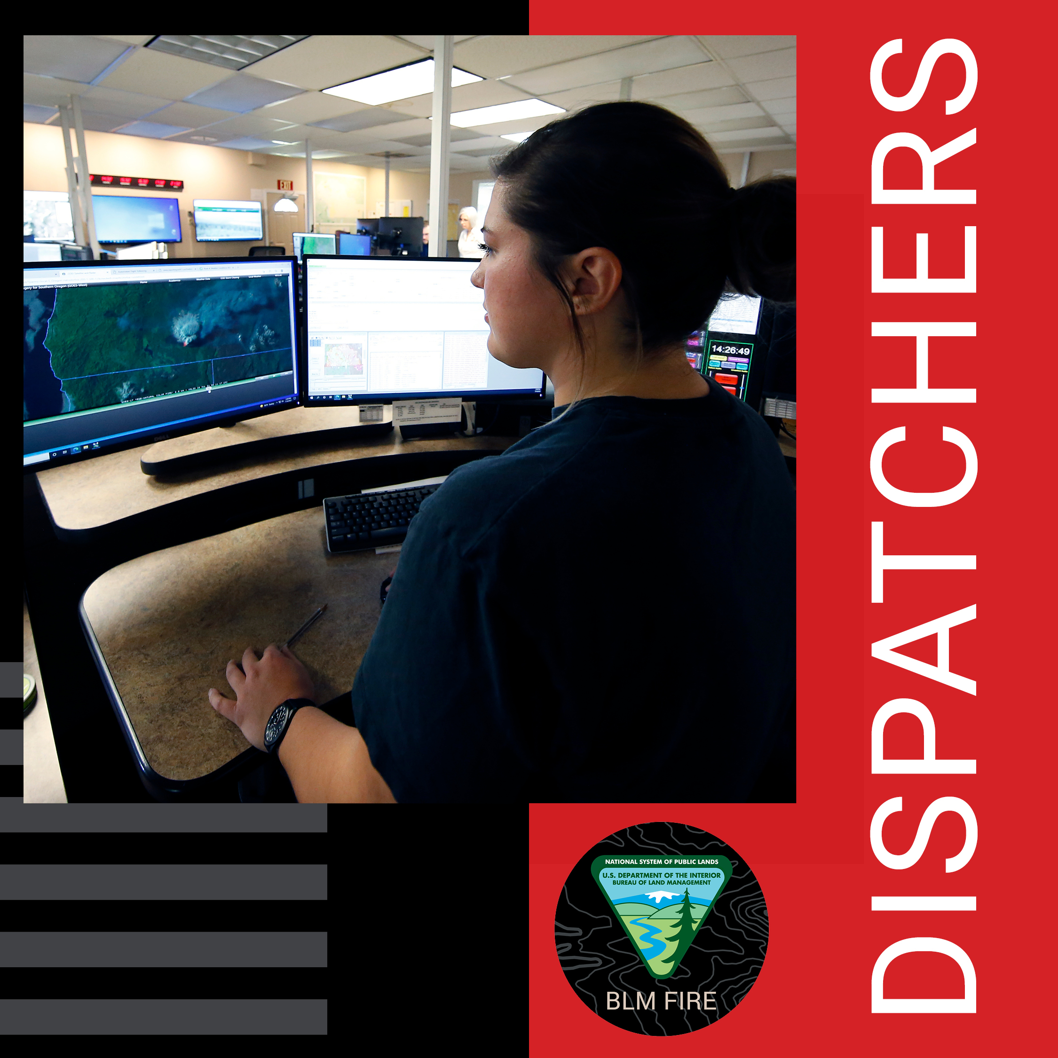
Social campaign
Share your photos of wildland firefighters and support personnel by customizing our graphic templates.
Use the templates provided to share your stories and images.
Once you complete the PowerPoint template or image, save the slide as an image and share the image on Twitter, Facebook, Instagram, or other platforms with the hashtag #WeAreBLMFire, #FireJob and #NotYourOrdinaryJob.
Be sure to tag the state and/or BLM Fire in your post where appropriate!
Share as many graphics as you’d like.

Slide 5
Sample social media

Slide 6
Sample Facebook Post
#FireJob alerts continue! One of the major support roles for the wildland fire community comes from the dispatching world! Dispatchers play a pivotal role in wildland fire programs, and dispatch work is often described as extremely satisfying and fast paced. From taking the first phone report of a new fire to mobilizing crews, engines, smokejumpers, caterers, showers and other assets around the country in support of fire suppression, dispatchers are never bored. #WeAreBLMFire #NotYourOrdinaryJob

Slide 7
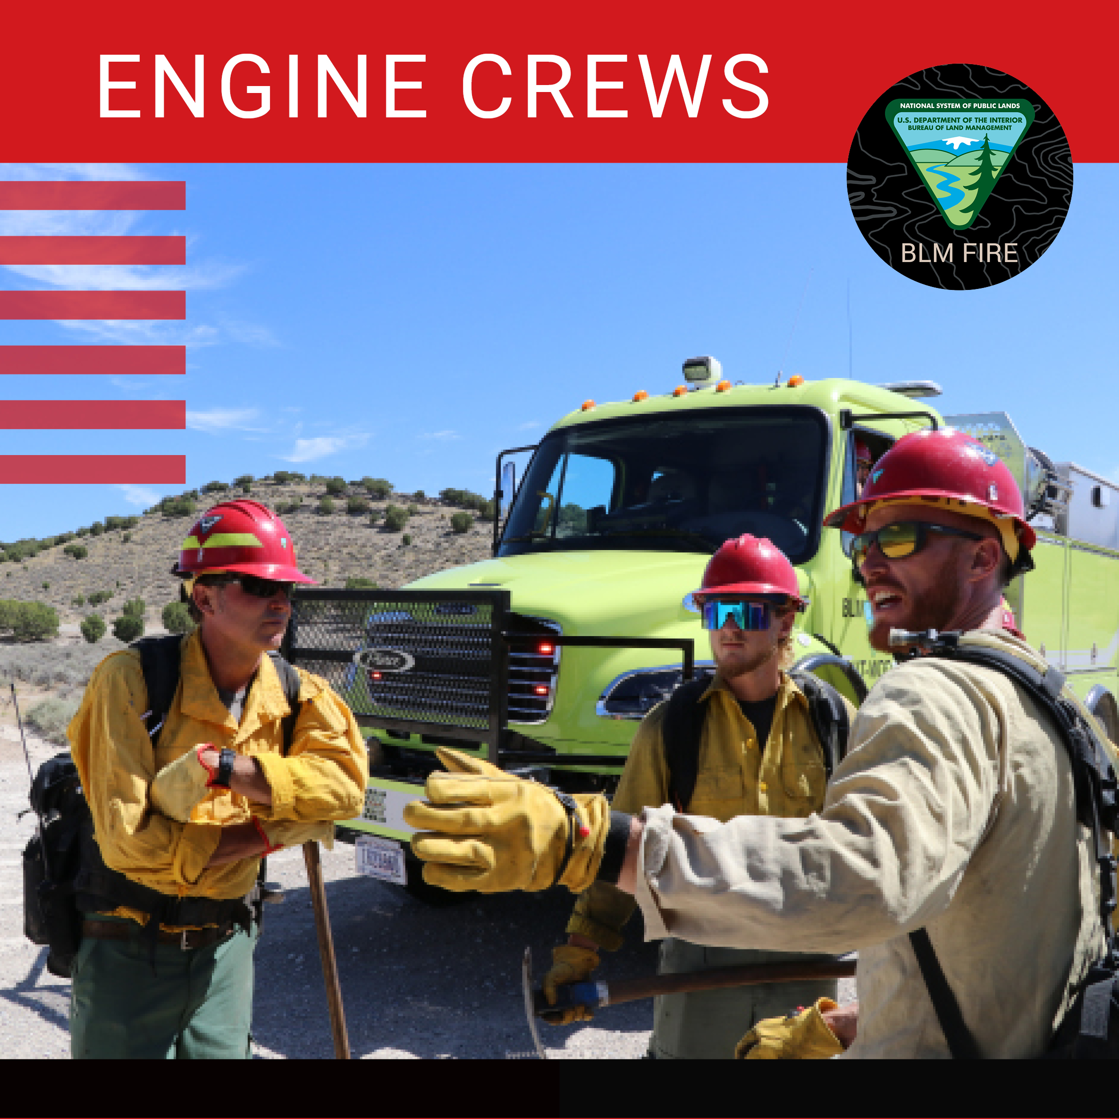
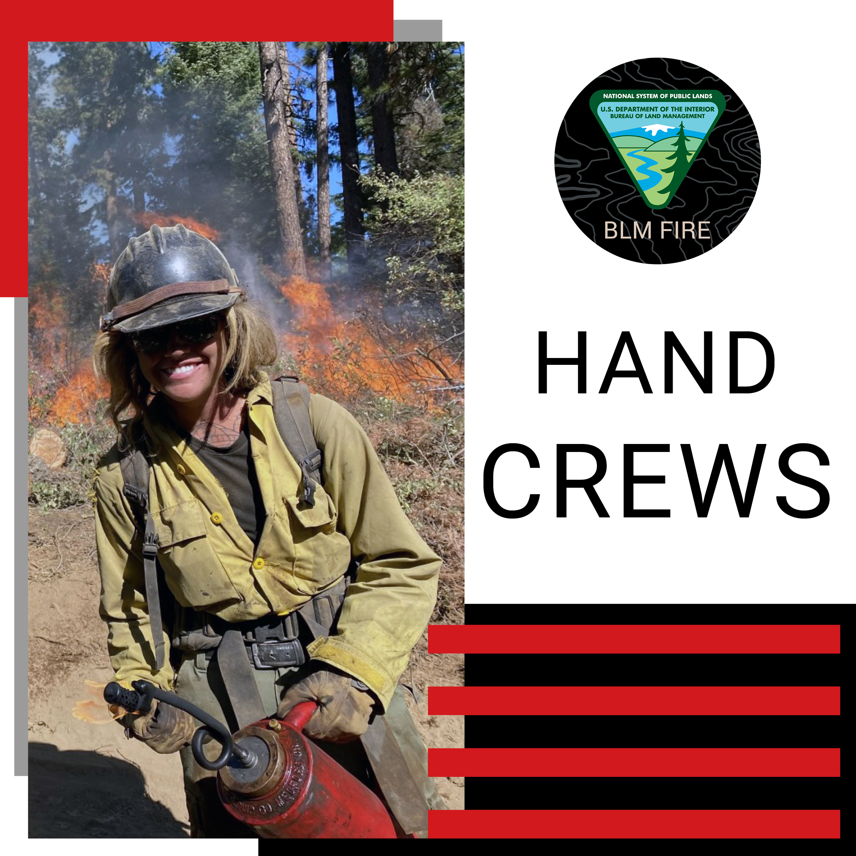
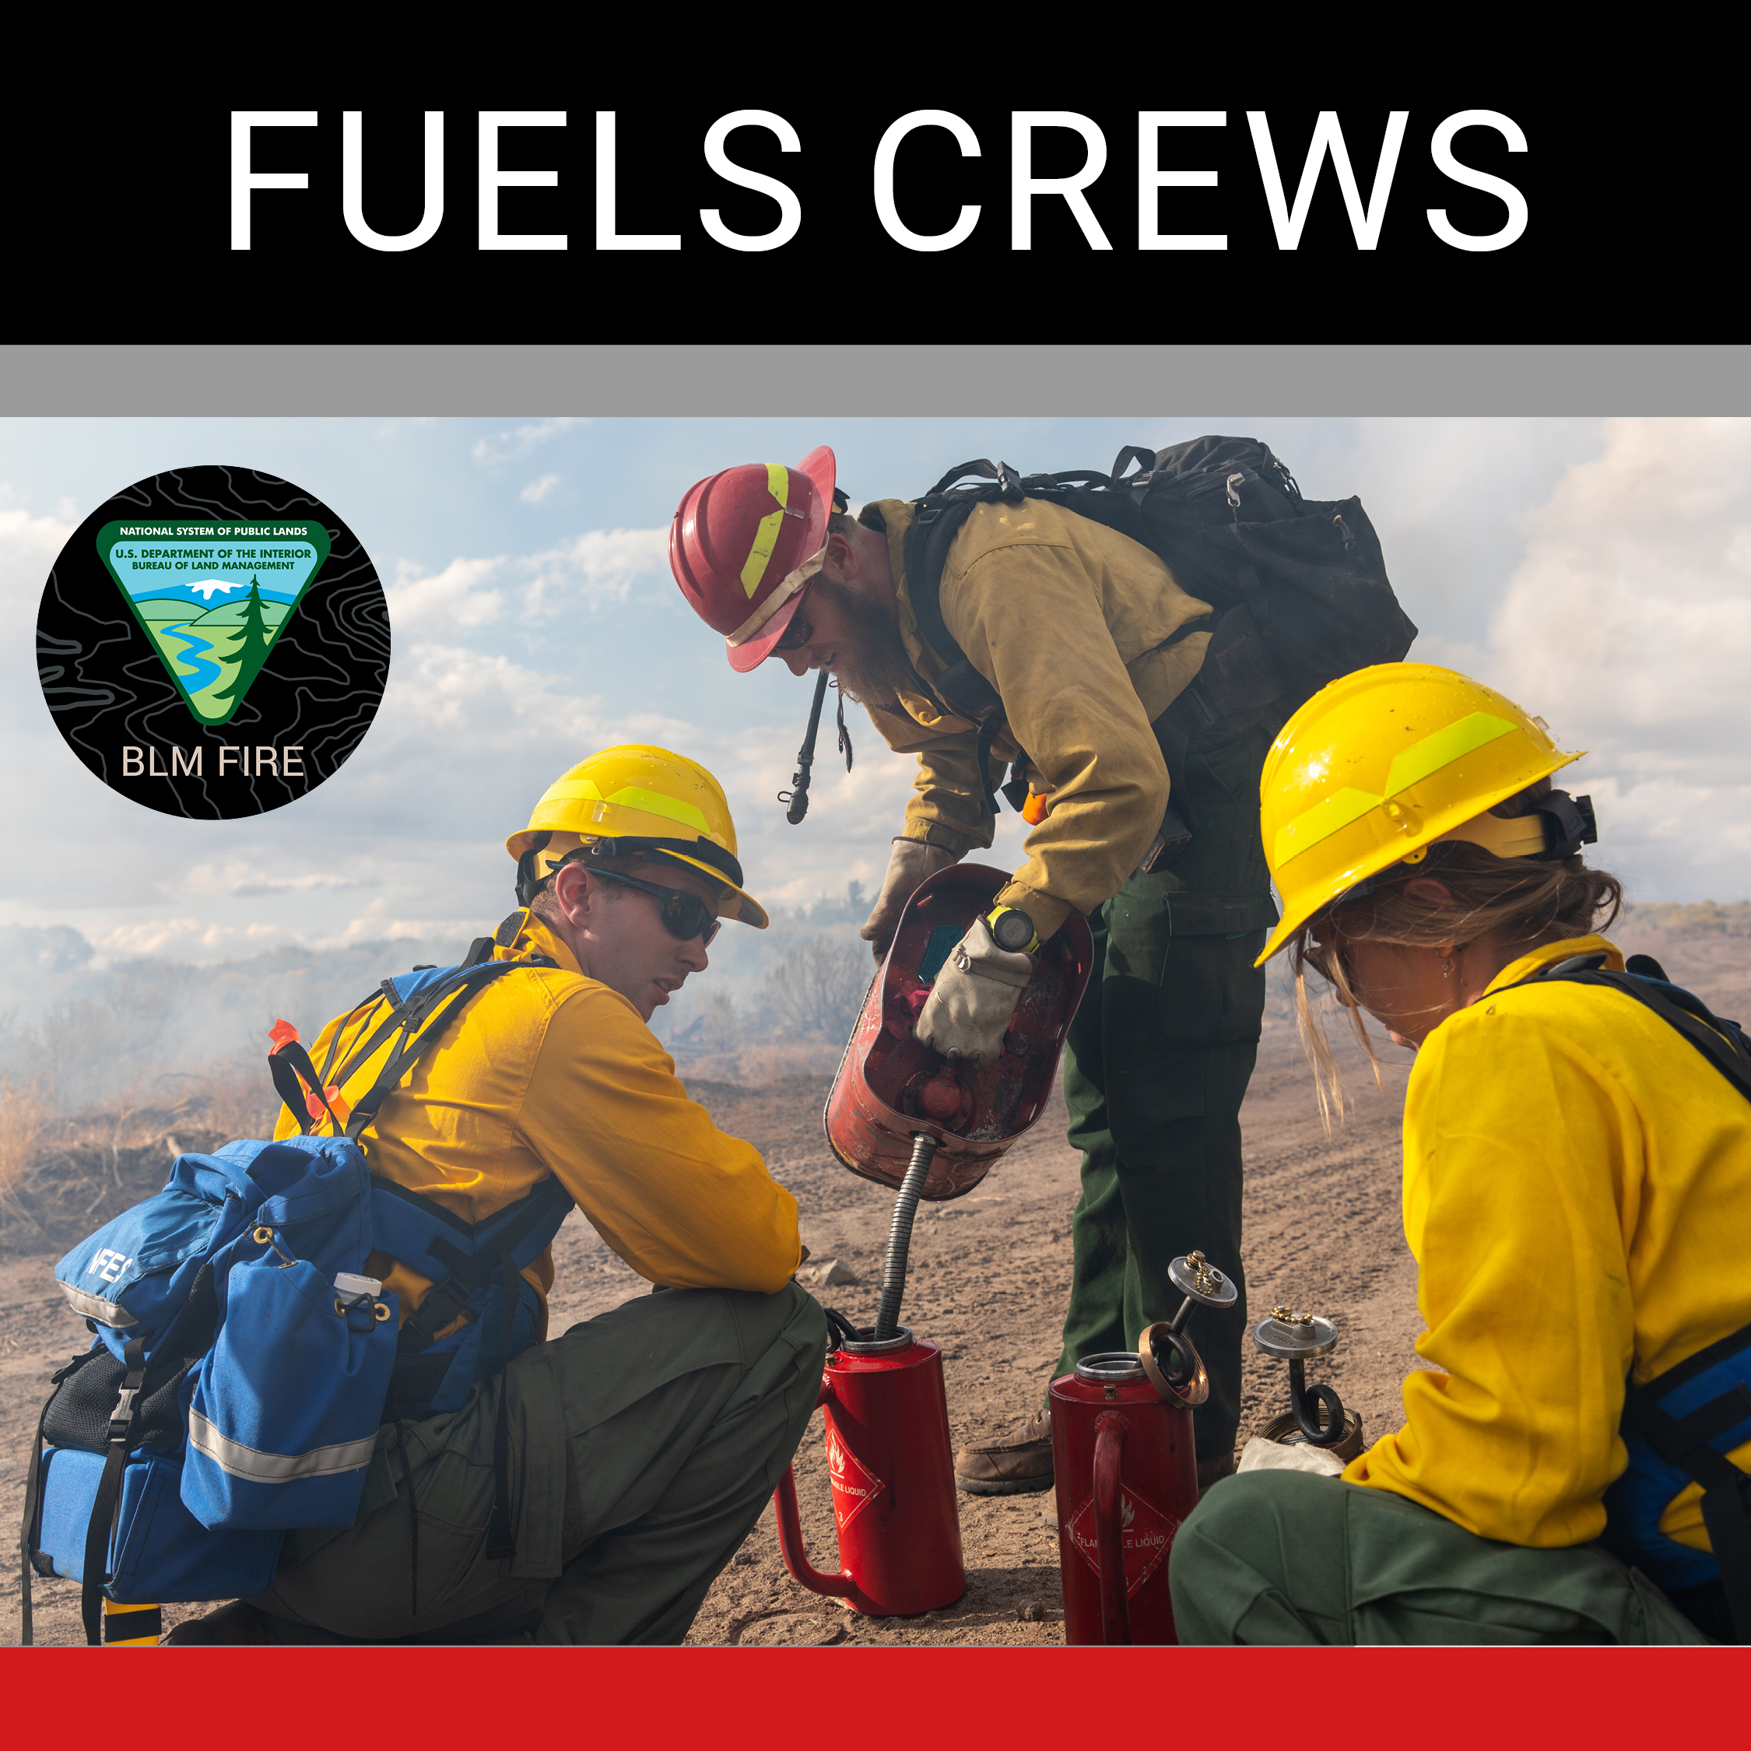
Sample Facebook Post
Here is another opportunity to work for the @BLMFire program as a #WildlandFirefighter crewmember on one of the following: engine, hand crew, or #prescribedfire crew.
This #FireJob has multiple locations to choose from in (add locations)!
#WeAreBLMFire #NotYourOrdinaryJob

Slide 8
How to customize outreach graphics
Graphic templates can be found on the following slides.
Right click an example graphic and “Save As Picture” to save the file to your computer.
Use the graphics with the blank squares to customize with your photos. Once finished “Save As Picture” then use anywhere!
The graphics are yours to use across any materials.
Use it for your social media platforms, blog posts, website, or in your newsletter – the possibilities are endless!

Slide 9
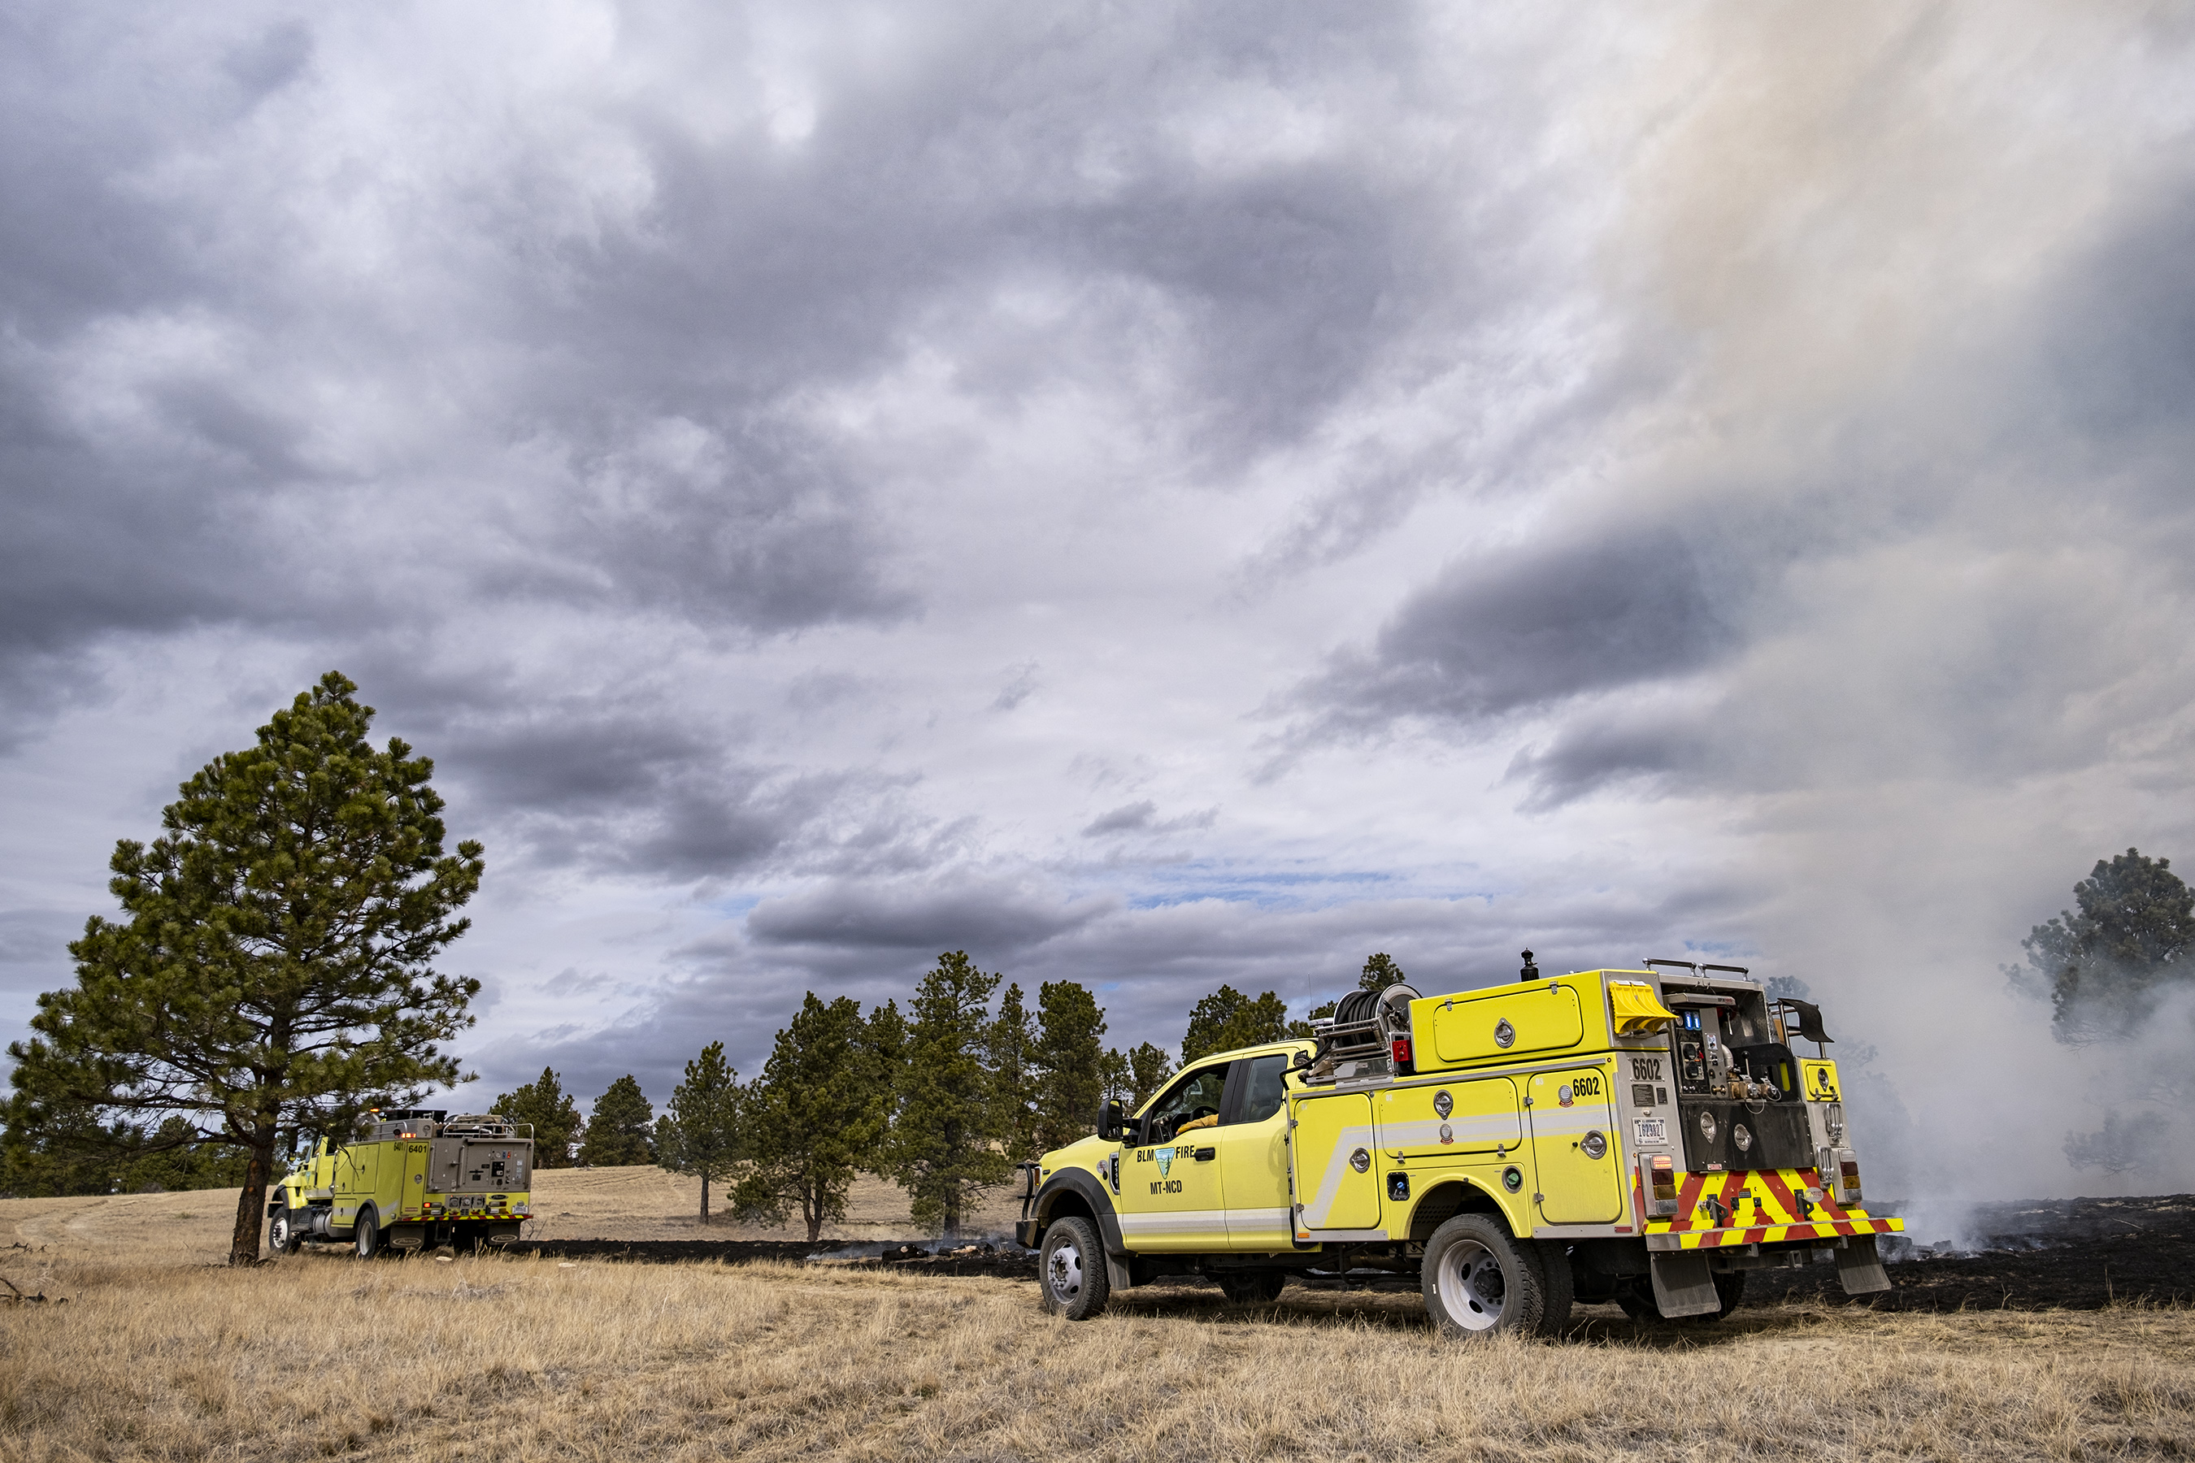
Customize the outreach graphics
Copy the graphic onto a new slide.
Add your photo to the slide.
Resize to fit into the open box.
Select your photo, right click and choose “Send to Back”
Add your text on top of the graphic, resizing it to fit.
Export the slide as a .jpg or .png to use for social media.
Sample on the next slide.
Engine Crews

Slide 10
Engine Crews

Slide 11
Customized outreach graphics.

Slide 12
Customized outreach graphics.

Slide 13
Customized outreach graphics.

Slide 14
Customized outreach graphics.

Slide 15
Customized outreach graphics.

Slide 16
Customized outreach graphics.

Slide 17
Customized outreach graphics.

Slide 18
Customized outreach graphics.

Slide 19
Customized outreach graphics.

