Slide 1
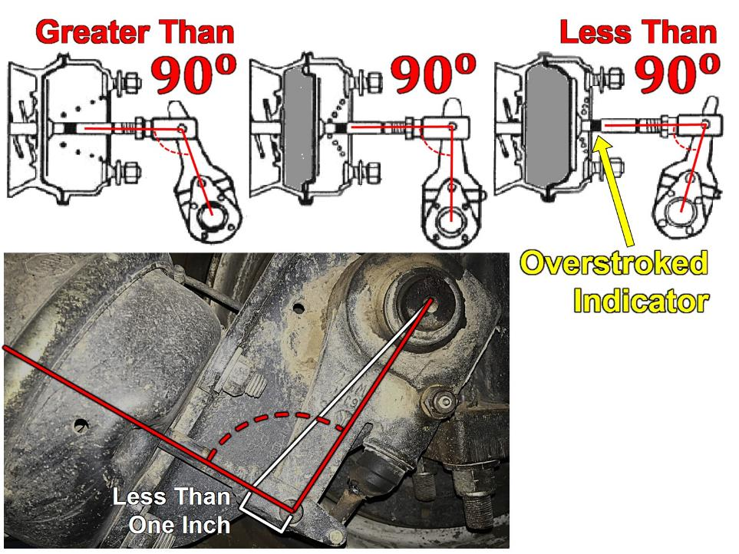

Slack Adjusters
1
Notes:
Slack Adjusters
Ensure the slack adjuster is securely mounted.
Check slack adjuster and pushrod for bent, broken, loose, or missing parts.
With brakes released and wheels chocked, pull the slack adjuster by hand using a large screwdriver as leverage.
The pushrod should not move more than approximately 1 inch.
The angle between the pushrod and the slack adjuster should not be less than 90 degrees.
You should not be able to see the overstroked indicator.

Slide 2
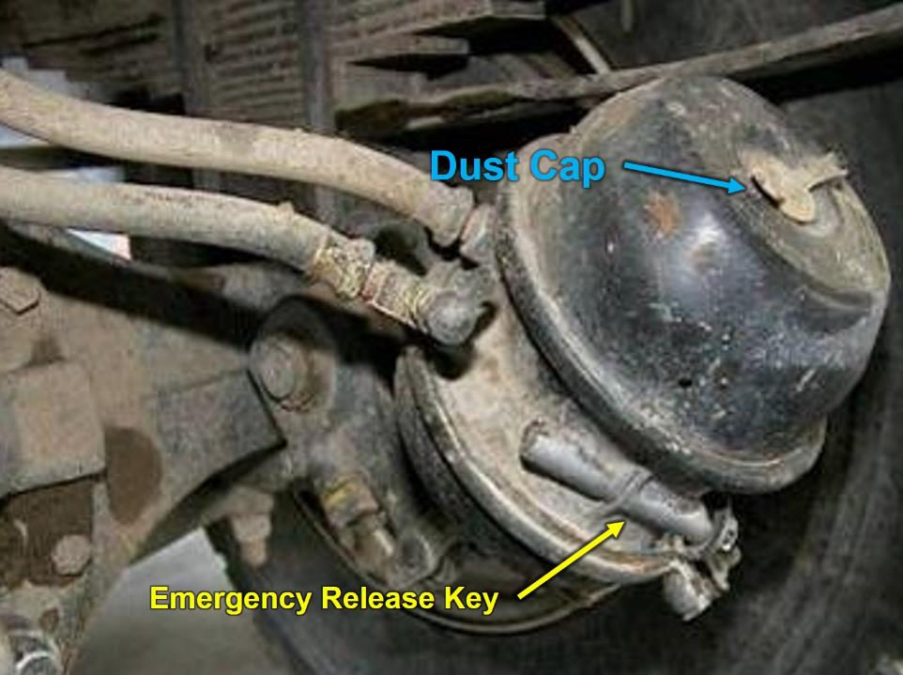
Brake Chamber/Canister
& Brake Lines
2
Notes:
Brake Chamber/Canister and Brake Lines
Inspect canisters for any physical damage.
Ensure the emergency release key is secured in the external mount.
Ensure the dust cap is covering the hole on top of the canister.
Check air lines and ensure there are no cracks, chafing, or bulging.

Slide 3
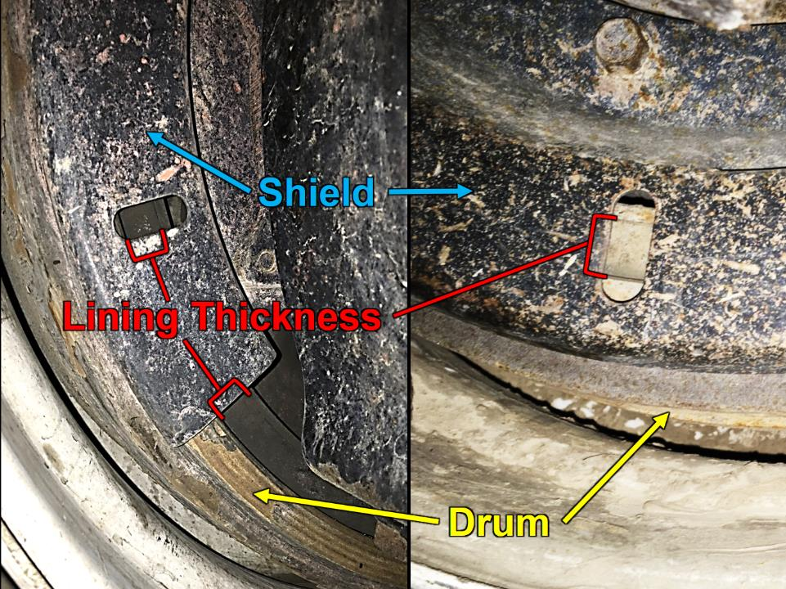
Brake Drums & Linings
3
Notes:
Brake Drums and Linings
Brake drums are located on each end of the vehicle’s axles. The wheels are bolted to the drums. The braking mechanism is inside the drum. To stop, the brake shoes and linings are pushed against the inside of the drum. Disk brakes use a caliper to clamp two brake pads against a rotor. Both of these cause friction, which slows the vehicle (and creates heat).
Ensure there are no cracked drums (or disks).
Ensure shoes or pads are not worn dangerously thin, missing, or broken.
Shoes should have a lining no less than ¼-inch thick.
Ensure shoes or pads do not have oil, grease, or brake fluid on them.
Axle hub seal or hydraulic wheel cylinder leaks can result in oil or brake fluid spraying on braking surfaces. The porous friction material will absorb the oil, acting as a lubricant on the brake surfaces and causing the other brakes to work harder to compensate for the faulty brake. If this occurs, the friction material must be replaced. Oil soaked linings and pads can also catch fire due to the heat generated by friction.

Slide 4
Air Compressor Governor Pressure Test
Pumping by the air compressor should start at about 100 PSI and stop at about 125 PSI (check manufacturer’s specifications).
Run the engine at a fast idle.
  The air governor should cut-out the air compressor at about the manufacturer’s specified pressure. The air pressure shown by your gauge(s) will stop rising.
With the engine idling, step on and off the brake to reduce the air tank pressure.
  The compressor should cut-in at about the manufacturer's specified cut-in pressure. The pressure should begin to rise.
Notes:
Air Compressor Governor Pressure Test
Pumping by the air compressor should start at about 100 PSI and stop at about 125 PSI (check manufacturer’s specifications).
Run the engine at a fast idle.
The air governor should cut-out the air compressor at about the manufacturer’s specified pressure. The air pressure shown by your gauge(s) will stop rising.
With the engine idling, step on and off the brake to reduce the air tank pressure.
The compressor should cut-in at about the manufacturer's specified cut-in pressure. The pressure should begin to rise.
If the air governor does not work as described above, it may need to be fixed. A governor that does not work properly may not keep enough air pressure for safe driving.

Slide 5
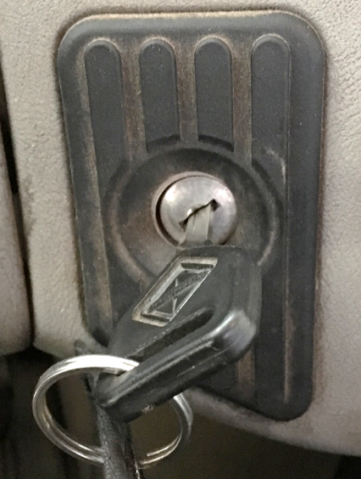
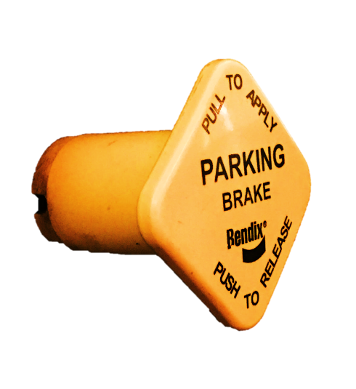
Parking Brake Leak Test
Notes:
Parking Brake Leak Test
Chock the wheels.
Build up air pressure until the governor cuts out (120 – 140 PSI).
Test the leakage rate without the foot brake applied.
Ensure the Ignition is in the “OFF” position.(You need to be able to listen.)
Turn the Ignition to the “ON” (not “START”) position. (Most vehicles need to have the ignition on for the gauges to work.)
Release the parking brake. (Push knob in.)
Monitor the air pressure gauge for 1 minute.
Listen for audible air leaks.
The system should lose no more than 2 PSI after the initial drop when the parking brake system is charged.
If the air loss rate exceeds 2 PSI, check for air leaks and fix before driving the vehicle. Otherwise, you could experience brake failure while driving.

Slide 6
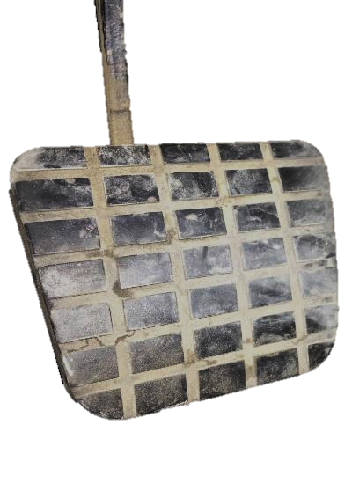
Service Brake Leak Test
Notes:
Service Brake Leak Test
Continuing from the parking brake leak test, check the leakage rate with foot brake applied.
Ensure the Ignition is in “ON” (not “START”) position.
Keep the parking brake released. (Push knob in.)
Fully apply the foot brake. (Never apply the service brake when the parking brake is set; the compound forces can damage components.)
Monitor the air pressure gauge for one minute.
After the initial drop when the service brake system is charged, you should lose no more than 3 PSI in one minute.
Listen for audible air leaks.
If the air loss rate is too much. Check for air leaks and fix before driving the vehicle. Brake failure could occur.

Slide 7
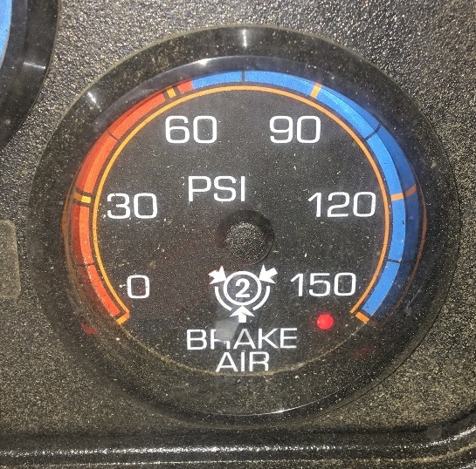
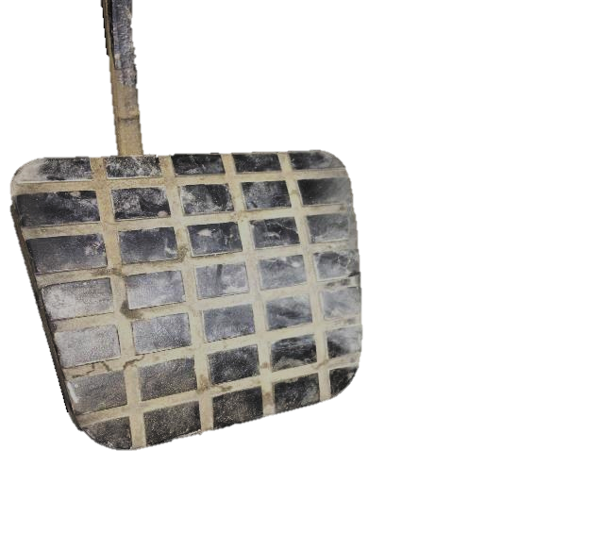
Low Pressure
Warning Signal Test
BEEP!
Notes:
Low Pressure Warning Signal Test
Continuing from the service brake leak test, perform a low pressure warning signal test.
Ensure the Ignition is in “ON” (not “START”) position.
Keep the parking brake released. (Push knob in.)
Fan (pump) the foot brake to bleed off air pressure. (Never apply the service brake when the parking brake is set; the compound forces can damage components.)
Monitor the air pressure gauge.
Ensure both the low air pressure warning light and audible alarm must come on when the air pressure drops below 60 PSI.
The low air pressure warning light and audible alarm are powered independent of each other for added safety.

Slide 8
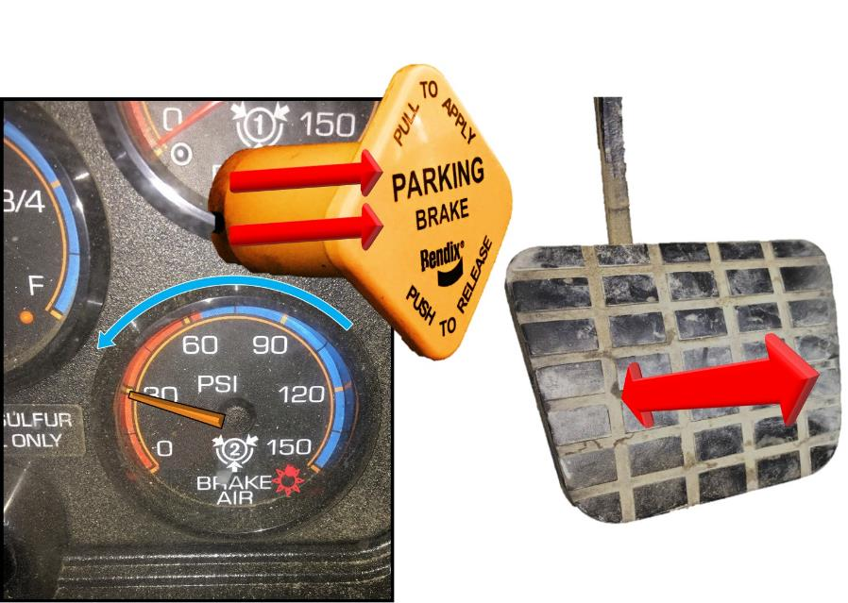
Parking Brake Check
Notes:
Parking Brake Check
Continuing from the low pressure warning signal test, ensure the parking brake comes on automatically.
Ensure the Ignition is in “ON” (not “START”) position.
Keep the parking brake released. (Push knob in)
Continue to fan (pump) the foot brake to bleed off air pressure.
Monitor the air pressure gauge.
Continue to fan off the air pressure. At approximately 20 - 45 PSI, the parking brake valve should close (pop out).
When the parking brake is set (pulled out) it requires no air pressure. Powerful springs hold the brakes by mechanical force (because air pressure can eventually leak away). When driving, the springs are held back by air pressure. If the air pressure is removed, the springs put on the brakes.
Do not wait for the brakes to come on automatically. When the low air pressure warning light and buzzer first come on, bring the vehicle to a safe stop right away, while you can still control the brakes. The braking power of spring brakes depends on the brakes being in adjustment. If the brakes are not adjusted properly, neither the regular brakes nor the emergency/parking brakes will work correctly.

Slide 9
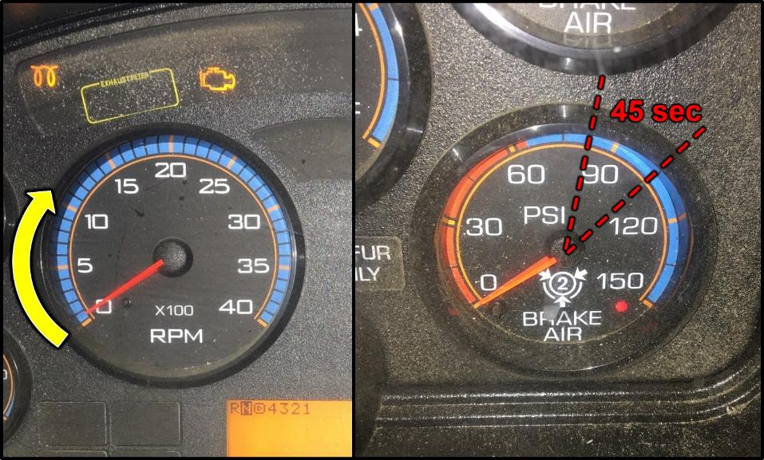
Air Pressure Buildup Rate Test
9
Notes:
Air Pressure Buildup Rate Test
Check the air pressure buildup rate.
Start the engine.
Increase engine RPMs to a “high idle.”
Watch the air pressure gauge.
Time how long it takes the air pressure to build from 85 to 100 PSI. The pressure should build from 85 to 100 PSI within 45 seconds. (If the vehicle has larger than minimum air tanks, the buildup time can be longer and still be safe. Check the manufacturer’s specifications.)
If you experience low air pressure while driving, make an emergency stop. Don't drive the engine until the problem is fixed.

Slide 10
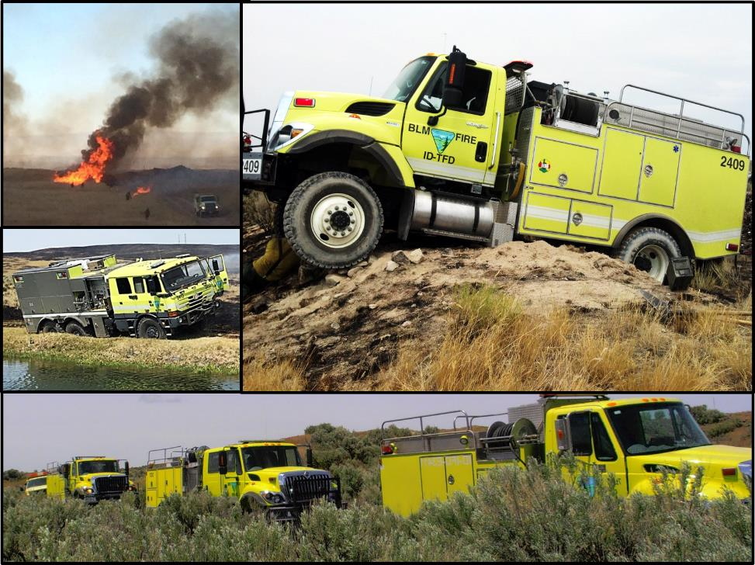
Post Off-Road Inspection
10
Notes:
Post Off-Road Inspections
Post off-road inspections are intended to identify any damage that may have occurred during fire suppression operations and require a more in depth look at major chassis components.
These inspections should be completed immediately after traveling off-road, before returning to maintained roads, both during and after suppression operations, project work, or training.
Document the inspection findings and corrective actions on the Preventive Maintenance Checklist in the “Notes” section.

Slide 11
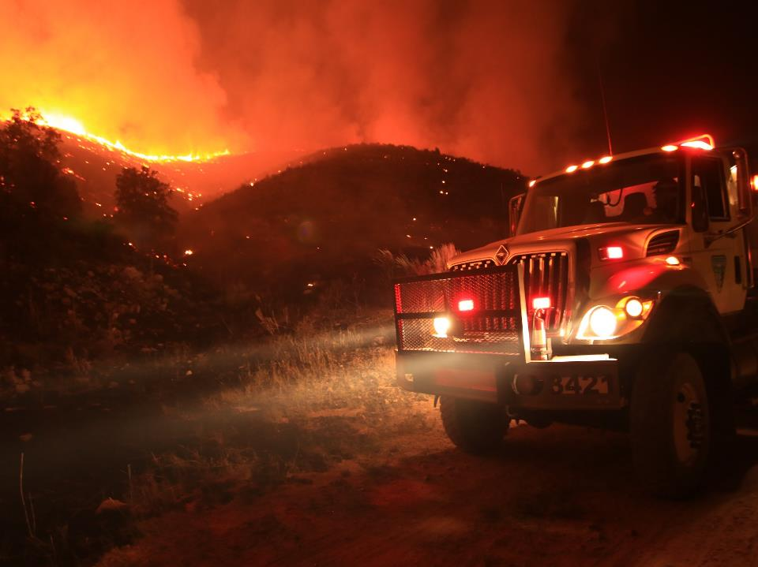
Post Off-Road Inspection Checklist
Steering
Tires/Rims
Brakes
Drive train
Suspension
Noxious weeds
11
Notes:
Post Off-road Inspection Checklist
When leaving post off-road driving conditions and before driving onto a solid road surface, perform a quick visual vehicle inspection addressing the items below.
Steering - Ensure there are no bent or broken tie rod, tie rod ends, steering stabilizer, and sway bar.
Tires/Rims - Ensure there is no rock(s) in the duals, no bent or broken rims, loose lug-nuts, and no cut/gouged/bulging/underinflated tires.
Brakes - Ensure brake pods are not bent/dented/broken, brake lines are not broken/bulging or dangling, and the vehicle does not pull when braking.
Drive Train - Ensure drivelines are not dented/bent, carrier bearings and driveline hoops are in place, disengage 4X4 and low range, disengage locking hubs (if equipped).
Suspension - Ensure there are no bent/broken spring/shock mounts, no cracked or shifting springs, no dented or leaking shock absorbers, and no bent/broken U-bolts.
Noxious Weeds – Ensure the undercarriage is free from debris buildup or noxious weeds.

Slide 12
Post Off-Road Inspection
12
Notes:
This incident was caused by loose lug nuts.

Slide 13
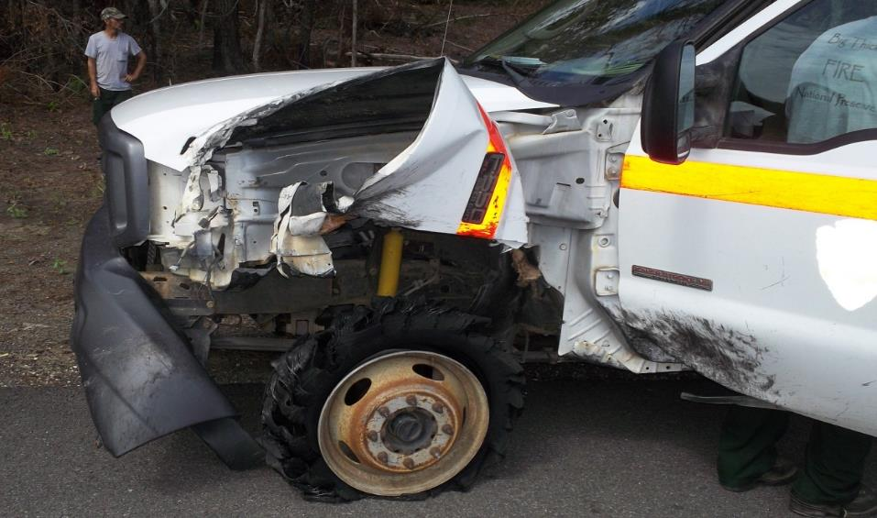
Post Off-Road Inspection
13
Notes:
This tire blew while driving at highway speeds. Was it damaged on a fire and missed on the post-fire inspection?

Slide 14
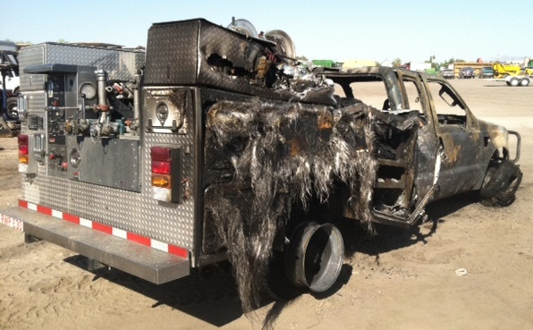
Post Off-Road Inspection
14
Notes:
This incident was caused by leaving the hubs locked in and driving at highway speeds. Eventually the drive-train failed catastrophically, igniting a fire and destroying the vehicle.

Slide 15
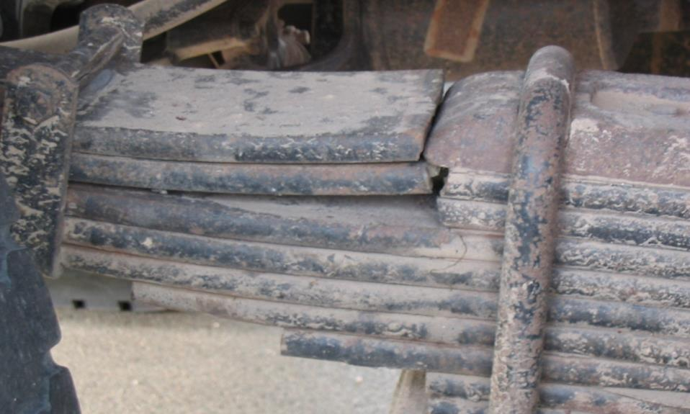
Post Off-Road Inspection
15
Notes:
This vehicle has a broken main leaf spring. Is this vehicle safe to drive?

Slide 16
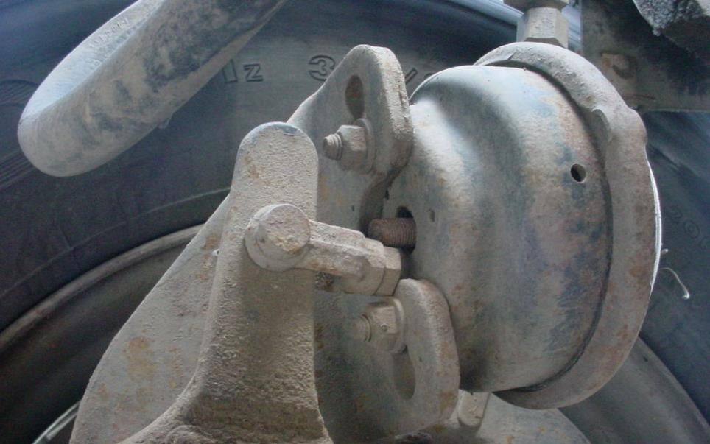
Post Off-Road Inspection
16
Notes:
This is a broken air brake push rod. Would this vehicle pull to one side?

Slide 17
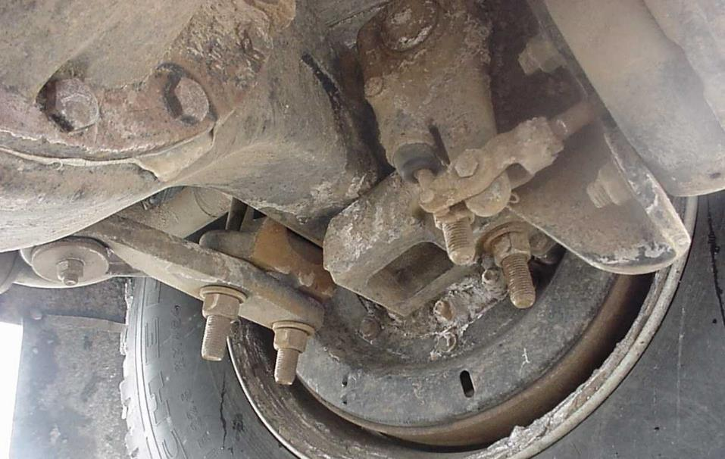
Post Off-Road Inspection
17
Notes:
This is a broken axle plate. Is this vehicle safe to drive?

Slide 18
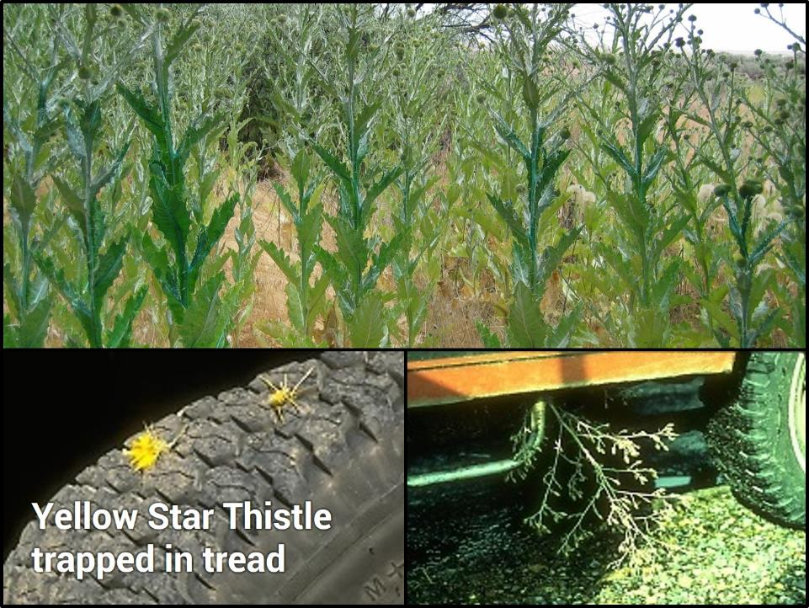
Post Off-Road Inspection Noxious Weeds
18
Notes:
Noxious Weeds
Check the undercarriage for debris.
When working in noxious weed infested areas, ensure the vehicle is cleaned according to local policy.

Slide 19
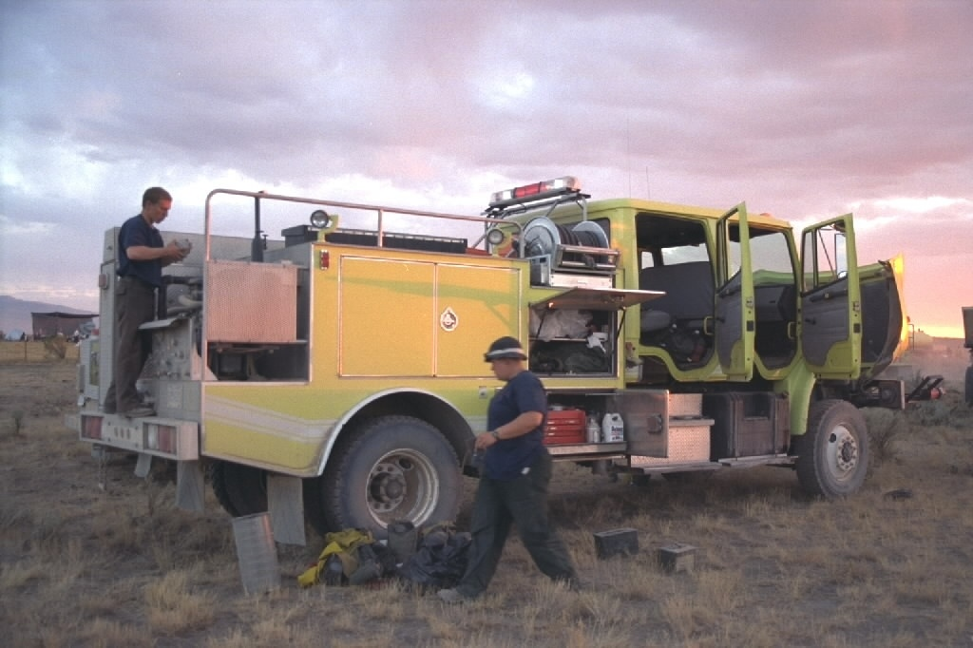
Engine Fire Readiness
(Post-Incident)
Items to clean and inspect
  Engine
  Undercarriage
  Tools
  PPE
19
Notes:
Engine Fire Readiness
Inspect and clean the following items following an incident:
Engine
Undercarriage
Tools
PPE

Slide 20
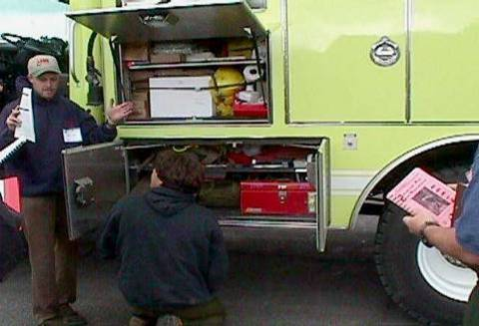
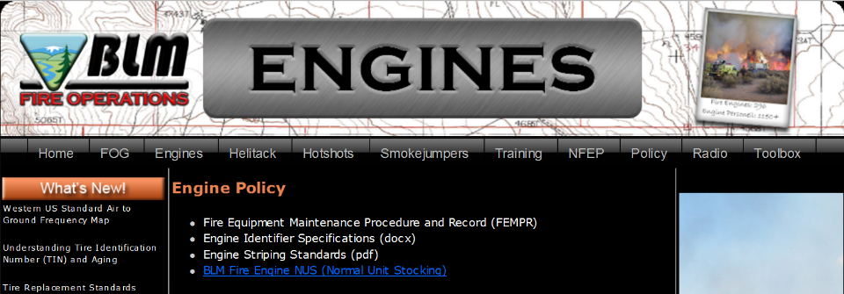
Normal Unit Stocking (NUS)
http://web.blm.gov/internal/fire/fire_ops/engine_policy.htm
20
Notes:
Normal Unit Stocking (NUS)
The NUS is the official documentation of items on board the engine.
Check for missing or damaged items; replace or repair at the appropriate site.
Ensure the NUS items are documented and kept current.
Ensure the vehicle meets the NUS (Normal Unit Stocking) found on the BLM Fire Operations internal website (http://web.blm.gov/internal/fire/fire_ops/engine_policy.htm)
Equipment/NUS Replacement
In-District/Local Area Process
Understand the in-district/local area equipment/NUS replacement process.
Agency-specific damage/loss forms
Local purchases, approval process, charge codes, etc.
Off-District/Out-of-Area Process
Understand and become informed on off-district/out-of-area processes.
BLM engine modules should follow the Interagency Incident Business Management Handbook (NFES 2160) – property loss/damage process.

Slide 21
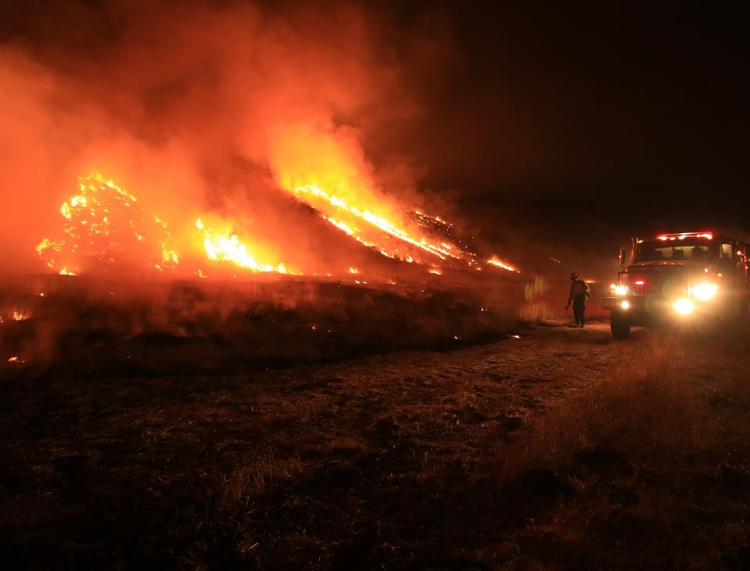
Incidents With a Supply Unit
To obtain general supply items, fill out a “General Message” form.
  Line supervisor signature may be required.
For fire replacement and damaged items:
  Fill out an “Incident Replacement Requisition”
  (OF-315).
  Compare the NUS to items being replaced or are damaged.
  Line supervisor and/or supply approval process must be met.
  Supply Unit personnel approve/deny replacement and assign “S” numbers.
21
Notes:
Incidents with a Supply Unit
To obtain general supply items, fill out a “General Message” form.
Line supervisor signature may be required.
For fire replacement and damaged items:
Fill out an “Incident Replacement Requisition” (OF-315).
Compare the NUS to items being replaced or are damaged.
Line supervisor and/or supply approval process must be met.
Supply Unit personnel approve/deny replacement and assign “S” numbers.
Many incidents require more documentation for tracking purposes. You may need to fill out a “Property Loss or Damage Report” (OF-298) and have Compensation/Claims, Ground Support, Communications, or Supply Unit approval, as well as you line supervisor’s approval (sometimes Division/Group Supervisor or above).

Slide 22
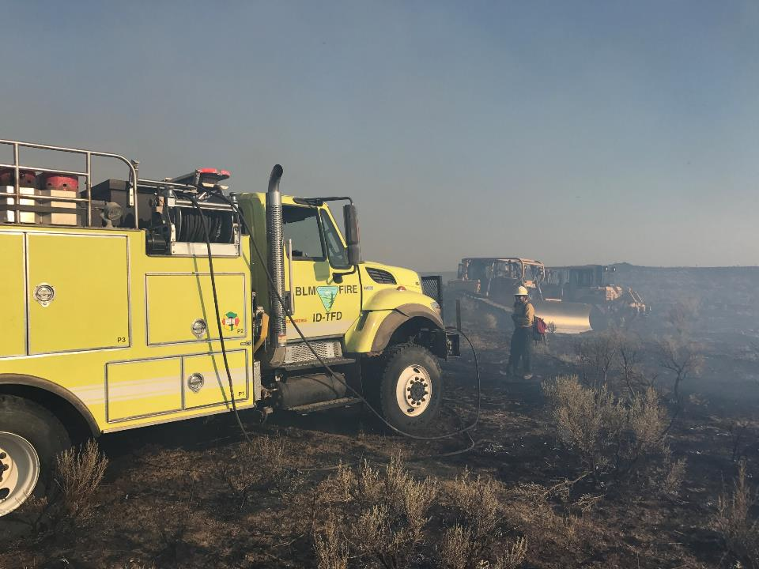
Incidents Without a Supply Unit
Fill out an “Incident Replacement Requisition” (OF-315).
Obtain line supervisor approval for use of the OF-315 and obtain “S” number(s) for expanded dispatch.
22
Notes:
Incident Without a Supply
Fill out an “Incident Replacement Requisition” (OF-315).
Obtain line supervisor approval for use of the OF-315 and obtain “S” number(s) from expanded dispatch.
Many units also require the use of a “Property Loss or Damage Report” (OF-289).

Slide 23
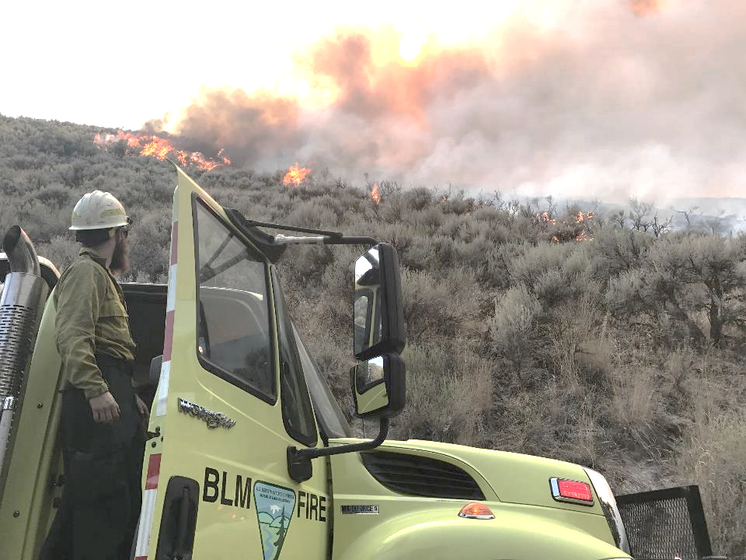
Damage or Repair Reporting and Documentation
Report and document damage to the engine or repairs to a fireline supervisor.
Complete proper documentation for the severity of damage before leaving any incident.
  “Incident Replacement Requisition” (OF-315)
  “Property Loss and Damage Report” (OF-289
  “Report of Accident/Incident” (DI-134)
  “Motor Vehicle Accident Report” (SF-91)
  “Motor Vehicle Accident Statement of Witness” (SF-94)
23
Notes:
Damage or Repair Reporting and Documentation
Report and document damage to the engine or repairs needed on the engine to a fireline supervisor.
Complete proper documentation for the severity of damage before leaving any incident. Forms may include:
“Incident Replacement Requisition” (OF-315)
“Property Loss and Damage Report” (OF-289
“Report of Accident/Incident” (DI-134)
“Motor Vehicle Accident Report” (SF-91)
“Motor Vehicle Accident Statement of Witness” (SF-94)

Slide 24
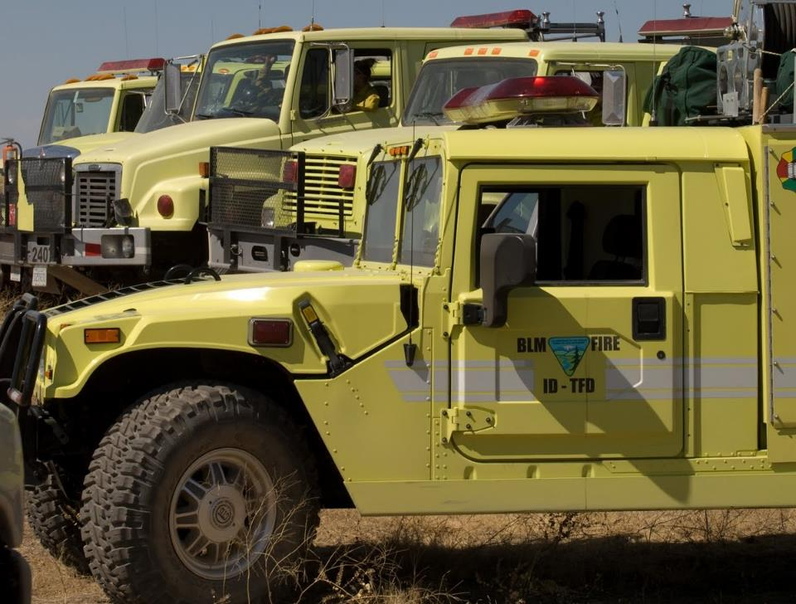
Vehicle Watch Out Situations
Skid plate/diesel particulate filter (DPF)
Radiator screen
Rock(s) between the duals
24
Notes:
Vehicle Watch Out Situations
Skid Plates/DPF
Brush and grass debris buildup can and has caused fires, resulting in loss of vehicles.
Radiator Screens
If not cleaned, the plugged screens can cause overheating and damage to the engine.
Rocks in the Duals
Rocks can cause flat tires, damage to other vehicles, and body damage to your vehicle.

Slide 25
Objectives
Complete all fire engine and post off-road inspections as identified in the Fire Equipment Maintenance Procedure Record (FEMPR).
Correctly enter all information in the Fire Equipment Maintenance Procedure Record (FEMPR).
25
Notes:
Objectives:
Complete all fire engine and post off-road inspections as identified in the Fire Equipment Maintenance Procedure Record (FEMPR).
Correctly enter all information in the Fire Equipment Maintenance Procedure Record (FEMPR).

