Slide 1
Fire Engine Maintenance
Unit 1C – Pump Inspections and Maintenance
Version: January 2023

Slide 2
Objectives
Inspect a pump package and describe pump maintenance procedures as outlined in the FEMPR.
Correctly enter all pump information in the FEMPR.
Conduct a pump performance test and record the results in the FEMPR.

Slide 3
Objectives
Discuss winterization procedures as outlined in the FEMPR.
Troubleshoot and correct common problems with the pump and pump plumbing.

Slide 4
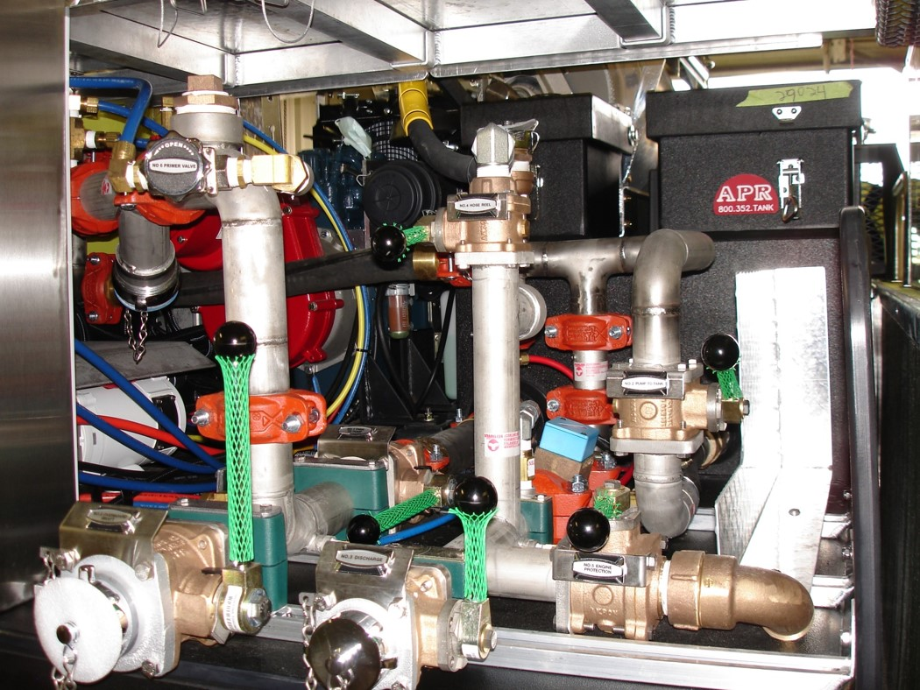
Pump Package Inspection

Slide 5
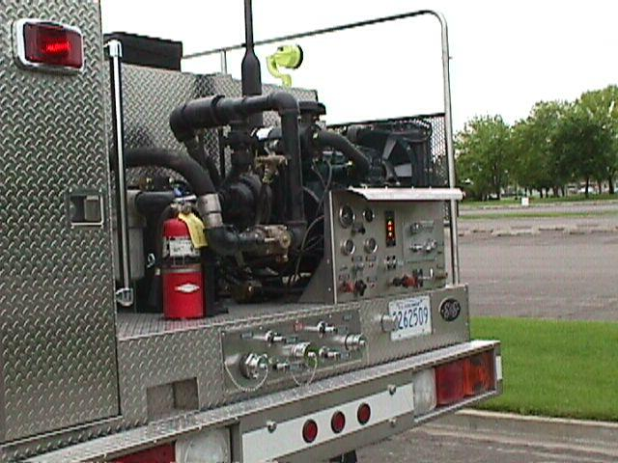
Pump Package

Slide 6
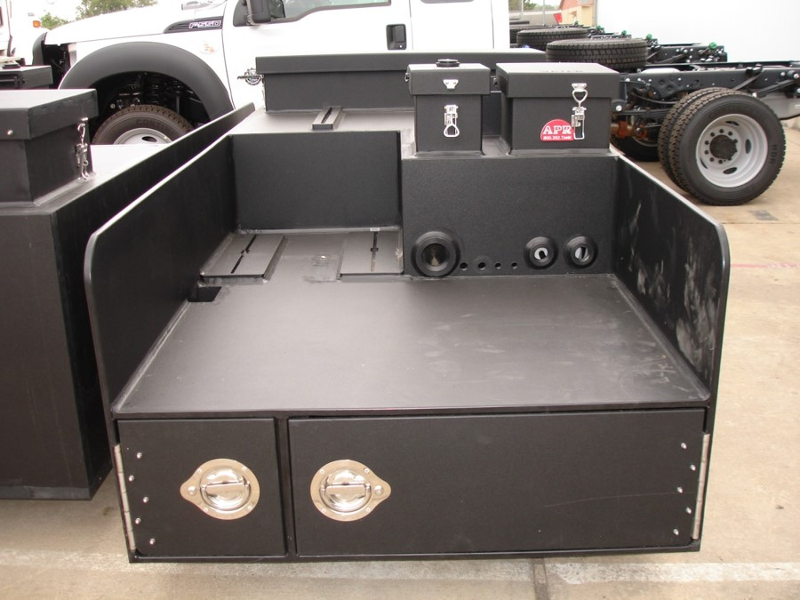
Water Tank and Foam Tank

Slide 7
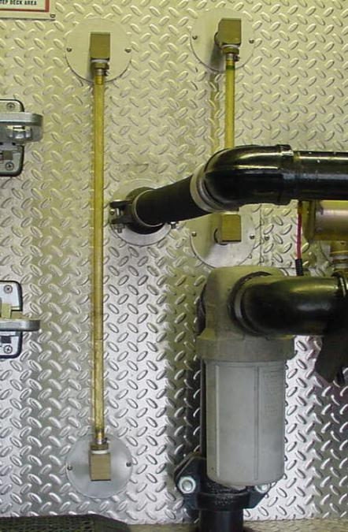
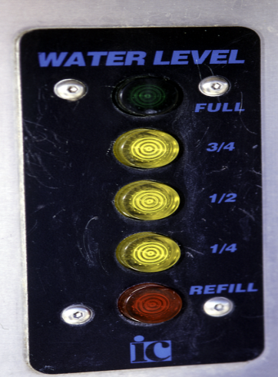
Sight and Water Level Gauges

Slide 8
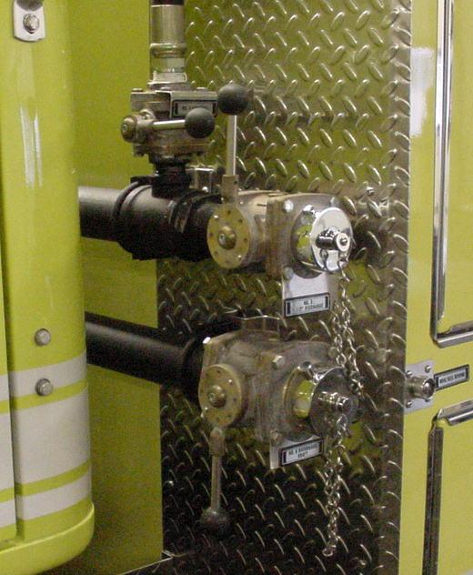
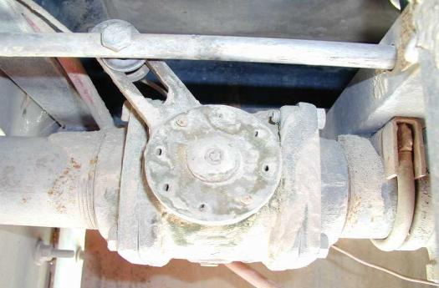
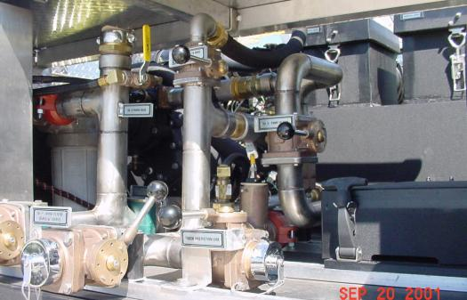
Valves

Slide 9
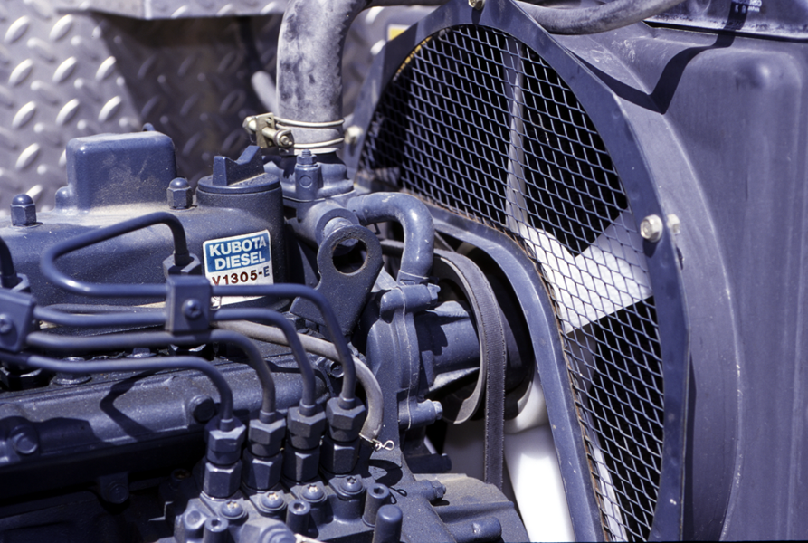
Coolant

Slide 10
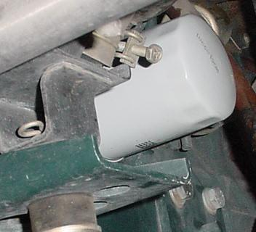
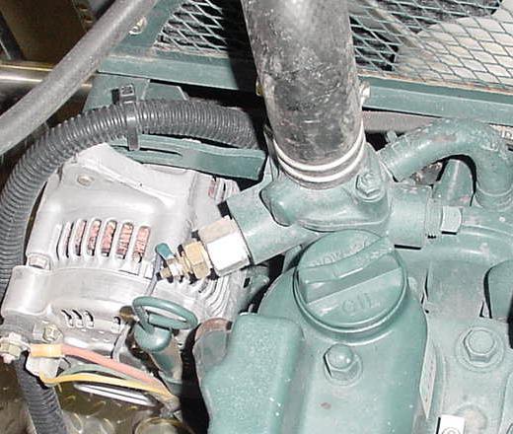
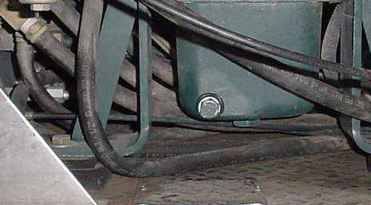
Oil
Notes:
Change oil as required from the pump motor manufacturer. It’s a good idea to write with a permanent marker on the filter when the next service is due or when the last service was completed.

Slide 11
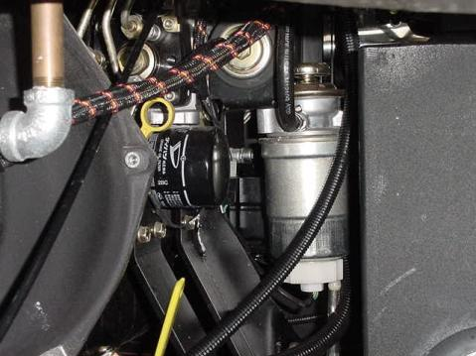
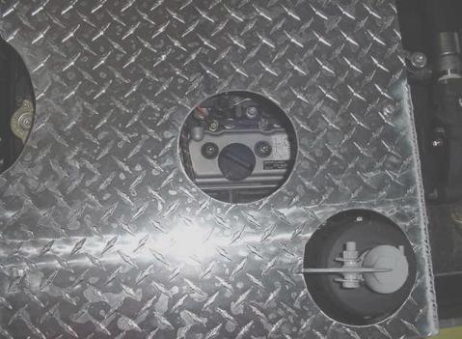
Oil Check and Fill
Oil level is checked with the dipstick. Due to different motors that are used on all our equipment you may have to hunt to find the dipstick.
Oil is added at the fill cap located on the top of the pump engine.

Slide 12
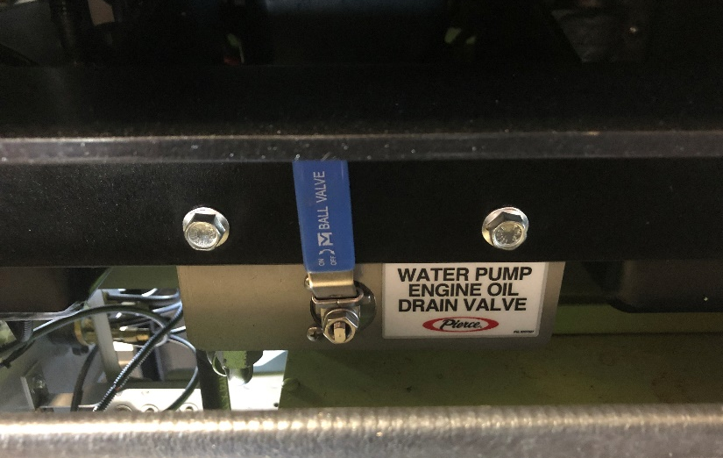
Oil Drain
Oil drain is located under the motor, and the remote drain valve will be labeled.
Drain is used to change oil.
Oil drain hose empties under the rear of the truck. A cap will be on the end of the hose to prevent accidental draining of the engine oil.

Slide 13
Oil Filter
Oil filter is located next to the dipstick.
Filter should be changed when oil is changed.

Slide 14
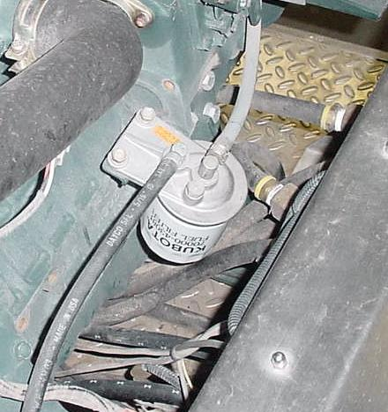
Fuel Filter
Notes:
Change when doing oil change service.

Slide 15
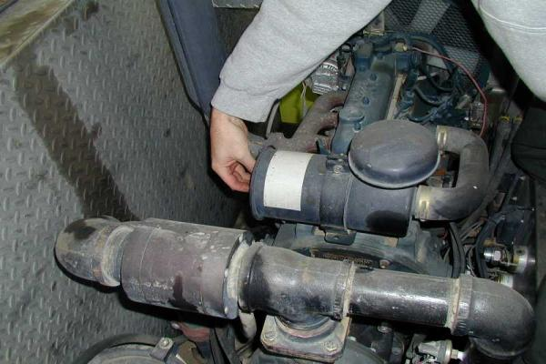
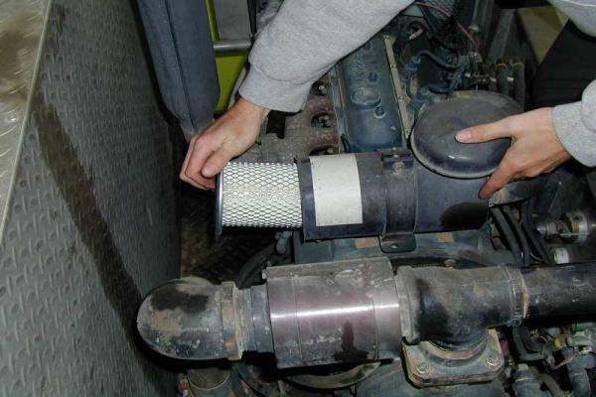
Air Filter(s)
Notes:
Lightly tap out filters away from open air intake system.
Never blow out an air filter!!!
Change as needed.
Check for dirt intrusion past the filter.
Air filters are cheaper that a new motor.

Slide 16
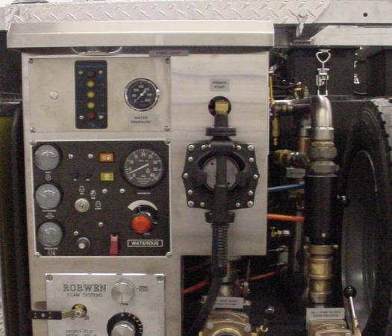
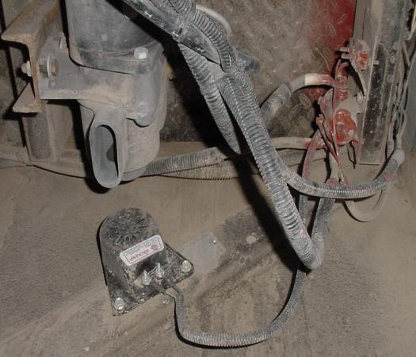
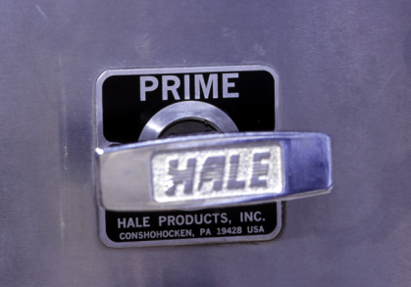
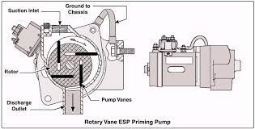
Primer
Notes:
Check operation, Hand primers tend to develop cracks in the rubber diaphragm and can leak or not pull a prime. Electrical primers may need to be rebuilt if the vanes get damaged.

Slide 17
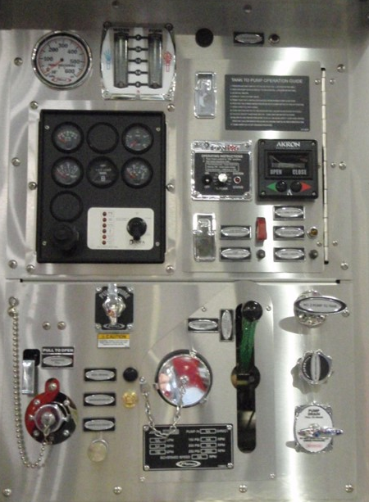
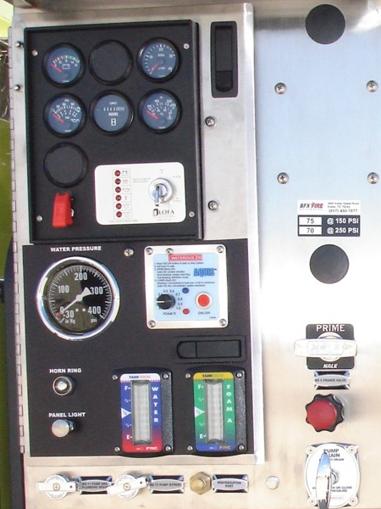
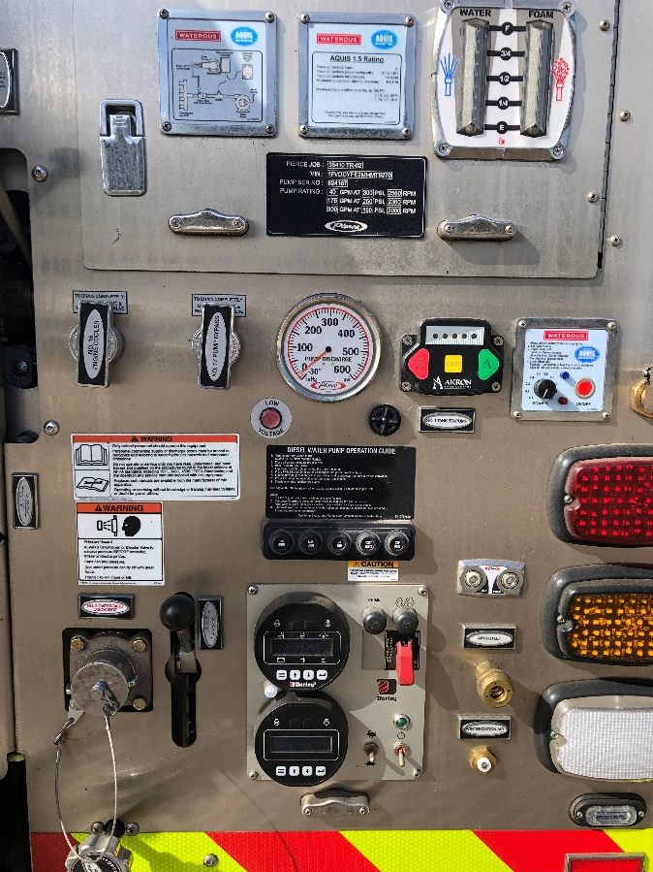
Switches, Glow Plugs, & Throttle
Notes:
New/Different pump panels may be seen on our fire engines. Take some time to learn and train on how they operate.

Slide 18
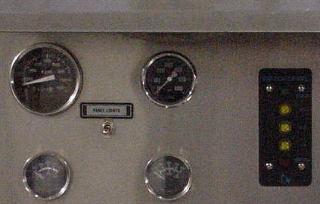
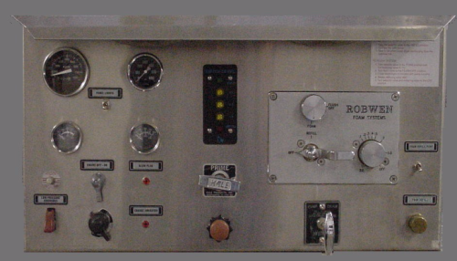
Gauges
Water Pressure Gauge
Water Tank Level Master Gauge
RPM Gauge
Engine Temperature Gauge
Oil Pressure Gauge
Notes:
Check that gauges are working.

Slide 19
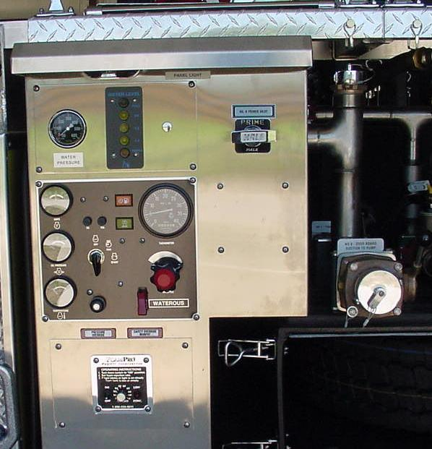
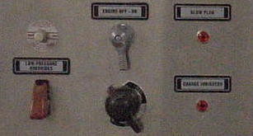
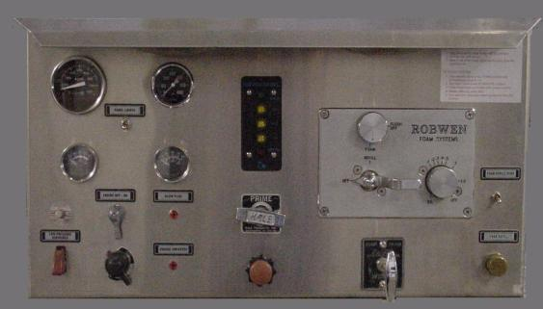
Water Pressure Safety Shutdown Switch

Slide 20
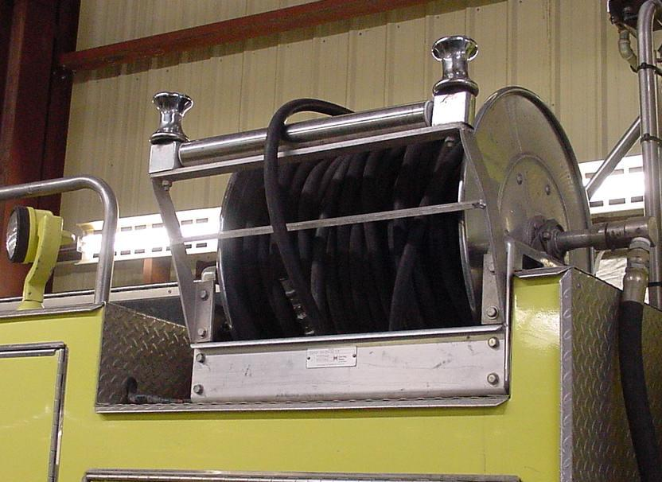
Live Reels
Notes:
Check for correct operation and that there are no damage to the hoses.

Slide 21
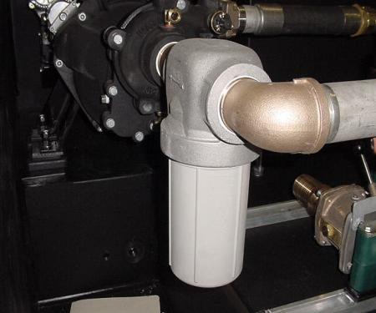
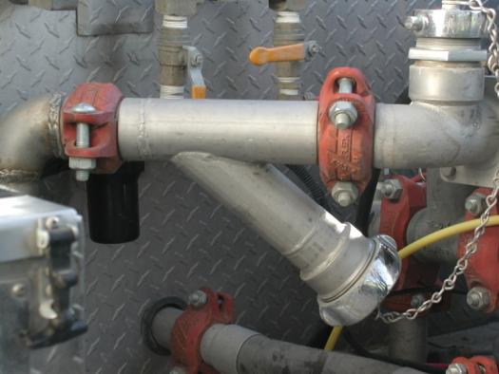
Water Inline Strainer

Slide 22
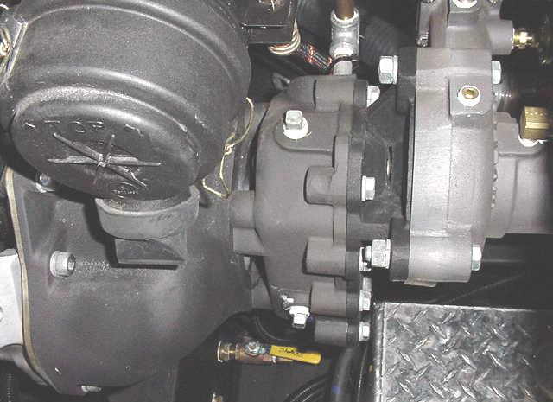
Pump Mounting Bolts
Notes:
Tighten bolts if loose, add lock tight if needed.

Slide 23
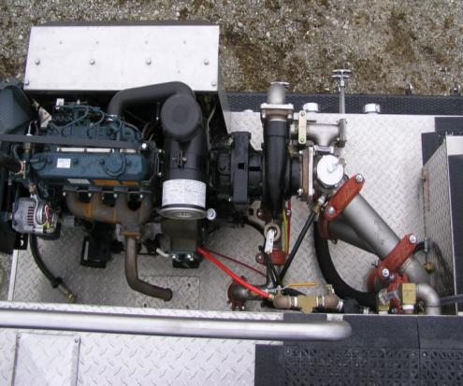
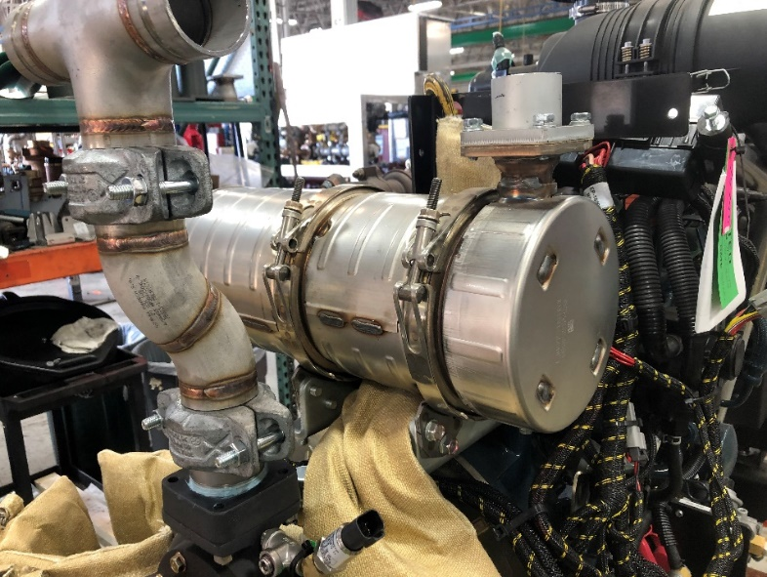
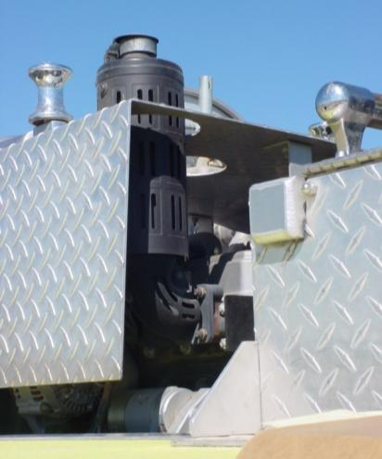
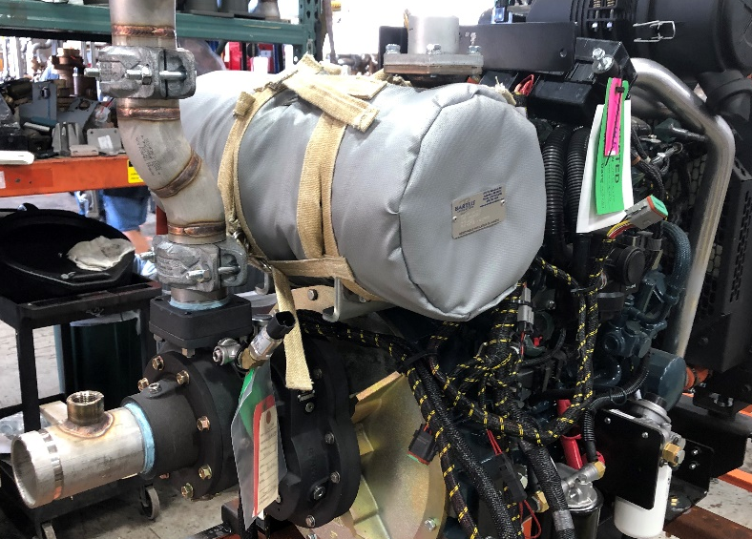
Pump Exhaust

Slide 24
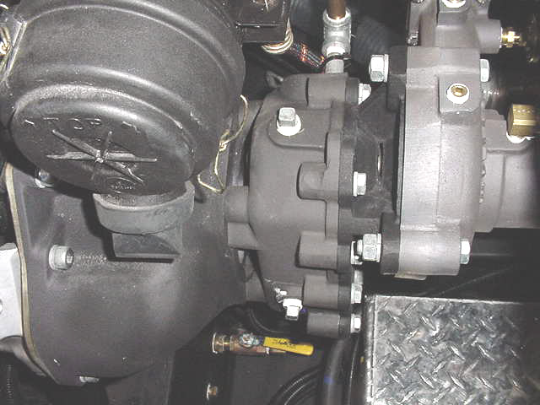
Gear Box
Gear Oil Fill Plug
Gear Oil Level Plug
Notes:
Darley gear box level is checked on the front of the gear face with a small allen wrench.
The fill locations are any larger size plugs on the side of the gear box.
Check the vent for dirt, if plugged it can cause seal damage and or leaks.

Slide 25
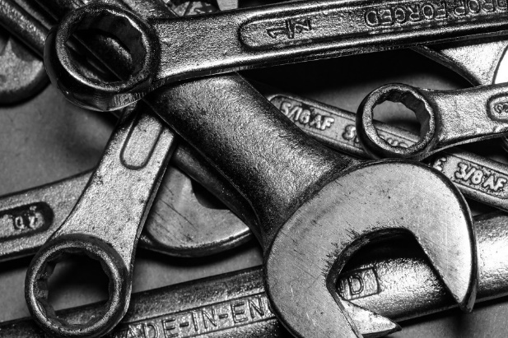
Pump Maintenance Requirements
Basic Service
Change oil and filters per the pump motor manufacturer’s recommendation or local policy.
Change gear oil every 50 pump hours.
Change fuel filter when changing pump motor oil.
Check bolts for tightness weekly.
Clean or replace air filter as needed.
Never blow out an air filter.
Check for leaks.
Document the service in the FEMPR.
Notes:
Look in the manuals that are provided with the fire engine to see the recommended service intervals.
Document all services that are completed in the FEMPR.
If not doing the work yourself, verify that the shop has completed the repairs/service correctly.

Slide 26
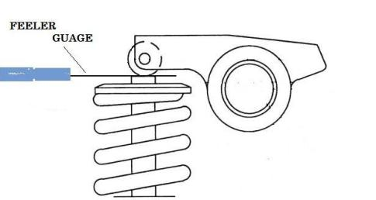
Yearly Pump Service
Annual Pump Motor Maintenance
Check “Service Record” in the FEMPR.
Change antifreeze every three (3) years.
Check belt and replace if needed.
At every 300 pump hours have a mechanic check and adjust the valve lash.
Check air filter system for leaks.
Check wiring for loose/worn wires.
Service foam system as directed in owner’s manual.

Slide 27
Pump Seal LeakS
The real question is how much and when?
Seals need water to cool the sealing surface between the seal and shaft.
An 11-15 drop per minute is acceptable while running at pressure.
Small leaks after sitting for hours/days may be OK.
Large leaks at pressure, the seal should be changed.
Document leaks and any repairs in the FEMPR.

Slide 28
Pump Seal
Notes:
Ceramic seal.
Left is ceramic part of seal assembly. The white part is the ceramic part with an o-ring outer seal.
The middle is the part that is glued to the pump shaft. The black part of that is a strong carbon ring that wears into the ceramic seal.
Right part is a spring to keep the sealing surfaces in good contact with each other.
Prolong cavitation of the pump can damage and break the sealing causing leaks. Water is used to cool the ceramic/carbon ring surfaces as shown in the following slide.

Slide 29
Pump Seal

Slide 30
Pump Seal Maintenance
Order the right seals before disassembly.
Use the pump model and serial number. (Hint check the FEMPR.)
Read the instructions and ask questions get help if needed.
Can be downloaded from manufacturer’s website.
Take pictures if needed.
Keep area clean.
Do not rush or force anything.
Use a torque wrench; no impacts for reassembly.
Seal may need to seat/wear in after assembly; it could still leak for a while.
Pumping water for 30 minutes should seat the seal.

Slide 31
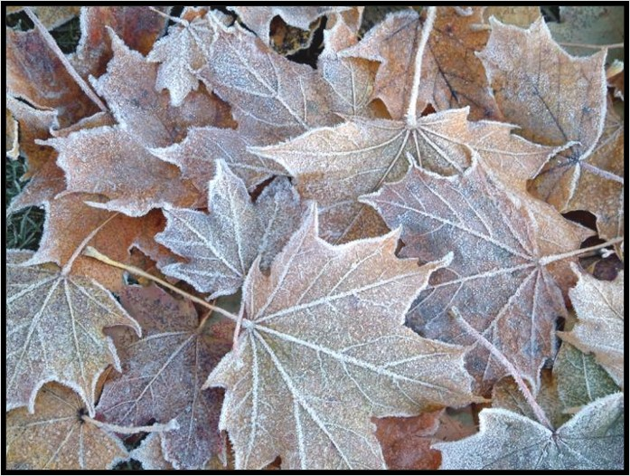
Winterization
Field or short-term
Full
Notes:
Discuss and demonstrate how to do a short-term winterization and what extra steps are required to do a full winterization. Maybe have the students discuss what would need to be done to do both. Then bring in the FEMPR and the pages to help them complete a proper winterization.
These can be work-stations or done to get the class out from the classroom with the help of cadre members.

Slide 32
Pump Performance Test Guidelines
Test according to FEMPR or local standards.
Use same discharge port.
Document test results and identify trends.
Notes:
This may be completed at a work-station or as an outside activity.
(smaller groups have better interactions and tend to learn the steps better).
(walk the small groups thru the test without the pump motor running so everyone can hear then have a couple of students perform a pump test while being supervised)

Slide 33
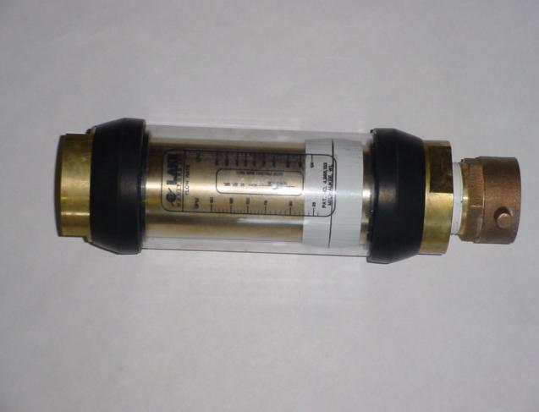
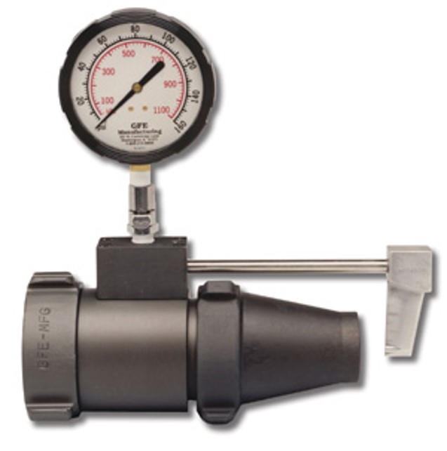
Commercial Certified Flow Meter

Slide 34
Troubleshooting
Lights
Not illuminated
Pump engine
Will not start
Starts but will not keep running
Starts and runs but no water pressure exists
Other problems
Notes:
Group discussion question: What problems have you have encountered?
As a group discuss a couple of the problems presented and how to troubleshoot them if they are not covered below. Use cadre experience to explain possible causes.
Utilize daily PM checks to troubleshoot issues. Have students present their findings and how they corrected the issues.

Slide 35
Objectives
Inspect a pump package and describe pump maintenance procedures as outlined in the FEMPR.
Correctly enter all pump information in the FEMPR.
Conduct a pump performance test and record the results in the FEMPR.

Slide 36
Objectives
Discuss winterization procedures as outlined in the FEMPR.
Troubleshoot and correct common problems with the pump and pump plumbing.

