Slide 1
Fire Engine Maintenance
Unit 1C – Pump Inspections and Maintenance

Slide 2
Objectives
Inspect a pump package and describe pump maintenance procedures as outlined in the FEMPR.
Correctly enter all pump information in the FEMPR.
Conduct a pump performance test and record the results in the FEMPR.

Slide 3
Objectives
Discuss winterization procedures as outlined in the FEMPR.
Troubleshoot and correct common problems with the pump and pump plumbing.

Slide 4
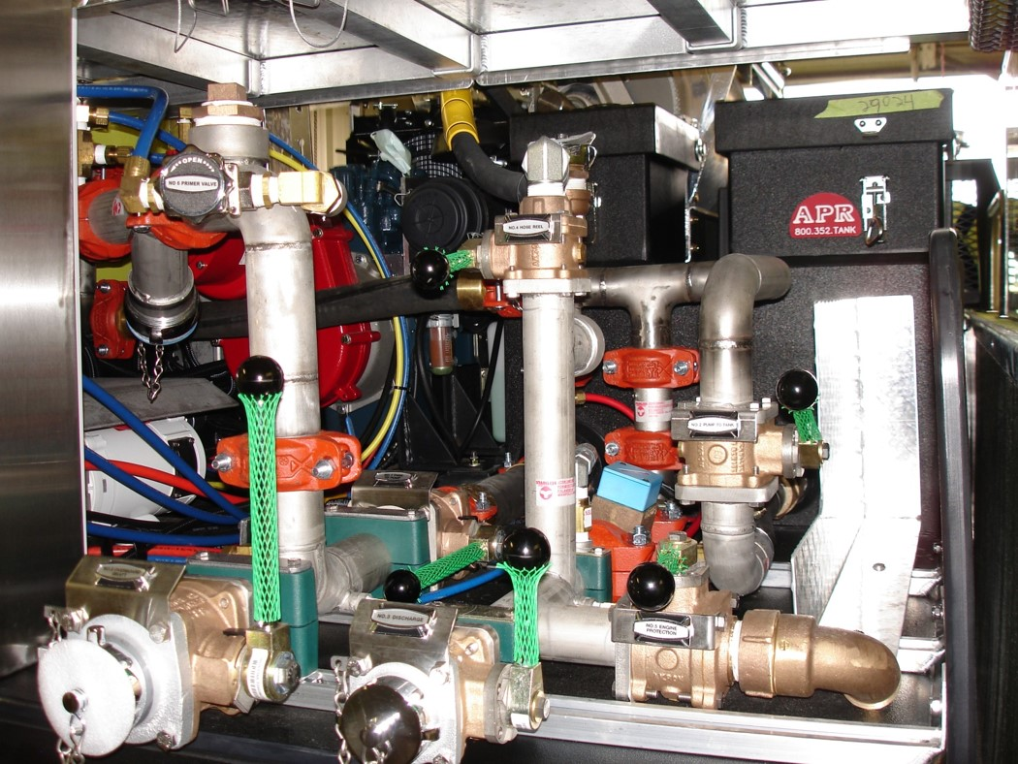
Pump Package Inspection

Slide 5
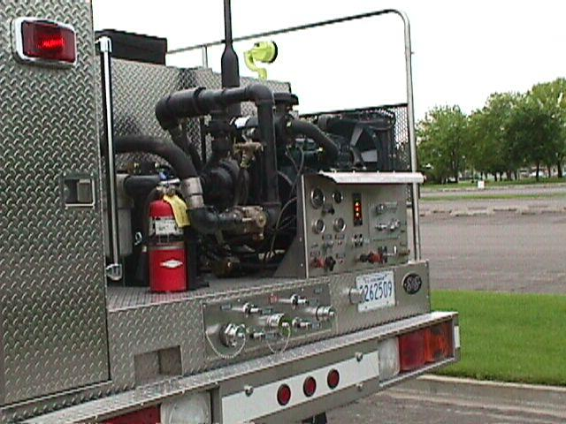
Pump Package

Slide 6
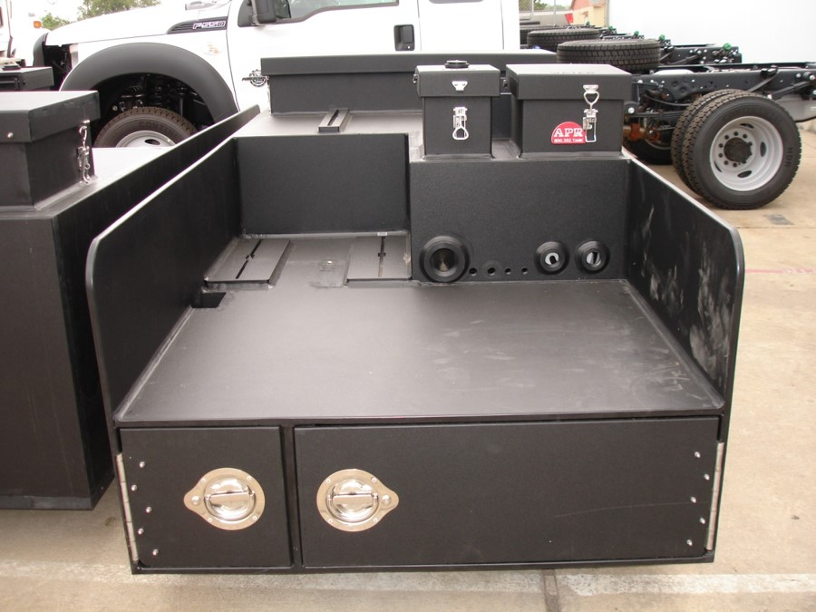
Water Tank and Foam Tank

Slide 7
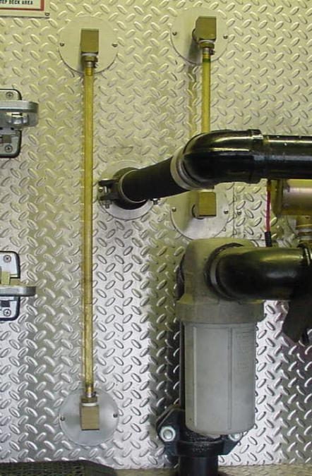
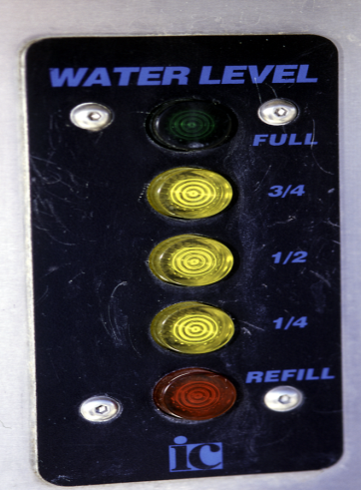
Sight and Water Level Gauges

Slide 8
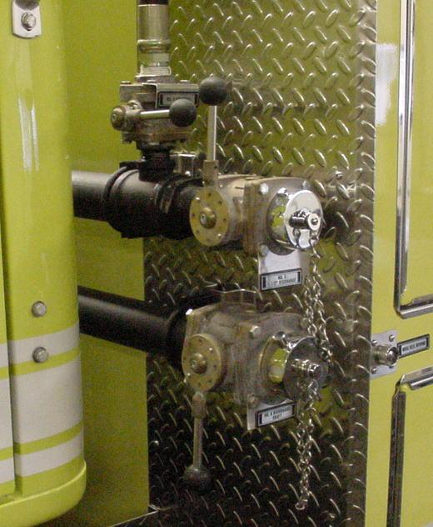
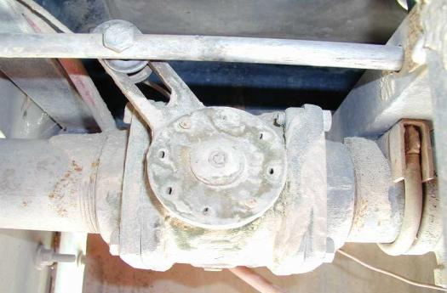
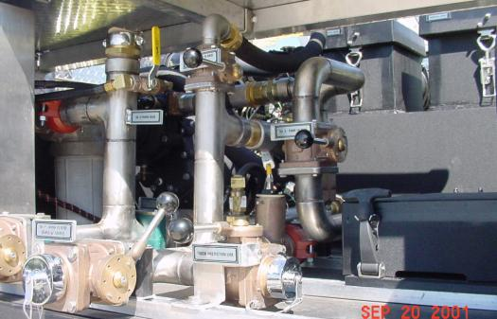
Valves

Slide 9
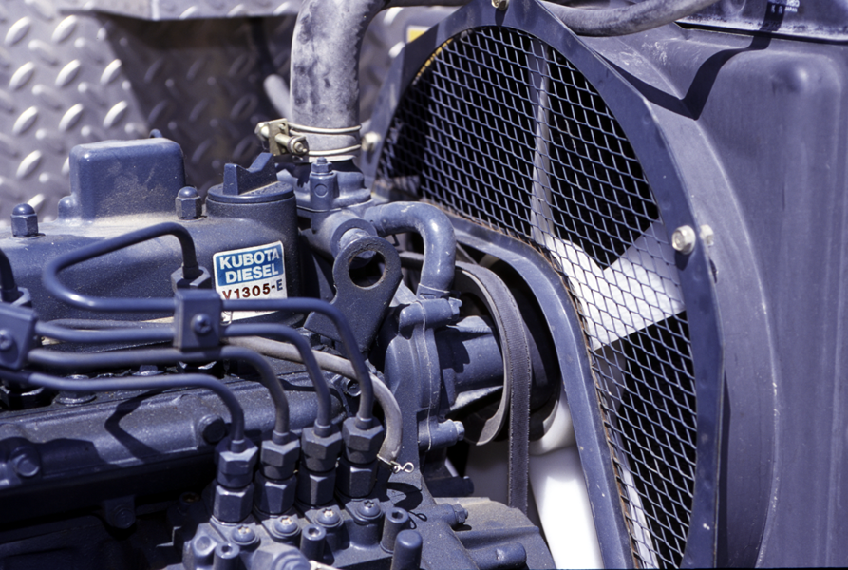
Coolant

Slide 10
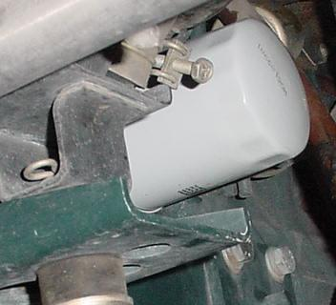
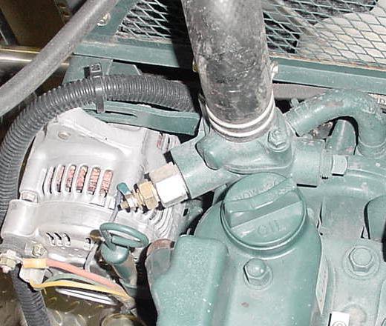
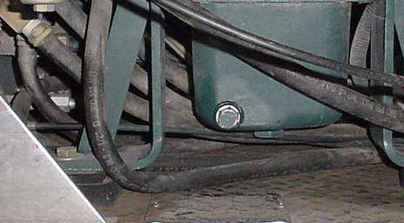
Oil

Slide 11
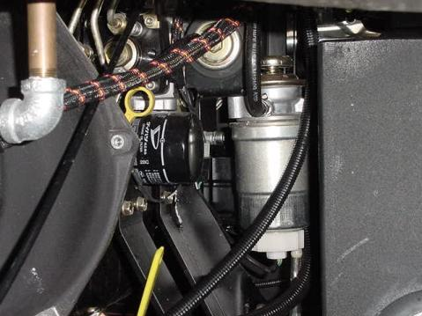
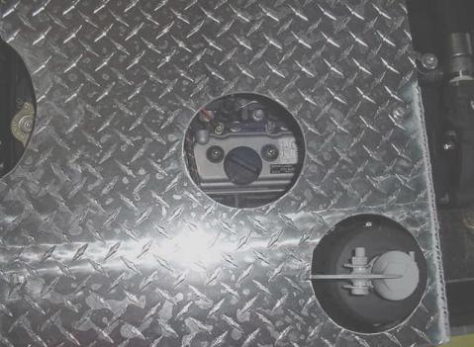
Oil Check and Fill
Oil level is checked with the dipstick on the right side of the pump engine.
Oil is added at the fill cap located on the top of the pump engine next to the exhaust.

Slide 12
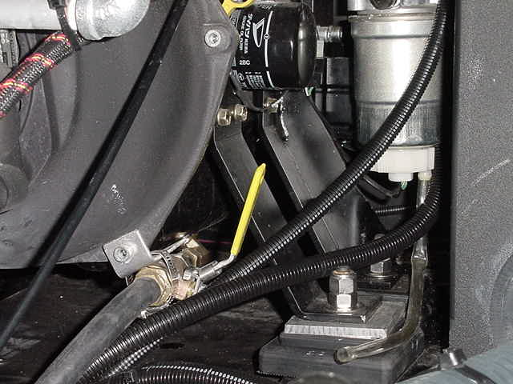
Oil Drain
Oil drain is located at the bottom on the right side of the pump engine.
Drain is used to change oil.
Oil drain hose empties under the rear of the truck on the left side.

Slide 13
Oil Filter
Oil filter is located next to the dipstick.
Filter should be changed when oil is changed.

Slide 14
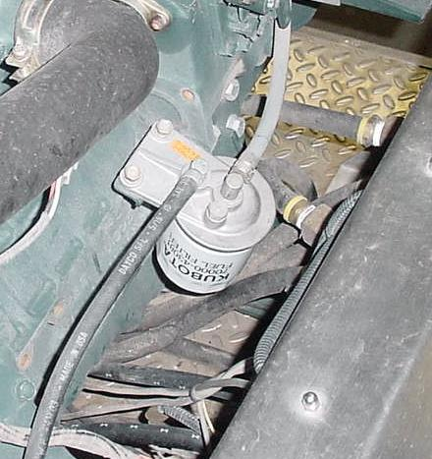
Fuel Filter

Slide 15
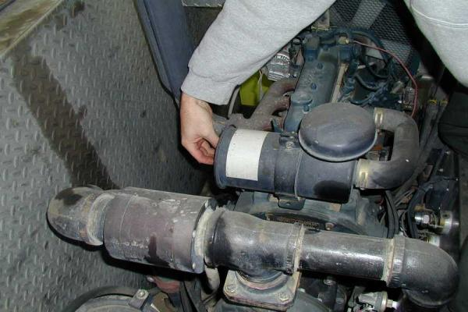
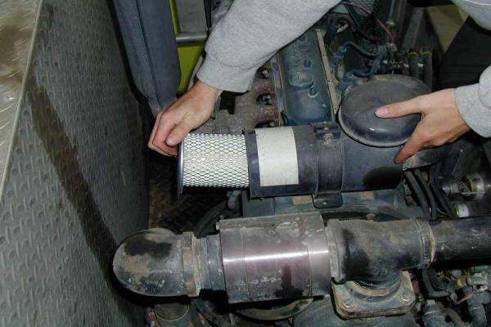
Air Filter(s)

Slide 16
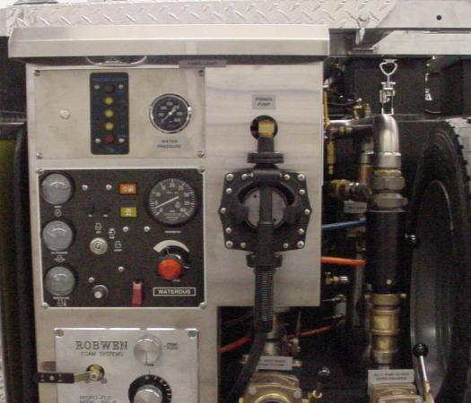
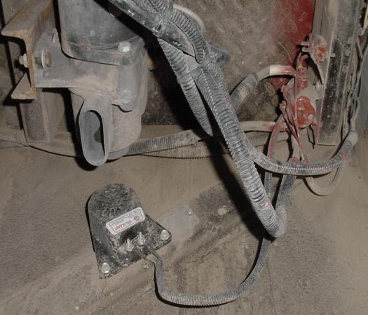
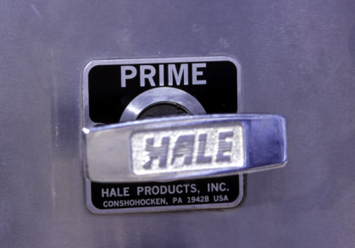
Primer

Slide 17
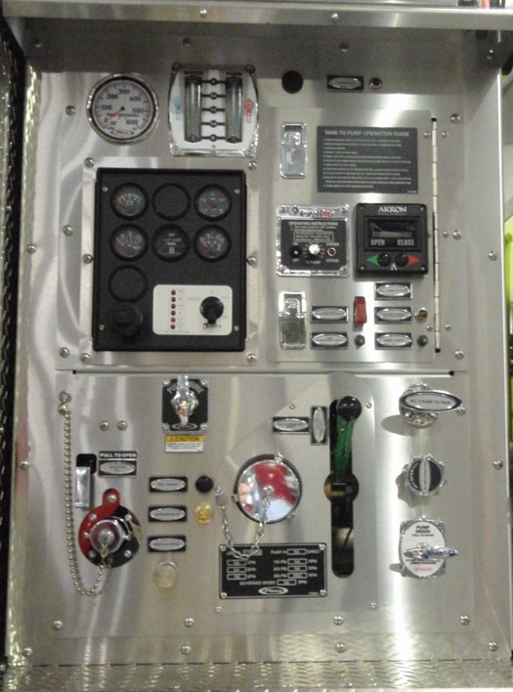
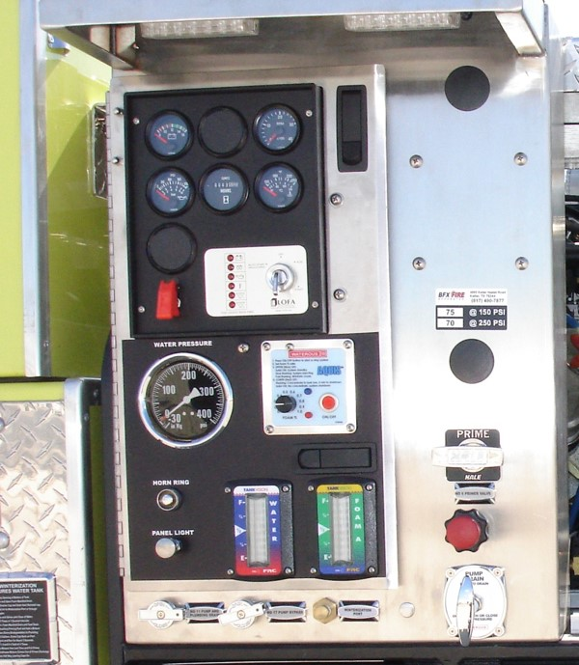
Switches, Glow Plugs, & Throttle

Slide 18
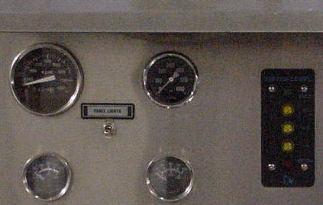
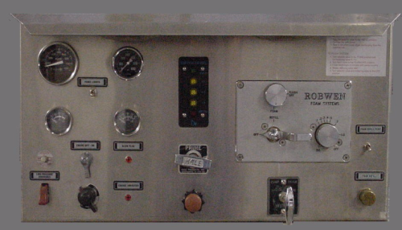
Gauges
Water Pressure Gauge
Water Tank Level Master Gauge
RPM Gauge
Engine Temperature Gauge
Oil Pressure Gauge

Slide 19
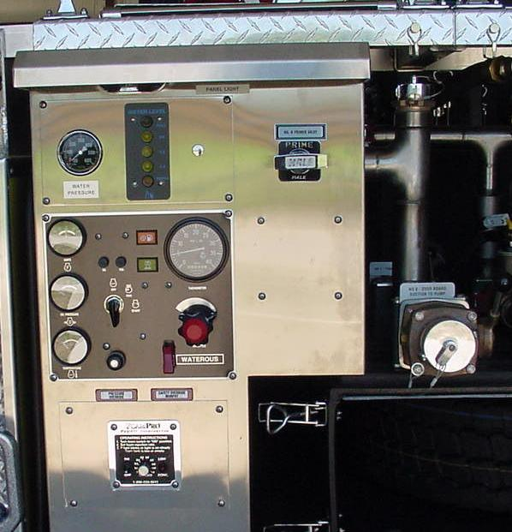
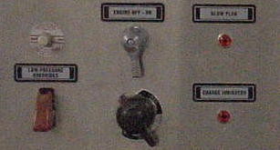
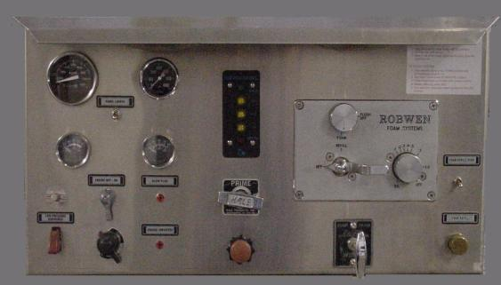
Water Pressure Safety Shutdown Switch

Slide 20
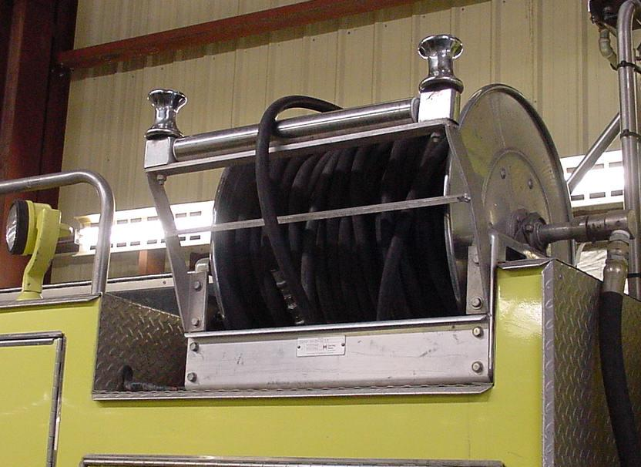
Live Reels

Slide 21
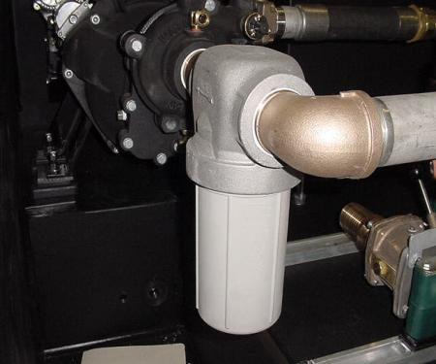
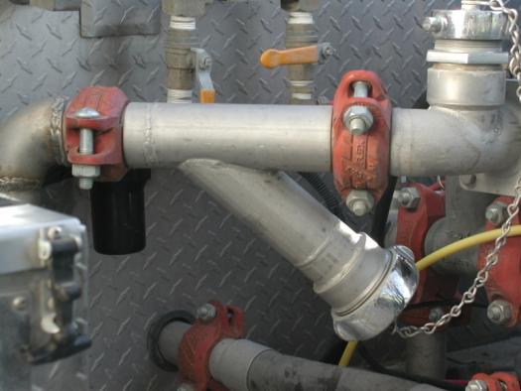
Water Inline Strainer

Slide 22
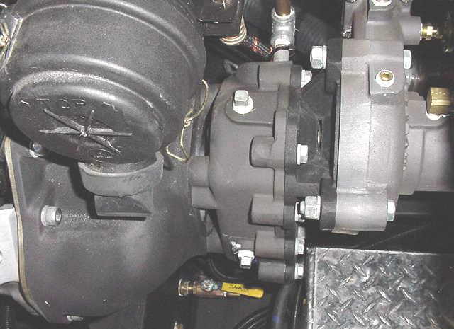
Pump Mounting Bolts

Slide 23
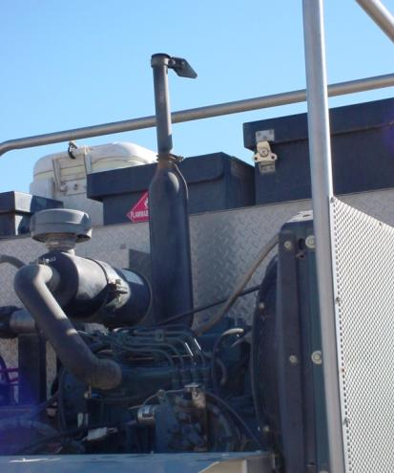
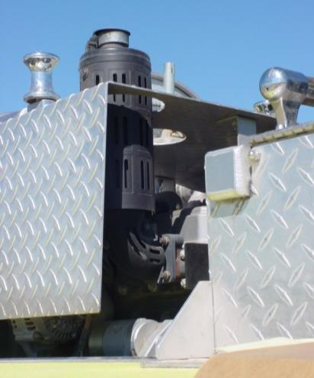
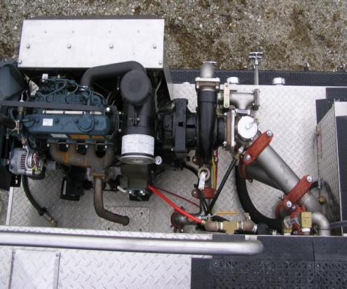
Pump Exhaust

Slide 24
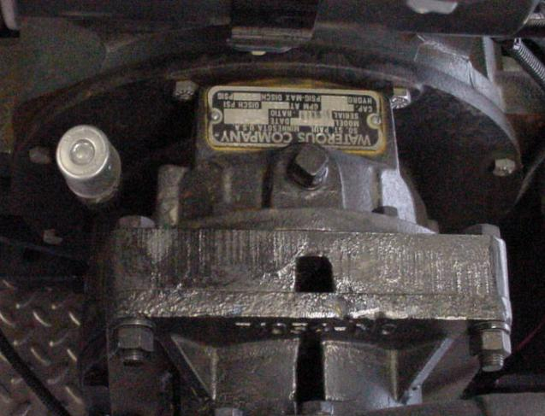
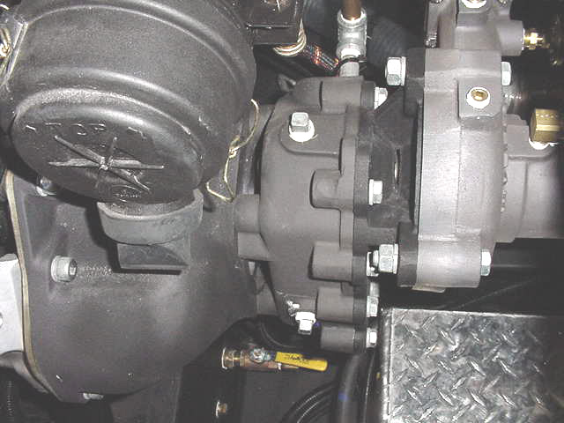
Gear Box
Gear Oil Fill Plug
Gear Oil Level Plug

Slide 25
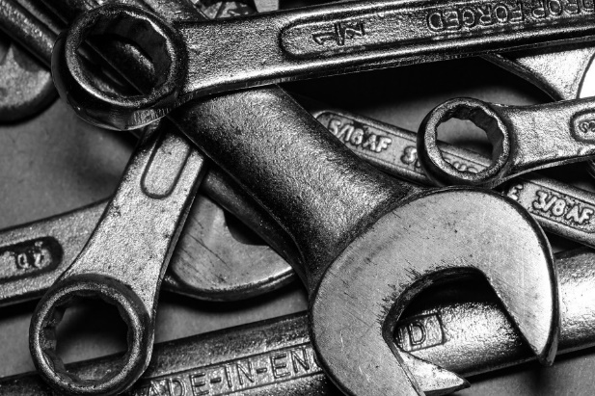
Pump Maintenance Requirements
Basic Service
Change oil and filter every 50 pump hours.
Change gear oil every 50 pump hours.
Change fuel filter every 100 pump hours.
Check bolts for tightness weekly.
Clean or replace air filter as needed.
Check for leaks.
Document the service in the FEMPR.

Slide 26
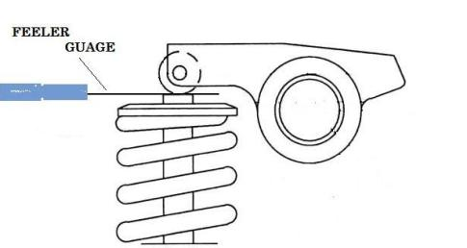
Yearly Pump Service
Annual Pump Motor Maintenance
Check “Service Record” in the FEMPR.
Change antifreeze every three (3) years.
Check belt and replace if needed.
At every 300 pump hours have a mechanic check and adjust the valve lash.
Check air filter system for leaks.
Check wiring for loose/worn wires.
Service foam system as directed in owner’s manual.

Slide 27
All Pump Seal Leak
The real question is how much and when?
Seals need water to cool the sealing surface between the seal and shaft.
An 11-15 drop per minute is acceptable while running at pressure.
Small leaks after sitting for hours/days may be OK.
Large leaks at pressure the seal should be changed.
Document leaks and any repairs in the FEMPR.

Slide 28
Pump Seal

Slide 29
Pump Seal

Slide 30
Pump Seal Maintenance
Order the right seals before disassembly.
Use the pump model and serial number. (Hint check the FEMPR.)
Read the instructions and ask questions get help if needed.
Can be downloaded from manufacturer’s website.
Take pictures if needed.
Keep area clean.
Do not rush or force anything.
Use a torque wrench; no impacts for reassembly.
Seal may need to seat/wear in after assembly; it could still leak for a while.
Pumping water for 30 minutes should seat the seal.

Slide 31
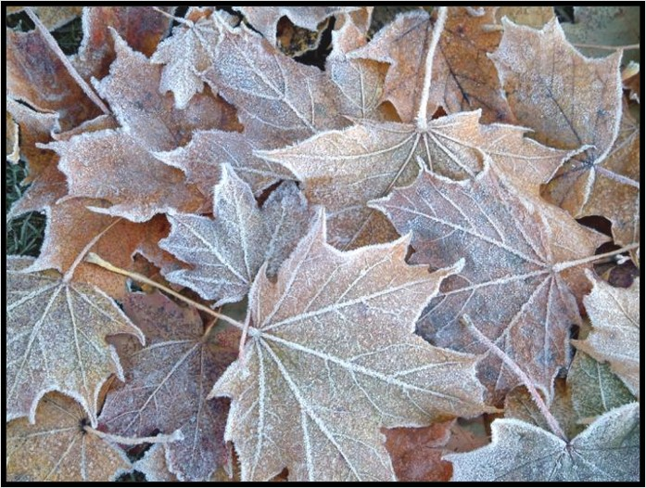
Winterization
Field or short-term
Full

Slide 32
Pump Performance Test Guidelines
Test according to FEMPR or local standards.
Use same discharge port.
Document test results and identify trends.

Slide 33
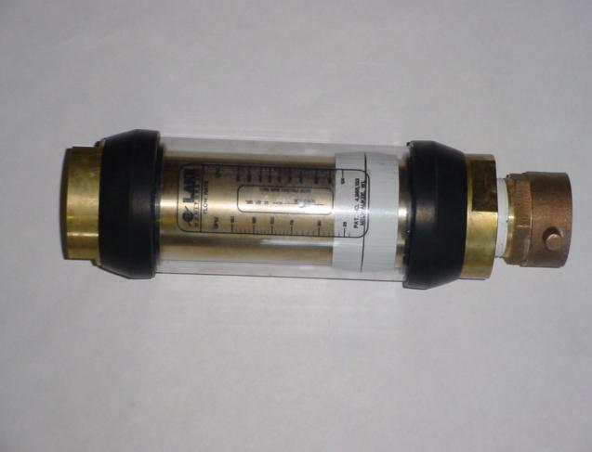
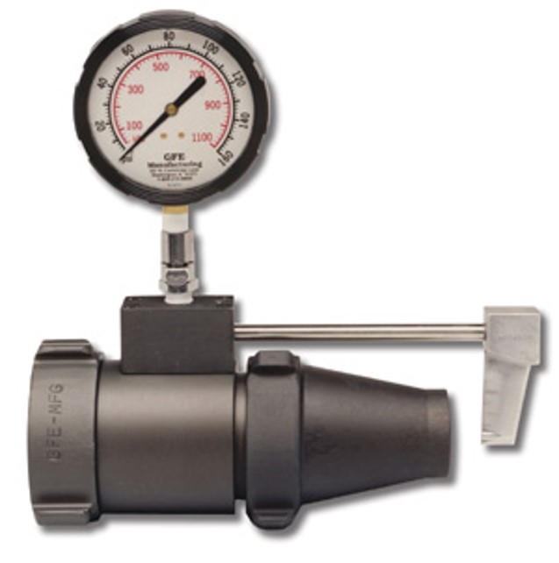
Commercial Certified Flow Meter

Slide 34
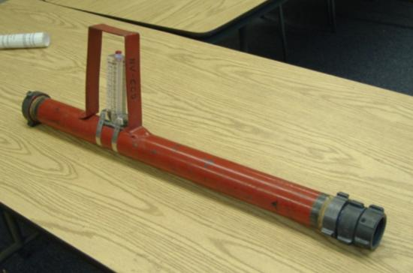
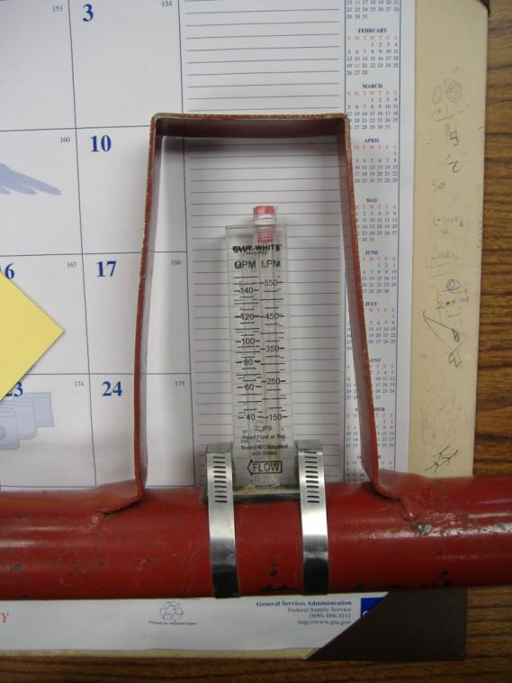
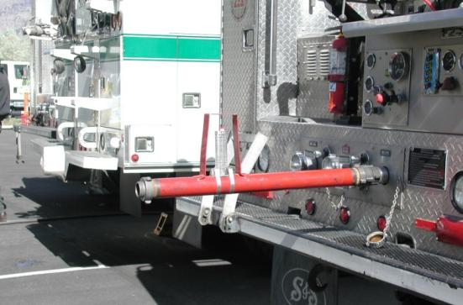
Non-Commercial Flow Meter

Slide 35
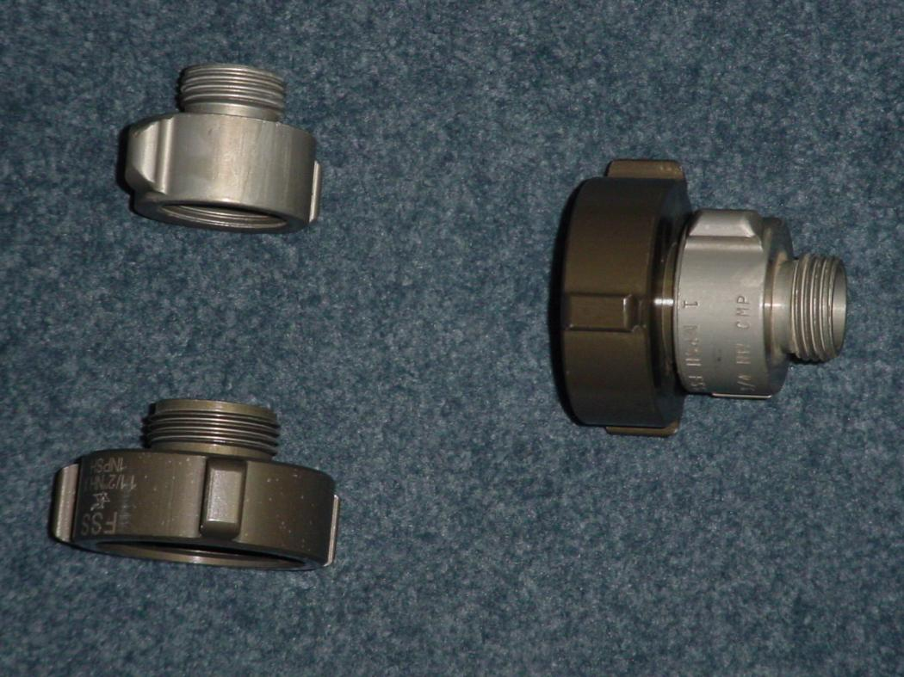
Homemade Pressure/Flow Tester

Slide 36
Troubleshooting
Lights
Not illuminated
Pump engine
Will not start
Starts but will not keep running
Starts and runs but no water pressure exists
Other problems

Slide 37
Objectives
Inspect a pump package and describe pump maintenance procedures as outlined in the FEMPR.
Correctly enter all pump information in the FEMPR.
Conduct a pump performance test and record the results in the FEMPR.

Slide 38
Objectives
Discuss winterization procedures as outlined in the FEMPR.
Troubleshoot and correct common problems with the pump and pump plumbing.

