Slide 1
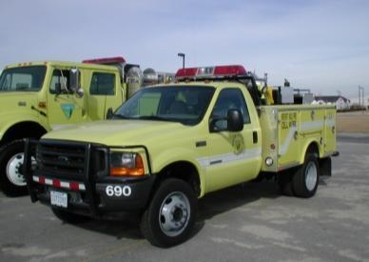
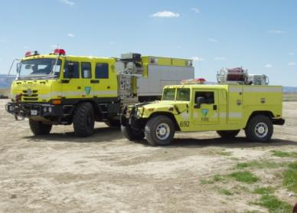
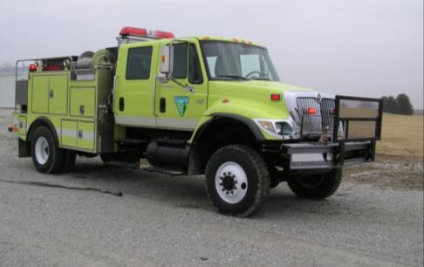
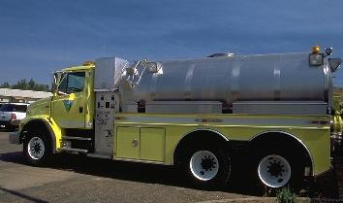
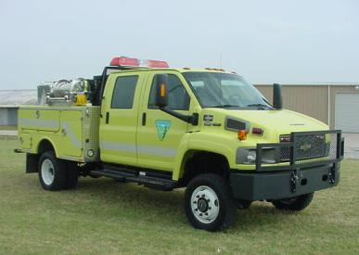
FLEET MANAGEMENT
UNIT 2
Version: January 2023

Slide 2
Objectives
Accurately identify expenditures that can be charged to the Working Capital Fund (WCF).
Discuss the ENOP’s fleet charge card responsibilities.
Explain the concepts of gross vehicle weight rating (GVWR), gross axle weight rating (GAWR), gross vehicle weight (GVW), and the ENOP’s role in maintaining proper GVW.
Identify items that are included in the vehicle use (log) book.

Slide 3
Objectives
Demonstrate the ability to complete and reconcile the “Utilization Record” (USDI/BLM Form 1520-042).
Explain the procedure an ENOP should follow when involved in a motor vehicle accident.
Explain fire engine warranty repairs and recall procedures.

Slide 4
Introduction to the Working Capital Fund
Notes:
The BLM WCF is managed by the BLM Fleet Manager at the National Operations Center, Denver. Replacement of fire vehicles that have reached the end of their service life and certain maintenance expenditures are managed through the WCF. Vehicle replacement and maintenance is accomplished with funds that are paid into the WCF over the life of the vehicle. The WCF collects funds through Fixed Ownership Rates (FOR) and Use Rates.

Slide 5
Fixed Ownership Rates (FOR)
Monthly hours- or miles-based fees that are assessed through the Automated Fleet Management System (AFMS) for each fire vehicle in service.
Assessed on a per-hour basis (BLM standard)
Accumulate over the life of a vehicle
Used to replace each vehicle at the end of its life cycle
Charged to the benefiting activity
Adjusted annually at a minimum (reflect changes in replacement costs for inflation and/or changes to benefitting activity)
Notes:
Revenues from FORs and expenditures for capitalized assets

Slide 6
Use Rates
Charged monthly based on a per-hour or per-mile basis for vehicle operating costs.
Independent of the FOR rates
Adjusted annually
May vary from year to year
Notes:
Revenues from use rates and expenditures for operating expenses.
Use rates are independent of the FOR rates and are adjusted annually to reflect all WCF costs associated with the administration, delivery, maintenance, and repair of vehicles in each vehicle class.
Use rates may vary from year to year, particularly in those vehicle classes which have low number of vehicles.

Slide 7
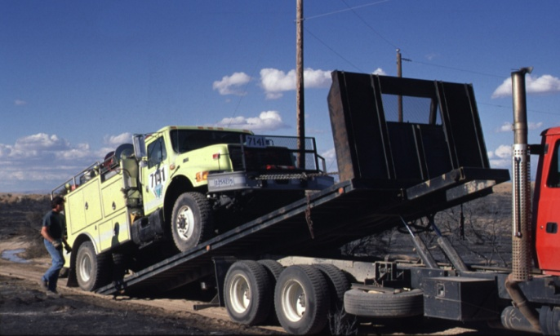
Use Rate Costs
Fuel
Repair/normal wear and tear on engine components
Tow charges resulting from mechanical breakdowns
Preventative maintenance
Overhead

Slide 8
Items WCF Covers
Normal wear and tear associated with use the vehicle was designed to perform.
Tires
Windshield wipers
Brakes
Shocks
Paint
Upholstery
Pumps
Lights
Scheduled/required maintenance and inspections
To service, replace and inspect fire vehicle components that were part of the initial vehicle build and options, as delivered to the BLM.
Mechanical failure unrelated to benefiting activity if there is no negligence or misuse associated with the damage.
Fire operations
Project work

Slide 9
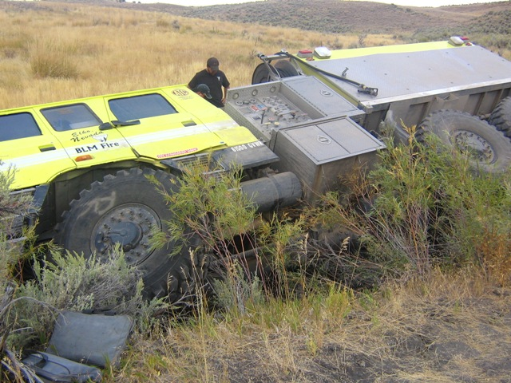
Items WCF Does Not Cover
Accident damage or repairs due to benefitting activity actions such as fire operations or other project work
Mechanical/component failure due to neglect or misuse
Towing charges related to accidents or getting stuck
Locally required vehicle modifications/add-ons/accessories
Light bars
Tools
Radios
Winches

Slide 10
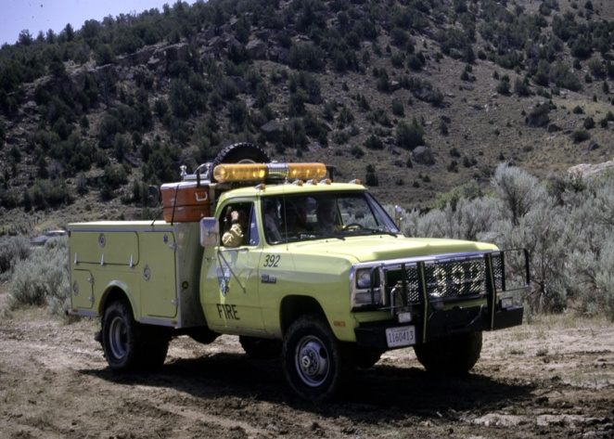
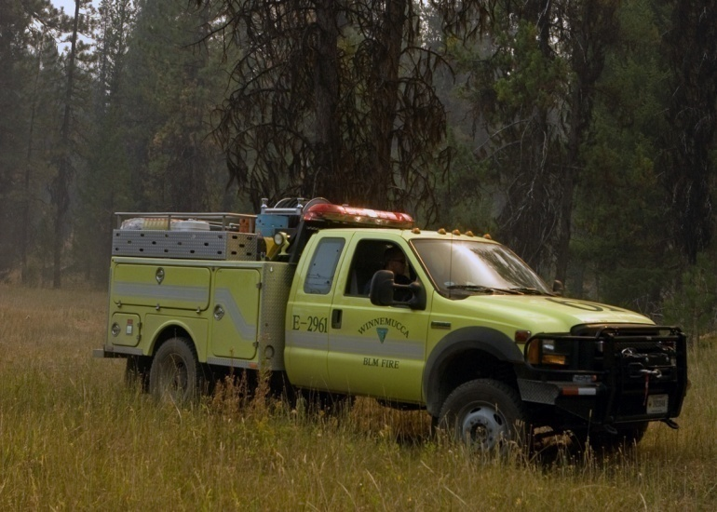
WCF Life Cycle
Predetermined period that vehicles of a given class are expected to be in service before they can be replaced.
Determined through evaluation of the historical amount of use and general durability for vehicles of that class.

Slide 12
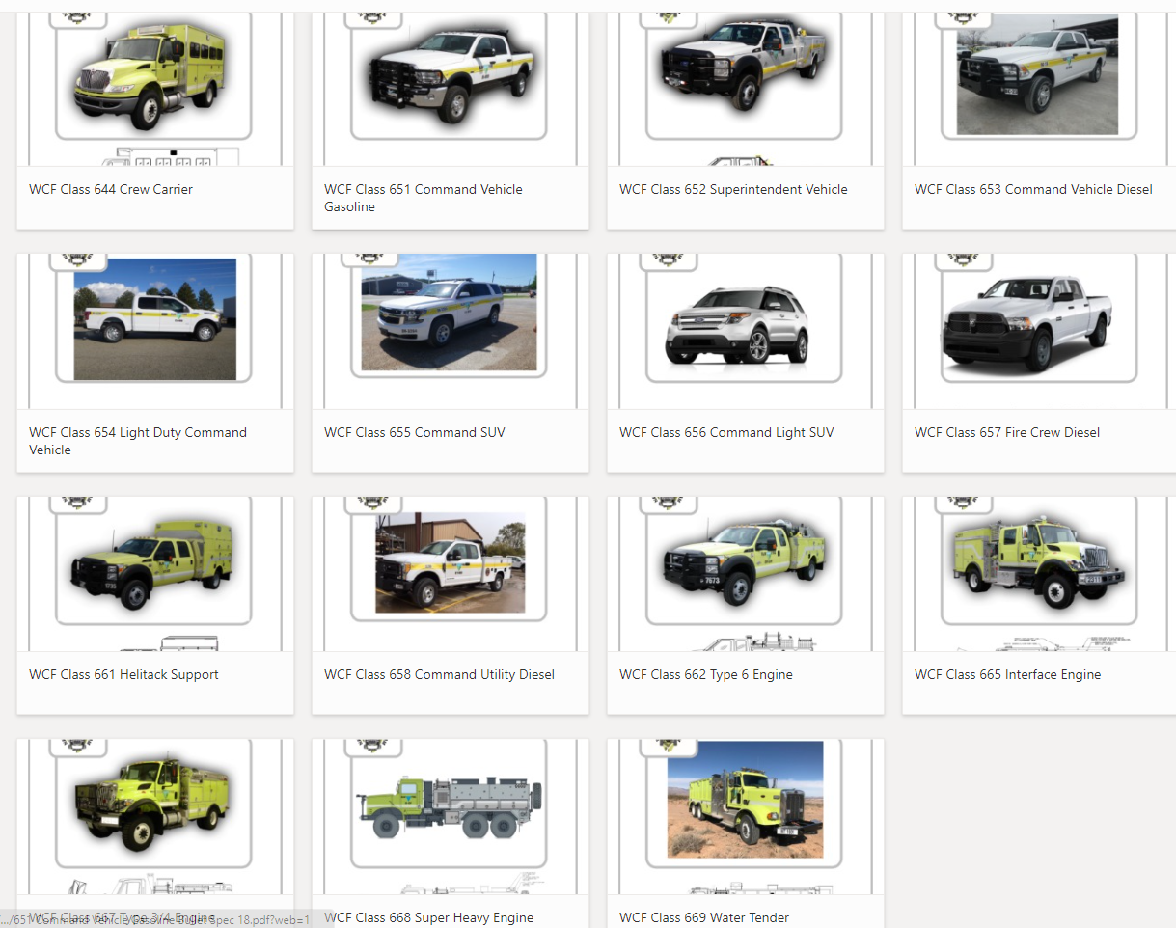
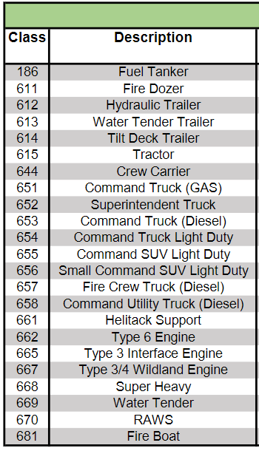
Equipment Classes

Slide 13
Fund Code Exercise Student Workbook pP. 59-60
Notes:
Complete scenarios 1-9, pp. 59-60 in the Student Workbook and page 18 in the Facilitator’s Guide.

Slide 14
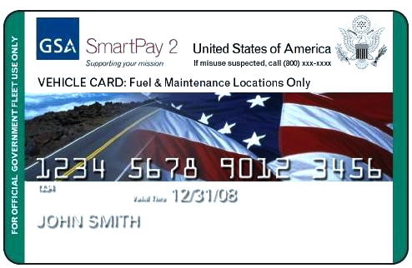
Fleet Charge Card

Slide 15
Fleet Charge Card Basics
Purchases restricted to the vehicle or piece of equipment to which the card is assigned.
Fuel costs for unleaded, non-premium fuel or fuel alternative
Emergency towing
Approved preventative maintenance (e.g., oil changes)
Approved repairs
Tolls
Parking
Note spending limits
Avoid abuse of limitations on authorized purchases.
Ensure vendor accepts the card prior to purchase.
Record purchases on the Utilization Record.
Safeguard the card.
Immediately notify the local Fleet Manager of problems with the card.

Slide 16
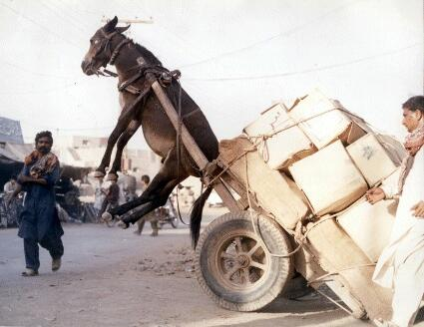
Gross Vehicle Weight (GVW)

Slide 17
What makes up the GVW?
GVW includes the total of
Vehicle weight
Fuel
Passengers
Water
Normal Unit Stocking (NUS or cargo and equipment)

Slide 18
ENOPs and the GVW
ENOPs are responsible for ensuring that the gross vehicle weight does not exceed maximum weight ratings.
When vehicles exceed maximum weight ratings:
Passengers are put at risk.
Poor handling on highways and off road may occur.
Mechanical break downs occur more often.

Slide 19
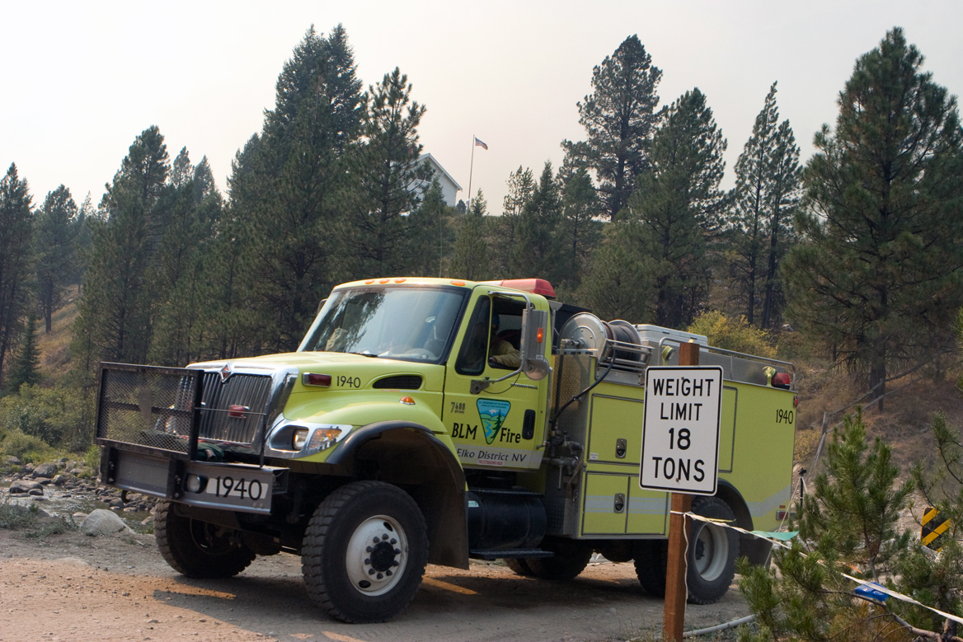
Weight-Restricted Bridges and Roads
ENOPs who know their vehicle’s GVW will know if they can travel on weight-restricted bridges and roads.

Slide 20
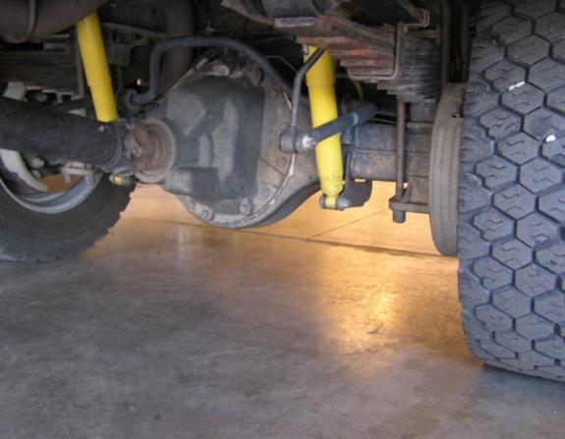
Chassis Manufacturer Weight Ratings
Gross Vehicle Weight Rating (GVWR)
The vehicle’s maximum load carrying capacity
Gross Axle Weight Rating (GAWR)
The maximum carrying capacity of an axle system as measured at the tire/ground interface

Slide 21
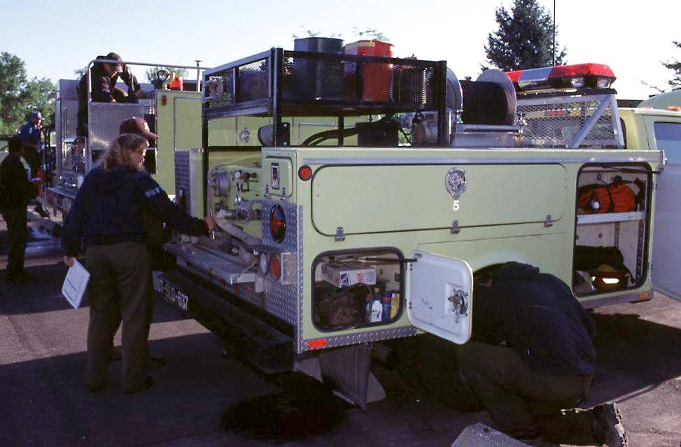
Does GVW exceed GVWR?
900 pounds overweight

Slide 22
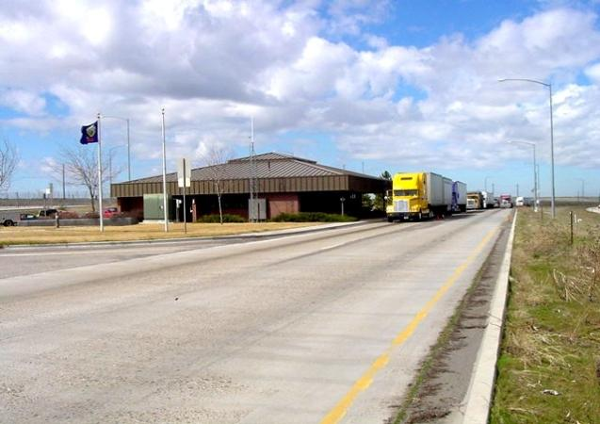
Weighing the Vehicle
Weigh the fully-loaded engine on a certified scale annually.
Allow 250 pounds for each person and their personal gear.
Keep the certified weight slip with the vehicle at all times.

Slide 23
Determining GVW
Weigh the front axle.
Is the weight less than the manufacturer’s front axle GAWR?
Weigh the rear axle.
Is the weight less than the manufacturer’s rear axle GAWR?
Add the front axle weight to the rear axle weight (this total weight is GVW).
Is the GVW less than the manufacturer’s GWVR?

Slide 24
RecordKeeping and Reporting

Slide 25
Reasons for Having Records
Avoid mechanical mishaps
Discover mechanical trends and assist with future fire engine design
Identify maintenance performed on incidents or during inspections
Identify maintenance issues charged to the WCF
Document when mechanical service was performed or needs to be performed
Facilitate information sharing

Slide 26
Improvement/Deficiency Reporting System (IDRS)
IDRS is used to collect improvement suggestions and deficiency reports for all BLM fire equipment.
NFEP personnel use the information to build a database to:
Document problems
Identify trends
Establish priorities for development and modification of new and existing equipment
Notes:
BIA is developing a Fire Equipment Deficiency, Major Repair or Improvement Reporting System. This is required for repairs over $1,000. The information reported will be used to help track deficiencies and make improvements to Bureau Wildland Fire Equipment.

Slide 27
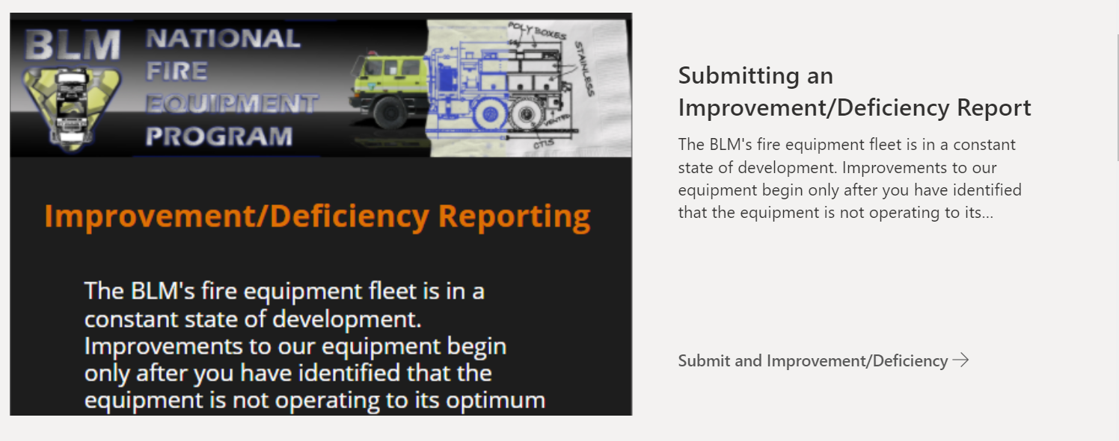
The IDRS Process
NFEP follows up on submissions
Results placed on the NFEP website
Individual submission of reports via the NFEP SharePoint
https://doimspp.sharepoint.com/sites/blm-fa/fire-operations/SitePages/Improvement-and-Deficiency-Reports.aspx?web=1

Slide 28
Vehicle Use (Log) Book

Slide 29
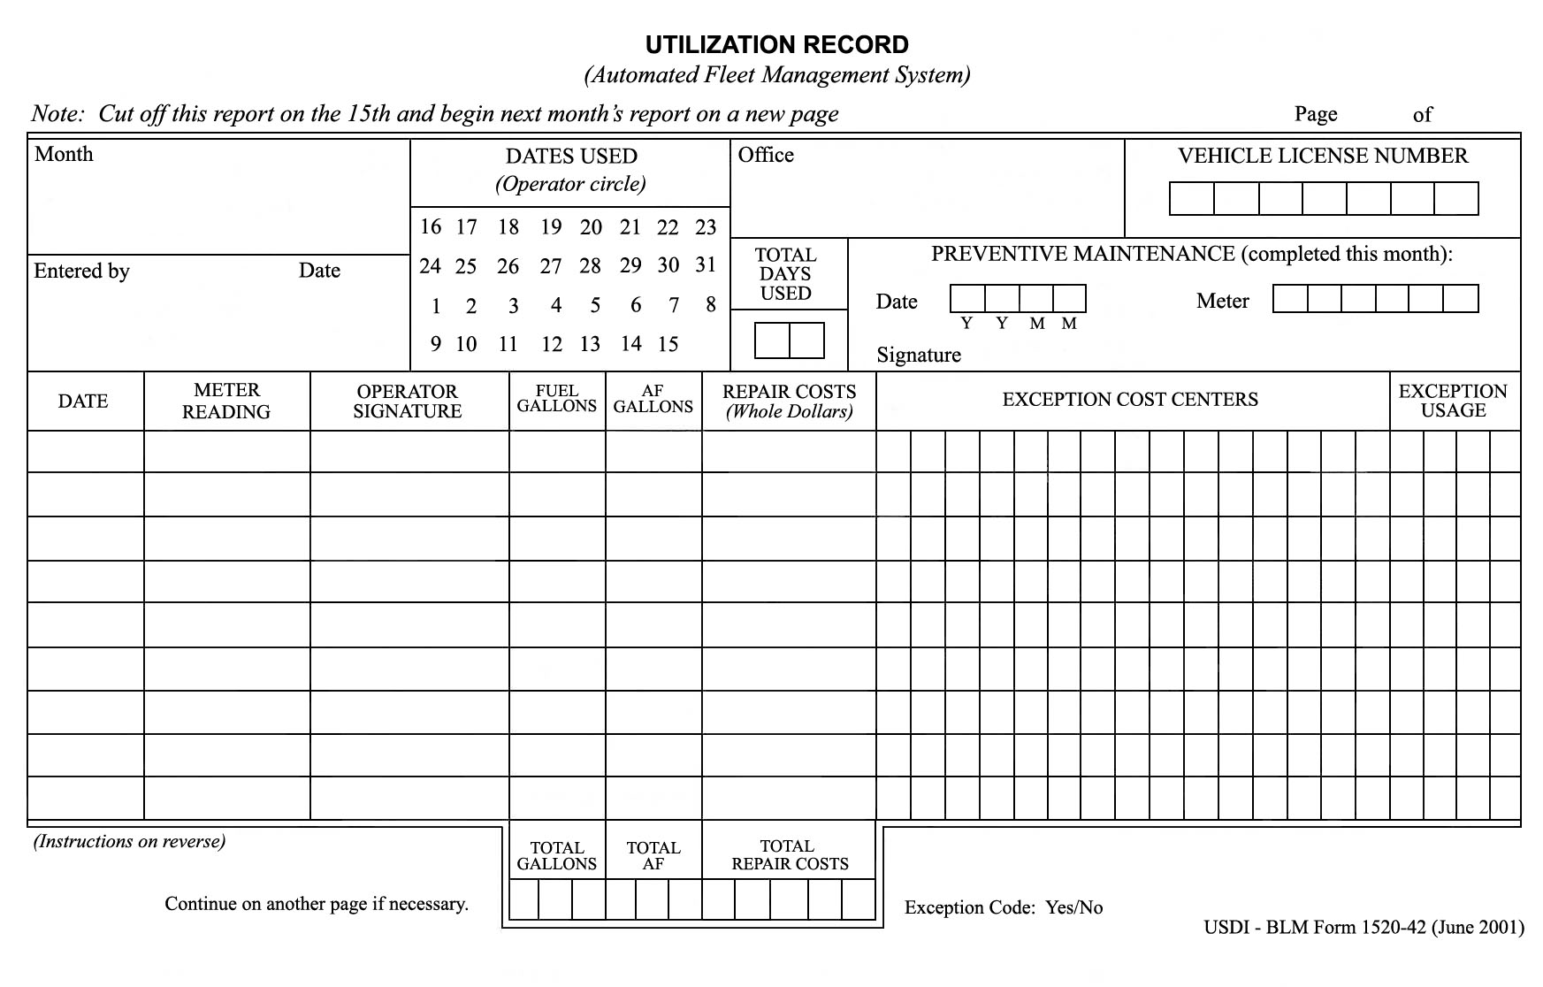
Utilization Record

Slide 30
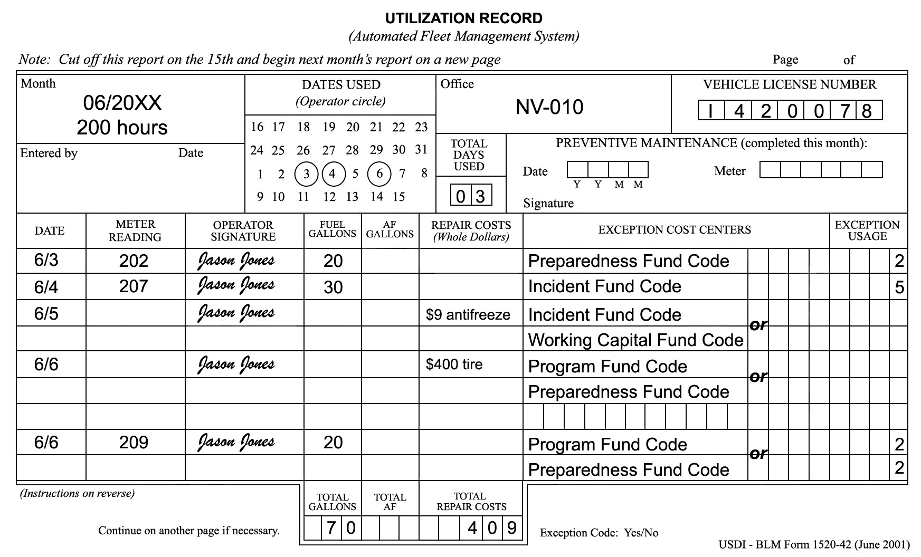
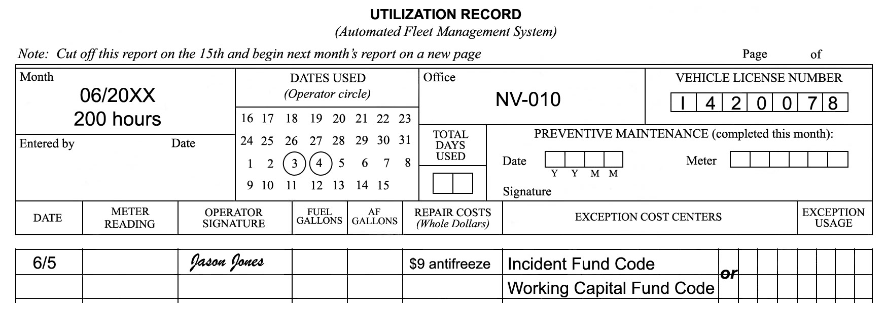
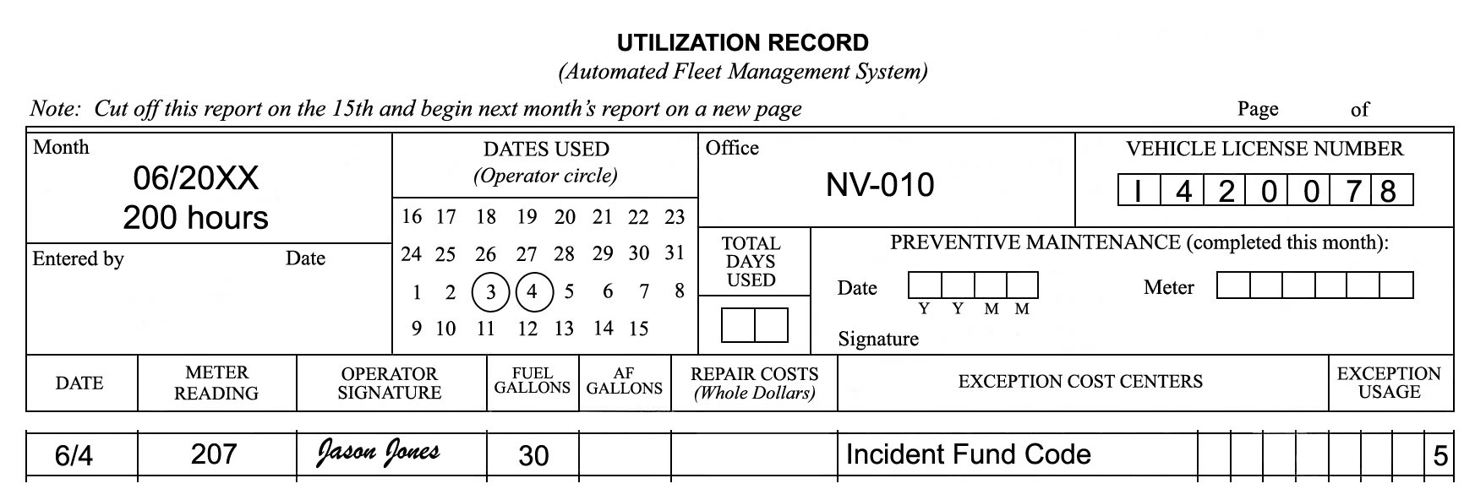
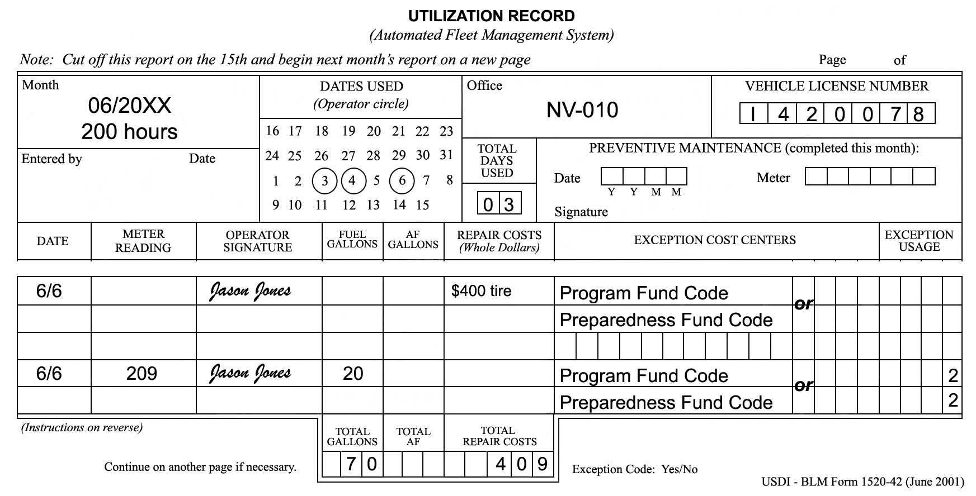
Utilization Record Completion

Slide 31
Engine Use Reporting
Standardized system to document and quantify important program accomplishments.
Necessary to ensure effective use of assets and to assist with critical planning decisions at local, state, and national levels.
Provides an accurate method of tracking daily statistics associated with each BLM wildland fire engine
Redbook requirement to enter data monthly
State FOG representative manages access

Slide 32
Utilization Record Exercise
Notes:
Students: Complete scenarios 1-4 on pp. 66-68 of the Student Workbook.
Instructors: Refer to Facilitator Guide, page 21, for conducting the exercise.

Slide 33
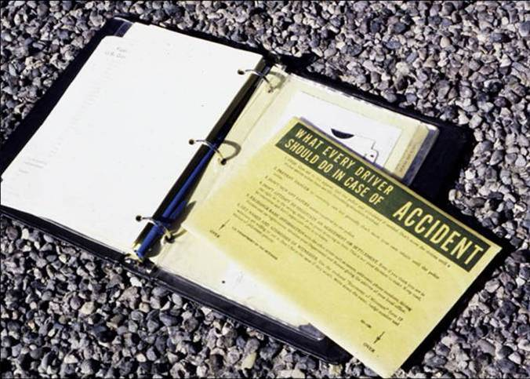
Accident Reporting Procedures

Slide 34
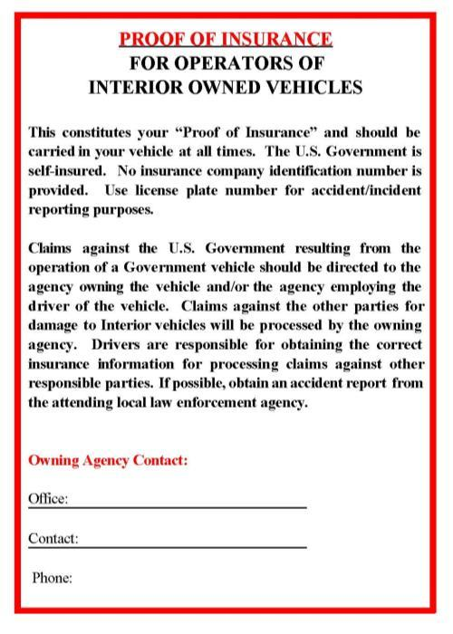
Proof of Insurance Form
Created as official documentation that the government is self-insured
Must be signed by the appropriate authorizing official and kept with the vehicle at all times

Slide 35
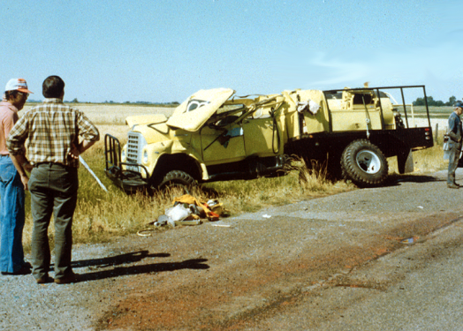
What To Do
Stop and give aid to the injured.
Notify the police and request an ambulance if needed.
Prevent danger to oncoming cars.
Try not to move your vehicle until police arrive.

Slide 36
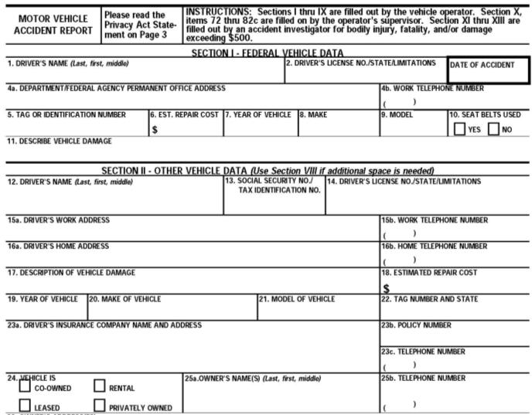
Exchange Basic Information (Standard Form 91)
Names
Addresses
Phone numbers
Driver license information
Vehicle registrations
Proof of insurance

Slide 37
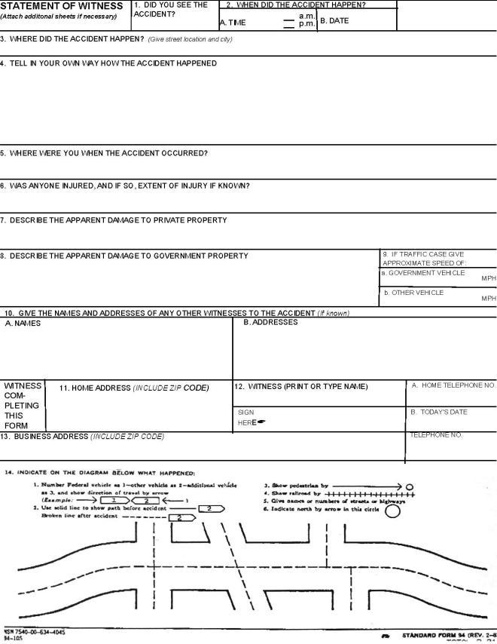
Statement of Witness (Standard Form 94)

Slide 38
Other Tasks To Do
Notify state, county, or municipal authorities, as required by law.
Complete the “Operator’s Report of Motor Vehicle Accident” (SF-91).
Notify your supervisor and Fleet Manager as quickly as possible.
Perform actions as required by local policy and procedures.
Notify the proper authorities before leaving the scene of the accident.

Slide 39
What Not To Do
Do not sign any papers or make any statement as to fault.
Do not attempt to negotiate an agreement or settlement.

Slide 40
Fire Engine Warranty Repairs and Recalls

Slide 41
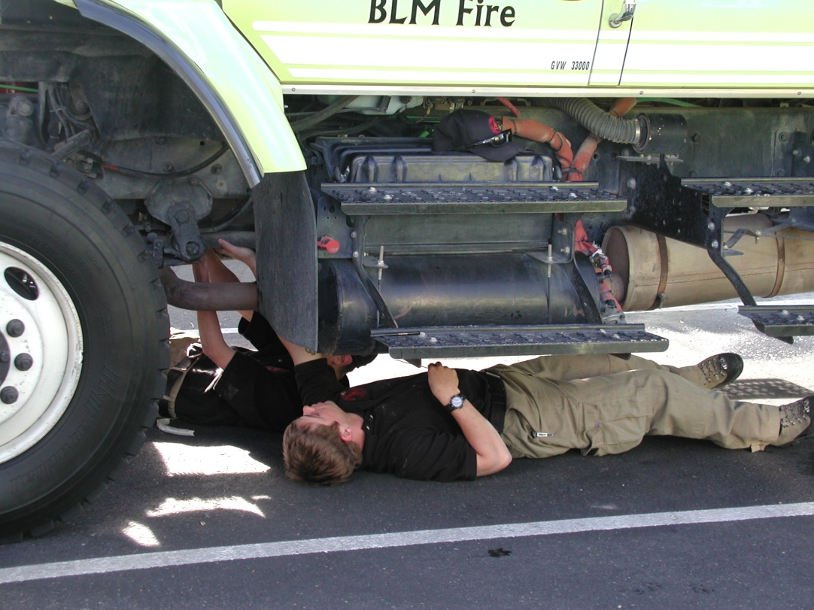
Warranty Repairs
For assistance with warranty repairs you can contact the National Fire Equipment Program at the following number(s).
(208) 387-5412, 5423, 5424, 5425, 5462, and 5445.

Slide 42
Recalls – Equipment Bulletins/ Equipment Alerts
The purpose of an equipment bulletin (EB) or an equipment alert (EA) is to share accurate and timely information regarding potential equipment problems and/or needed repairs.
EB is intended to inform the equipment users of recommendations for repairs, potential hazards, or general information related to the overall maintenance, awareness, and safe operation of fire equipment.
EA is time sensitive and addresses potentially serious hazards or risks. The alert includes specific actions users must act upon.
https://doimspp.sharepoint.com/sites/blm-fa/fire-operations/SitePages/Equipment-Alerts-Bulletins.aspx?web=1

Slide 43
Notes:
To view equipment alerts or recall notices, visit the BLM National Fire Equipment Program website. Additionally, a notification email will be sent to the states. Operators must follow the recommended or required actions. Contact NFEP for additional information or assistance.

Slide 44
Objectives
Accurately identify expenditures that can be charged to the Working Capital Fund (WCF).
Discuss the ENOP’s fleet charge card responsibilities.
Explain the concepts of gross vehicle weight rating (GVWR), gross axle weight rating (GAWR), gross vehicle weight (GVW), and the ENOP’s role in maintaining proper GVW.
Identify items that are included in the vehicle use (log) book.

Slide 45
Objectives
Demonstrate the ability to complete and reconcile the “Utilization Record” (USDI/BLM Form 1520-042).
Explain the procedure an ENOP should follow when involved in a motor vehicle accident.
Explain fire engine warranty repairs and recall procedures.

