Slide 1
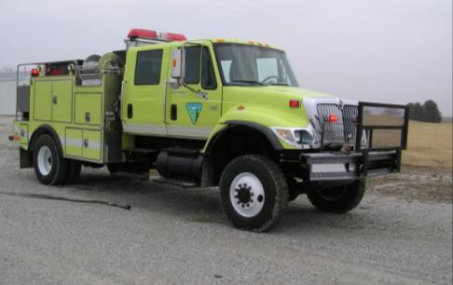
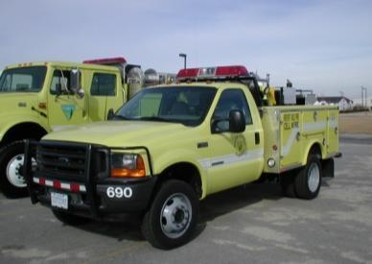
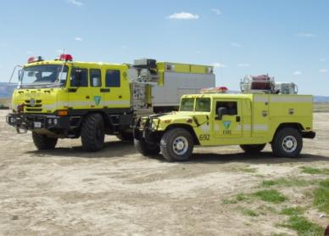
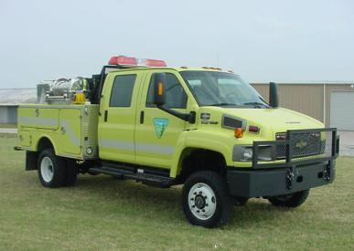
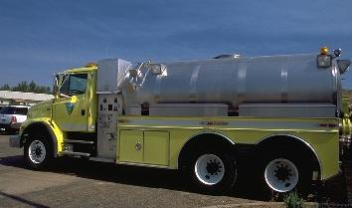
FLEET MANAGEMENT
UNIT 2

Slide 2
Objectives
Accurately identify expenditures that can be charged to the Working Capital Fund (WCF).
Discuss the ENOP’s fleet charge card responsibilities.
Explain the concepts of gross vehicle weight rating (GVWR), gross axle weight rating (GAWR), gross vehicle weight (GVW), and the ENOP’s role in maintaining proper GVW.
Identify items that are included in the vehicle use (log) book.

Slide 3
Objectives
Demonstrate the ability to complete and reconcile the “Utilization Record” (USDI/BLM Form 1520-042).
Explain the procedure an ENOP should follow when involved in a motor vehicle accident.
Explain fire engine warranty repairs and recall procedures.

Slide 4
Introduction to the Working Capital Fund

Slide 5
Fixed Ownership Rates (FORs)
Monthly hours- or miles-based fees that are assessed through the Automated Fleet Management System (AFMS) for each fire vehicle in service.
Assessed on a per-hour basis (BLM standard)
Accumulate over the life of a vehicle
Used to replace each vehicle at the end of its life cycle
Charged to the benefiting activity
Adjusted annually

Slide 6
Use Rates
Charged monthly based on a per-hour or per-mile basis for vehicle operating costs.
Independent of the FOR rates
Adjusted annually
May vary from year to year

Slide 7
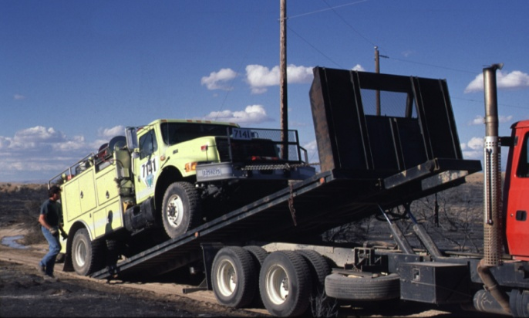
Use Rate Costs
Fuel
Repair/normal wear and tear on engine components
Tow charges resulting from mechanical breakdowns
Preventative maintenance
Overhead

Slide 8
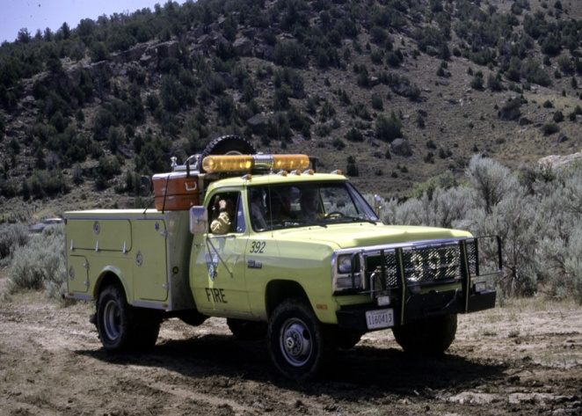
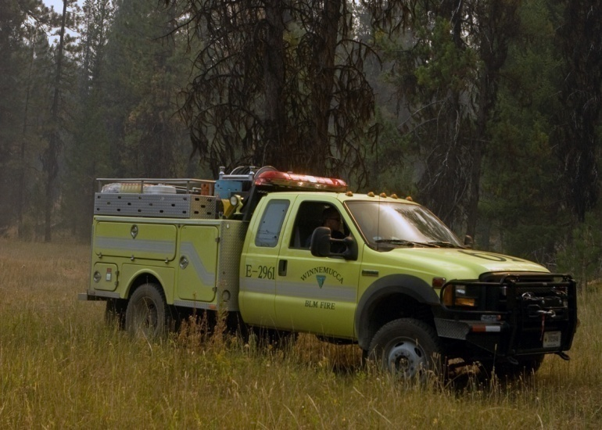
WCF Life Cycle
Predetermined period that vehicles of a given class are expected to be in service before they can be replaced.
Determined through evaluation of the historical amount of use and general durability for vehicles of that class.

Slide 9
Equipment Classes

Slide 10
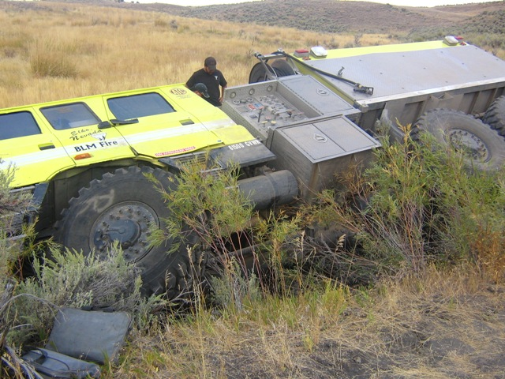
Items WCF Does Not Cover
Accident damage
Towing charges related to accidents or getting stuck
Locally required vehicle modifications
Add-ons and accessories
Light bars
Tools
Radios
Winches

Slide 11
Fund Code Exercise

Slide 12
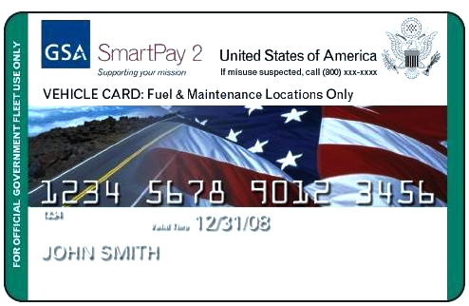
Fleet Charge Card

Slide 13
Fleet Charge Card Basics
Purchases restricted to the vehicle or piece of equipment to which the card is assigned.
Fuel costs for unleaded, non-premium fuel or fuel alternative
Emergency towing
Approved preventative maintenance (e.g., oil changes)
Approved repairs
Tolls
Parking
Avoid abuse of limitations on authorized purchases.
Ensure vendor accepts the card prior to purchase.
Record purchases on the Utilization Record.
Safeguard the card.
Immediately notify the local Fleet Manager of problems with the card.

Slide 14
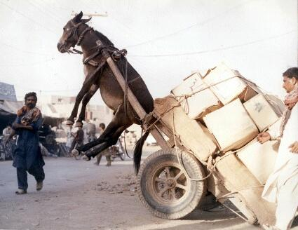
Gross Vehicle Weight (GVW)

Slide 15
What makes up the GVW?
GVW includes the total of
Vehicle weight
Fuel
Passengers
Water
Normal Unit Stocking (NUS or cargo and equipment)

Slide 16
ENOPs and the GVW
ENOPs are responsible for ensuring that the gross vehicle weight does not exceed maximum weight ratings.
When vehicles exceed maximum weight ratings:
Passengers are put at risk.
Poor handling on highways and off road may occur.
Mechanical break downs occur more often.

Slide 17
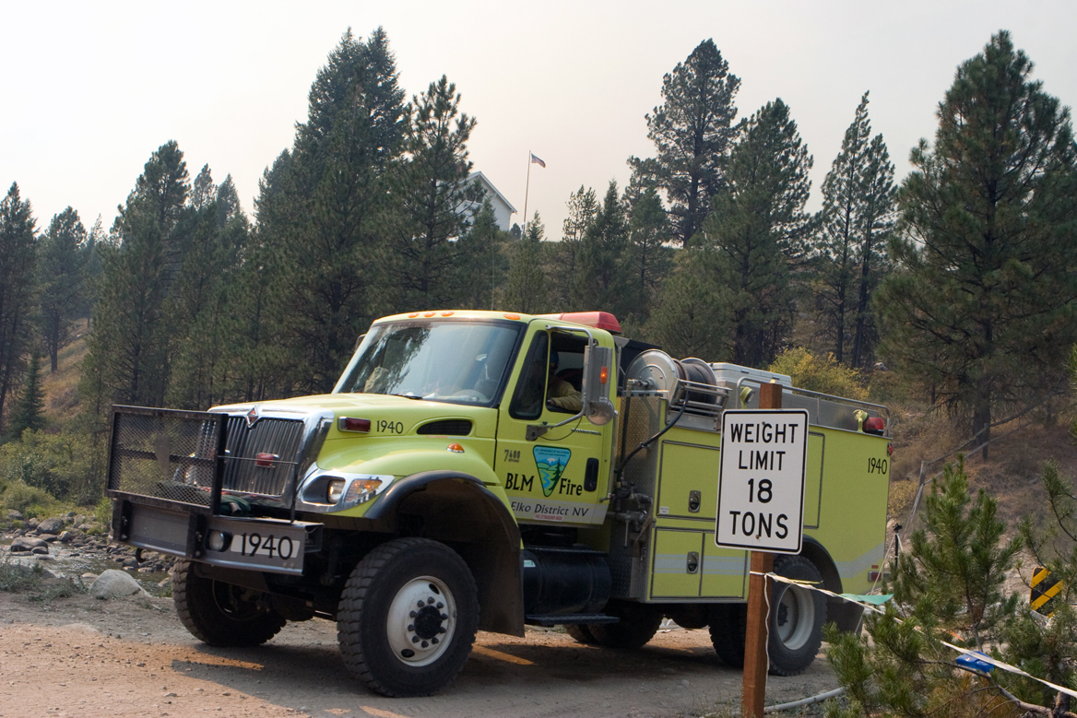
Weight-Restricted Bridges and Roads
ENOPs who know their vehicle’s GVW will know if they can travel on weight-restricted bridges and roads.

Slide 18
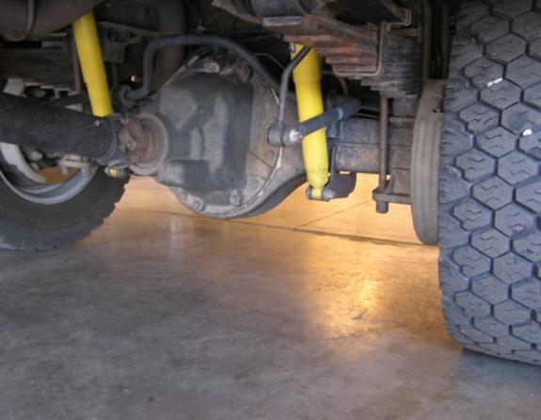
Chassis Manufacturer Weight Ratings
Gross Vehicle Weight Rating (GVWR)
The vehicle’s maximum load carrying capacity
Gross Axle Weight Rating (GAWR)
The maximum carrying capacity of an axle system as measured at the tire/ground interface

Slide 19
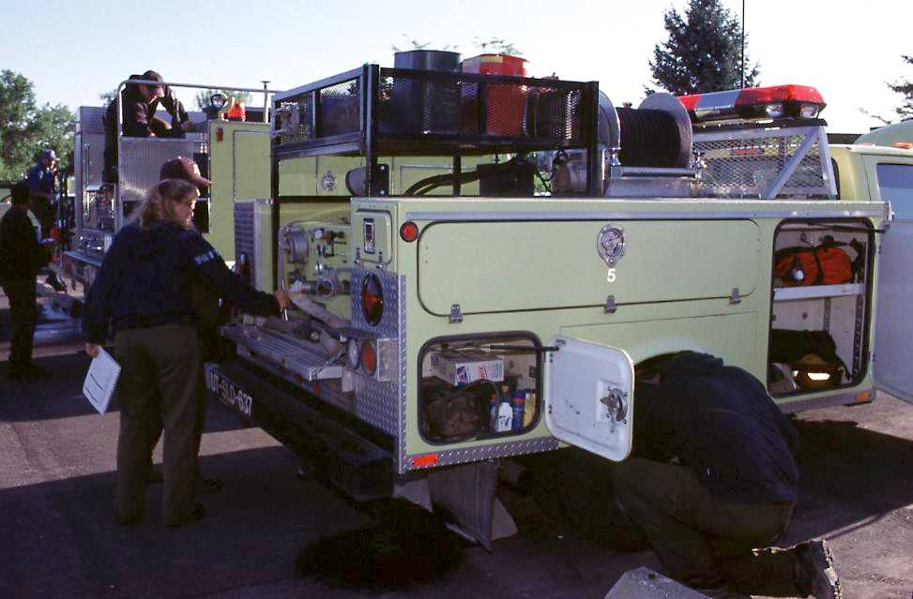
Does GVW exceed GVWR?
900 pounds overweight

Slide 20
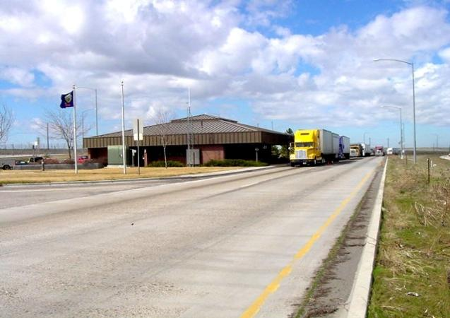
Weighing the Vehicle
Weigh the fully-loaded engine on a certified scale annually.
Allow 250 pounds for each person and their personal gear.
Keep the certified weight slip with the vehicle at all times.

Slide 21
Determining GVW
Weigh the front axle.
Is the weight less than the manufacturer’s front axle GAWR?
Weigh the rear axle.
Is the weight less than the manufacturer’s rear axle GAWR?
Add the front axle weight to the rear axle weight (this total weight is GVW).
Is the GVW less than the manufacturer’s GWVR?

Slide 22
RecordKEEping and Reporting

Slide 23
Reasons for Having Records
Avoid mechanical mishaps
Discover mechanical trends and assist with future fire engine design
Identify maintenance performed on incidents or during inspections
Identify maintenance issues charged to the WCF
Document when mechanical service was performed or needs to be performed
Facilitate information sharing

Slide 24
Improvement/Deficiency Reporting System (IDRS)
IDRS is used to collect improvement suggestions and deficiency reports for all BLM fire equipment.
NFEP personnel use the information to build a database to:
Document problems
Identify trends
Establish priorities for development and modification of new and existing equipment

Slide 25
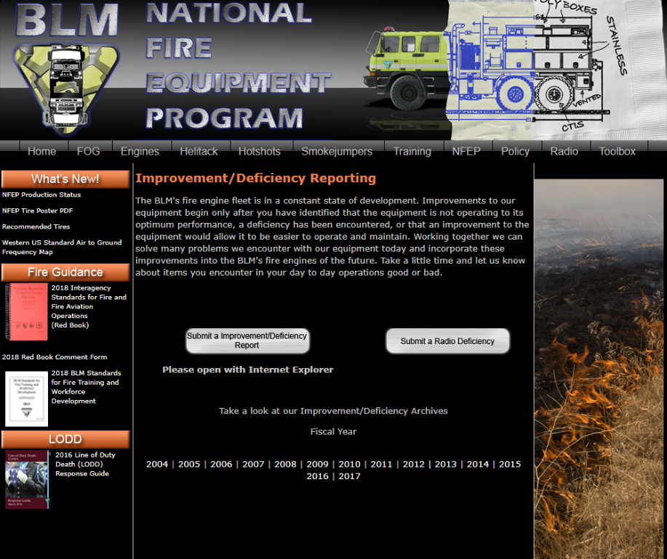
The IDRS Process
Individual submission of reports via the NFEP website
http://web.blm.gov/internal/fire/fire_ops/nfep.htm
NFEP follows up on submissions
Results placed on the NFEP website

Slide 26
Vehicle Use (Log) Book

Slide 27
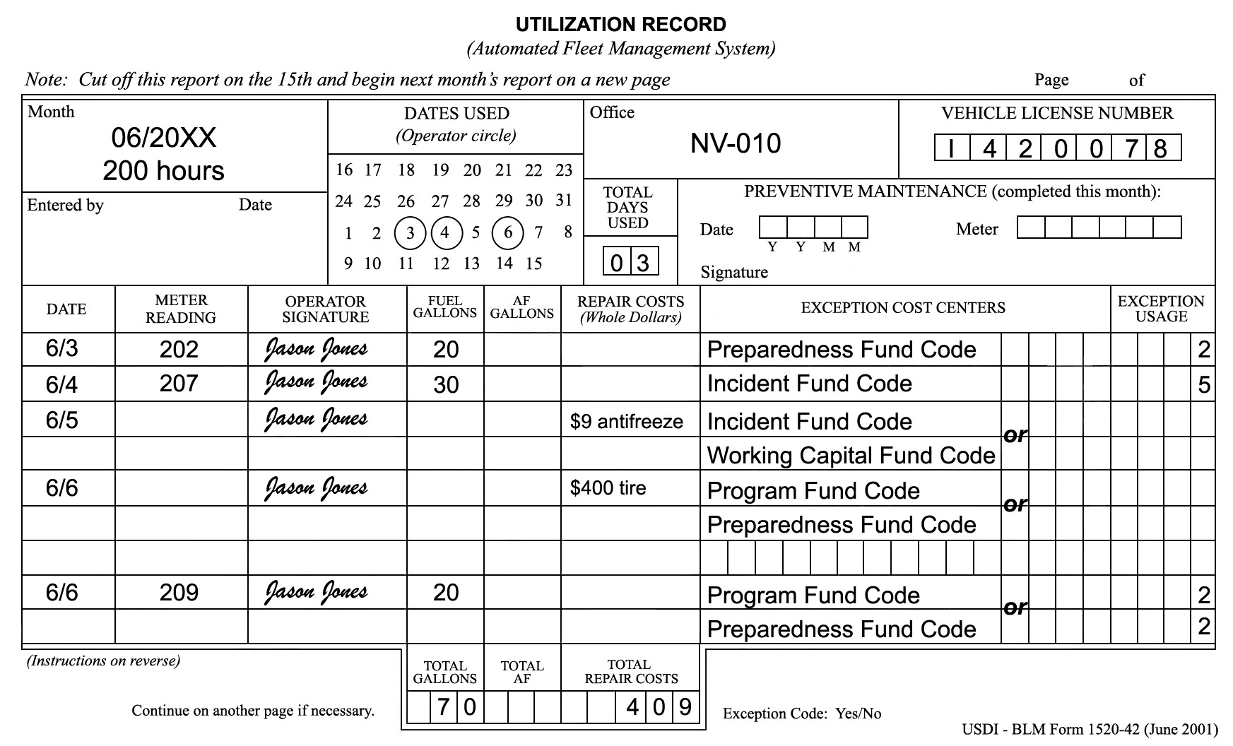
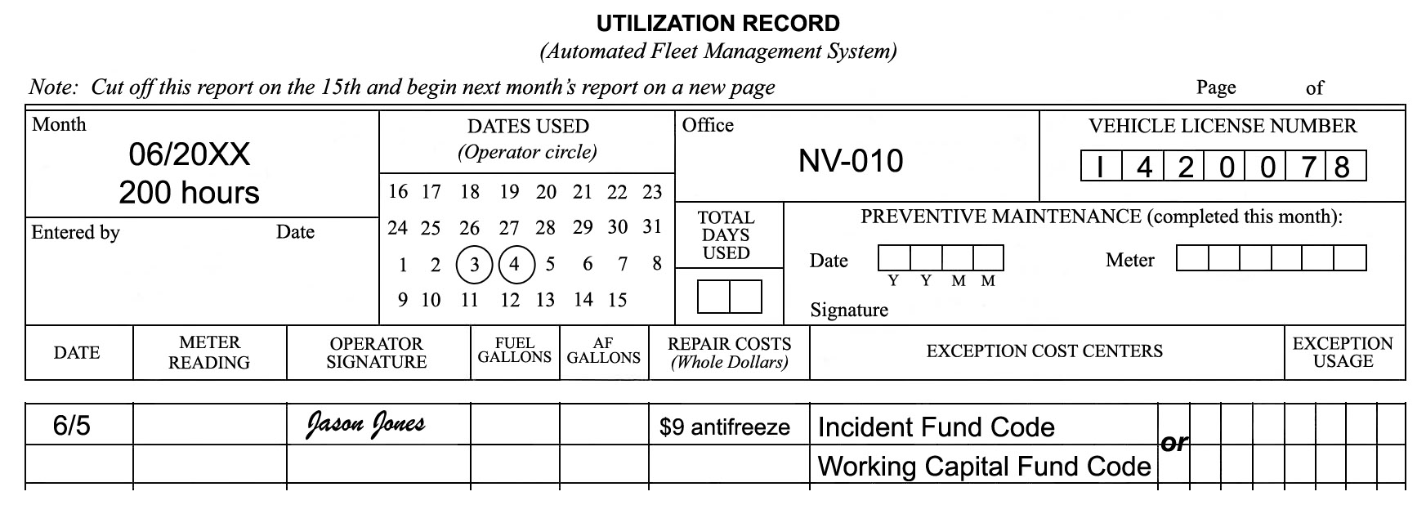
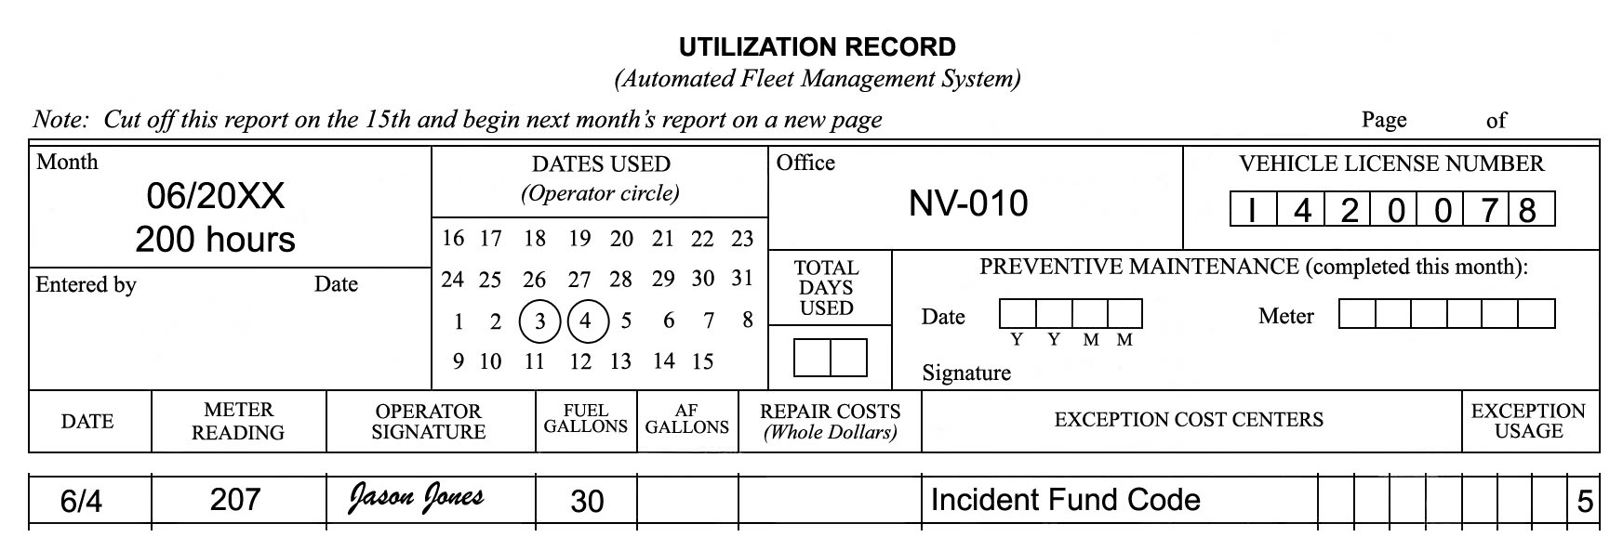
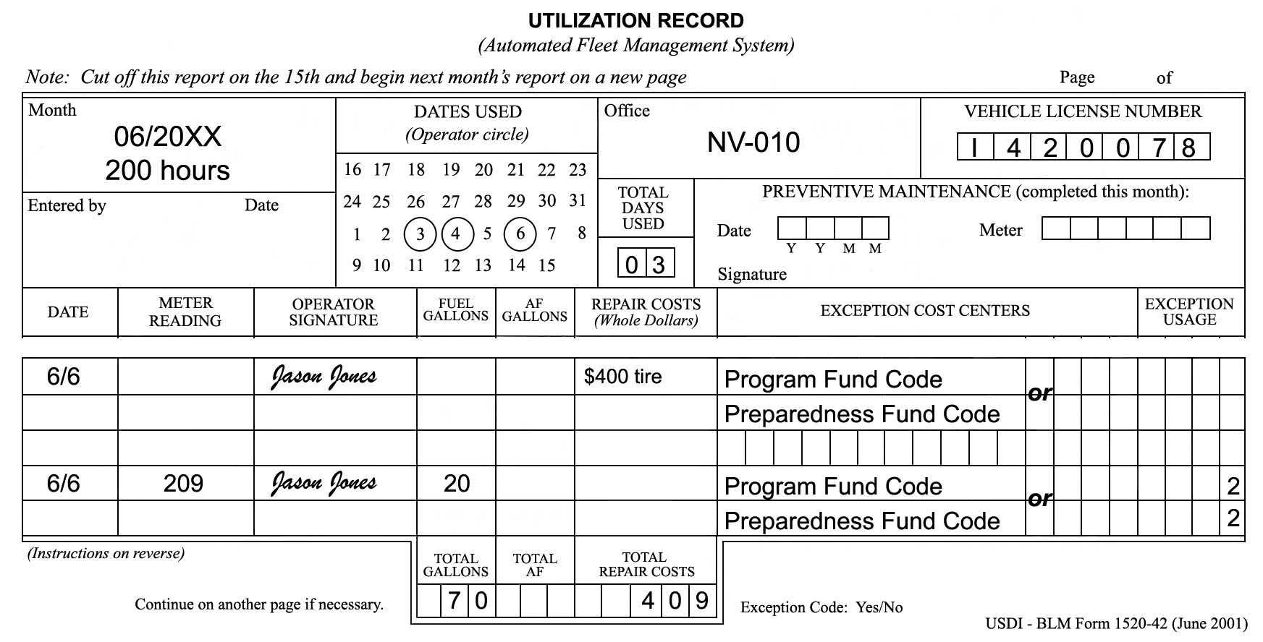
Utilization Record Completion

Slide 28
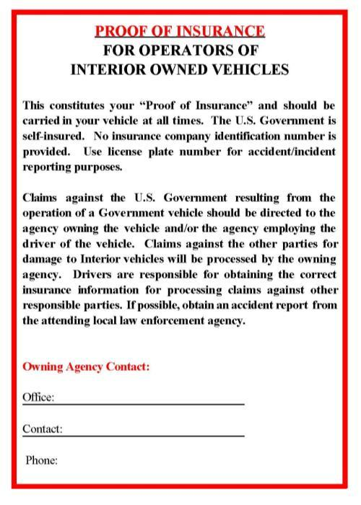
Proof of Insurance Form
Created as official documentation that the government is self-insured
Must be signed by the appropriate authorizing official and kept with the vehicle at all times

Slide 29
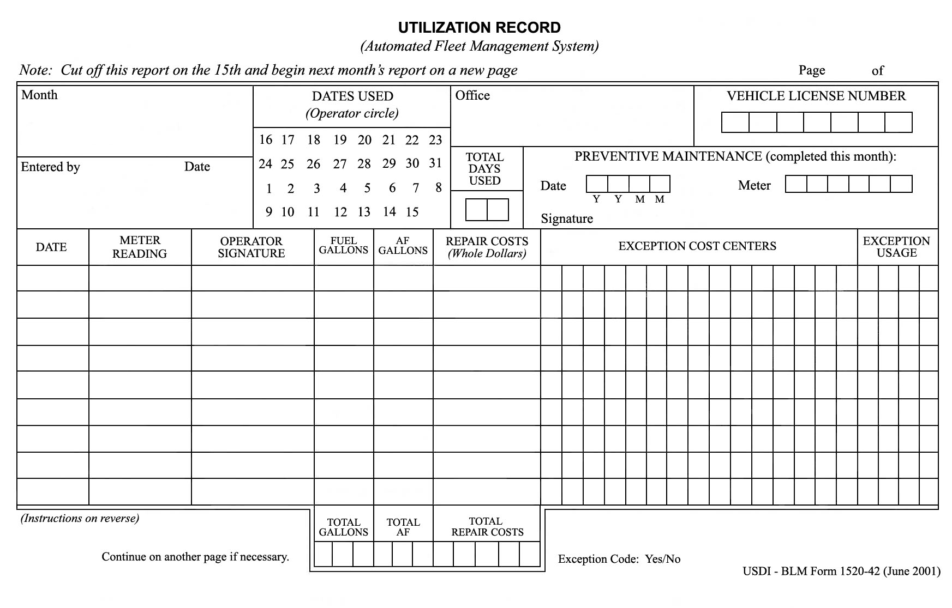
Utilization Record

Slide 30
Utilization Record Exercise

Slide 31
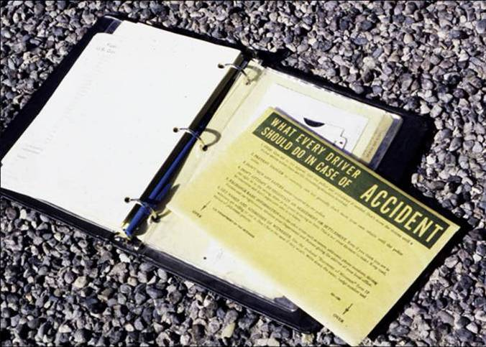
Accident Reporting Procedures

Slide 32
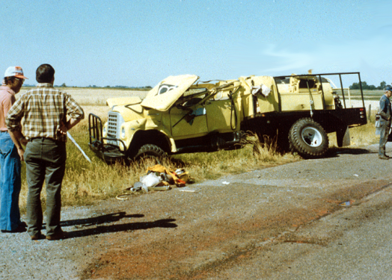
What To Do
Stop and give aid to the injured.
Notify the police and request an ambulance if needed.
Prevent danger to oncoming cars.
Try not to move your vehicle until police arrive.

Slide 33
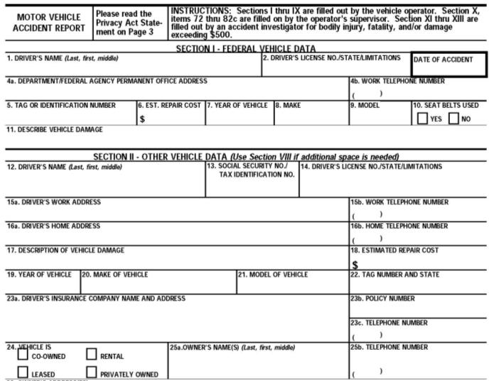
Exchange Basic Information (Standard Form 91)
Names
Addresses
Phone numbers
Driver license information
Vehicle registrations
Proof of insurance

Slide 34
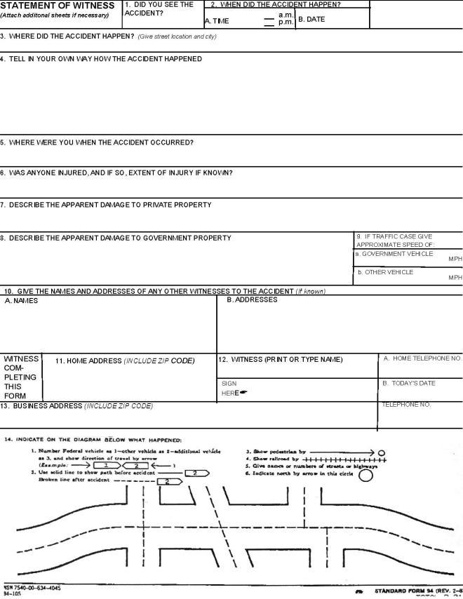
Statement of Witness (Standard Form 94)

Slide 35
Other Tasks To Do
Notify state, county, or municipal authorities, as required by law.
Try to complete the “Operator’s Report of Motor Vehicle Accident” (SF-91).
Notify your supervisor and Fleet Manager as quickly as possible.
Perform actions as required by local policy and procedures.
Notify the proper authorities before leaving the scene of the accident.

Slide 36
What Not To Do
Do not sign any papers or make any statement as to fault except to your supervisor or to a Federal government investigator.
Do not attempt to negotiate an agreement or settlement.

Slide 37
Fire Engine Warranty Repairs and Recalls

Slide 38
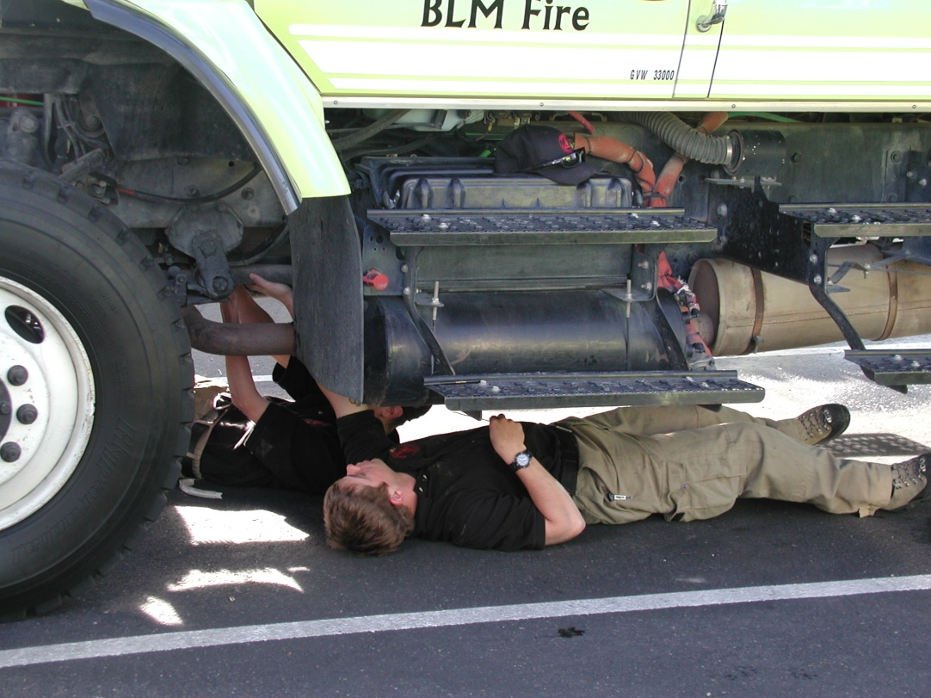
Warranty Repairs
Call National Fire Equipment personnel before taking your vehicle to a repair facility.
(208) 387-5422, 5423, 5424, 5425, and 5445.

Slide 39
Recalls
There is no standard procedure for recall notification; however, recall notices can be found on the NFEP website.
http://web.blm.gov/internal/fire/fire_ops/nfep.htm

Slide 40
Objectives
Accurately identify expenditures that can be charged to the Working Capital Fund (WCF).
Discuss the ENOP’s fleet charge card responsibilities.
Explain the concepts of gross vehicle weight rating (GVWR), gross axle weight rating (GAWR), gross vehicle weight (GVW), and the ENOP’s role in maintaining proper GVW.
Identify items that are included in the vehicle use (log) book.

Slide 41
Objectives
Demonstrate the ability to complete and reconcile the “Utilization Record” (USDI/BLM Form 1520-042).
Explain the procedure an ENOP should follow when involved in a motor vehicle accident.
Explain fire engine warranty repairs and recall procedures.

