Slide 1
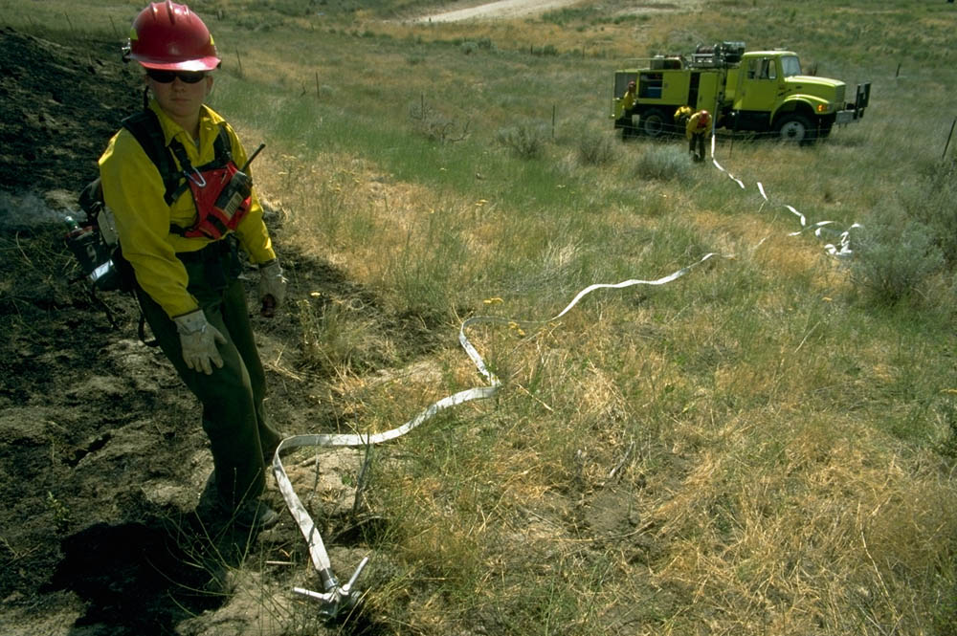
Water Handling Operations
Unit 4A – Water and
Hose Hydraulics
Version: January 2023

Slide 2

Objectives
Identify…
  The elements that should be considered when calculating pump discharge pressure.
  Ways to reduce friction loss.
Perform…
  Friction loss calculations using
    Friction loss calculators
    Principles of Hydraulics – Rule of 5s
Describe, Discuss, and/or Demonstrate…
  The causes and effects of pump cavitation and the corrective actions the ENOP must take if cavitation occurs.
  Ejector use during pumping operations.
  How hydraulics affect drafting procedures used to refill an engine.

Slide 3
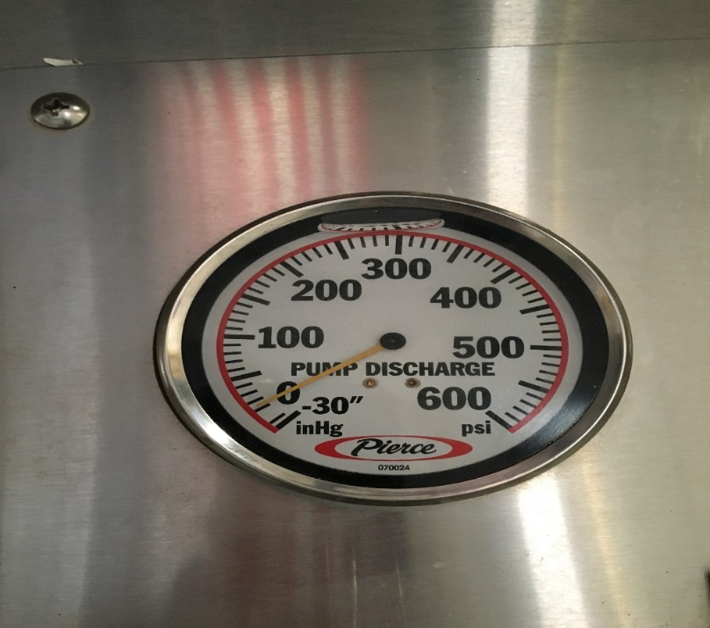
Pump Discharge Pressure
(PDP)
The amount of pressure in pounds per square inch (PSI) as measured at the pump discharge.

Slide 4
Nozzle Pressure - (NP)
Pressure that must be delivered to the nozzle to produce an effective stream.
  Optimum operating pressures:
    Straight stream and Forester nozzles is 50 PSI
    Variable pattern or fog nozzle is 100 PSI

Slide 5
Head Pressure - (H)
Head pressure is the weight of a given height (depth) of water column at its base.
  Also known as lift, back pressure, gravity/elevation loss or gain
  Measured in terms of feet of water
    One foot of water exerts a pressure of .5 PSI at the base of a column of water.
        OR
    Two feet of water exerts a pressure of 1 PSI at the base of a column of water.

Slide 6
Friction Loss - (FL)
Pressure loss caused by the turbulent movement of water or solution against the interior surface of fire hose, pipe, or fittings.
  Normally measured in pressure loss (PSI) per 100’ length of hose or pipe.

Slide 7
Appliances - (A)
Items (gated wyes, inline tees, and check valves) that connect or interconnect the hose and pump together to form a hose lay.
  Appliances have an insignificant effect on friction loss calculations at flows used in wildland suppression and have been omitted from calculations in this lesson.
  Friction loss for 1½” fittings at 50 GPM:
    Wye valve: 0.46 PSI
    Inline tee: 0.05 PSI
    Inline tee w/valve 0.77 PSI

Slide 8

Friction Loss Calculations
Overview

Slide 9
Why do we need to perform friction loss calculations?
To gain an understanding of the capabilities and limitations of our equipment
To identify unsafe and inefficient operations

Slide 10
References and Tools
Wildland Fire Hose Guide
Water Handling Equipment Guide
Incident Response Pocket Guide
Friction Loss Calculator
Principles of Hydraulics—“Rule of 5s”

Slide 11
Friction Loss Formula
Pump Discharge Pressure (PDP)
=
  Nozzle Pressure (NP)
  +/-
  Head (Elevation Gain or Loss) (H)
  +
  Friction Loss (FL)
PDP = NP +/- H + FL

Slide 12
Considerations
Must know the flow, or gallons per minute (GPM) that each nozzle will discharge.
Simple hose lays
  Always start at the nozzle and work towards the pump.
Progressive hose lays
  Always start from the most distant nozzle and work towards the pump.
Always pump to the highest pump discharge pressure (PDP) required.
Gate down any laterals that require substantially less pressure.

Slide 13
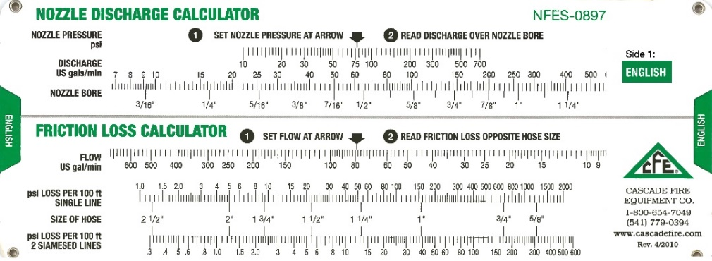
Friction Loss Calculation Exercises
Pre-course Work

Slide 14
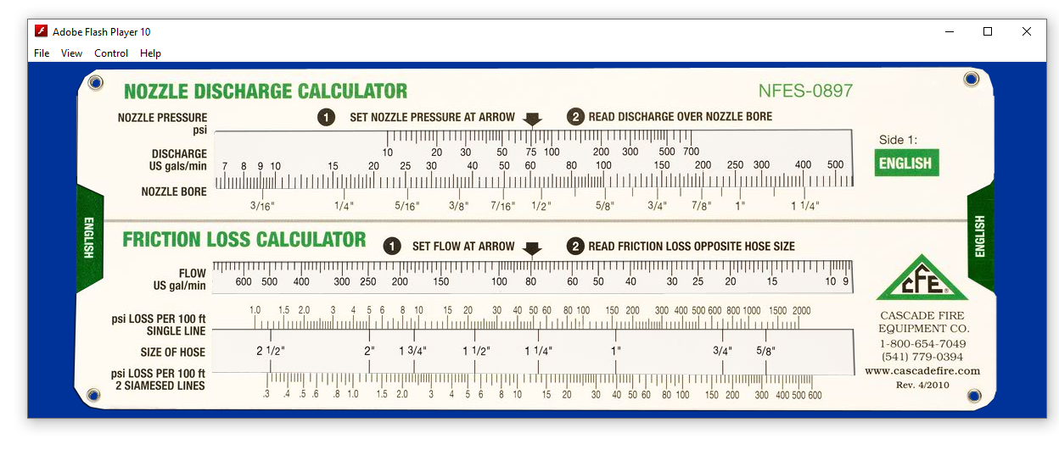


Adobe Flash Friction Loss Calculator
Notes:
The use of the Adobe Flash friction loss calculator is optional.

Slide 15
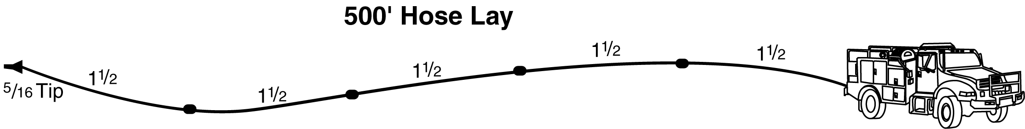
Exercise 1
Pre-course Work
20 GPM
You are pumping a 1½” hose lay 500’ long with a 5/16” tip.
What is the GPM?
What is the PDP?
+ NP = 50 Forester nozzle
+/- H = 0 no elevation change
+ FL = 10 1½” hose @ 20 GPM (2 PSI/100’ or 10 PSI/500’)
PDP = 60 PSI

Slide 16
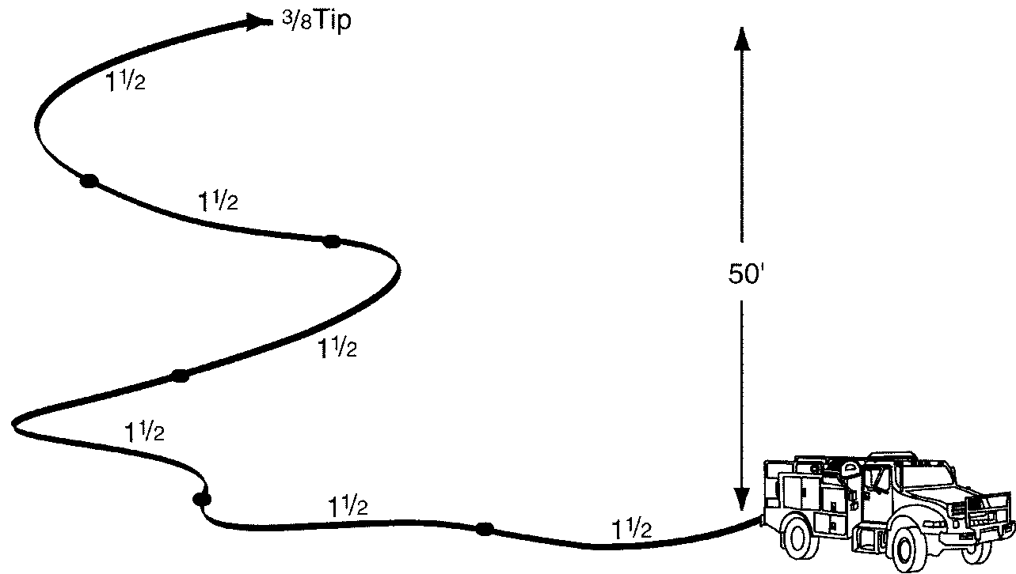
Exercise 2
Pre-course Work
30 GPM
You are pumping 600’ of 1½” hose 50’ above the pump with a ⅜” tip.
What is the GPM?
What is the PDP?
+ NP = 50 Forester nozzle
+/- H = +25 50’ of elevation gain (50 ÷ 2)
+ FL = 18 1½” hose @ 30 GPM (3 PSI/100’ or 18 PSI/600’)
PDP = 93 PSI

Slide 17
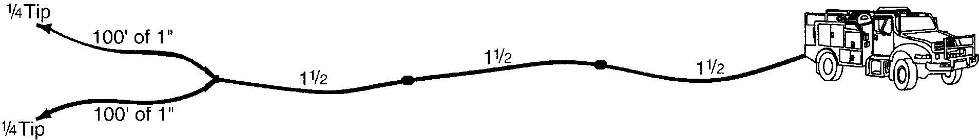
Exercise 3
Pre-course Work
13 GPM
26 GPM
13 GPM
You are pumping 300’ of 1½” hose through a wye to 2 sections of 1” hose, each 100’ long with ¼” tips (remember tips are 50 PSI).
What are the GPMs?
What is the PDP?
+ NP = 50 Forester nozzle
+/- H = 0 no elevation change
+ FL = 5 1” hose @ 13 GPM (5 PSI/100’)
+ FL = 9 1½” hose @ 26 GPM (3 PSI/100’ or 9 PSI/300’)
PDP = 64 PSI

Slide 18
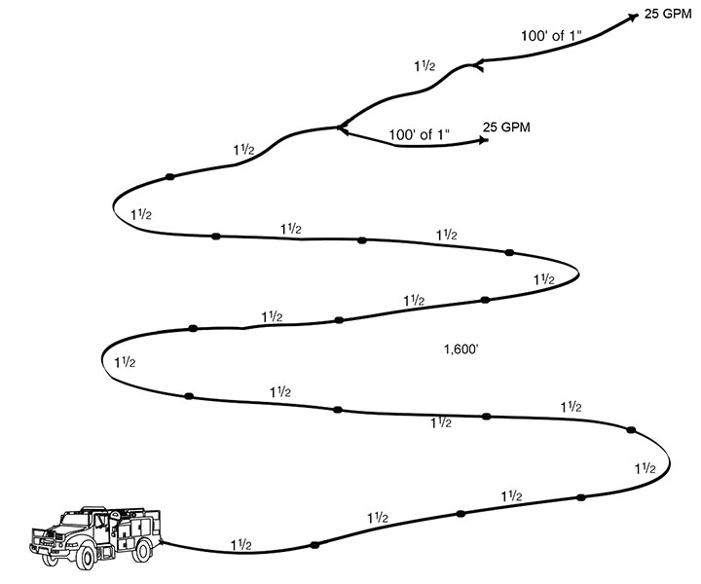
Exercise 4
Pre-course Work
You are pumping to a hose lay with the first lateral at 1,500’. You have another 100’ of 1½” hose to another lateral. Both laterals are flowing 25 GPMs out of variable flow nozzles.
What are the GPMs?
What is the PDP?
50 GPM
+ NP = 100 variable flow nozzle
+/- H = 0 no elevation change
+ FL = 15 1” hose @ 25 GPM
(15 PSI/100’)
+ FL = 3 1½” hose @ 25 GPM
(3 PSI/100’)
+ FL = 135 1½” hose @ 50 GPM
(9 PSI/100’ or 135 PSI/1,500’)
PDP = 253 PSI

Slide 19
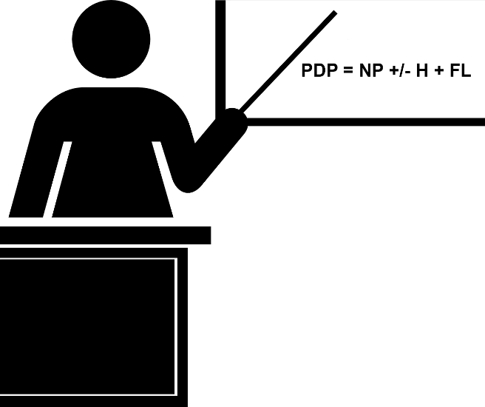
Friction Loss
Calculation Exercises
In-class

Slide 20
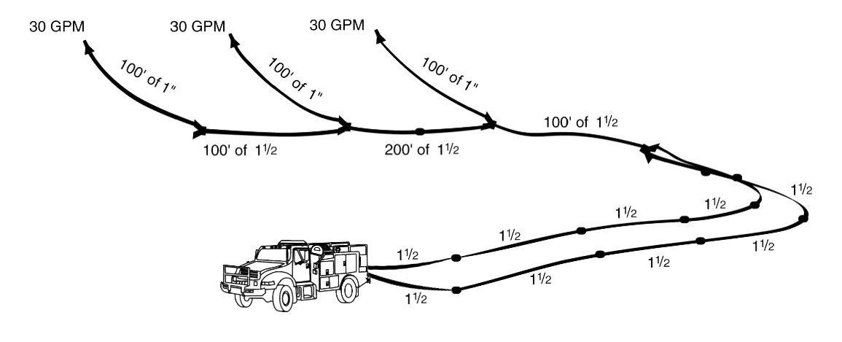
Exercise 5
In-class
60 GPM
90 GPM
You have 400’ of 1½” parallel hose to a Siamese valve. Attached to the wye is 100’ of 1½-inch hose to another wye and the first lateral, another 200’ of 1½” hose to the second lateral, and another 100’ of 1½” hose to last lateral. Each lateral is 100’ of 1” hose with a variable flow nozzle flowing 30 GPM. Consider this flat ground.
What are the GPMs?
What is the PDP?
+ NP = 100 variable flow nozzle
+/- H = 0 no elevation change
+ FL = 23 1” hose @ 30 GPM (23 PSI/100’)
+ FL = 3 1½” hose @ 30 GPM (3 PSI/100’)
+ FL = 26 1½” hose @ 60 GPM (13 PSI/100’)
+ FL = 28 1½” hose @ 90 GPM (28 PSI/100’)
+ FL = 42 1½” hose @ 90 GPM (5 PSI/100’ x 4)
PDP = 222 PSI

Slide 21
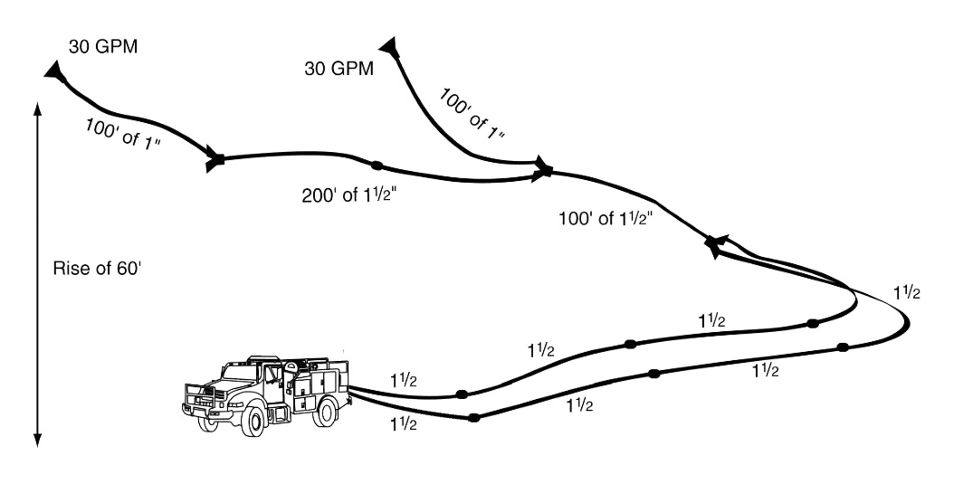
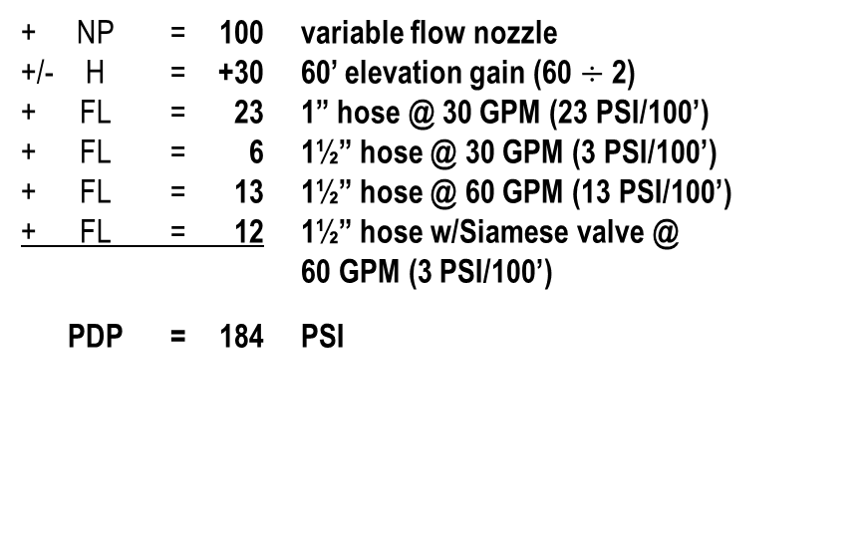
Exercise 6
In-class
60 GPM
You have 400’ of 1½” parallel hose to a Siamese valve. Attached to the Siamese is 100’ of 1½” hose to a wye and the first lateral, another 200’ of 1½” hose to the second lateral. Each lateral is 100’ of 1” hose with a variable flow nozzle flowing 30 GPM. There is a 60’ rise in elevation.
What are the GPMs?
What is the PDP?
+ NP = 100 variable flow nozzle
+/- H = +30 60’ elevation gain (60 $÷$ 2)
+ FL = 23 1” hose @ 30 GPM (23 PSI/100’)
+ FL = 6 1½” hose @ 30 GPM (3 PSI/100’)
+ FL = 13 1½” hose @ 60 GPM (13 PSI/100’)
+ FL = 12 1½” hose w/Siamese valve @
60 GPM (3 PSI/100’)
PDP = 184 PSI

Slide 22
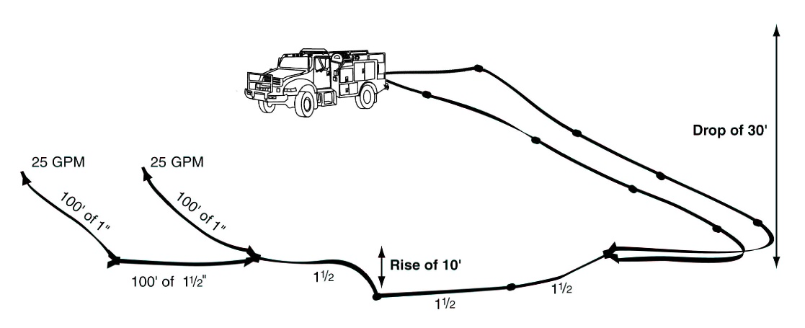
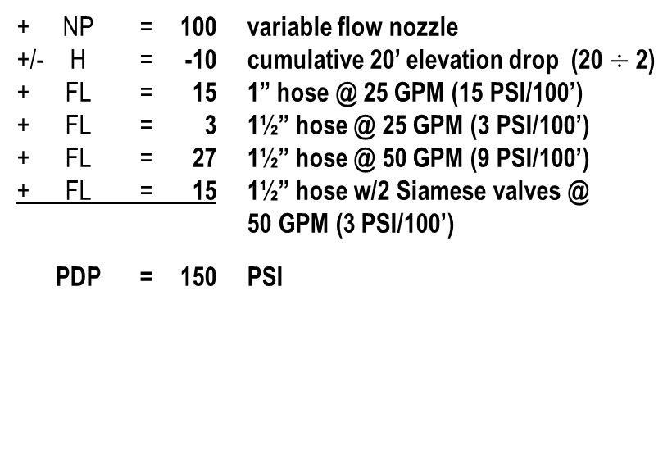
Exercise 7
In-class
You have 500’ of 1½” parallel hose to a Siamese valve with a 30’ drop in elevation. Attached to the Siamese valve is 300’ of 1½” hose to a wye and the first lateral has a gain of 10’ in elevation. There is another 100’ of 1½” hose to the second and last lateral. Each lateral is 100’ of 1” hose with a variable flow nozzle flowing 25 GPM.
What is the PDP?
50 GPM
+ NP = 100 variable flow nozzle
+/- H = -10 cumulative 20’ elevation drop (20 $÷$ 2)
+ FL = 15 1” hose @ 25 GPM (15 PSI/100’)
+ FL = 3 1½” hose @ 25 GPM (3 PSI/100’)
+ FL = 27 1½” hose @ 50 GPM (9 PSI/100’)
+ FL = 15 1½” hose w/2 Siamese valves @
50 GPM (3 PSI/100’)
PDP = 150 PSI

Slide 23

Friction Loss Calculations
“Rule of 5S”

Slide 24
“Rule of 5s”
Rule based on experience or practice rather than on scientific knowledge.
Method of estimating that is practical though not precise.

Slide 25
Friction Loss
“Rule of 5s”
1½” Hose < 60 GPM = 5 PSI/100’
1½” Hose Siamese (all flows) = 5 PSI/100’
1” Hose (all flows) = 10 PSI/100’
1½” Hose ≥ 60 GPM = 15 PSI/100’

Slide 26

Exercise 1
“Rule of 5s”
20 GPM
You are pumping a 1½” hose lay 500’ long with a 5/16” tip.
What is the GPM?
What is the PDP?
+ NP = 50 Forester nozzle
+/- H = 0 no elevation change
+ FL = 25 1½” hose @ 20 GPM (5 PSI/100’ or 25 PSI/500’)
PDP = 75 PSI

Slide 27
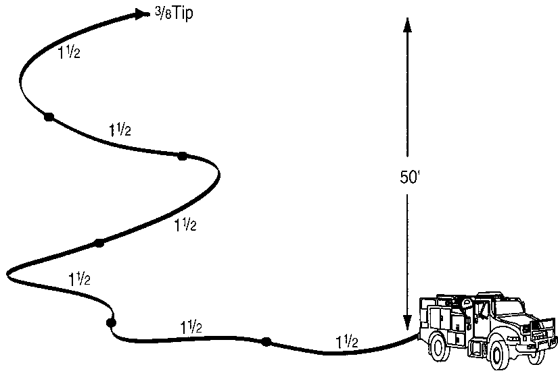
Exercise 2
“Rule of 5s”
30 GPM
You are pumping 600’ of 1½” hose 50’ above the pump with a 3/8” tip.
What is the GPM?
What is the PDP?
+ NP = 50 Forester nozzle
+/- H = +25 50’ of elevation gain (50 ÷ 2)
+ FL = 30 1½” hose @ 30 GPM (5 PSI/100’ or 30 PSI/600’)
PDP = 105 PSI

Slide 28
Exercise 3
“Rule of 5s”
15 GPM
30 GPM
15 GPM
You are pumping 300’ of 1½” hose through a wye to two sections of 1” hose, each 100’ long with ¼” tips (remember tips are 50 PSI).
What are the GPMs?
What is the PDP?
+ NP = 50 nozzle
+/- H = 0 no elevation change
+ FL = 10 1” hose @ 13 GPM (10 PSI/100’)
+ FL = 15 1½” hose @ 26 GPM (5 PSI/100’ or 15 PSI/300’)
PDP = 75 PSI

Slide 29
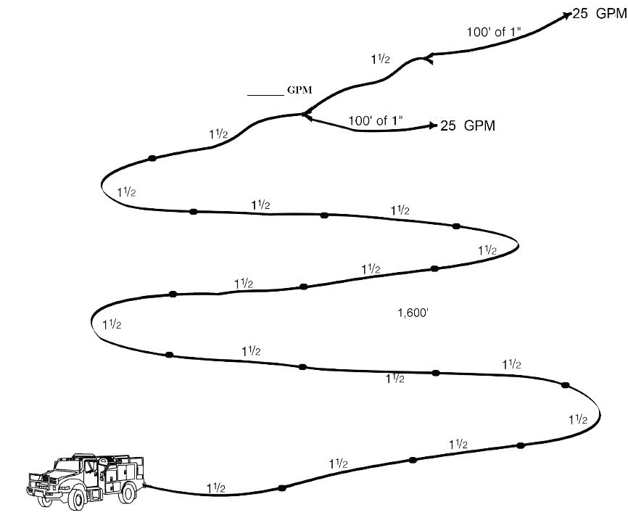
Exercise 4
“Rule of 5s”
50 GPM
You are pumping to a hose lay with the first lateral at 1,500’. You have another 100’ of 1½” hose to another lateral. Both laterals are flowing 25 GPMs out of variable flow nozzles.
What is the GPM?
What is the PDP?
+ NP = 100 variable flow nozzle
+/- H = 0 no elevation change
+ FL = 10 1” hose @ 25 GPM (10 PSI/100’)
+ FL = 5 1½” hose @ 25 GPM (5 PSI/100’)
+ FL = 75 1½” hose @ 50 GPM (5 PSI/100’ or 75 PSI/1,500’)
PDP = 190 PSI

Slide 30
Comparing Methods
How do they compare?

Slide 31
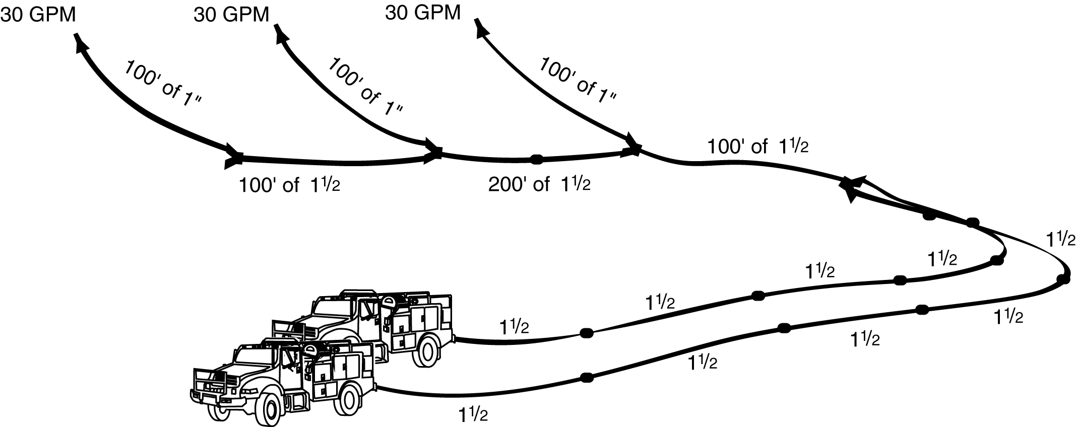
Exercise 5
“Rule of 5s”
90 GPM
You have 600’ of 1½” parallel hose to a Siamese valve. Attached to the wye is 100’ of 1½” hose to another wye and the first lateral, another 200’ of 1½” hose to the second lateral, and another 100’ of 1½” hose to last lateral. Each lateral is 100’ of 1” hose with a variable flow nozzle flowing 30 GPM. Consider this flat ground.
What are the GPMs?
What is the PDP?
60 GPM
+ NP = 100 variable flow nozzle
+/- H = 0 no elevation change
+ FL = 10 1” hose @ 30 GPM (10 PSI/100’)
+ FL = 5 1½” hose @ 30 GPM (5 PSI/100’)
+ FL = 30 1½” hose @ 60 GPM (13 PSI/100’)
+ FL = 15 1½” hose @ 90 GPM (15 PSI/100’)
+ FL = 30 1½” hose @ 90 GPM (5 PSI/100’ x 6)
PDP = 190 PSI

Slide 32
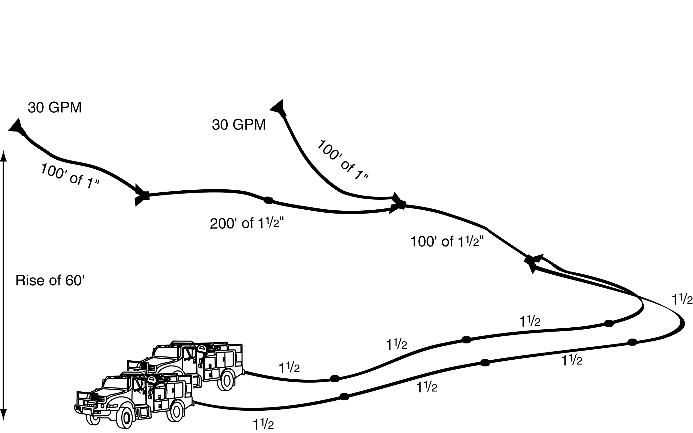
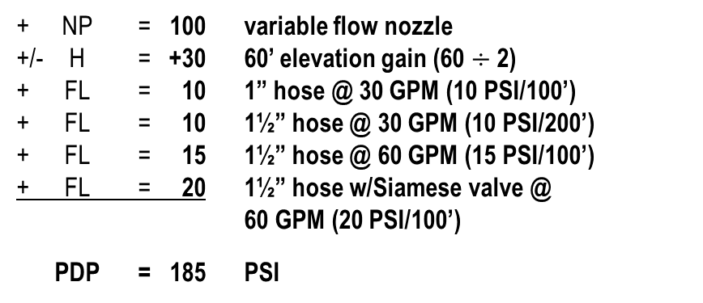
Exercise 6
“Rule of 5s”
60 GPM
You have 400’ of 1½” parallel hose to a Siamese valve. Attached to the Siamese valve is 100’ of 1½” hose to a wye and the first lateral, another 200’ of 1½” hose to the second lateral. Each lateral is 100’ of 1” hose with a variable flow nozzle flowing 30 GPM. There is a 60’ rise in elevation.
What is the GPM?
What is the PDP?
+ NP = 100 variable flow nozzle
+/- H = +30 60’ elevation gain (60 $÷$ 2)
+ FL = 10 1” hose @ 30 GPM (10 PSI/100’)
+ FL = 10 1½” hose @ 30 GPM (10 PSI/200’)
+ FL = 15 1½” hose @ 60 GPM (15 PSI/100’)
+ FL = 20 1½” hose w/Siamese valve @
60 GPM (20 PSI/100’)
PDP = 185 PSI

Slide 33
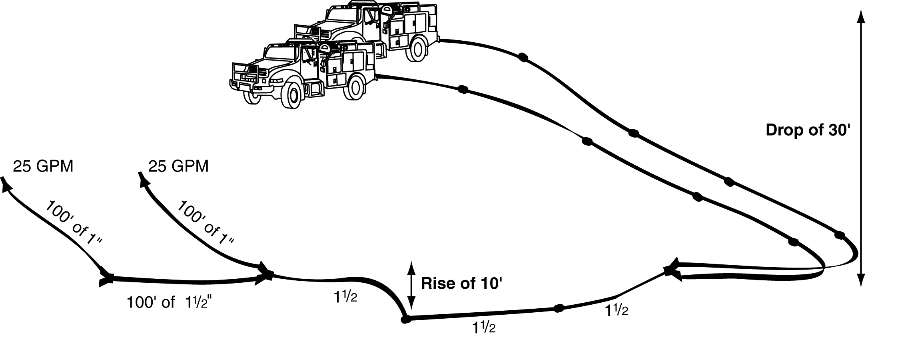
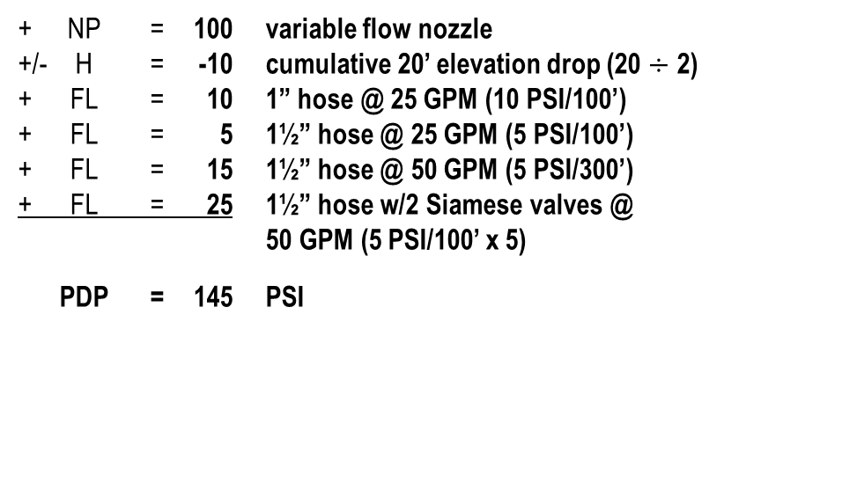
Exercise 7
“Rule of 5s”
You have 500’ of 1½” parallel hose to a Siamese valve with a 30’ drop in elevation. Attached to the Siamese valve is 300’ of 1½” hose to a wye and the first lateral has a gain of 10’ in elevation. There is another 100’ of 1½” hose to the second and last lateral. Each lateral is 100’ of 1” hose with a variable flow nozzle flowing 25 GPM.
What is the GPM?
What is the PDP?
50 GPM
+ NP = 100 variable flow nozzle
+/- H = -10 cumulative 20’ elevation drop (20 $÷$ 2)
+ FL = 10 1” hose @ 25 GPM (10 PSI/100’)
+ FL = 5 1½” hose @ 25 GPM (5 PSI/100’)
+ FL = 15 1½” hose @ 50 GPM (5 PSI/300’)
+ FL = 25 1½” hose w/2 Siamese valves @
50 GPM (5 PSI/100’ x 5)
PDP = 145 PSI

Slide 34
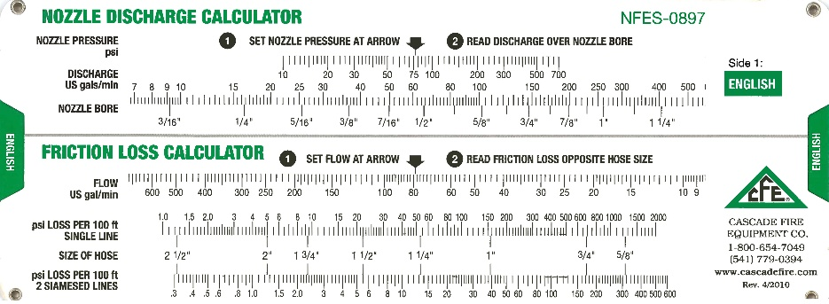
Why are there differences?
Friction Loss Calculator
  Derived from a mathematical equation
“Rule of 5s”
  An estimation

Slide 35
Are the differences significant enough . . .?
The goal is to supply an adequate amount of water and pressure to the nozzle operator(s).
We are making a “reasonable estimate” of friction loss. Calculations for either method is not exact.
Both methods provide a starting point to meet the goal.
NO!

Slide 36
A Comparison
Friction Loss Calculator
“Rule of 5s”
Provides consistency and validation (the theory behind hydraulics).
Based on theories.
Provide quick solutions for fire situations.
Make fast and practical decisions during hose lay construction.

Slide 37
Reducing Friction Loss
Increase hose diameters where possible.
Lay parallel hose.
  Calculate friction loss for one hose, then divide by 4.
Reduce the nozzle tip size.
  Reduces discharge flow.
Eliminate unnecessary plumbing parts.

Slide 38
Other considerations
Pump Cavitation, Drafting, & Ejector Use

Slide 39
Pump Cavitation
Pump cavitation occurs when more water is being discharged from the pump than is being supplied to the pump.
  This creates a low-pressure area within the eye of the pump that causes vapor bubbles to form and implode on the discharge side of the pump.

Slide 40
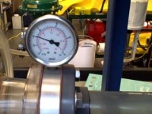
Pump Cavitation

Slide 41
Effects of Cavitation
When water enters the low-pressure area at the eye of the impeller, water vaporizes, or boils more easily.
When vapor bubbles reach the pressure or discharge side of the pump, they implode, or forcefully collapse, resulting in an intense shock wave which creates dings and pits of the pump walls and impeller.
  Damage is cumulative and progressive.
Excessive cavitation will eventually lead to impeller failure

Slide 42
Signs of Cavitation
Pump RPMs suddenly increase due to a lack of water resistance on the impeller.
Rattling, whining, or a sound like gravel flowing through the pump.
Increase in pump RPMs without an increase in pump discharge pressure (PDP).

Slide 43
Corrective Actions
Increase the supply of water coming into the pump and/or decrease the volume going out from the pump.
Clean out the suction strainer.
Do not deadhead the pump for prolonged period.
  Ensure that water is circulating through the plumbing.
If the pump is not staffed, the low-pressure shutoff switch must be in the down position.

Slide 44
Drafting
General Facts
Atmospheric pressure is approximately 15 pounds per inch (PSI) at sea level.
  An excellent pump can pull water 24’ at sea level.
Atmospheric pressure decreases .5 PSI for each 1,000 foot increase in elevation.
  *If you remember, head pressure equals .5 PSI/foot, therefore …
Each 1,000’ increase in elevation results in a loss of about 1’ of draft power.
Locating a pump as close to the water source as possible and reducing the vertical distance a pump must draft will increase its pumping ability.

Slide 45
Drafting Using Engine
Pump Setup
Locate a water source with adequate water supply.
Always obtain permission from the land owner before using a private water source.
Source site should allow for good ingress and egress.
Source site should free of floating debris.
All fittings and hoses on the suction side should be free of air leaks.

Slide 46
Drafting Using Engine
Pump Setup
Foot valve should be completely submerged, free of debris, and properly functioning.
Obtain a prime by using the hand/electric primer on the engine or fill the draft hose with water manually.
Set the water pressure shutdown switch to the up (override) position. Leave the switch in this position for the entire drafting process.

Slide 47
Drafting Using Engine
Pump Setup
Set correct valve configuration.
  Draft-to-tank
  Draft-to-fire
Confirm pump is drafting water into the tank.

Slide 48
Ejector Use - Refill Operations General Information
Picks up between 50-150% additional flow of water.
Can lift water 80’ or more vertically.
Can move water 300’ or more horizontally.
Must have enough water in the tank to fill all hose used on intake and return line.

Slide 49
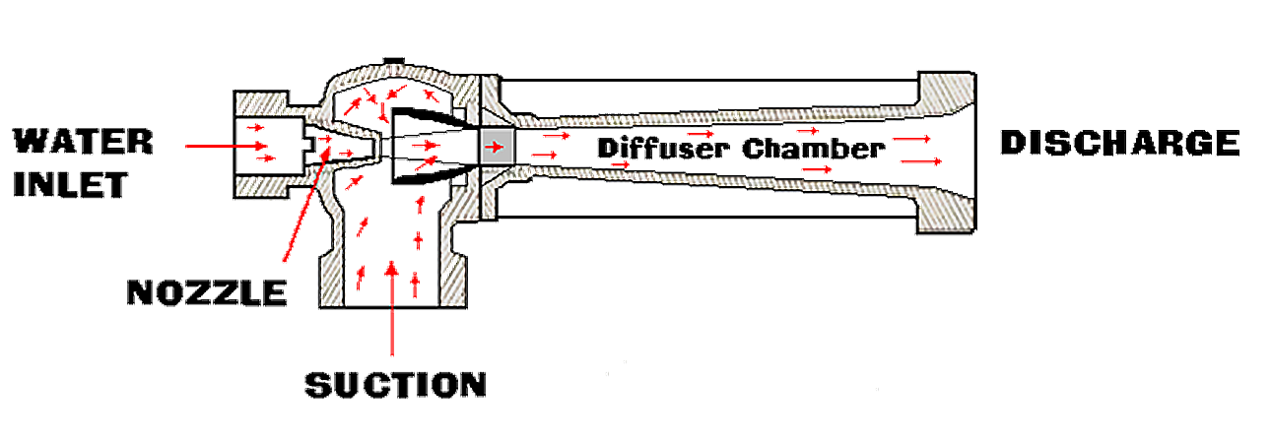
Working Principles

Slide 50
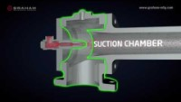
Ejector

Slide 51
Ejector Setup
Connect a section of 1-inch hose to overboard discharge and the water inlet side of the ejector.
Attach a strainer foot valve to ejector suction port of the ejector.
Attach 1½” hose to discharge side of ejector.
Submerge ejector in water source.

Slide 52
Ejector Setup
Start pump and throttle up to desired output.
  100-150 PSI at ejector is adequate.
Keep kinks out of supply and return lines.
If the site is going to be used multiple times, then leave hardware in place for refill operations.

Slide 53
Objectives
Identify…
  The elements that should be considered when calculating pump discharge pressure.
  Ways to reduce friction loss.
Perform…
  Friction loss calculations using
    Friction loss calculators
    Principles of Hydraulics – “Rule of 5s”
Describe, Discuss, and/or Demonstrate…
  The causes and effects of pump cavitation and the corrective actions the ENOP must take if cavitation occurs.
  Ejector use during pumping operations.
  How hydraulics affect drafting procedures used to refill an engine.

