Slide 1
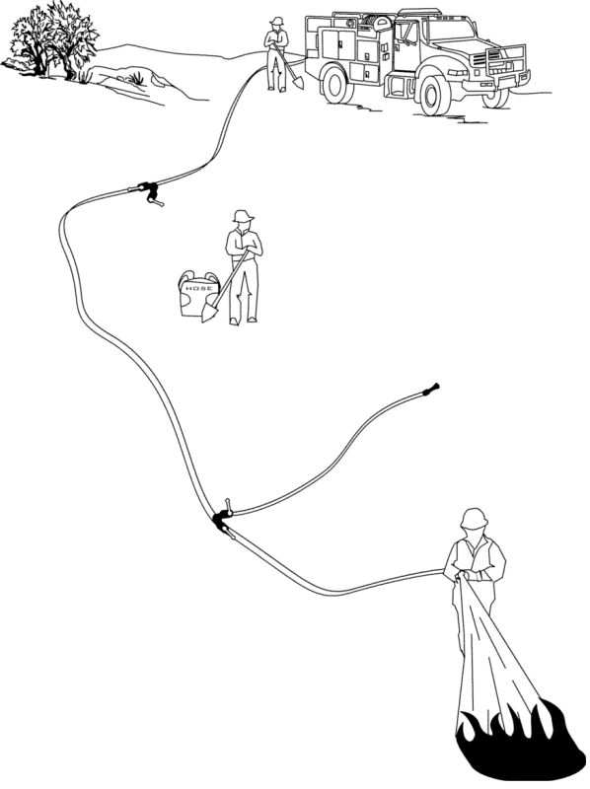
Water Handling Operations
Unit 4B – Water Sources
and Pumping Operations

Slide 2

Objectives
Identify water sources used in engine refill operations.
Define aquatic invasive species.
Discuss actions an ENOP can perform to help reduce/eliminate the spread of aquatic invasive species.
Identify potential problems that occur when interfacing with a municipal apparatus.
Demonstrate the use and hazards of hydrants during refill operations.

Slide 3
Objectives
Describe the differences between parallel, stage, and series pumping.
Describe the differences between a simple and progressive hose lay.
List the advantages and disadvantages of hose deployment methods.
Locate and describe the function of valves in the fire engine plumbing system.

Slide 4
Water Sources for Engine Refill
Operations

Slide 5
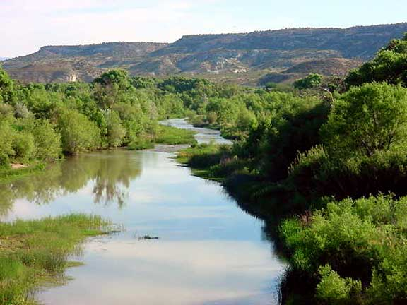
Natural Water Sources
Streams
Ponds
Lakes
Springs
Other

Slide 6
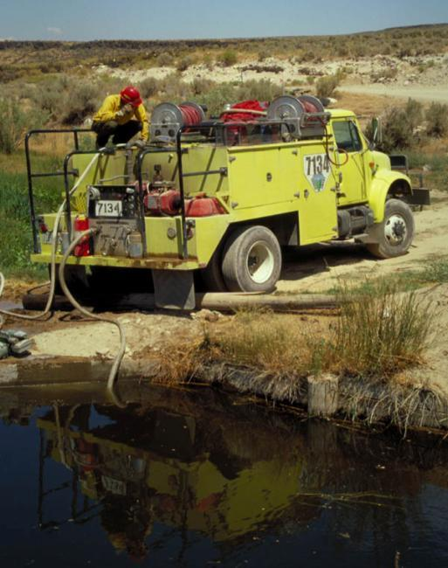
Considerations
Limit environmental impacts
Adequate water supply (flow)
Good ingress and egress
Owner permission for private water source
Communicate location to others
Flush tank and plumbing after use

Slide 7
Dam Building
Locate dams in areas narrow enough to dam easily.
Use rocks, logs, or plastic to build a dam.
Tear down the dam after use.

Slide 8
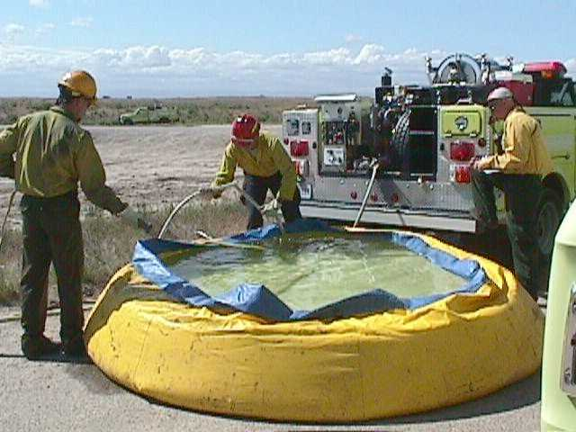
Portable Tank Setup
Locate in an area where the water can drain on the downhill side without causing access problems.
Locate on relatively smooth, flat ground.
Communicate location to others.

Slide 9
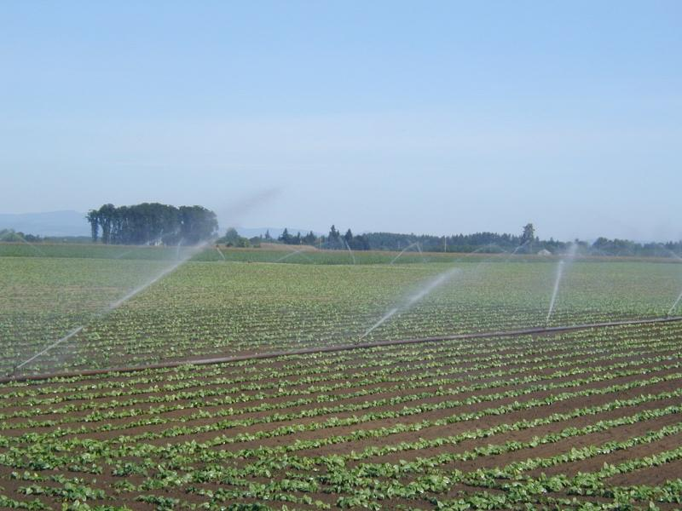
Agricultural Sources

Slide 10
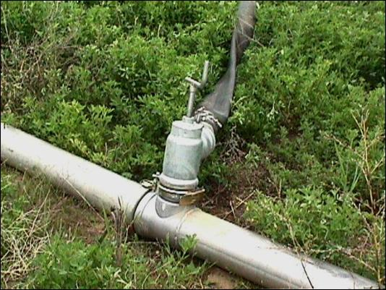
Irrigation Risers
Obtain owner permission.
Consult with owner regarding line and pump.
Use riser adapter and fill hose.
Open with caution.
Communicate location to others.

Slide 11
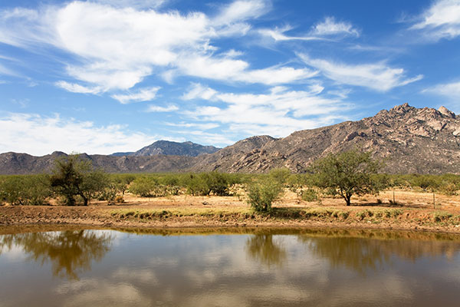
Stock Ponds
Limit environmental impacts.
Obtain owner permission.
Adequate water supply.
Good ingress and egress.
Communicate location to others.
Pond refilled after use, if required.

Slide 12
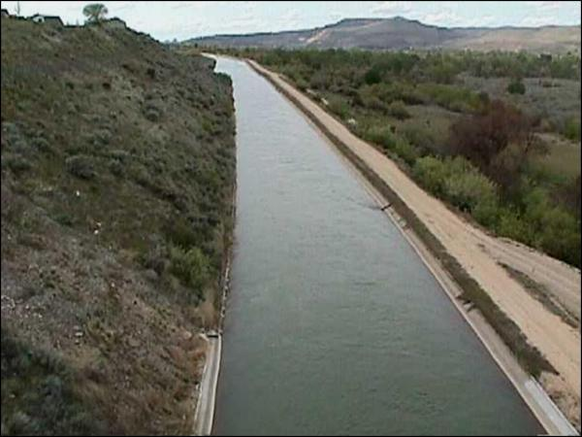
Canals
Obtain owner permission before use.
Inspect site for safe access (cut banks, soft or loose banks can cause engine rollovers).
Communicate location to others.

Slide 13
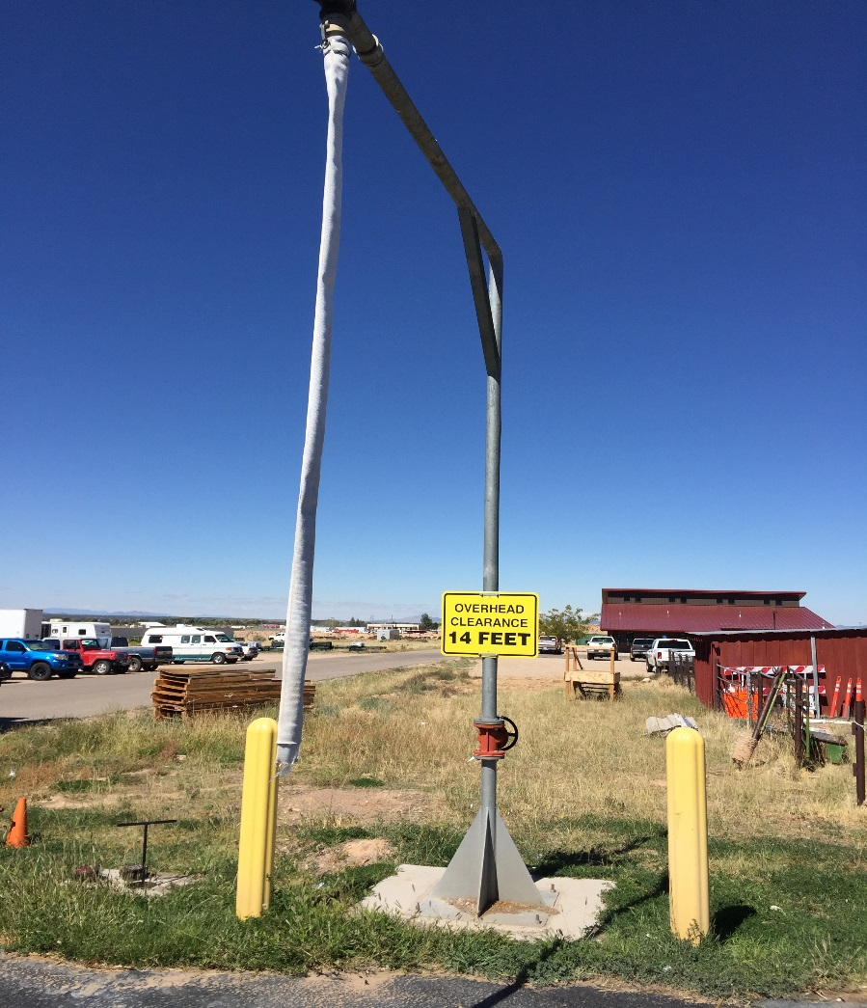
Stand Pipes
Obtain owner permission.
Ensure fill hose is long enough to be placed in tank.
  Use an air gap as backflow prevention.
Employ a two-person operation when necessary.
Open with caution.
Communicate location to others.

Slide 14
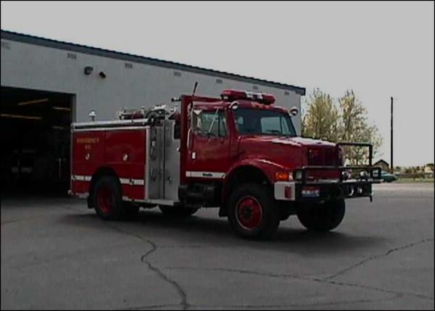
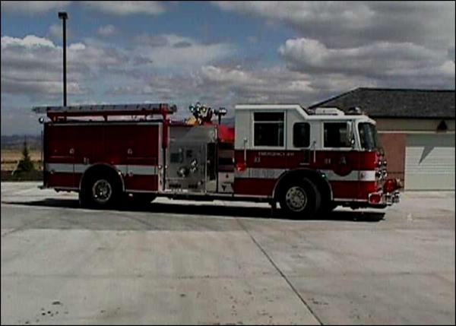
Municipal Apparatus

Slide 15
Considerations
Municipal apparatus deal primarily with large volume pumps.
Thread types vary from department to department. Carefully inspect all connections before using.
When filling through the direct fill (Dri-Fill) valve, do not exceed 50 PSI.

Slide 16
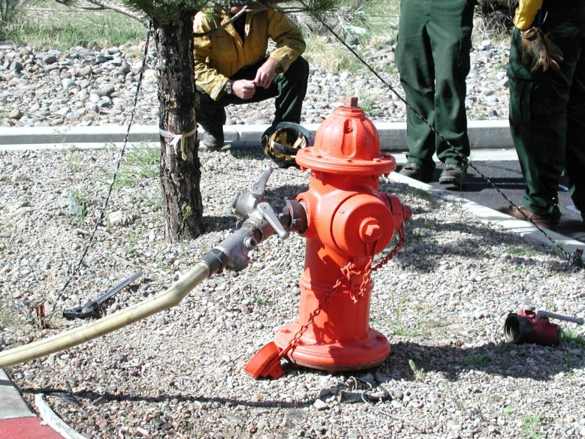
Fire Hydrants

Slide 17
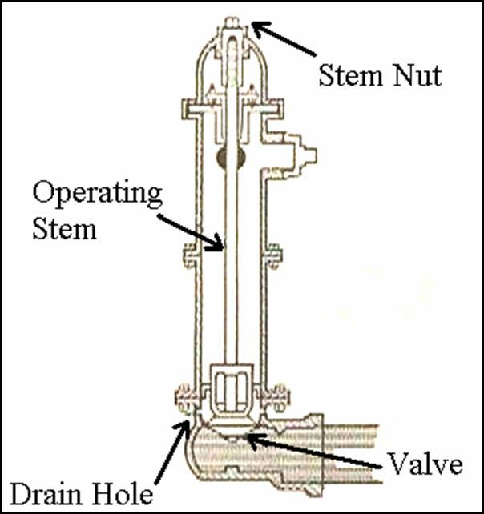
Dry Barrel Fire Hydrant
Most common.
Used in areas subject to freezing.
Drain when not in use.
Single on/off system.
Stem nut must be opened all the way.

Slide 18
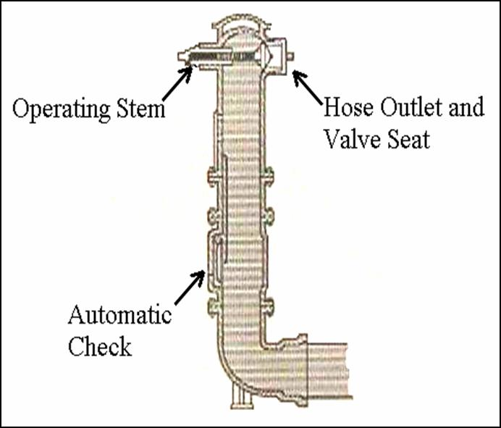
Wet Barrel Fire Hydrant
Used in areas not subject to freezing.
Always charged.
Individual hookup.

Slide 19
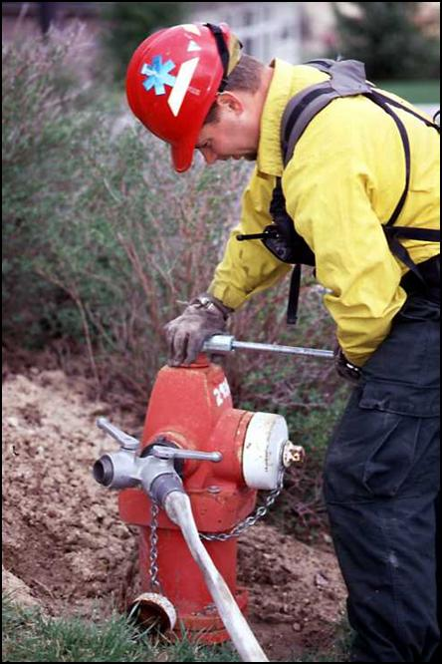
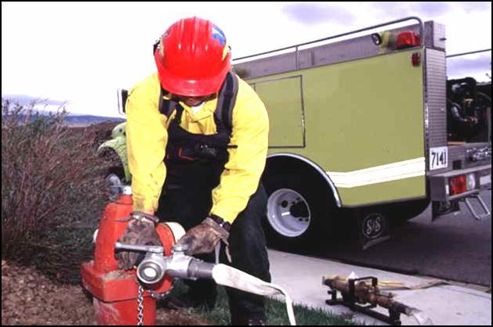
Proper Use and Hazards Associated with Hydrant Use

Slide 20
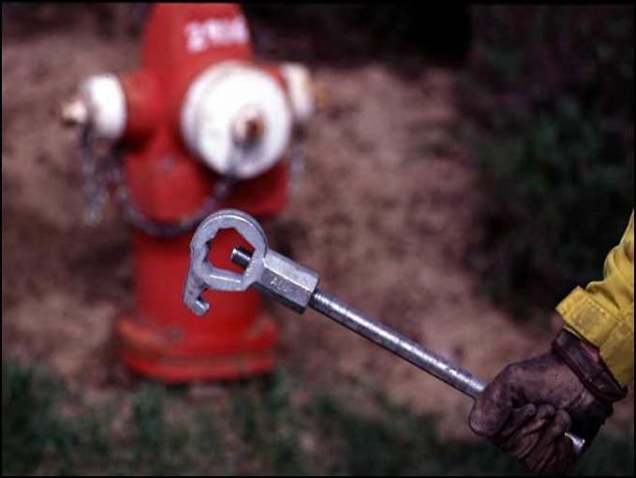
Hydrant Hookup
The five-sided hydrant wrench is the only wrench that should be used on hydrants.

Slide 21
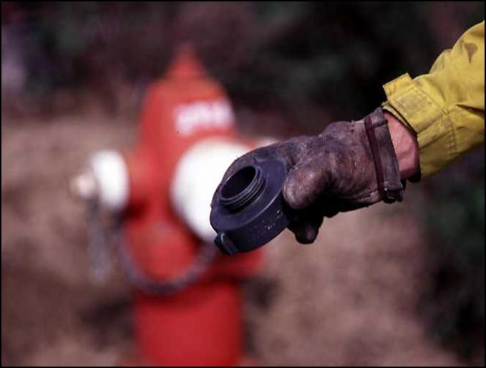
Hydrant Hookup
Always use the correct thread adapters and reducers.

Slide 22
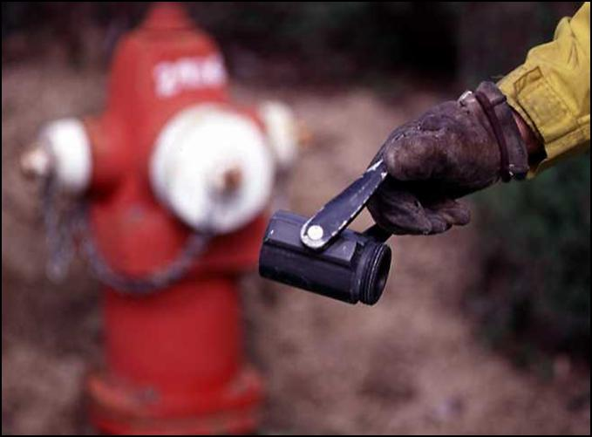
Hydrant Hookup
While the hydrant is in the off position, install appropriate fittings to control hydrant flow.

Slide 23
Hydrant Use
Open and close hydrant and valves slowly to avoid water hammer.
Bleed off any air, rust, or debris before attaching hose.

Slide 24

Hydrant Use
Open hydrant completely.
  Never control hydrant flow with the stem nut!

Slide 25
Improper Hydrant Use
Contamination of water supply
Damage to underground water supply lines
Injury to the operator
Damage to the engine attachments, fill controls, backflow prevention devices, or hose

Slide 26
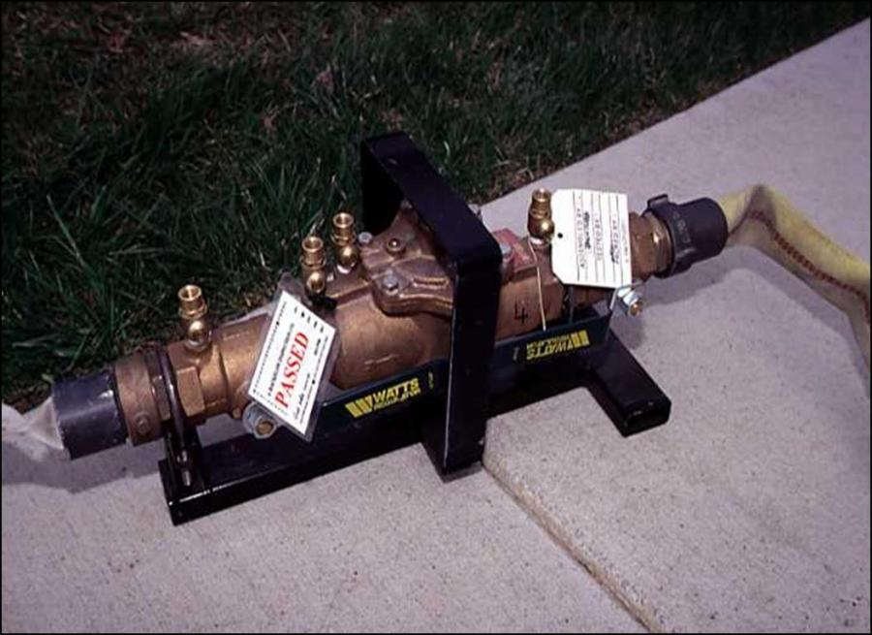
Backflow Prevention Devices

Slide 27

Why backflow prevention devices Required?
Answer:
To prevent contamination of the drinking water supply!

Slide 28
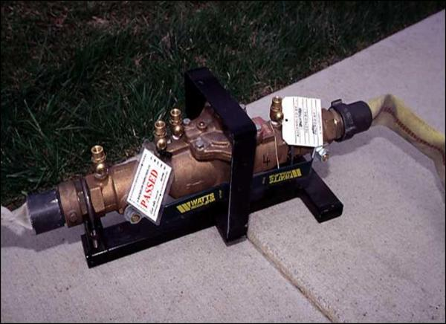
Backflow Prevention Device Components
Two check valves
Differential pressure relief valve
Four properly located test cocks
Two isolation valves

Slide 29
Backflow Prevention Devices
Use of
Place between the hydrant and the engine tank.
Know the local protocol regarding hydrant use.
Certify and test device annually.
Use the air gap method to refill if you do not have a backflow prevention device.

Slide 30
Air Gap Method
An air gap assembly is a permanently attached pipe with a hose connection.
Requirements:
  Air gap distance is required to be two times the inside diameter of the pipe.
  If no air gap assembly or backflow prevention device assembly is available, use the manual air gap method.

Slide 31
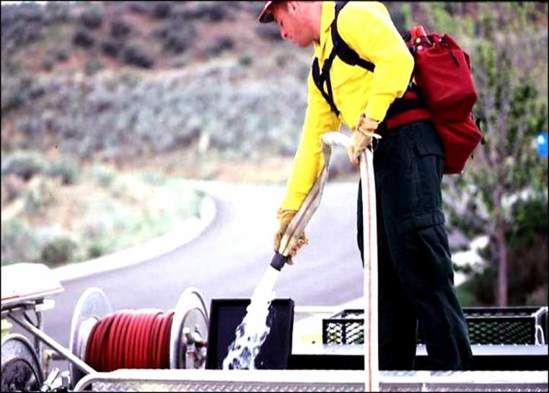
Manual Air Gap Method
Person holds the fill hose.
Never insert the fill hose into the tank.
Always maintain the air gap.

Slide 32
Aquatic Invasive Species
(AIS)

Slide 33
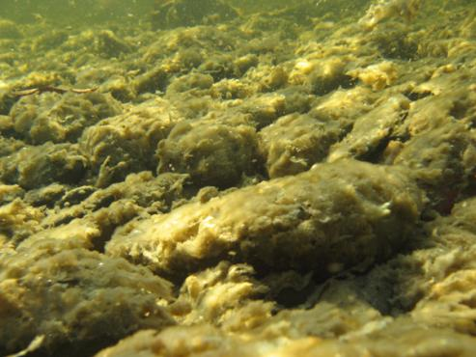
Aquatic Invasive Species (AIS)
“Aquatic invasive species” are alien (non-native) aquatic plants and animals whose introduction into an ecosystem causes, or is likely to cause, economic or environmental harm or harm to human health.

Slide 34

Invasive Aquatic Plants
Invasive aquatic plants are non-native plants that have adapted to living in, on, or next to water, and that can grow either submerged or partially submerged in water.

Slide 35
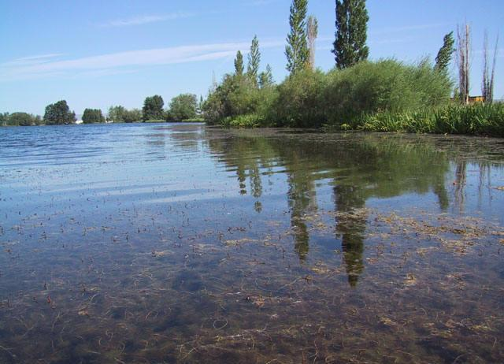
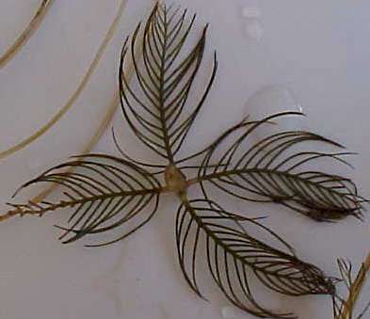
Eurasian Milfoil

Slide 36
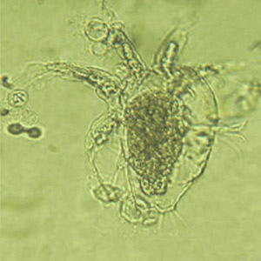
Chytrid Fungus
Microscopic
Mainly affects amphibians

Slide 37
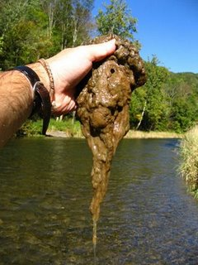
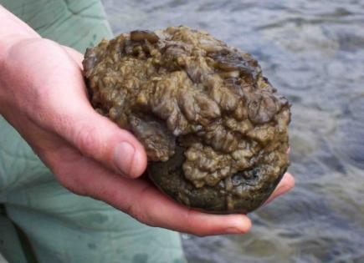
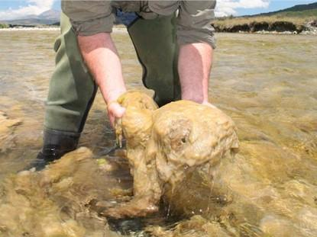
Didymo (Rock Snot)

Slide 38

Invasive Aquatic Animals
Invasive aquatic animals are non-native animals that require a watery habitat but do not necessarily have to live entirely in water.

Slide 39
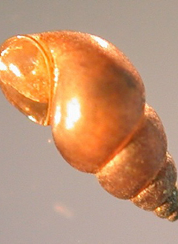
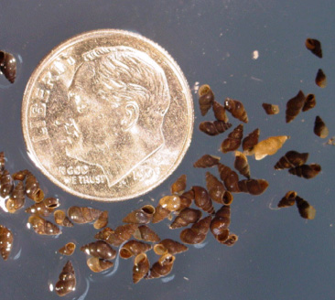
New Zealand Mudsnails

Slide 40
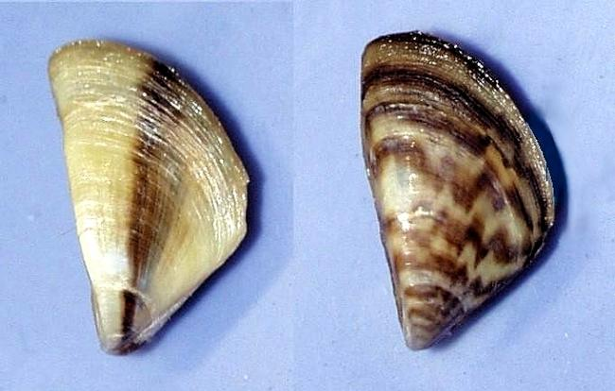
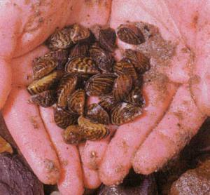
Zebra Mussels

Slide 41
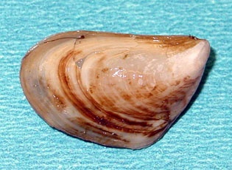
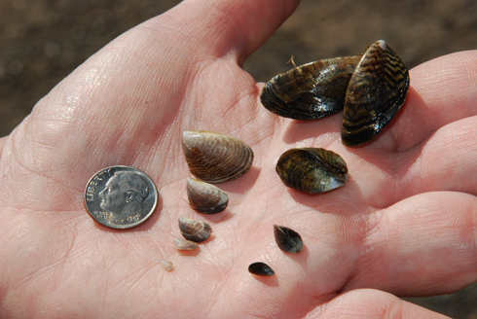
Quagga Mussels

Slide 42

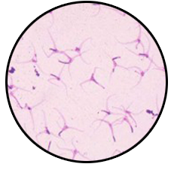

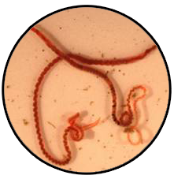
Whirling Disease Parasite

Slide 43
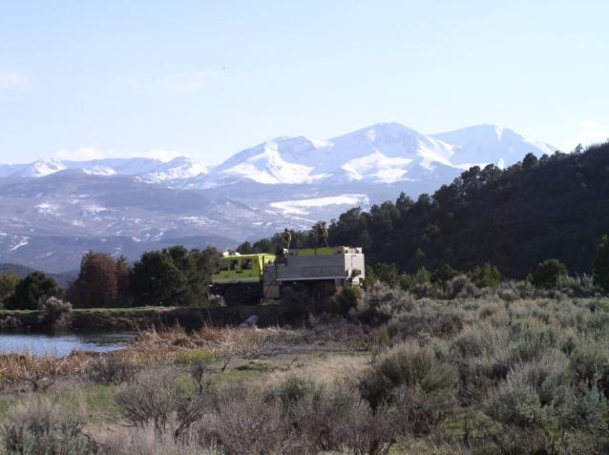
AIS Policy Direction
AIS is an emerging issue with no clear national policy direction for fire operations.
ENOPs are encouraged to:
  Self educate.
  Ask questions of geographic area specialists.
  Follow local SOPs.

Slide 44
Standard Operating Procedures
Understand and follow the SOPs for AIS in your area.
Brief out-of-area engine crews working with you about AIS problems in your area.
When working outside your local area, learn and understand the SOPs for AIS in that area.
Treat every body of water as if AIS is present!

Slide 45
Cleaning and Sanitizing Equipment
Screening Methods
  May be impractical
Chemical Use
  Mix ratio
  Cleaning solution disposal
  Consult the Safety Data Sheet (SDS)

Slide 46
Common Sense Mitigation Measures for AIS Prevention
Always assume that AIS could be present in any body of water.
When possible, avoid driving through bodies of water.
Avoid dumping water directly from one waterway into another.
Avoid drafting water from multiple sources during a single operational period unless equipment is sanitized between sources.
Avoid sucking organic and bottom material when drafting.
Clean out and sanitize the plumbing strainers.

Slide 47
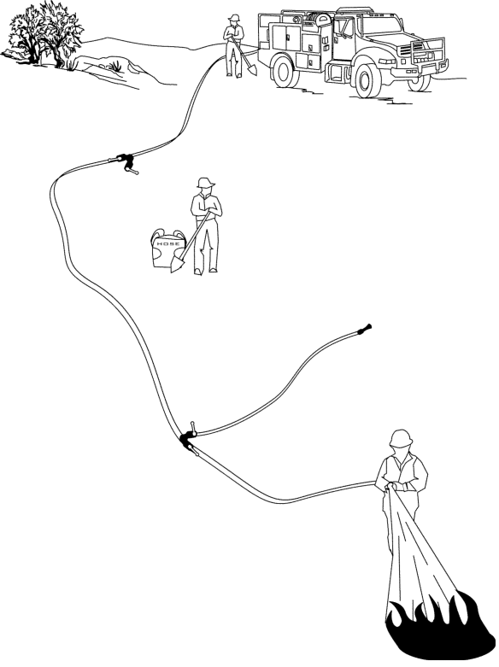
Pumping
Operations

Slide 48
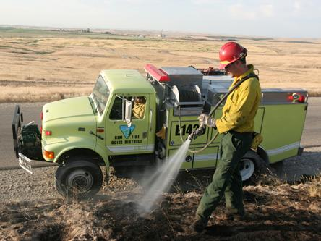
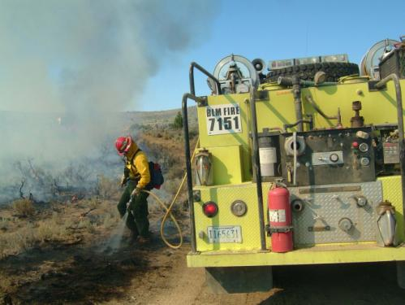
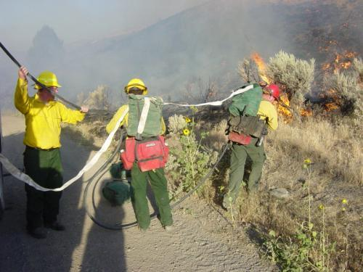
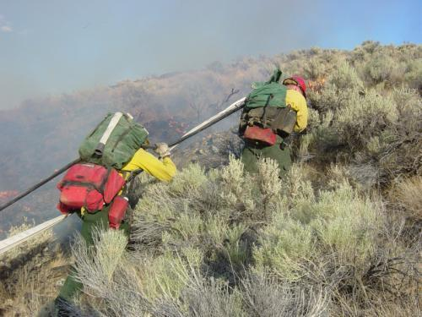
Water Delivery

Slide 49
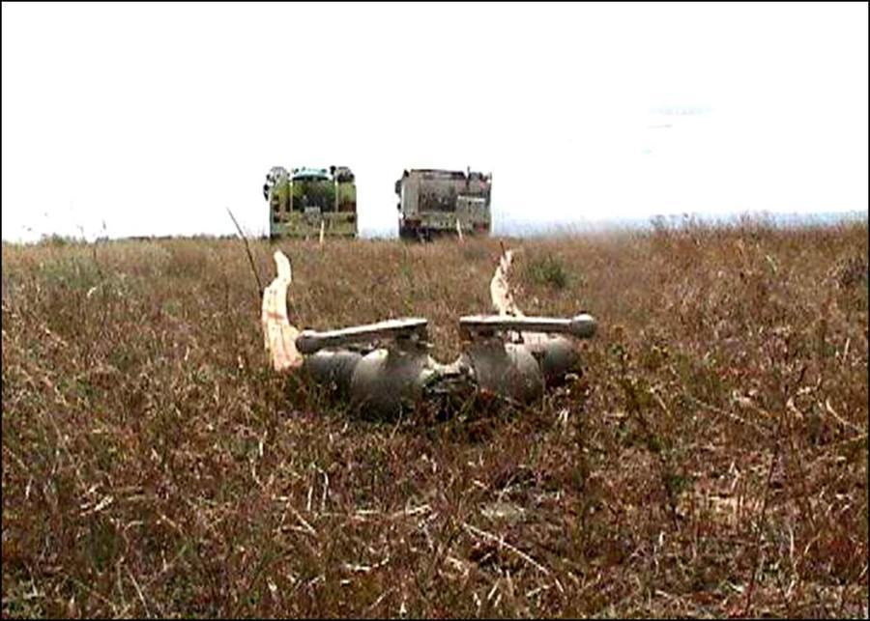
Parallel Pumping
Two engines with similar pump capacities are parked in a side-by-side formation.
Notes:
4C-06-ENOP-OT

Slide 50
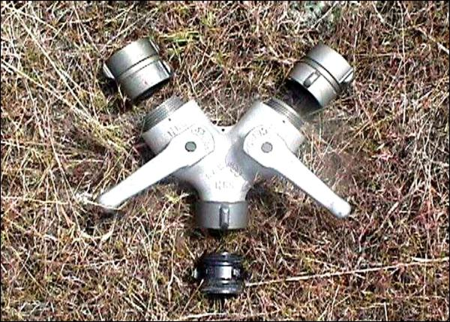
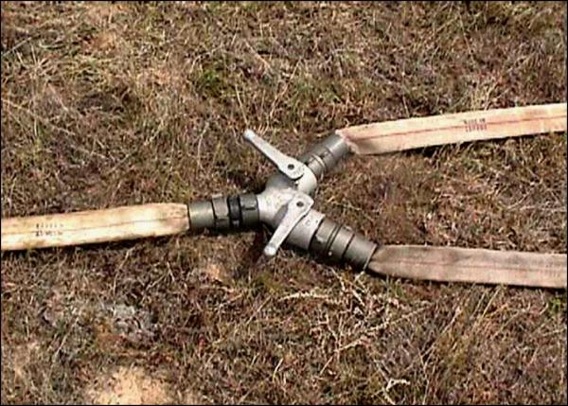
Parallel Pumping
A Siamese fitting is used to connect the two water supplies.
Water is pumped independently from each engine into a single hose lay coming off the Siamese fitting.
  The hydraulic effect is increased volume.
Notes:
4C-06-ENOP-OT

Slide 51
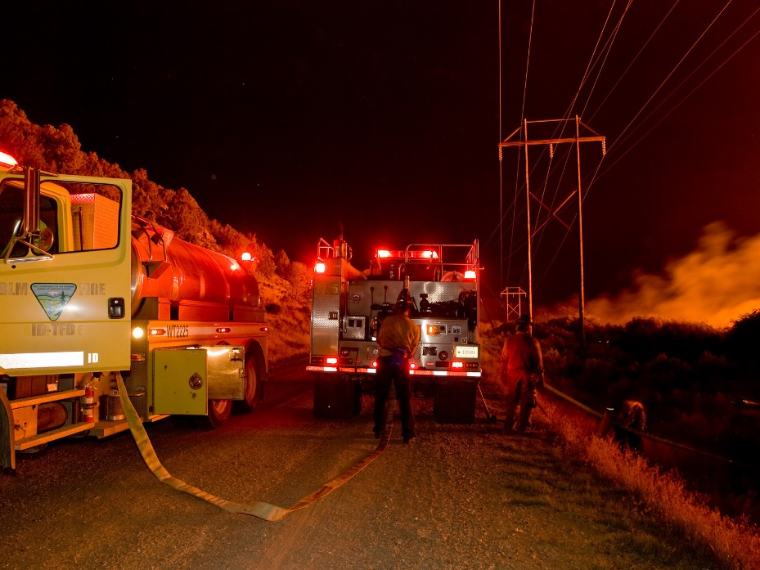
Stage Pumping
Two engines operate independently of one another.
Water pumped from one engine/ pump into another holding tank.
  The hydraulic effect is equal to the ability of each pump.
Notes:
4C-10-ENOP-OT

Slide 52
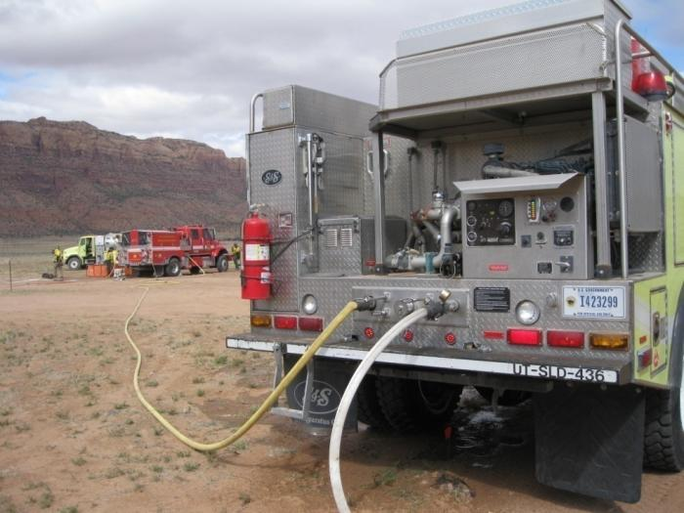
Series Pumping
Two or more pumps are directly connected in series.
Place the pump with the highest output closest to the source.
  The hydraulic effect is to increase the pressure.
Notes:
4C-12-ENOP-OT

Slide 53
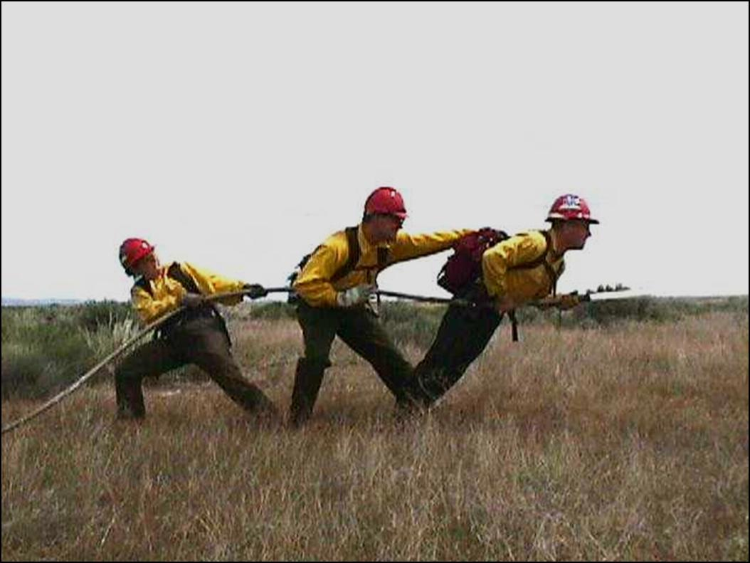
Hose Lays

Slide 54
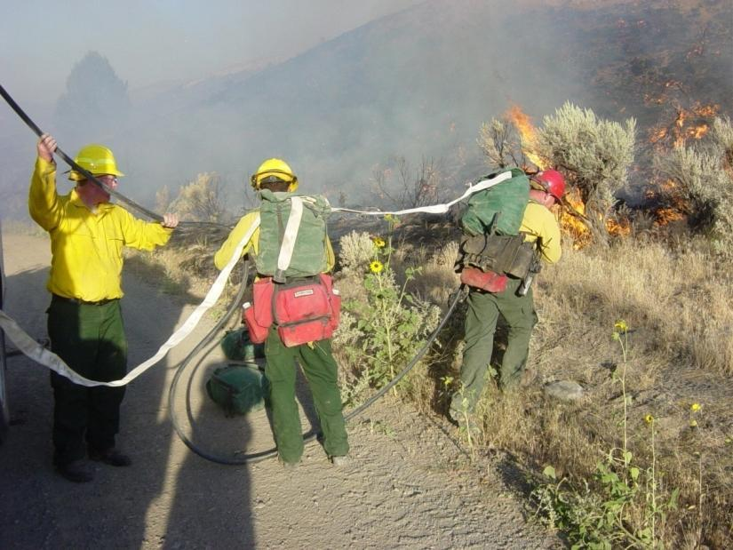
Simple Progressive Hose Lay
Comes straight off the pump and goes directly to the nozzle with no appliances in between hose connections.
Notes:
4C-14-ENOP-OT

Slide 55

Progressive Hose Lay
Comes from the pump source to the fire via a series of laterals coming off different appliances.
Notes:
4C-16-ENOP-OT

Slide 56



Hose Deployment
Attack Methods

Slide 57

Rolled Hose
Advantages:
Disadvantages:
Easy to store and transport.
Comes from the supply cache single rolled.
Hard to deploy uphill or through brush or slash
Takes both hands to unroll

Slide 58



Hose Packs
Used for quick deployment of predetermined lengths of hose.
Specific to needs of geographic area.
Forester hose packsack
Gasner
Notes:
4C-23-ENOP-OT

Slide 59

Hose Packs
Advantages:
Disadvantages:
Easy to deploy
Fittings attached
Ease to store and transport
Takes skills and time to package
Requires extra training time

Slide 60
Mobile Attack
Live Reel Use
Placement of hoses for mobile attack:
  Lead hose usually knocks down the fire, and the trail hose catches any remaining threat to the line.
Speed of line construction:
  Dependent upon number of resources and fuel type.
Notes:
4C-25-ENOP-OT

Slide 61
Mobile Attack
From the Black
Entails positioning the engine and personnel in the black and directing the water stream towards the green.
  Used when terrain, obstacles and fuel type allow.
Hazards:
  Residual heat from the flaming fire front
  Burning debris under the engine.
Notes:
4C-26-ENOP-OT

Slide 62
Mobile Attack
From the Green
Entails positioning the engine and personnel in the unburned fuel on the fire perimeter and directing the water stream towards the black.
Hazards:
  Unburned fuel between you and the fire
  Rocks or holes hidden by fuels
Notes:
4C-27-ENOP-OT

Slide 63

Engine Placement
Stationary Pumping
Adhere to LCES during all fire operations.
Keep in mind ingress and egress during pumping operations.
  Back in vehicle for quick egress.
  Chock vehicle.
Look Up, Look Down, Look Around
Notes:
4C-28-ENOP-OT

Slide 64



Engine Protection Lines

Slide 65
Engine Protection Lines
Know the location of engine protection lines.
Leave a quick connect hose in place to protect the engine at all times.
Engine protection line should be 1½” hose with samed size nozzle.
Leave a supply of water in tank for engine protection.
Line needs to be deployed quickly and cover all sides of the engine.

Slide 66

Communications
Radio
PA system
Headset
Hand signals
Others?

Slide 67

Fire Engine Plumbing

Slide 68


Tank-to-Pump Valve

Slide 69



Pump-to-Tank Valve

Slide 70




Pump-to-Discharge Valve

Slide 71



Primer

Slide 72


Bypass/Recirculation Valve

Slide 73


Bypass/Recirculation Valve

Slide 74



Overboard Draft

Slide 75



Strainer

Slide 76


Gravity Drain/Direct (Dri-Fill)

Slide 77


Engine Protection Valve

Slide 78


Slide 79


Valve Configuration

Slide 80


Slide 81


Slide 82


Slide 83
Objectives
Identify water sources used in engine refill operations.
Define aquatic invasive species.
Discuss actions an ENOP can perform to help reduce/eliminate the spread of aquatic invasive species.
Identify potential problems that occur when interfacing with a municipal apparatus.
Demonstrate the use and hazards of hydrants during refill operations.

Slide 84
Objectives
Describe the differences between parallel, stage, and series pumping.
Describe the differences between a simple and progressive hose lay.
List the advantages and disadvantages of hose deployment methods.
Locate and describe the function of valves in the fire engine plumbing system.

