Slide 1
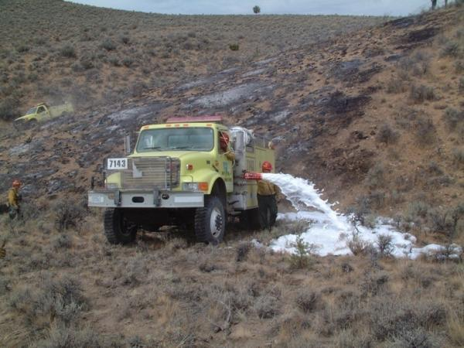
Water Handling Operations
Unit 4C - Foam and Foam Proportioning Equipment
Version: January 2023

Slide 2
Objectives
Discuss why foam is more effective than plain water when performing wildland fire suppression operations.
Discuss foam safety, including guidelines for handling foam products.
Identify and discuss the advantages and disadvantages of manual foam proportioning methods used when performing wildland fire suppression operations.

Slide 3
Objectives
Identify various operational components of the FoamPro® 1600/1601 and Waterous Aquis 1.5.
Demonstrate the ability to set up, run, have foam solution pumped to a nozzle person, and shut down a foam proportioner.
Discuss basic maintenance, winterization, and troubleshooting methods for foam systems

Slide 4
Reasons to use foam
Makes water “wetter” (more effective)
Reduces evaporation/improves absorption
Adheres to surfaces for pre-treating fuels and structures
Improves water conservation and usage, especially during mop-up.
Use as holding feature during ignition operations
Restricts oxygen. Reduces fuel temperature to below ignition point.

Slide 5
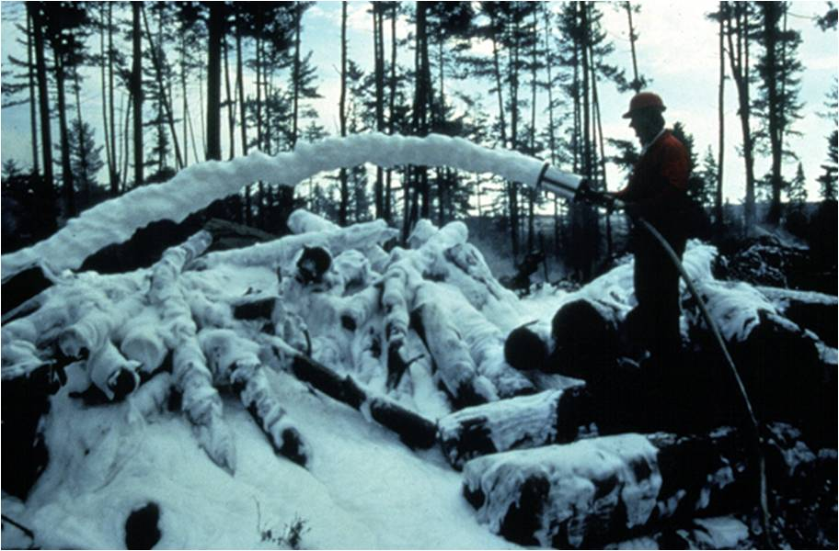

Slide 6
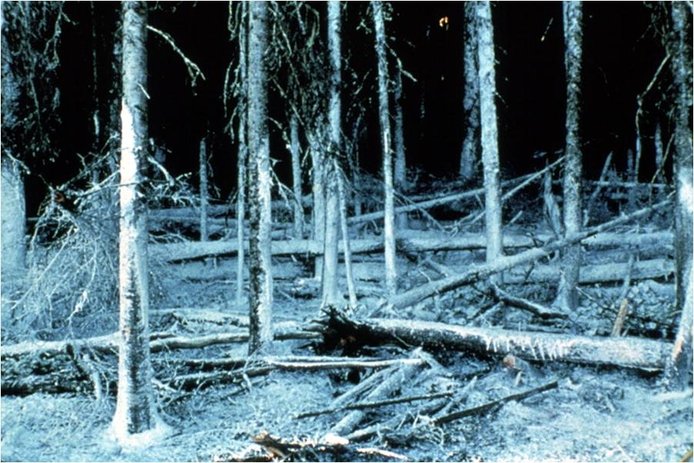

Slide 7
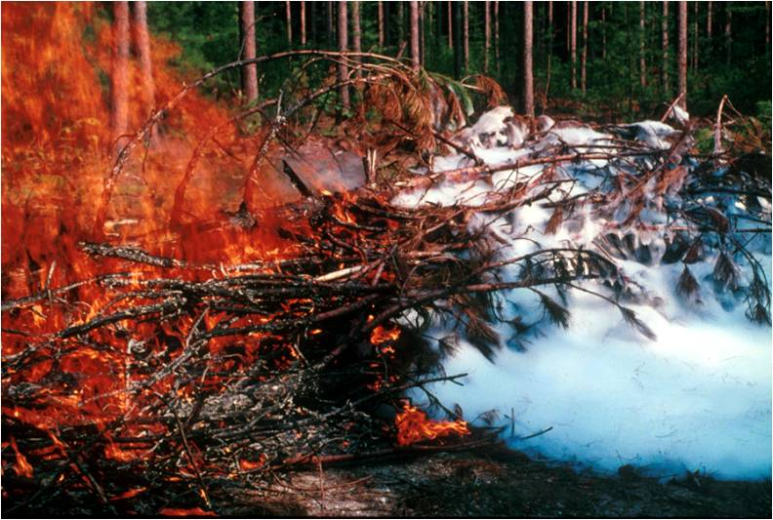

Slide 8
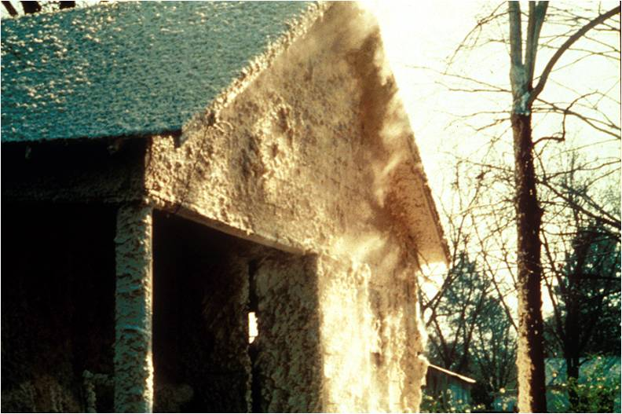

Slide 9
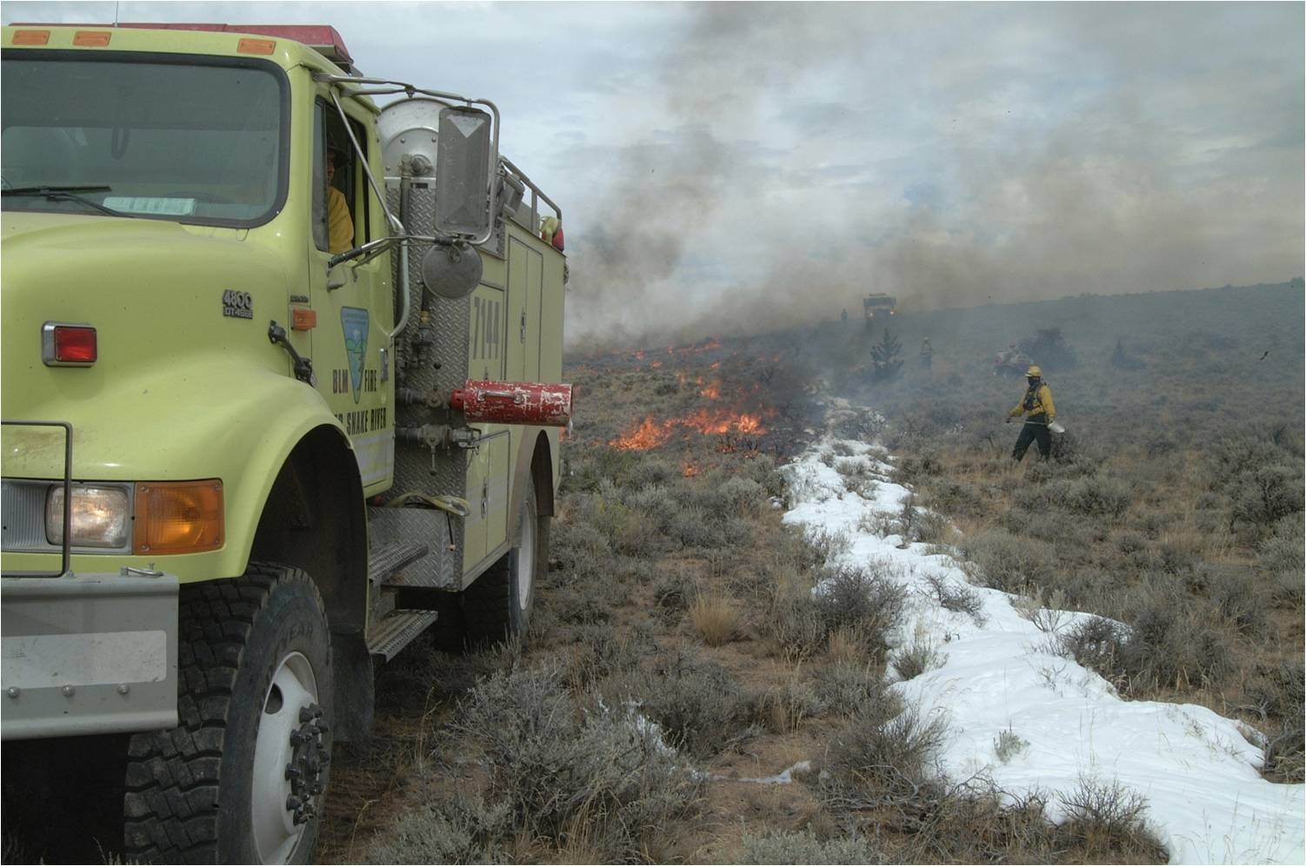

Slide 10
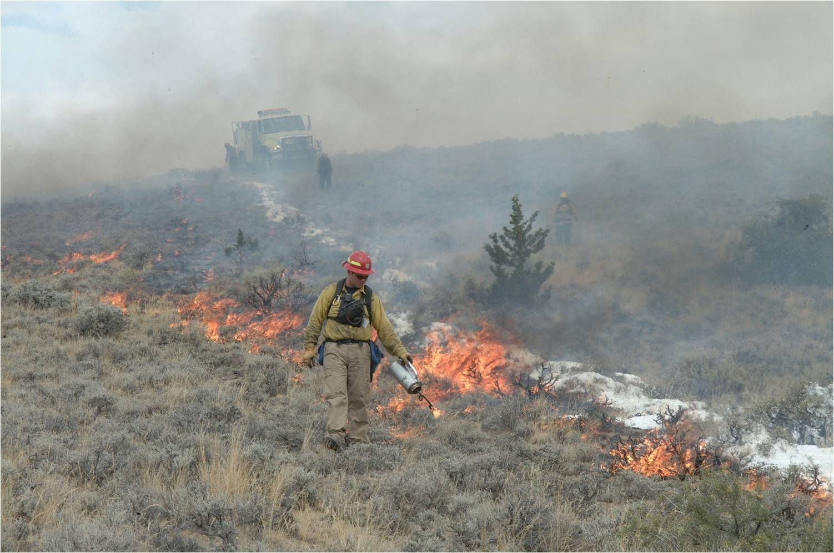

Slide 11
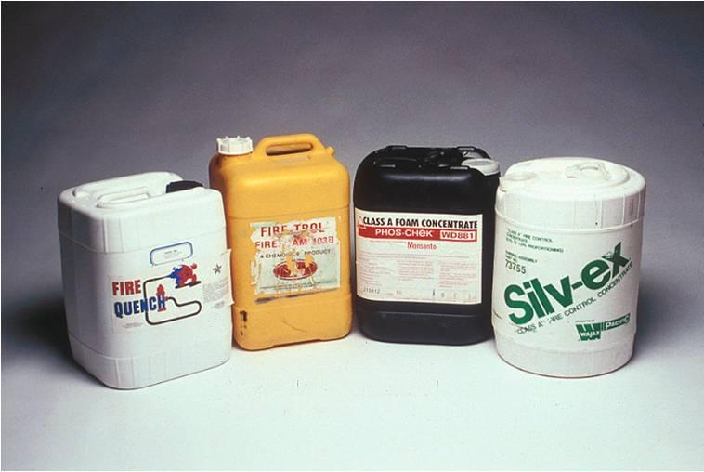
To Mix or Not to Mix....
THAT Is the question!

Slide 12
Safety Concerns
Skin and eye irritant
Dries out skin, boots, gloves, etc.
Caution when using in sensitive areas and waterways

Slide 13
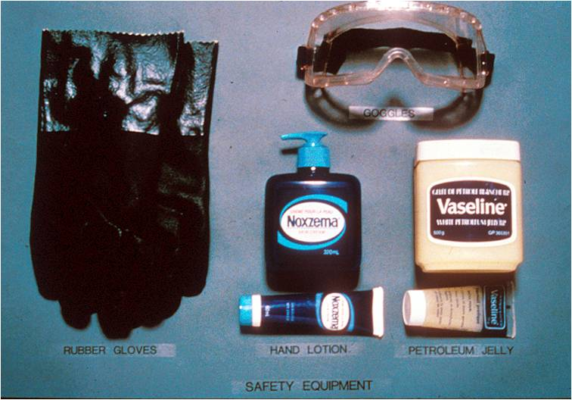
Safety equipment

Slide 14
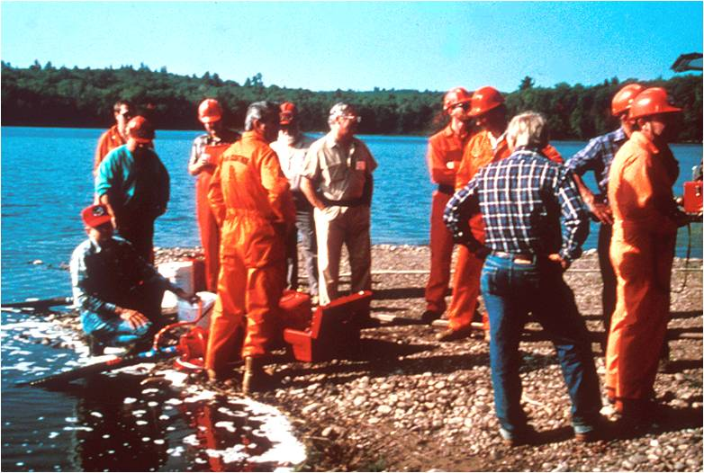

Slide 15
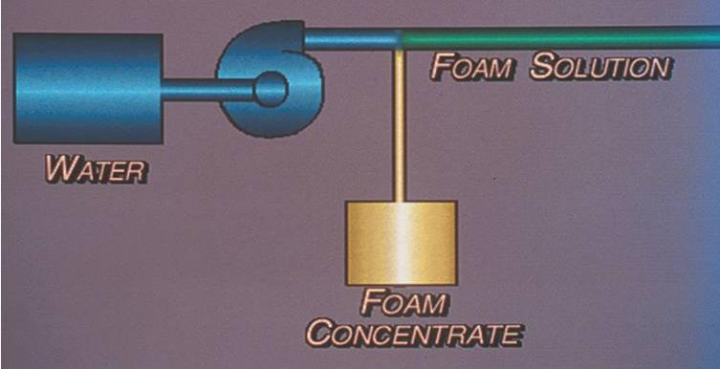
Foam Proportioners

Slide 16
Manual Foam Proportioners
Operators manually adjust the device to maintain a constant mix ratio when water flow and pressure changes.
Cannot maintain constant mix ratio over various flow and pressure rates
Caution with plumbing configuration to not "foam the tank"

Slide 17
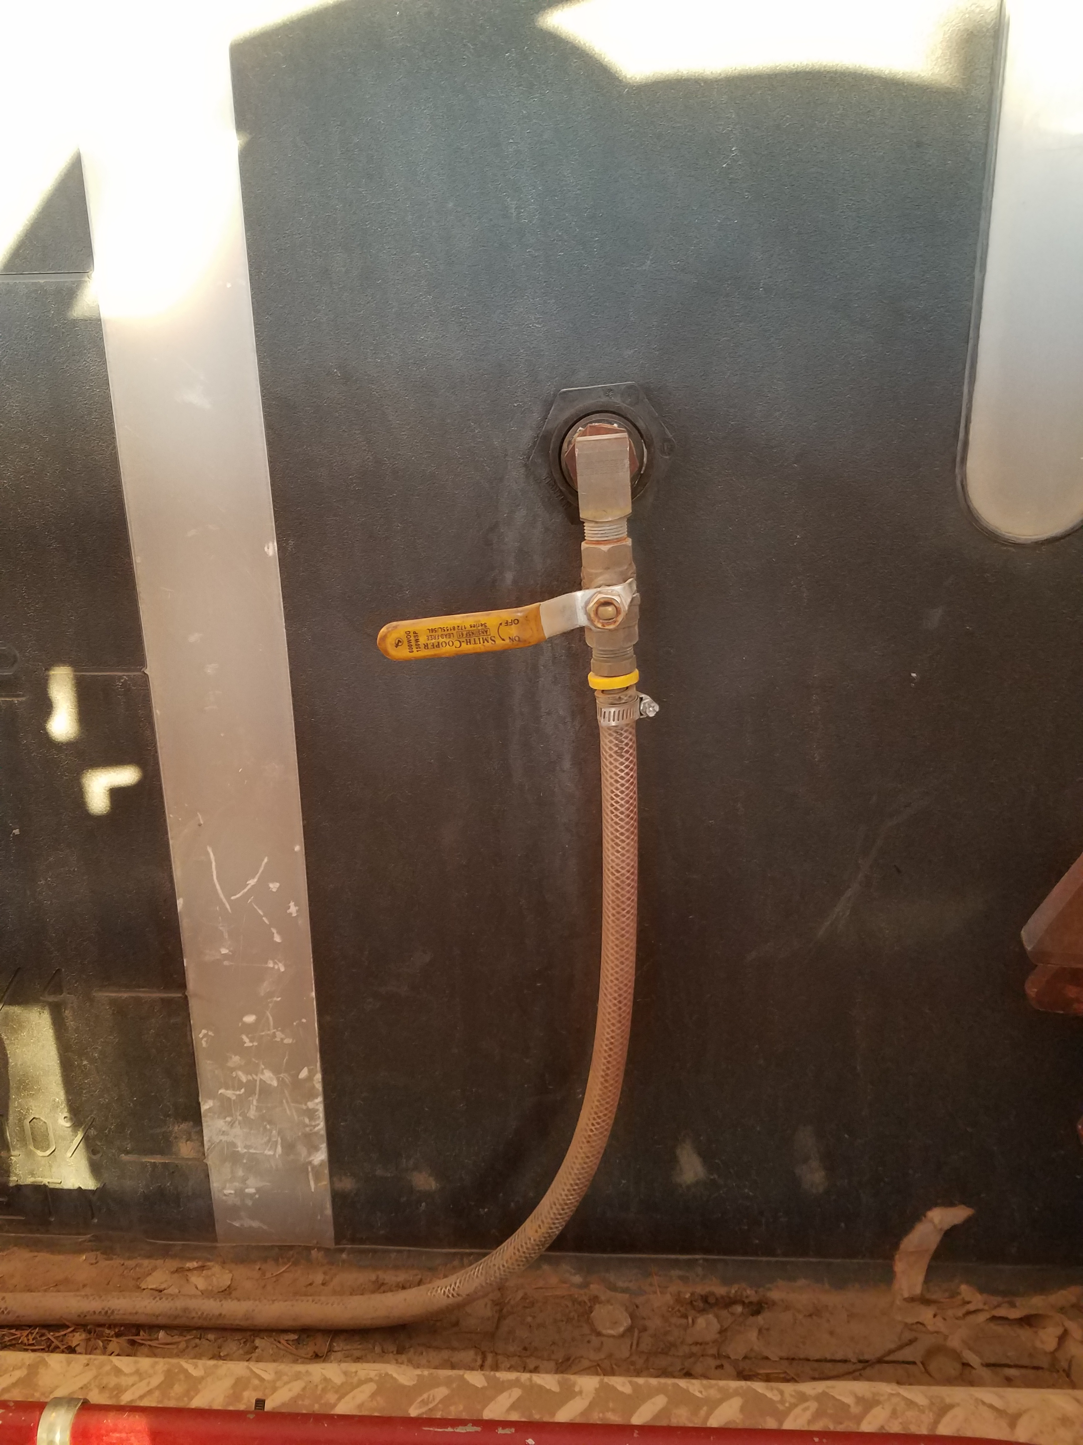
Foam On/off valve at tank
Notes:
On/Off valve to foam tank. Must be opened to flow foam.

Slide 18
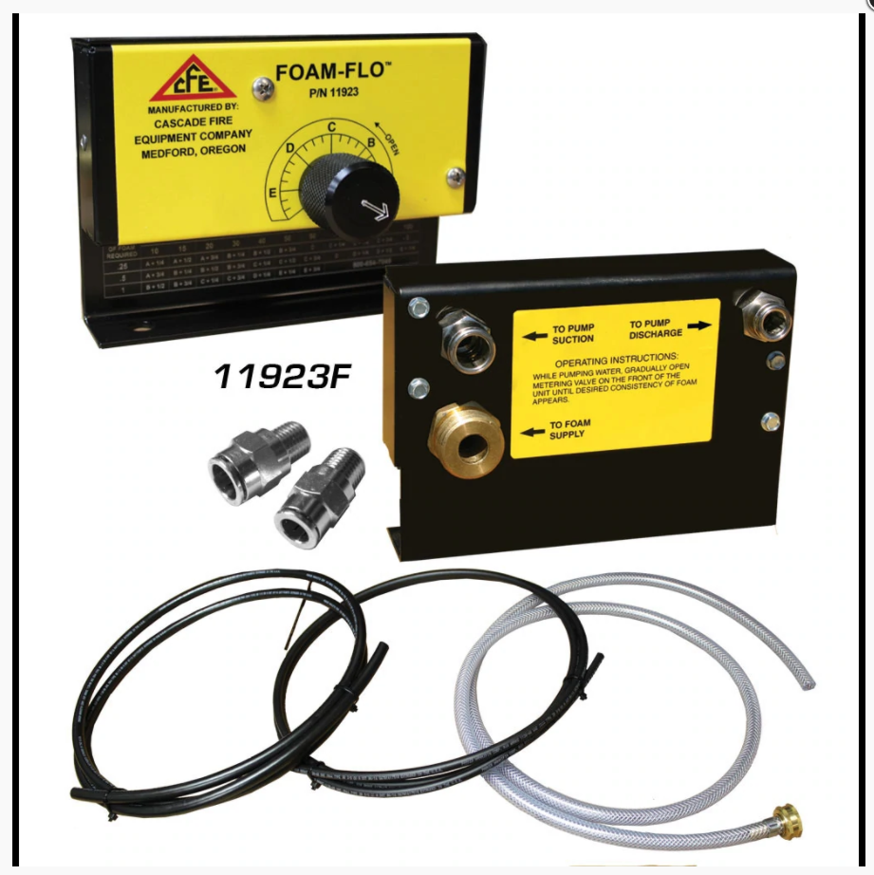
Cascade Foam Flo
Simple and effective.
Uses standard fittings and is unpowered.
Caution: Foam can get into the tank if valving is not correctly installed or if internal check ball malfunctions.

Slide 19
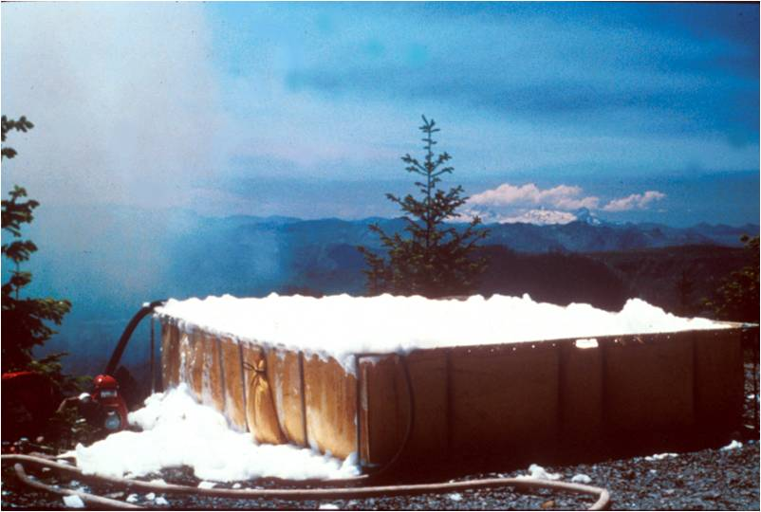
Batch Mixing

Slide 20
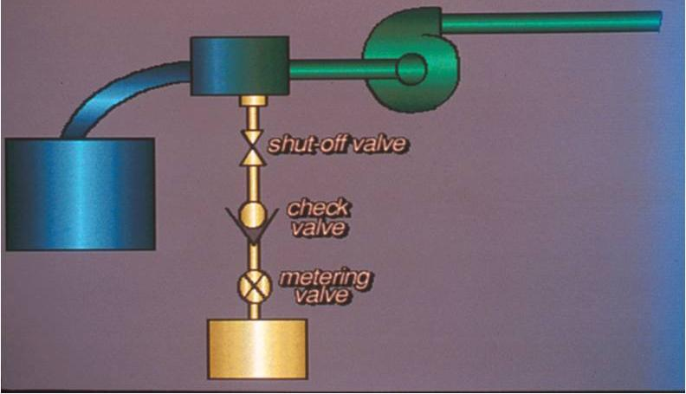
Suction-Side Proportioners

Slide 21
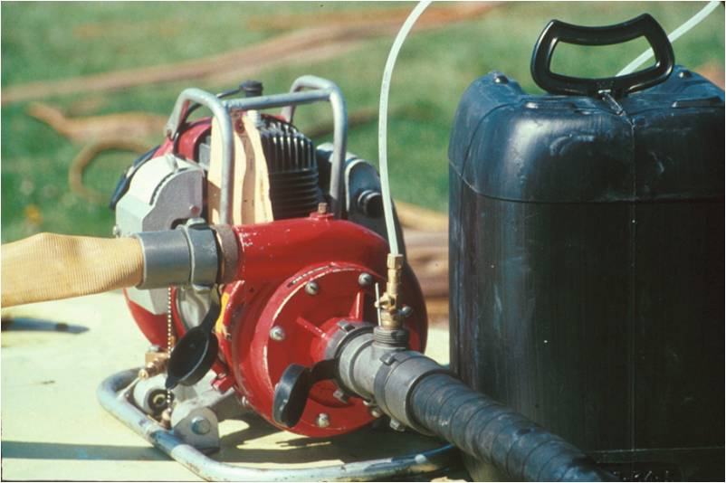

Slide 22
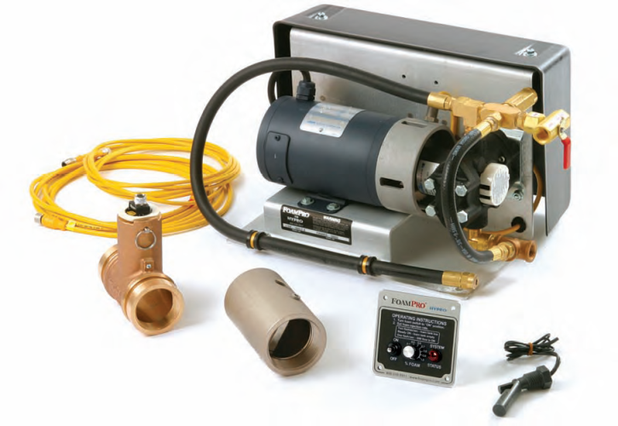
Automatic Foam Proportioner
The automatic foam proportioner makes an adjustment on its own to maintain a constant mix ratio when water flow and pressure changes.
FoamPro® 1601
Waterous Aquis™ 1.5

Slide 23
Foam Proportioner
Proportional and automatic
Works on discharge side of pump
Class A foam only
Requires water flow and electrical current
No restrictions due to hose length or number of nozzles
No loss of pressure or flow
Accurate at all flow ranges
Resupply foam without interruption

Slide 24
Operating the Foam Proportioner Major Components
Operator control module
Motor driver box/module
Paddlewheel flowmeter
Foam pump and electric motor
Calibrate/Inject valve
Inline strainer

Slide 25
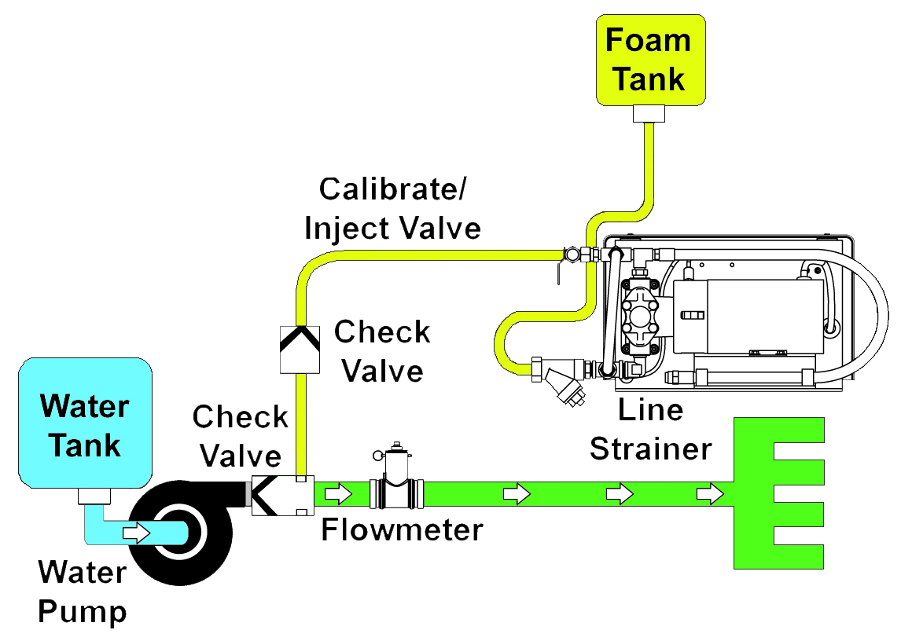
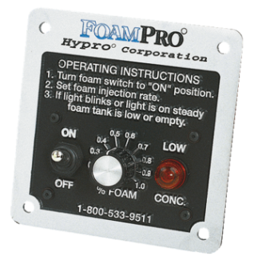
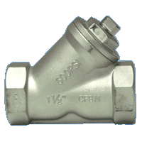
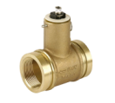
Foam Proportioner
s

Slide 26
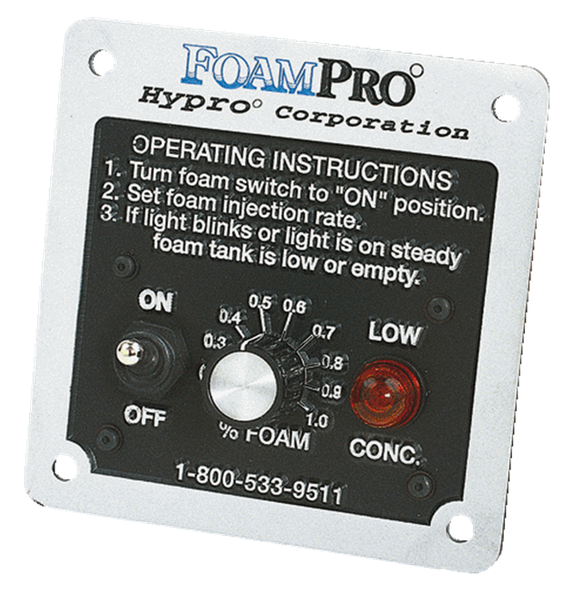
Operator Control Module Panel Mounted
Operating instructions
On/Off switch
Injection rate control
Adjustable from 0.1%-1.0%
Low concentrate (“LOW CONC.”) light

Slide 27
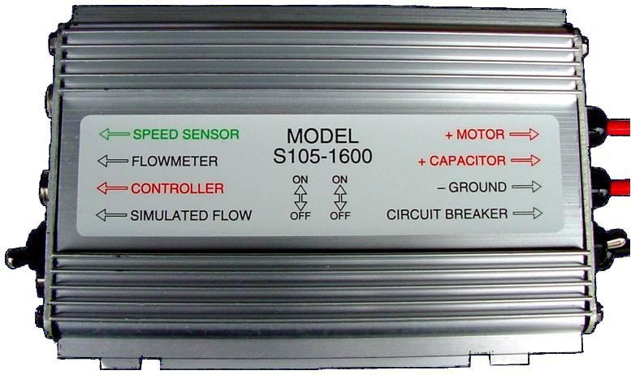
Motor Driver Box/Module Normal Operation
Simulated flow switch “Down” for normal operation
Circuit breaker switch “Up” for normal operation

Slide 28
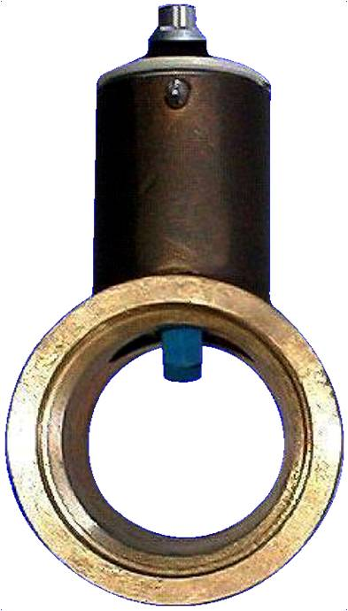
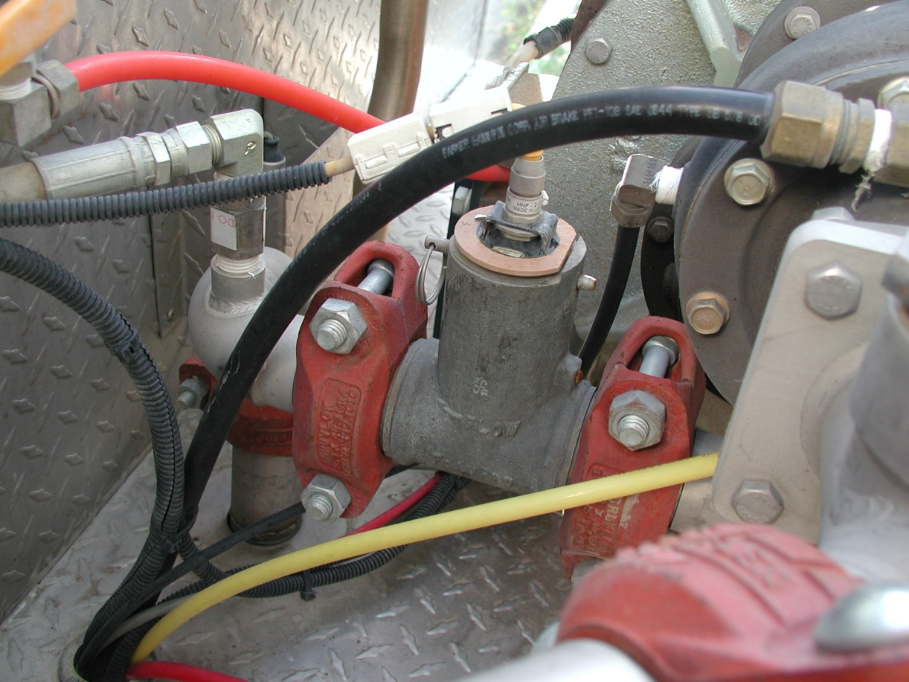
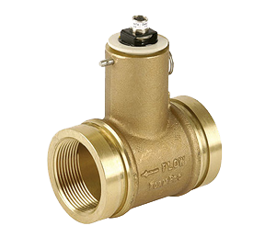
Paddlewheel Flowmeter

Slide 29
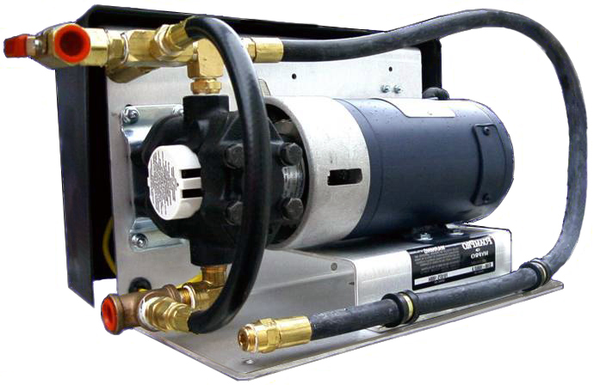
Foam Pump and Electric Motor

Slide 30
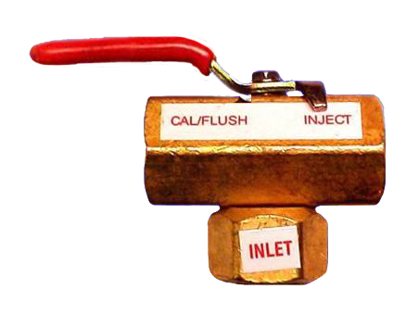
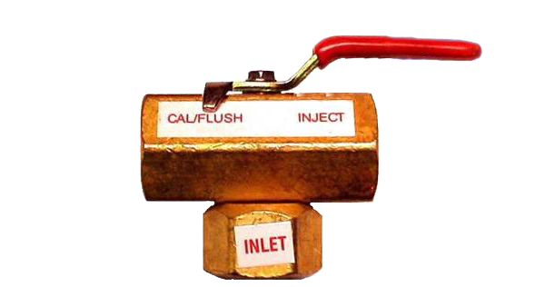
Calibrate/Inject Valve

Slide 31
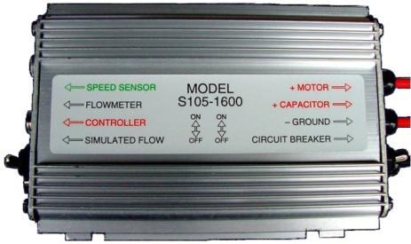
Purging Air
Enter “Simulated Flow”
Switch to “Up” position
Preprogrammed for 100 gpm
Valve to “Cal/Flush”
Turn panel switch “On”
Run pump until concentrate flows from dump line

Slide 32
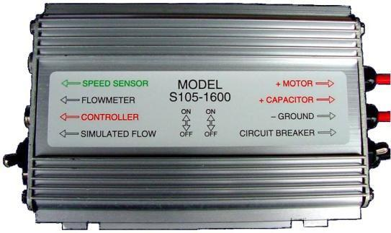
Purging Air Continued
Turn control panel to “Off” position
Return valve to “Inject”
Exit “Simulated Flow” by returning switch to “Down” position

Slide 33
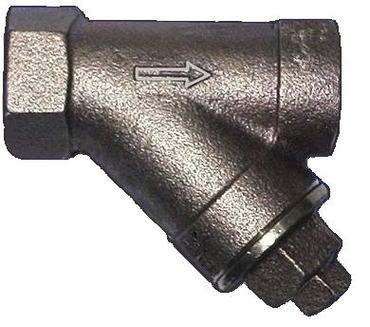
Inline Strainer

Slide 34
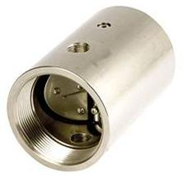
Foam Injection Check Valve and Injection Port

Slide 35
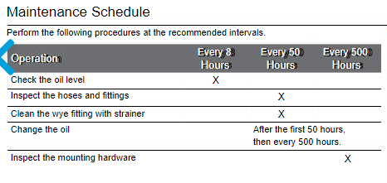
Maintenance/Calibration
Follow manufacturer recommendations for service intervals.
Waterous Aquis 1.5
6.1 oz., SAE30, non-detergent
FoamPro 1601 – grease every 50 hours
Calibrating the system:
Check flow rates
Flush system
Purge air/prime system
Notes:
Steps to Prime the Foam Proportioner
1. Make sure that the motor driver box toggle switches are set correctly. (FoamPro® 1601 only; otherwise, skip to step 2.)
“Simulated Flow” switch is in the “Up” position.
“Circuit Breaker” switch is in the “Up” position.
2. Set the Foam Percentage” switch to “1%.”
3. Place a container to collect the output that will be coming from the foam pump through the outflow foam concentrate line.
4. Turn the “Calibrate/Inject” valve to the “Cal/Flush” position.
5. Turn the “Controller Module” switch to the “On” position
Foam concentrate should start flowing into the container. When it is flowing at a steady rate (about 20 seconds), the foam pump is primed and ready for operation.
6. Turn the “Controller Module” switch to the “Off” position.

Slide 36
Winterization
Drain tank.
Drain lines.
Clean inline "Y" strainer.
Flush with clean water.
Flush with recreational vehicle antifreeze
When in doubt, follow the manual.

Slide 37
Troubleshooting
Is there foam?
Is there enough water flowing?
Check valves
Paddlewheels
Correct settings on proportioner/control module
Manufacturer’s manual for workflows/common issues

Slide 38
Objectives
Discuss why foam is more effective than plain water when performing wildland fire suppression operations.
Discuss foam safety, including guidelines for handling foam products.
Identify and discuss the advantages and disadvantages of manual foam proportioning methods used when performing wildland fire suppression operations.

Slide 39
Objectives
Identify various operational components of the FoamPro® 1600/1601 and Waterous Aquis 1.5.
Demonstrate the ability to set up, run, have foam solution pumped to a nozzle person, and shut down a foam proportioner.

