Slide 1
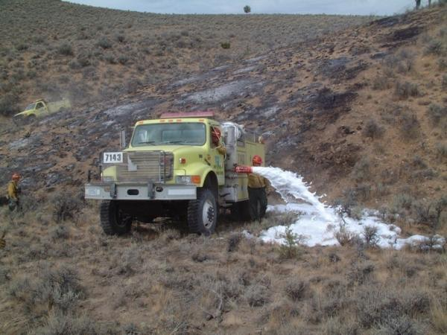
Water Handling Operations
Unit 4C - Foam and Foam Proportioning Equipment

Slide 2
Objectives
Discuss why foam is more effective than plain water when performing wildland fire suppression operations.
Discuss foam safety, including guidelines for handling foam products.
Identify and discuss the advantages and disadvantages of two manual foam proportioning methods used when performing wildland fire suppression operations.

Slide 3
Objectives
Identify various operational components of the FoamPro® 1600/1601 and Waterous Aquis 1.5.
Demonstrate the ability to set up, run, have foam solution pumped to a nozzle person, and shut down a foam proportioner.

Slide 4
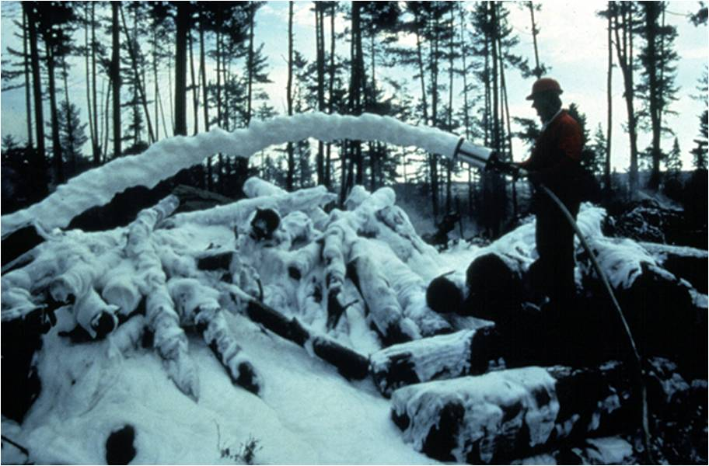

Slide 5
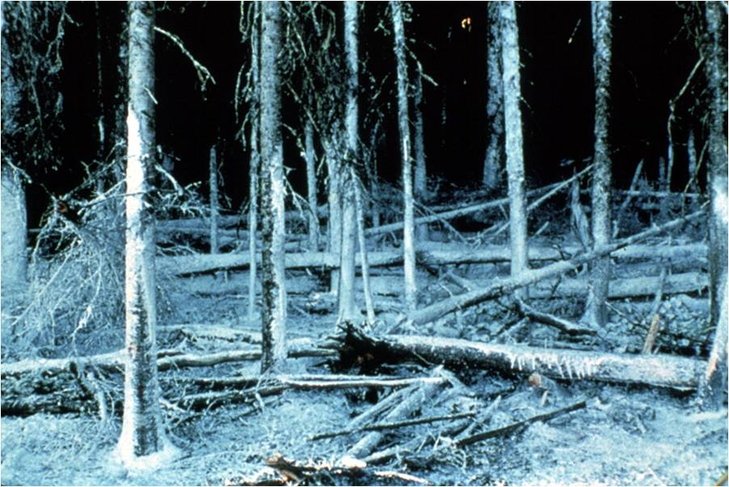

Slide 6
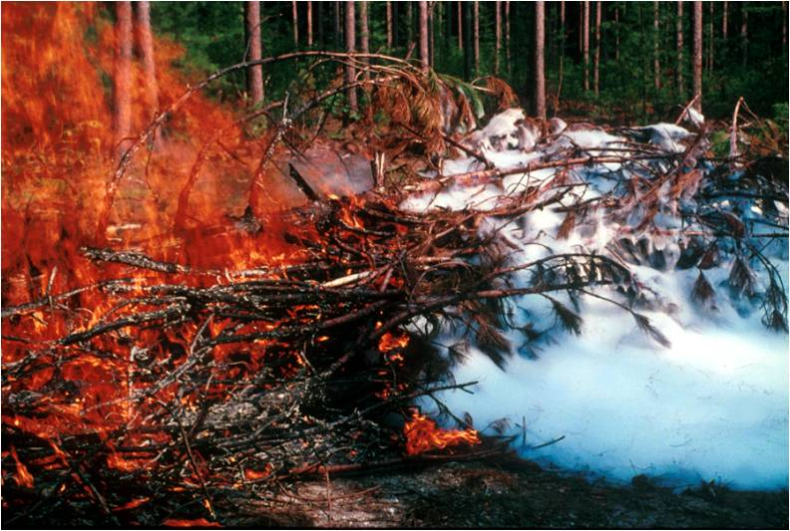

Slide 7
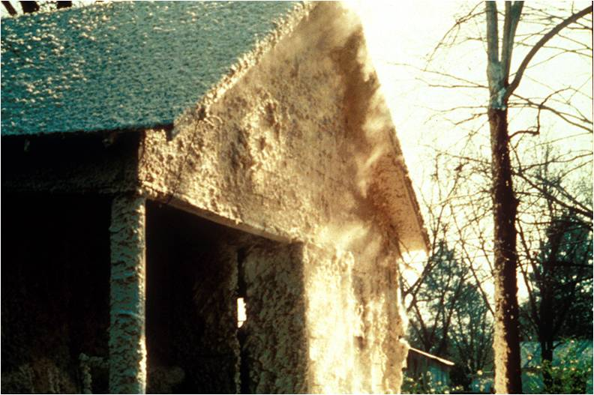

Slide 8
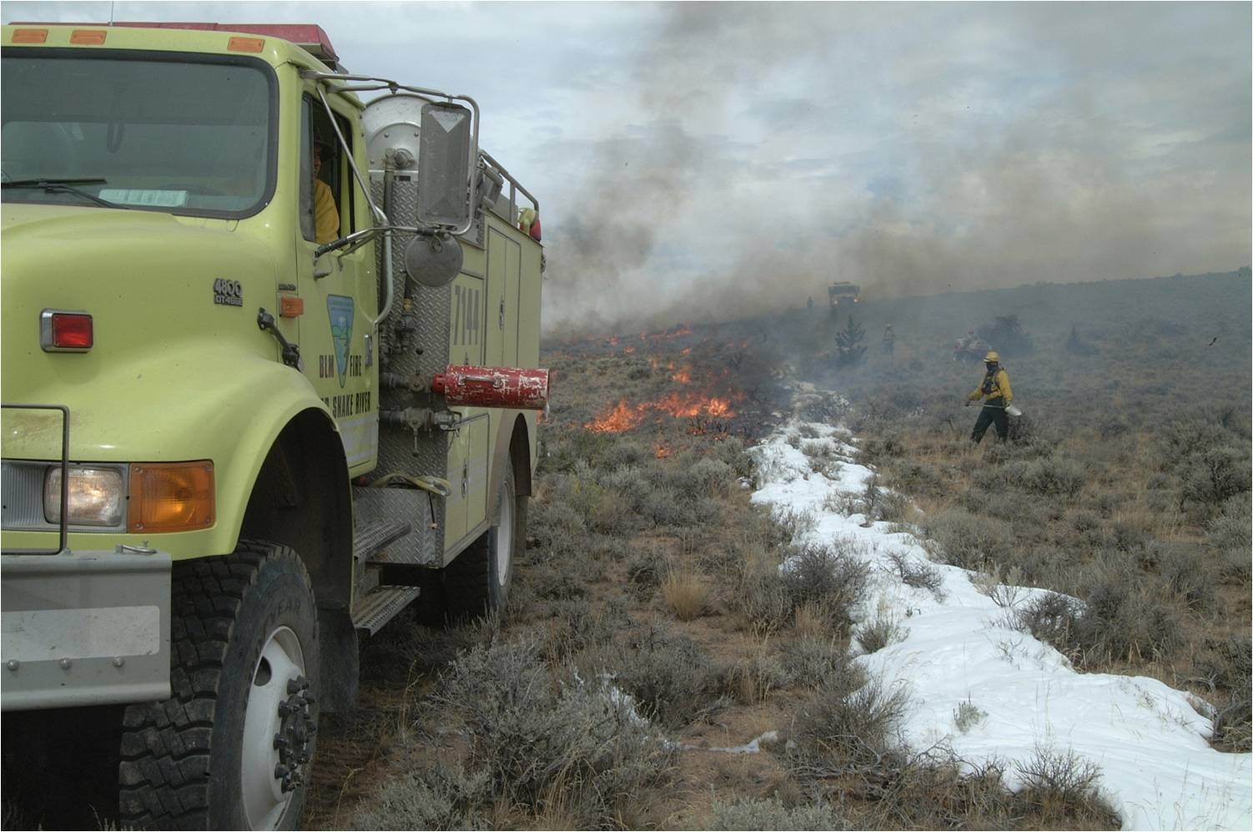

Slide 9
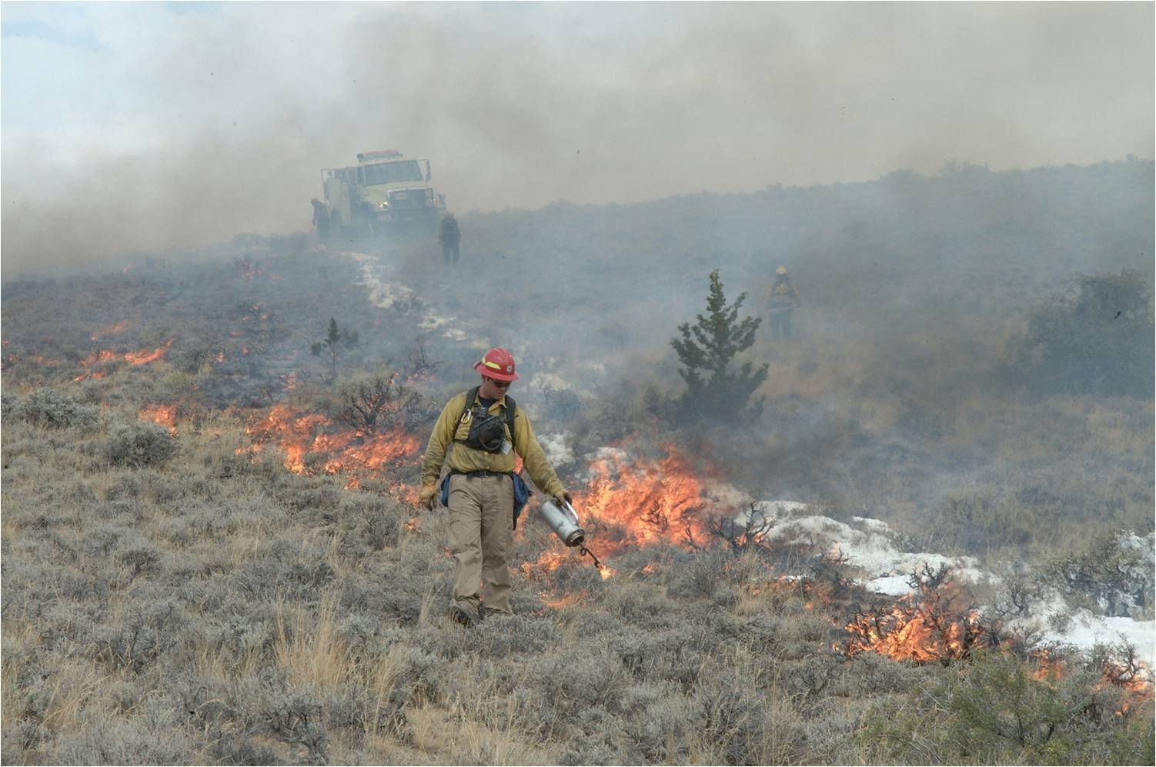

Slide 10
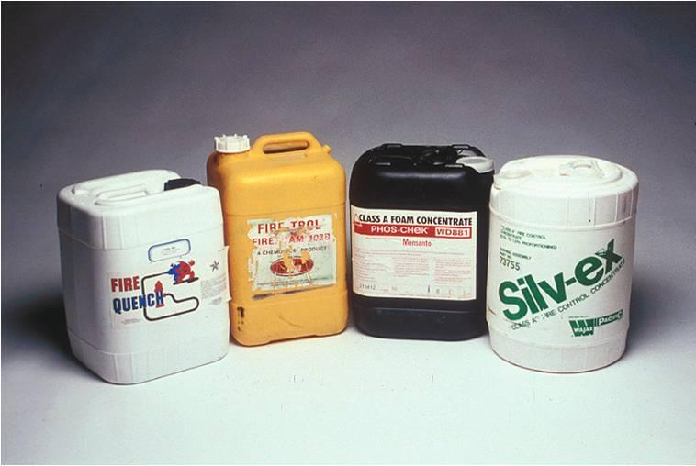

Slide 11
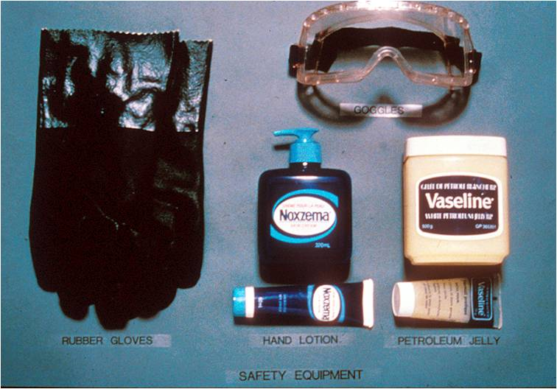
Safety equipment

Slide 12
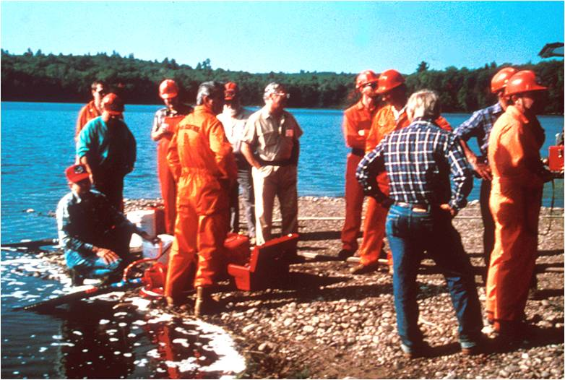

Slide 13
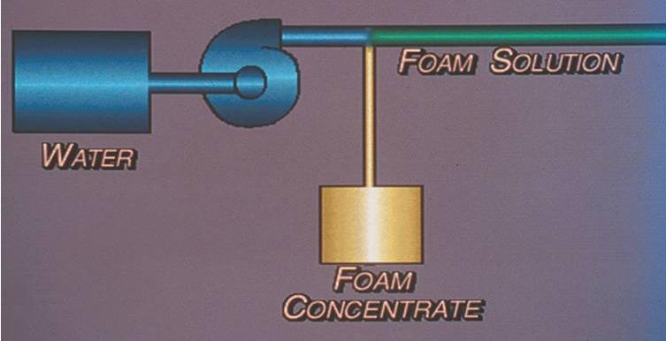
Foam Proportioners

Slide 14
Manual Foam Proportioners
Operators manually adjust the device to maintain a constant mix ratio when water flow and pressure changes.
Cannot maintain constant mix ratio over various flow and pressure rates

Slide 15
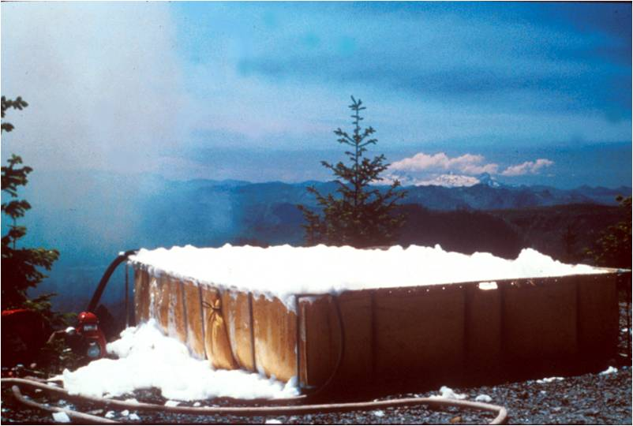
Batch Mixing

Slide 16
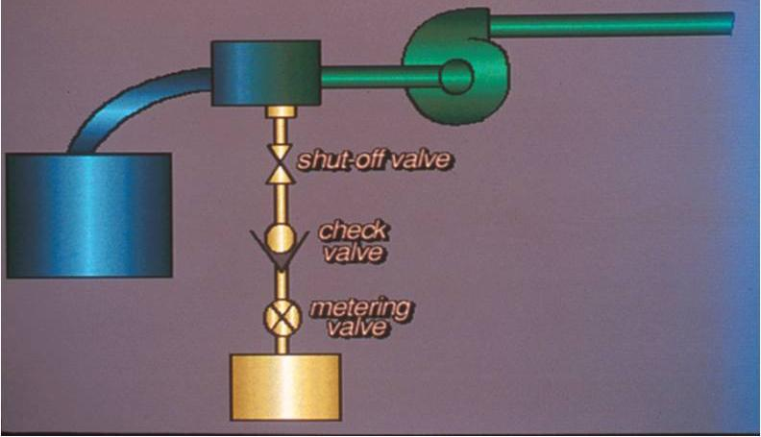
Suction-Side Proportioners

Slide 17
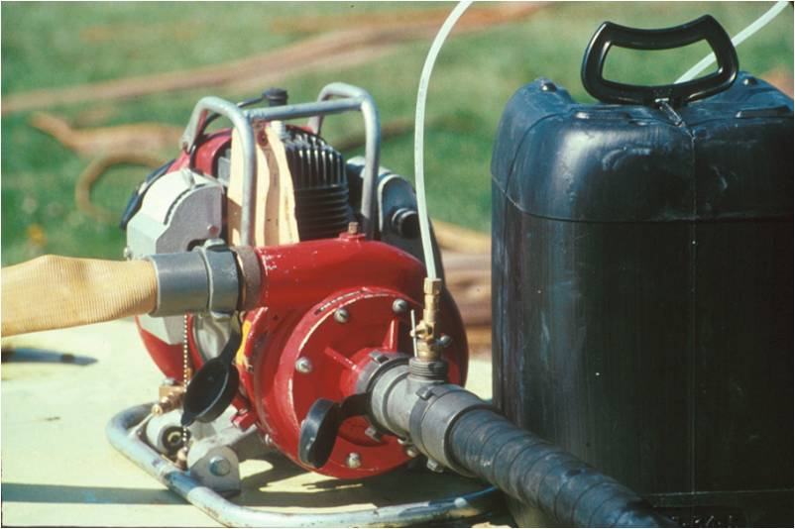

Slide 18
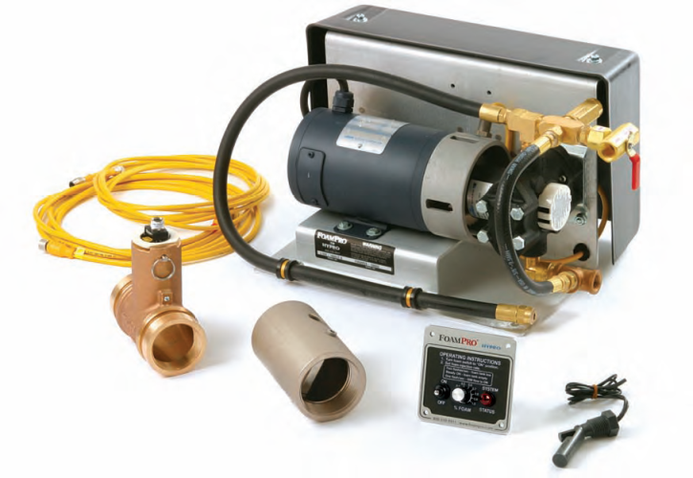
Automatic Foam Proportioner
The automatic foam proportioner makes an adjustment on its own to maintain a constant mix ratio when water flow and pressure changes.
FoamPro® 1601
Waterous Aquis™ 1.5

Slide 19
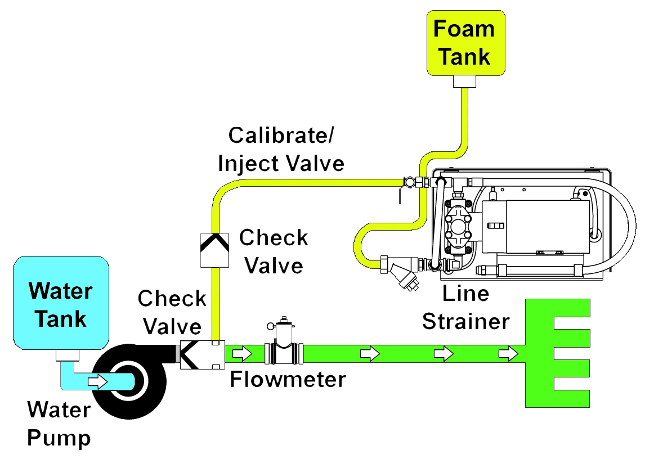
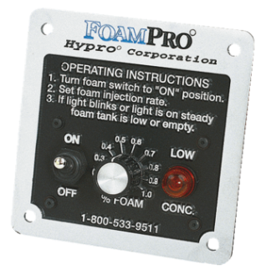
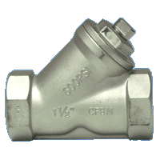
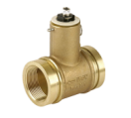
Foam Proportioner
s

Slide 20
Foam Proportioner
Proportional and automatic
Works on discharge side of pump
Class A foam only
Requires water flow and electrical current
No restrictions due to hose length or number of nozzles
No loss of pressure or flow
Accurate at all flow ranges
Resupply foam without interruption

Slide 21
Operating the Foam Proportioner Major Components
Operator control module
Motor driver box/module
Paddlewheel flowmeter
Foam pump and electric motor
Calibrate/Inject valve
Inline strainer

Slide 22
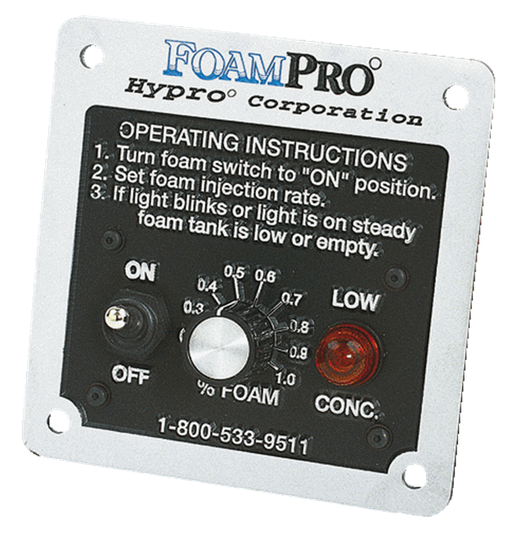
Operator Control Module Panel Mounted
Operating instructions
On/Off switch
Injection rate control
Adjustable from 0.1%-1.0%
Low concentrate (“LOW CONC.”) light

Slide 23
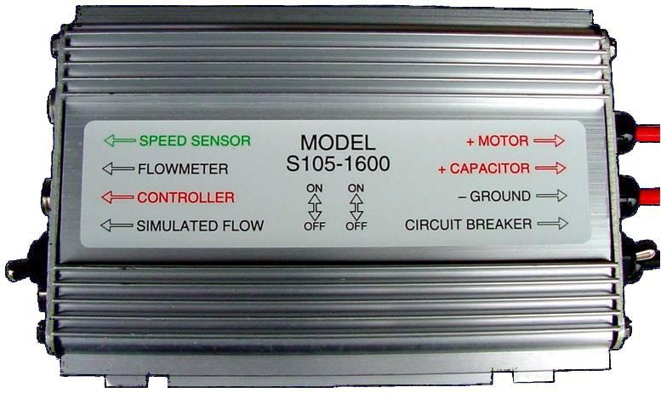
Motor Driver Box/Module Normal Operation
Simulated flow switch “Down” for normal operation
Circuit breaker switch “Up” for normal operation

Slide 24
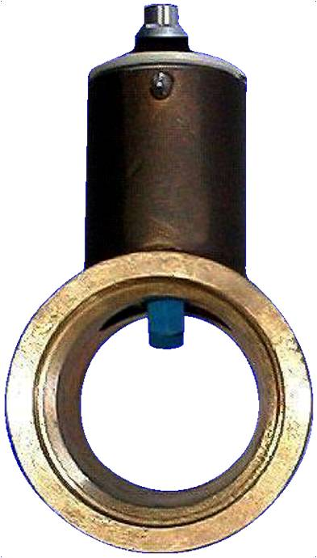
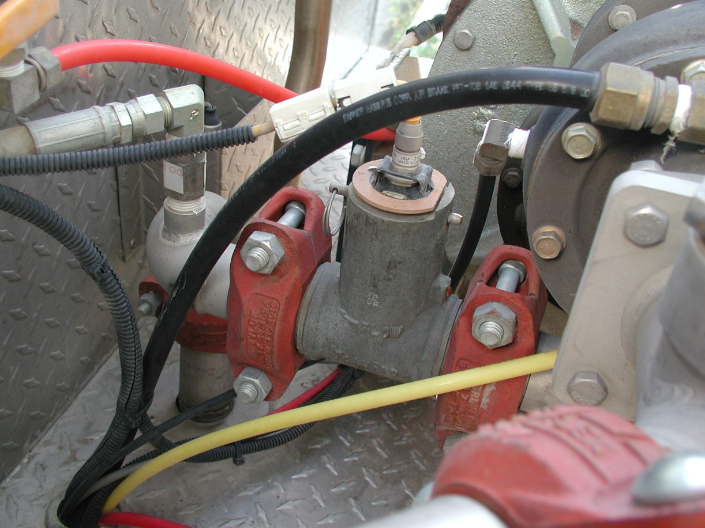
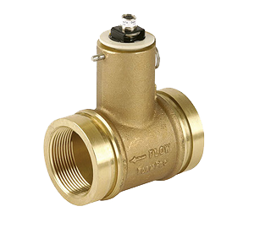
Paddlewheel Flowmeter

Slide 25
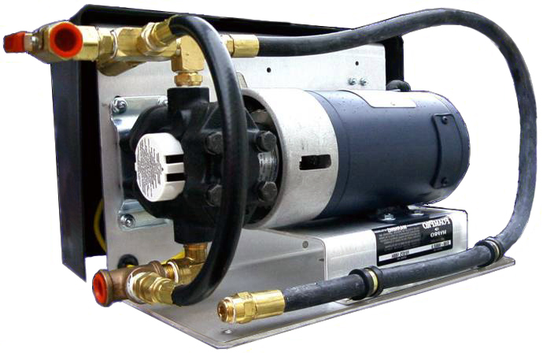
Foam Pump and Electric Motor

Slide 26
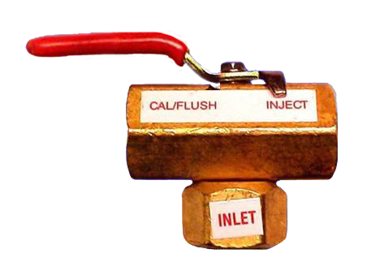
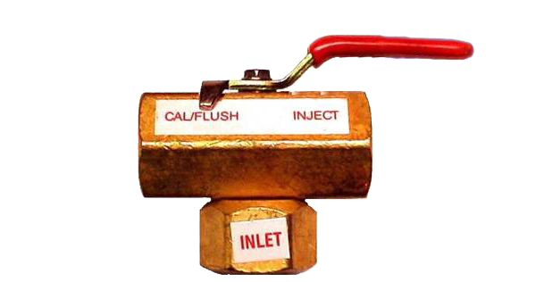
Calibrate/Inject Valve

Slide 27
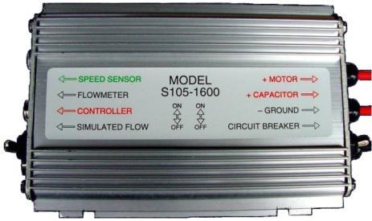
Purging Air
Enter “Simulated Flow”
Switch to “Up” position
Preprogrammed for 100 gpm
Valve to “Cal/Flush”
Turn panel switch “On”
Run pump until concentrate flows from dump line

Slide 28
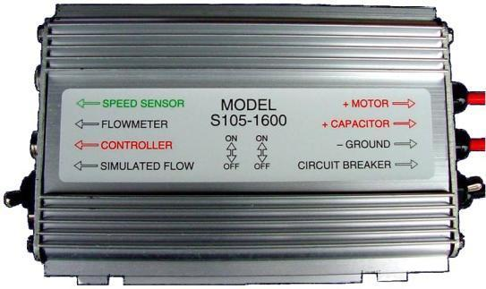
Purging Air Continued
Turn control panel to “Off” position
Return valve to “Inject”
Exit “Simulated Flow” by returning switch to “Down” position

Slide 29
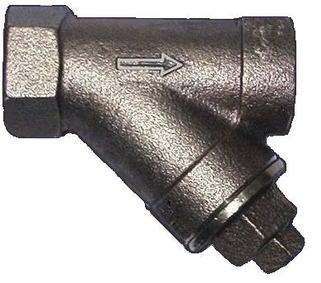
Inline Strainer

Slide 30
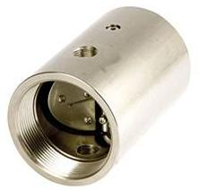
Foam Injection Check Valve and Injection Port

Slide 31
Objectives
Discuss why foam is more effective than plain water when performing wildland fire suppression operations.
Discuss foam safety, including guidelines for handling foam products.
Identify and discuss the advantages and disadvantages of two manual foam proportioning methods used when performing wildland fire suppression operations.

Slide 32
Objectives
Identify various operational components of the FoamPro® 1600/1601 and Waterous Aquis 1.5.
Demonstrate the ability to set up, run, have foam solution pumped to a nozzle person, and shut down a foam proportioner.

