Slide 1
Celebrating our nation's wildland firefighters on #NWFFD
National Wildland Firefighter Day
Established July 2, 2022

Slide 2
#NWFFD - July 2, 2023 - Celebrating our nation’s wildland firefighters
National Wildland Firefighter Day was established in 2022 as a day of recognition for our nation’s wildland firefighters and support personnel.
By working together to recognize and show gratitude to our wildland firefighting forces you directly make an impact at the federal, state, and local levels.

Slide 3
Core messages
To our wildland firefighters and support personnel: Thank you!
Let’s spotlight - and thank dedicated professionals across the nation.
NWFFD offers an opportunity to unify the wildland fire community.
Let’s showcase interagency coordination and cooperation.

Slide 4
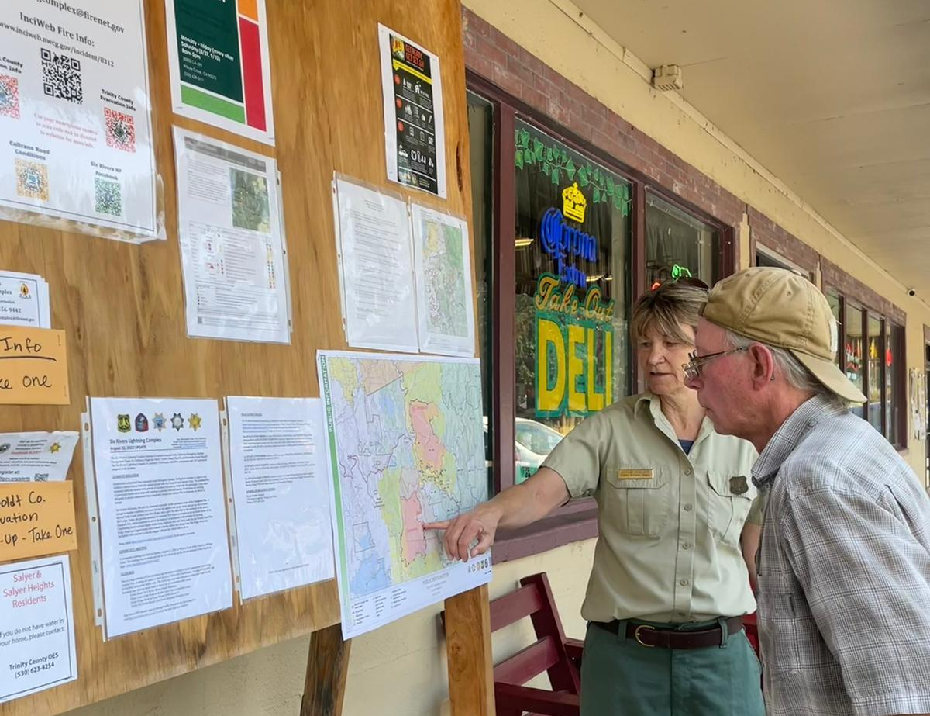
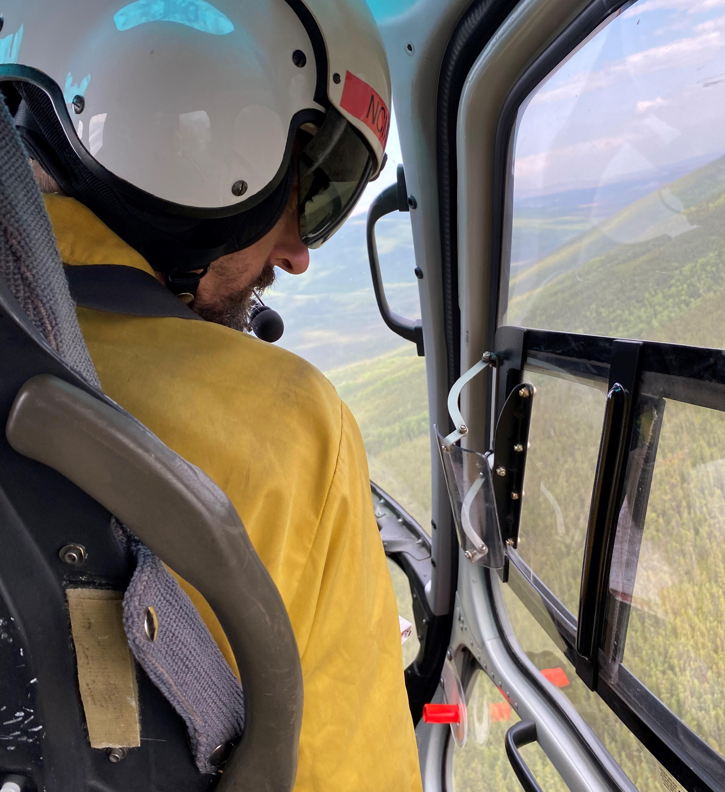
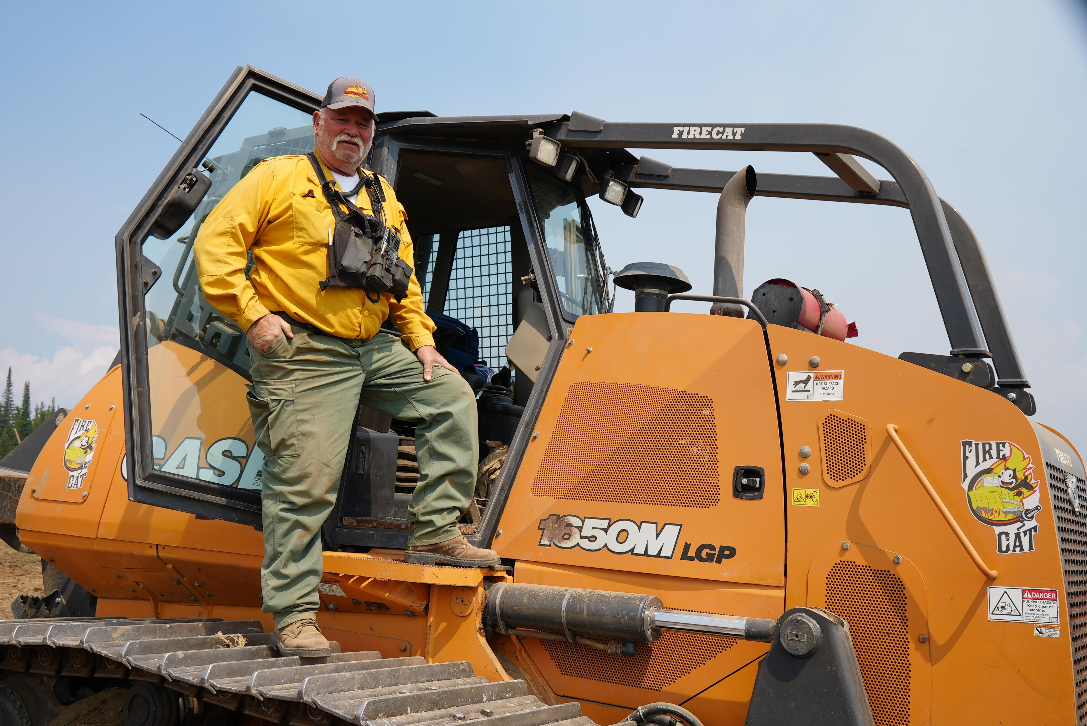
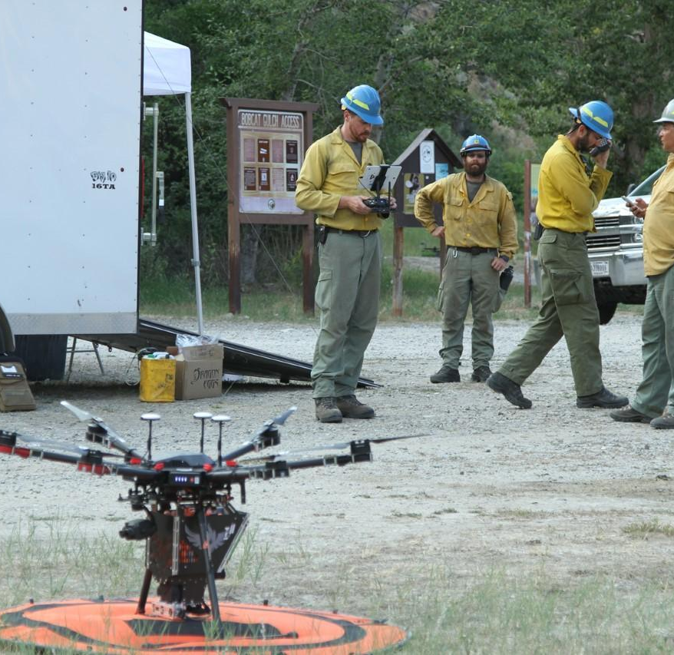
Social campaign
Share your appreciation for wildland firefighters and support personnel with a National Wildland Firefighter Day message and card. See our examples for inspiration!
Use the templates provided to share your stories and images.
Once you complete the PowerPoint template or image, save the slide as an image and share the image on Twitter, Facebook, Instagram, or other platforms with the hashtag #NWFFD, #NationalWildlandFirefighterDay and #ItTakesAllOfUs.
Be sure to tag the agency, team, and/or individual in your post where appropriate!
Share as many stories as you’d like.

Slide 5
Toolkit
Sample social media posts Graphic overlays Virtual backgrounds

Slide 7
Sample
Today is #NationalWildlandFirefighterDay, we honor wildland firefighters, support staff, and contractors that serve the public across the country. #ItTakesAllOfUs

Slide 8
Sample
Today we celebrate those that live by the values of duty, respect, and integrity. On #NationalWildlandFirefighterDay we thank every wildland firefighter, support staff, and contractor who work together to protect life, property, and natural and cultural resources. #ItTakesAllOfUs

Slide 9
Sample
#NationalWildlandFirefighterDay is a time to show appreciation for the wildland firefighting community. Thanks to the dispatchers, map creators, IT specialists, equipment operators, radio technicians, prevention specialists, and everyone else who has a role in getting the job done! #ItTakesAllOfUs

Slide 10
Sample
July 2 is #NationalWildlandFirefighterDay. Thousands of responders unite in teams to suppress wildland fires each year. It takes many people with specialized skills and we show appreciation for all of them today. Whether you carry a Pulaski, radio, computer, headset, map, clipboard, or camera to work, we thank you for your service! #ItTakesAllOfUs

Slide 11
Sample
Today for #NationalWildlandFirefighterDay, we appreciate the thousands of local, state, federal, or contract workers who fulfill a role in wildland fire response. Thank you for your service and dedication! #ItTakesAllOfUs

Slide 12
Sample
Here’s your reminder that on #NationalWildlandFirefighterDay, thank the wildland fire responder in your life for the service they provide to protect life, property, and natural and cultural resources. #ItTakesAllOfUs

Slide 13
Sample
Each year we experience more extreme and longer wildland fires, and the wildland firefighting community rises to the challenge to protect life, property, and natural and cultural resources. On July 2, for #NationalWildlandFirefighterDay we show appreciation and recognize the hard work and dedication of every wildland fire responder. Thank you also to the supporting families and friends of wildland fire responders who make it possible for responders to be away for weeks or months at a time. #ItTakesAllOfUs

Slide 14
Sample
#NationalWildlandFirefighterDay is July 2, but we appreciate you every day! For the firefighters and support personnel who work long hours and then rise up and do it day after day, we thank you for your service and dedication for protecting our communities and precious natural resources. #ItTakesAllOfUs

Slide 15
How to use #NWFFD graphics
Our graphics can be found on the following slides.
Right click an example graphic and “Save As Picture” to save the file to your computer.
Use the graphics with the blank squares to customize with your photos. Once finished “Save As Picture” then use anywhere!
The graphics are yours to use across any materials.
Use it for your social media platforms, blog posts, website, or in your newsletter – the possibilities are endless!

Slide 20
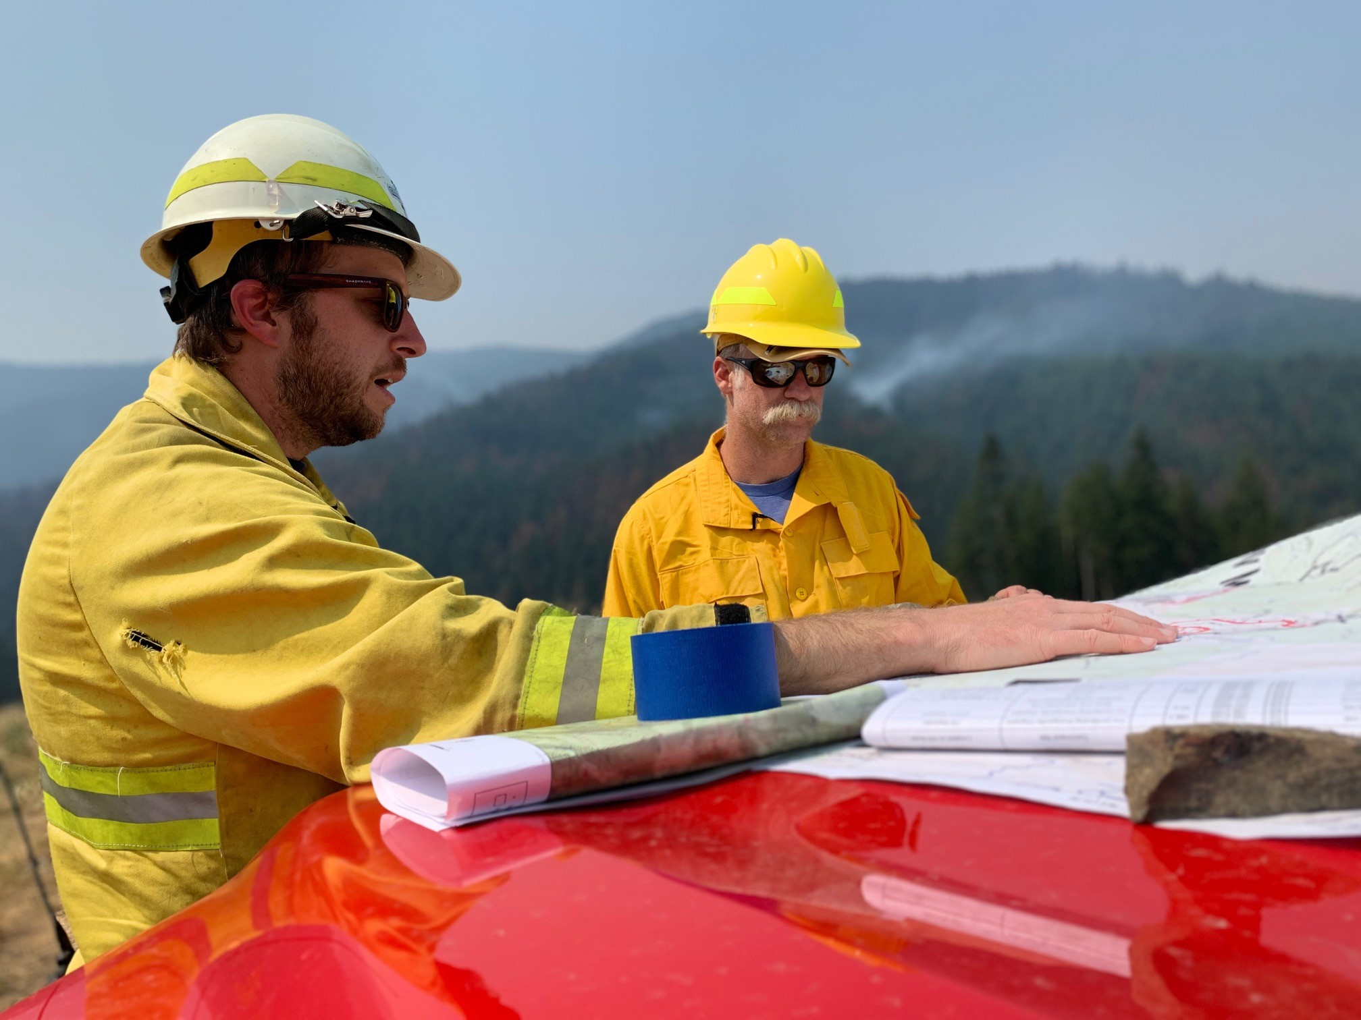
Customize #NWFFD graphics
Add your photo to the slide.
Resize to fit into one of the open boxes.
Select your photo.
Right click and choose “Send to Back”

Slide 27
Video backgrounds
Video Backgrounds
Download three video background to use on your next call.

