Slide 1
INTERAGENCY FIRE OPERATIONS
2019
Notes:
The BLM UAS program continues to grow. Flight time and missions are trending up.

Slide 2
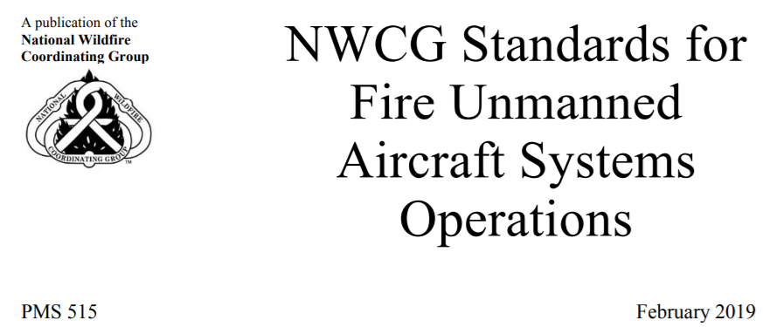
Incident Standards and Flight Procedures
NWCG Standards for Fire UAS Operations (PMS 515)
Notes:
UAS mission procedures are identical to those of all incident Aircraft (Fire Traffic Area)

Slide 3
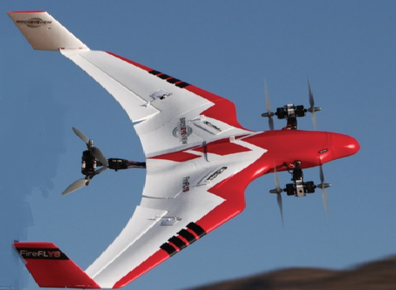
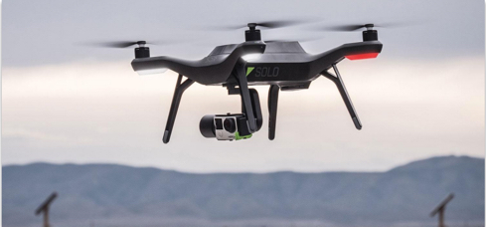
SYSTEMS
3DR Solo
Firefly 6 Pro
Call when Needed (CWN) UAS Contract
Insitu ScanEagle
Bridger Aerospace/Silent Falcon
Precision Stalker
Pathways2Solutions Bramor
Additional Vendors Awarded Soon
Firefly6Pro
3DR Solo
Notes:
3DR is no longer available. The replacement for it is being researched. DJI products with private edition firmware are available.

Slide 4
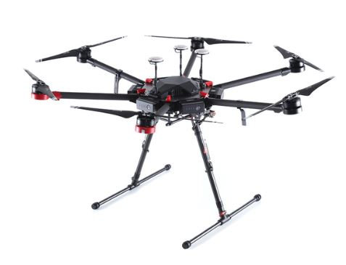
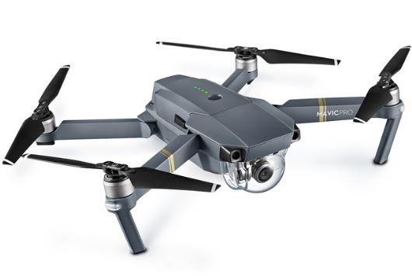
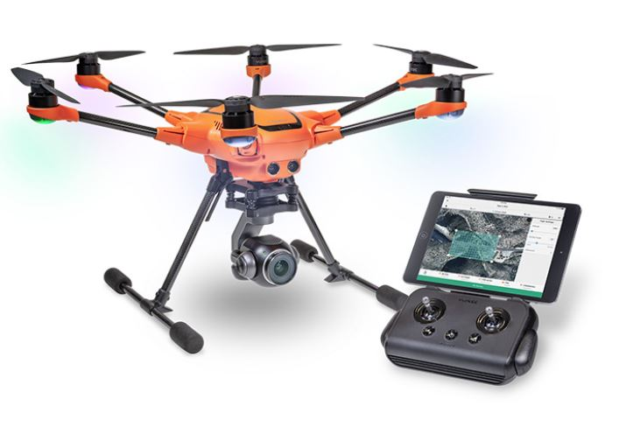
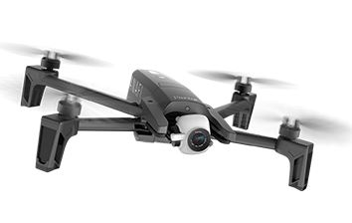
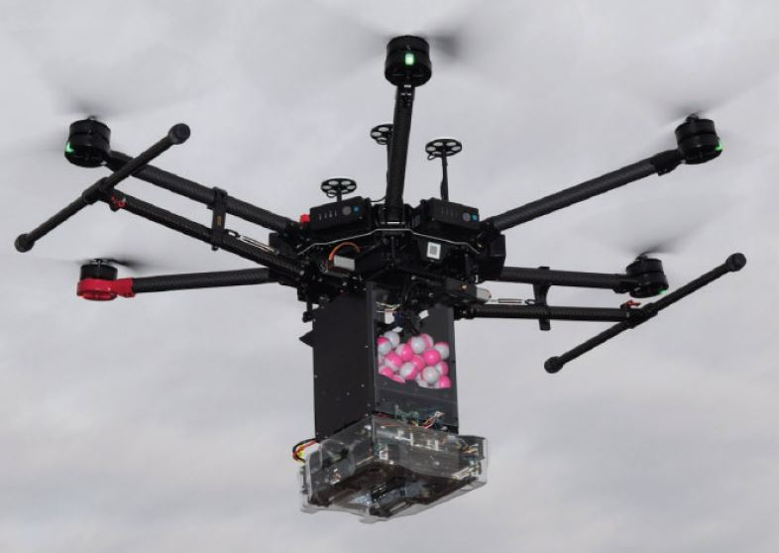
NEW AGENCY SYSTEMS
M600
MAVIC
H-520
DJI M600 Private Edition
DJI Mavic Private Edition
Yuneec H520 (R&D)
Parrot Anafi
Ignis PSD
Anafi
Ignis PSD
Notes:
DJI are available but the private edition firmware may get nixed by DOI in DC. The Parrot Anafi is low cost and will be used as the A450 platform. The H520 is not available yet.

Slide 5
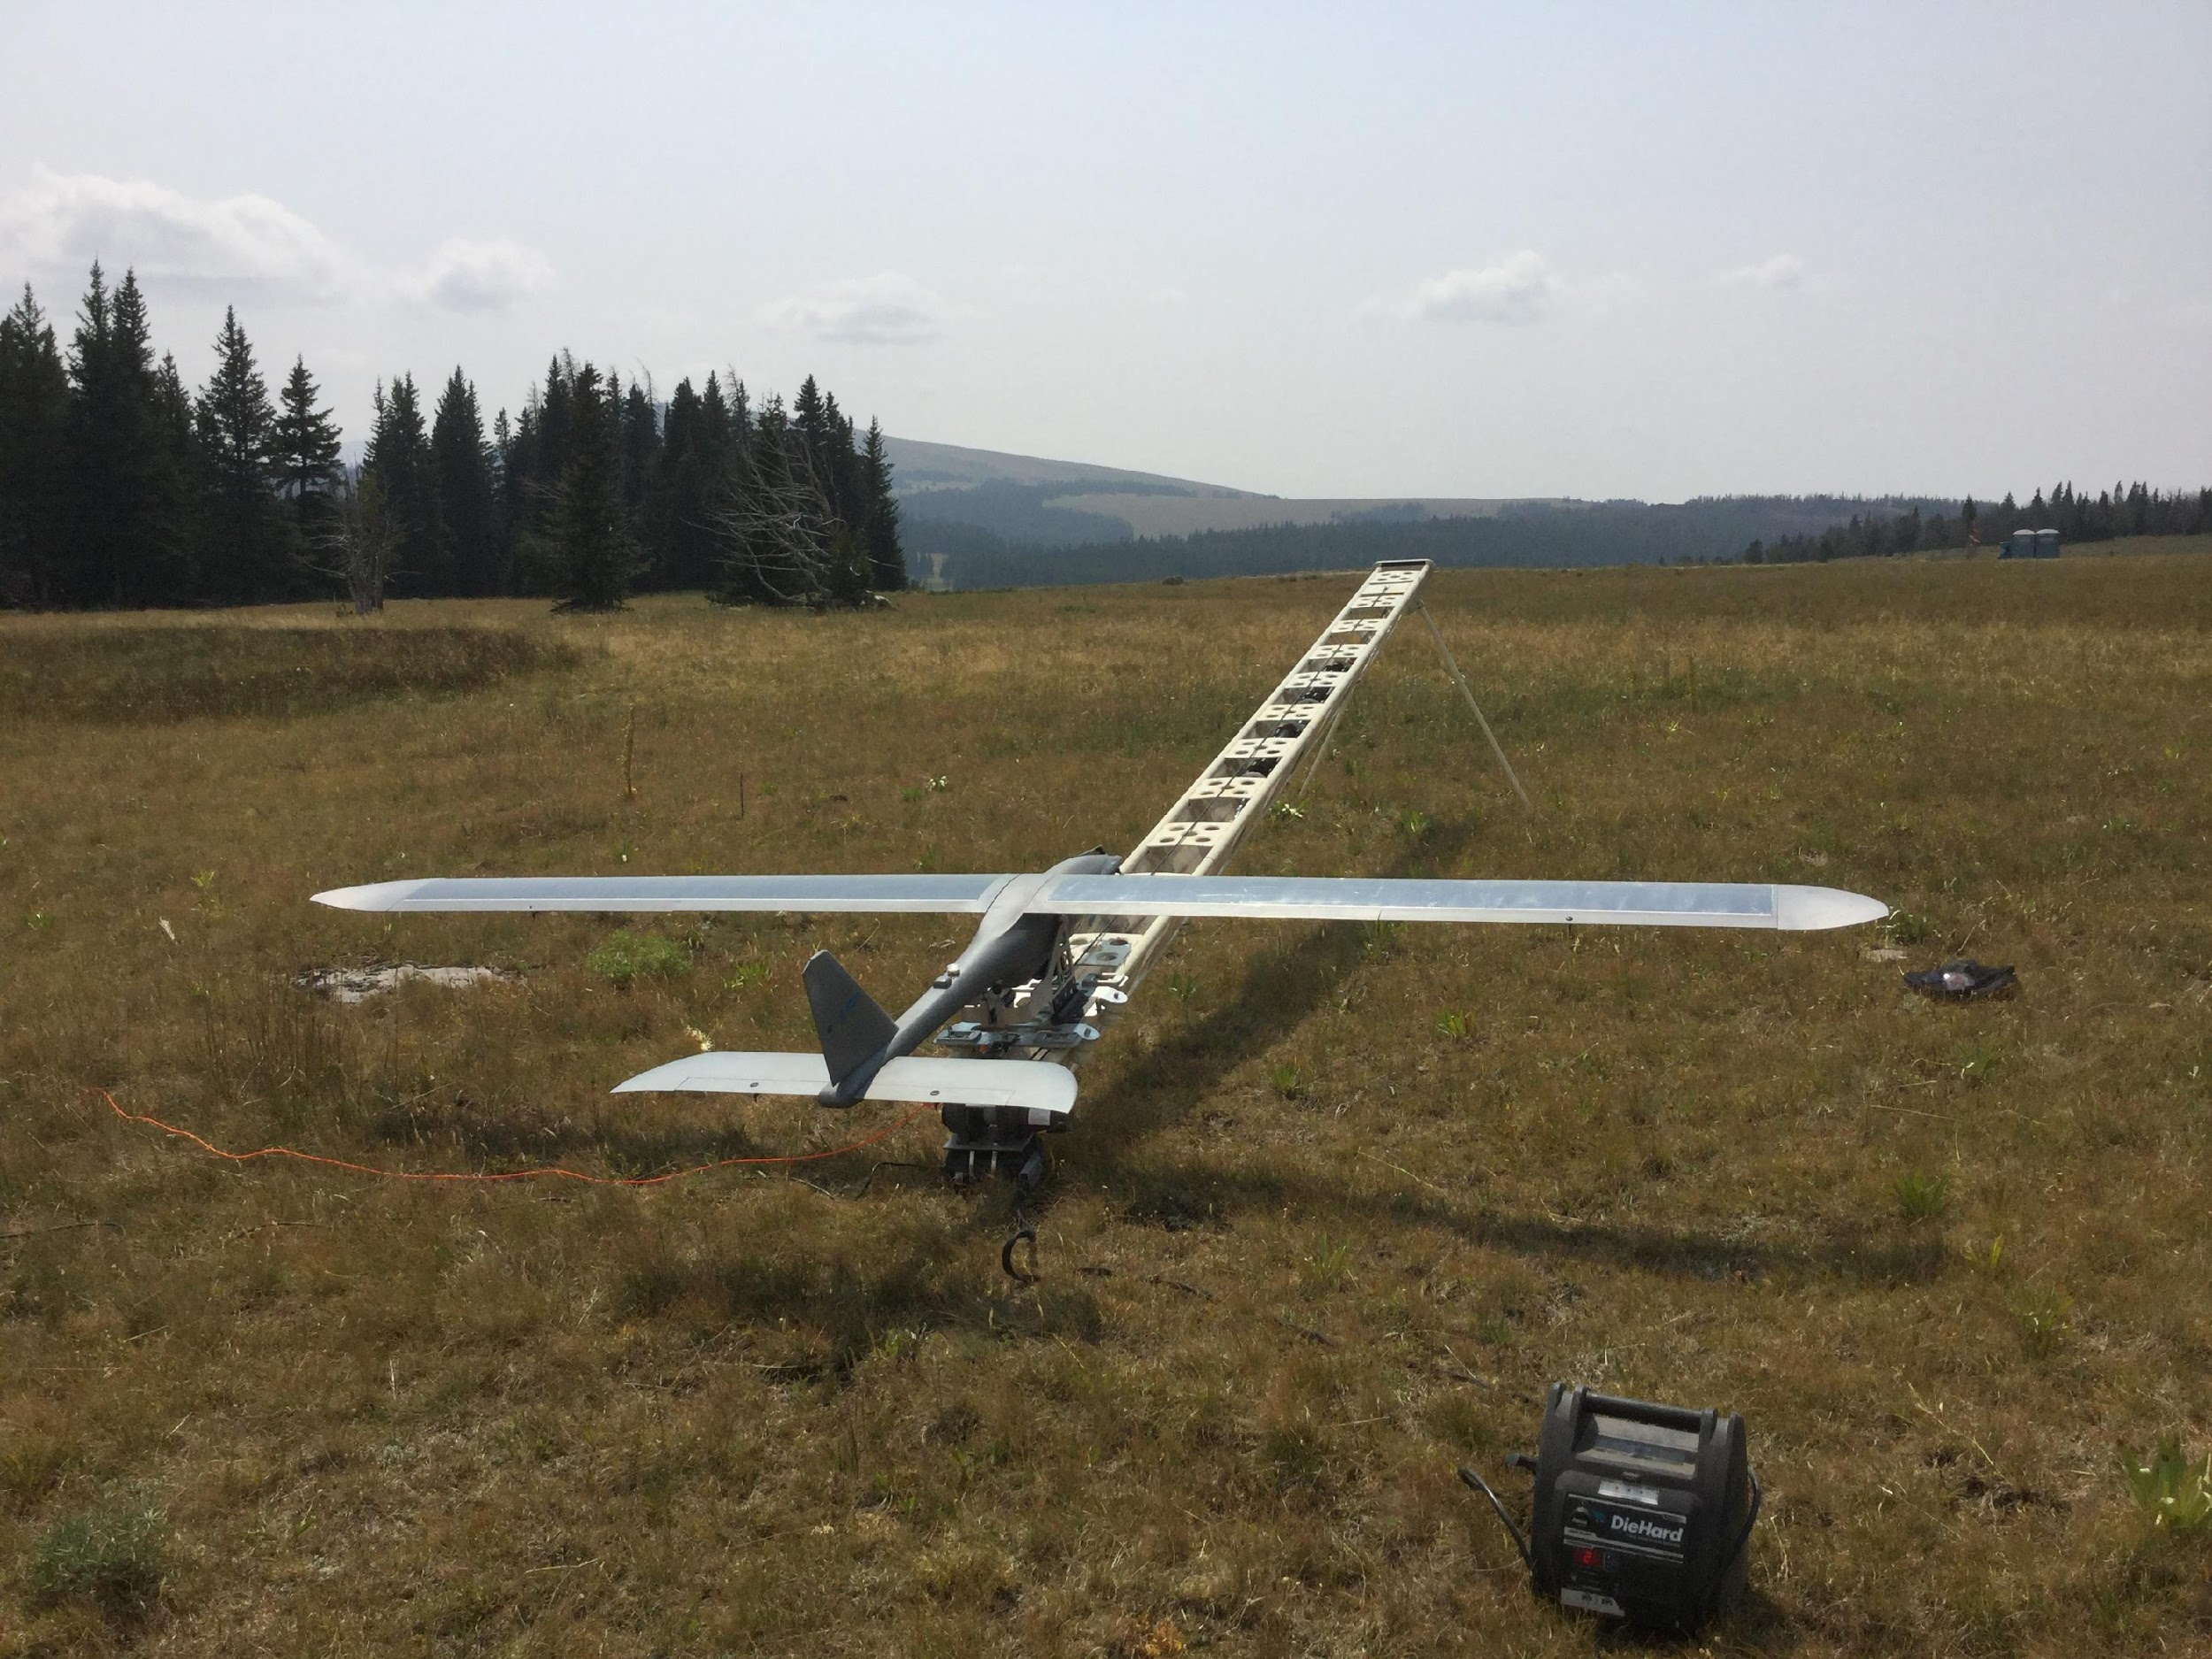
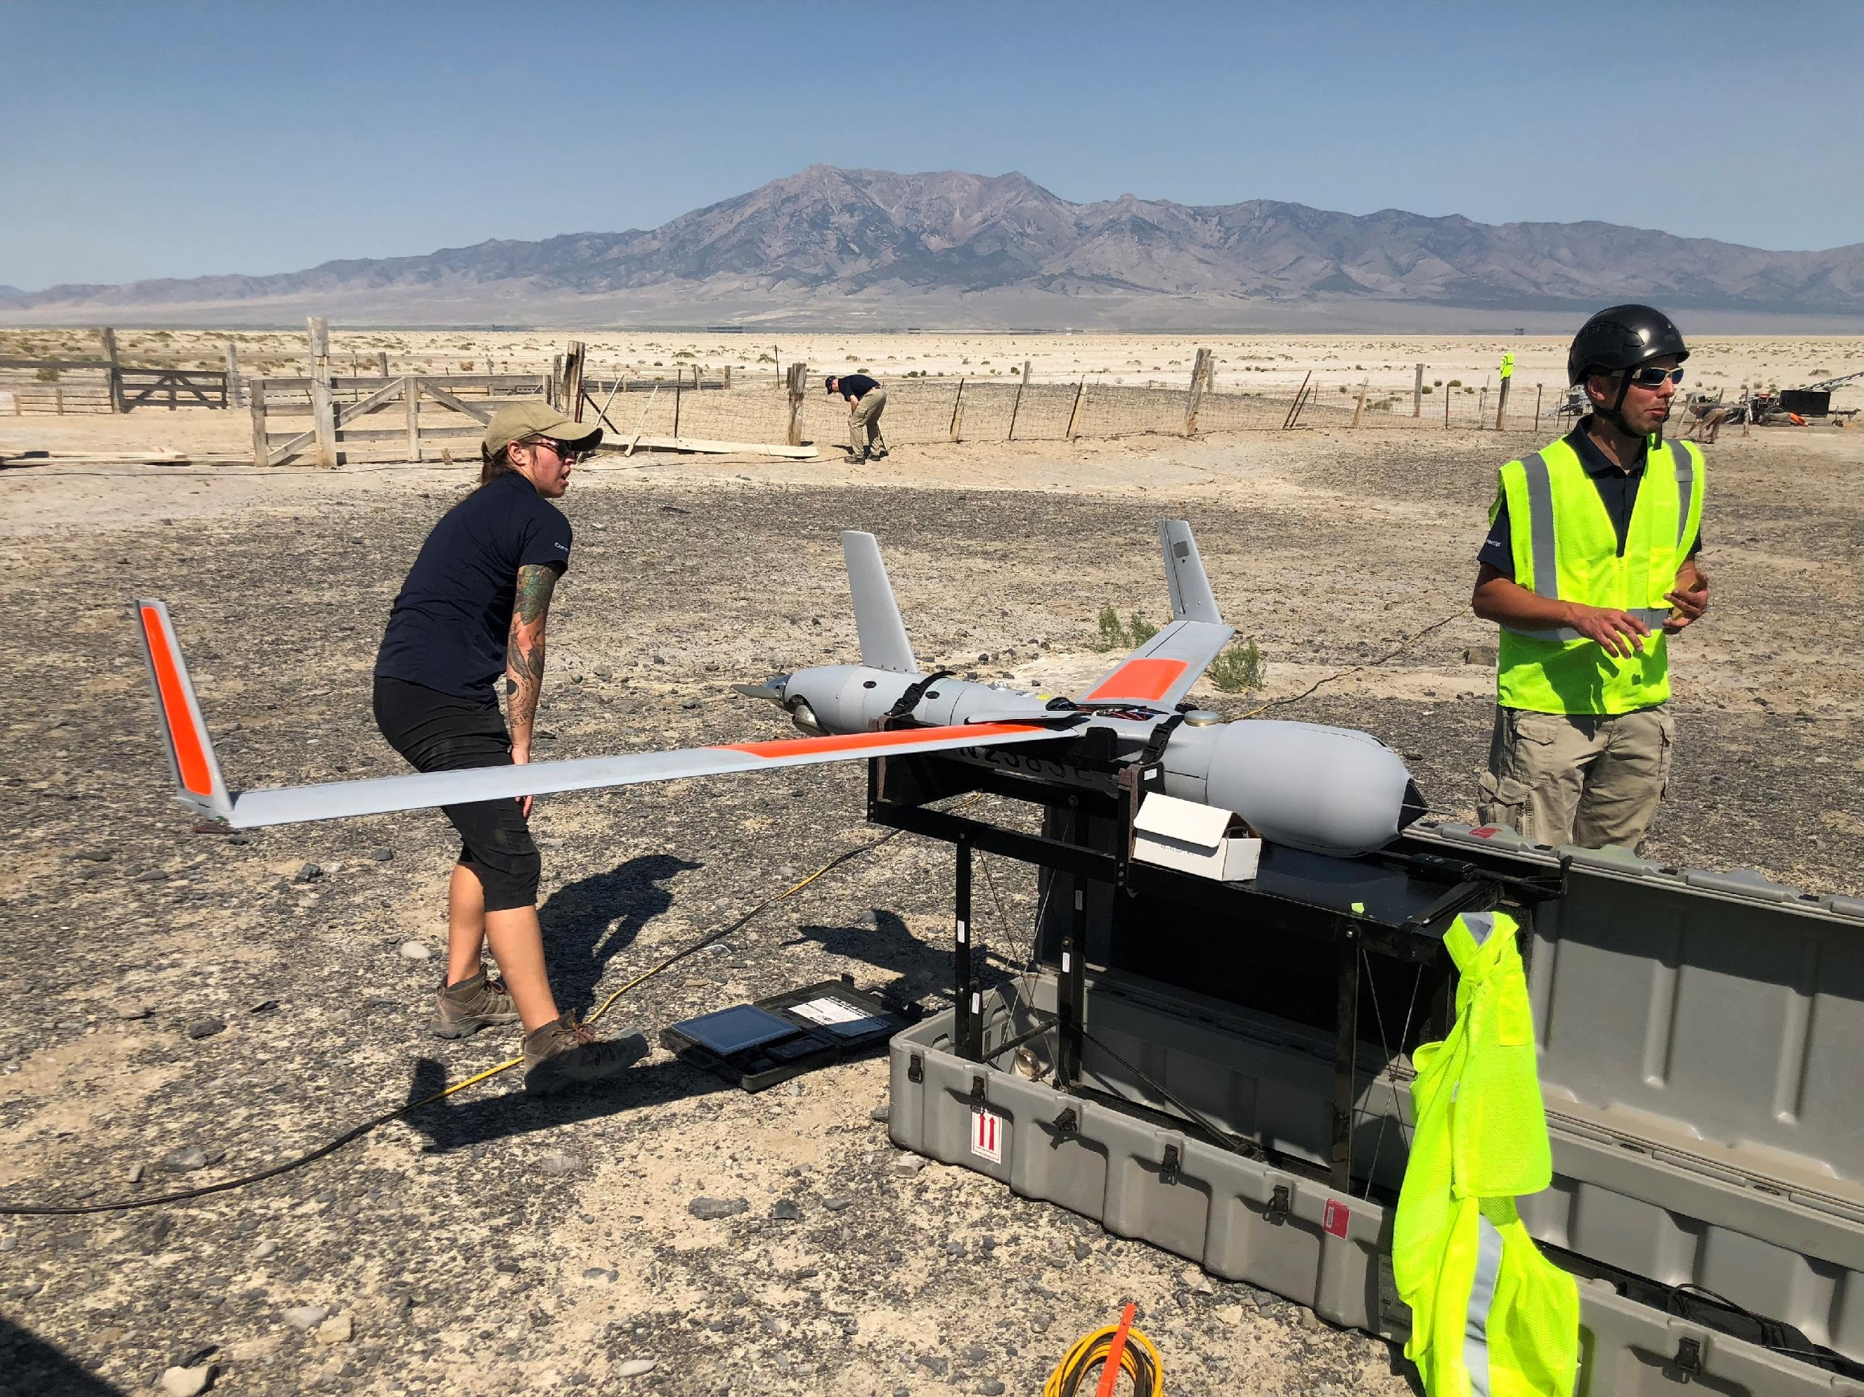
CONTRACT SYSTEMS, Additional Systems Will Be Awarded Spring
Bridger/Silent Falcon
Insitu ScanEagle
Notes:
Call when needed systems

Slide 6
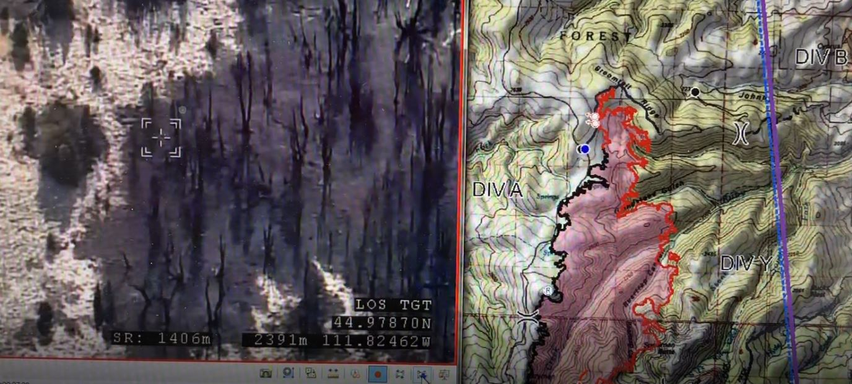
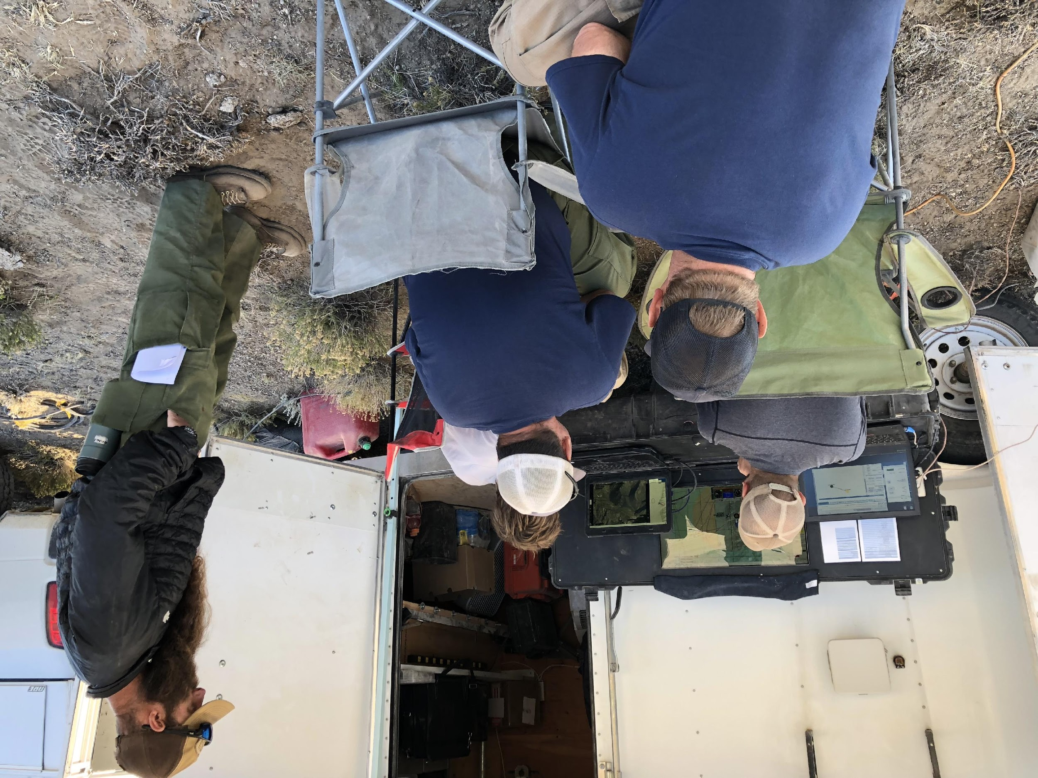
PRODUCTS: REAL-TIME SITUATIONAL AWARENESS
Division/Ops recon on the Wigwam fire with Silent Falcon UAS
Notes:
Tactical decision makers can view the fire in real time and make timely assessments regarding fire activity and determine priority locations to send resources.

Slide 7
PRODUCTS: FIRE MAPPING
Mapping and real-time video display with Silent Falcon UAS
Notes:
Fires can be mapped while the camera on the UAS is aimed at the fireline.

Slide 8
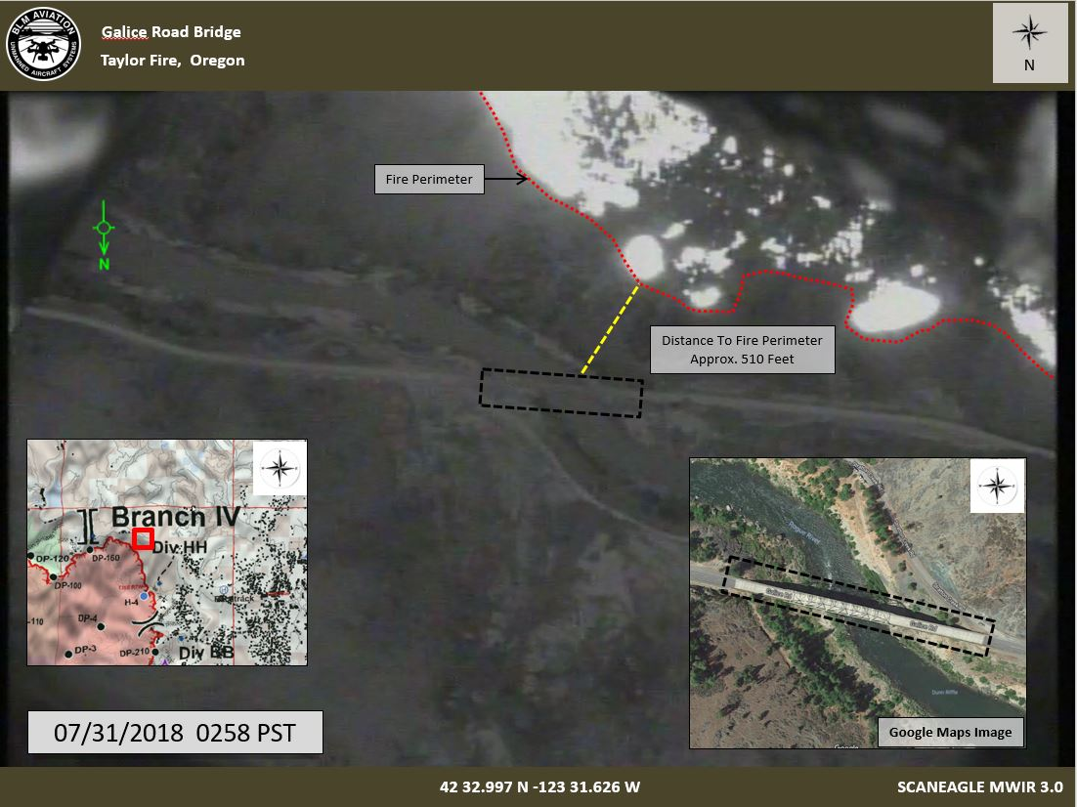
PRODUCTS: INFRARED FIRE MAPPING
Mapping and real-time IR video display with ScanEagle UAS on the Taylor fire
Notes:
Infrared can be used to map fires and accurately display where the fire is most active.

Slide 9
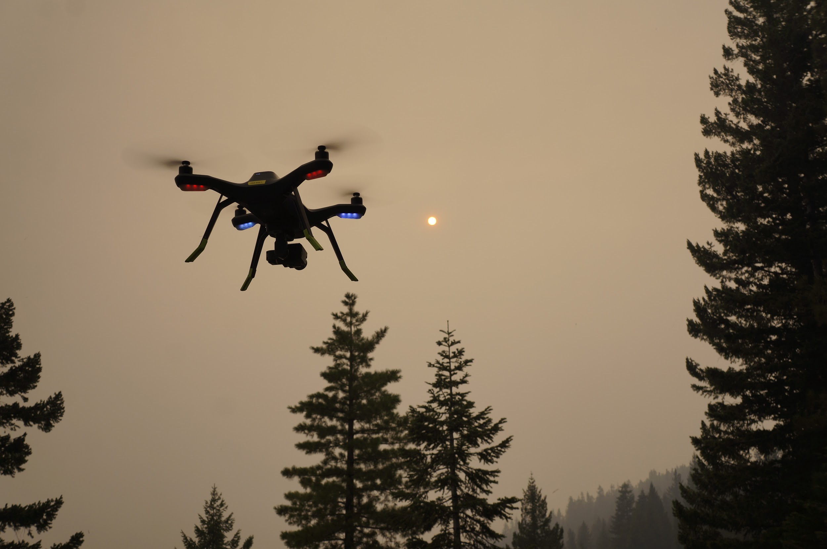
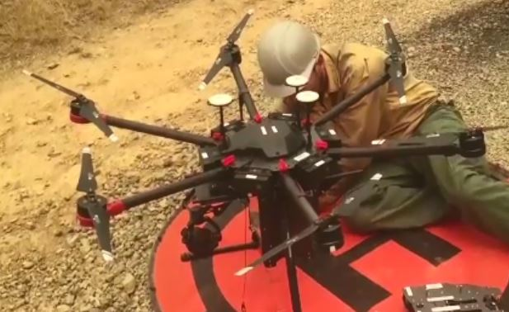
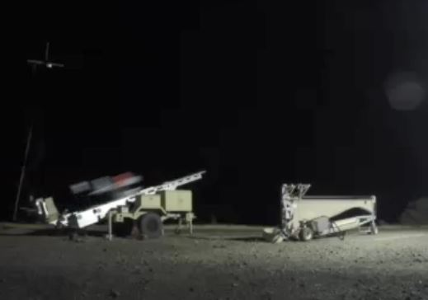
PRODUCTS: Video Examples - Click on Image
3DR Solo Operations
PSD Operations
Contract Operations
Click for Video
Click for Video
Click for Video
Notes:
Infrared can be used to map fires and accurately display where the fire is most active.

Slide 10
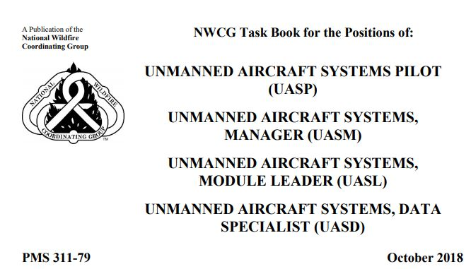
FIRE QUALIFICATIONS UPDATE
Four nwcg fire positions
Support Elements
Remote Pilot (UASP)
Data Specialist (UASD)
Manager (UASM)
Module Leader (UASL)
Fire Operations Guide (PMS-515)
Position Task Book
Operational Training (S-373)
Refresher Training (RT-373)
ROSS
IQCS
Historical Recognition
Notes:
These positions will be cataloged in ROSS and IQCS. BLM will submit a national roster of historically recognized personnel (Q and T)

Slide 11
Planned Training
8 weeks of Classroom training
UAS Remote Pilot (A450) (2 Classes)
Fire operations (S373) (2 Classes)
Vendor Fire operations (2 Classes)
Aerial Ignition
Refresher training (1 Class)
Incident Training
UASP
UASM
UASL
UASD
Aerial Ignition
Anticipate trainee requests on every order
Vendor training in Wendover, NV
Notes:
Training was conducted in Fairbanks, St. George, Bozeman, Boise, Wendover, Ft. Collins, St. George, and Ruidoso

Slide 12
Personnel (IQCS/ROSS)
UASP – approx. 60 qualified and 20 trainees
UASL – approx. 30 qualified and 50 trainees
UASD – approx. 6 qualified and 6 trainees
UASM – approx. 6 qualified and 20 trainees
Aerial Ignition – approx 4 qualifies and 12 trainees
All UAS positions are collateral
High probability of unable to fill (UTF) orders
Focus is on filling uasm to support contract operations
Notes:
3DR is no longer available. The replacement for it is being researched. DJI products with private edition firmware are available.

Slide 13
CHALLENGES
Workforce – The curse of the collateral duty
Budget – the bulk of UAS program funding comes from soft $.
Information Sharing – Policy, training, Ordering, capabilities, sensors, etc.
Notes:
The program needs dedicated positions and funding. There is little support for UAS outside of fire.

Slide 14
2019 Talking Points
Budget and workforce solutions
Collaboration with USFS to build a Service First Fire UAS Program
Aerial Ignition (PSD)
Initial Phase – Lots of Work Still to be done
Consistent Message
Standardized GIS data formats – dissemination and storage
Notes:
Our number one priority is to legitimize this program through dedicated positions and budget.

Slide 15
Additional Information
BLM UAS Program: Gil Dustin, gdustin@blm.gov
USFS UAS Program: Dirk Giles, dirk.giles@usda.gov
BLM UAS Program
Interagency Fire UAS

