Slide 1
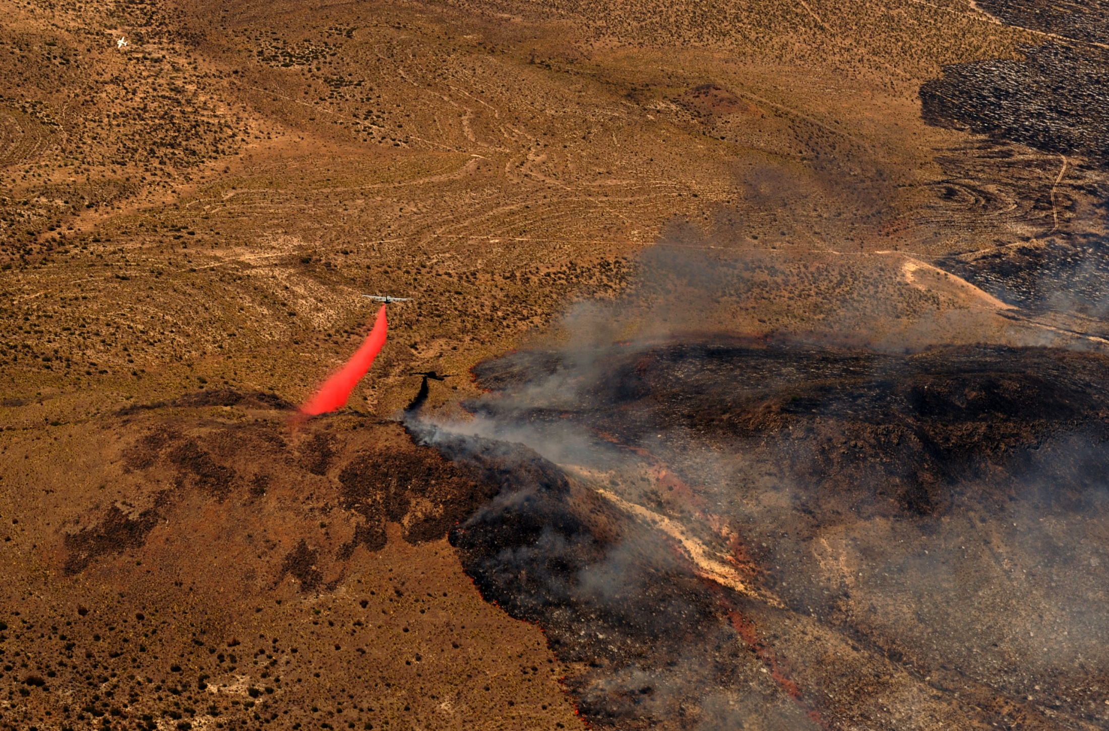
MAFFS
Modular
Airborne
Fire
Fighting
System
Lynn Ballard
USDA Forest Service
Lt Col Dave Condit
US Air Force Reserve

Slide 2
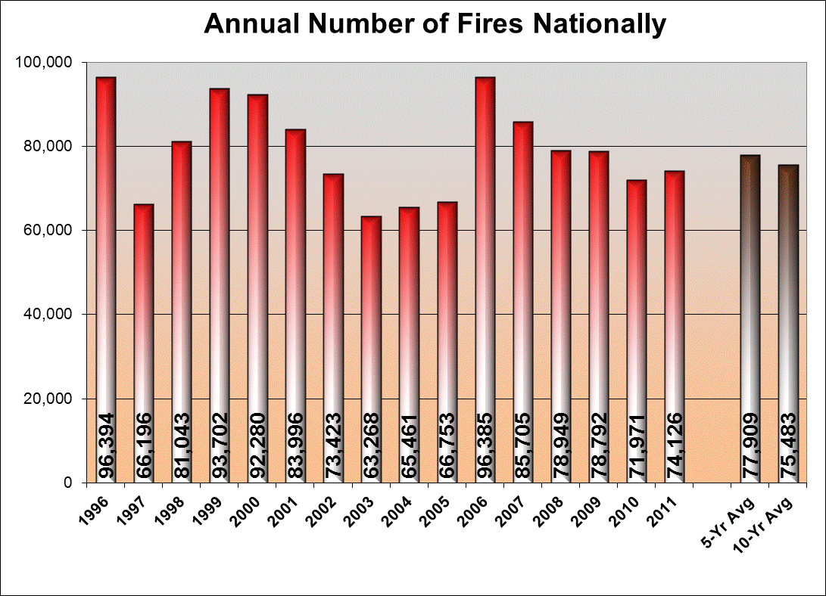
Wildfire Suppression
Notes:
We have an average of about 80,000 wildfires in the U.S. each year.

Slide 3
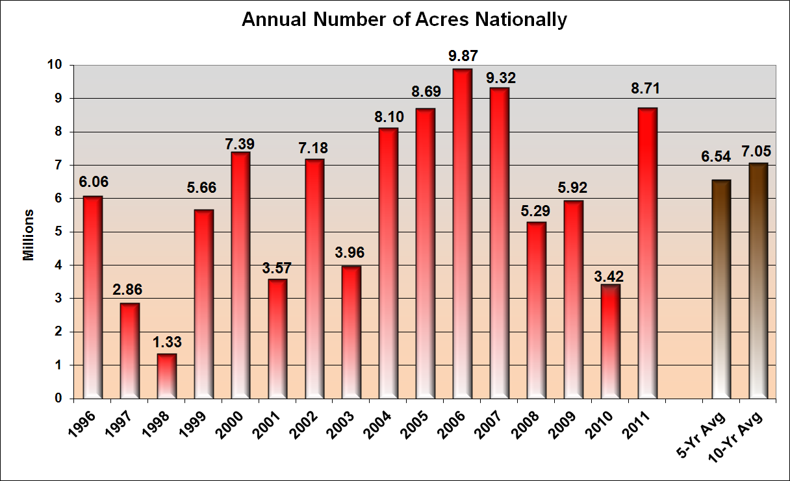
Wildfire Suppression
Notes:
Those wildfires burn an average of about 6.5 million acres annually.
More than 95% of wildfires are suppressed during initial attack, so only a small percentage become large wildfires.
Each wildfire has a different response ranging from monitoring to full suppression.

Slide 4
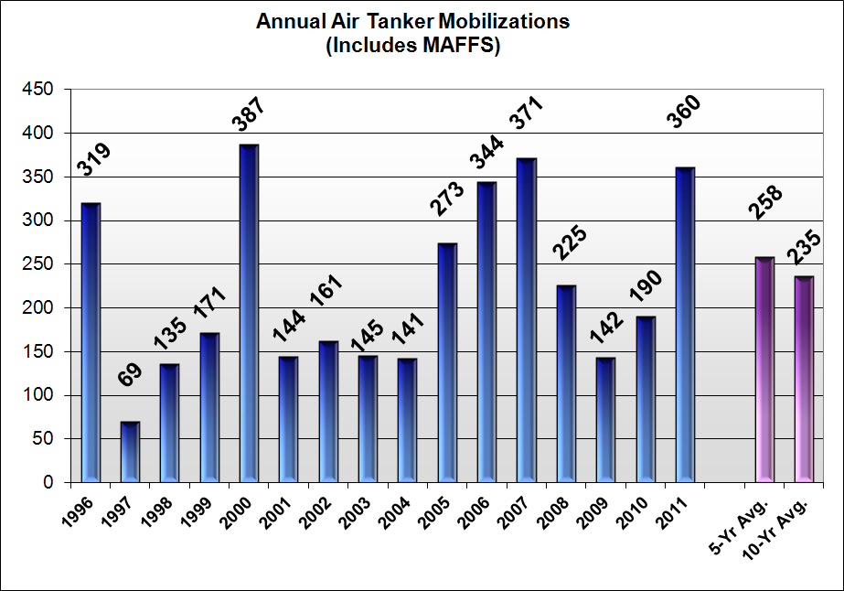
Air Tanker Use
Notes:
Airtankers are especially important in initial attack, or the early stages of responding to a wildfire.
We mobilize Airtankers, including MAFFS, for use in wildfire suppression an average of more than 200 times per year.

Slide 5
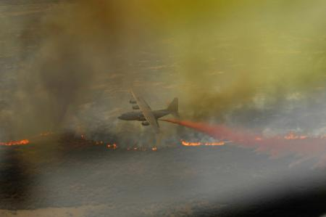
Ordering MAFFS
Civil tanker fleet committed or not available
Current & predicted fire activity
Available all year
Air tanker not always the best tool for the job

Slide 6
MAFFS Use

Slide 7
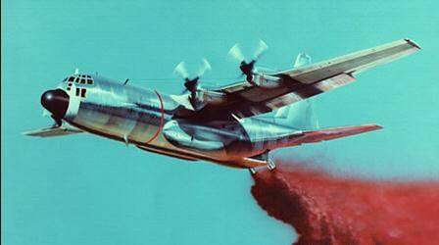
MAFFS History
1970 fires destroyed property (AF & Public)
1971 Sec AF directive for military aerial system
1971 - 1972 research & development
1973 MAFFS Operational Employment
1974 USFS buys additional units
1975 MOU between DoD, DoA, DoI
40th year of operational use

Slide 8
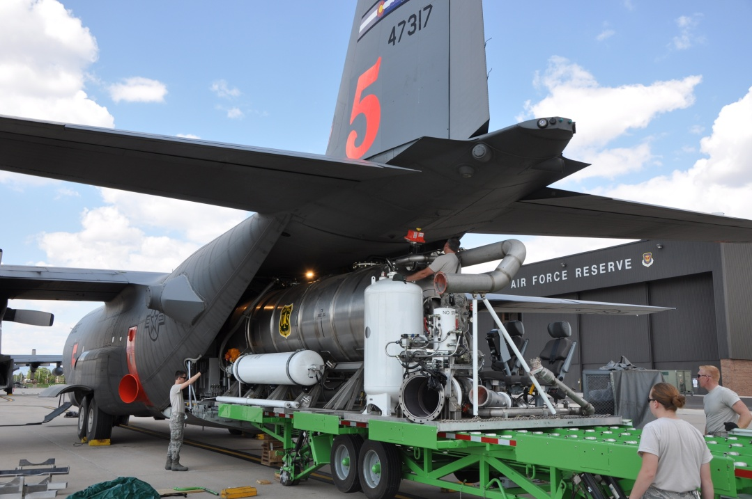
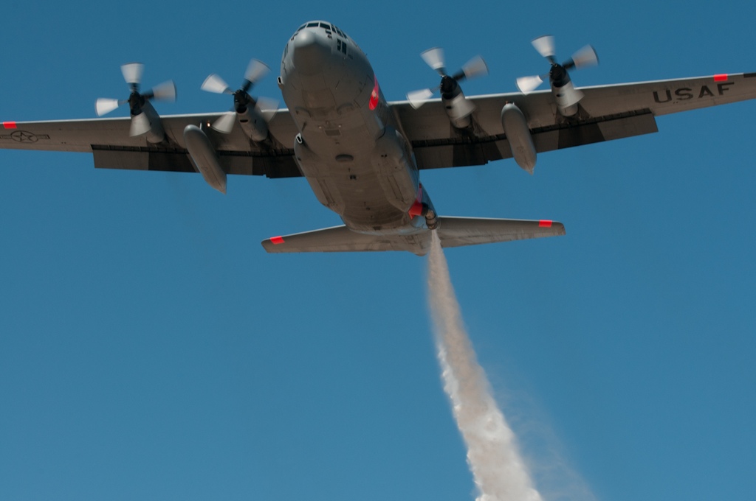
MAFFS Capability
Eight C-130 large air tankers
3000 gallon capacity (retardant, water or foam)
Variable disbursement for fuel type
Pre-positioned in CA, CO, NC & WY
Can be loaded in 2.5 hours

Slide 9

Mission
Lead Planes
Fire containment line
Very low altitude
Multiple hazards
Rapid reload

Slide 10
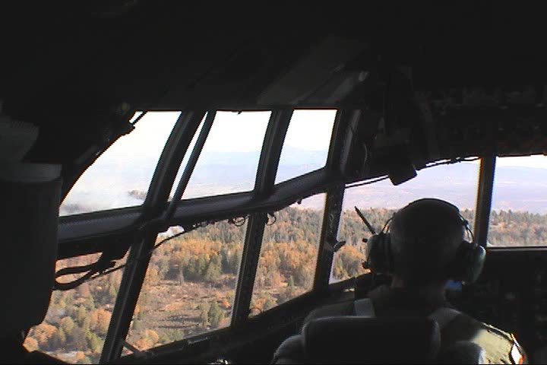

Slide 11

Annual Training
Certification by US Forest Service
Joint with military & other agencies
Prior to the main fire season
About 10 local crews – 36 missions
Loading Colorado Springs & Pueblo
Dropping potable water in Pike National Forest

Slide 12
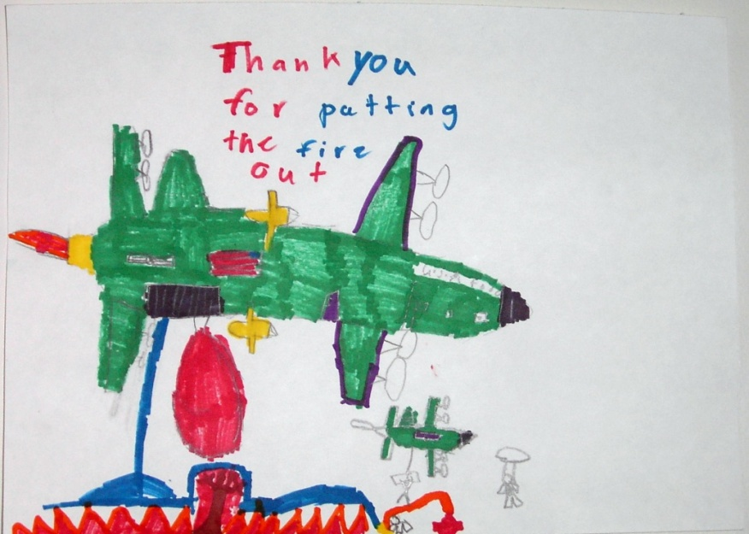
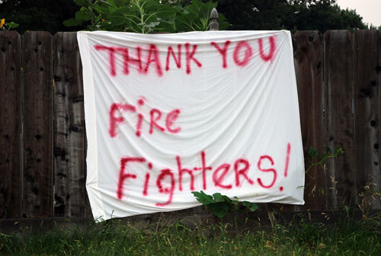
Benefits
Leverage available government assets
Test/prove Civil Support capability
Public confidence
International relations

Slide 13
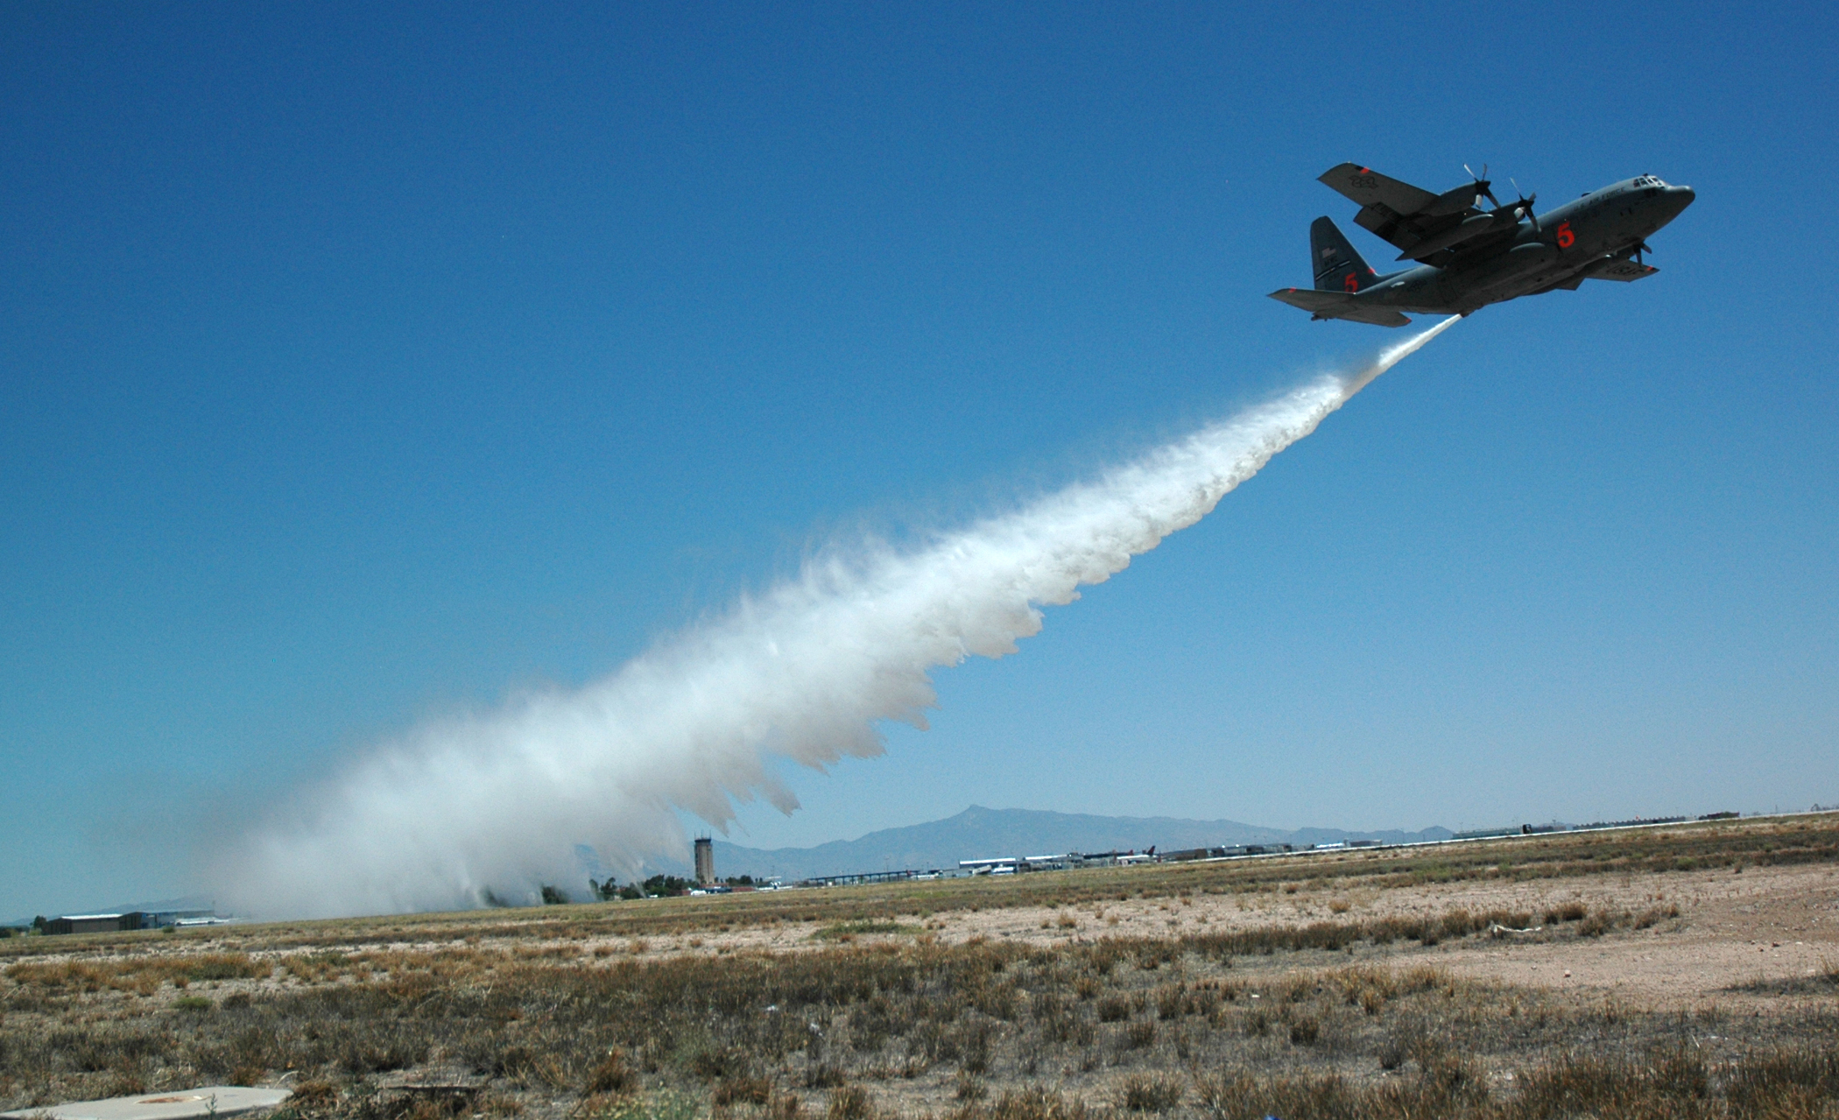
Questions

