Slide 1
Forest Service Photography and Video
Cecilio (Rick) Ricardo
202-777-7561
Cecilio.Ricardo@usda.gov
Tanya Flores
Tanya.flores@usda.gov

Slide 2
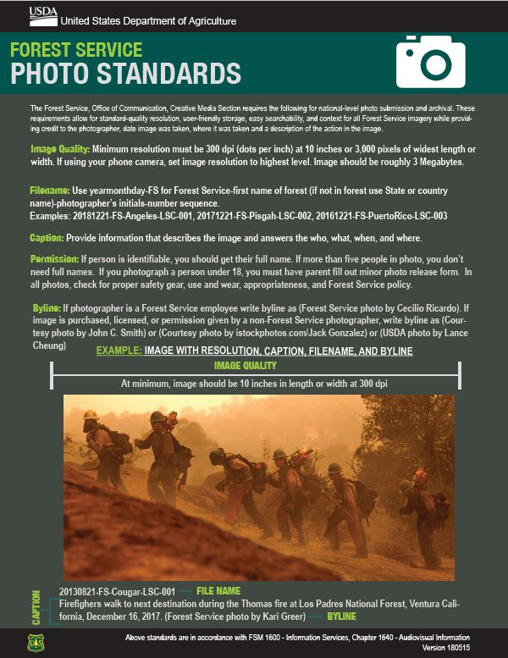
Forest Service Photography Standards
Filename: 20190515-FS-LosPadres-JMS-001
Captions
What, where, and when?
Firefighters dig a trench in Los Padres National Forest, California.
Byline
(Forest Service photo by John Smith)
Firefighters dig a trench in Los Padres National Forest,
California. (Forest Service photo by John Smith)

Slide 3
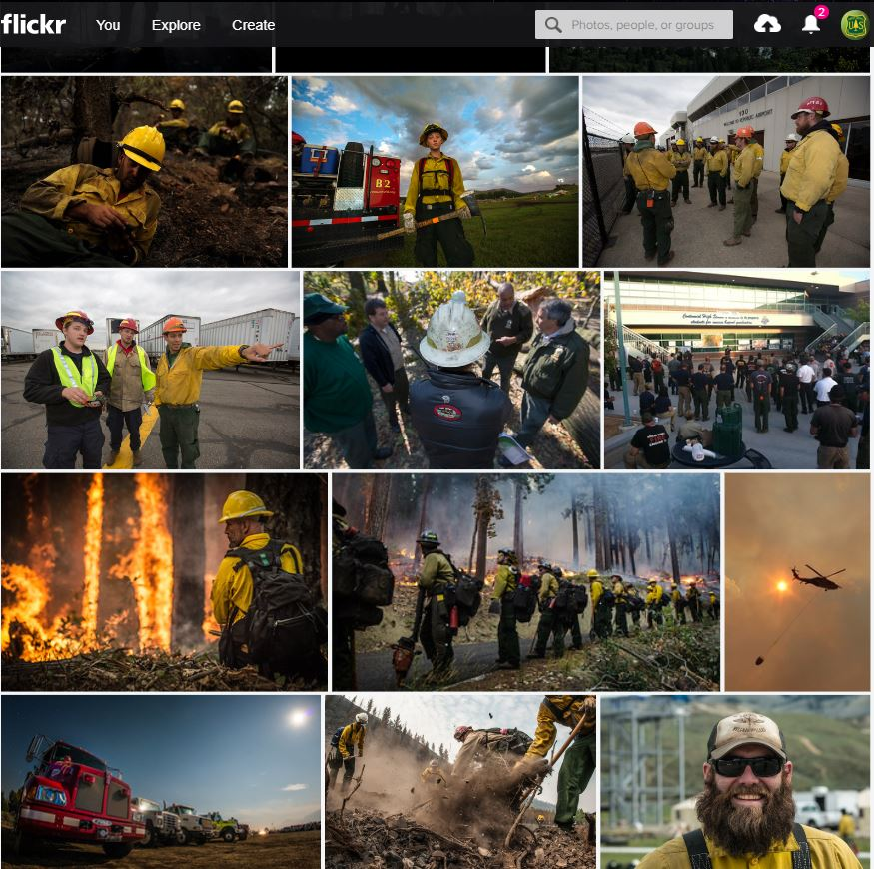
Forest Service Flickr Photography Archive
Forest Service Flickr
Externally accessible
Contains multiple sized images w/captions
Regional Flickr Sites
Region 1 Northern Region Flickr
Region 2 Rocky Mountain Flickr
Region 3 Southwestern Flickr
Region 4 Intermountain Flickr
Region 5 California Flickr
Region 6 Pacific Northwest Flickr
Pacific Northwest Research Station Flickr
Region 9 Eastern Flickr
Region 10 Alaska

Slide 4
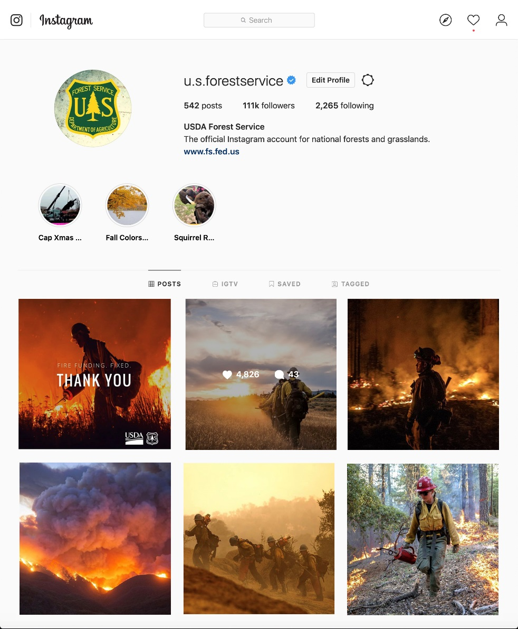
Forest Service Instagram
112K Followers and growing
Average of 2,500 likes per image
Share our Instagram
Send us images to share and help us
connect you to our national audience

Slide 5
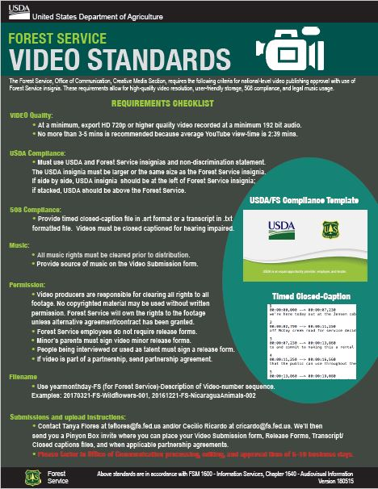
Forest Service Video Standards
USDA/FS logos with EEO Statement Slate
Approval form with leadership signatures
Partnership agreement
Closed captions. An .srt or .txt file works
Send into our Pinyon folder
Note: If you share a video clip on social media with PA approval,
without editing, it does not need Video slate, approval form, or closed captions

Slide 6
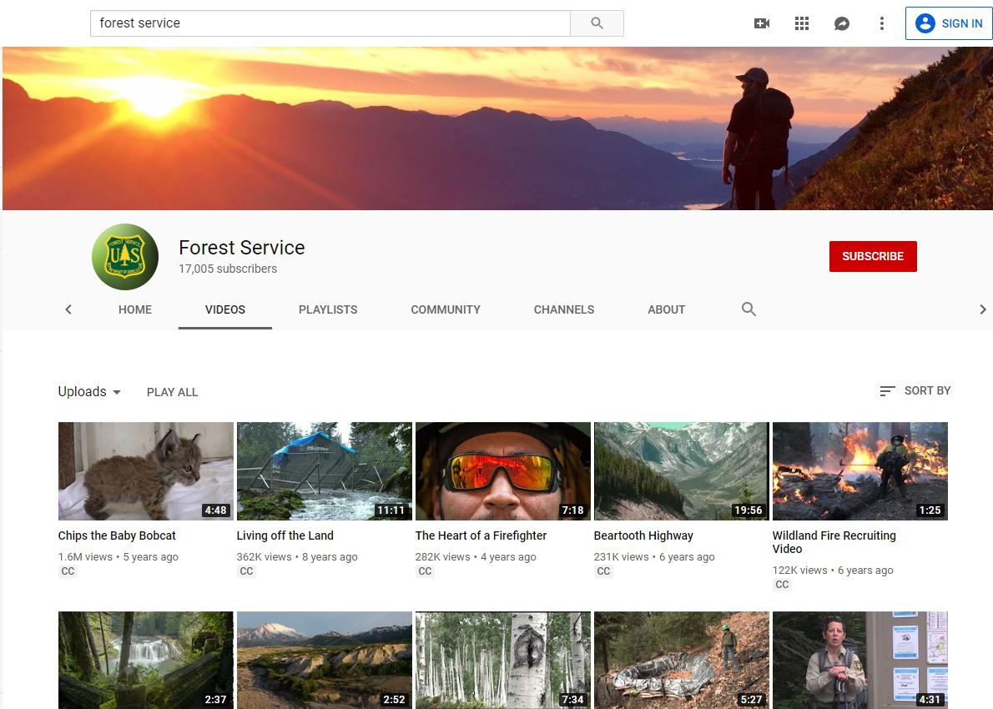
Forest Service Video Youtube
Official Forest Service Videos
Public Service Announcements

Slide 7
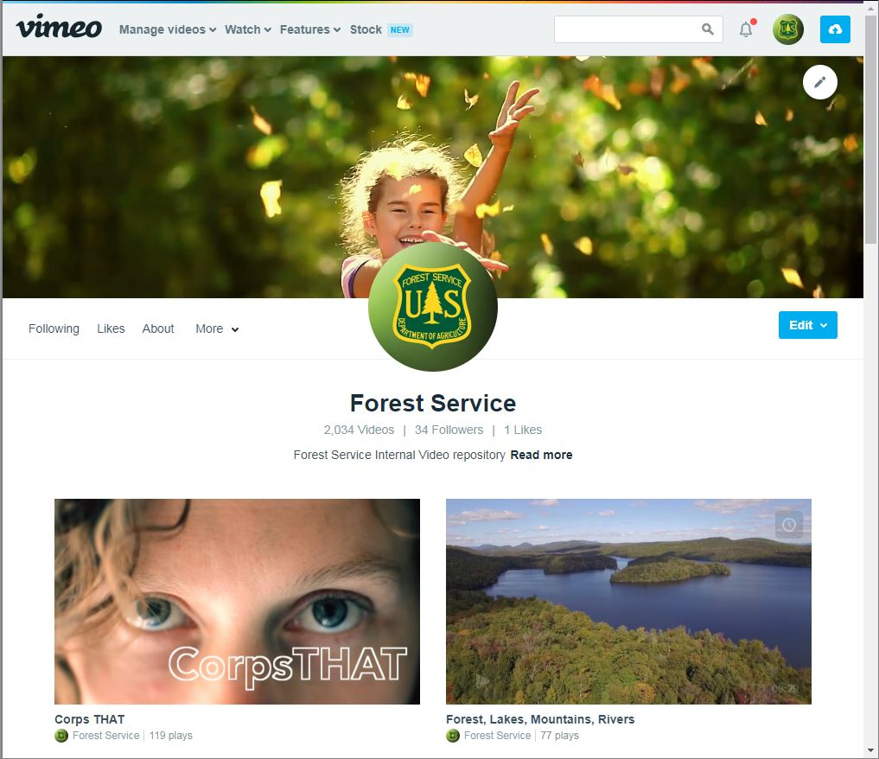
Forest Service Video Vimeo – video Archive
Forest Service video clips
Fire
Recreation
Training video clips
Internal messaging
Story Map links to videos

Slide 8
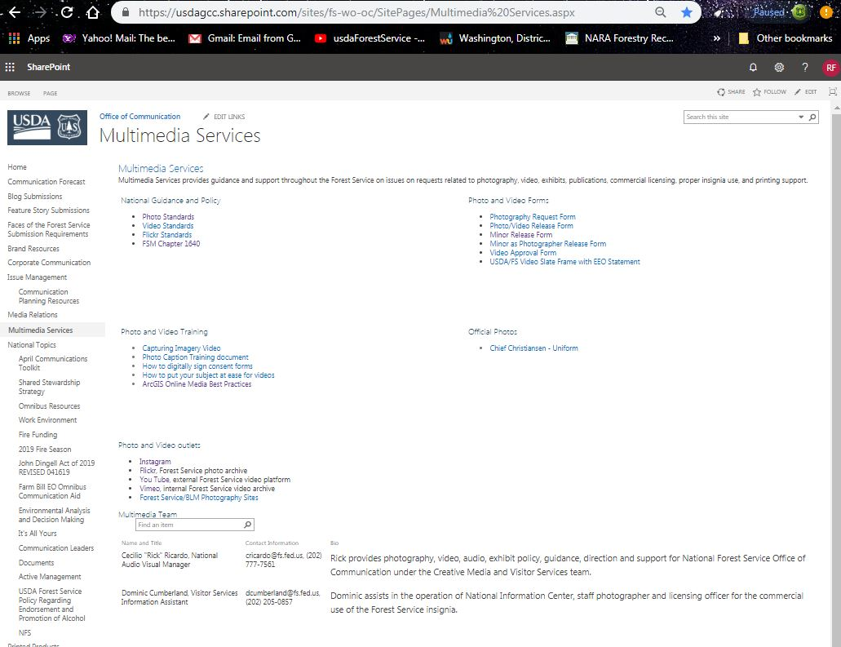
Forest Service Office of Communication Hub
OC Hub
Multimedia Standards
Multimedia Forms
Multimedia Training
Multimedia Links

